Slide 1
BASICS data plots HAND

Slide 2
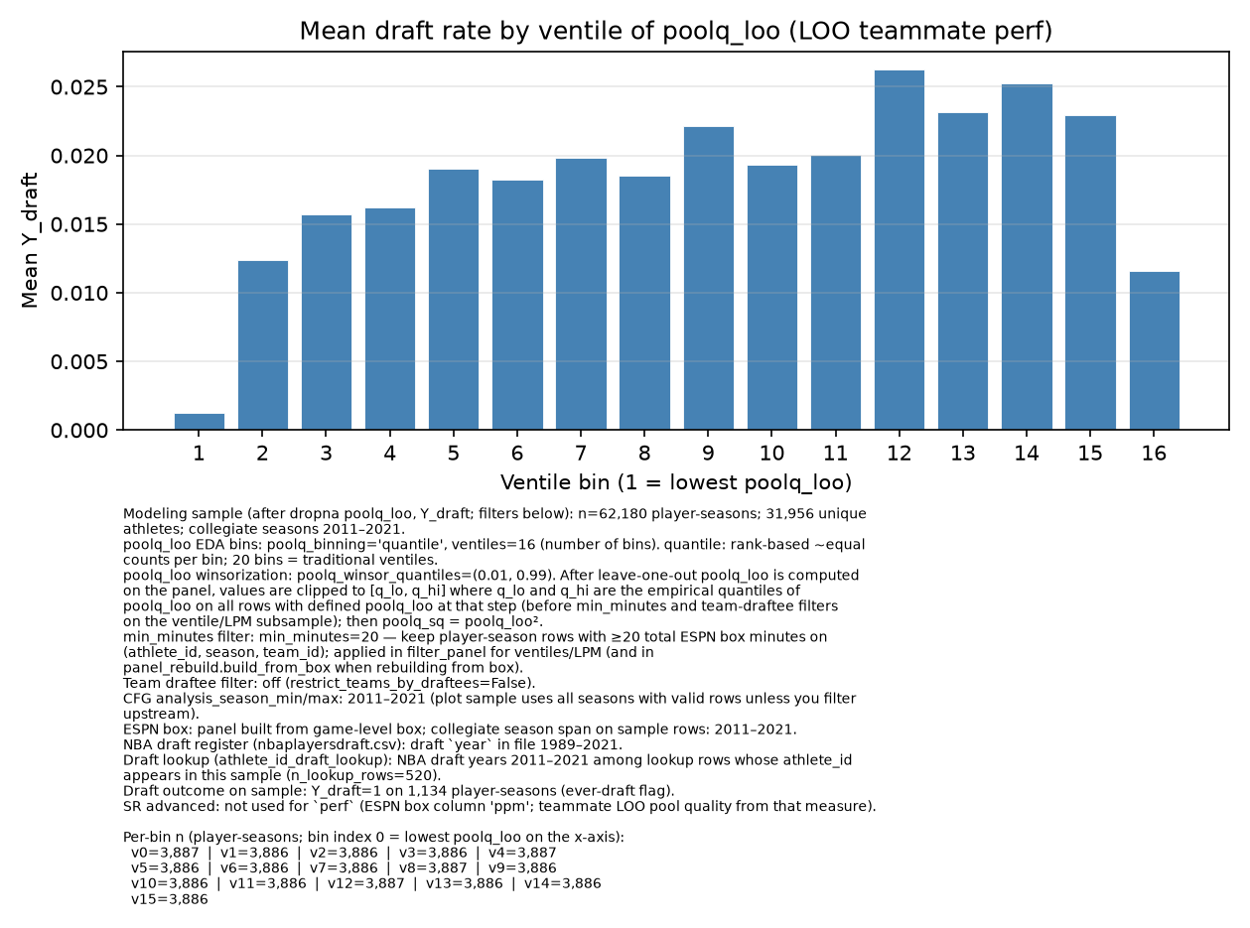
Original HERO slide (R.I.P.)

Slide 3
Abbreviations Glossary
BDP – Basic Data Plots analysis
FP – full population
08_21 – include years 2008-2021
mg10 – (minimum games10) removing rows for teams that had <= 10 games that team season. So 11+ games.
CPR – Cut Player Rows, specifically the rows cut by the mg10 filter
min20 – removing player rows for players with < 20 total minutes for that team season.
QC – MINIMUM DATA SET - post Quality Control – for now this means after removing the “-” player rows with no name. For right now assume ALL data is QC. Note- it does not yet mean mg10 also.
DFT – Draft Only Teams – remove all teams that have Never had a player drafted any season in the data
Example Usage
FP 11_21 – This means the full data population of players from 2011-2021
mg10 13_21 – This means start with FP, then remove mg10, for just years 2013-2021
min5 mg10 11_21 – This means start FP, then remove players with less than 5 minutes for the season, then remove mg10 rows and for seasons 2011-2021.

Slide 4
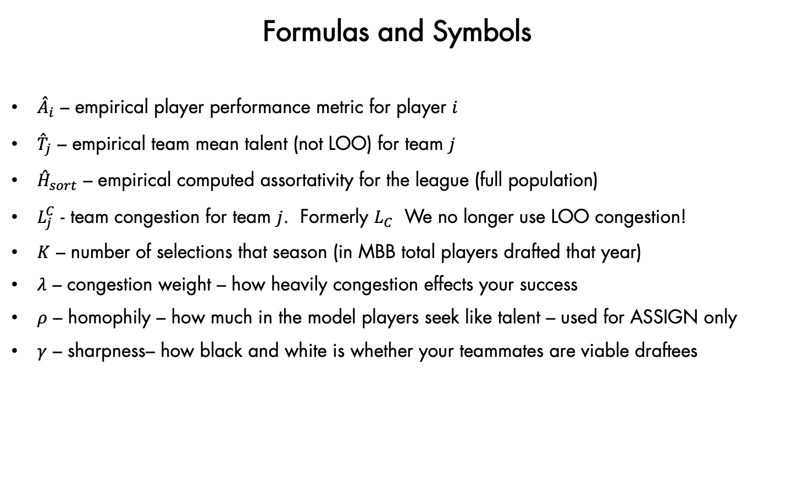
Formulas and Symbols
${\overset{ˆ}{A}}_{i}$ – empirical player performance metric for player $i$
${\overset{ˆ}{T}}_{j}$ – empirical team mean talent (not LOO) for team $j$
${\overset{ˆ}{H}}_{sort}$ – empirical computed assortativity for the league (full population)
$L_{j}^{C}$ - team congestion for team $j$. Formerly $L_{C}$ We no longer use LOO congestion!
$K$ – number of selections that season (in MBB total players drafted that year)
$λ$ – congestion weight – how heavily congestion effects your success
$ρ$ – homophily – how much in the model players seek like talent – used for ASSIGN only
$γ$ – sharpness– how black and white is whether your teammates are viable draftees

Slide 5
4 BASE POPULATIONS FOR ANALYSIS – all 2012-2021
FP 11_21 – The full league population no minimum team games, no min playing minutes per season
mg10 min0 – Only teams with more than10 games per season, no playing time floor for players
mg10 min10 – Teams more than10 games, at least 10 minutes season playing time for players
mg10 min20 – Teams more than10 games, at least 20 minutes season playing time for players

Slide 6
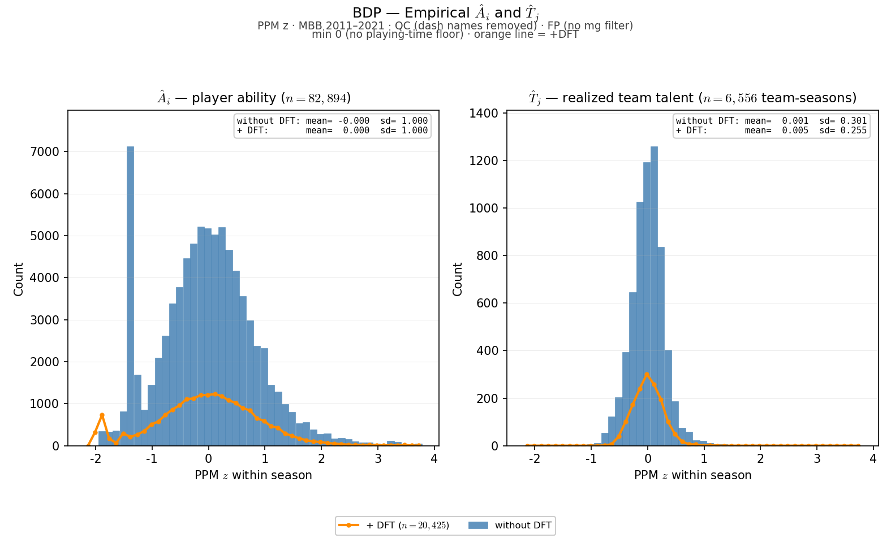
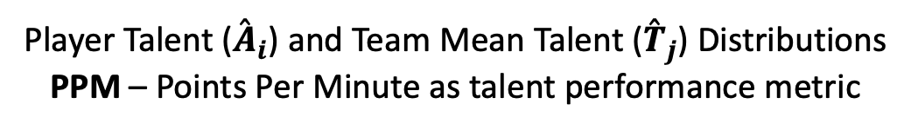
Player Talent (${\overset{ˆ}{A}}_{i}$) and Team Mean Talent (${\overset{ˆ}{T}}_{j}$) Distributions
PPM – Points Per Minute as talent performance metric

Slide 7
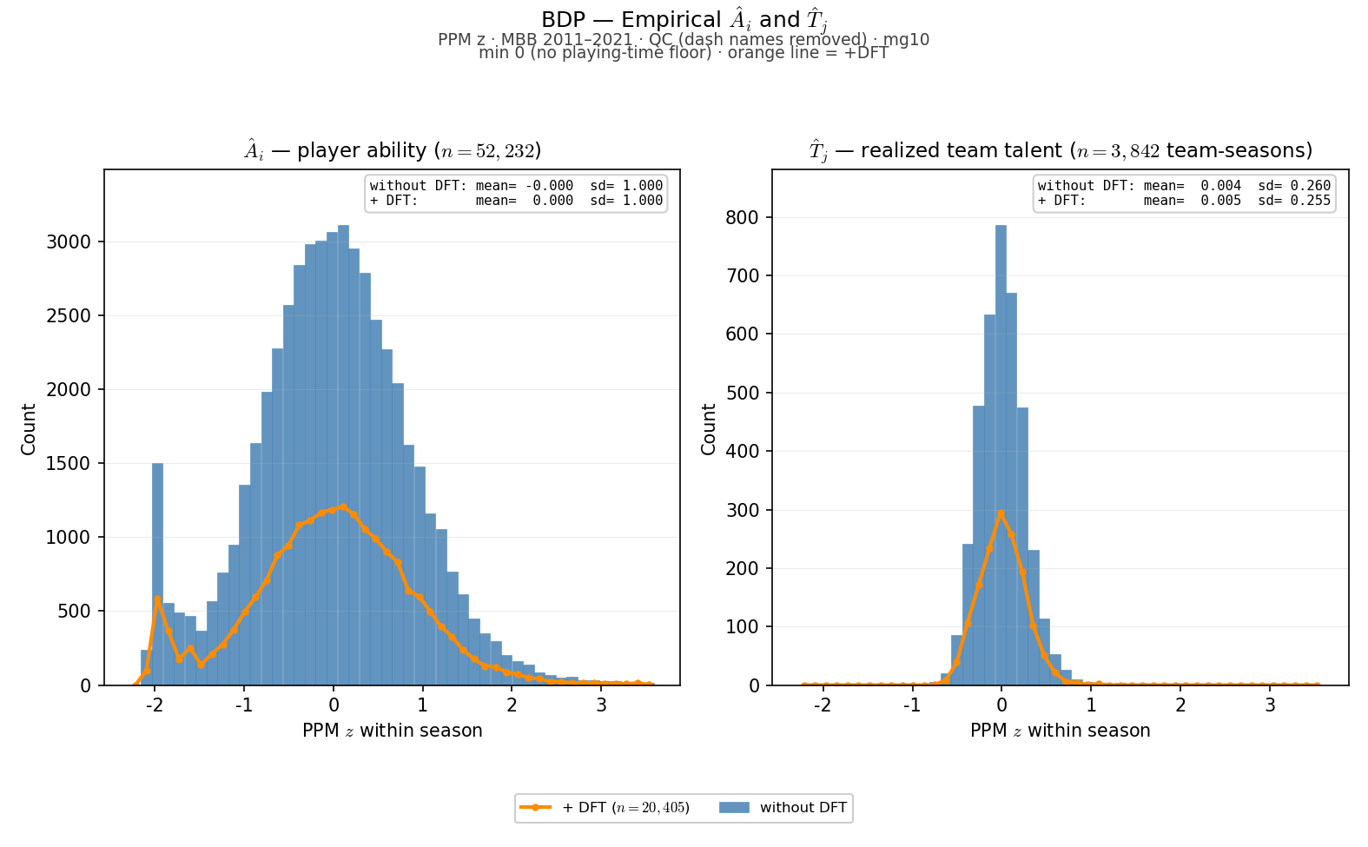
Player Talent (${\overset{ˆ}{A}}_{i}$) and Team Mean Talent (${\overset{ˆ}{T}}_{j}$) Distributions
PPM – Points Per Minute as talent performance metric

Slide 8
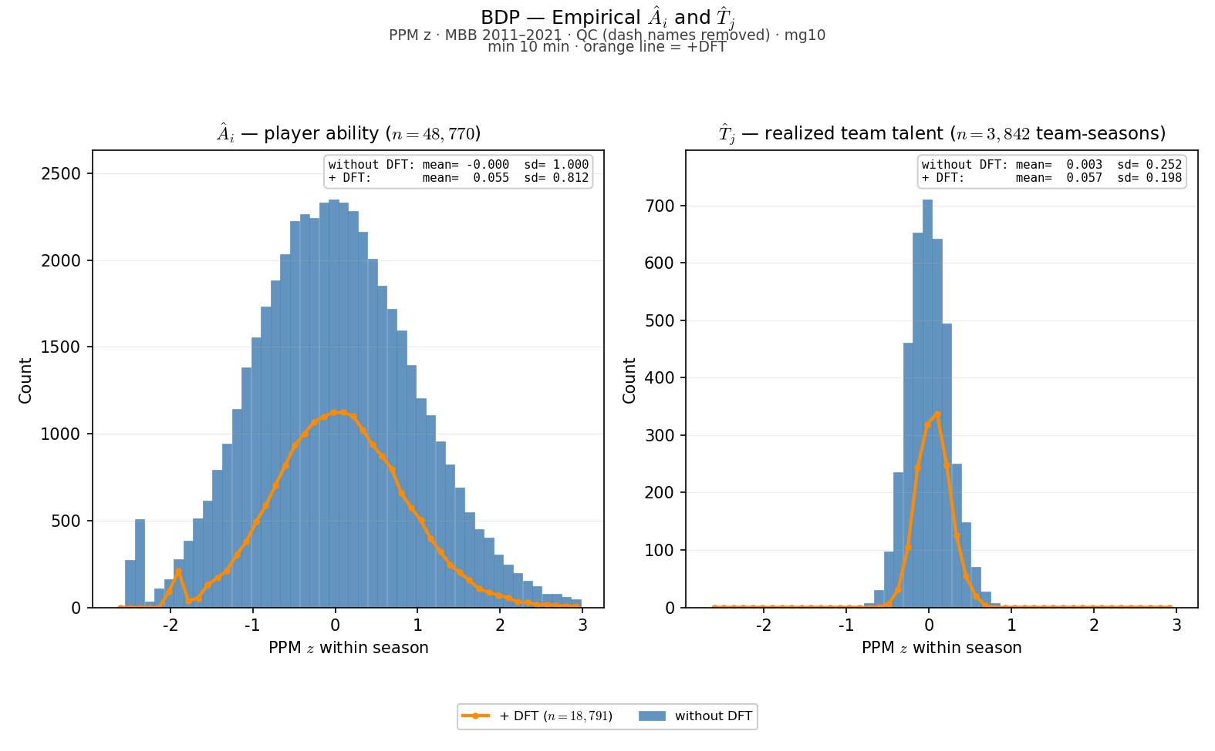
Player Talent (${\overset{ˆ}{A}}_{i}$) and Team Mean Talent (${\overset{ˆ}{T}}_{j}$) Distributions
PPM – Points Per Minute as talent performance metric

Slide 9
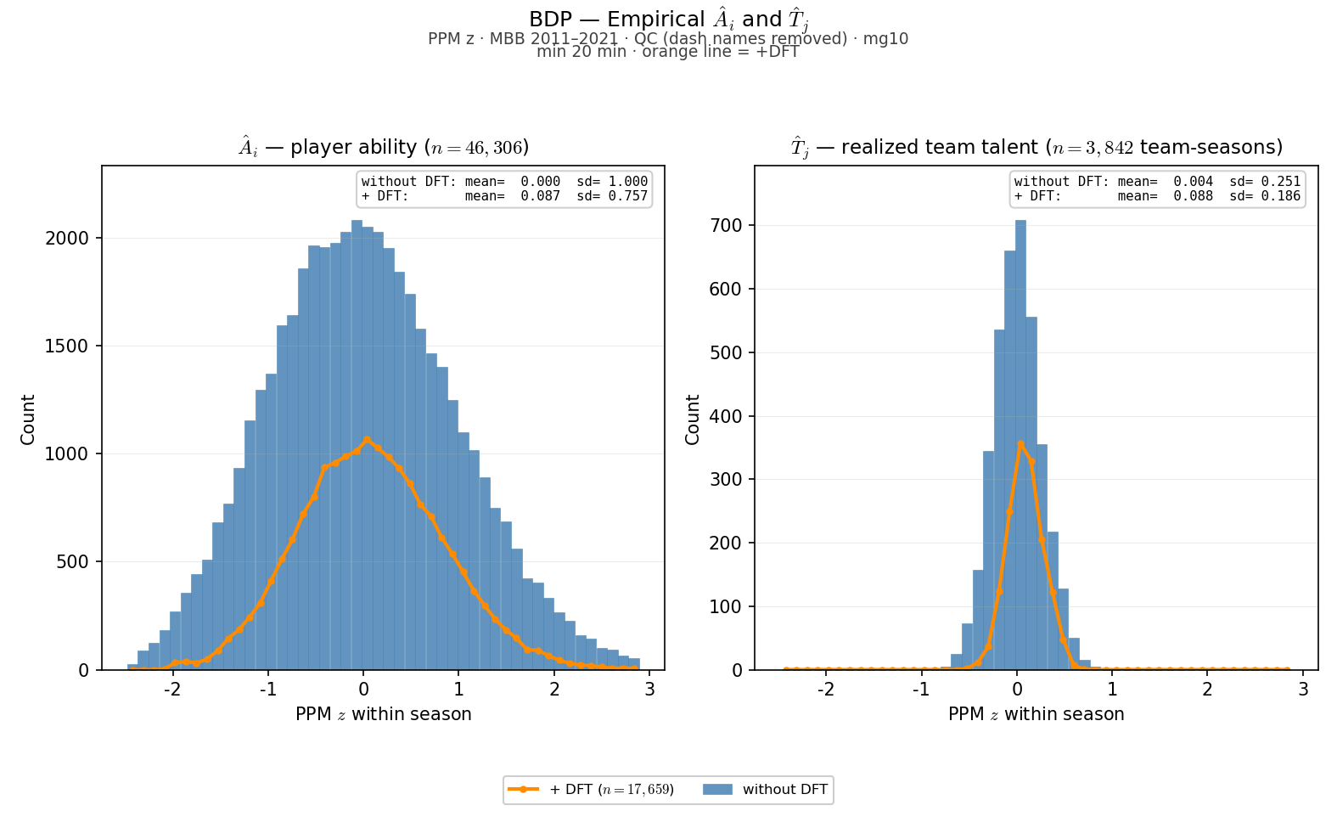
Player Talent (${\overset{ˆ}{A}}_{i}$) and Team Mean Talent (${\overset{ˆ}{T}}_{j}$) Distributions
PPM – Points Per Minute as talent performance metric

Slide 10
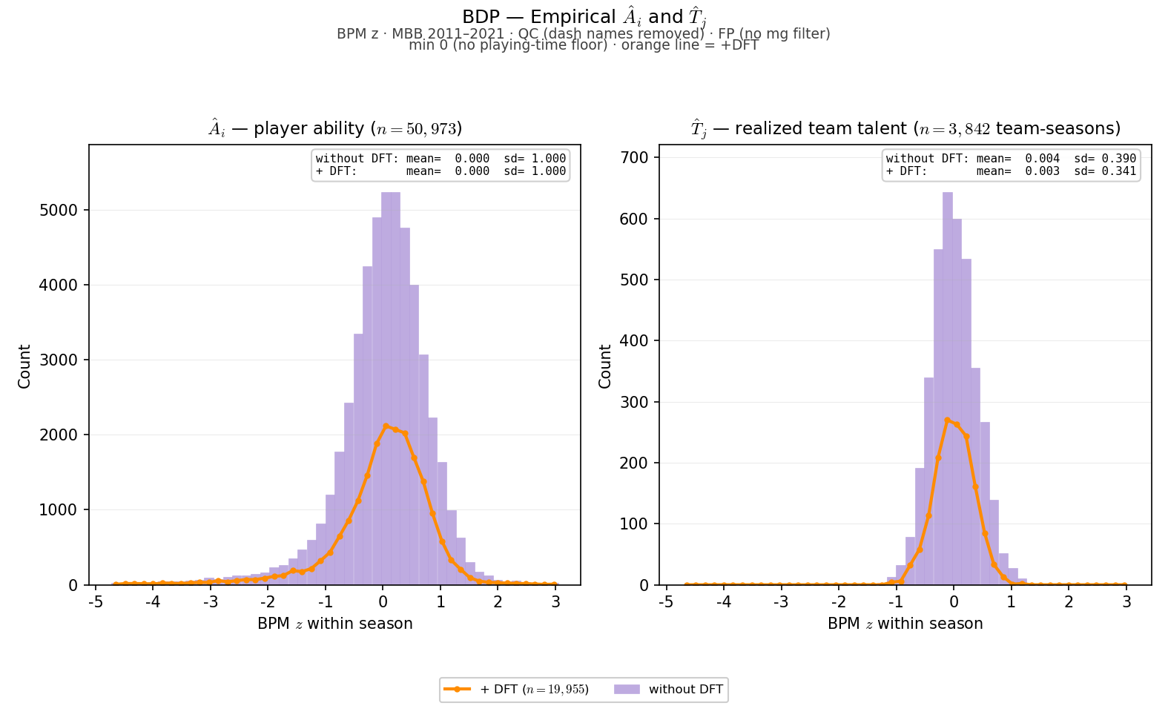
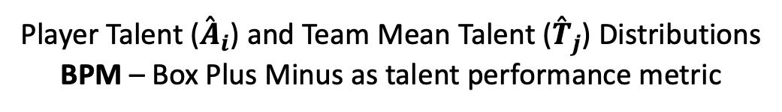
Player Talent (${\overset{ˆ}{A}}_{i}$) and Team Mean Talent (${\overset{ˆ}{T}}_{j}$) Distributions
BPM – Box Plus Minus as talent performance metric

Slide 11
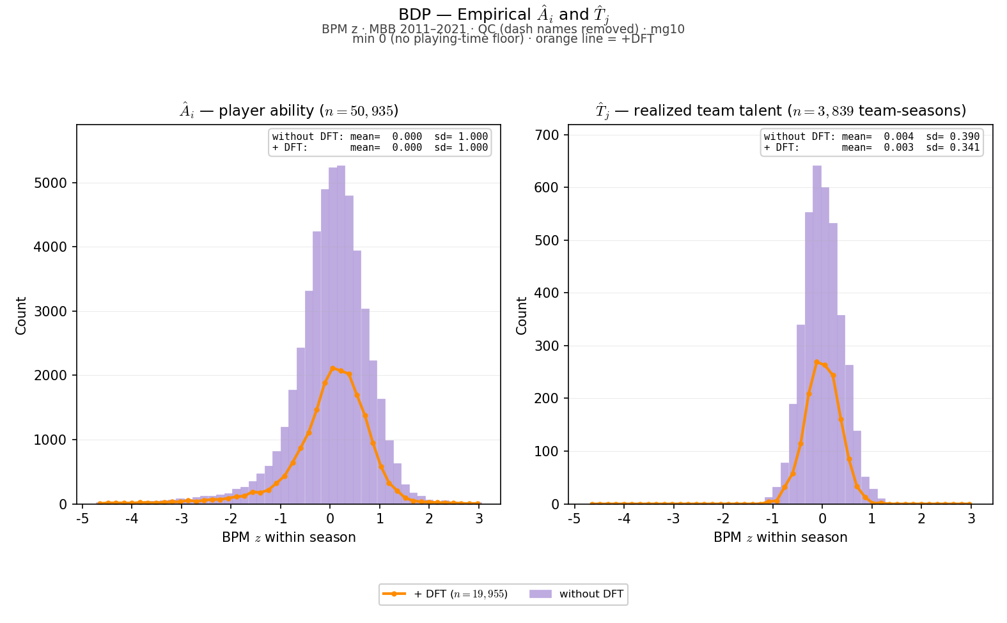
Player Talent (${\overset{ˆ}{A}}_{i}$) and Team Mean Talent (${\overset{ˆ}{T}}_{j}$) Distributions
BPM – Box Plus Minus as talent performance metric

Slide 12
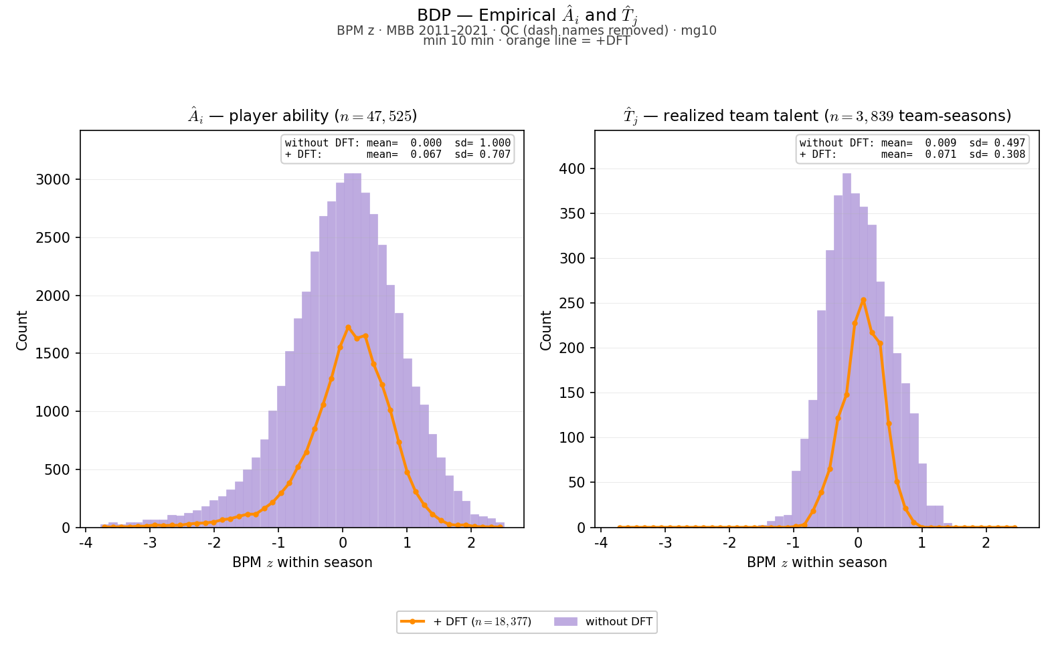
Player Talent (${\overset{ˆ}{A}}_{i}$) and Team Mean Talent (${\overset{ˆ}{T}}_{j}$) Distributions
BPM – Box Plus Minus as talent performance metric

Slide 13
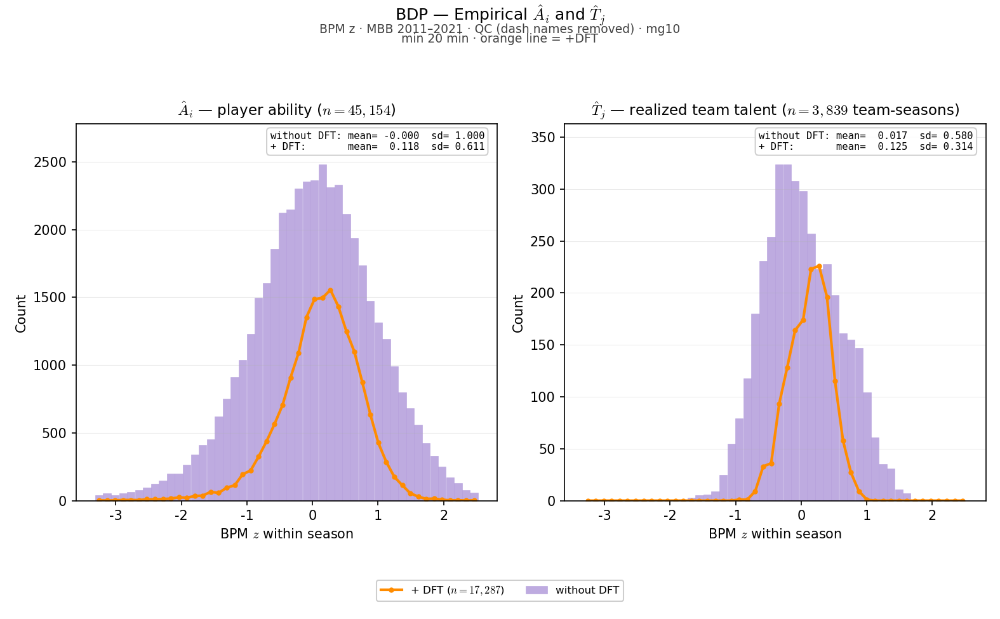
Player Talent (${\overset{ˆ}{A}}_{i}$) and Team Mean Talent (${\overset{ˆ}{T}}_{j}$) Distributions
BPM – Box Plus Minus as talent performance metric

Slide 14
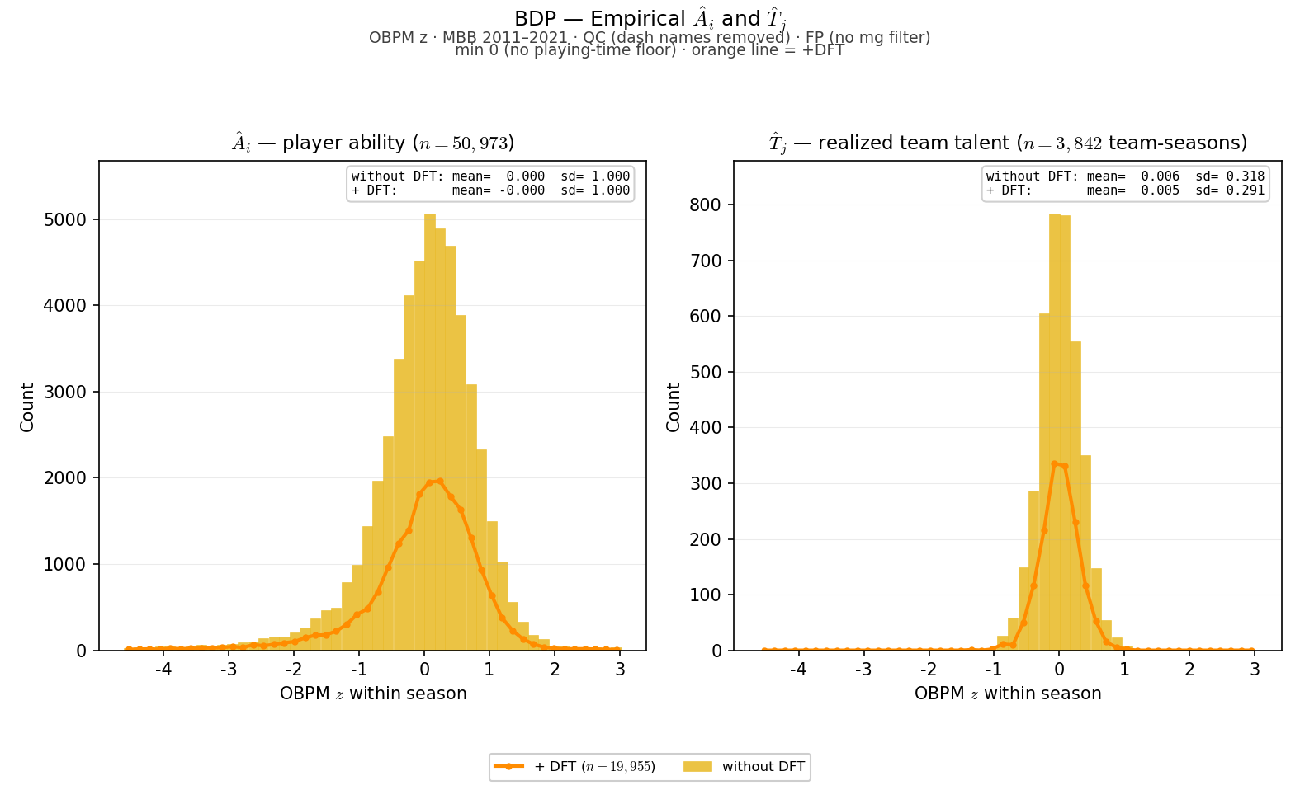
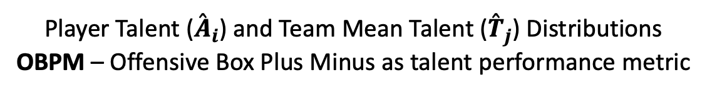
Player Talent (${\overset{ˆ}{A}}_{i}$) and Team Mean Talent (${\overset{ˆ}{T}}_{j}$) Distributions
OBPM – Offensive Box Plus Minus as talent performance metric

Slide 15

Player Talent (${\overset{ˆ}{A}}_{i}$) and Team Mean Talent (${\overset{ˆ}{T}}_{j}$) Distributions
OBPM – Offensive Box Plus Minus as talent performance metric

Slide 16
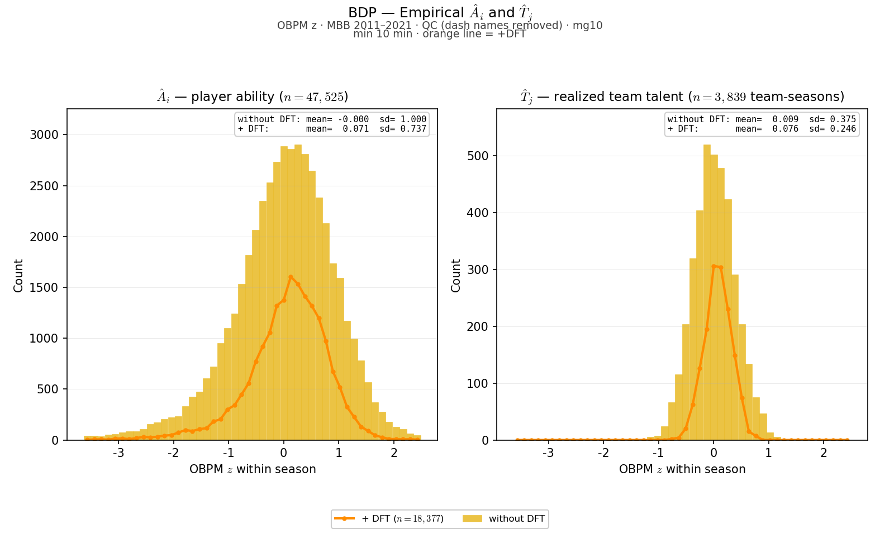
Player Talent (${\overset{ˆ}{A}}_{i}$) and Team Mean Talent (${\overset{ˆ}{T}}_{j}$) Distributions
OBPM – Offensive Box Plus Minus as talent performance metric

Slide 17
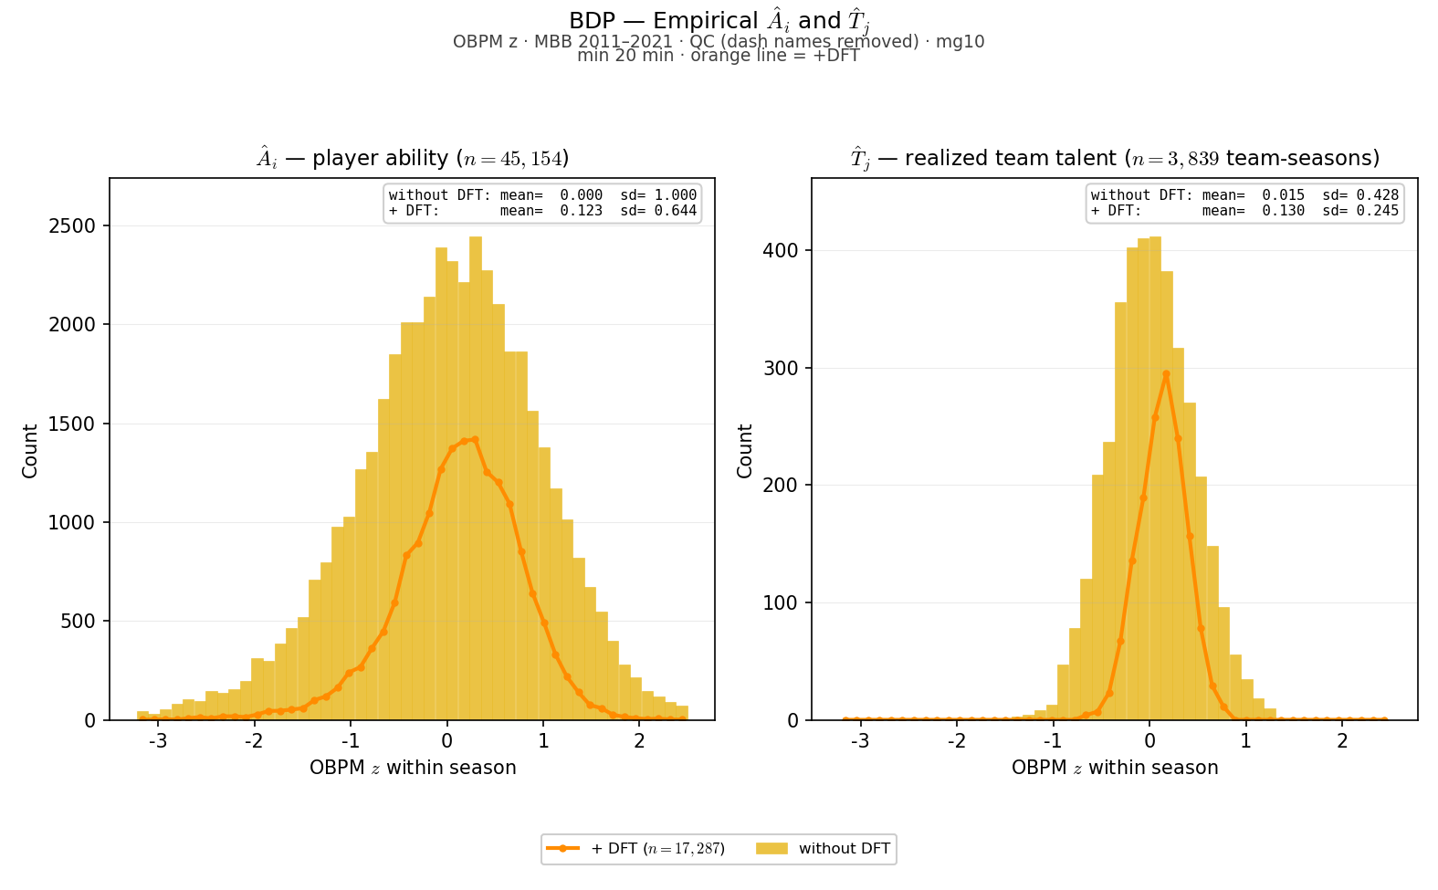
Player Talent (${\overset{ˆ}{A}}_{i}$) and Team Mean Talent (${\overset{ˆ}{T}}_{j}$) Distributions
OBPM – Offensive Box Plus Minus as talent performance metric

Slide 18
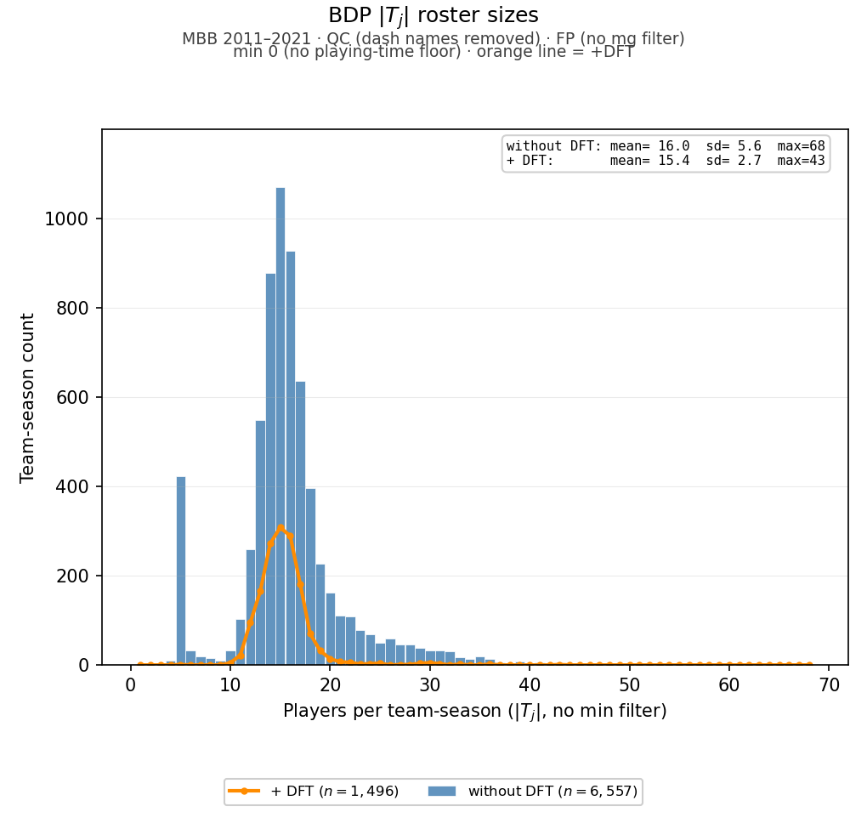

Team Roster Size ($\left|{\overset{ˆ}{T}}_{j}\right|$) Distributions

Slide 19
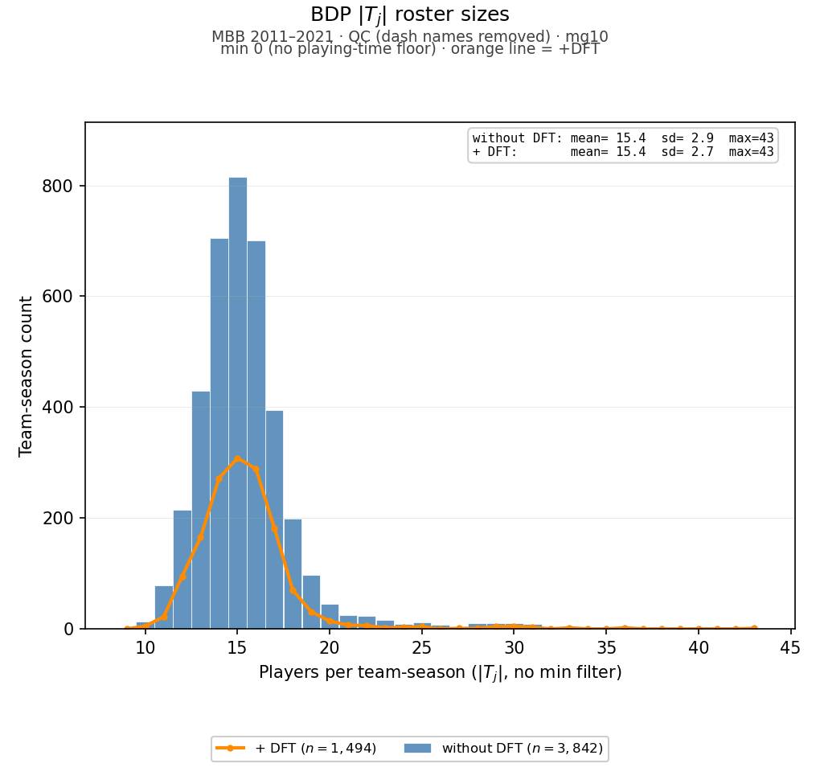
Team Roster Size ($\left|{\overset{ˆ}{T}}_{j}\right|$) Distributions

Slide 20
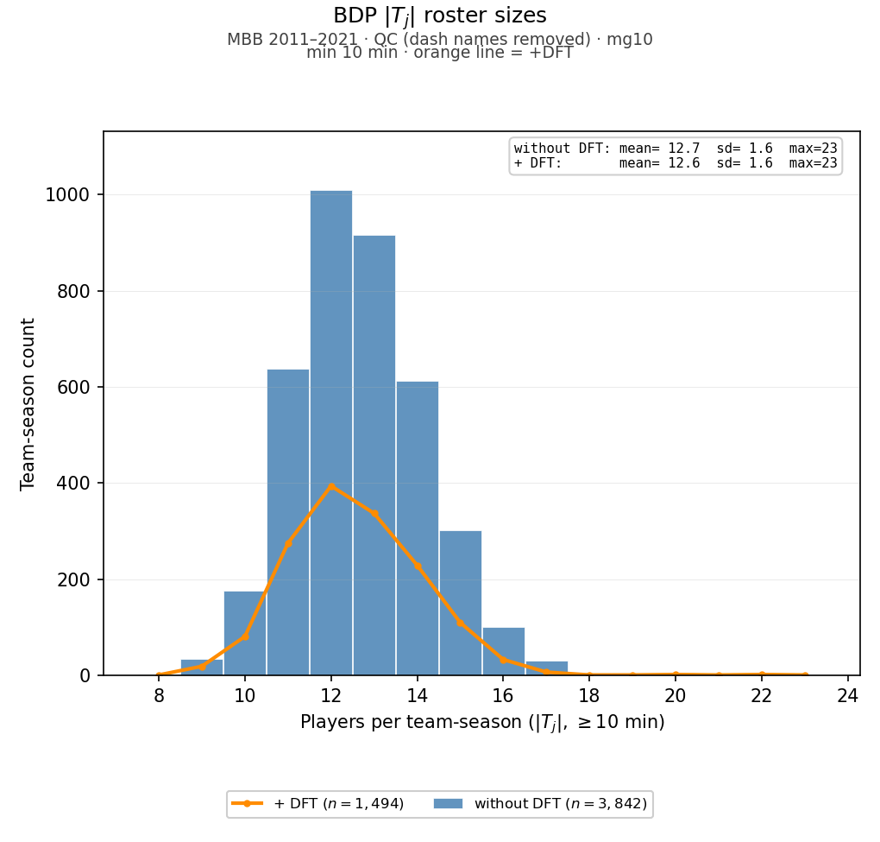
Team Roster Size ($\left|{\overset{ˆ}{T}}_{j}\right|$) Distributions

Slide 21
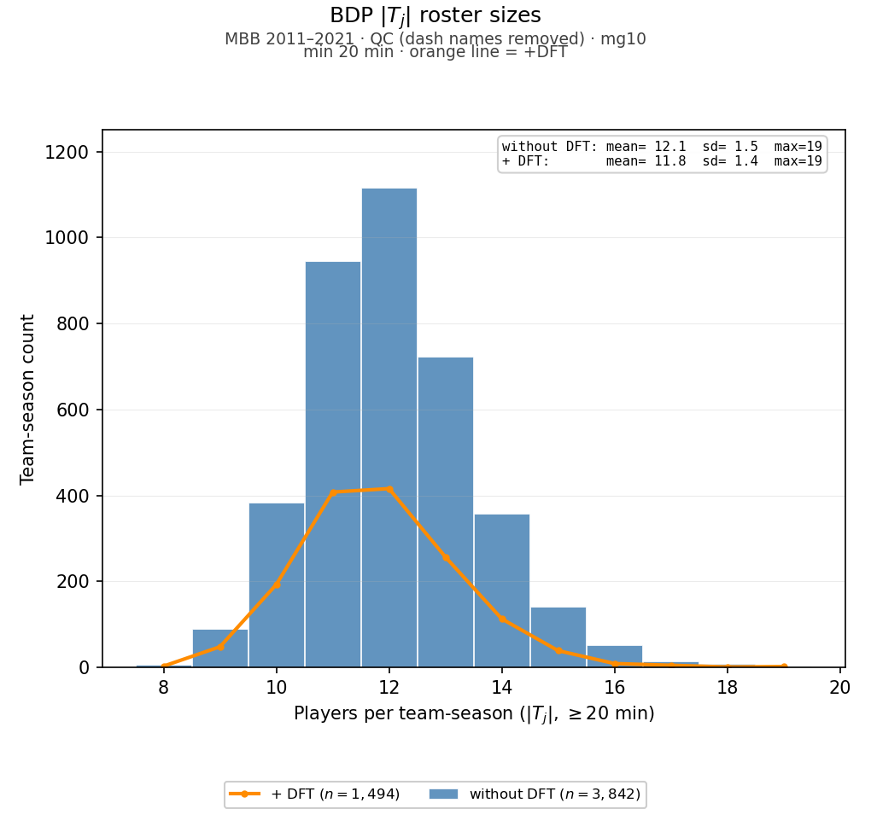
Team Roster Size ($\left|{\overset{ˆ}{T}}_{j}\right|$) Distributions

