Slide 1
PD16 HAND

Slide 2
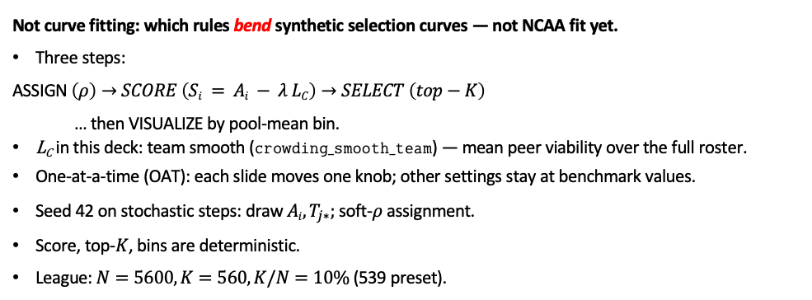
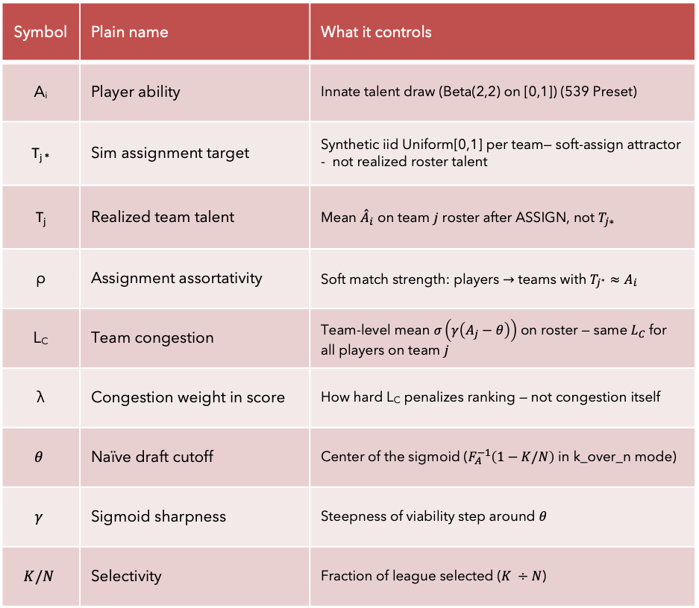
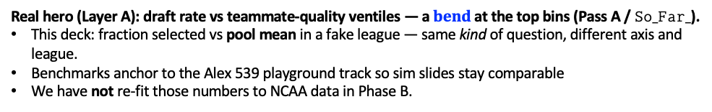
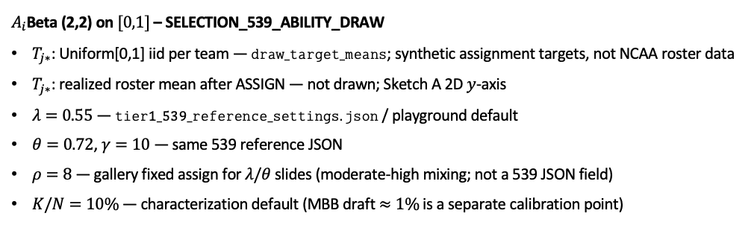
Phase B — Fake-league characterization (not curve fitting)
Knobs (mini glossary)
Symbol | Plain name | What it controls
A_{i} | Player ability | Innate talent draw (Beta(2,2) on [0,1]) (539 Preset)
T_{j *} | Sim assignment target | Synthetic iid Uniform[0,1] per team— soft-assign attractor - not realized roster talent
T_{j} | Realized team talent | Mean ${\overset{ˆ}{A}}_{i}$ on team $j$ roster after ASSIGN, not $T_{j∗}$
ρ | Assignment assortativity | Soft match strength: players $→$ teams with $T_{j^{∗}}≈A_{i}$
L_{C} | Team congestion | Team-level mean $σ\left(γ\left(A_{j}−θ\right)\right)$ on roster — same $L_{C}$ for all players on team $j$
λ | Congestion weight in score | How hard L_{C} penalizes ranking — not congestion itself
$$θ$$ | Naïve draft cutoff | Center of the sigmoid ($F_{A}^{−1}\left(1−K/N\right)$ in k_over_n mode)
$$γ$$ | Sigmoid sharpness | Steepness of viability step around $θ$
$$K/N$$ | Selectivity | Fraction of league selected ($K ÷N$)
Not curve fitting: which rules bend synthetic selection curves — not NCAA fit yet.
Three steps:
ASSIGN $\left(ρ\right)→SCORE \left(Si = Ai − λ LC\right)→SELECT \left(top−K\right)$
… then VISUALIZE by pool-mean bin.
L_{C} in this deck: team smooth ($crowding_smooth_team$) — mean peer viability over the full roster.
One-at-a-time (OAT): each slide moves one knob; other settings stay at benchmark values.
Seed 42 on stochastic steps: draw $Ai, T_{j∗};$soft-$ρ$ assignment.
Score, top-$K$, bins are deterministic.
League:$N=5600, K=560, K/N=10\%$(539 preset).
$A_{i}$Beta (2,2) on $[0,1]$– SELECTION_539_ABILITY_DRAW
$T_{j∗}$: Uniform[0,1] iid per team — $draw_target_means$; synthetic assignment targets, not NCAA roster data
$T_{j∗}$: realized roster mean after ASSIGN — not drawn; Sketch A 2D $y$-axis
$λ=0.55$ — $tier1_539_reference_settings.json$ / playground default
$θ=0.72$, $γ=10$ — same 539 reference JSON
$ρ=8$— gallery fixed assign for $λ\text{/}θ$ slides (moderate-high mixing; not a 539 JSON field)
$K/N=10\%$— characterization default (MBB draft $≈1\%$is a separate calibration point)
Real hero (Layer A): draft rate vs teammate-quality ventiles — a $bend$ at the top bins (Pass A / $So_Far_$).
This deck: fraction selected vs pool mean in a fake league — same kind of question, different axis and league.
Benchmarks anchor to the Alex 539 playground track so sim slides stay comparable
We have not re-fit those numbers to NCAA data in Phase B.
Claim: Phase B maps which generative knobs move who gets selected — prerequisite before Phase C calibration to the hero.

Slide 3
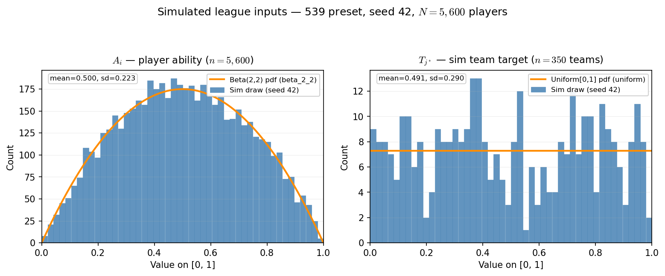
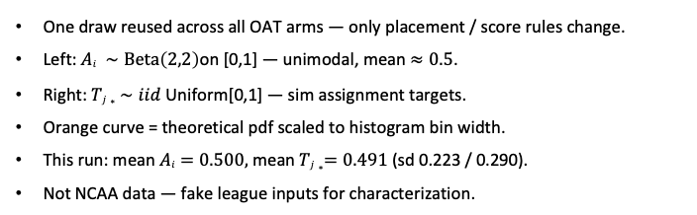
Phase B — Simulated league inputs: actual $Ai$and $Tj∗$ draws
539 preset · seed $42$ · $N=5,600$players · $350$teams × roster $16$
One draw reused across all OAT arms — only placement / score rules change.
Left: $Ai ∼\text{Beta}\left(2,2\right)$on [0,1] — unimodal, mean $≈0.5$.
Right: $Tj∗ ∼iid$Uniform[0,1] — sim assignment targets.
Orange curve = theoretical pdf scaled to histogram bin width.
This run: mean $Ai=0.500,$mean $Tj∗=0.491$(sd 0.223 / 0.290).
Not NCAA data — fake league inputs for characterization.
Claim: Phase B fixes one stochastic league draw (seed 42) — A_{i} and T_{j*} are the inputs every OAT arm reuses; only ASSIGN / SCORE knobs change across slides.

Slide 4
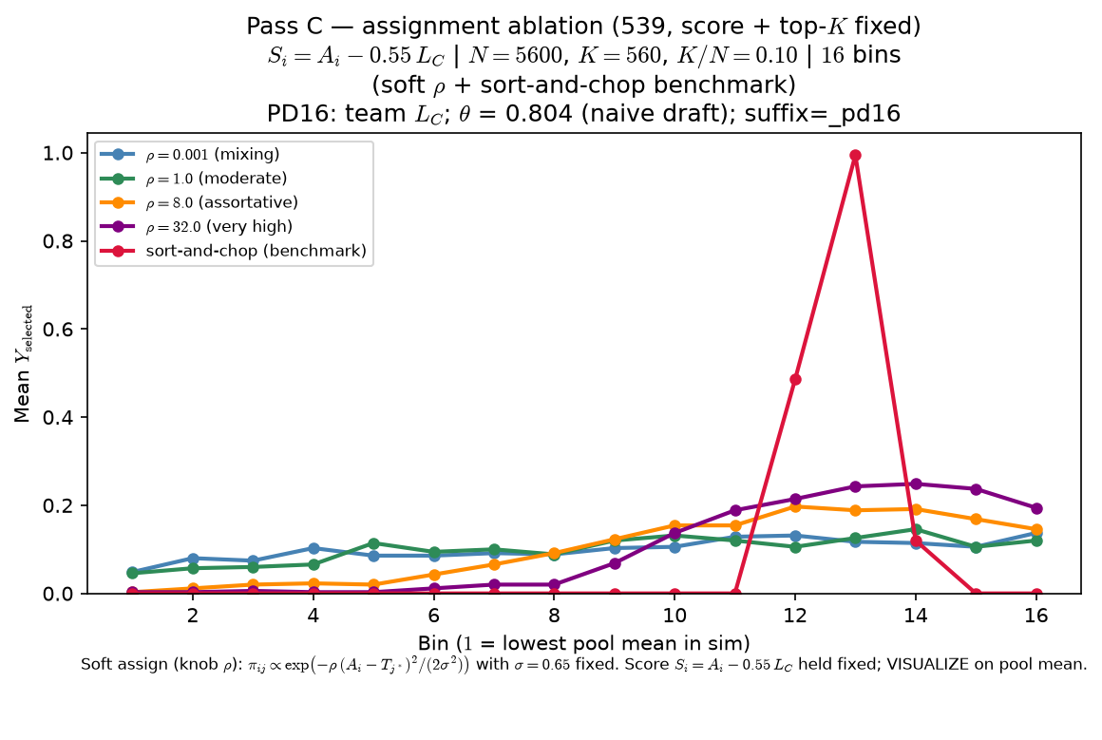
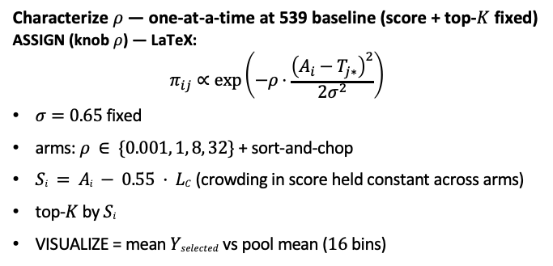
Phase B — Characterize ρ (assignment assortativity) — sort-and-chop shown
Characterize $ρ$— one-at-a-time at 539 baseline (score + top-$K$ fixed)
ASSIGN (knob $ρ$) — LaTeX:
$$π_{ij}∝\exp\left(−ρ⋅\frac{{\left(A_{i}−T_{j∗}\right)}^{2}}{2σ^{2}}\right)$$
$σ=0.65$fixed
arms: $ρ ∈ \{0.001, 1, 8, 32\}$+ sort-and-chop
$Si = Ai − 0.55 · LC$(crowding in score held constant across arms)
top-$K$by $Si$
VISUALIZE = mean $Yselected$vs pool mean ($16$ bins)
OAT: one draw of $Ai{ ,T}_{j∗}$(seed $42$); only ASSIGN changes across arms.
Low $ρ$: players mix across teams — selection vs pool mean stays nearly flat.
High $ρ$: assortative matching — peer environments concentrate; inverted-U emerges.
Sort-and-chop benchmark: hard rank match (same score rule as soft arms).
Claim: at fixed score and top-$K$, ρ in assignment matters — low-ρ mixing yields a nearly flat curve; high-ρ assortativity delivers the peer-pressure inverted-U readout.

Slide 5
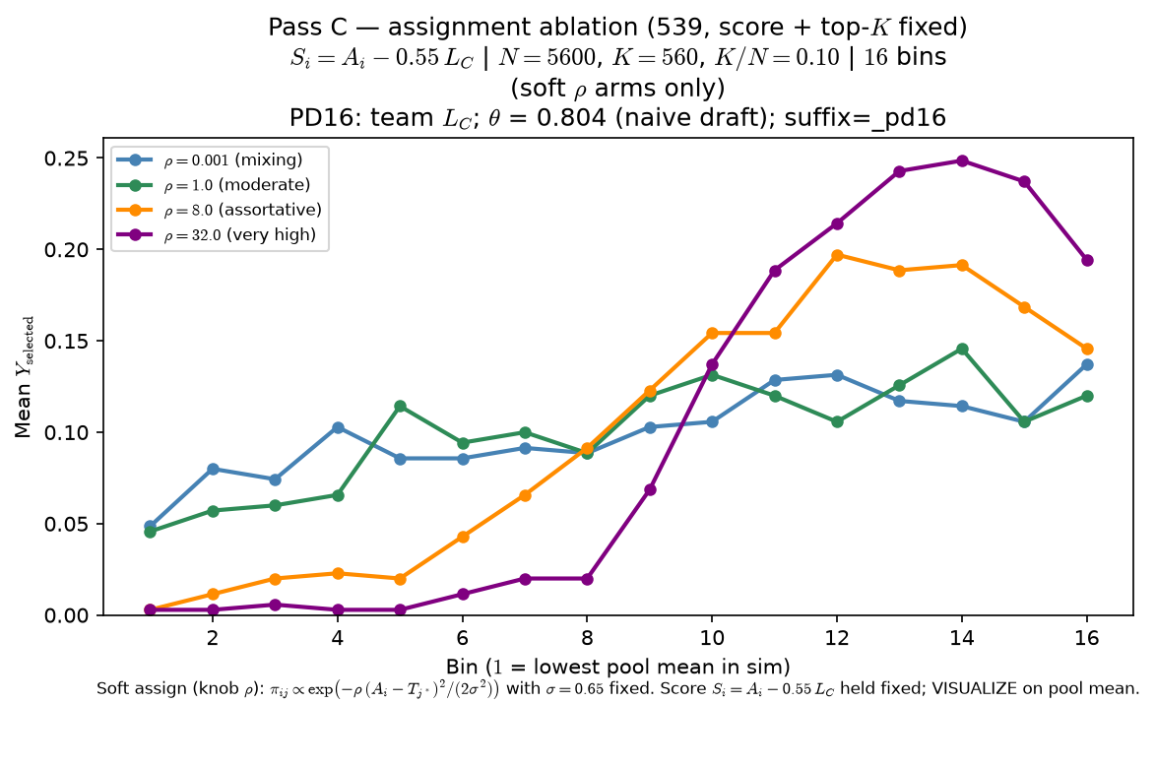
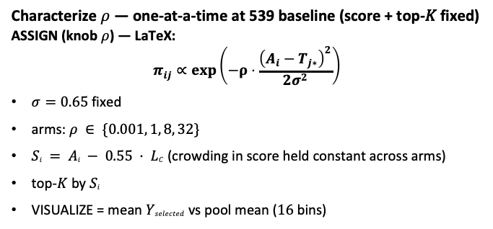
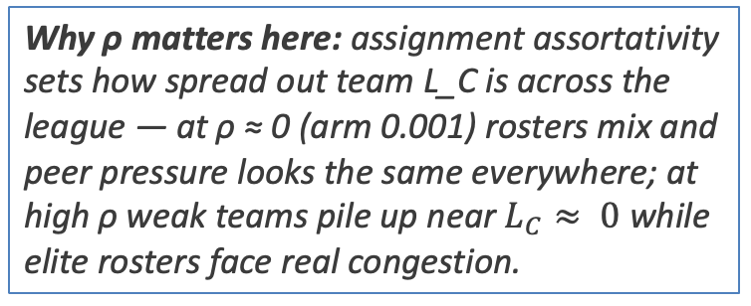
Phase B — Characterize $ρ$ (assignment assortativity) — sort-and-chop suppressed
Characterize $ρ$ — one-at-a-time at 539 baseline (score + top-𝐾 fixed)
ASSIGN (knob $ρ$) — LaTeX:
$$π_{ij}∝\exp\left(−ρ⋅\frac{{\left(A_{i}−T_{j∗}\right)}^{2}}{2σ^{2}}\right)$$
$σ=0.65$ fixed
arms: $ρ ∈ \{0.001, 1, 8, 32\}$
$Si = Ai − 0.55 · LC$(crowding in score held constant across arms)
top-$K$ by $Si$
VISUALIZE = mean $Yselected$vs pool mean ($16$ bins)
Why ρ matters here: assignment assortativity sets how spread out team L_C is across the league — at ρ ≈ 0 (arm 0.001) rosters mix and peer pressure looks the same everywhere; at high ρ weak teams pile up near $L_{C}≈ 0$while elite rosters face real congestion.
OAT: one draw of $Ai{ ,T}_{j∗}$(seed $42$); only ASSIGN changes across arms.
Low $ρ$ : players mix across teams — selection vs pool mean stays nearly flat.
High $ρ$ : assortative matching — peer environments concentrate; inverted-$U$ emerges.
Sort-and-chop arm omitted from plot (still in CSV bundle; toggle restores it).
Claim: at fixed score and top-$K$, $ρ$in assignment matters — low-$ρ$ mixing yields a weak monotone tilt; high-$ρ$assortativity delivers the peer-pressure inverted-U readout.

Slide 6
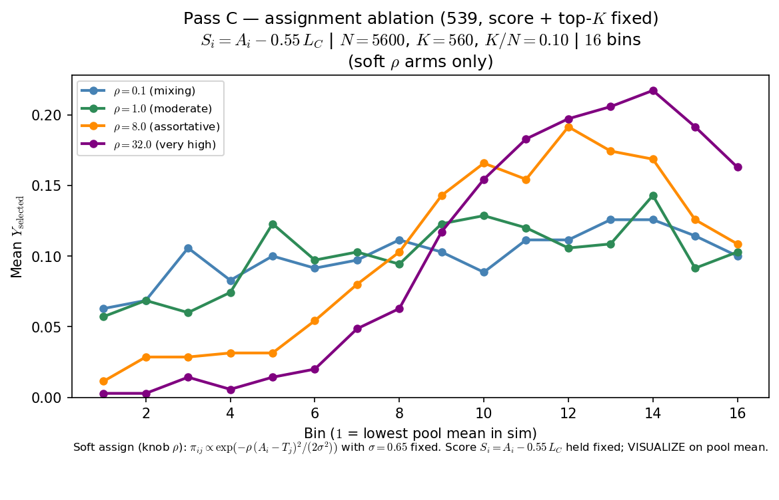
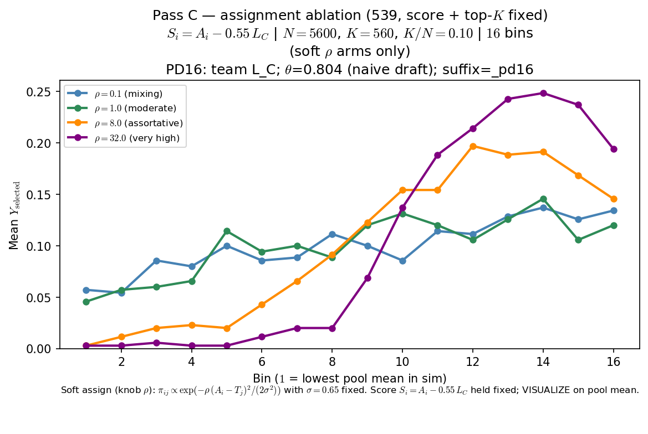
Phase B — Characterize $ρ$ (assignment assortativity) . BEFORE and AFTER $θ$ Standardization

Slide 7
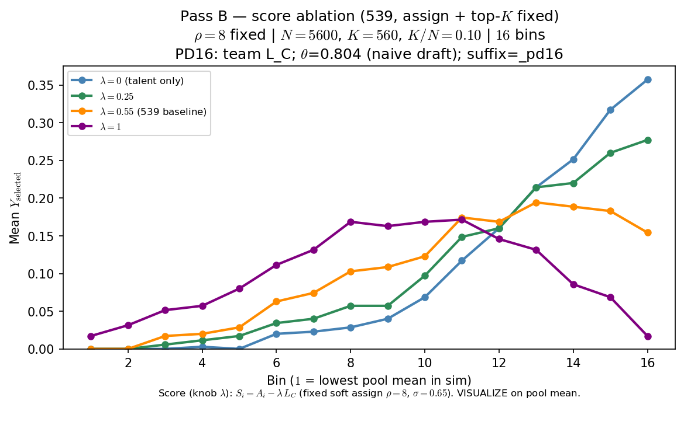
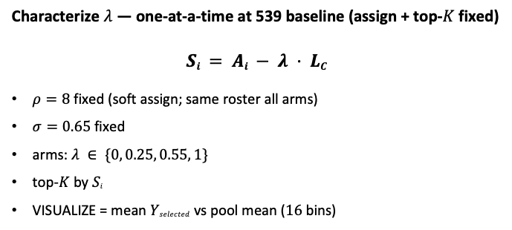
Phase B — Characterize λ (congestion in score)
Characterize $λ$ — one-at-a-time at 539 baseline (assign + top-$K$fixed)
fixed (soft assign; same roster all arms)
$σ=0.65$fixed
arms: $λ ∈ \{0, 0.25, 0.55, 1\}$
top-$K$by $Si$
VISUALIZE = mean $Yselected$vs pool mean ($16$bins)
OAT: one draw of $Ai, T_{j∗}$+ one assignment (seed $42$); only SCORE changes.
$λ=0: Si = Ai$only — selection vs pool mean stays roughly monotone.
$λ>0$: congestion in score — inverted-U / roster-pressure readout emerges.
Pairs with Pass C: $λ$ bends score; $ρ$ shapes the sorted roster world.
Claim: at fixed $ρ$ and top-$K$, $λ$ in score matters — $λ=0$yields a roughly monotone talent ladder; $λ>0$puts roster pressure in the advancement rule and bends the curve.

Slide 8
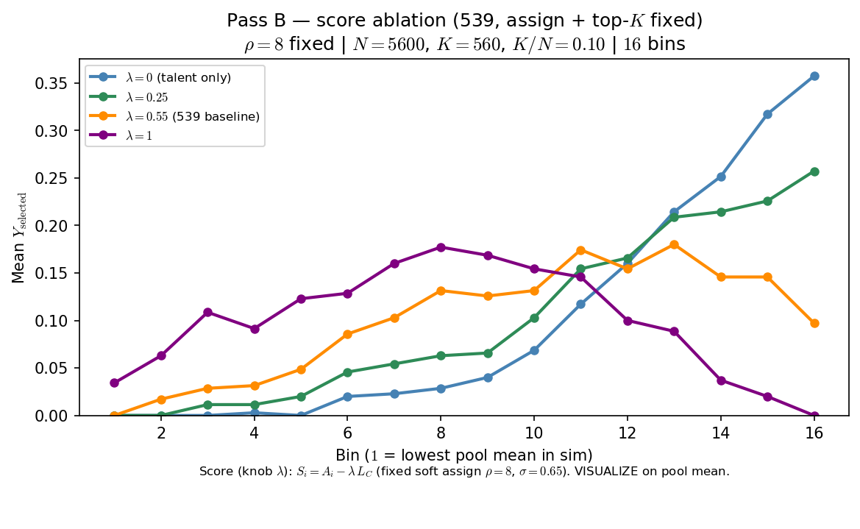
Phase B — Characterize λ (congestion in score). BEFORE and AFTER $θ$ Standardization

Slide 9
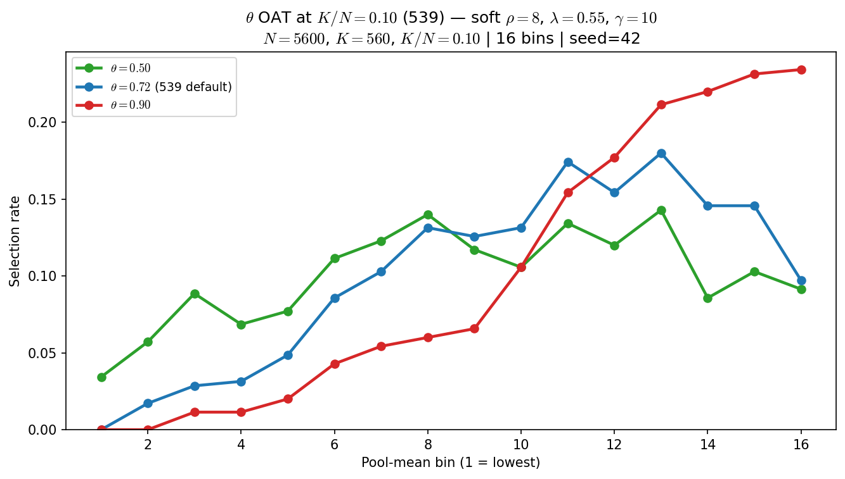
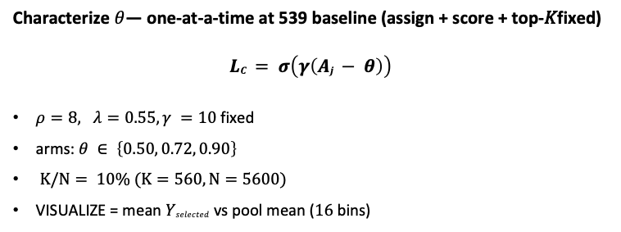
Phase B — Characterize $θ$ (viability cutline) — OAT at $K/N=10\%$
Characterize $θ$— one-at-a-time at 539 baseline (assign + score + top-𝐾fixed)
$$LC = σ\left(γ\left(Aj − θ\right)\right)$$
$ρ=8, λ=0.55, γ =10$fixed
arms: $θ ∈ \left\{0.50, 0.72, 0.90\right\}$
$K/N= 10\% (K=560, N=5600)$
VISUALIZE = mean $Yselected$vs pool mean ($16$bins)
OAT: soft $ρ=8, λ=0.55, γ=10$fixed; only $θ$ in $σ(γ(A−θ))$changes.
$θ=0.50$: mid-pool hump (peak bin $≈13$).
$θ=0.72$(539 default): similar hump, slightly higher peak rate.
$θ=0.90$: top bins dominate — curve becomes monotone-increasing at the elite edge.
Claim: at fixed $ρ, λ, and K/N=10\%, θ$(viability cutline) moves the readout — low $θ$ keeps a mid-pool hump; high $θ$ top-saturates the curve.

Slide 10
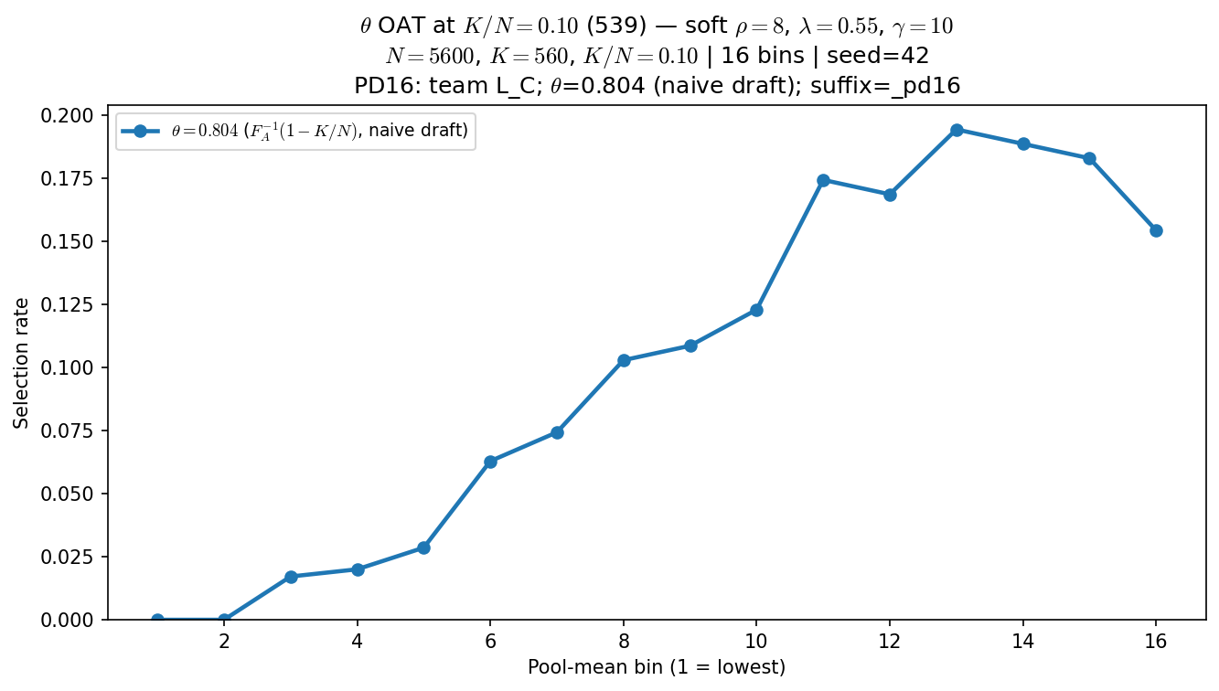
Phase B — Characterize $θ$ (viability cutline) — OAT at $K/N=10\%$ COMPARE with COMPUTED $θ$

Slide 11
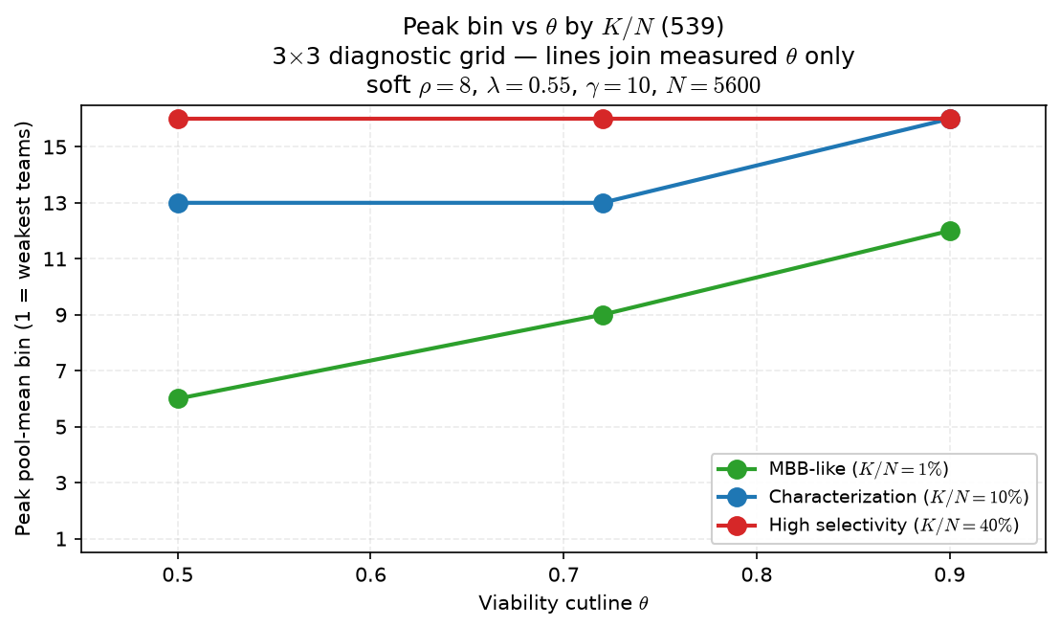
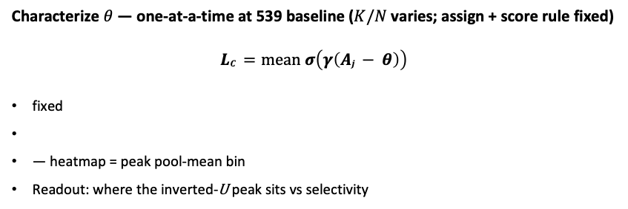
Phase B — Characterize $θ$— panel with $K/N$(selectivity)
Characterize $θ$ — one-at-a-time at 539 baseline ($K/N$varies; assign + score rule fixed)
$$LC =mean σ\left(γ\left(Aj − θ\right)\right)$$
fixed
— heatmap = peak pool-mean bin
Readout: where the inverted-U peak sits vs selectivity
Grid: $θ ∈ \left\{0.50, 0.72, 0.90\right\} × K/N ∈ \{1\%, 10\%, 40\%\}$on N=5600.
At$K/N=1\%:$peak bin rises $6 →9 →12$as $θ$increases.
$At K/N=10\%: θ=0.90$pushes peak to bin $16$ (top saturation).
At $K/N=40\%$: all arms peak at bin $16$ — selectivity dominates $θ$.
Do not fix $θ = f(K/N)$without Alex — panel is descriptive.
Claim: $θ$ and $K/N$co-vary — at MBB-like selectivity ($1\%$) raising $θ$ shifts peak bin up the pool ladder; at $40\%$ selectivity curves are top-saturated regardless of $θ$.

Slide 12
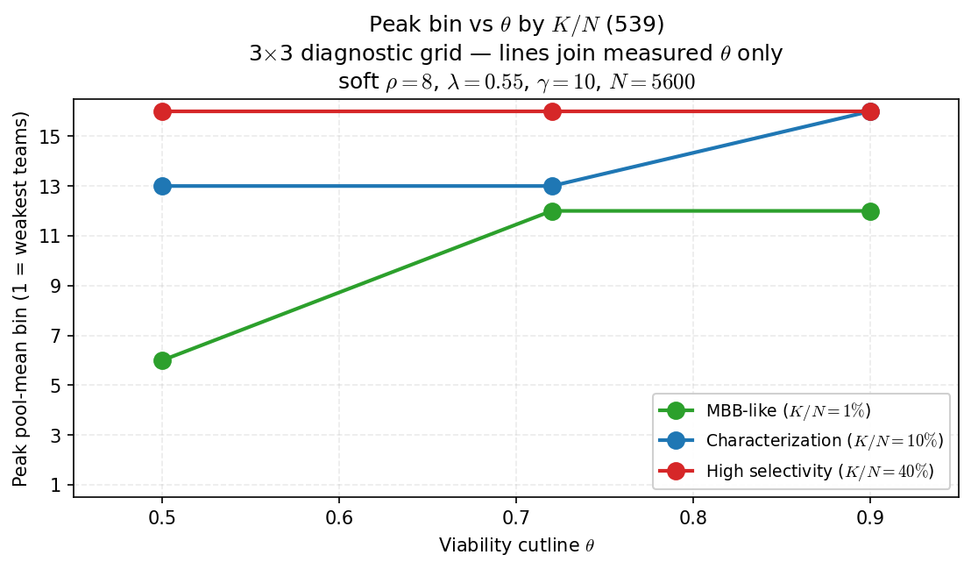
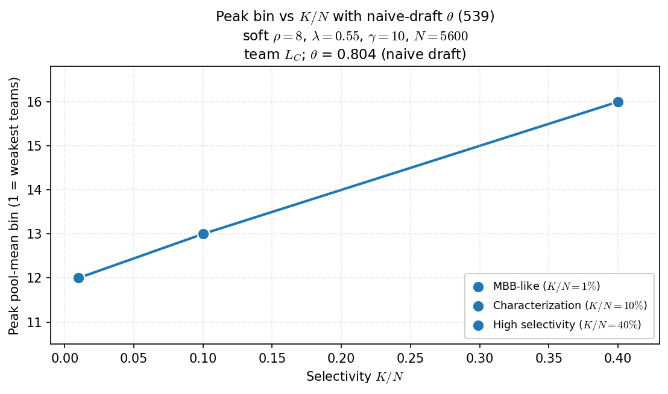
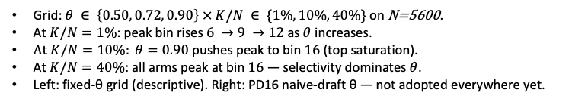
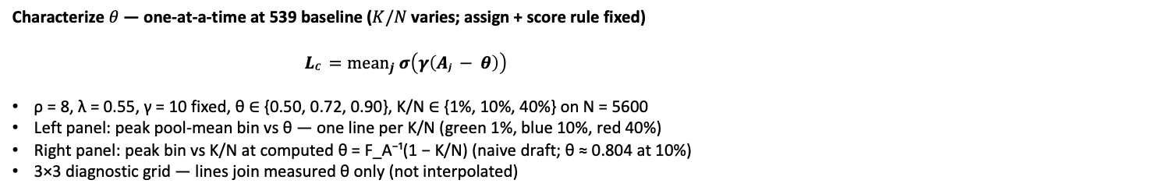
Phase B — Characterize $θ$— panel with $K/N$(selectivity) - COMPARE with COMPUTED $θ$
Characterize $θ$ — one-at-a-time at 539 baseline ($K/N$varies; assign + score rule fixed)
$LC ={mean}_{j} σ\left(γ\left(Aj − θ\right)\right)$
ρ = 8, λ = 0.55, γ = 10 fixed, θ ∈ {0.50, 0.72, 0.90}, K/N ∈ {1%, 10%, 40%} on N = 5600
Left panel: peak pool-mean bin vs θ — one line per K/N (green 1%, blue 10%, red 40%)
Right panel: peak bin vs K/N at computed θ = F_A⁻¹(1 − K/N) (naive draft; θ ≈ 0.804 at 10%)
3×3 diagnostic grid — lines join measured θ only (not interpolated)
Grid: $θ ∈ \left\{0.50, 0.72, 0.90\right\} × K/N ∈ \{1\%, 10\%, 40\%\}$on N=5600.
At$K/N=1\%:$peak bin rises $6 →9 →12$as $θ$increases.
$At K/N=10\%: θ=0.90$pushes peak to bin $16$ (top saturation).
At $K/N=40\%$: all arms peak at bin $16$ — selectivity dominates $θ$.
Left: fixed-θ grid (descriptive). Right: PD16 naive-draft θ — not adopted everywhere yet.
Claim: $θ$ and $K/N$co-vary — at MBB-like selectivity ($1\%$) raising $θ$ shifts peak bin up the pool ladder; at $40\%$ selectivity curves are top-saturated regardless of $θ$.

Slide 13
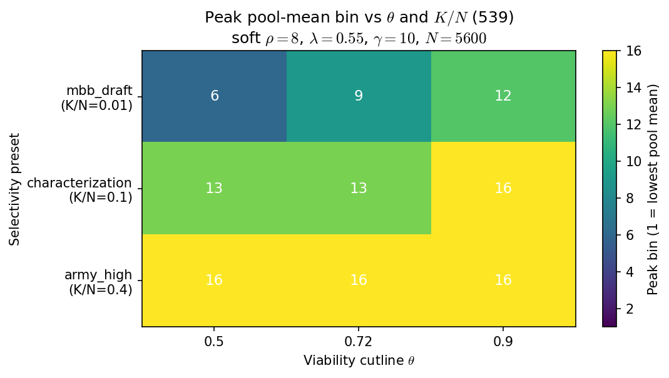
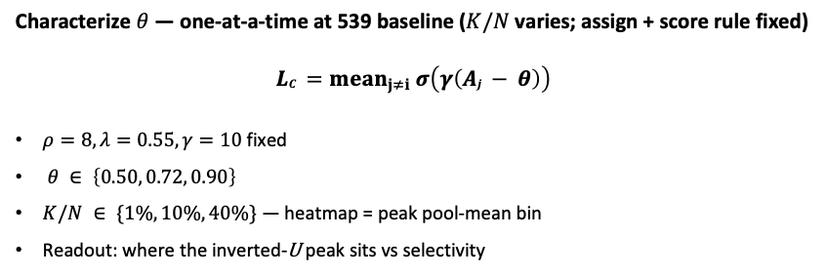
Phase B — Characterize $θ$— panel with $K/N$(selectivity)
Characterize $θ$ — one-at-a-time at 539 baseline ($K/N$varies; assign + score rule fixed)
$$LC ={mean}_{j≠i} σ\left(γ\left(Aj − θ\right)\right)$$
fixed
— heatmap = peak pool-mean bin
Readout: where the inverted-U peak sits vs selectivity
Grid: $θ ∈ \left\{0.50, 0.72, 0.90\right\} × K/N ∈ \{1\%, 10\%, 40\%\}$on N=5600.
At$K/N=1\%:$peak bin rises $6 →9 →12$as $θ$increases.
$At K/N=10\%: θ=0.90$pushes peak to bin $16$ (top saturation).
At $K/N=40\%$: all arms peak at bin $16$ — selectivity dominates $θ$.
Do not fix $θ = f(K/N)$without Alex — panel is descriptive.
Claim: $θ$ and $K/N$co-vary — at MBB-like selectivity ($1\%$) raising $θ$ shifts peak bin up the pool ladder; at $40\%$ selectivity curves are top-saturated regardless of $θ$.

Slide 14
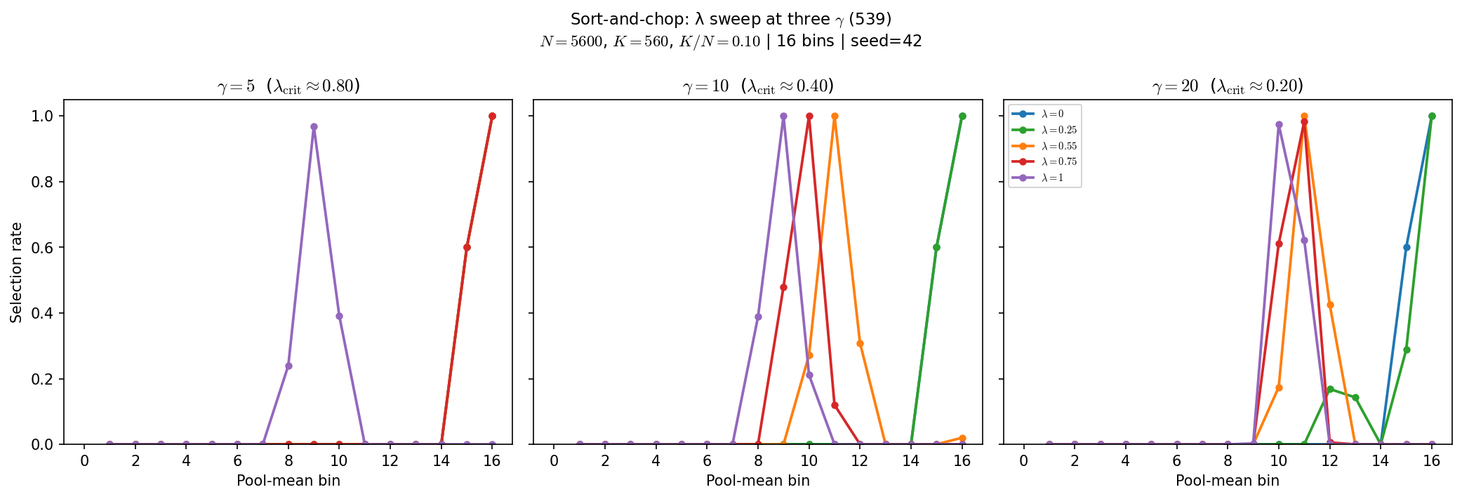
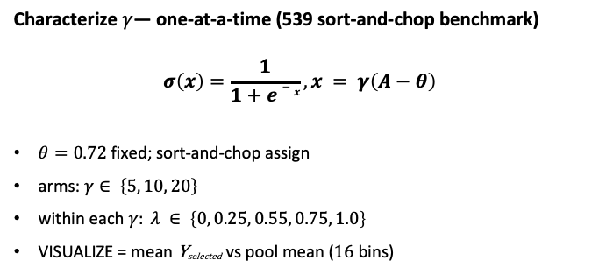
Phase B — Characterize $γ$ (viability sharpness) — selection curves
Characterize $γ$— one-at-a-time (539 sort-and-chop benchmark)
$$σ\left(x\right)=\frac{1}{1+e−x}, x = γ\left(A−θ\right)$$
$θ=0.72$fixed; sort-and-chop assign
arms: $γ∈ \left\{5, 10, 20\right\}$
within each $γ: λ ∈ \left\{0, 0.25, 0.55, 0.75, 1.0\right\}$
VISUALIZE = mean Y_{selected} vs pool mean ($16$bins)
Sort-and-chop benchmark: same rosters per $γ$; only $γ$and $λ$ in score change.
$γ=5: λcrit≈0.8$— hump needs larger $λ$.
$γ=10 \left(539\right): λcrit≈0.4$— curve morph near $λ≳0.4$.
$γ=20: λcrit≈0.2$— congestion reorders at modest $λ$.
Below crit: monotone elite-edge shape; above crit: inverted-U / hump.
Claim: $γ$ (sigmoid slope in $LC$) shifts when congestion bites — higher $γ$ lowers $λcrit ≈4/γ$ on sort-and-chop; below crit, $λ$arms can look identical.

Slide 15
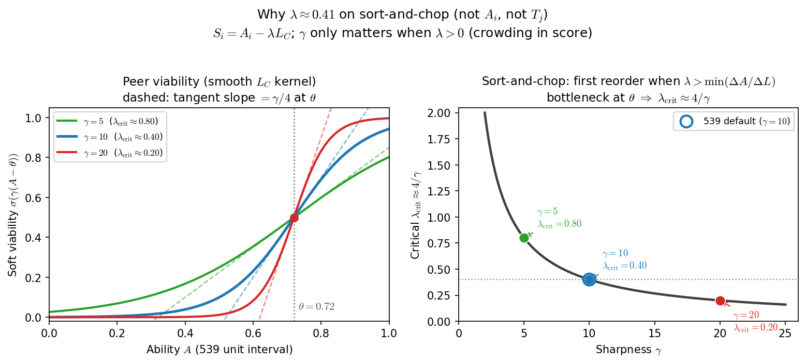
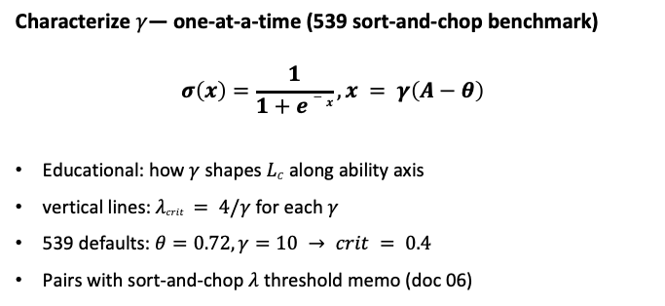

Phase B — $λcrit ≈4/γ$ (sort-and-chop algebra)
Characterize $γ$— one-at-a-time (539 sort-and-chop benchmark)
$$σ\left(x\right)=\frac{1}{1+e−x}, x = γ\left(A−θ\right)$$
Educational: how $γ$ shapes $LC$ along ability axis
vertical lines: $λcrit = 4/γ$for each $γ$
539 defaults: $θ=0.72, γ=10 → crit = 0.4$
Pairs with sort-and-chop $λ$threshold memo (doc 06)
Soft viability: $σ\left(γ\left(A−θ\right)\right)$— not a hard step; $γ$ sets knee steepness.
On sort-and-chop, A_{i} $∥$L_{C} within teams → small λ may not reorder top-K.
$λcrit$ : first $λ$ where $Si = Ai − λ LC$changes who gets selected.
Visual curve departure in $16$ bins can lag $λcrit$— use finer bins or check reorder.
Ties to Alex Q: why $λ=0$ and $λ=0.25$ match until $λ >4/γ$.
Claim: $λcrit ≈4/γ$ is the first $λ$ where score reorder beats talent-only on sort-and-chop — not when the curve visually departs from $λ=0$in coarse bins.

Slide 16
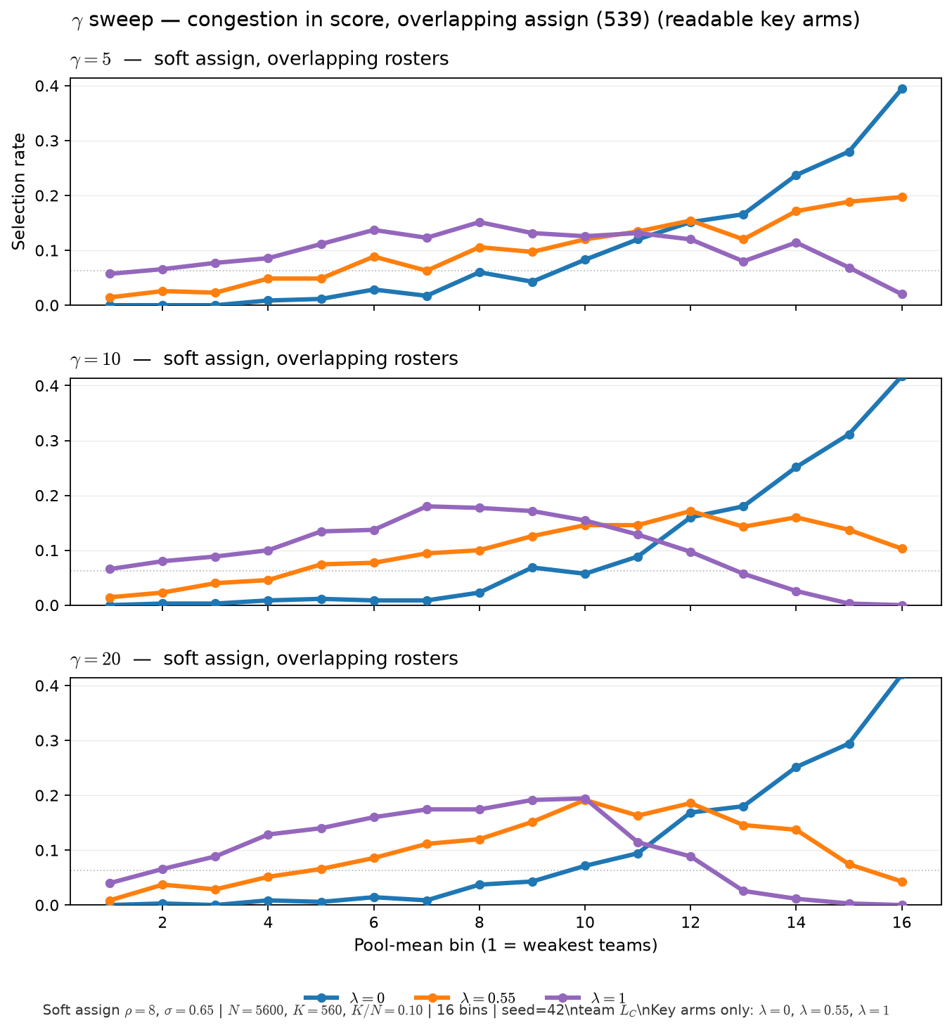
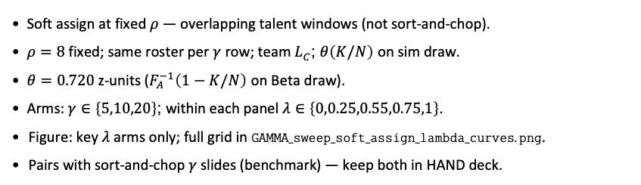
Phase B — $γ × λ$ sweep (soft assign, overlapping rosters)
Overlap regime — same readout as sort-and-chop grid, different ASSIGN world
Soft assign at fixed $ρ$ — overlapping talent windows (not sort-and-chop).
$ρ=8$ fixed; same roster per $γ$ row; team $L_{C}$; $θ\left(K/N\right)$ on sim draw.
$θ=0.720$ z-units ($F_{A}^{−1}\left(1−K/N\right)$ on Beta draw).
Arms: $γ∈\left\{5,10,20\right\}$; within each panel $λ∈\left\{0,0.25,0.55,0.75,1\right\}$.
Figure: key $λ$ arms only; full grid in $GAMMA_sweep_soft_assign_lambda_curves.png$.
Pairs with sort-and-chop $γ$ slides (benchmark) — keep both in HAND deck.
Claim: under soft assign (overlapping rosters), $γ$ reshapes team $L_{C}$ and $λ$ in score bends selection — the regime where we will pin $λ$ on data. No $λ_{crit}≈4/γ$ law here (sort-and-chop only).

Slide 17
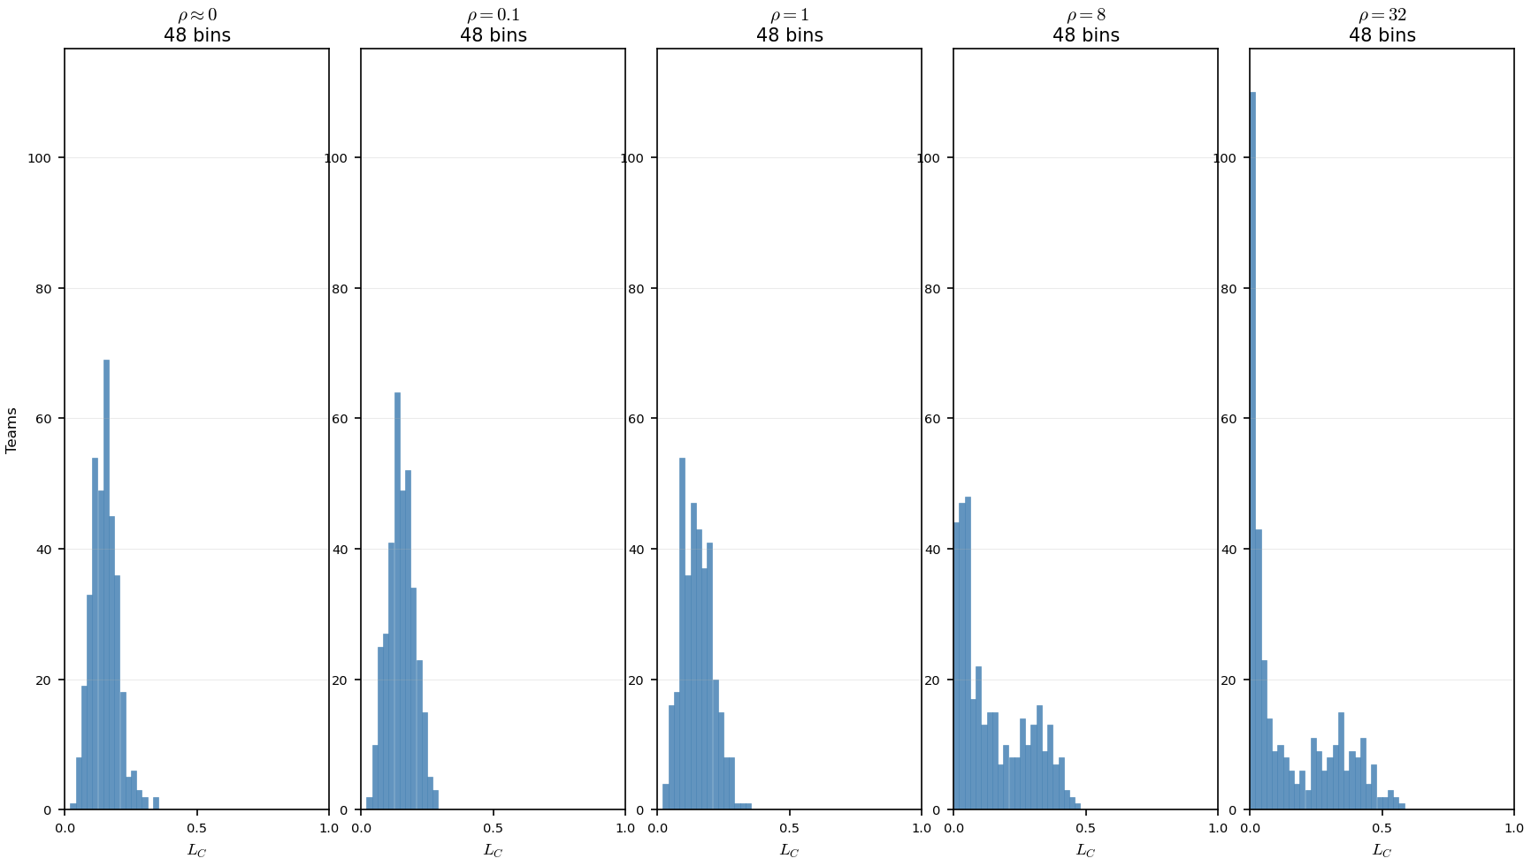
Phase B — Team $LC$vs $ρ$ (PD16 Sketch A) -- How Congestion alone $\left(L_{C}\right)$ varies with change in $ρ$
PD16: team $L_{C}$; $θ=0.804$ (naive draft); suffix=_pd16 · 48 bins · 350 teams · seed 42
low $ρ =$one narrow spike near $LC≈0.15.$ First 3 panels
High $ρ =$ mass at $LC≈0$(weak rosters) + second hump at elite L_{C}.
At $ρ=32: 48\%$ of teams below $LC=0.05$ — weak rosters - almost no peer pressure.
Of Note: The mean $L_{C}$ is almost identical for all plots, hovering $≈.15$
Claim: $ρ$stratifies team congestion across the league — low-$ρ$ mixing yields one narrow $LC$hump; high-$ρ$ assortativity piles weak teams at $LC≈0$and elite rosters at higher $LC$.

Slide 18
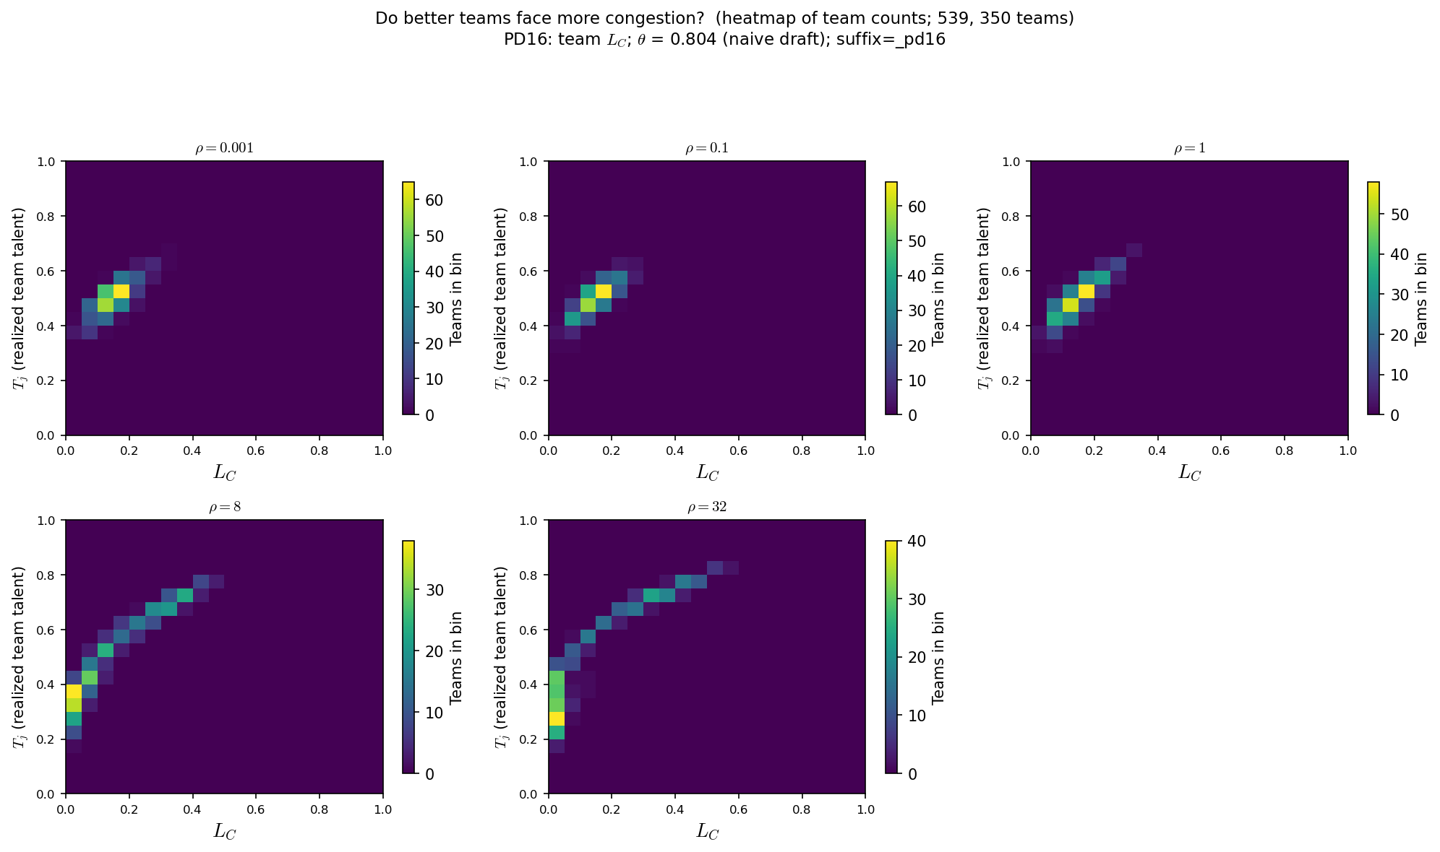
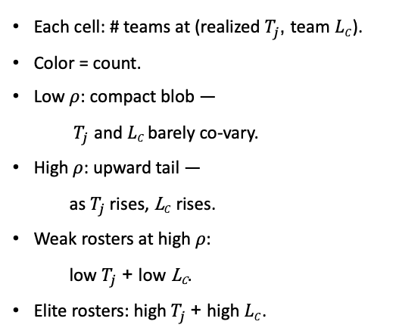
Phase B — Realized $Tj$vs $LC$ (PD16 Sketch A — co-movement) -- Realized $Tj$vs Congestion alone $\left(L_{C}\right)$ as $ρ$varies
PD16: team $L_{C}; θ=0.804$ (naive draft); suffix=_pd16 · 48 bins · 350 teams · seed 42
Each cell: # teams at (realized $T_{j}$, team $LC$).
Color = count.
Low $ρ$: compact blob —
$T_{j}$ and $LC$barely co-vary.
High $ρ$: upward tail —
as $T_{j}$rises, L$C$rises.
Weak rosters at high $ρ$:
low $T_{j}$ + low L_{C}.
Elite rosters: high$T_{j}$ + high $LC$.
Claim: at high $ρ$, better teams systematically face more peer pressure — the upward cloud in$T_{j}$ vs $LC$.
That gives $ρ$ a model-internal read beyond “the Pass C selection plot moved.”

