Slide 1
PD17 HAND

Slide 2
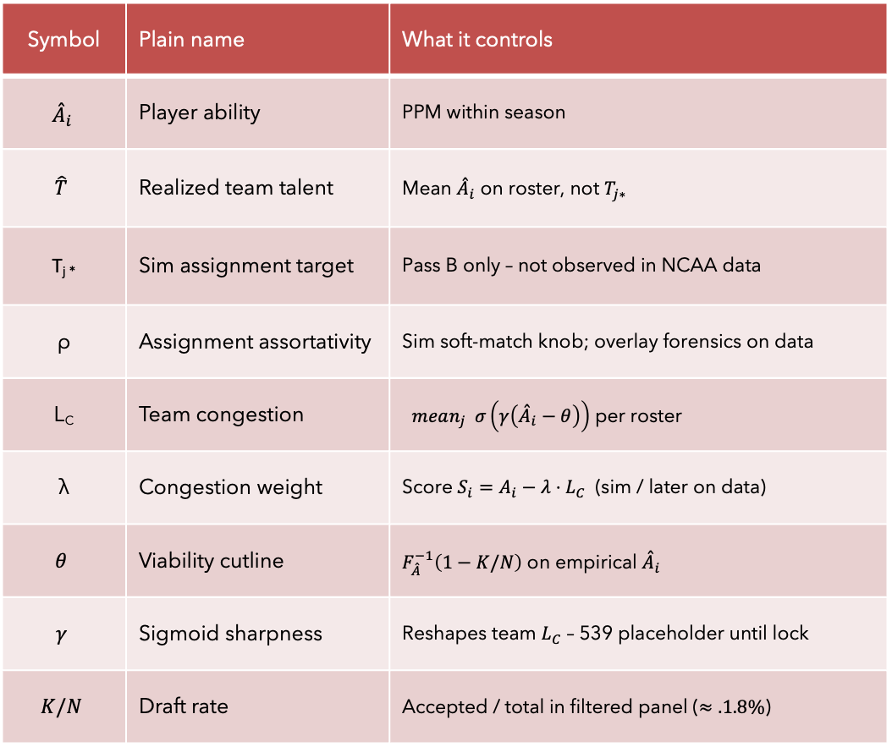
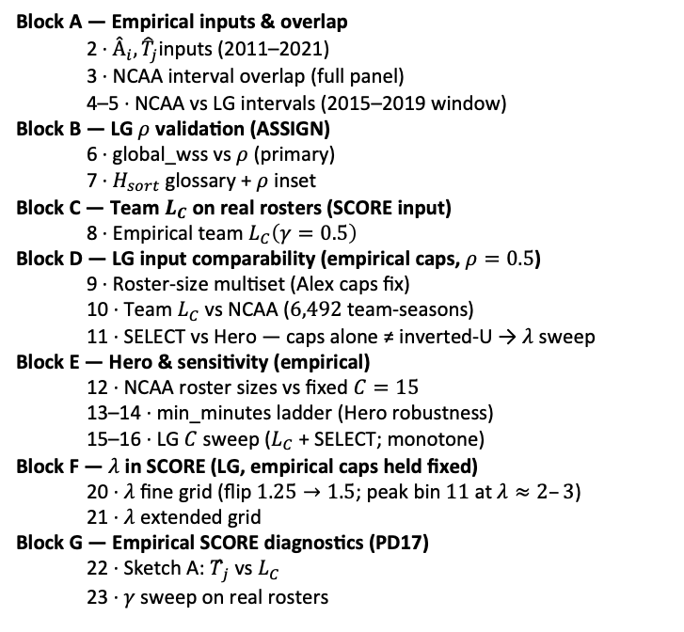
PD17 — Empirical MBB characterization
Knobs (mini glossary)
Deck map (assign $→$ score $→$ comparability $→$ Hero)
Symbol | Plain name | What it controls
$${\overset{ˆ}{A}}_{i}$$ | Player ability | PPM within season
$$\hat{T}$$ | Realized team talent | Mean ${\overset{ˆ}{A}}_{i}$ on roster, not $T_{j∗}$
T_{j *} | Sim assignment target | Pass B only – not observed in NCAA data
ρ | Assignment assortativity | Sim soft-match knob; overlay forensics on data
L_{C} | Team congestion | $mean_{j} σ\left(γ\left({\overset{ˆ}{A}}_{i}−θ\right)\right)$ per roster
λ | Congestion weight | Score $S_{i}=A_{i}−λ{⋅L}_{C}$ (sim / later on data)
$$θ$$ | Viability cutline | $F_{\overset{ˆ}{A}}^{−1}\left(1−K/N\right)$ on empirical ${\overset{ˆ}{A}}_{i}$
$$γ$$ | Sigmoid sharpness | Reshapes team $L_{C}$ – 539 placeholder until lock
$$K/N$$ | Draft rate | Accepted / total in filtered panel ($≈.1.8\%$)
Block A — Empirical inputs & overlap 2 · $Â_{i}, {\hat{T}}_{j}$inputs (2011–2021) 3 · NCAA interval overlap (full panel) 4–5 · NCAA vs LG intervals (2015–2019 window)
Block B — LG $ρ$ validation (ASSIGN) 6 · global_wss vs $ρ$ (primary) 7 · $H_{sort}$ glossary + $ρ$ inset
Block C — Team $L_{C}$ on real rosters (SCORE input) 8 · Empirical team $L_{C}\left(γ=0.5\right)$
Block D — LG input comparability (empirical caps, $ρ=0.5$) 9 · Roster-size multiset (Alex caps fix) 10 · Team $L_{C}$ vs NCAA ($6,492$ team-seasons) 11 · SELECT vs Hero — caps alone ≠ inverted-U → $λ$ sweep
Block E — Hero & sensitivity (empirical) 12 · NCAA roster sizes vs fixed $C=15$ 13–14 · min_minutes ladder (Hero robustness) 15–16 · LG $C$ sweep ($L_{C}$ + SELECT; monotone)
Block F — $λ$ in SCORE (LG, empirical caps held fixed) 20 · $λ$ fine grid (flip $1.25→1.5$; peak bin $11$ at $λ≈2–3$) 21 · $λ$ extended grid
Block G — Empirical SCORE diagnostics (PD17) 22 · Sketch A: $T̂_{j}$ vs $L_{C}$ 23 · $γ$ sweep on real rosters
Claim (PD17): Map empirical roster geometry; validate $ρ$ on ASSIGN; with caps fixed, Hero shape on LOO emerges in LG via $λ$ in SCORE (slides 20–21) — not via $ρ$ or roster alignment alone.

Slide 3
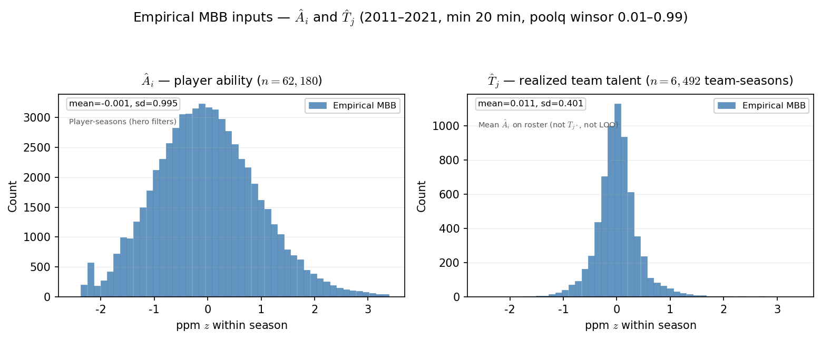

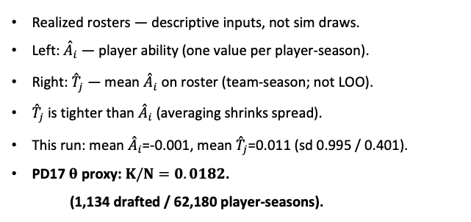
PD17 — Empirical MBB inputs: ${\overset{ˆ}{A}}_{i}$ and ${\overset{ˆ}{T}}_{j}$
MBB 2011-2021 · ppm z within season · min 20 min · poolq winsor 0.01–0.99
Realized rosters — descriptive inputs, not sim draws.
Left: ${\overset{ˆ}{A}}_{i}$ — player ability (one value per player-season).
Right: ${\overset{ˆ}{T}}_{j}$ — mean ${\overset{ˆ}{A}}_{i}$ on roster (team-season; not LOO).
${\overset{ˆ}{T}}_{j}$ is tighter than ${\overset{ˆ}{A}}_{i}$ (averaging shrinks spread).
This run: mean ${\overset{ˆ}{A}}_{i}$=-0.001, mean ${\overset{ˆ}{T}}_{j}$=0.011 (sd 0.995 / 0.401).
PD17 $θ$ proxy: $K/N=0.0182$.
(1,134 drafted / 62,180 player-seasons).
Claim (PD17): World-first inputs from the real MBB panel — ${\overset{ˆ}{A}}_{i}$ per player-season and ${\overset{ˆ}{T}}_{j}$ per team-season. Not $T_{j^{∗}}$(sim assignment targets).

Slide 4
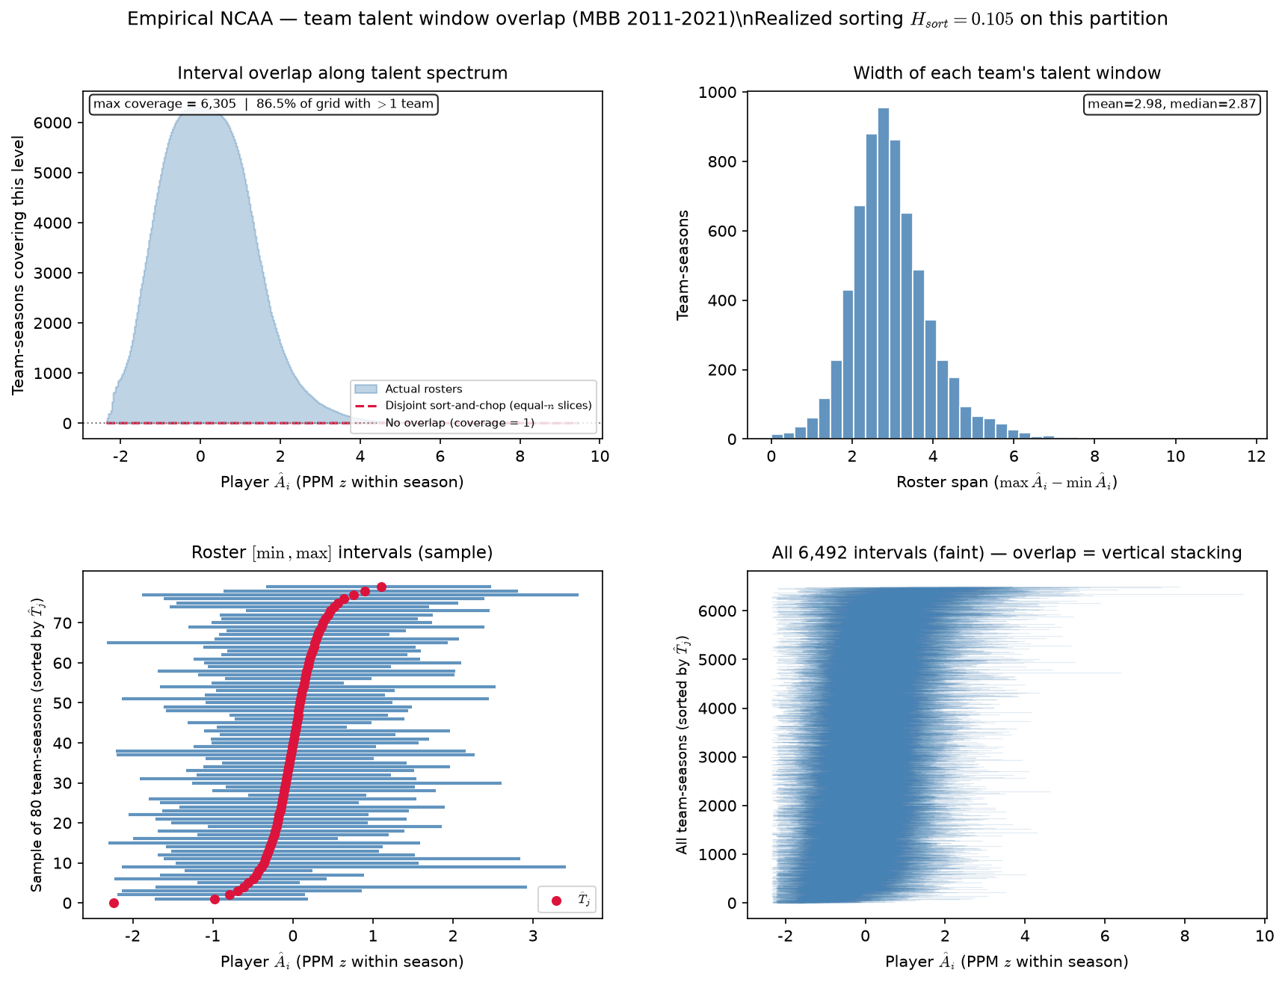
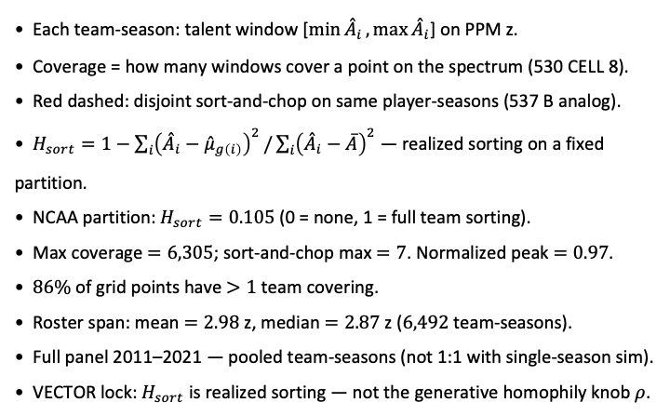
PD17 — Empirical team ${\overset{ˆ}{A}}_{i}$ interval overlap ($ρ$ diagnostic)
MBB 2011-2021 · PPM z within season · min 20 min · poolq winsor $0.01–0.99$ · $6,492$ team-seasons (530 CELL 8 port) · $H_{sort}=0.105$
Each team-season: talent window [$\min{{\overset{ˆ}{A}}_{i}},\max{{\overset{ˆ}{A}}_{i}}$] on PPM z.
Coverage = how many windows cover a point on the spectrum (530 CELL 8).
Red dashed: disjoint sort-and-chop on same player-seasons (537 B analog).
$H_{sort}=1−\sum_{i}{{\left({\overset{ˆ}{A}}_{i}−{\overset{ˆ}{μ}}_{g\left(i\right)}\right)}^{2}}/\sum_{i}{{\left({\overset{ˆ}{A}}_{i}−\overline{A}\right)}^{2}}$ — realized sorting on a fixed partition.
NCAA partition: $H_{sort}=0.105$ (0 = none, 1 = full team sorting).
Max coverage $=6,305$; sort-and-chop max $=7$. Normalized peak $=0.97$.
$86\%$ of grid points have $>1$ team covering.
Roster span: mean $=2.98$ z, median $=2.87$ z ($6,492$ team-seasons).
Full panel 2011–2021 — pooled team-seasons (not 1:1 with single-season sim).
VECTOR lock: $H_{sort}$ is realized sorting — not the generative homophily knob $ρ$.
Claim (PD17): Real NCAA rosters leave massively overlapping team talent windows — full 2011–2021 panel target for \rho characterization (530 CELL 8).

Slide 5
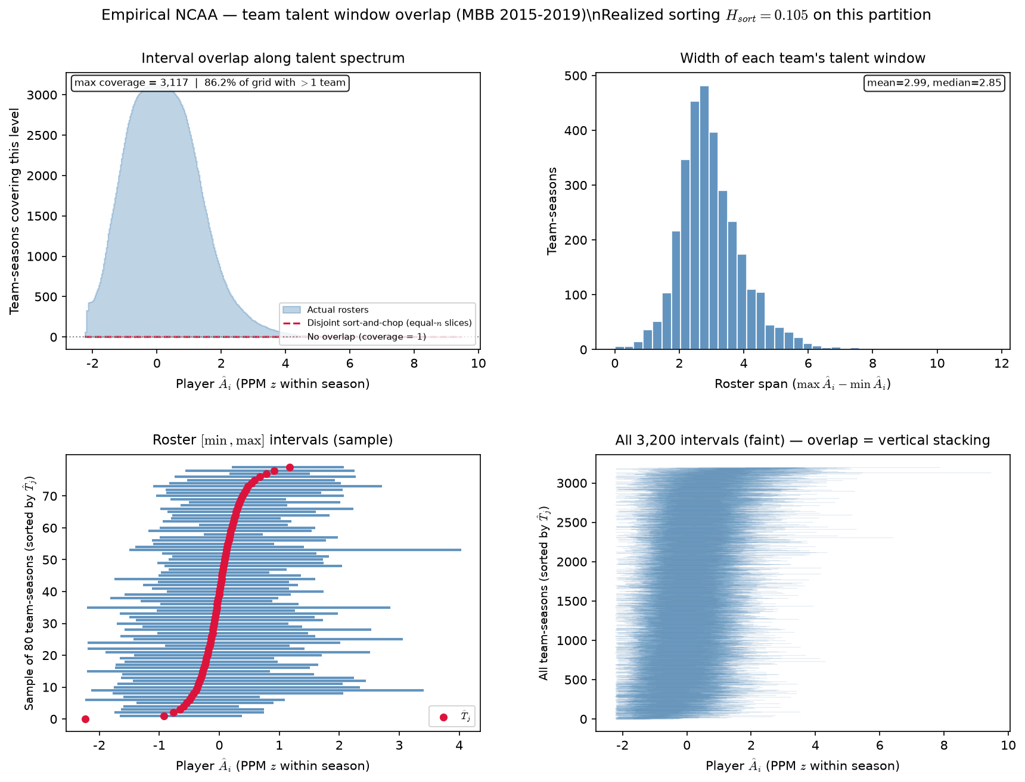

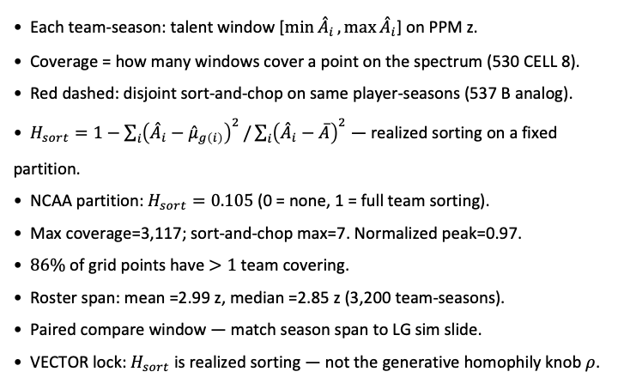
PD17 — NCAA team ${\overset{ˆ}{A}}_{i}$ interval overlap (2015-2019)
MBB 2015-2019 · PPM z within season · min 20 min · poolq winsor 0.01–0.99 · 3,200 team-seasons (530 CELL 8 port) · $H_{sort}=0.105$
Each team-season: talent window [$\min{{\overset{ˆ}{A}}_{i}},\max{{\overset{ˆ}{A}}_{i}}$] on PPM z.
Coverage = how many windows cover a point on the spectrum (530 CELL 8).
Red dashed: disjoint sort-and-chop on same player-seasons (537 B analog).
$H_{sort}=1−\sum_{i}{{\left({\overset{ˆ}{A}}_{i}−{\overset{ˆ}{μ}}_{g\left(i\right)}\right)}^{2}}/\sum_{i}{{\left({\overset{ˆ}{A}}_{i}−\overline{A}\right)}^{2}}$ — realized sorting on a fixed partition.
NCAA partition: $H_{sort}=0.105$ (0 = none, 1 = full team sorting).
Max coverage=3,117; sort-and-chop max=7. Normalized peak=0.97.
$86\%$ of grid points have $>1$ team covering.
Roster span: mean =2.99 z, median =2.85 z (3,200 team-seasons).
Paired compare window — match season span to LG sim slide.
VECTOR lock: $H_{sort}$ is realized sorting — not the generative homophily knob $ρ$.
Claim: NCAA interval overlap on a fixed season window — paired compare to LG ASSIGN sim on the same window.

Slide 6
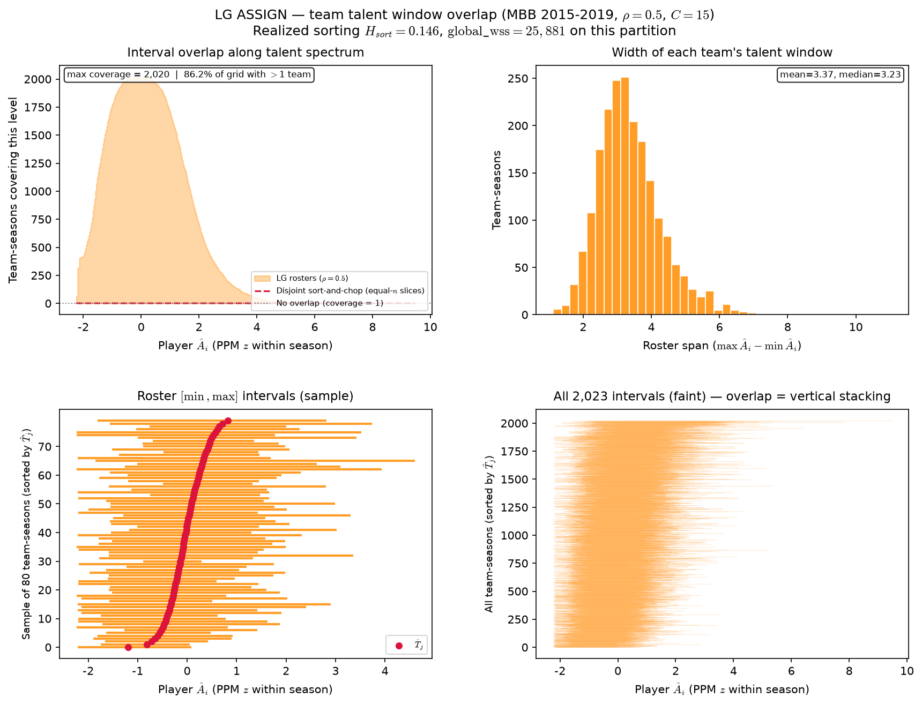

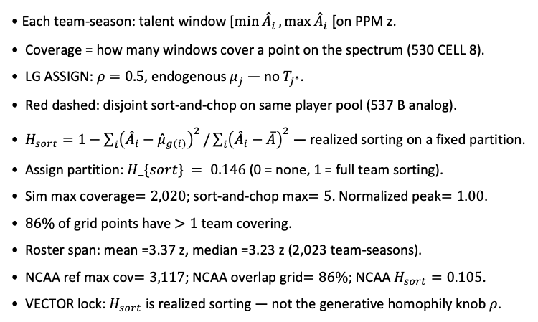
LG sim — team ${\overset{ˆ}{A}}_{i}$ interval overlap (2015-2019)
MBB 2015-2019 · LG ASSIGN · $ρ=0.5$ · $C=15$ · $N=30,345$ $2,023$ team-seasons · $H_{sort}=0.146$
Each team-season: talent window [$\min{{\overset{ˆ}{A}}_{i}},\max{{\overset{ˆ}{A}}_{i}}$] on PPM z.
Coverage = how many windows cover a point on the spectrum (530 CELL 8).
LG ASSIGN: $ρ=0.5$, endogenous $μ_{j}$ — no $T_{j^{∗}}$.
Red dashed: disjoint sort-and-chop on same player pool (537 B analog).
$H_{sort}=1−\sum_{i}{{\left({\overset{ˆ}{A}}_{i}−{\overset{ˆ}{μ}}_{g\left(i\right)}\right)}^{2}}/\sum_{i}{{\left({\overset{ˆ}{A}}_{i}−\overline{A}\right)}^{2}}$ — realized sorting on a fixed partition.
Assign partition: $H_\{sort\} = 0.146$ (0 = none, 1 = full team sorting).
Sim max coverage$=2,020$; sort-and-chop max$=5$. Normalized peak$=1.00$.
$86\%$ of grid points have $>1$ team covering.
Roster span: mean =3.37 z, median =3.23 z (2,023 team-seasons).
NCAA ref max cov$=3,117$; NCAA overlap grid$=86\%$; NCAA $H_{sort}=0.105$.
VECTOR lock: $H_{sort}$ is realized sorting — not the generative homophily knob $ρ$.
Claim: LG ASSIGN on the same season window as paired NCAA slide — one realization per season, stacked team-seasons.

Slide 7
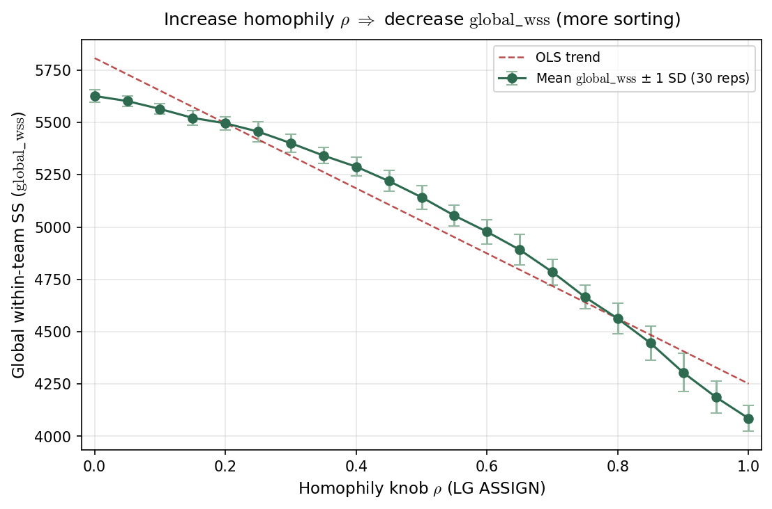

LG ASSIGN — $global_wss$ vs $ρ$ — total global within-team sum of squared-errors
LG ASSIGN · 2015 PPM z · $J=402,C=15$ · $ρ∈\left[0,1\right]$ · $30$ reps/arm
$ρ$ = LG ASSIGN homophily knob in $\exp\left(−ρ\left|{\overset{ˆ}{A}}_{i}−μ_{j}\right|\right)$.
Each point: mean $±1$ SD of $global_wss$ over stochastic LG realizations.
$global_wss=$ $\sum_{j}{\sum_{i∈j}{{\left({\overset{ˆ}{A}}_{i}−{\overset{ˆ}{T}}_{j}\right)}^{2}}}$ — global within-team SS; ${\overset{ˆ}{T}}_{j}=$ realized roster mean.
$H_{sort}=1−$ $global_wss/SS_{total}$ on the same partition
$global_wss$ is raw magnitude;
$H_{sort}$ is scale-free explained variance.
$ρ=0:global_wss≈5627→ρ=1:global_wss≈4085$.
2015 empirical PPM z · $J=402$· $C=15$ · $30$ reps × $21 ρ$ arms.
$ρ↑$ sorting $⇒global_wss$ $↓$, $H_{sort}↑$ (monotone mirror on a fixed ability pool).
Companion slide: $H_{sort}=1−global_wss/{SS}_{total}$
(scale-free assortativity on the same sweep).
VECTOR lock: $H_{sort}$ is realized sorting — not the generative homophily knob $ρ$.
Claim (Alex): $global_wss$ is the within-team SS numerator on the assign partition — $ρ↑$ lowers $global_wss$ on the same 2015 LG league ($H_{sort}$ is the scale-free companion).

Slide 8
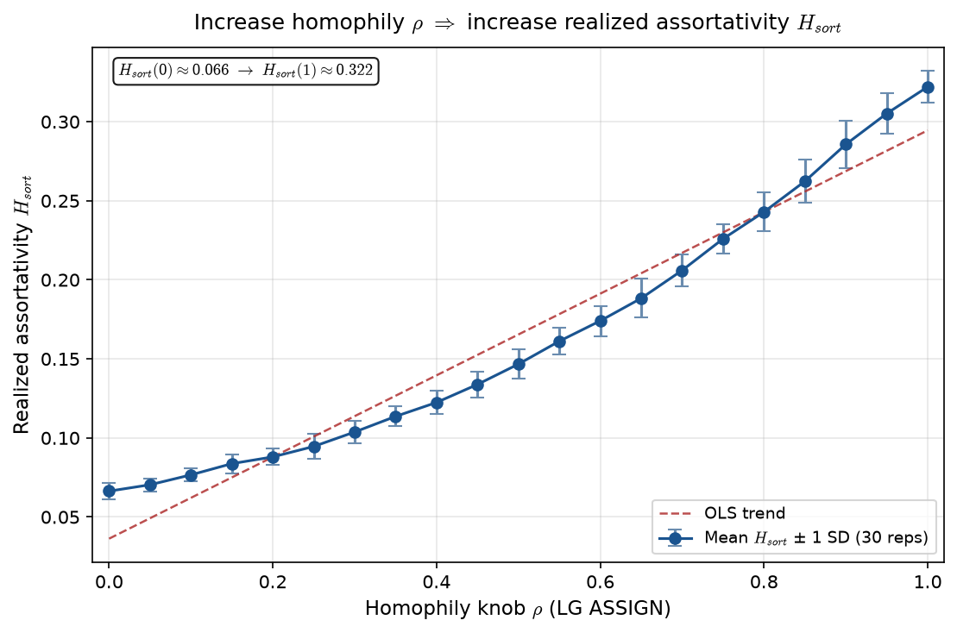

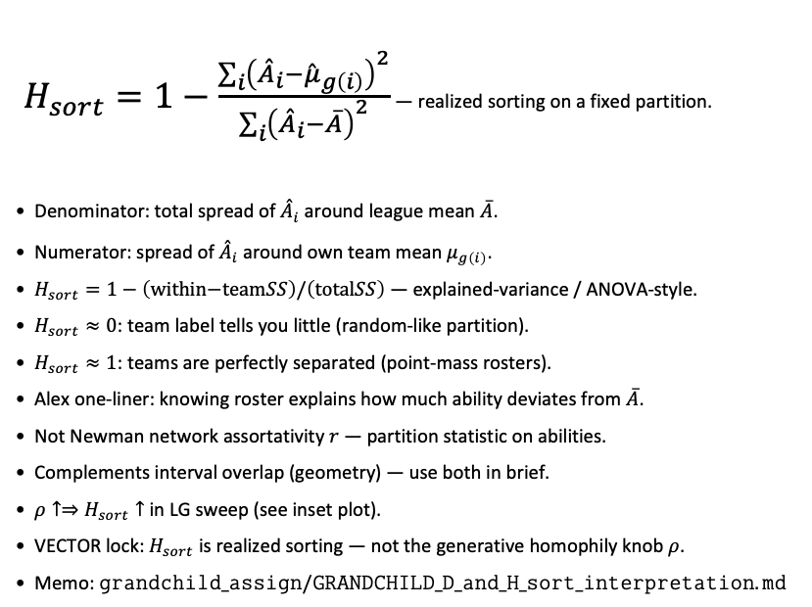
What is $H_{sort}$ ? Realized assortativity on rosters
Realized sorting index · LG / PD17 · alias $sorting_index_h$ in code
$H_{sort}=1−\frac{\sum_{i}{{\left({\overset{ˆ}{A}}_{i}−{\overset{ˆ}{μ}}_{g\left(i\right)}\right)}^{2}}}{\sum_{i}{{\left({\overset{ˆ}{A}}_{i}−\overline{A}\right)}^{2}}}$ — realized sorting on a fixed partition.
Denominator: total spread of ${\overset{ˆ}{A}}_{i}$ around league mean $\overline{A}$.
Numerator: spread of ${\overset{ˆ}{A}}_{i}$ around own team mean $μ_{g\left(i\right)}$.
$H_{sort}=1−\left(\text{within−team}SS\right)/\left(\text{total}SS\right)$ — explained-variance / ANOVA-style.
$H_{sort}≈0$: team label tells you little (random-like partition).
$H_{sort}≈1$: teams are perfectly separated (point-mass rosters).
Alex one-liner: knowing roster explains how much ability deviates from $\overline{A}$.
Not Newman network assortativity $r$ — partition statistic on abilities.
Complements interval overlap (geometry) — use both in brief.
$ρ↑⇒H_{sort}↑$ in LG sweep (see inset plot).
VECTOR lock: $H_{sort}$ is realized sorting — not the generative homophily knob $ρ$.
Memo: $grandchild_assign/GRANDCHILD_D_and_H_sort_interpretation.md$
Claim: $H_{sort}$ is realized assortativity on a fixed partition — generative homophily $ρ$ is the ASSIGN knob; measure $H_{sort}$ after assign.

Slide 9
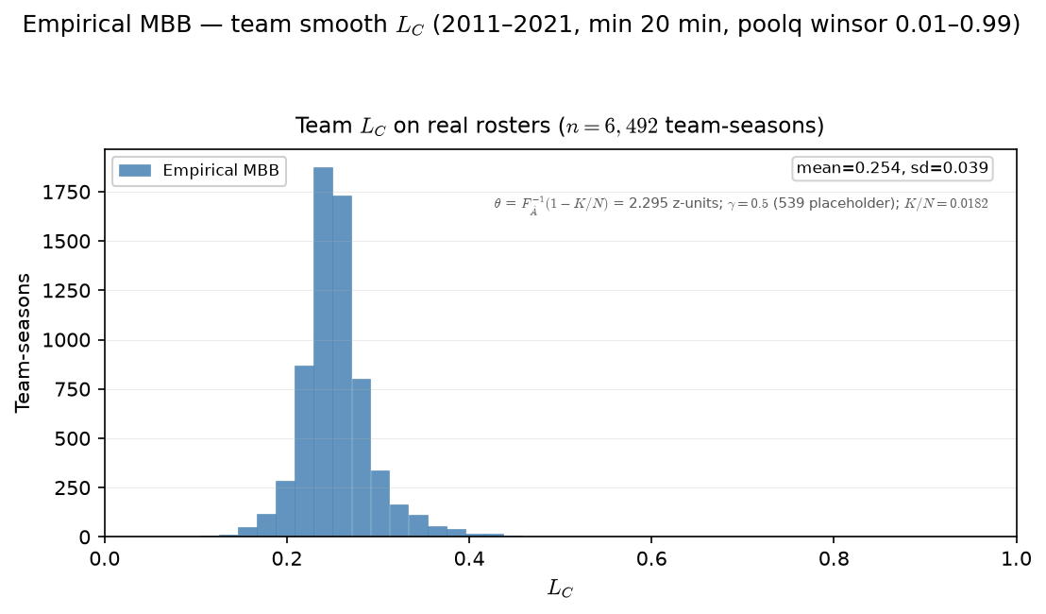

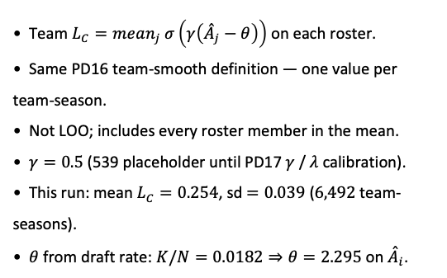
PD17 — Empirical team $L_{C}$ distribution
MBB 2011-2021 · team smooth $L_{C}$ · PPM z within season · min 20 min · $θ=F_{\overset{ˆ}{A}}^{−1}\left(1−K/N\right)=2.295 \left(K/N=0.0182\right)$· $γ=0.5$ placeholder
Team $L_{C}=mean_{j} σ\left(γ\left({\overset{ˆ}{A}}_{j}−θ\right)\right)$ on each roster.
Same PD16 team-smooth definition — one value per team-season.
Not LOO; includes every roster member in the mean.
$γ=0.5$ (539 placeholder until PD17 $γ$ / $λ$ calibration).
This run: mean $L_{C}=0.254$, sd$=0.039$ ($6,492$ team-seasons).
$θ$ from draft rate: $K/N=0.0182⇒θ=2.295$ on ${\overset{ˆ}{A}}_{i}$.
Claim (PD17): Real rosters carry a spread of team congestion $L_{C}$ — the descriptive input $ρ$ was meant to stratify in sim.

Slide 10
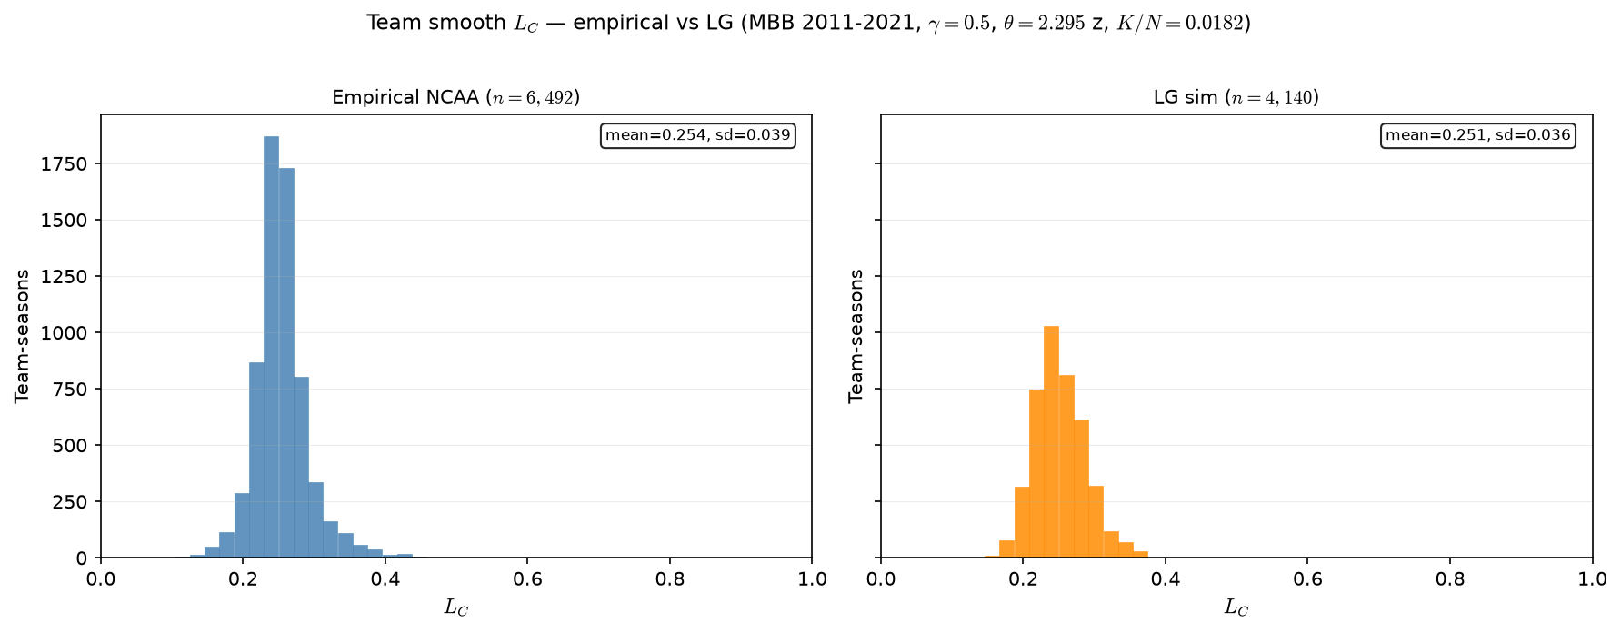

Empirical vs LG — team $L_{C}$ distribution vs NCAA
MBB 2011-2021 · 6,492 team-seasons · NCAA mean=0.254
Team $L_{C}$ after empirical-cap ASSIGN vs real NCAA rosters.
MBB 2011-2021 · $ρ=0.5$, $γ=0.5$.
NCAA: $n=6,492$ · mean $=0.254$ · sd $=0.039$.
LG empirical caps: $n=6,492$ · mean $=0.251$ · sd $=0.045$.
Team count now aligned ($6,492$) — fixed $C=15$ had only $4,140$ teams.
$L_{C}$ first moment still matches; slightly wider LG tail (assign noise).
Input comparability fixed; SCORE/SELECT shape is a separate question.
Talking point: comparability achieved — same team count and L_C mean; assignment layer is now apples-to-apples on roster geometry.

Slide 11
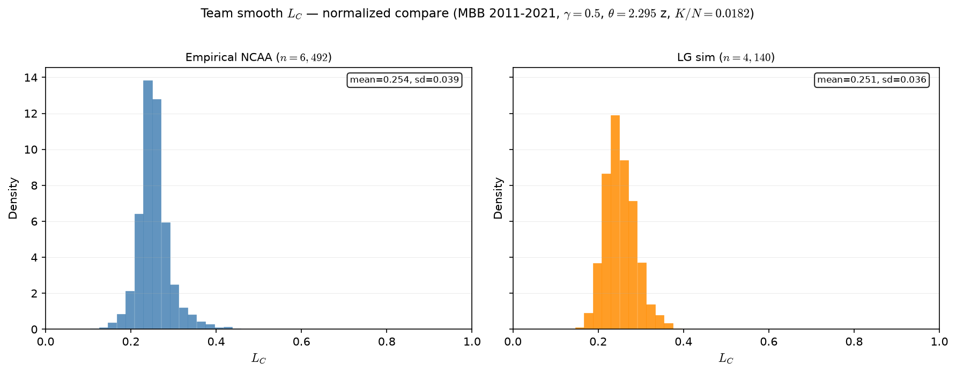
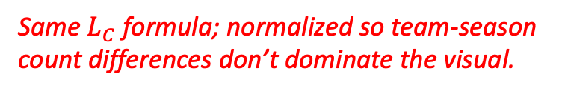
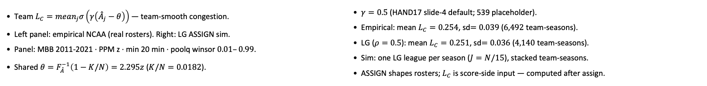
Empirical vs LG — team $L_{C}$ distribution (normalized)
Same $L_{C}$ formula; normalized so team-season count differences don’t dominate the visual.
MBB 2011-2021 · team smooth $L_{C}$ · LG $ρ=0.5$ · $γ=0.5$ · $θ=2.295 z$ ($K/N=0.0182$)
Team $L_{C}=mean_{j}σ\left(γ\left({\overset{ˆ}{A}}_{j}−θ\right)\right)$ — team-smooth congestion.
Left panel: empirical NCAA (real rosters). Right: LG ASSIGN sim.
Panel: MBB 2011-2021 · PPM z · min 20 min · poolq winsor $0.01–0.99$.
Shared $θ=F_{\overset{ˆ}{A}}^{−1}\left(1−K/N\right)=2.295z$ ($K/N=0.0182$).
$γ=0.5$ (HAND17 slide-4 default; 539 placeholder).
Empirical: mean $L_{C}=0.254$, sd$=0.039$ ($6,492$ team-seasons).
LG ($ρ=0.5$): mean $L_{C}=0.251$, sd$=0.036$ ($4,140$ team-seasons).
Sim: one LG league per season ($J=N/15$), stacked team-seasons.
ASSIGN shapes rosters; $L_{C}$ is score-side input — computed after assign.
Claim (PD17 / LG): Team smooth $L_{C}$ on real rosters vs LG sim — same $σ\left(γ\left({\overset{ˆ}{A}}_{j}−θ\right)\right)$ formula; compare distribution shape before SCORE.

Slide 12
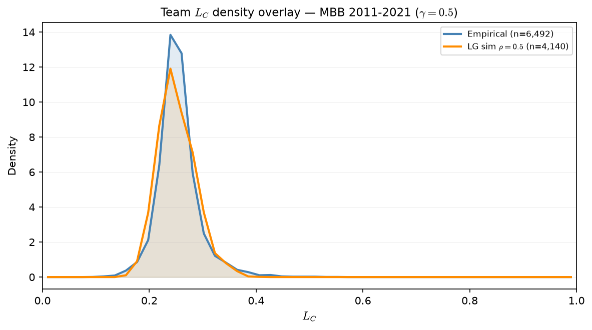
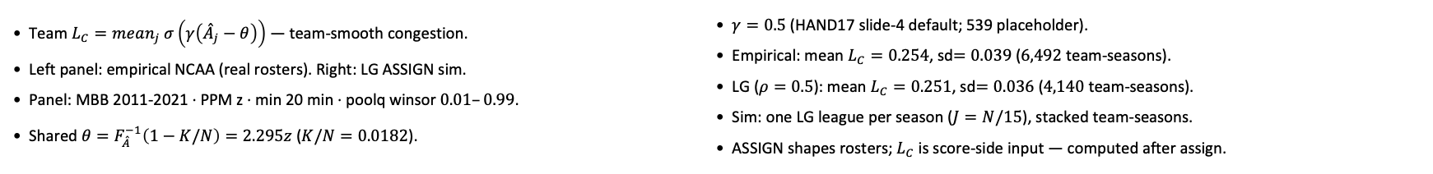
Empirical vs LG — team $L_{C}$ distribution (normalized)
Same $L_{C}$ formula; normalized so team-season count differences don’t dominate the visual.
MBB 2011-2021 · team smooth $L_{C}$ · LG $ρ=0.5$ · $γ=0.5$ · $θ=2.295 z$ ($K/N=0.0182$)
Team $L_{C}=mean_{j} σ\left(γ\left({\overset{ˆ}{A}}_{j}−θ\right)\right)$ — team-smooth congestion.
Left panel: empirical NCAA (real rosters). Right: LG ASSIGN sim.
Panel: MBB 2011-2021 · PPM z · min 20 min · poolq winsor $0.01–0.99$.
Shared $θ=F_{\overset{ˆ}{A}}^{−1}\left(1−K/N\right)=2.295z$ ($K/N=0.0182$).
$γ=0.5$ (HAND17 slide-4 default; 539 placeholder).
Empirical: mean $L_{C}=0.254$, sd$=0.039$ ($6,492$ team-seasons).
LG ($ρ=0.5$): mean $L_{C}=0.251$, sd$=0.036$ ($4,140$ team-seasons).
Sim: one LG league per season ($J=N/15$), stacked team-seasons.
ASSIGN shapes rosters; $L_{C}$ is score-side input — computed after assign.
Claim (PD17 / LG): Team smooth $L_{C}$ on real rosters vs LG sim — same $σ\left(γ\left({\overset{ˆ}{A}}_{j}−θ\right)\right)$ formula; compare distribution shape before SCORE.

Slide 13
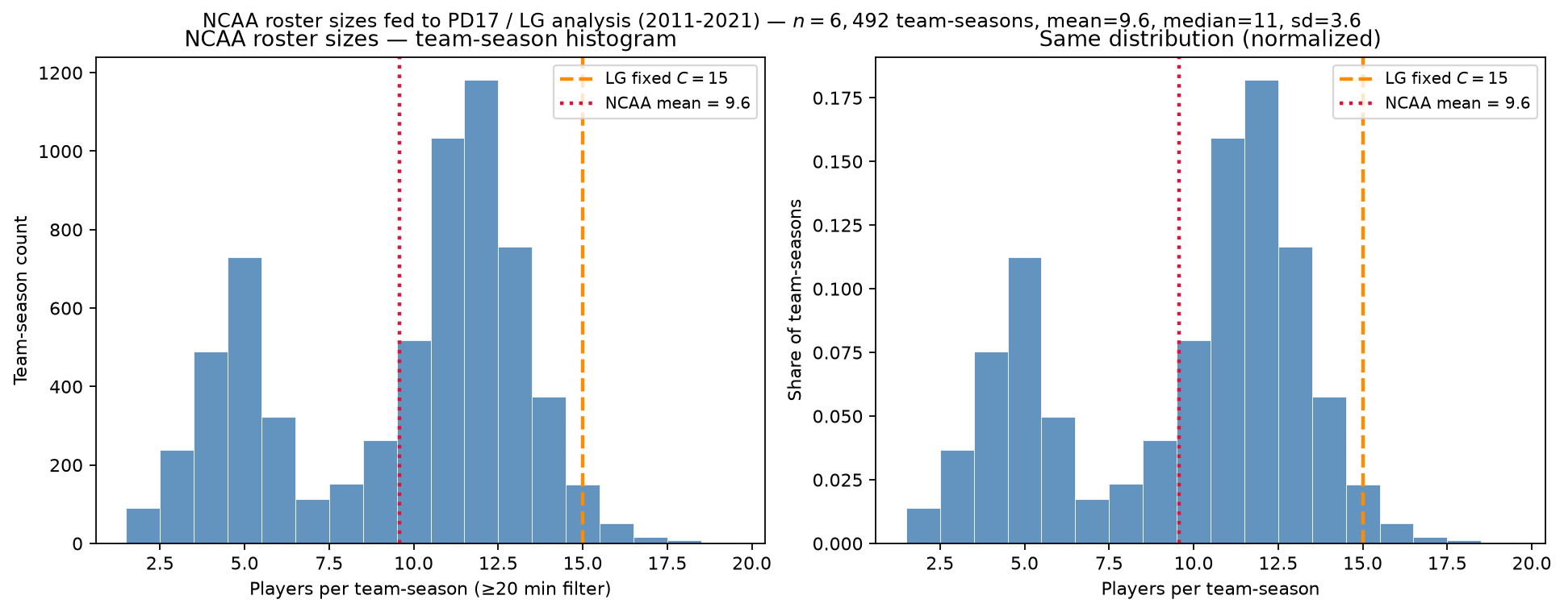
NCAA roster sizes after the minutes filter
MBB 2011-2021 · min 20 min · mean $=9.6$ vs LG $C=15$
Qualifying players per real NCAA team-season ($≥20$ ESPN minutes).
$n=6,492$ team-seasons · mean $=9.6$ · median $=11$ · sd $=3.6$.
Red dotted = NCAA mean; orange dashed = LG fixed $C=15$.
Only $2.3\%$ of teams have exactly $15$ qualifying players.
Same ability pool $≈62$k; LG repacks into $J=N/15$ synthetic $15$-man leagues.
Minutes floor shapes peer count — state explicitly in methods.
Talking point: empirical teams are $≈10$ rotation players; LG uses fixed $15$ — comparability is distributional, not headcount.

Slide 14
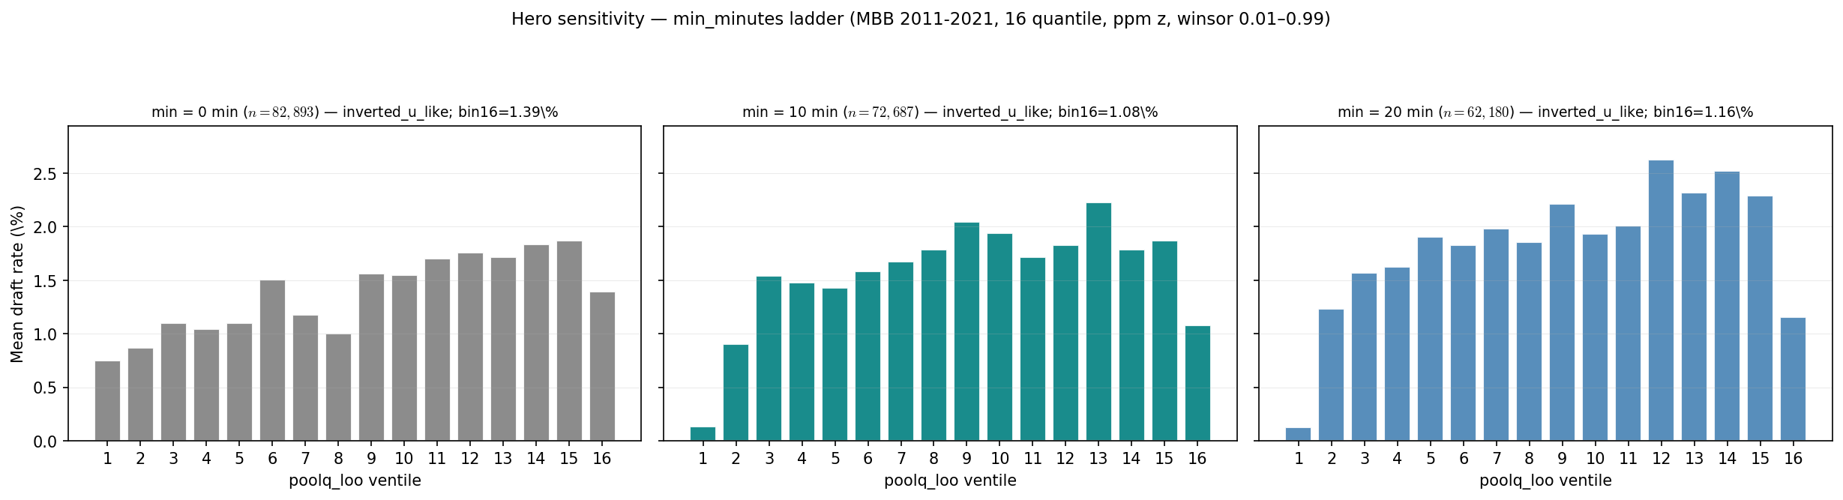
Hero sensitivity — min_minutes ladder
MBB 2011-2021 · poolq_loo ventiles · 0 / 10 / 20 min
Hero x-axis: draft rate vs poolq_loo ventiles · MBB 2011-2021 · 16 quantile.
min_minutes defines who enters the panel and LOO peer pool — not neutral QC.
min $=0$: $n=82,893$, drafted $=1,136$, bin16 $=1.39\%$, inverted_u_like.
min $=10$: $n=72,687$, drafted $=1,136$, bin16 $=1.08\%$, inverted_u_like.
min $=20$: $n=62,180$, drafted $=1,134$, bin16 $=1.16\%$, inverted_u_like.
Hero lock: min $=20$ — cleanest top-ventile cliff; min $=10$ robust appendix.
We are not simulating minutes in LG.
Talking point: inverted-U survives 10- and 20-minute floors; min $=20$ sharpens the elite ventile dip (+2 drafted vs min $=0$).

Slide 15
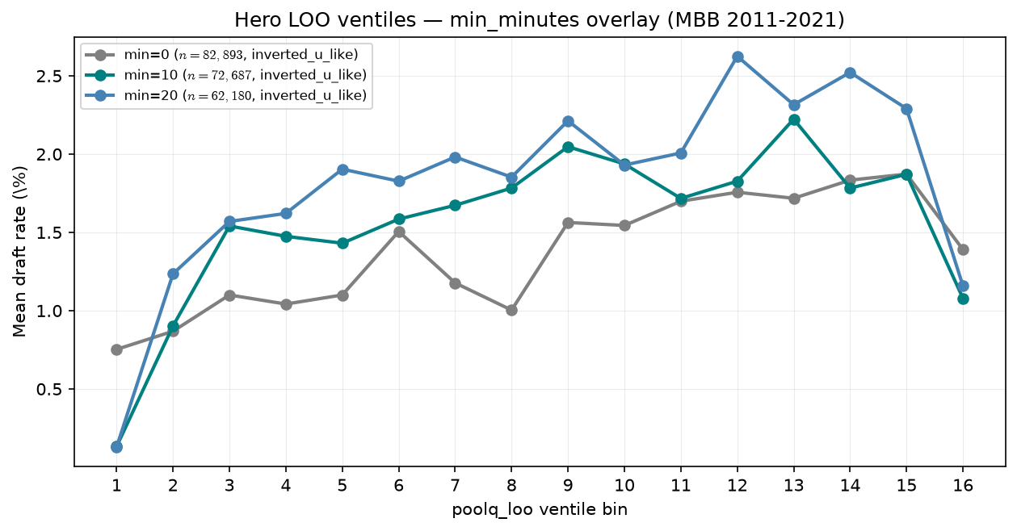
Hero sensitivity — min_minutes overlay
MBB 2011-2021 · same bins, three floors
Hero x-axis: draft rate vs poolq_loo ventiles · MBB 2011-2021 · 16 quantile.
min_minutes defines who enters the panel and LOO peer pool — not neutral QC.
min $=0$: $n=82,893$, drafted $=1,136$, bin16 $=1.39\%$, inverted_u_like.
min $=10$: $n=72,687$, drafted $=1,136$, bin16 $=1.08\%$, inverted_u_like.
min $=20$: $n=62,180$, drafted $=1,134$, bin16 $=1.16\%$, inverted_u_like.
Overlay: same estimand, different playing-time floors.
We are not simulating minutes in LG.
Talking point: pattern is not an artifact of one arbitrary cutoff.

Slide 16
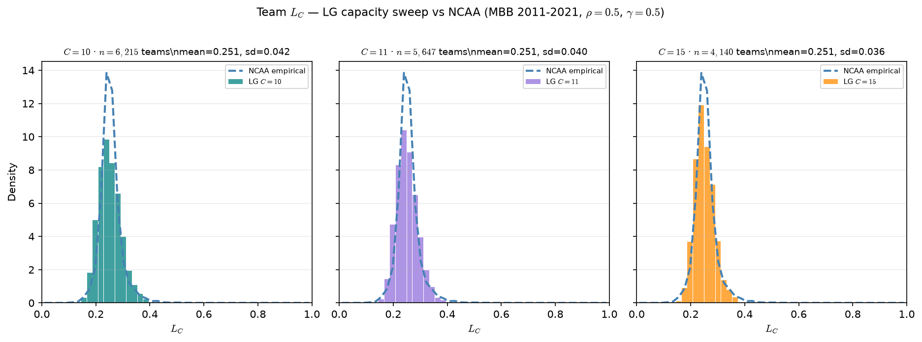

LG capacity sweep — team $L_{C}$ vs NCAA
MBB 2011-2021 · $C∈10,11,15$ · NCAA mean =$0.254$
Team $L_{C}$ after ASSIGN — same $σ\left(γ\left({\overset{ˆ}{A}}_{j}−θ\right)\right)$ as NCAA.
MBB 2011-2021 · min $20$ min panel · $ρ=0.5$, $γ=0.5$.
NCAA: $n=6,492$ team-seasons · mean $=0.254$ · sd $=0.039$.
$C=10$: $n=6,215$ teams · mean $=0.251$ · sd $=0.042$.
$C=11$: $n=5,647$ teams · mean $=0.251$ · sd $=0.040$.
$C=15$: $n=4,140$ teams · mean $=0.251$ · sd $=0.036$.
$C=10$ closest to NCAA team count ($≈6.2$k vs $6.5$k); $C=15=$ gallery default.
$L_{C}$ first moment stable across capacity — score-side calibration OK.
Capacity is a labeled sensitivity, not a silent swap for $C=15$.
Talking point: $C=10$ aligns team counts; $L_{C}$ mean $≈0.251$ at every $C$ — capacity mismatch is interpretive, not a broken $L_{C}$ calibration.

Slide 17
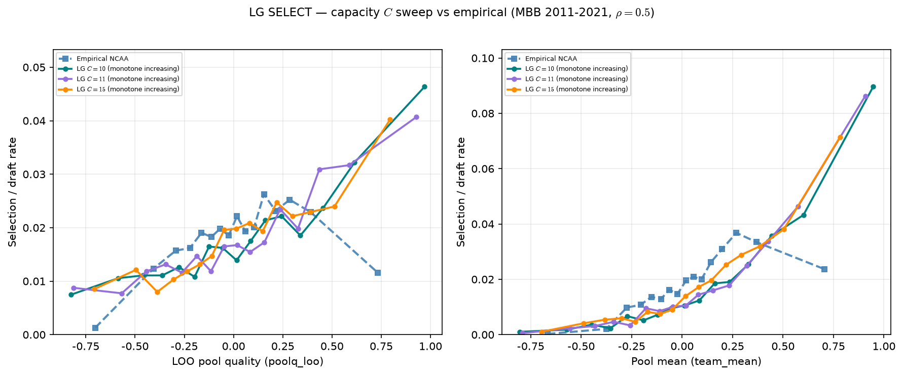
LG capacity sweep — SELECT vs empirical Hero
MBB 2011-2021 · LOO + pool mean · all LG curves monotone
SELECT: draft rate vs LOO peer quality (left) and pool mean (right).
MBB 2011-2021 · fixed $ρ=0.5$ · empirical dashed blue.
Empirical LOO: inverted u like (peak bin $11,2.62\%$).
LG $C=10$ : monotone increasing on LOO.
LG $C=11$ : monotone increasing on LOO.
LG $C=15$ : monotone increasing on LOO.
Lowering $C$ toward rotation-cohort scale does not recover inverted-U.
$ρ$ shapes ASSIGN sorting; selection curvature lives in SCORE ($λ$).
$λ$ sweep results $→$ slides 20-21.
Talking point: C fixes headcount, not selection shape — empirical inverted-U survives; λ is the promising SCORE knob.

Slide 18
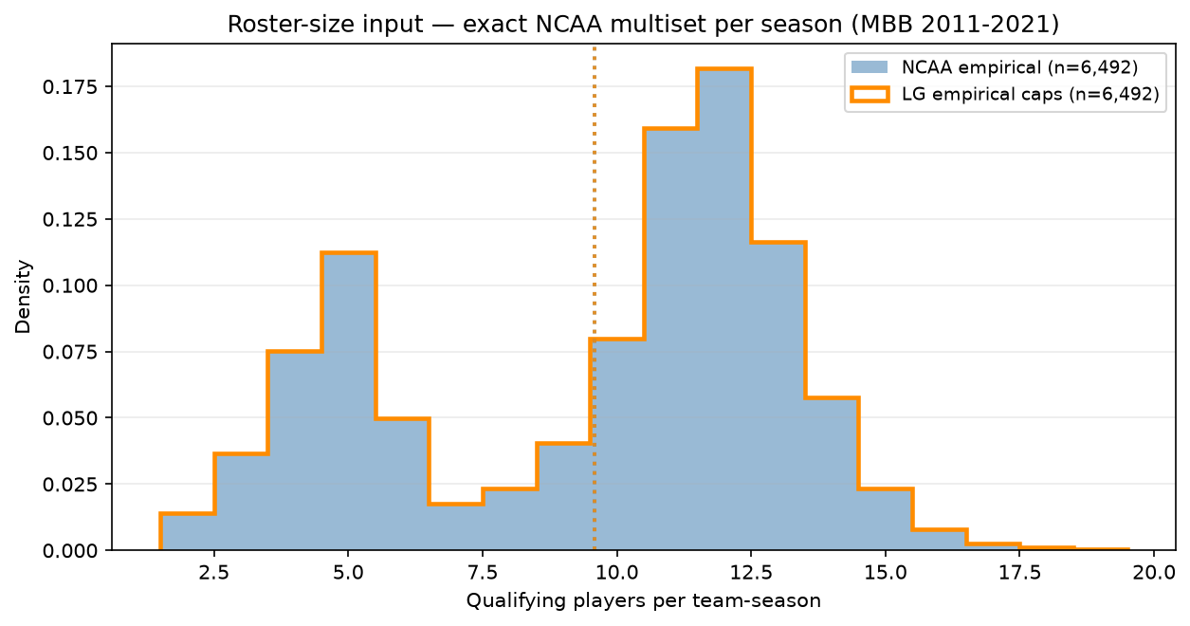
LG input — empirical roster-size multiset
MBB 2011-2021 · mean $=9.6$ vs old fixed $C=15$
Alex ask: LG stub capacities = exact NCAA filtered roster-size multiset.
MBB 2011-2021 · min 20 min · one capacity per real team-season per year.
NCAA / LG: $n=6,492$ team-seasons · mean $=9.6$ · median $=11$ · sd $=3.6$.
Range $2–19$ qualifying players per team.
Replaces fixed C=15 repack ($J=N/15$, every roster exactly 15).
Same player pool ($≈62$k); ASSIGN homophily unchanged — only input geometry.
LG realized roster sizes match NCAA by construction (overlay).
Talking point: Alex's fix — LG teams get the exact filtered NCAA roster-size distribution, not a synthetic 15-man league.

Slide 19
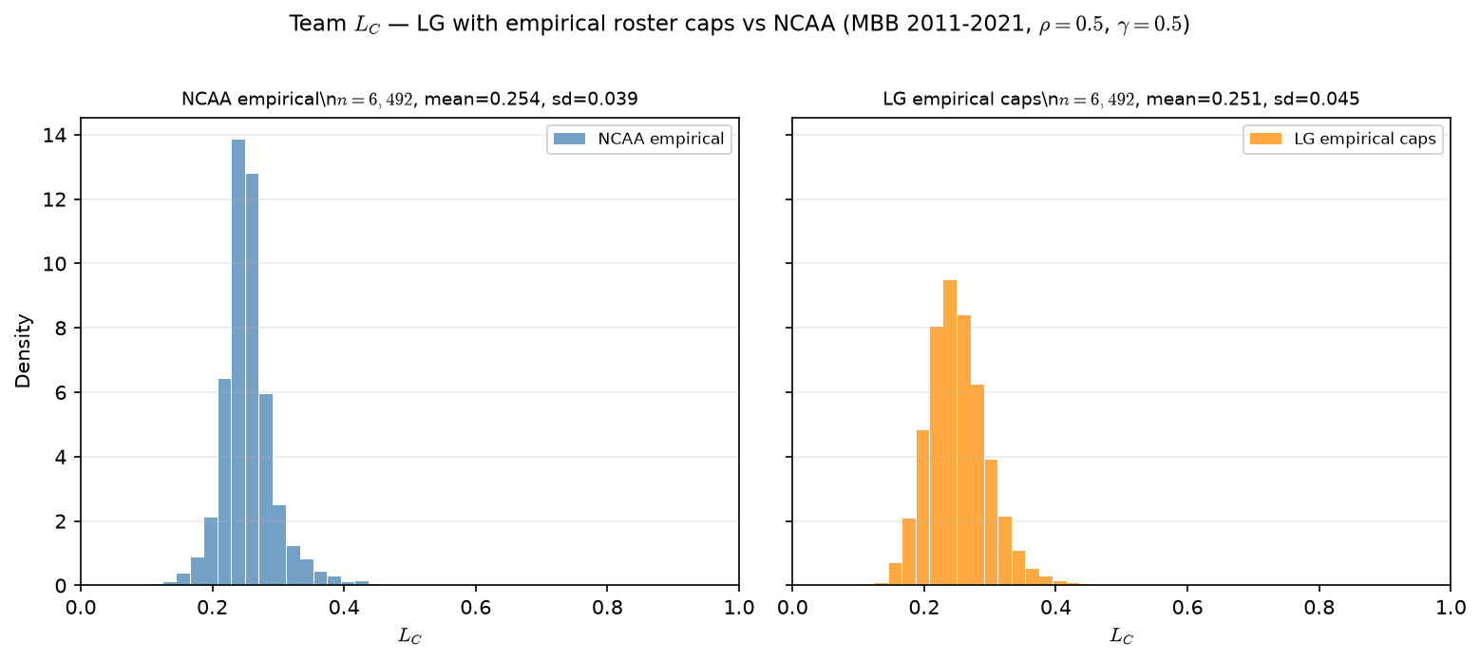

Empirical caps — team $L_{C}$ vs NCAA
MBB 2011-2021 · 6,492 team-seasons · NCAA mean =0.254
Team $L_{C}$ after empirical-cap ASSIGN vs real NCAA rosters.
MBB 2011-2021 · $ρ=0.5$, $γ=0.5$.
NCAA: $n=6,492$ · mean $=0.254$ · sd $=0.039$.
LG empirical caps: $n=6,492$ · mean $=0.251$ · sd $=0.045$.
Team count now aligned ($6,492$) — fixed $C=15$ had only $4,140$ teams.
$L_{C}$ first moment still matches; slightly wider LG tail (assign noise).
Input comparability fixed; SCORE/SELECT shape is a separate question.
Talking point: comparability achieved — same team count and $L_{C}$ mean; assignment layer is now apples-to-apples on roster geometry.

Slide 20
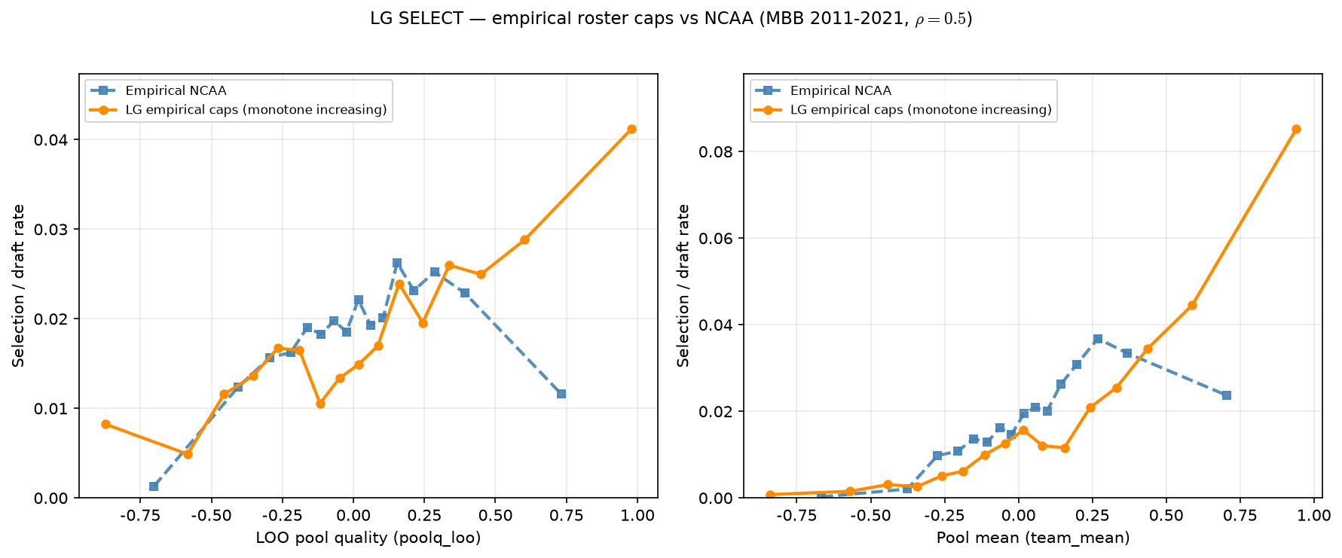
Empirical caps — SELECT vs Hero
MBB 2011-2021 · LOO still monotone · empirical inverted-U
SELECT: draft rate vs LOO peer quality (left) and pool mean (right).
MBB 2011-2021 · empirical caps · $ρ=0.5$ · default $λ$.
Empirical LOO: inverted u like (peak bin $11, 2.62\%$).
LG empirical caps: monotone increasing on LOO.
Roster-size alignment does not recover Hero inverted-U alone.
$ρ=$ ASSIGN sorting; $λ=$ SCORE congestion penalty — next sweep.
C sweep and exact caps both monotone — shape gap is not headcount.
Talking point: input fix necessary but not sufficient — λ sweep on SELECT is the next experiment.

Slide 21
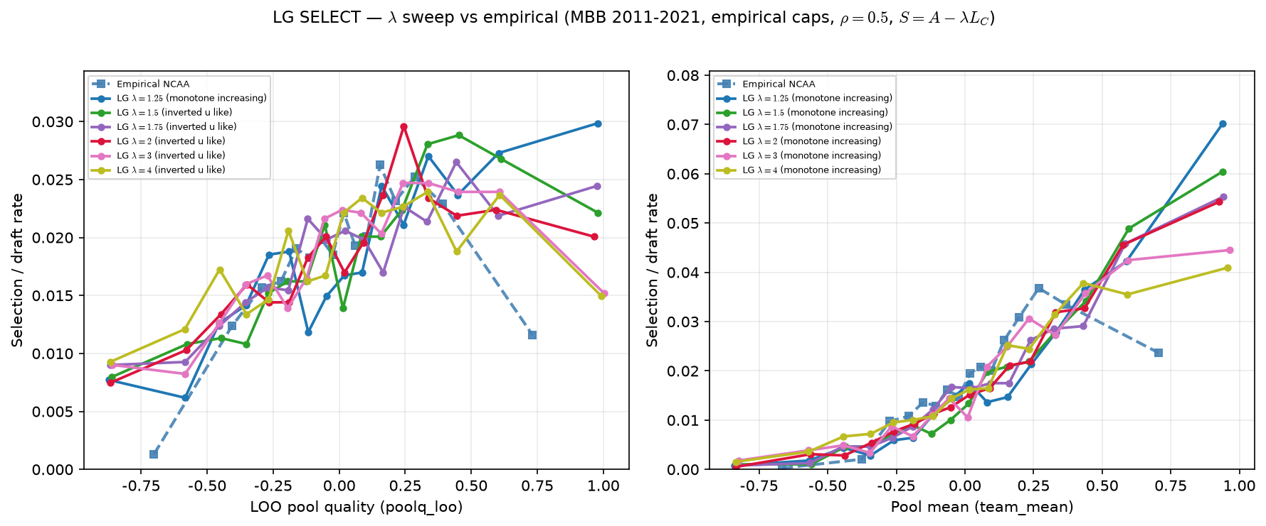

LG SELECT — $λ$ sweep (fine grid)
MBB 2011-2021 · empirical roster caps · $ρ=0.5$ · $S=A−λC$ · $λ∈1.25,1.5,1.75,2,3,4$
Empirical NCAA (dashed): inverted-U on LOO; peak bin 11 (~2.6% draft rate).
λ = 1.25: still monotone ↑ on LOO — last arm before the flip.
λ = 1.5: first inverted-U-like LOO curve.
λ = 2, 3: inverted-U on LOO; peak bin 11 matches empirical.
Pool mean (right): all arms monotone ↑ at these λ — Hero on LOO axis only here.
Takeaway: with inputs fixed, curvature lives in SCORE (λ), not ASSIGN (ρ) or caps.
Talking point: With NCAA-comparable inputs fixed, LOO SELECT stays monotone at λ = 1.25 and flips to inverted-U by λ = 1.5; λ = 2–3 matches the empirical peak bin (11) on LOO — curvature lives in SCORE, not ASSIGN.

Slide 22
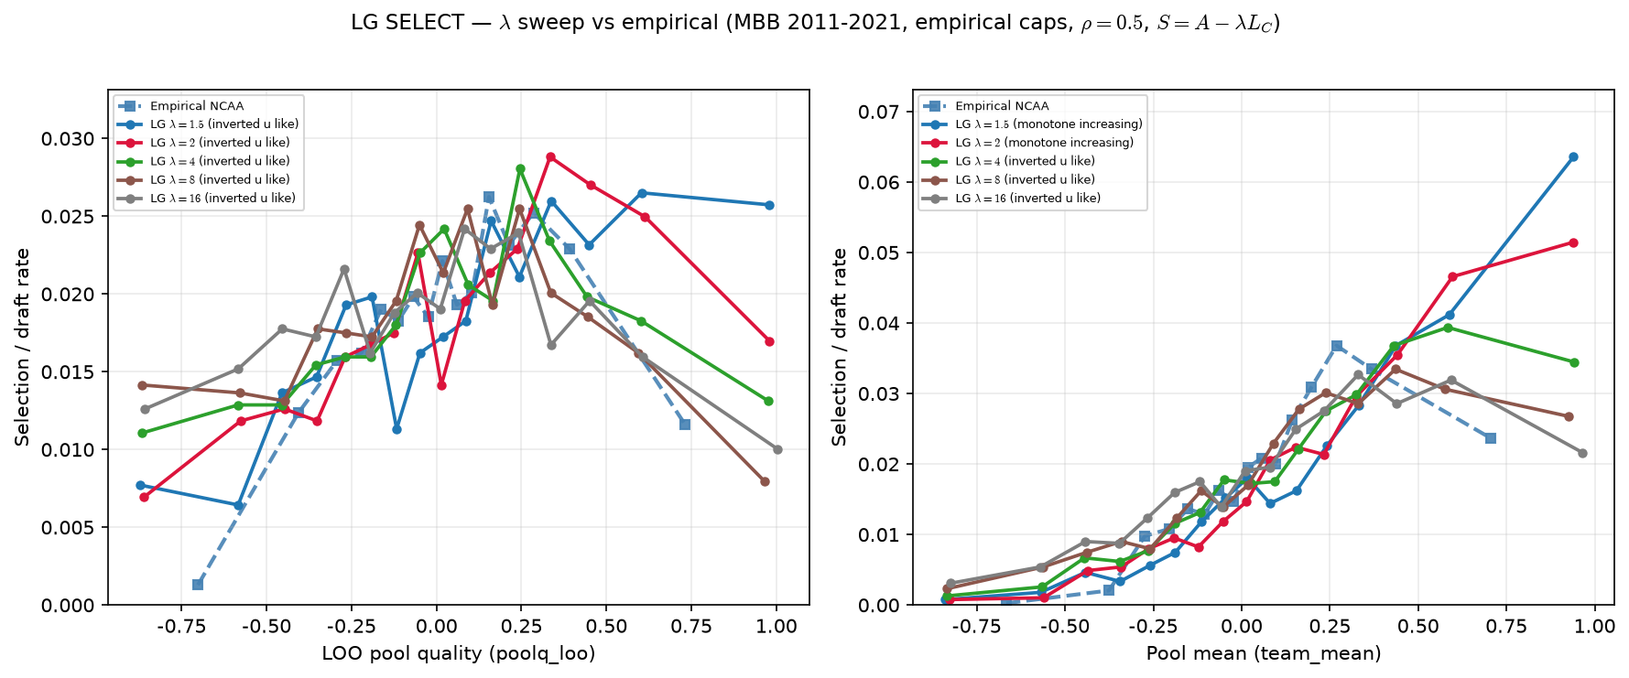

LG SELECT — $λ$ sweep (extended arms)
Same panel · λ ∈ {1.5, 2, 4, 8, 16}
LOO (left): inverted-U persists for all arms ≥ 1.5.
λ = 2, 4: peak bins 11–12 — closest to empirical shape on LOO.
λ = 8, 16: peak shifts left (bins 9–12) — high λ over-penalizes elite pools.
Pool mean (right): λ = 4, 8, 16 show inverted-U-like shape; λ = 1.5, 2 still monotone.
Takeaway: λ controls both whether and where the dip appears; very high λ is not “more empirical.”
Talking point: Inverted-U on LOO persists for λ ≥ 1.5, but λ = 8–16 shifts the peak too far left; on pool mean, inverted-U appears only at λ ≥ 4 — so “more λ” is not uniformly “more empirical.”

Slide 23
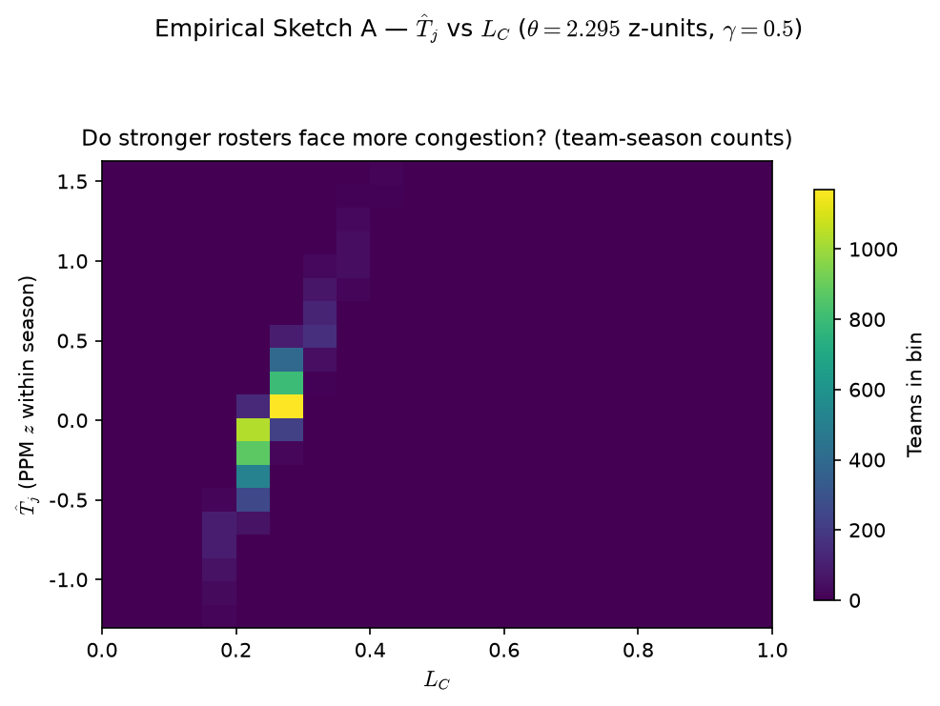

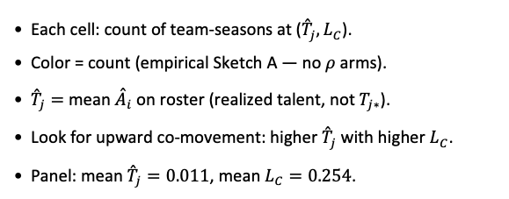
PD17 — Empirical Sketch A: ${\overset{ˆ}{T}}_{j}$ vs $L_{C}$
MBB 2011-2021 · team smooth $L_{C}$ · PPM z within season · min 20 min · $θ=F_{\overset{ˆ}{A}}^{−1}\left(1−K/N\right)=2.295. \left(K/N=0.0182\right)$ ·$γ=0.5$placeholder
Each cell: count of team-seasons at (${\overset{ˆ}{T}}_{j},L_{C}$).
Color = count (empirical Sketch A — no $ρ$ arms).
${\overset{ˆ}{T}}_{j}=$ mean ${\overset{ˆ}{A}}_{i}$ on roster (realized talent, not $T_{j∗}$).
Look for upward co-movement: higher ${\overset{ˆ}{T}}_{j}$ with higher $L_{C}$.
Panel: mean ${\overset{ˆ}{T}}_{j}=0.011$, mean $L_{C}=0.254$.
Claim (PD17): On actual team-seasons, stronger realized rosters (${\overset{ˆ}{T}}_{j}$) tend to co-occur with higher $L_{C}$ — empirical Sketch A.

Slide 24
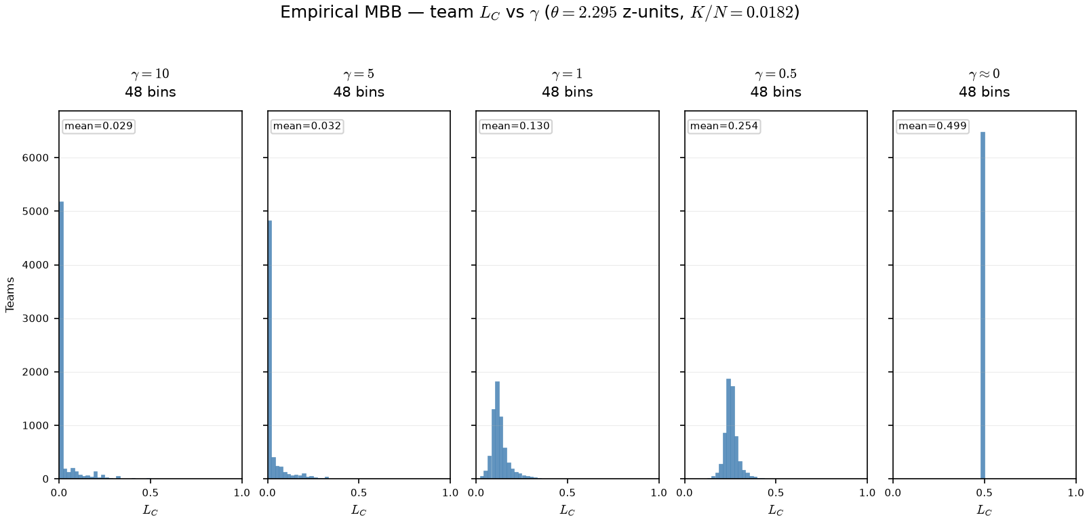

PD17 — Empirical $γ$ sweep: team $L_{C}$ on real rosters
MBB 2011-2021 · team smooth $L_{C}$ · PPM z · min 20 min · $θ=2.295$ z-units ($K/N=0.0182$) fixed across $γ$ arms
OAT on real panel: fixed $θ$ ($K/N$ cutline on PPM z); only $γ$ in $σ\left(γ\left(\overset{ˆ}{A}−θ\right)\right)$ changes.
Arms: $γ∈\left\{10,5,1,0.5,0.001\right\}$ — same team-seasons, same rosters.
At $γ=10$: mean $L_{C}=0.029, 84\%$ teams below $0.05$.
At $γ≈0$: mean $L_{C}=0.499$, max $L_{C}=0.500$ — spread opens on z-scale.
Claim (PD17): On real rosters, γ reshapes team $L_{C}$ — high γ compresses viability near 0 on the PPM-z scale; low γ spreads $L_{C}$ into the interior of [0,1].

