Slide 1
TAKEAWAYS MEMO HAND

Slide 2
How to use this companion deck
Read each narrative slide out loud, then paste the matching \texttt{CHAR\_PD20\_HAND} slide immediately after it.
Structure:
Slides 2–5 = wavetops (dissertation → Wang arc → LG pipeline → HAND preview). Slides 6–9 = the snag and three PD22 questions with answer summaries. Then Act bridges + 21 HAND companions (footer shows which slide to paste). End = where we stand + what lies ahead (main line, predictions, parked, manuscript).
Format:
Every substantive slide uses the same beats: why we cared, what we ran, What showed up, What you can say. Numbers come from locked JSON on disk.
Optional read-aloud order:
After slide 9 you can jump Acts I → II → IV (17–19) → III (14–16) → IV (20–21) if you want policy evidence before 𝜌 and overlap.

Slide 3
Part 0 — Big picture: where the dissertation started
Army inverted-U → cross-domain test → MBB hero (Layer A).
Army:
Officer careers: advancement rate vs peer-group quality often rises through the middle and dips in the very best peer environments — the inverted-U tail.
Cross-domain:
We asked whether that pattern is Army-only. MBB (NBA draft vs teammate quality) became the main working example; tenure is the parallel third leg (parked).
Hero (Layer A):
Bin real player-seasons by leave-one-out teammate pool quality; plot draft rate. Rate rises, plateaus, dips in the top bin. That is a stylized fact about outcomes — not yet a proof of why.

Slide 4
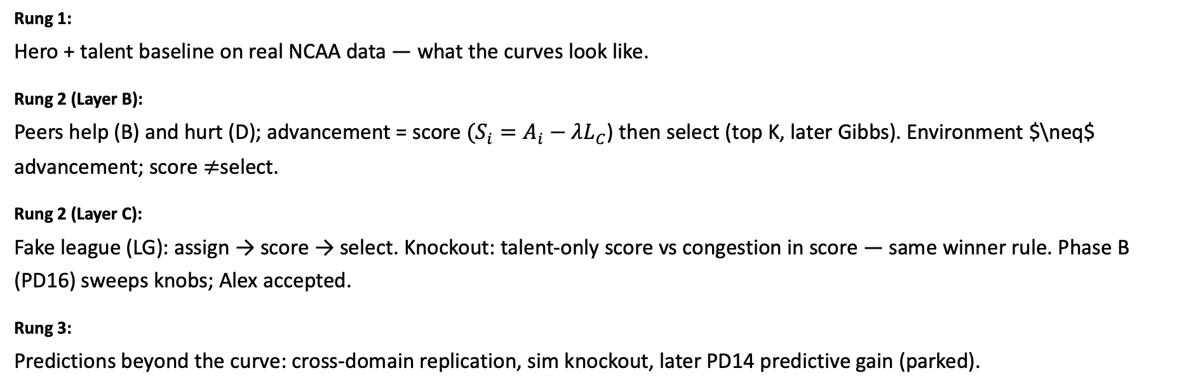
Part 1 — The Wang-style arc (smaller picture)
Phenomenon → simplest mechanism story → wind-tunnel sim → predictions.
Rung 1:
Hero + talent baseline on real NCAA data — what the curves look like.
Rung 2 (Layer B):
Peers help (B) and hurt (D); advancement = score $(S_{i}=A_{i}−λL_{C}$) then select (top K, later Gibbs). Environment $\neq$ advancement; score $≠$select.
Rung 2 (Layer C):
Fake league (LG): assign → score → select. Knockout: talent-only score vs congestion in score — same winner rule. Phase B (PD16) sweeps knobs; Alex accepted.
Rung 3:
Predictions beyond the curve: cross-domain replication, sim knockout, later PD14 predictive gain (parked).

Slide 5
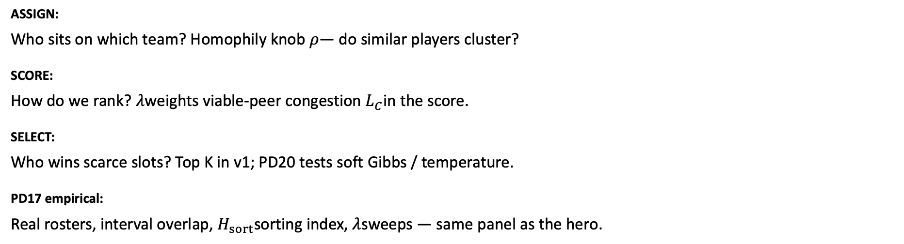
Part 2 — LG pipeline (one mechanism, three steps)
ASSIGN → SCORE → SELECT — how the fake league is wired.
ASSIGN:
Who sits on which team? Homophily knob $ρ$— do similar players cluster?
SCORE:
How do we rank? $λ$weights viable-peer congestion $L_{C}$in the score.
SELECT:
Who wins scarce slots? Top K in v1; PD20 tests soft Gibbs / temperature.
PD17 empirical:
Real rosters, interval overlap, $H_{sort}$sorting index, $λ$sweeps — same panel as the hero.

Slide 6
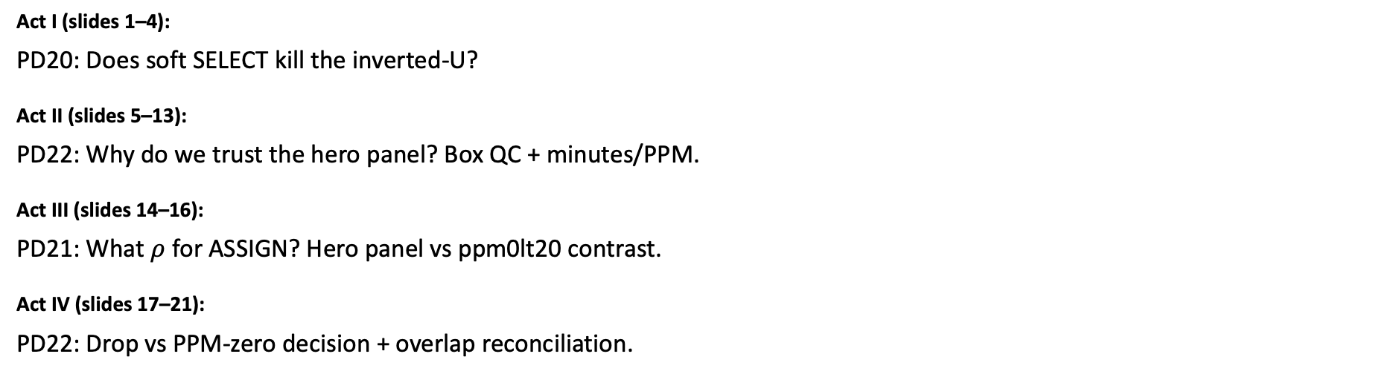
Part 3 preview — CHAR\_PD20\_HAND in four acts
21 slides: PD20 gate → panel backup → 𝜌 calibration → policy/overlap.
Act I (slides 1–4):
PD20: Does soft SELECT kill the inverted-U?
Act II (slides 5–13):
PD22: Why do we trust the hero panel? Box QC + minutes/PPM.
Act III (slides 14–16):
PD21: What $ρ$ for ASSIGN? Hero panel vs ppm0lt20 contrast.
Act IV (slides 17–21):
PD22: Drop vs PPM-zero decision + overlap reconciliation.

Slide 7
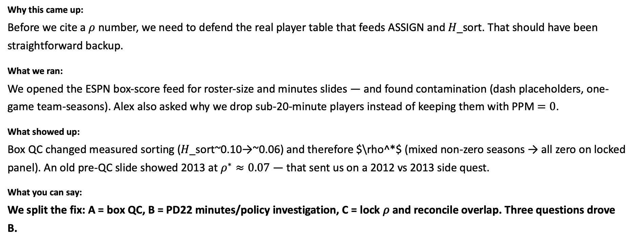
The snag — Act II was supposed to be quick
What went wrong while we were building panel-backup slides?
Why this came up:
Before we cite a $ρ$ number, we need to defend the real player table that feeds ASSIGN and 𝐻_sort. That should have been straightforward backup.
What we ran:
We opened the ESPN box-score feed for roster-size and minutes slides — and found contamination (dash placeholders, one-game team-seasons). Alex also asked why we drop sub-20-minute players instead of keeping them with PPM $=0$.
What showed up:
Box QC changed measured sorting (𝐻_sort~0.10→~0.06) and therefore $\rho^*$ (mixed non-zero seasons → all zero on locked panel). An old pre-QC slide showed 2013 at $ρ^{∗}≈0.07$ — that sent us on a 2012 vs 2013 side quest.
What you can say:
We split the fix: A = box QC, B = PD22 minutes/policy investigation, C = lock 𝜌 and reconcile overlap. Three questions drove B.

Slide 8
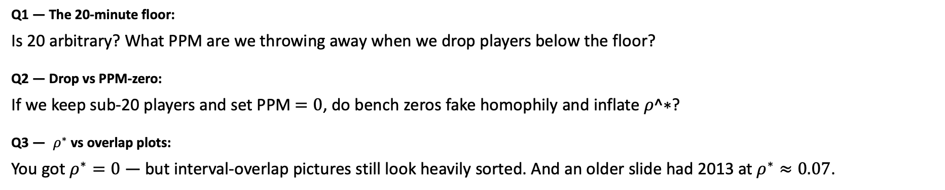
Three questions the snag generated (PD22)
Alex's Aug 17 scope — answer each before locking panel and 𝜌 in front of him.
Q1 — The 20-minute floor:
Is 20 arbitrary? What PPM are we throwing away when we drop players below the floor?
Q2 — Drop vs PPM-zero:
If we keep sub-20 players and set PPM $=0$, do bench zeros fake homophily and inflate 𝜌^∗?
Q3 — $ρ^{∗}$vs overlap plots:
You got $ρ^{∗}=0$ — but interval-overlap pictures still look heavily sorted. And an older slide had 2013 at $ρ^{∗}≈0.07$.

Slide 9
Q1 answered — Keep the 20-minute floor (drop sub-20)
Is 20 minutes arbitrary? What PPM are we throwing away?
Why this came up:
Alex asked whether we can defend the hero panel with more than "we always used 20." We need to see where playing-time mass sits and how noisy sub-20-minute PPM is.
What we ran:
Minutes ECDF/histogram, PPM of filtered-out players, drafted-player audit (1,177 drafted player-seasons), overlay plots — HAND slides 10–13.
What showed up:
Most mass above 20 minutes; below 20 is bench noise and zero-minute rows. At 20 we drop 44 drafted player-seasons — 42 were 0-minute. One ever-draft career fully lost (Ricky Ledo); everyone else keeps rotation years.
What you can say:
"We keep the floor at 20 and drop sub-20 players — not because every row is draft-safe, but because PPM below 20 is too noisy for ASSIGN." Evidence: HAND slides 5–13.

Slide 10
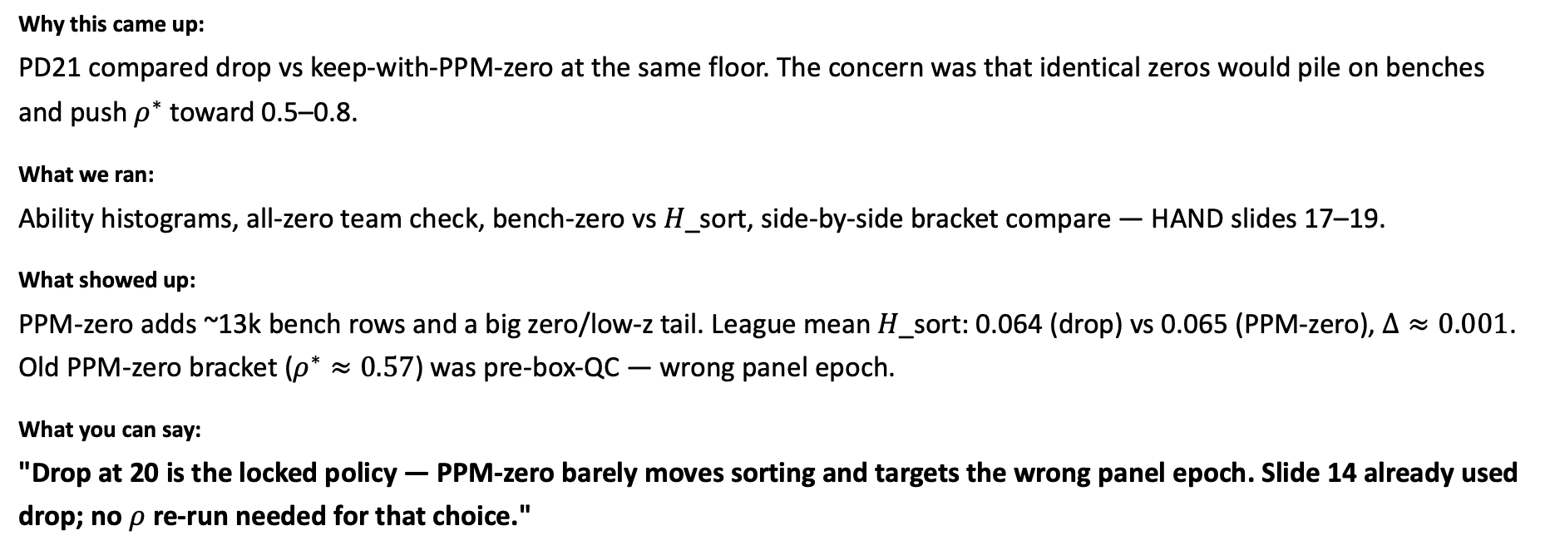
Q2 answered — Drop beats PPM-zero on the locked panel
Does PPM-zero inflate sorting and $ρ^{∗}$?
Why this came up:
PD21 compared drop vs keep-with-PPM-zero at the same floor. The concern was that identical zeros would pile on benches and push $ρ^{∗}$ toward 0.5–0.8.
What we ran:
Ability histograms, all-zero team check, bench-zero vs 𝐻_sort, side-by-side bracket compare — HAND slides 17–19.
What showed up:
PPM-zero adds ~13k bench rows and a big zero/low-z tail. League mean 𝐻_sort: 0.064 (drop) vs 0.065 (PPM-zero), $Δ≈0.001$. Old PPM-zero bracket ($ρ^{∗}≈0.57$) was pre-box-QC — wrong panel epoch.
What you can say:
"Drop at 20 is the locked policy — PPM-zero barely moves sorting and targets the wrong panel epoch. Slide 14 already used drop; no $ρ$ re-run needed for that choice."

Slide 11
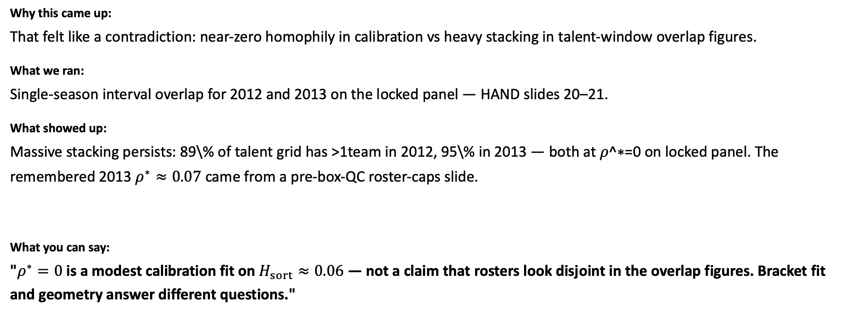
Q3 answered — Bracket $ρ^{∗}$ and overlap answer different questions
Why 𝜌^∗=0 when overlap plots look sorted? What about 2013?
Why this came up:
That felt like a contradiction: near-zero homophily in calibration vs heavy stacking in talent-window overlap figures.
What we ran:
Single-season interval overlap for 2012 and 2013 on the locked panel — HAND slides 20–21.
What showed up:
Massive stacking persists: 89\% of talent grid has >1team in 2012, 95\% in 2013 — both at 𝜌^∗=0 on locked panel. The remembered 2013 $ρ^{∗}≈0.07$ came from a pre-box-QC roster-caps slide.
What you can say:
"$ρ^{∗}=0$ is a modest calibration fit on $H_{sort}≈0.06$ — not a claim that rosters look disjoint in the overlap figures. Bracket fit and geometry answer different questions."

Slide 12
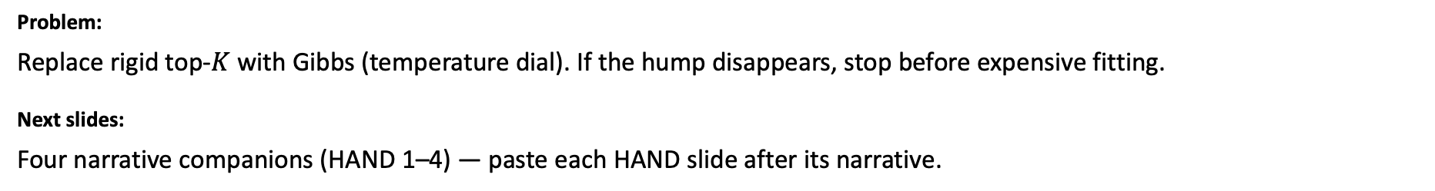
Act I — PD20: Gibbs SELECT gate
Before MLE for SELECT — does soft selection kill the inverted-U?
Problem:
Replace rigid top-$K$ with Gibbs (temperature dial). If the hump disappears, stop before expensive fitting.
Next slides:
Four narrative companions (HAND 1–4) — paste each HAND slide after its narrative.

Slide 13
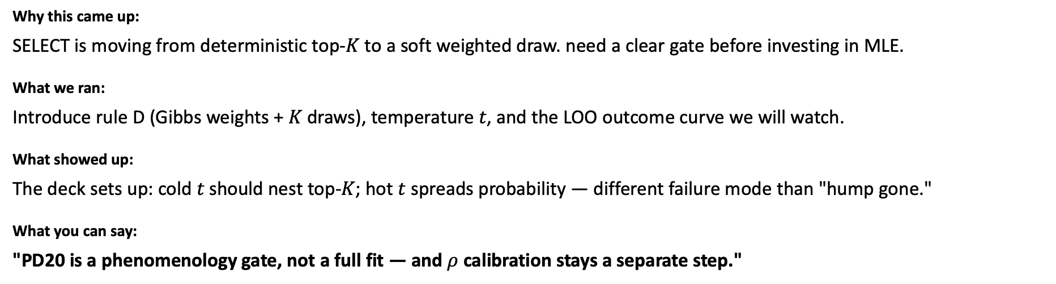

Gibbs SELECT intro
Act I — PD20 $\text{−−−}$ narrative for HAND slide 1
What are we testing and why does temperature matter?
Why this came up:
SELECT is moving from deterministic top-𝐾 to a soft weighted draw. need a clear gate before investing in MLE.
What we ran:
Introduce rule D (Gibbs weights + 𝐾 draws), temperature 𝑡, and the LOO outcome curve we will watch.
What showed up:
The deck sets up: cold 𝑡 should nest top-𝐾; hot $t$ spreads probability — different failure mode than "hump gone."
What you can say:
"PD20 is a phenomenology gate, not a full fit — and $ρ$ calibration stays a separate step."
↓ Paste 𝙲𝙷𝙰𝚁_𝙿𝙳𝟸𝟶_𝙷𝙰𝙽𝙳 slide 1 immediately after this slide

Slide 14

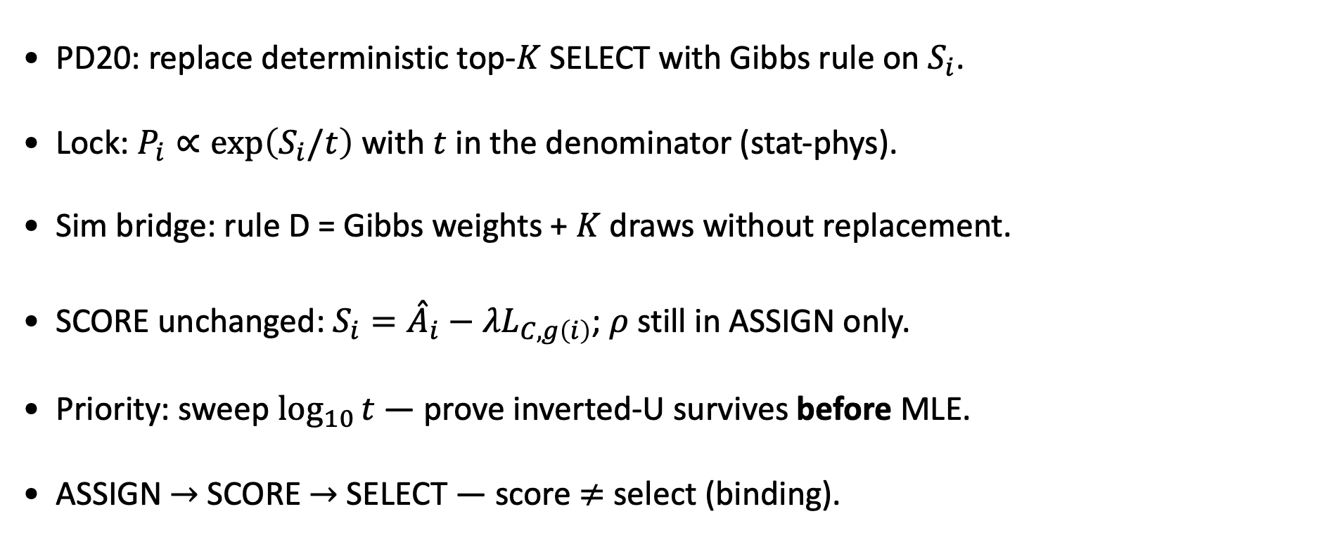
PD20 — Gibbs SELECT (temperature $t$)
MBB empirical caps · $ρ=0.5$ · inverted-U before MLE
PD20: replace deterministic top-$K$ SELECT with Gibbs rule on $S_{i}$.
Lock: $P_{i}∝\exp\left(S_{i}/t\right)$ with $t$ in the denominator (stat-phys).
Sim bridge: rule D = Gibbs weights + $K$ draws without replacement.
SCORE unchanged: $S_{i}={\overset{ˆ}{A}}_{i}−λL_{C,g\left(i\right)}$; $ρ$ still in ASSIGN only.
Priority: sweep $\log_{10}{t}$ — prove inverted-U survives before MLE.
ASSIGN $→$ SCORE $→$ SELECT — score $≠$ select (binding).
Goal: soft SELECT must not erase the phenomenological inverted-U on LOO pool quality.

Slide 15
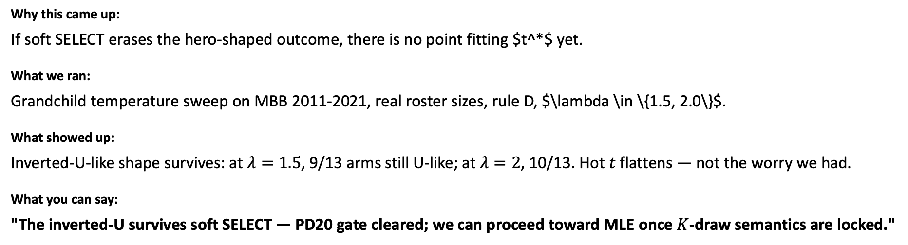
Temperature sweep (rule D)
Act I — PD20 \text{---} narrative for HAND slide 2
Across $\log_{10} t$ from $-3$ to $+3$, does the inverted-U survive?
Why this came up:
If soft SELECT erases the hero-shaped outcome, there is no point fitting $t^*$ yet.
What we ran:
Grandchild temperature sweep on MBB 2011-2021, real roster sizes, rule D, $\lambda \in \{1.5, 2.0\}$.
What showed up:
Inverted-U-like shape survives: at $λ=1.5$, 9/13 arms still U-like; at $λ=2$, 10/13. Hot 𝑡 flattens — not the worry we had.
What you can say:
"The inverted-U survives soft SELECT — PD20 gate cleared; we can proceed toward MLE once $K$-draw semantics are locked."
↓ Paste 𝙲𝙷𝙰𝚁_𝙿𝙳𝟸𝟶_𝙷𝙰𝙽𝙳 slide 2 immediately after this slide

Slide 16
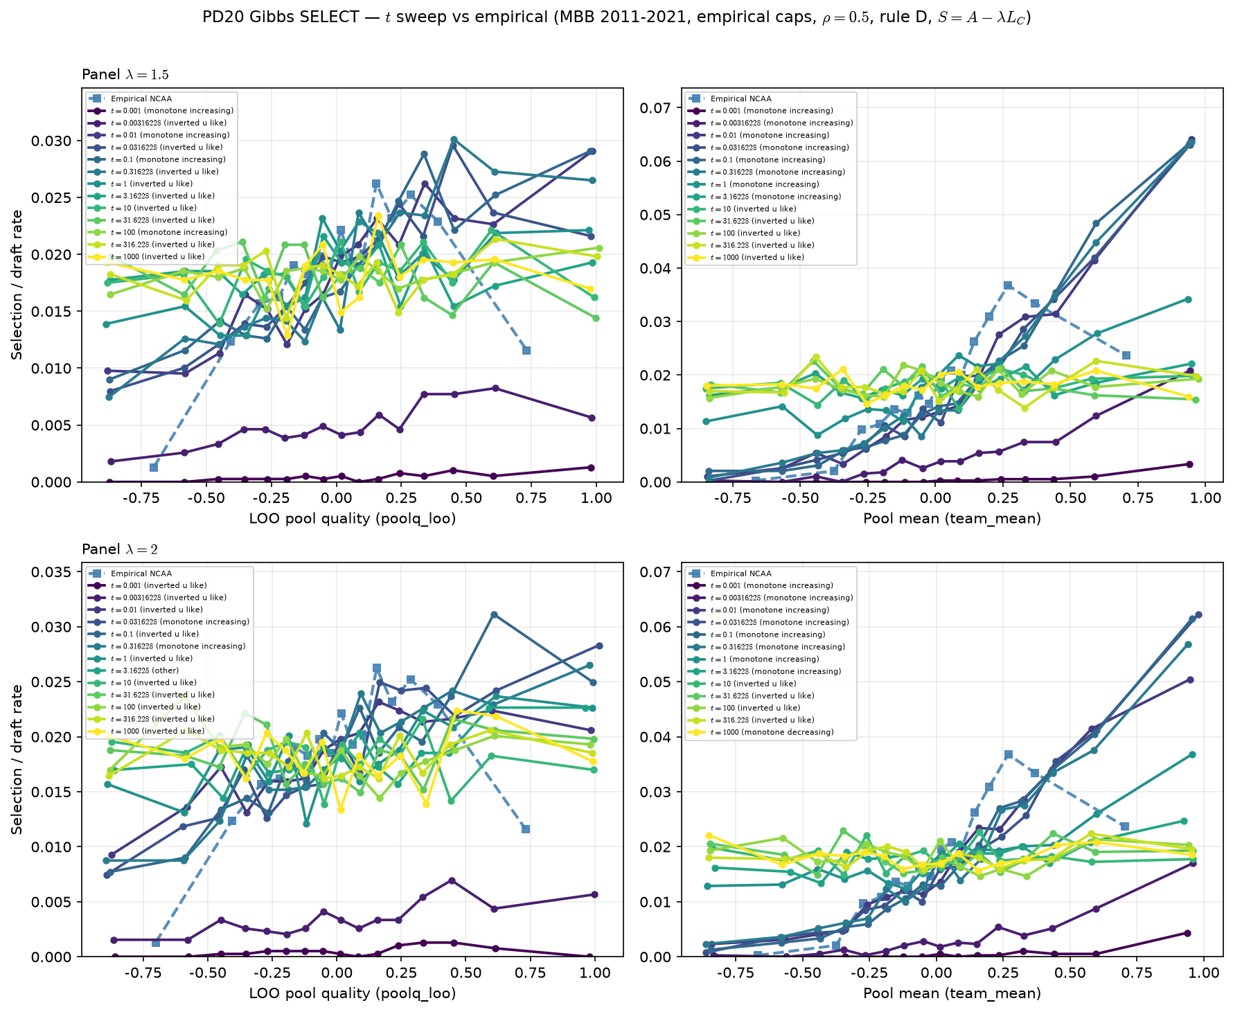


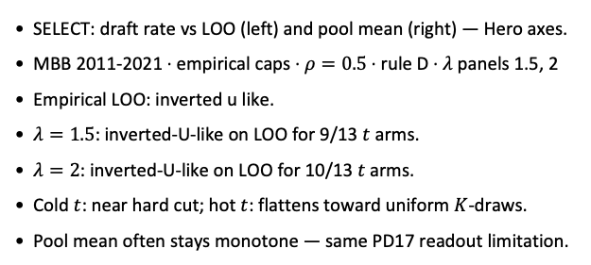
Temperature sweep — rule D (Gibbs + $K$ draws)
MBB 2011-2021 · $λ∈\left\{1.5,2\right\}$ · $\log_{10}{t}∈\left[−3,3\right]$
SELECT: draft rate vs LOO (left) and pool mean (right) — Hero axes.
MBB 2011-2021 · empirical caps · $ρ=0.5$ · rule D · $λ$ panels 1.5, 2
Empirical LOO: inverted u like.
$λ=1.5$: inverted-U-like on LOO for 9/13 $t$ arms.
$λ=2$: inverted-U-like on LOO for 10/13 𝑡 arms.
Cold $t$: near hard cut; hot $t$: flattens toward uniform $K$-draws.
Pool mean often stays monotone — same PD17 readout limitation.
Talking point: check LOO panels at $λ=1.5$–$2$ — does a $t$ window preserve inverted-U vs empirical?

Slide 17
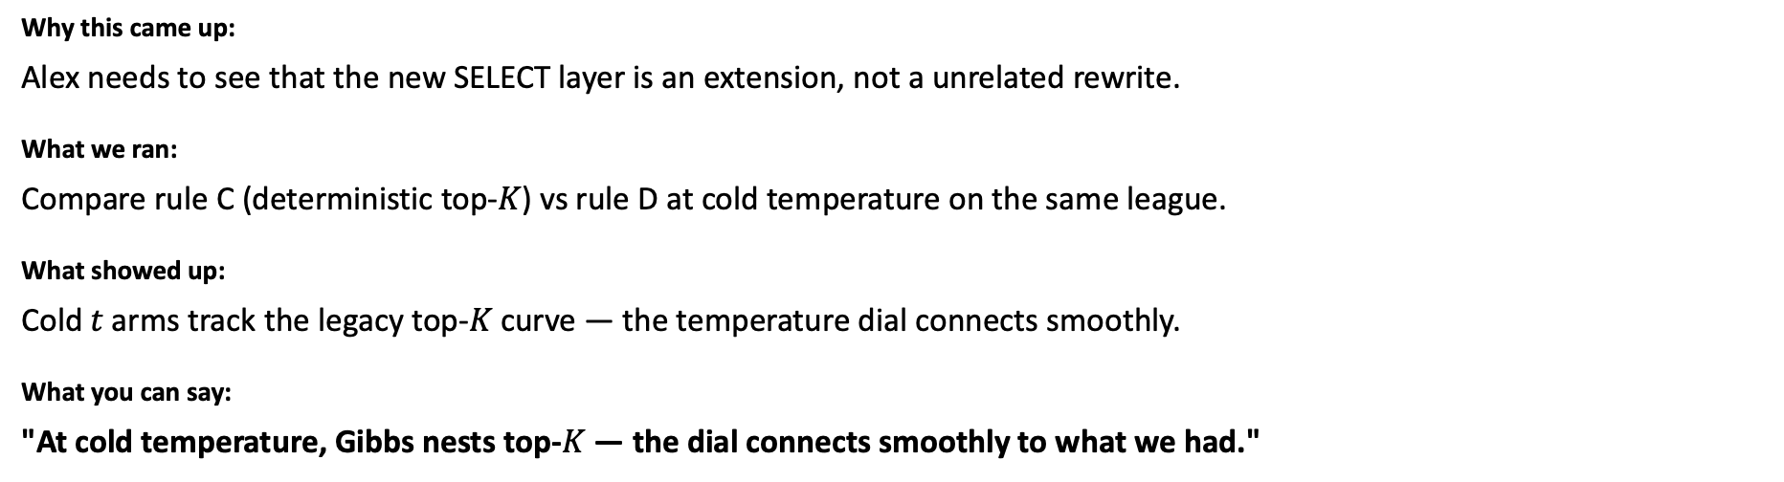
Cold limit — rule C vs rule D
Act I — PD20 \text{---} narrative for HAND slide 3
At small 𝑡, does Gibbs nest the old top-𝐾 rule?
Why this came up:
Alex needs to see that the new SELECT layer is an extension, not a unrelated rewrite.
What we ran:
Compare rule C (deterministic top-𝐾) vs rule D at cold temperature on the same league.
What showed up:
Cold 𝑡 arms track the legacy top-𝐾 curve — the temperature dial connects smoothly.
What you can say:
"At cold temperature, Gibbs nests top-$K$ — the dial connects smoothly to what we had."
↓ Paste 𝙲𝙷𝙰𝚁_𝙿𝙳𝟸𝟶_𝙷𝙰𝙽𝙳 slide 3 immediately after this slide

Slide 18
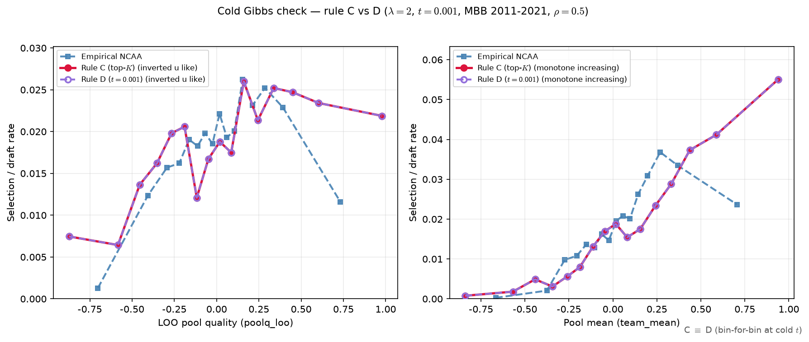

Cold limit — rule C vs rule D
$λ=2$ · $t=0.001$ · same seeds
Same ASSIGN seeds; only SELECT rule differs (C = top-$K$, D = cold Gibbs).
Fixed $λ=2$, $t=0.001$ ($\log_{10}{t}=−3$).
Max bin gap C vs D: LOO = 0.00e+00, pool mean = 0.00e+00.
LOO curvature: C = inverted u like; D = inverted u like.
Expect overlay coincidence at cold $t$ (Gibbs $→$ hard ranking).
Numerical match flag: True (gap $<{10}^{−9}$ on binned curves).
Talking point: rule D at cold $t$ reproduces rule C bin-for-bin — Gibbs SELECT nests the old top-$K$ limit.

Slide 19
PD20 takeaways
Act I — PD20 \text{---} narrative for HAND slide 4
What do we lock from Act I?
Why this came up:
Close the PD20 thread before panel and 𝜌 work so Alex knows SELECT is unblocked.
What we ran:
Summarize sweep + cold-limit evidence in plain bullets on the HAND slide.
What showed up:
Inverted-U survives Gibbs SELECT; proceed to MLE; 𝜌 is a separate calibration step.
What you can say:
"Act I is done: inverted-U survives Gibbs SELECT; next we defend the real panel."
↓ Paste 𝙲𝙷𝙰𝚁_𝙿𝙳𝟸𝟶_𝙷𝙰𝙽𝙳 slide 4 immediately after this slide

Slide 20
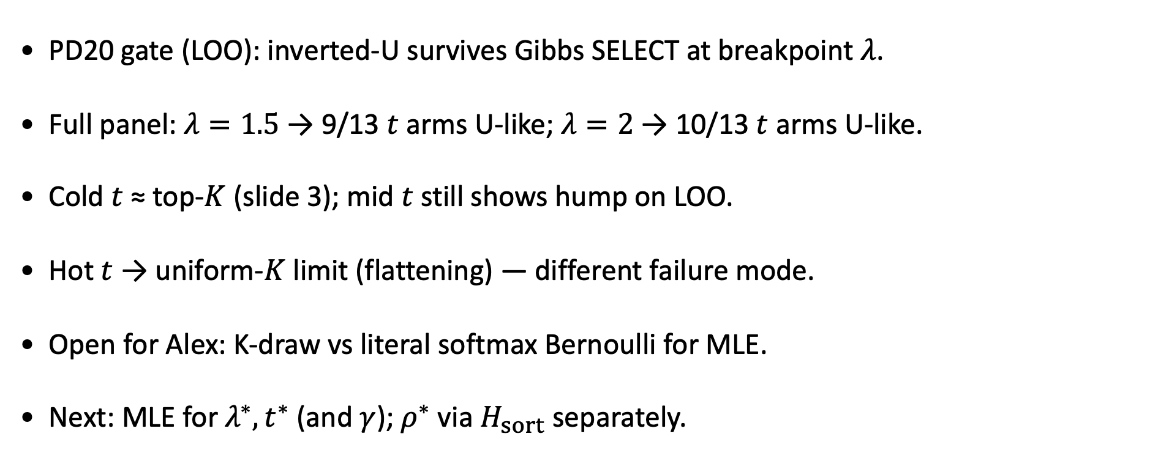
PD20 takeaways
MBB 2011-2021 · empirical caps · rule D
PD20 gate (LOO): inverted-U survives Gibbs SELECT at breakpoint $λ$.
Full panel: $λ=1.5$ → 9/13 $t$ arms U-like; $λ=2$ → 10/13 $t$ arms U-like.
Cold $t$ ≈ top-$K$ (slide 3); mid $t$ still shows hump on LOO.
Hot $t$ → uniform-$K$ limit (flattening) — different failure mode.
Open for Alex: K-draw vs literal softmax Bernoulli for MLE.
Next: MLE for $λ^{∗},t^{∗}$ (and $γ$); $ρ^{∗}$ via $H_{sort}$ separately.
PD20 step 4 cleared on LOO: proceed to MLE design once K-draw semantics are confirmed with Alex.

Slide 21
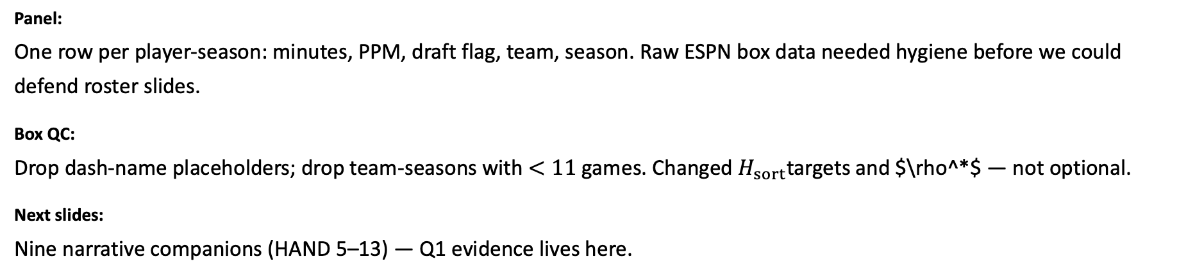
Act II — PD22: Why we trust the hero panel
Box QC + minutes/PPM backup — the table that feeds ASSIGN and 𝐻_sort.
Panel:
One row per player-season: minutes, PPM, draft flag, team, season. Raw ESPN box data needed hygiene before we could defend roster slides.
Box QC:
Drop dash-name placeholders; drop team-seasons with $<11$ games. Changed $H_{sort}$targets and $\rho^*$ — not optional.
Next slides:
Nine narrative companions (HAND 5–13) — Q1 evidence lives here.

Slide 22
Roster size — raw box (before QC)
Act II — PD22 panel \text{---} narrative for HAND slide 5
Why do roster-count slides show absurd tails before we clean the feed?
Why this came up:
Start with the raw ESPN mess — before claiming the panel is obvious.
What we ran:
Histogram of players per team-season from the box file before dash/QC filters.
What showed up:
Long tails (e.g. 100+ names) from placeholder rows — not real NCAA dress lists.
What you can say:
"These tails are placeholder rows — that is why we added box QC at panel build."
↓ Paste 𝙲𝙷𝙰𝚁_𝙿𝙳𝟸𝟶_𝙷𝙰𝙽𝙳 slide 5 immediately after this slide

Slide 23
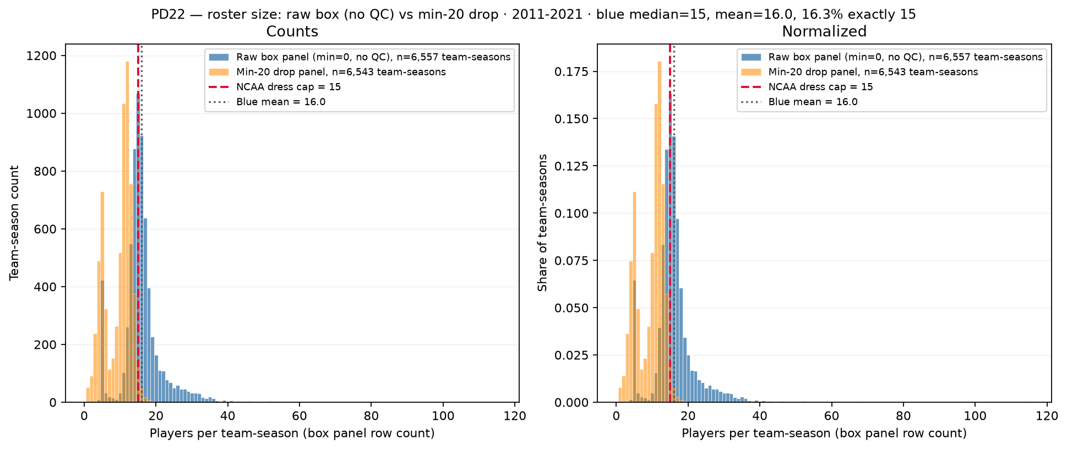
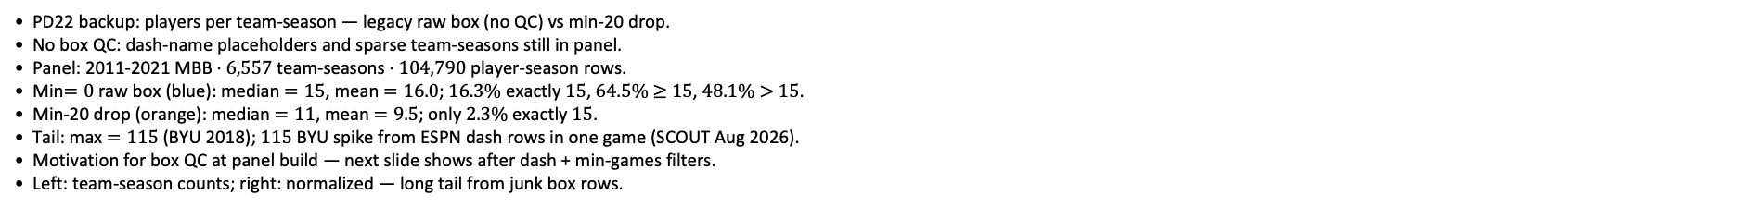
PD22 — Roster size: raw box (No QC) vs min-20 drop
PD22 · roster size (before QC) · 2011-2021 · raw median = $15$ · max $=115$
PD22 backup: players per team-season — legacy raw box (no QC) vs min-20 drop.
No box QC: dash-name placeholders and sparse team-seasons still in panel.
Panel: 2011-2021 MBB · $6,557$ team-seasons · $104,790$ player-season rows.
Min$=0$ raw box (blue): median $=15$, mean $=16.0$; $16.3\%$ exactly $15$, $64.5\%$ $≥$ $15$, $48.1\%$ $>$ $15$.
Min-20 drop (orange): median $=11$, mean $=9.5$; only $2.3\%$ exactly $15$.
Tail: max $=115$ (BYU 2018); $115$ BYU spike from ESPN dash rows in one game (SCOUT Aug 2026).
Motivation for box QC at panel build — next slide shows after dash + min-games filters.
Left: team-season counts; right: normalized — long tail from junk box rows.
Claim (PD22 backup): Raw ESPN box rows inflate team-season roster counts — dash placeholders and sparse junk games before panel QC at build.

Slide 24
Games per team-season — before QC
Act II — PD22 panel \text{---} narrative for HAND slide 6
Are one-game "seasons" polluting roster structure?
Why this came up:
Fragmentary team-seasons inflate noise in ASSIGN inputs.
What we ran:
Count games listed per team-season in raw box feed, pre-QC.
What showed up:
Many schools with only one game — not a season for our purposes.
What you can say:
"One-game team-seasons are not real seasons for our purposes — we drop them at build."
↓ Paste 𝙲𝙷𝙰𝚁_𝙿𝙳𝟸𝟶_𝙷𝙰𝙽𝙳 slide 6 immediately after this slide

Slide 25
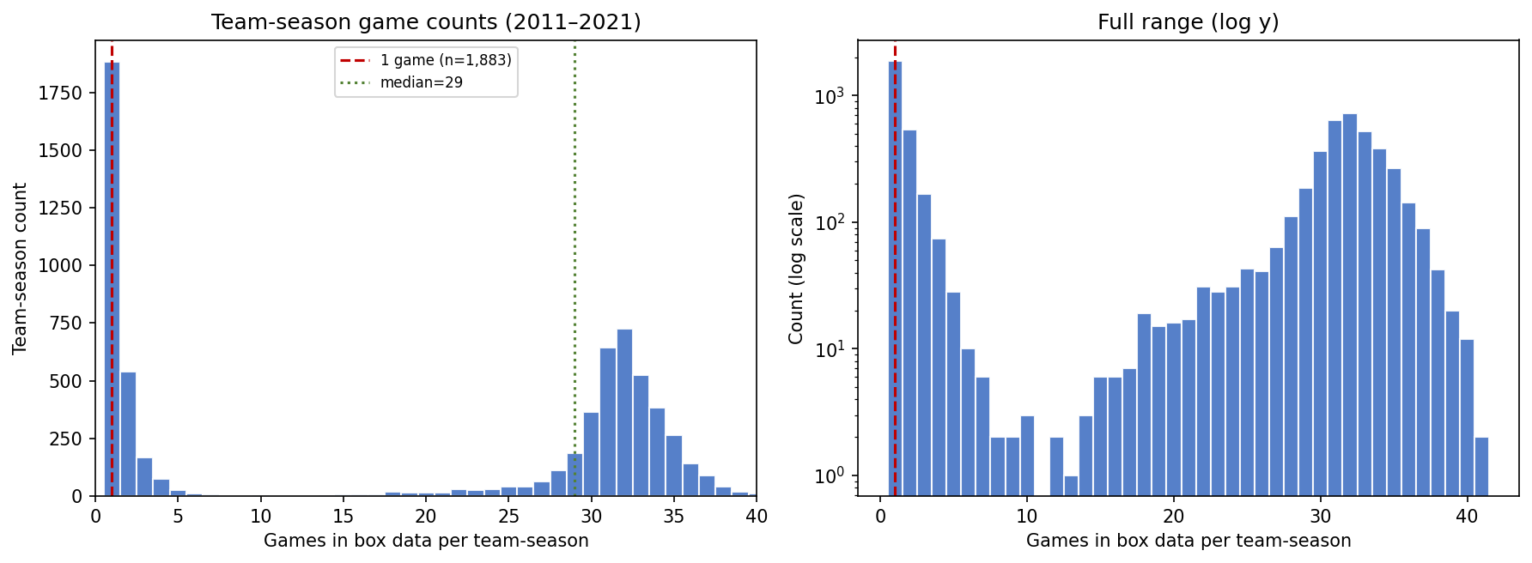
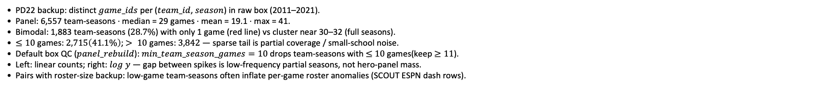
PD22 — Games per team-season in raw box data (before QC)
PD22 · team-season games · 2011–2021 · 1,883 with 1 game · median = 29
PD22 backup: distinct $game_ids$ per ($team_id$, $season$) in raw box (2011–2021).
Panel: 6,557 team-seasons · median = 29 games · mean = 19.1 · max = 41.
Bimodal: 1,883 team-seasons ($28.7\%$) with only 1 game (red line) vs cluster near 30–32 (full seasons).
$≤10$ games: $2,715\left(41.1\%\right)$; $> 10$ games: $3,842$ — sparse tail is partial coverage / small-school noise.
Default box QC ($panel_rebuild$): $min_team_season_games=10$ drops team-seasons with $≤$ $10$ games(keep $≥11$).
Left: linear counts; right: $log$ $y$ — gap between spikes is low-frequency partial seasons, not hero-panel mass.
Pairs with roster-size backup: low-game team-seasons often inflate per-game roster anomalies (SCOUT ESPN dash rows).
Claim (PD22 backup): Box panel mixes full D-I seasons ($∼30$ games) with sparse one-game team-seasons — default $min_team_season_games=10$ drops team-seasons with $≤10$ games (keep $≥11$) before player-season aggregation.

Slide 26
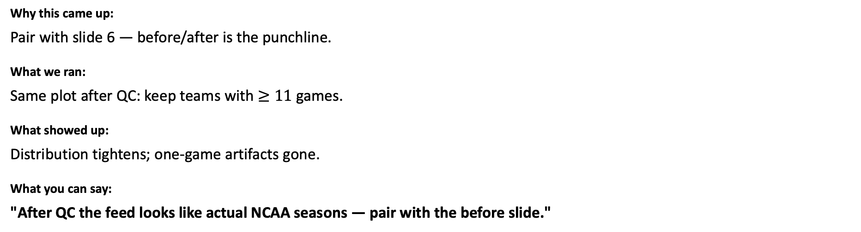
Games per team-season — after QC
Act II — PD22 panel \text{---} narrative for HAND slide 7
What does the feed look like once we require real seasons?
Why this came up:
Pair with slide 6 — before/after is the punchline.
What we ran:
Same plot after QC: keep teams with $≥11$ games.
What showed up:
Distribution tightens; one-game artifacts gone.
What you can say:
"After QC the feed looks like actual NCAA seasons — pair with the before slide."
↓ Paste 𝙲𝙷𝙰𝚁_𝙿𝙳𝟸𝟶_𝙷𝙰𝙽𝙳 slide 7 immediately after this slide

Slide 27
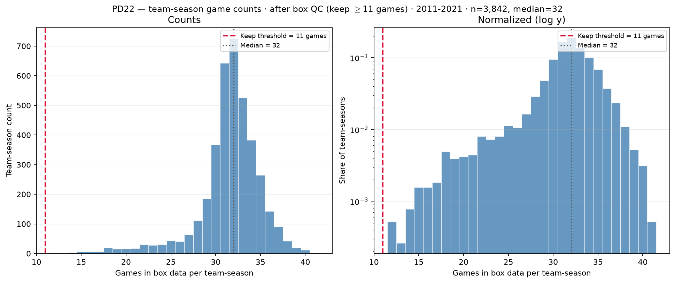
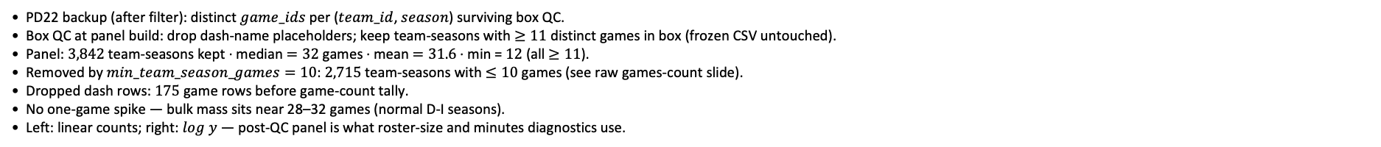
PD22 — Games per team-season after box QC
PD22 · games after box QC · 2011–2021 · $3,842$ team seasons · median $=32$ · min $≥11$
PD22 backup (after filter): distinct $game_ids$ per ($team_id$, $season$) surviving box QC.
Box QC at panel build: drop dash-name placeholders; keep team-seasons with $≥11$ distinct games in box (frozen CSV untouched).
Panel: $3,842$ team-seasons kept · median $=32$ games · mean $=31.6$ · min = $12$ (all $≥11$).
Removed by $min_team_season_games=10$: $2,715$ team-seasons with $≤10$ games (see raw games-count slide).
Dropped dash rows: $175$ game rows before game-count tally.
No one-game spike — bulk mass sits near 28–32 games (normal D-I seasons).
Left: linear counts; right: $log$ $y$ — post-QC panel is what roster-size and minutes diagnostics use.
Claim (PD22 backup): After box QC, team-season game counts are full-season D-I coverage ($≥11$ games) — low-game tail ($≤10$ games) removed before panel build.

Slide 28
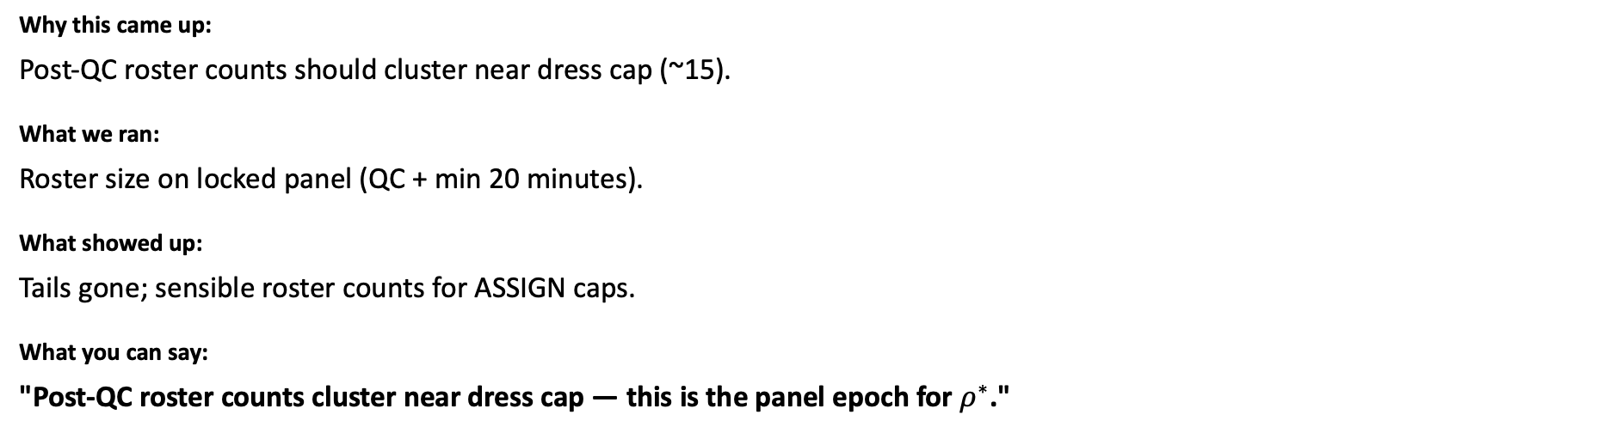
Roster size — box-QC panel vs min-20
Act II — PD22 panel \text{---} narrative for HAND slide 8
After QC, do roster sizes look like NCAA?
Why this came up:
Post-QC roster counts should cluster near dress cap (~15).
What we ran:
Roster size on locked panel (QC + min 20 minutes).
What showed up:
Tails gone; sensible roster counts for ASSIGN caps.
What you can say:
"Post-QC roster counts cluster near dress cap — this is the panel epoch for $ρ^{∗}$."
$↓ Paste CHAR_PD20_HAND$ slide 8 immediately after this slide

Slide 29
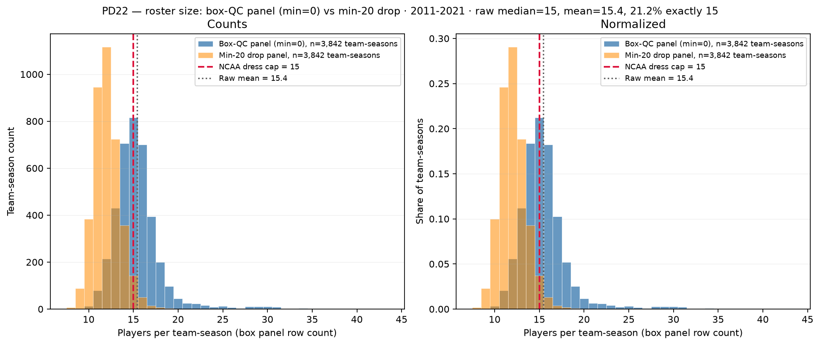
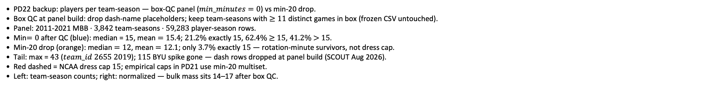
PD22 — Roster size: box-QC panel (min$=0$) vs min-20 drop
PD22 · roster size · 2011-2021 · raw median = $15$ · $21.2\%$ exactly $15$
PD22 backup: players per team-season — box-QC panel ($min_minutes=0$) vs min-20 drop.
Box QC at panel build: drop dash-name placeholders; keep team-seasons with $≥11$ distinct games in box (frozen CSV untouched).
Panel: 2011-2021 MBB · $3,842$ team-seasons · $59,283$ player-season rows.
Min$=0$ after QC (blue): median = 15, mean $=15.4$; $21.2\%$ exactly 15, $62.4\%$ $≥$ $15$, $41.2\%$ $>$ $15$.
Min-20 drop (orange): median $=12$, mean $=12.1$; only $3.7\%$ exactly $15$ — rotation-minute survivors, not dress cap.
Tail: max = $43$ ($team_id$ $2655$ $2019$); $115$ BYU spike gone — dash rows dropped at panel build (SCOUT Aug 2026).
Red dashed = NCAA dress cap $15$; empirical caps in PD21 use min-20 multiset.
Left: team-season counts; right: normalized — bulk mass sits 14–17 after box QC.
Claim (PD22 backup): After box QC, team-season roster counts cluster near NCAA dress cap $15$; empirical hero caps (min $≥$ $20$) count rotation-minute contributors — not game-day dress lists.

Slide 30
ESPN coverage 2013→2014 depth break
Act II — PD22 panel \text{---} narrative for HAND slide 9
Why does ppm0lt20 contrast jump in 2014?
Why this came up:
ESPN lists more bench rows after 2013 — policy contrasts must account for this.
What we ran:
Players listed per team by season in raw feed.
What showed up:
Step up at 2013→2014; hero min-20 panel is flat — contrast policy is sensitive.
What you can say:
"ESPN lists more bench rows after 2013 — that is why ppm0lt20 jumps in 2014 (contrast only)."
↓ Paste 𝙲𝙷𝙰𝚁_𝙿𝙳𝟸𝟶_𝙷𝙰𝙽𝙳 slide 9 immediately after this slide

Slide 31
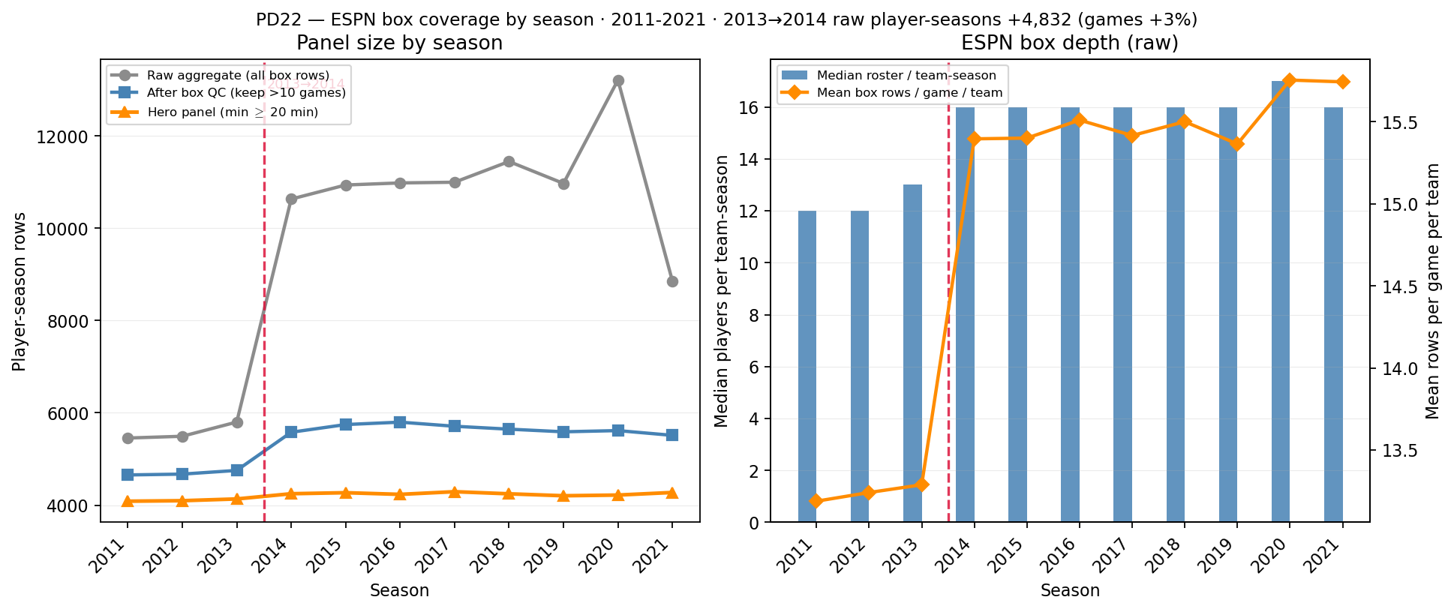
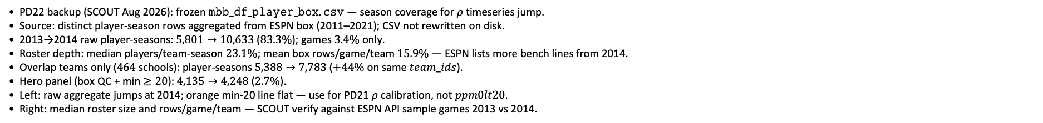
PD22 — ESPN box coverage by season (2013→2014 depth break)
PD22 · ESPN box coverage · 2011–2021 · 2013→2014 raw +$83.3\%$ · min-20 +$2.7\%$
PD22 backup (SCOUT Aug 2026): frozen $mbb_df_player_box.csv$ — season coverage for $ρ$ timeseries jump.
Source: distinct player-season rows aggregated from ESPN box (2011–2021); CSV not rewritten on disk.
2013→2014 raw player-seasons: $5,801→10,633$ ($83.3\%$); games $3.4\%$ only.
Roster depth: median players/team-season $23.1\%$; mean box rows/game/team $15.9\%$ — ESPN lists more bench lines from 2014.
Overlap teams only ($464$ schools): player-seasons $5,388→7,783$ ($+44\%$ on same $team_ids$).
Hero panel (box QC + min $≥20$): $4,135→4,248$ ($2.7\%$).
Left: raw aggregate jumps at 2014; orange min-20 line flat — use for PD21 $ρ$ calibration, not $ppm0lt20$.
Right: median roster size and rows/game/team — SCOUT verify against ESPN API sample games 2013 vs 2014.
Claim (PD22 backup): 2013→2014 jump in raw player-season counts is ESPN box depth (more players listed per game), not doubled games — hero min-20 panel is longitudinal-safe for $ρ$ / $H_{sort}$.

Slide 32
Drafted-player retention vs minutes floor
Act II — PD22 panel \text{---} narrative for HAND slide 10
At min 20 drop, do we lose anyone who mattered for draft?
Why this came up:
Q1 audit — conservative guardrail on the floor choice.
What we ran:
Audit all drafted player-seasons; who drops at 20? (44 lost, 42 zero-minute).
What showed up:
At 20: drop 44 drafted seasons — 42 were 0-minute. One ever-draft career fully lost; others keep rotation years.
What you can say:
"At 20 we drop mostly zero-minute rows — defend the floor on PPM noise, not draft-safe row-by-row."
↓ Paste 𝙲𝙷𝙰𝚁_𝙿𝙳𝟸𝟶_𝙷𝙰𝙽𝙳 slide 10 immediately after this slide

Slide 33
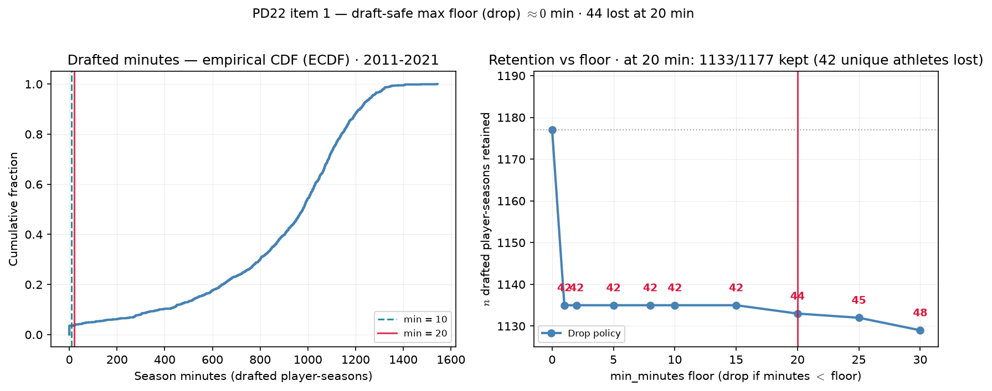
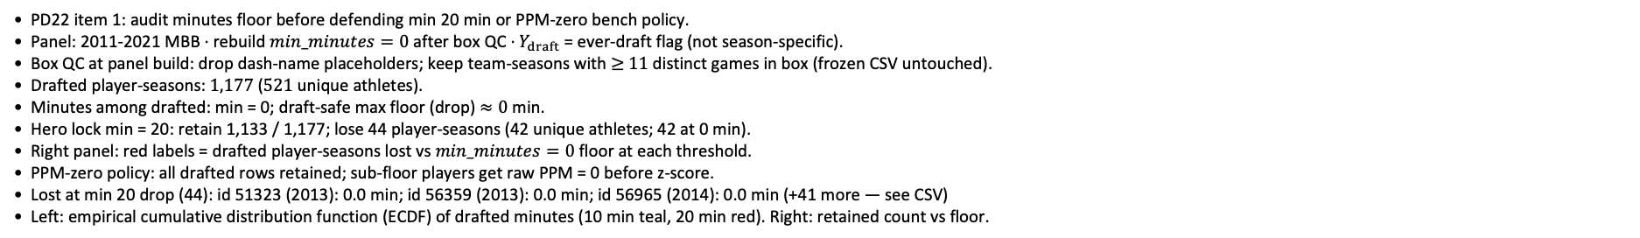
PD22 — Drafted-player retention vs playing-time floor
PD22 · drafted retention audit · 2011-2021 · at min 20 drop: 1133/1177 drafted player-seasons kept
PD22 item 1: audit minutes floor before defending min 20 min or PPM-zero bench policy.
Panel: 2011-2021 MBB · rebuild $min_minutes=0$ after box QC · $Y_{draft}$ = ever-draft flag (not season-specific).
Box QC at panel build: drop dash-name placeholders; keep team-seasons with $≥$ $11$ distinct games in box (frozen CSV untouched).
Drafted player-seasons: $1,177$ ($521$ unique athletes).
Minutes among drafted: min = 0; draft-safe max floor (drop) $≈0$ min.
Hero lock min = 20: retain 1,133 / 1,177; lose 44 player-seasons (42 unique athletes; 42 at 0 min).
Right panel: red labels = drafted player-seasons lost vs $min_minutes=0$ floor at each threshold.
PPM-zero policy: all drafted rows retained; sub-floor players get raw PPM = 0 before z-score.
Lost at min 20 drop (44): id 51323 (2013): 0.0 min; id 56359 (2013): 0.0 min; id 56965 (2014): 0.0 min (+41 more — see CSV)
Left: empirical cumulative distribution function (ECDF) of drafted minutes (10 min teal, 20 min red). Right: retained count vs floor.
Claim (PD22): Playing-time floor must be draft-safe — retain every ever-draft ($Y_{draft}=1$) player-season before we justify min 20 min or PPM-zero bench policy for $ρ$ / $H_{sort}$ calibration.

Slide 34
Raw panel season-minutes distribution
Act II — PD22 panel \text{---} narrative for HAND slide 11
Where does playing-time mass sit relative to 20?
Why this came up:
Q1 — show that sub-20 is a long noisy tail, not core rotation.
What we ran:
ECDF / histogram of total season minutes on raw panel.
What showed up:
Most mass above 20; below 20 is bench and sit-outs.
What you can say:
"Most playing-time mass sits above 20 minutes — below that is bench noise."
↓ Paste 𝙲𝙷𝙰𝚁_𝙿𝙳𝟸𝟶_𝙷𝙰𝙽𝙳 slide 11 immediately after this slide

Slide 35
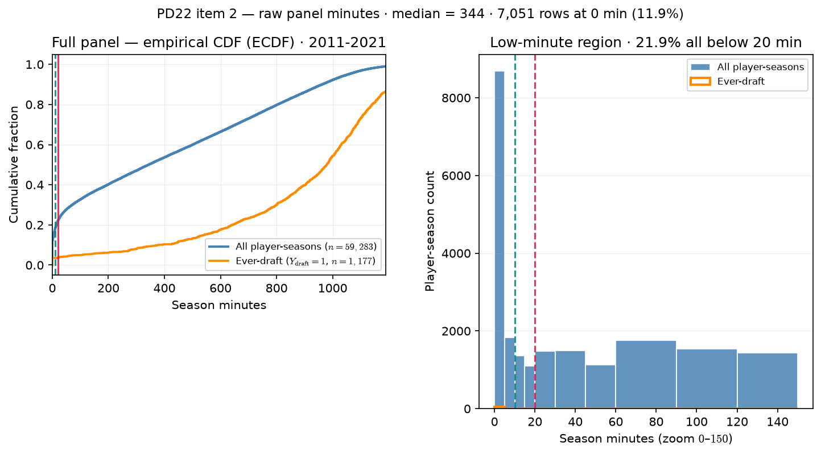
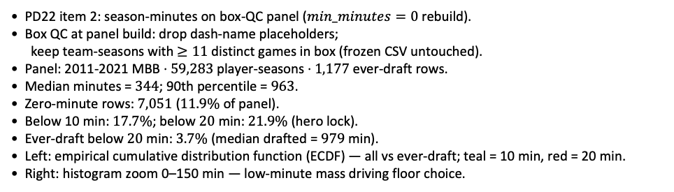
PD22 — Raw panel season-minutes distribution
PD22 · raw panel minutes · 2011-2021 · median = 344 min · $21.9\%$ below 20 min
PD22 item 2: season-minutes on box-QC panel ($min_minutes=0$ rebuild).
Box QC at panel build: drop dash-name placeholders;
keep team-seasons with $≥11$ distinct games in box (frozen CSV untouched).
Panel: 2011-2021 MBB · $59,283$ player-seasons · $1,177$ ever-draft rows.
Median minutes = $344$; 90th percentile = $963$.
Zero-minute rows: $7,051$ ($11.9\%$ of panel).
Below 10 min: $17.7\%$; below $20$ min: $21.9\%$ (hero lock).
Ever-draft below $20$ min: $3.7\%$ (median drafted = $979$ min).
Left: empirical cumulative distribution function (ECDF) — all vs ever-draft; teal = 10 min, red = 20 min.
Right: histogram zoom 0–150 min — low-minute mass driving floor choice.
Claim (PD22): Minutes floor must be grounded in the raw roster distribution — not an arbitrary cut — before we defend min 20 min for $ρ$/ ASSIGN panels.

Slide 36
PPM — filtered tail vs hero ASSIGN input
Act II — PD22 panel \text{---} narrative for HAND slide 12
How noisy is PPM below the floor?
Why this came up:
Sub-20 PPM is unstable — why we drop rather than trust those values.
What we ran:
PPM distribution for players filtered out at candidate floors.
What showed up:
Extreme noise below 20; z-scored ASSIGN input needs stable PPM.
What you can say:
"Sub-20 PPM is too unstable to feed ASSIGN — that is the case for drop, not PPM-zero."
↓ Paste 𝙲𝙷𝙰𝚁_𝙿𝙳𝟸𝟶_𝙷𝙰𝙽𝙳 slide 12 immediately after this slide

Slide 37
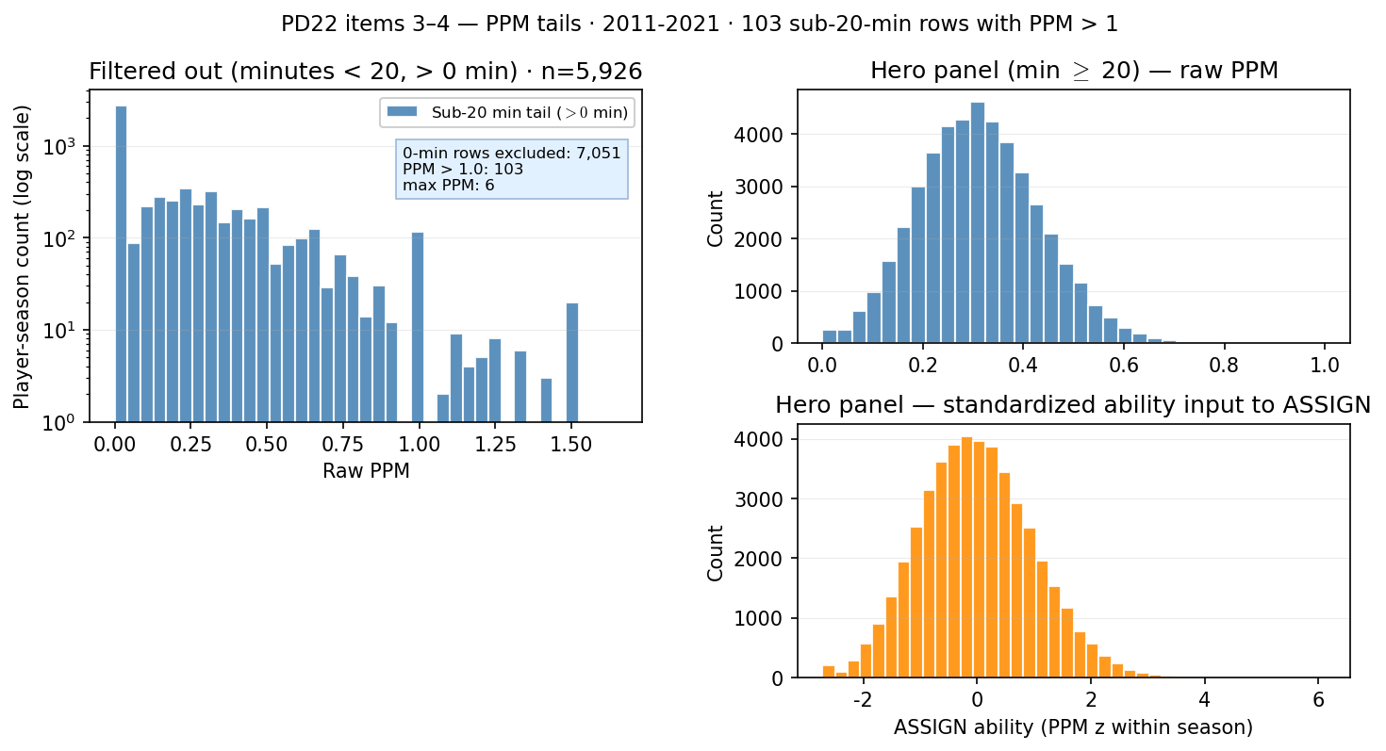
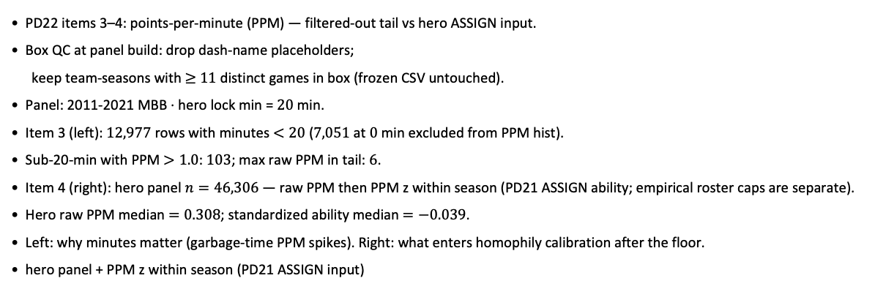
PD22 — PPM distribution: filtered-out tail vs hero ASSIGN input
PD22 · PPM tails · 2011-2021 · $103$ sub-20-min rows with PPM > 1
PD22 items 3–4: points-per-minute (PPM) — filtered-out tail vs hero ASSIGN input.
Box QC at panel build: drop dash-name placeholders;
keep team-seasons with $≥$ $11$ distinct games in box (frozen CSV untouched).
Panel: 2011-2021 MBB · hero lock min = $20$ min.
Item 3 (left): $12,977$ rows with minutes $<20$ ($7,051$ at $0$ min excluded from PPM hist).
Sub-20-min with PPM $>1.0$: $103$; max raw PPM in tail: $6$.
Item 4 (right): hero panel $n=46,306$ — raw PPM then PPM z within season (PD21 ASSIGN ability; empirical roster caps are separate).
Hero raw PPM median $=0.308$; standardized ability median $=−0.039$.
Left: why minutes matter (garbage-time PPM spikes). Right: what enters homophily calibration after the floor.
hero panel + PPM z within season (PD21 ASSIGN input)
Claim: Minutes floor guards against noisy PPM tails — sub-20-min rows include extreme points-per-minute spikes; hero ASSIGN uses PPM z-scored within season on the min-20 panel.

Slide 38
PPM overlay — full vs sub-20 tail
Act II — PD22 panel \text{---} narrative for HAND slide 13
Optional detail: full distribution vs tail emphasis.
Why this came up:
Slide 12 is the main argument; 13 is overlay for appendix trim.
What we ran:
Overlay full-panel PPM with sub-20 tail highlighted.
What showed up:
Same story as 12 with visual emphasis on the tail.
What you can say:
"Same PPM story as the prior slide — optional appendix if someone wants the overlay."
↓ Paste 𝙲𝙷𝙰𝚁_𝙿𝙳𝟸𝟶_𝙷𝙰𝙽𝙳 slide 13 immediately after this slide

Slide 39
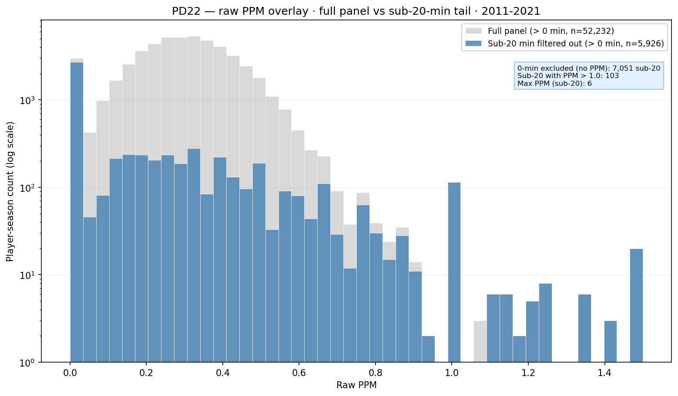
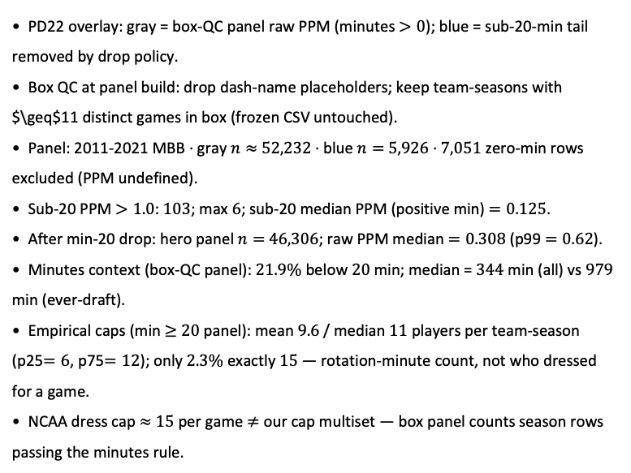
PD22 — Raw PPM: full panel vs sub-20-min filtered tail
PD22 · PPM overlay · 2011-2021 · 103 sub-20-min rows with PPM $>1$
PD22 overlay: gray = box-QC panel raw PPM (minutes $>0$); blue = sub-20-min tail removed by drop policy.
Box QC at panel build: drop dash-name placeholders; keep team-seasons with $\geq$11 distinct games in box (frozen CSV untouched).
Panel: 2011-2021 MBB · gray $n≈$ $52,232$ · blue $n=$ $5,926$ · $7,051$ zero-min rows excluded (PPM undefined).
Sub-20 PPM $>1.0$: $103$; max $6$; sub-20 median PPM (positive min) $=0.125$.
After min-20 drop: hero panel $n=$ $46,306$; raw PPM median $=0.308$ (p99 $=0.62$).
Minutes context (box-QC panel): $21.9\%$ below $20$ min; median = $344$ min (all) vs $979$ min (ever-draft).
Empirical caps (min $≥$ $20$ panel): mean $9.6$ / median $11$ players per team-season (p25$=6$, p75$=12$); only $2.3\%$ exactly $15$ — rotation-minute count, not who dressed for a game.
NCAA dress cap $≈$ $15$ per game $≠$ our cap multiset — box panel counts season rows passing the minutes rule.
Claim (PD22): Sub-20-min rows add PPM noise (103 with PPM $>1$, max 6) on top of a rotation-player cloud — minutes floor cleans ability before hero / ASSIGN; empirical roster caps count season contributors, not NCAA dress-out 15.

Slide 40
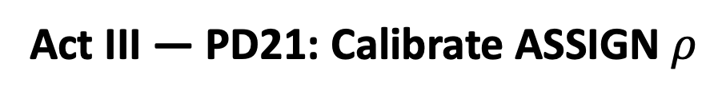
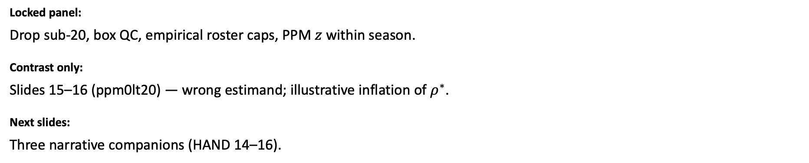
Act III — PD21: Calibrate ASSIGN $ρ$
Bracket search until sim $H_{sort}$ matches empirical NCAA sorting.
Locked panel:
Drop sub-20, box QC, empirical roster caps, PPM $z$ within season.
Contrast only:
Slides 15–16 (ppm0lt20) — wrong estimand; illustrative inflation of $ρ^{∗}$.
Next slides:
Three narrative companions (HAND 14–16).

Slide 41
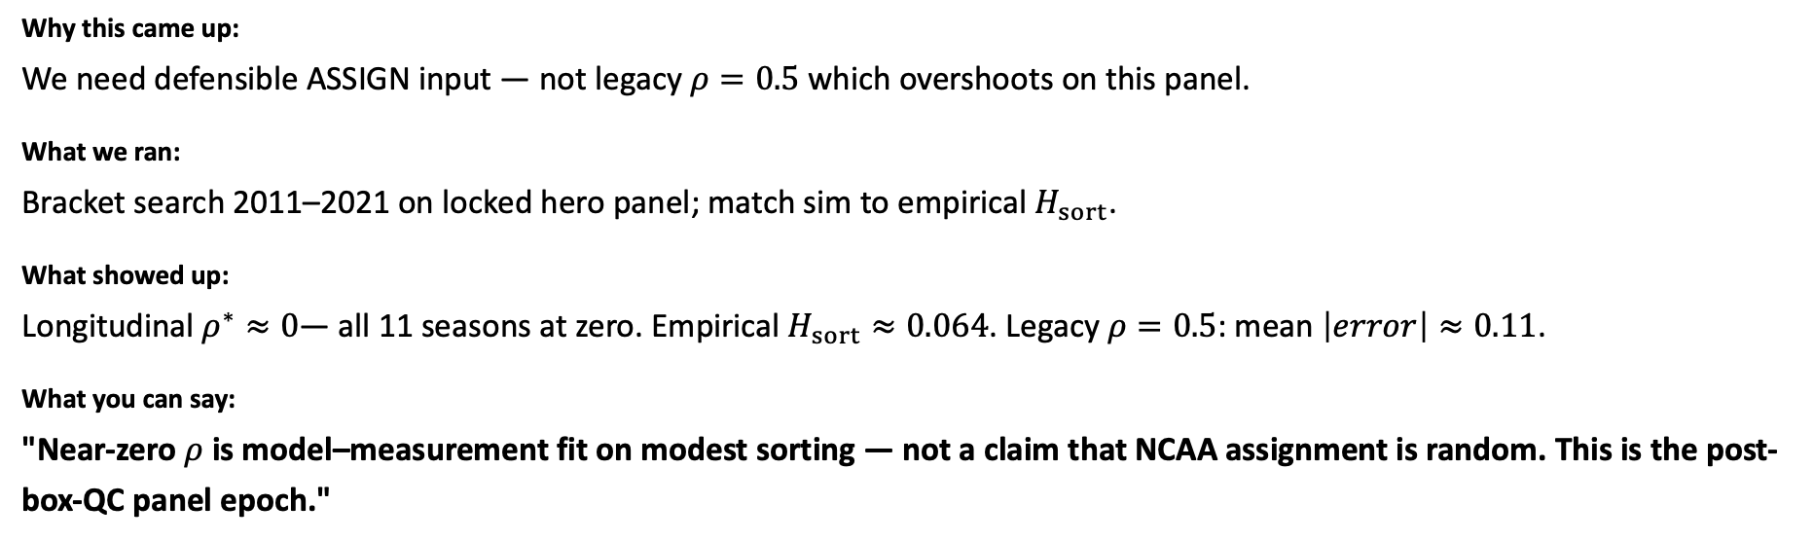
Calibrate 𝜌 — hero panel (locked)
Act III — PD21 \text{---} narrative for HAND slide 14
What homophily 𝜌 makes sim sorting match empirical 𝐻_sort?
Why this came up:
We need defensible ASSIGN input — not legacy $ρ=0.5$ which overshoots on this panel.
What we ran:
Bracket search 2011–2021 on locked hero panel; match sim to empirical $H_{sort}$.
What showed up:
Longitudinal $ρ^{∗}≈0$— all 11 seasons at zero. Empirical $H_{sort}≈0.064$. Legacy $ρ=0.5$: mean $\left|error\right|≈0.11$.
What you can say:
"Near-zero $ρ$ is model–measurement fit on modest sorting — not a claim that NCAA assignment is random. This is the post-box-QC panel epoch."
↓ Paste 𝙲𝙷𝙰𝚁_𝙿𝙳𝟸𝟶_𝙷𝙰𝙽𝙳 slide 14 immediately after this slide

Slide 42
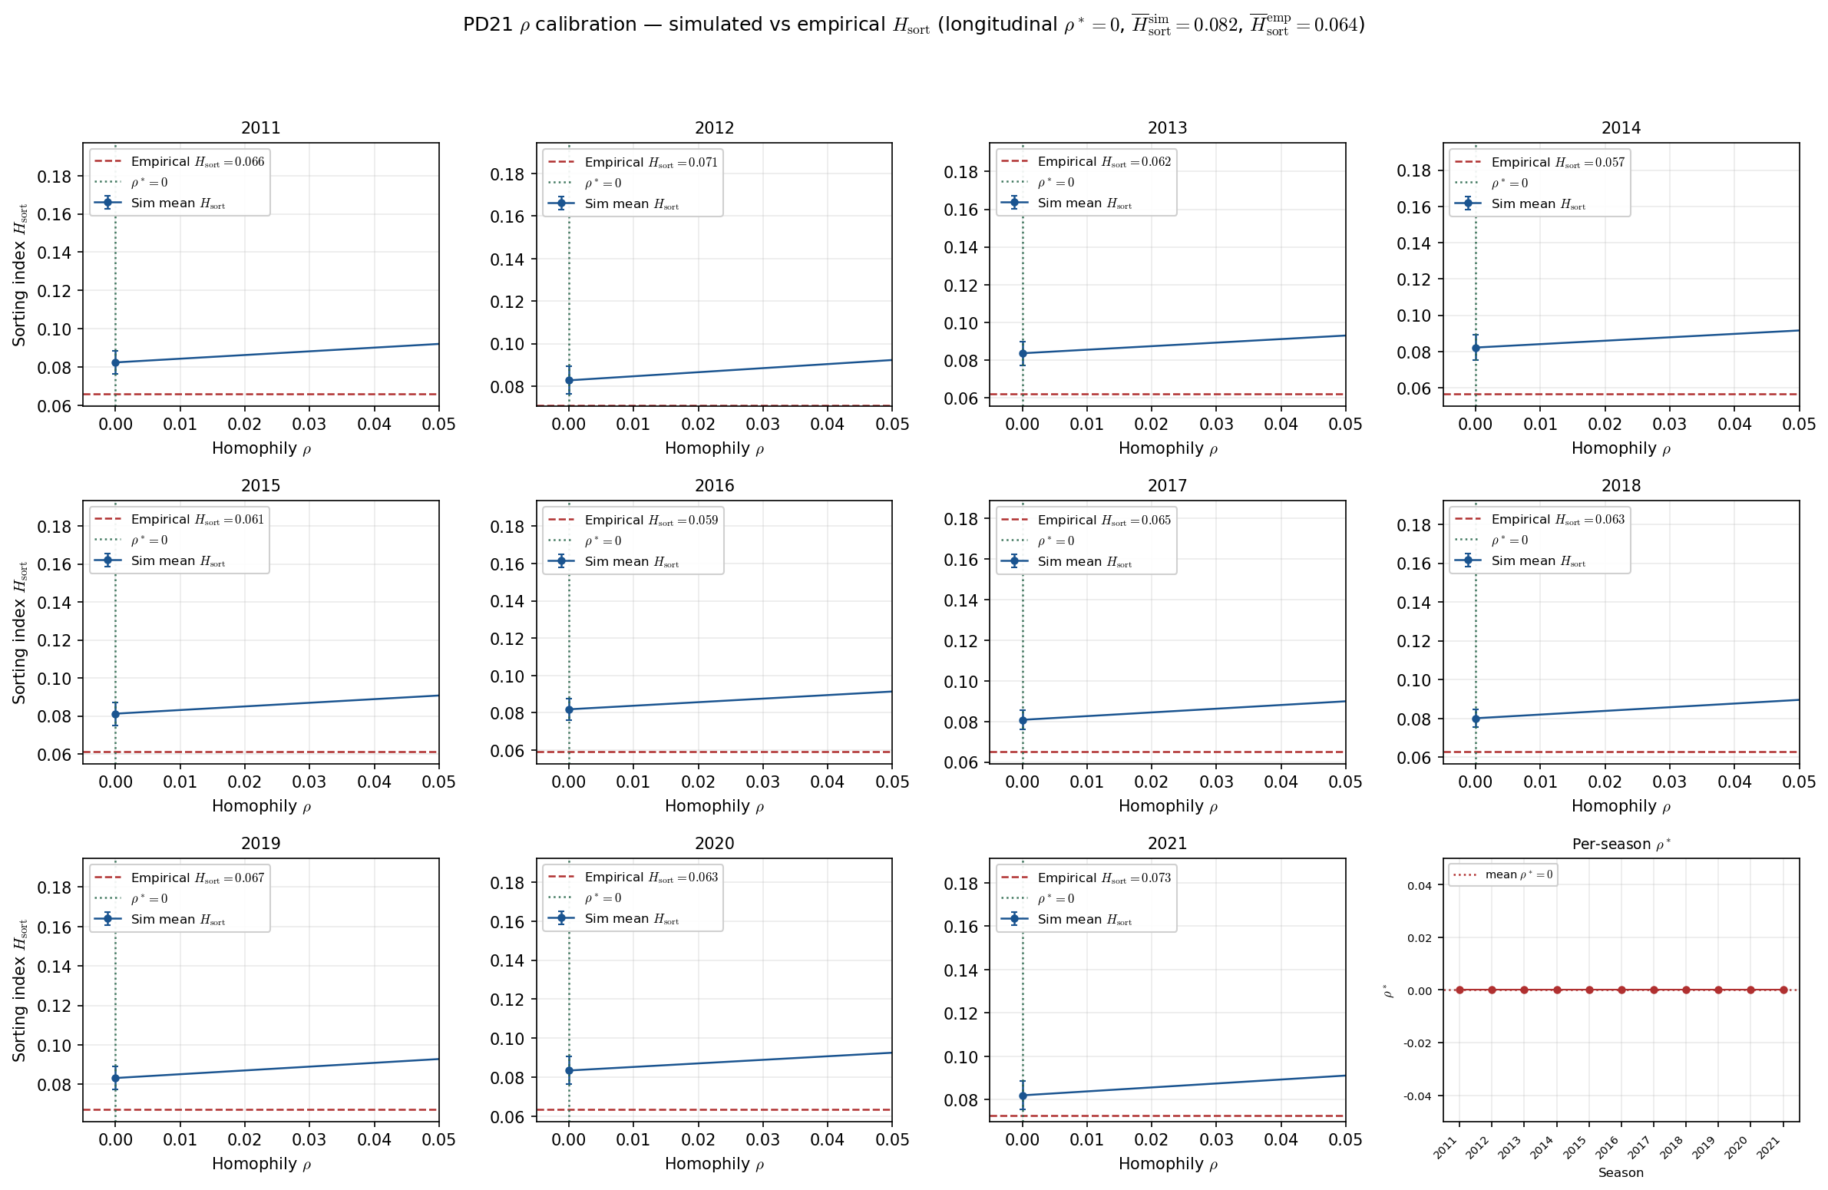
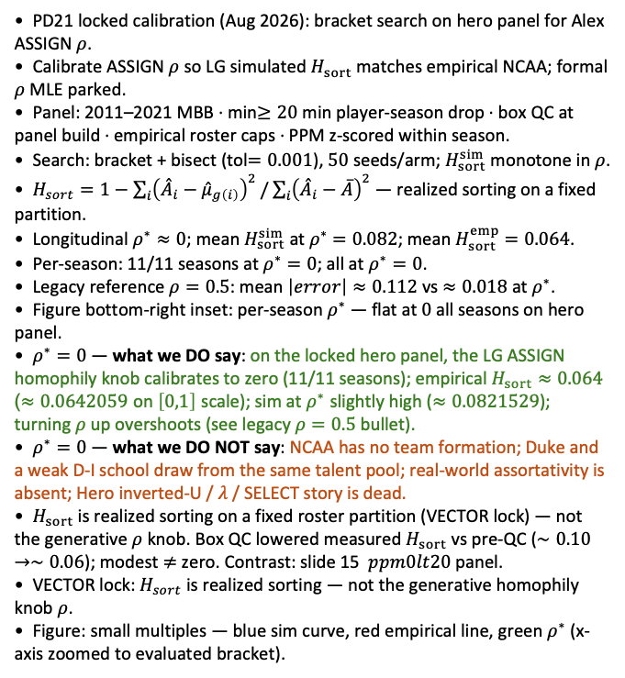
PD21 — Calibrate homophily $ρ$ to empirical sorting index $H_{sort}$ (hero panel — locked calibration)
PD21 · LG ASSIGN calibration · 2011-2021 · $50$ seeds · bracket tol$=0.001$ · longitudinal $ρ^{∗}≈0$ · hero panel
PD21 locked calibration (Aug 2026): bracket search on hero panel for Alex ASSIGN $ρ$.
Calibrate ASSIGN $ρ$ so LG simulated $H_{sort}$ matches empirical NCAA; formal $ρ$ MLE parked.
Panel: 2011–2021 MBB · min$≥20$ min player-season drop · box QC at panel build · empirical roster caps · PPM z-scored within season.
Search: bracket + bisect (tol$=0.001$), $50$ seeds/arm; $H_{sort}^{sim}$ monotone in $ρ$.
$H_{sort}=1−\sum_{i}{{\left({\overset{ˆ}{A}}_{i}−{\overset{ˆ}{μ}}_{g\left(i\right)}\right)}^{2}}/\sum_{i}{{\left({\overset{ˆ}{A}}_{i}−\overline{A}\right)}^{2}}$ — realized sorting on a fixed partition.
Longitudinal $ρ^{∗}≈0$; mean $H_{sort}^{sim}$ at $ρ^{∗}$ $=0.082$; mean $H_{sort}^{emp}$ $=0.064$.
Per-season: 11/11 seasons at $ρ^{∗}=0$; all at $ρ^{∗}=0$.
Legacy reference $ρ=0.5$: mean $\left|error\right|≈0.112$ vs $≈0.018$ at $ρ^{∗}$.
Figure bottom-right inset: per-season $ρ^{∗}$ — flat at $0$ all seasons on hero panel.
$ρ^{∗}=0$ — what we DO say: on the locked hero panel, the LG ASSIGN homophily knob calibrates to zero (11/11 seasons); empirical $H_{sort}≈0.064$ ($≈0.0642059$ on $\left[0,1\right]$ scale); sim at $ρ^{∗}$ slightly high ($≈0.0821529$); turning $ρ$ up overshoots (see legacy $ρ=0.5$ bullet).
$ρ^{∗}=0$ — what we DO NOT say: NCAA has no team formation; Duke and a weak D-I school draw from the same talent pool; real-world assortativity is absent; Hero inverted-U / $λ$ / SELECT story is dead.
$H_{sort}$ is realized sorting on a fixed roster partition (VECTOR lock) — not the generative $ρ$ knob. Box QC lowered measured $H_{sort}$ vs pre-QC ($∼0.10→∼0.06$); modest $≠$ zero. Contrast: slide 15 $ppm0lt20$ panel.
VECTOR lock: $H_{sort}$ is realized sorting — not the generative homophily knob $ρ$.
Figure: small multiples — blue sim curve, red empirical line, green $ρ^{∗}$ (x-axis zoomed to evaluated bracket).
Claim: Hero panel — LG ASSIGN $ρ^{∗}=0$ matches modest empirical $H_{sort}≈0.064$; legacy $ρ=0.5$ overshoots ($0.11$ mean $\left|error\right|$). Model–measurement fit on this panel — not a claim that NCAA rosters are random.

Slide 43

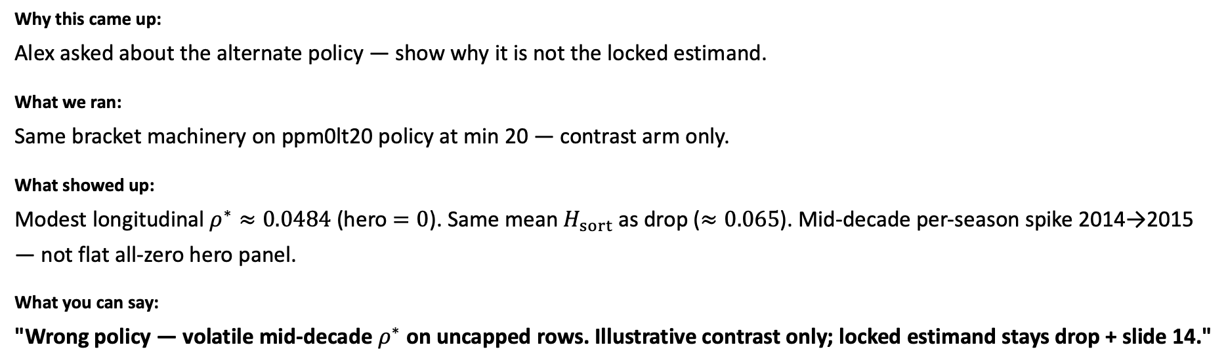
Calibrate 𝜌 — ppm0lt20 contrast
Act III — PD21 $\text{−−−}$ narrative for HAND slide 15
What if we keep sub-20 players with PPM $=0$ instead of dropping?
Why this came up:
Alex asked about the alternate policy — show why it is not the locked estimand.
What we ran:
Same bracket machinery on ppm0lt20 policy at min 20 — contrast arm only.
What showed up:
Modest longitudinal $ρ^{∗}≈0.0484$ (hero $=0$). Same mean $H_{sort}$ as drop ($≈0.065$). Mid-decade per-season spike 2014→2015 — not flat all-zero hero panel.
What you can say:
"Wrong policy — volatile mid-decade $ρ^{∗}$ on uncapped rows. Illustrative contrast only; locked estimand stays drop + slide 14."
↓ Paste 𝙲𝙷𝙰𝚁_𝙿𝙳𝟸𝟶_𝙷𝙰𝙽𝙳 slide 15 immediately after this slide

Slide 44
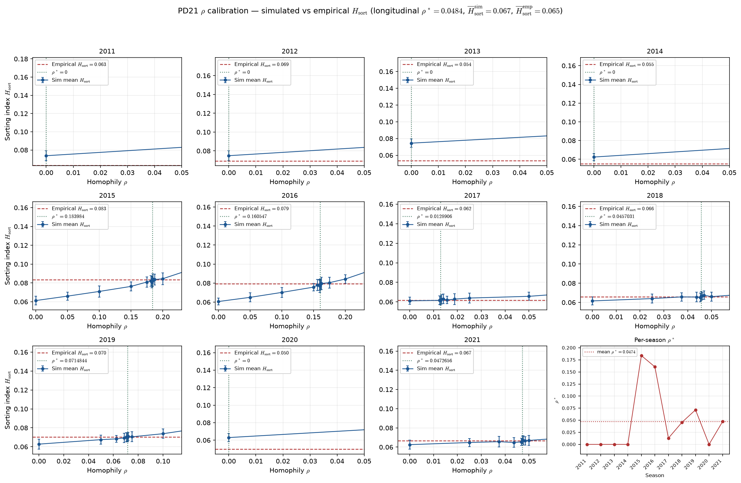
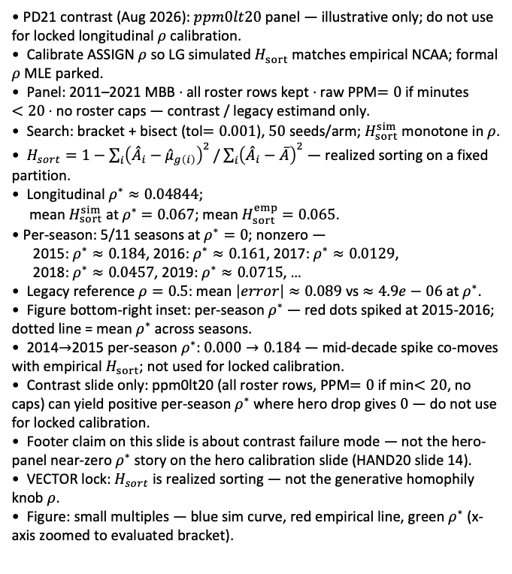
PD21 — Calibrate homophily $ρ$ to empirical sorting index $H_{sort}$ (contrast: $ppm0lt20$ — not for calibration)
PD21 · LG ASSIGN calibration · 2011-2021 · 50 seeds · bracket tol$=0.001$ · longitudinal $ρ^{∗}≈0.0484$ · contrast ppm0lt20
PD21 contrast (Aug 2026): $ppm0lt20$ panel — illustrative only; do not use for locked longitudinal $ρ$ calibration.
Calibrate ASSIGN $ρ$ so LG simulated $H_{sort}$ matches empirical NCAA; formal $ρ$ MLE parked.
Panel: 2011–2021 MBB · all roster rows kept · raw PPM$=0$ if minutes $<20$ · no roster caps — contrast / legacy estimand only.
Search: bracket + bisect (tol$=0.001$), $50$ seeds/arm; $H_{sort}^{sim}$ monotone in $ρ$.
$H_{sort}=1−\sum_{i}{{\left({\overset{ˆ}{A}}_{i}−{\overset{ˆ}{μ}}_{g\left(i\right)}\right)}^{2}}/\sum_{i}{{\left({\overset{ˆ}{A}}_{i}−\overline{A}\right)}^{2}}$ — realized sorting on a fixed partition.
Longitudinal $ρ^{∗}≈0.04844$;
mean $H_{sort}^{sim}$ at $ρ^{∗}$ $=0.067$; mean $H_{sort}^{emp}$ $=0.065$.
Per-season: 5/11 seasons at $ρ^{∗}=0$; nonzero —
2015: $ρ^{∗}≈0.184$, 2016: $ρ^{∗}≈0.161$, 2017: $ρ^{∗}≈0.0129$,
2018: $ρ^{∗}≈0.0457$, 2019: $ρ^{∗}≈0.0715$, …
Legacy reference $ρ=0.5$: mean $\left|error\right|≈0.089$ vs $≈4.9e−06$ at $ρ^{∗}$.
Figure bottom-right inset: per-season $ρ^{∗}$ — red dots spiked at 2015-2016; dotted line = mean $ρ^{∗}$ across seasons.
2014$→$2015 per-season $ρ^{∗}$: $0.000→0.184$ — mid-decade spike co-moves with empirical $H_{sort}$; not used for locked calibration.
Contrast slide only: ppm0lt20 (all roster rows, PPM$=0$ if min$<20$, no caps) can yield positive per-season $ρ^{∗}$ where hero drop gives $0$ — do not use for locked calibration.
Footer claim on this slide is about contrast failure mode — not the hero-panel near-zero $ρ^{∗}$ story on the hero calibration slide (HAND20 slide 14).
VECTOR lock: $H_{sort}$ is realized sorting — not the generative homophily knob $ρ$.
Figure: small multiples — blue sim curve, red empirical line, green $ρ^{∗}$ (x-axis zoomed to evaluated bracket).
Claim (PD21 contrast): ppm0lt20 yields modest longitudinal $ρ^{∗}≈0.0484$ (hero panel $=0$) — not the locked estimand; 2014$→$2015 per-season spike co-moves with mid-decade $H_{sort}$ on uncapped roster rows (PD22 ESPN coverage — HAND20 slide 9).

Slide 45

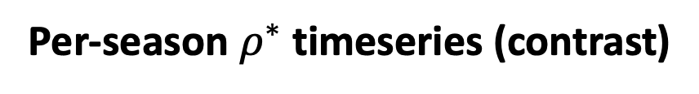
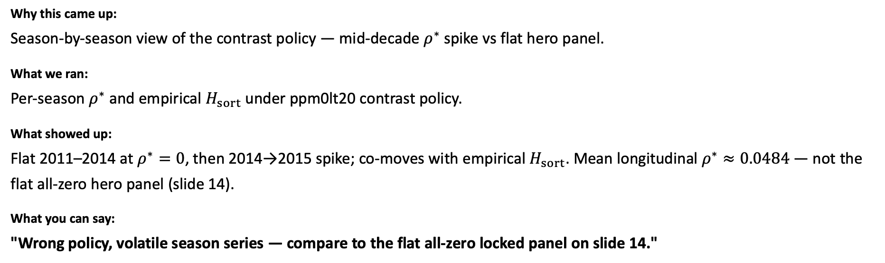
Per-season $ρ^{∗}$ timeseries (contrast)
Act III — PD21 $\text{−−−}$ narrative for HAND slide 16
How does the wrong policy look season-by-season?
Why this came up:
Season-by-season view of the contrast policy — mid-decade $ρ^{∗}$ spike vs flat hero panel.
What we ran:
Per-season $ρ^{∗}$ and empirical $H_{sort}$ under ppm0lt20 contrast policy.
What showed up:
Flat 2011–2014 at $ρ^{∗}=0$, then 2014→2015 spike; co-moves with empirical $H_{sort}$. Mean longitudinal $ρ^{∗}≈0.0484$ — not the flat all-zero hero panel (slide 14).
What you can say:
"Wrong policy, volatile season series — compare to the flat all-zero locked panel on slide 14."
↓ Paste 𝙲𝙷𝙰𝚁_𝙿𝙳𝟸𝟶_𝙷𝙰𝙽𝙳 slide 16 immediately after this slide

Slide 46
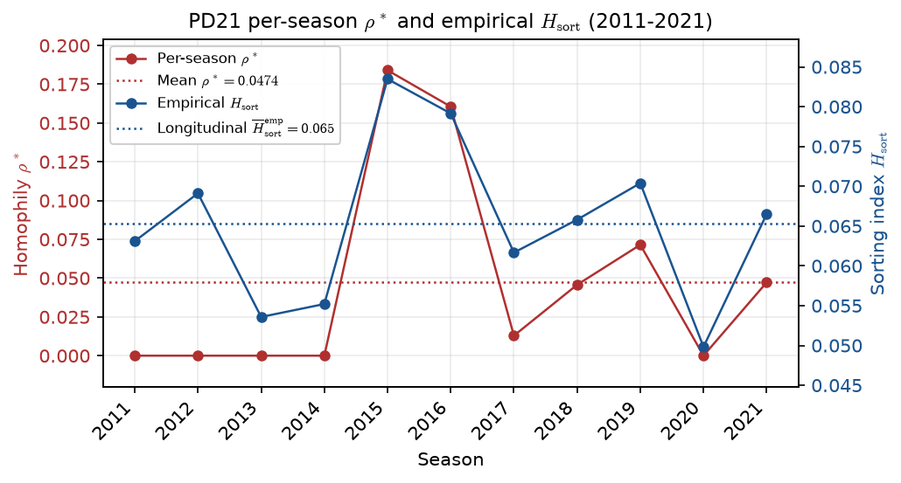
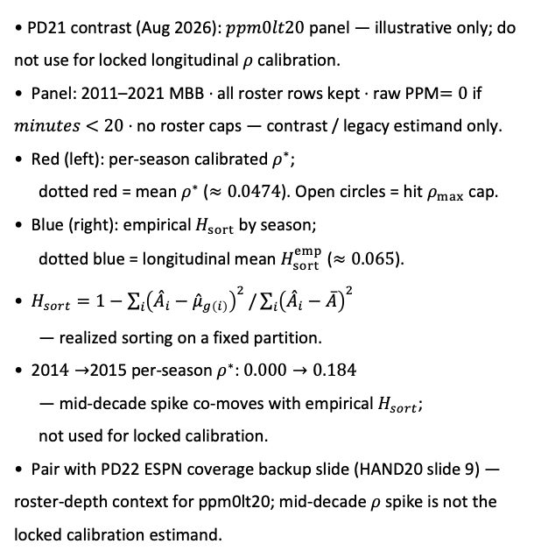
PD21 — Per-season $ρ^{∗}$ and empirical $H_{sort}$ (contrast: $ppm0lt20$ — not for calibration)
PD21 · per-season $ρ^{∗}$ vs empirical $H_{sort}$ · 2011-2021 · contrast $ppm0lt20$
PD21 contrast (Aug 2026): $ppm0lt20$ panel — illustrative only; do not use for locked longitudinal $ρ$ calibration.
Panel: 2011–2021 MBB · all roster rows kept · raw PPM$=0$ if $minutes$ $<20$ · no roster caps — contrast / legacy estimand only.
Red (left): per-season calibrated $ρ^{∗}$;
dotted red = mean $ρ^{∗}$ ($≈0.0474$). Open circles = hit $ρ_{max}$ cap.
Blue (right): empirical $H_{sort}$ by season;
dotted blue = longitudinal mean $H_{sort}^{emp}$ ($≈0.065$).
$H_{sort}=1−\sum_{i}{{\left({\overset{ˆ}{A}}_{i}−{\overset{ˆ}{μ}}_{g\left(i\right)}\right)}^{2}}/\sum_{i}{{\left({\overset{ˆ}{A}}_{i}−\overline{A}\right)}^{2}}$
— realized sorting on a fixed partition.
201$4→$2015 per-season $ρ^{∗}$: $0.000→0.184$
— mid-decade spike co-moves with empirical $H_{sort}$;
not used for locked calibration.
Pair with PD22 ESPN coverage backup slide (HAND20 slide 9) — roster-depth context for ppm0lt20; mid-decade $ρ$ spike is not the locked calibration estimand.
Claim (PD21 contrast): ppm0lt20 mid-decade per-season $ρ^{∗}$ spike ($2014→2015$) co-moves with empirical $H_{sort}$ — hero min-20 panel gives flat $ρ^{∗}$; see PD22 ESPN coverage (HAND20 slide 9).

Slide 47
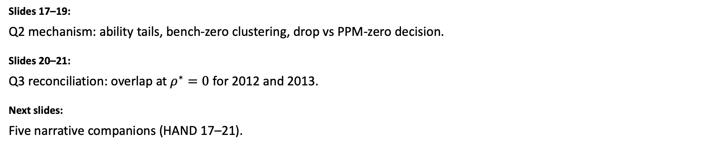
Act IV — PD22: Policy deep dive + overlap reconciliation
Back to Q2 and Q3 with evidence slides — then lock the story.
Slides 17–19:
Q2 mechanism: ability tails, bench-zero clustering, drop vs PPM-zero decision.
Slides 20–21:
Q3 reconciliation: overlap at $ρ^{∗}=0$ for 2012 and 2013.
Next slides:
Five narrative companions (HAND 17–21).

Slide 48

PPM-zero vs drop — ability distribution
Act IV — PD22 policy \text{---} narrative for HAND slide 17
How does the ability picture change under PPM-zero?
Why this came up:
Q2 — zeros change ASSIGN inputs even if mean $H_{sort}$ barely moves.
What we ran:
Side-by-side ability histograms: drop sub-20 vs keep with PPM $=0$.
What showed up:
PPM-zero adds ~13k bench rows and a large zero/low-$z$ tail drop removes entirely.
What you can say:
"PPM-zero reshapes the ability scale even when mean sorting barely moves — drop is cleaner input."
↓ Paste 𝙲𝙷𝙰𝚁_𝙿𝙳𝟸𝟶_𝙷𝙰𝙽𝙳 slide 17 immediately after this slide

Slide 49


PD22 — ability under PPM-zero vs drop policy
PD22 item 6 · PPM-zero vs drop · 2011-2021 · $12,977$ bench rows at PPM $=0$
PD22 item 6: PPM-zero vs drop — raw PPM and ASSIGN ability (PPM z within season).
Box QC at panel build: drop dash-name placeholders; keep team-seasons with $≥11$ distinct games in box (frozen CSV untouched).
Panel: 2011-2021 MBB · floor $=20$ min.
Drop panel ($n=46,306$): sub-20 rows removed at rebuild.
PPM-zero panel ($n=59,283$): $12,977$ rows ($0.2\%$) forced to PPM $=0$ (min $<20$).
Raw PPM spike: $13,180$ rows at PPM $=0$ under PPM-zero.
ASSIGN below $−1$ z: drop $7,356$ vs PPM-zero $14,028$; zeroed cohort median $=$ $−1.39$.
Left column = drop (PD21 default). Right column = PPM-zero alternative Alex flagged for induced homophily.
Claim (PD22): PPM-zero keeps bench players on roster at forced PPM = 0 — expect a zero-heavy ability distribution vs the min-20 drop panel; may inflate homophily if identical zeros cluster on teams.

Slide 50

Bench-zero clustering vs 𝐻_sort
Act IV — PD22 policy \text{---} narrative for HAND slide 18
Do identical bench zeros mechanically inflate sorting?
Why this came up:
Alex's worry: zeros pile on deep benches and fake homophily.
What we ran:
Correlate bench-zero share with empirical 𝐻_sort; all-zero team sanity check.
What showed up:
No all-zero team-seasons; bench zeros do not move league mean 𝐻_sort much on locked panel — but ability picture still favors drop.
What you can say:
"Bench zeros do not blow up league mean $H_{sort}$ here — but the ability picture still favors drop; see the decision slide next."
↓ Paste 𝙲𝙷𝙰𝚁_𝙿𝙳𝟸𝟶_𝙷𝙰𝙽𝙳 slide 18 immediately after this slide

Slide 51


PD22 — bench-zero clustering vs empirical sorting
PD22 item 8 · bench zeros vs $H_{sort}$ · 2011-2021 · $Δ$ mean = $0.0010$
PD22 item 8: bench-zero share vs within-team dispersion; season $H_{sort}$ drop vs PPM-zero.
Box QC at panel build: drop dash-name placeholders; keep team-seasons with $≥11$ distinct games in box (frozen CSV untouched).
Panel: 2011-2021 MBB · PPM-zero floor $=20$ min.
Team-season scatter: corr(zero fraction, within-team perf std) $=0.534$ ($3,842$ team-seasons).
Mean empirical $H_{sort}$: drop $=0.0642$ vs PPM-zero = $0.0653$ ($Δ$ mean $=0.0010$).
Teams with $≥$ half roster zeroed: $74$.
Left: more bench zeros $⇒$ lower within-team dispersion (identical zeroed cohort). Right: season $H_{sort}$ under both panel policies.
Claim (PD22): PPM-zero piles identical bench abilities on rosters — check whether that mechanically inflates empirical $H_{sort}$ vs drop-at-20.

Slide 52

Panel policy — drop vs PPM-zero at min 20
Act IV — PD22 policy \text{---} narrative for HAND slide 19
Which policy do we lock for the hero panel and 𝜌 calibration?
Why this came up:
Q2 decision slide — one clear policy before citing slide 14 $ρ^{∗}$.
What we ran:
Side-by-side bracket summary: drop vs PPM-zero on post-QC panel at min 20.
What showed up:
$H_{sort}$: 0.064 vs 0.065 ($Δ≈0.001$). Drop wins — slide 14 already used this policy.
What you can say:
"Drop at 20 is locked — slide 14 already used it; no $ρ$ re-run for drop-vs-zero."
↓ Paste 𝙲𝙷𝙰𝚁_𝙿𝙳𝟸𝟶_𝙷𝙰𝙽𝙳 slide 19 immediately after this slide

Slide 53


Interval overlap — season 2012 ($ρ^{∗}=0$)
Act IV — PD22 overlap \text{---} narrative for HAND slide 20
Why do overlap plots look sorted when bracket says $ρ^{∗}=0$?
Why this came up:
Q3 — reconcile the calibration number with what the overlap figures show.
What we ran:
Single-season talent-window overlap on locked panel, 2012.
What showed up:
$89\%$ of talent grid has $>1$ team covering the same ability bin — massive stacking.
What you can say:
"Overlap is roster geometry; bracket $ρ^{∗}$ is sim fit to $H_{sort}$ — different questions, both valid."
↓ Paste 𝙲𝙷𝙰𝚁_𝙿𝙳𝟸𝟶_𝙷𝙰𝙽𝙳 slide 20 immediately after this slide

Slide 54


PD22 — panel policy: drop vs PPM-zero at min 20
PD22 item 9 · policy compare · 2011-2021 · $ρ^{∗}$ drop $0.000$ vs PPM-zero $0.570$
PD22 item 9: panel policy compare at min 20 — drop (PD21 default) vs PPM-zero.
Box QC at panel build: drop dash-name placeholders;
keep team-seasons with $≥11$ distinct games in box (frozen CSV untouched).
Panel: 2011-2021 MBB · floor $=20$ min.
Longitudinal bracket $ρ^{∗}$: drop $=0.000$
vs PPM-zero $=0.570$ (legacy JSON — pre-box-QC $H_{sort}$ target).
Empirical $H_{sort}$ mean (current panel, item 8): drop $=0.0642$
vs PPM-zero $=0.0653$ ($Δ=0.0010$).
Seasons with $ρ^{∗}=0$: drop $11$ / $11$ vs PPM-zero $0$.
Recommendation: drop — PPM-zero inflates $ρ^{∗}$ without proportional $H_{sort}$ gain;
partial shrinkage not pursued.
Top: per-season $ρ^{∗}$. Bottom: empirical $H_{sort}$ (items 6–8 context).
Claim (PD22): At min 20, drop vs PPM-zero — bracket $ρ^{∗}$ and empirical $H_{sort}$ decide which panel policy enters PD21 calibration.

Slide 55


PD22 — team interval overlap · season 2012
PD22 item 10 · season 2012 · min 20 min drop panel · 345 team-seasons · $H_{sort}=0.071$ · $ρ^{∗}=0$
PD22 item 10: single-season interval overlap —
season $2,012$ only (not pooled).
Box QC at panel build: drop dash-name placeholders;
keep team-seasons with $≥11$ distinct games in box (frozen CSV untouched).
Bracket $ρ^{∗}$ (drop-at-20): $0.000$ · $H_{sort}=0.0709$.
Each team-season: talent window $\left[\min{{\overset{ˆ}{A}}_{i}},\max{{\overset{ˆ}{A}}_{i}}\right]$ on PPM $z$.
Top-left: coverage along spectrum;
crimson dashed = disjoint sort-and-chop benchmark.
Bottom: roster intervals sorted by ${\overset{ˆ}{T}}_{j}$ — stacking = overlap.
$ρ^{∗}≈0$ but overlap structure remains — bracket fit $≠$ visual absence of sorting.
Paired compare window — match season span to LG sim slide.
VECTOR lock: $H_{sort}$ is realized sorting — not the generative homophily knob $ρ$.
Claim (PD22): Single-season overlap diagnostic — does talent-window stacking persist when bracket $ρ^{∗}≈0$?

Slide 56


Interval overlap — season 2013 ($ρ^{∗}=0$)
Act IV — PD22 overlap \text{---} narrative for HAND slide 21
What about the remembered 2013 $ρ^{∗}≈0.07$?
Why this came up:
2013 was the season that triggered the side quest — close it on locked panel.
What we ran:
Same overlap plot for 2013; compare to pre-box-QC calibration epoch.
What showed up:
$95\%$ grid stacking in 2013 — stronger than 2012, still at $ρ^{∗}=0$ locked. Old $ρ^{∗}≈0.07$ was pre-QC panel, not today's estimand.
What you can say:
"2013 still stacks heavily at $ρ^{∗}=0$ on the locked panel — the old 0.07 was pre-box-QC. Q3 closed; resume SELECT / MLE."
↓ Paste 𝙲𝙷𝙰𝚁_𝙿𝙳𝟸𝟶_𝙷𝙰𝙽𝙳 slide 21 immediately after this slide

Slide 57


PD22 — team interval overlap · season 2013
PD22 item 11 · season 2013 · min 20 min drop panel · 347 team-seasons · $H_{sort}=0.062$ · $ρ^{∗}=0$
PD22 item 11: single-season interval overlap —
season $2,013$ only (not pooled).
Box QC at panel build: drop dash-name placeholders;
keep team-seasons with $≥11$ distinct games in box (frozen CSV untouched).
Bracket $ρ^{∗}$ (drop-at-20): $0.000$ · $H_{sort}=0.0620$.
Each team-season: talent window $\left[\min{{\overset{ˆ}{A}}_{i}},\max{{\overset{ˆ}{A}}_{i}}\right]$ on PPM $z$.
Top-left: coverage along spectrum;
crimson dashed = disjoint sort-and-chop benchmark.
Bottom: roster intervals sorted by ${\overset{ˆ}{T}}_{j}$ — stacking = overlap.
$ρ^{∗}≈0$ but overlap structure remains — bracket fit $≠$ visual absence of sorting.
Paired compare window — match season span to LG sim slide.
VECTOR lock: $H_{sort}$ is realized sorting — not the generative homophily knob $ρ$.
Claim (PD22): Single-season overlap diagnostic — does talent-window stacking persist when bracket $ρ^{∗}≈0$?

Slide 58

Where we stand — August 18, 2026
What is locked and what is the exact next beat?
Why this came up:
PD20–22 were scoped to justify panel and calibration quickly — not to perfect every sensitivity before returning to SELECT and outcomes.
What we ran:
Walked minutes data, box QC, drop vs PPM-zero, $ρ^{∗}$ on locked panel, overlap reconciliation, PD20 Gibbs gate.
What showed up:
Drop sub-20 + box QC hero panel; $ρ^{∗}≈0$ modest fit; overlap still stacked; Gibbs SELECT preserves inverted-U. Not blocked on panel policy or 𝜌 re-calibration.
What you can say:
"Campaign checkpoint cleared — panel policy and $ρ$ calibration are not blocking the main line. Next slides map what lies ahead."

Slide 59

What lies ahead — main line (resume here)
PD20–22 were defensive; the scientific campaign continues on the locked panel.
Beat 1 — SELECT / MLE:
PD20 cleared soft Gibbs SELECT. Next: lock 𝐾-draw semantics, then statistical fit for SELECT parameters (MLE) on the locked panel story.
Beat 2 — SCORE + SELECT knobs:
Fit $λ^{∗}$ (congestion in score), $t^{∗}$ (temperature), $γ$ (viability sharpness) — on the same hero panel, ASSIGN at locked $ρ^{∗}≈0$.
Beat 3 — Side-by-side deliverable:
Empirical hero + sim curves with honest axes and one limitation sentence — the simplified-model chapter (not bin-for-bin replication yet).

Slide 60

What lies ahead — Wang Rung 3 (predictions)
After MBB v1 fit is tight, climb the prediction rung — not blocking the next Alex meeting.
Already partly done:
Cross-domain inverted-U (Army + MBB); sim knockout (talent-only score vs congestion in score).
PD14 — predictive gain (parked):
Model A (ability + roster congestion) vs Model B (ability only): does roster pressure improve draft prediction? Largest gain expected for top ability under few slots.
Near-threshold / composition:
Candidate tests under small 𝐾: does congestion matter most where slots are scarce? Ties to $λ$sweeps and SELECT capacity.

Slide 61

What lies ahead — parked (do not block main line)
Optional sensitivity — run only if asked in meeting or a reviewer forces it.
PD22 item 12:
Team-rank forensics — skipped; pre-box-QC $ρ^{∗}$ side quest already closed.
PD22 items 13–14:
Caps-off sensitivity; minutes-floor ladder (min 10 / 15 / 20 / 30 overlay). Useful appendix, not gating SELECT / MLE.
Tenure third leg:
Preliminary hero on faculty panel — parallel domain, not MBB v1 blocker.

Slide 62
What lies ahead — manuscript horizon
Summer–Fall 2026 target: one coherent Wang-style object, not two half-finished models.
MBB v1 chapter:
Hero (Layer A) + mechanism story (Layer B) + wind-tunnel sim (Layer C) + honest limits. Side-by-side deliverable: same kind of outcome axis, explicit what we do not claim.
Three-setting paper:
Army (strong) + MBB (replicated LOO inverted-U) + tenure (preliminary). Mechanism section must read as one ladder, not stitched regressions.
After MBB v1 is tight:
Tenure Cox pass; PD14 magnitude; richer predictions — sequence per COMPASS, not parallel rabbit holes.

Slide 63

One breath — closing line
Closing line before you open the floor to SELECT / MLE planning.
What you can say:
We cleared soft SELECT (PD20). We cleaned the ESPN panel (box QC) and defended drop sub-20 over PPM-zero (PD22). On that locked panel, $ρ^{∗}≈0$ matches modest sorting — not random NCAA rosters — and overlap pictures still look stacked because they measure geometry, not the homophily knob. We can go back to fitting SELECT without redoing $ρ$ for the drop decision.
Open next:
Lock $K$-draw semantics for Gibbs SELECT, then scope MLE for $λ^{∗}$, $t^{∗}$, and the next fit checkpoint deliverable.

