Slide 1
PD20 HAND

Slide 2

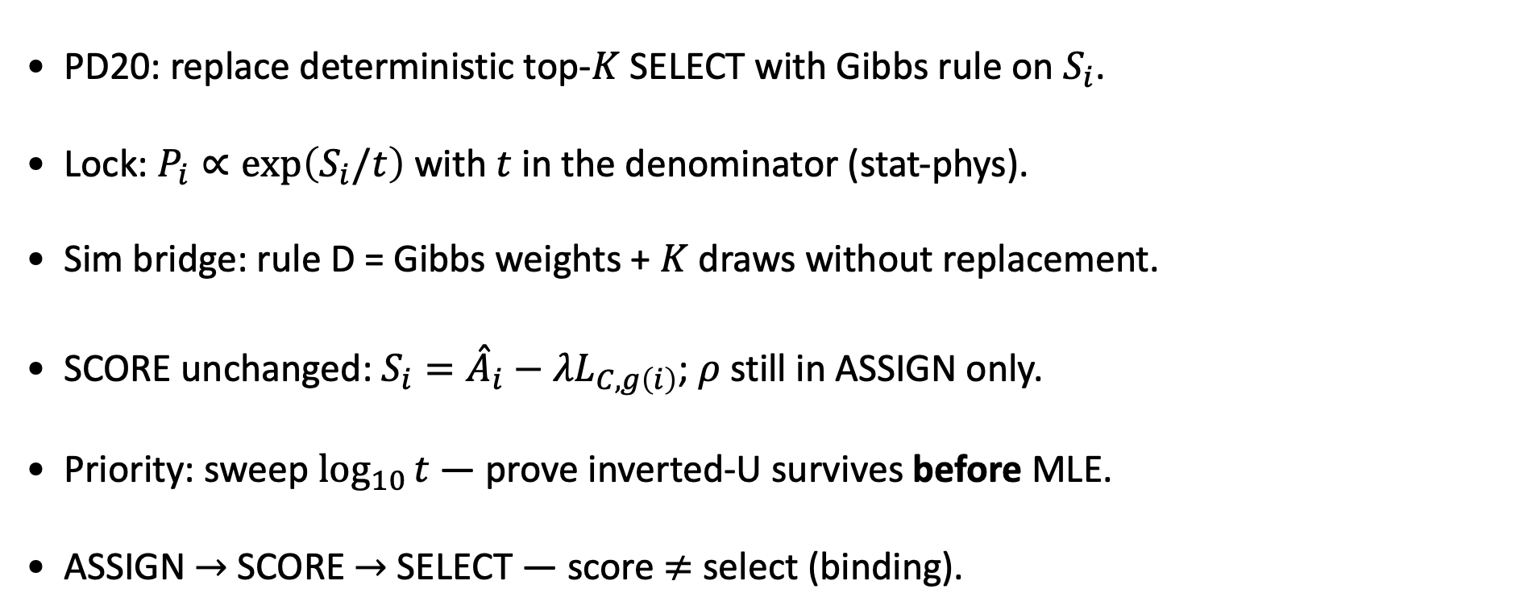
PD20 — Gibbs SELECT (temperature $t$)
MBB empirical caps · $ρ=0.5$ · inverted-U before MLE
PD20: replace deterministic top-$K$ SELECT with Gibbs rule on $S_{i}$.
Lock: $P_{i}∝\exp\left(S_{i}/t\right)$ with $t$ in the denominator (stat-phys).
Sim bridge: rule D = Gibbs weights + $K$ draws without replacement.
SCORE unchanged: $S_{i}={\overset{ˆ}{A}}_{i}−λL_{C,g\left(i\right)}$; $ρ$ still in ASSIGN only.
Priority: sweep $\log_{10}{t}$ — prove inverted-U survives before MLE.
ASSIGN $→$ SCORE $→$ SELECT — score $≠$ select (binding).
Goal: soft SELECT must not erase the phenomenological inverted-U on LOO pool quality.

Slide 3
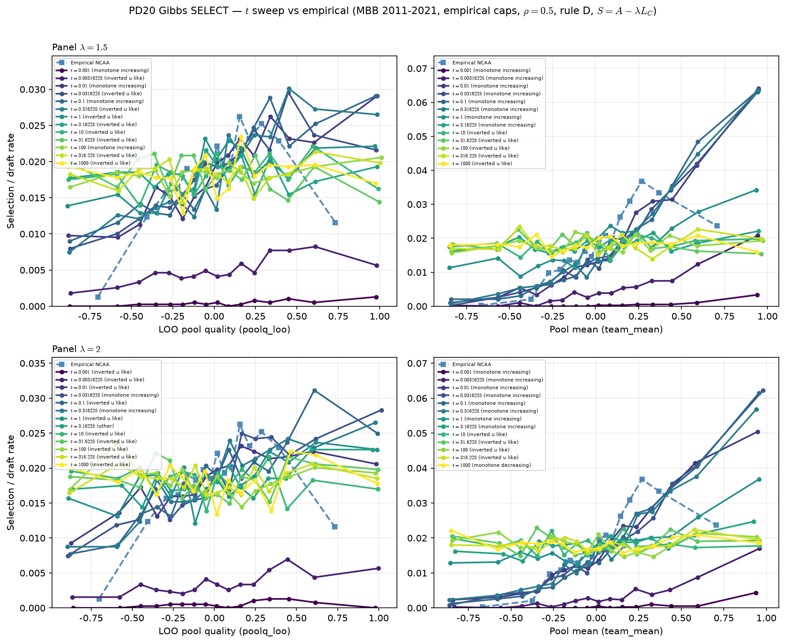


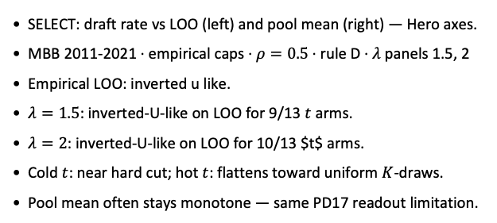
Temperature sweep — rule D (Gibbs + $K$ draws)
MBB 2011-2021 · $λ∈\left\{1.5,2\right\}$ · $\log_{10}{t}∈\left[−3,3\right]$
SELECT: draft rate vs LOO (left) and pool mean (right) — Hero axes.
MBB 2011-2021 · empirical caps · $ρ=0.5$ · rule D · $λ$ panels 1.5, 2
Empirical LOO: inverted u like.
$λ=1.5$: inverted-U-like on LOO for 9/13 $t$ arms.
$λ=2$: inverted-U-like on LOO for 10/13 $t$ arms.
Cold $t$: near hard cut; hot $t$: flattens toward uniform $K$-draws.
Pool mean often stays monotone — same PD17 readout limitation.
Talking point: check LOO panels at $λ=1.5$–$2$ — does a $t$ window preserve inverted-U vs empirical?

Slide 4
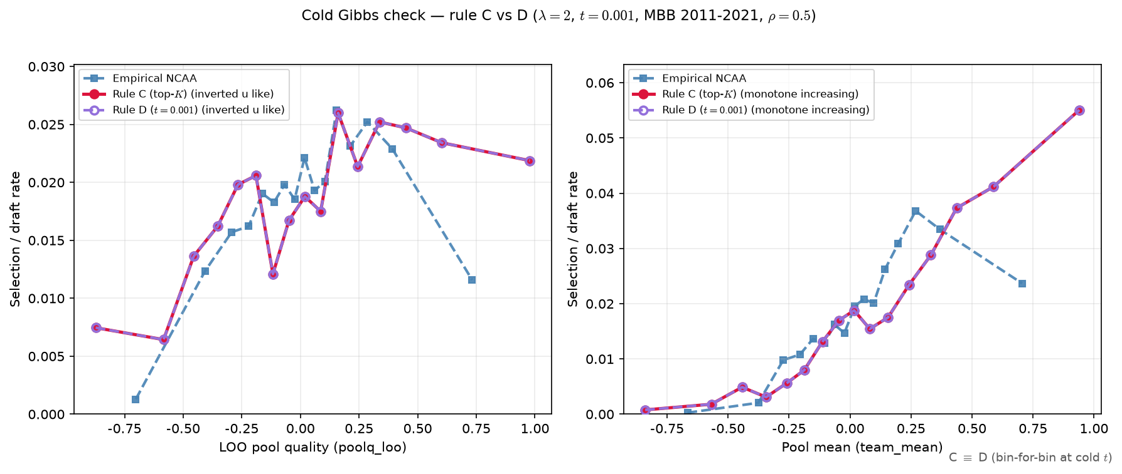

Cold limit — rule C vs rule D
$λ=2$ · $t=0.001$ · same seeds
Same ASSIGN seeds; only SELECT rule differs (C = top-$K$, D = cold Gibbs).
Fixed $λ=2$, $t=0.001$ ($\log_{10}{t}=−3$).
Max bin gap C vs D: LOO = 0.00e+00, pool mean = 0.00e+00.
LOO curvature: C = inverted u like; D = inverted u like.
Expect overlay coincidence at cold $t$ (Gibbs $→$ hard ranking).
Numerical match flag: True (gap $<{10}^{−9}$ on binned curves).
Talking point: rule D at cold $t$ reproduces rule C bin-for-bin — Gibbs SELECT nests the old top-$K$ limit.

Slide 5
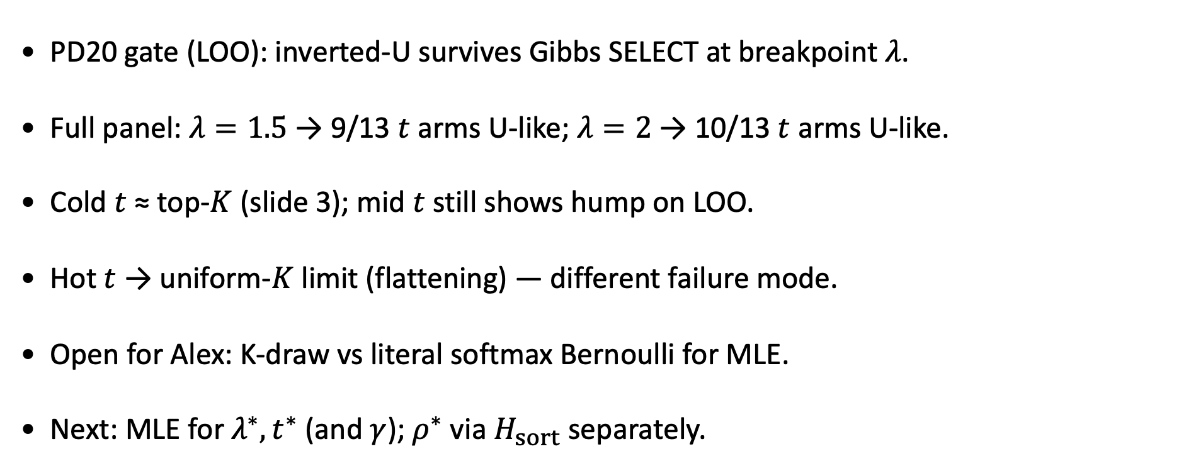
PD20 takeaways
MBB 2011-2021 · empirical caps · rule D
PD20 gate (LOO): inverted-U survives Gibbs SELECT at breakpoint $λ$.
Full panel: $λ=1.5$ → 9/13 $t$ arms U-like; $λ=2$ → 10/13 $t$ arms U-like.
Cold $t$ ≈ top-$K$ (slide 3); mid $t$ still shows hump on LOO.
Hot $t$ → uniform-$K$ limit (flattening) — different failure mode.
Open for Alex: K-draw vs literal softmax Bernoulli for MLE.
Next: MLE for $λ^{∗},t^{∗}$ (and $γ$); $ρ^{∗}$ via $H_{sort}$ separately.
PD20 step 4 cleared on LOO: proceed to MLE design once K-draw semantics are confirmed with Alex.

Slide 6
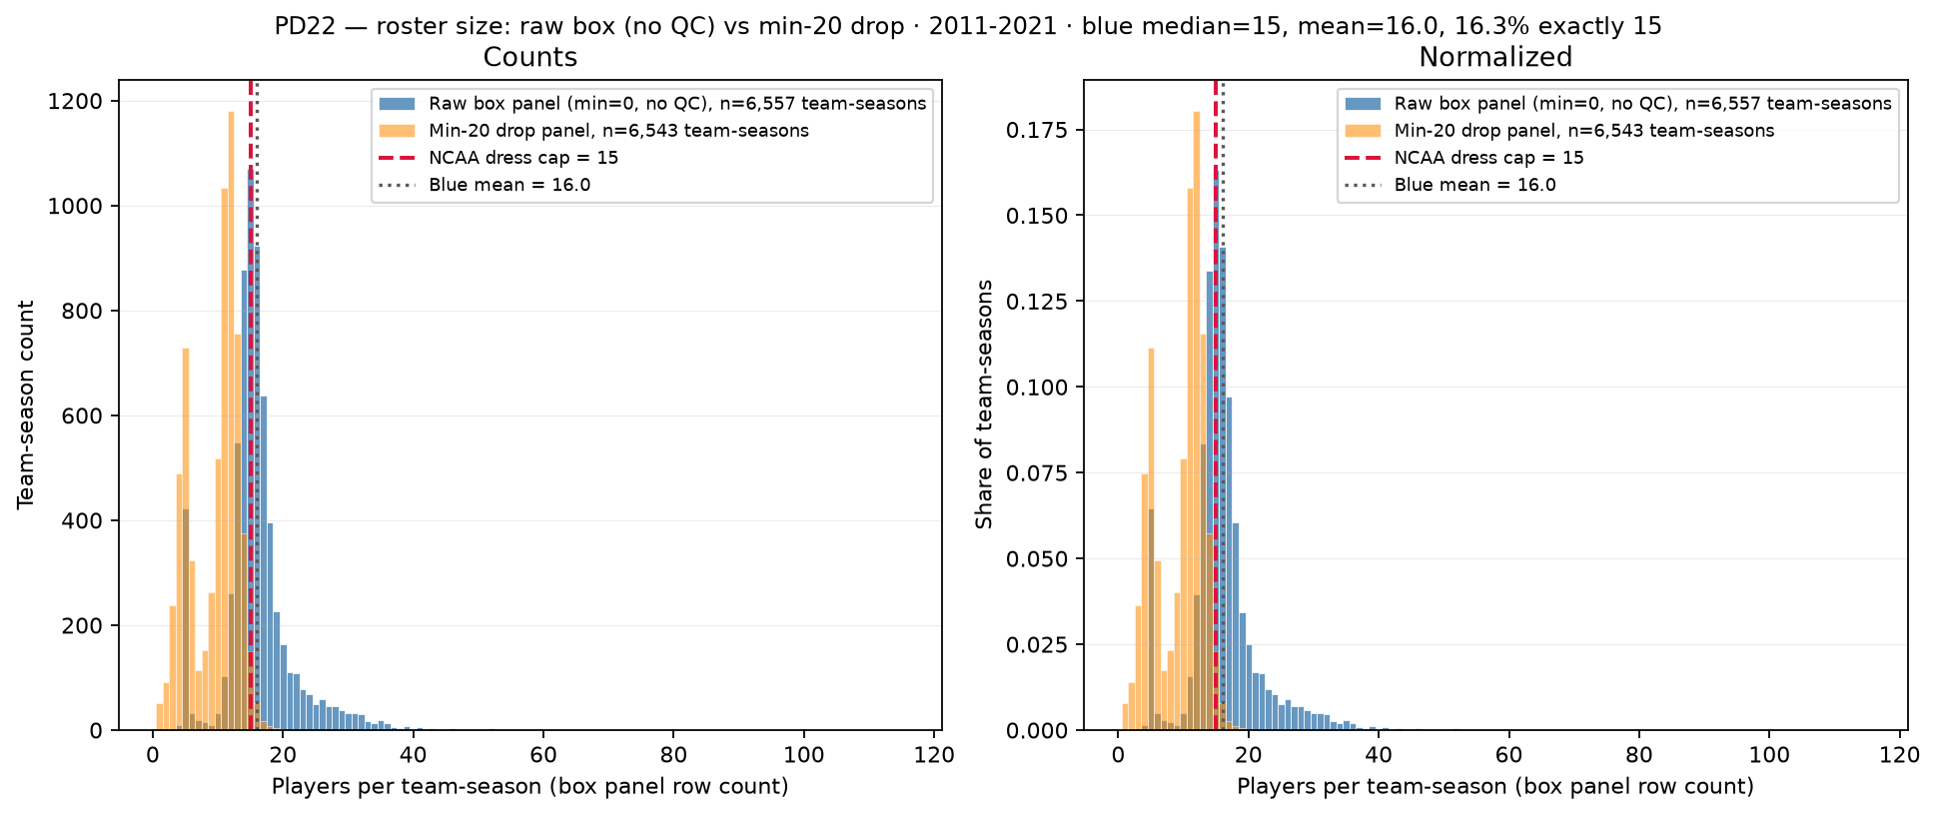
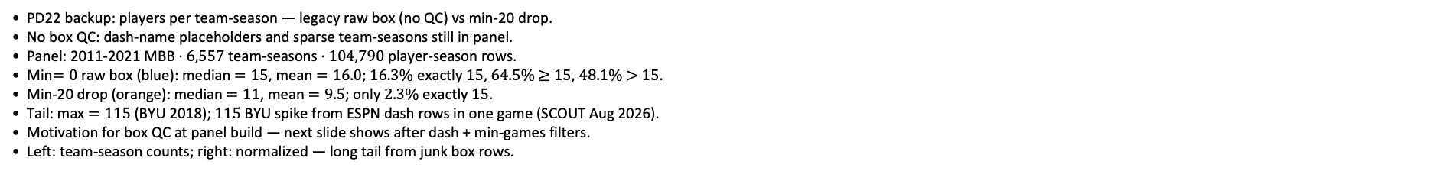
PD22 — Roster size: raw box (No QC) vs min-20 drop
PD22 · roster size (before QC) · 2011-2021 · raw median = $15$ · max $=115$
PD22 backup: players per team-season — legacy raw box (no QC) vs min-20 drop.
No box QC: dash-name placeholders and sparse team-seasons still in panel.
Panel: 2011-2021 MBB · $6,557$ team-seasons · $104,790$ player-season rows.
Min$=0$ raw box (blue): median $=15$, mean $=16.0$; $16.3\%$ exactly $15$, $64.5\%$ $≥$ $15$, $48.1\%$ $>$ $15$.
Min-20 drop (orange): median $=11$, mean $=9.5$; only $2.3\%$ exactly $15$.
Tail: max $=115$ (BYU 2018); $115$ BYU spike from ESPN dash rows in one game (SCOUT Aug 2026).
Motivation for box QC at panel build — next slide shows after dash + min-games filters.
Left: team-season counts; right: normalized — long tail from junk box rows.
Claim (PD22 backup): Raw ESPN box rows inflate team-season roster counts — dash placeholders and sparse junk games before panel QC at build.

Slide 7
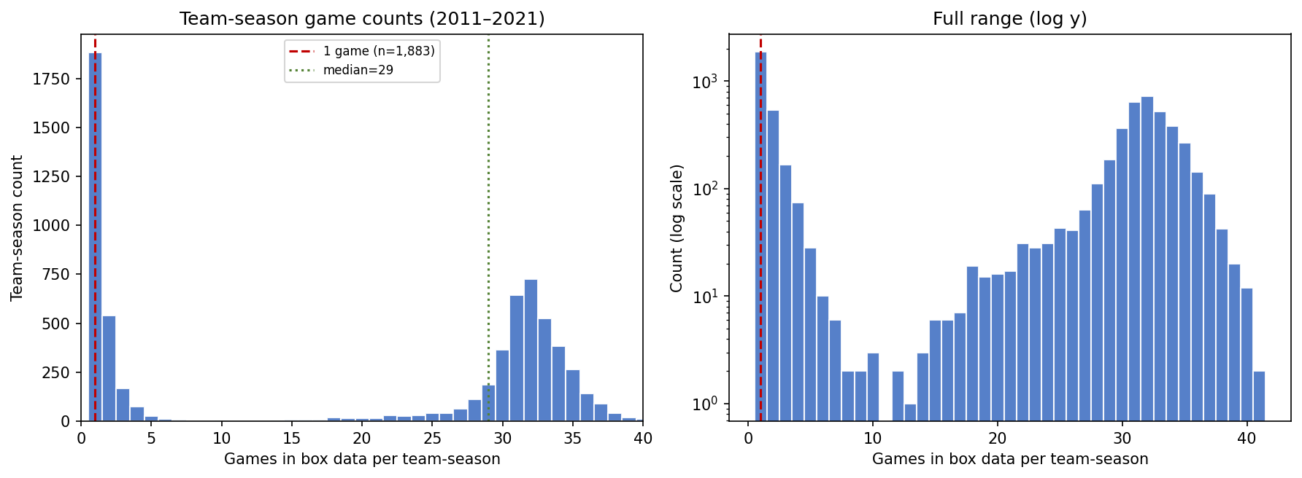
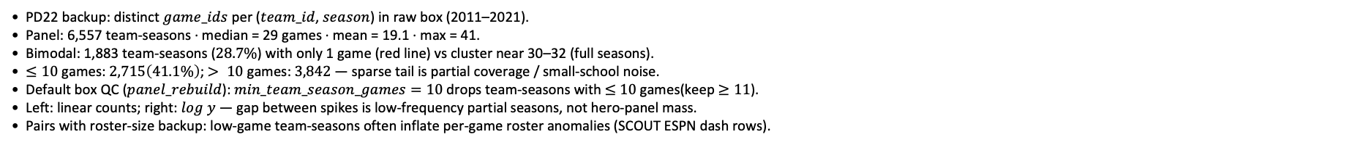
PD22 — Games per team-season in raw box data (before QC)
PD22 · team-season games · 2011–2021 · 1,883 with 1 game · median = 29
PD22 backup: distinct $game_ids$ per ($team_id$, $season$) in raw box (2011–2021).
Panel: 6,557 team-seasons · median = 29 games · mean = 19.1 · max = 41.
Bimodal: 1,883 team-seasons ($28.7\%$) with only 1 game (red line) vs cluster near 30–32 (full seasons).
$≤10$ games: $2,715\left(41.1\%\right)$; $> 10$ games: $3,842$ — sparse tail is partial coverage / small-school noise.
Default box QC ($panel_rebuild$): $min_team_season_games=10$ drops team-seasons with $≤$ $10$ games(keep $≥11$).
Left: linear counts; right: $log$ $y$ — gap between spikes is low-frequency partial seasons, not hero-panel mass.
Pairs with roster-size backup: low-game team-seasons often inflate per-game roster anomalies (SCOUT ESPN dash rows).
Claim (PD22 backup): Box panel mixes full D-I seasons ($∼30$ games) with sparse one-game team-seasons — default $min_team_season_games=10$ drops team-seasons with $≤10$ games (keep $≥11$) before player-season aggregation.

Slide 8
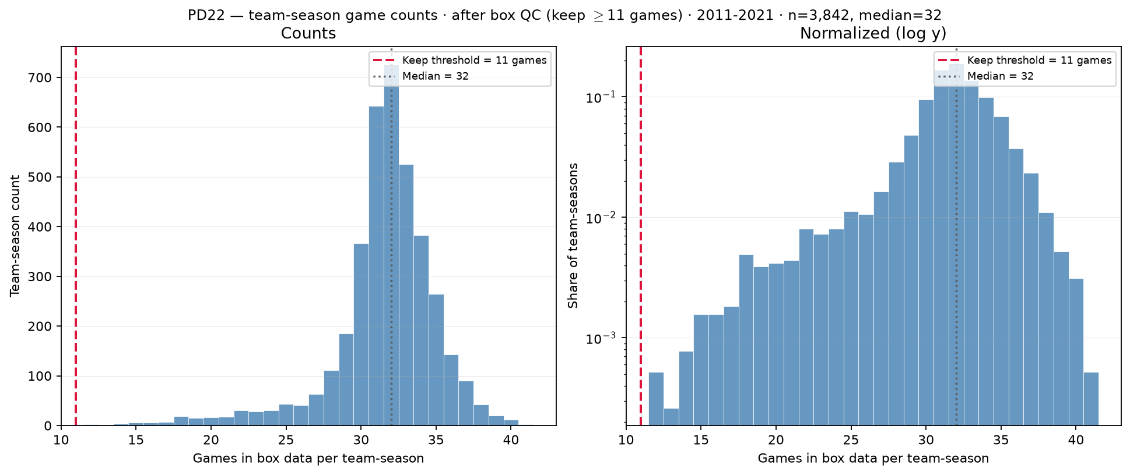
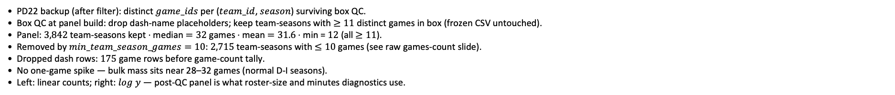
PD22 — Games per team-season after box QC
PD22 · games after box QC · 2011–2021 · $3,842$ team seasons · median $=32$ · min $≥11$
PD22 backup (after filter): distinct $game_ids$ per ($team_id$, $season$) surviving box QC.
Box QC at panel build: drop dash-name placeholders; keep team-seasons with $≥11$ distinct games in box (frozen CSV untouched).
Panel: $3,842$ team-seasons kept · median $=32$ games · mean $=31.6$ · min = $12$ (all $≥11$).
Removed by $min_team_season_games=10$: $2,715$ team-seasons with $≤10$ games (see raw games-count slide).
Dropped dash rows: $175$ game rows before game-count tally.
No one-game spike — bulk mass sits near 28–32 games (normal D-I seasons).
Left: linear counts; right: $log$ $y$ — post-QC panel is what roster-size and minutes diagnostics use.
Claim (PD22 backup): After box QC, team-season game counts are full-season D-I coverage ($≥11$ games) — low-game tail ($≤10$ games) removed before panel build.

Slide 9
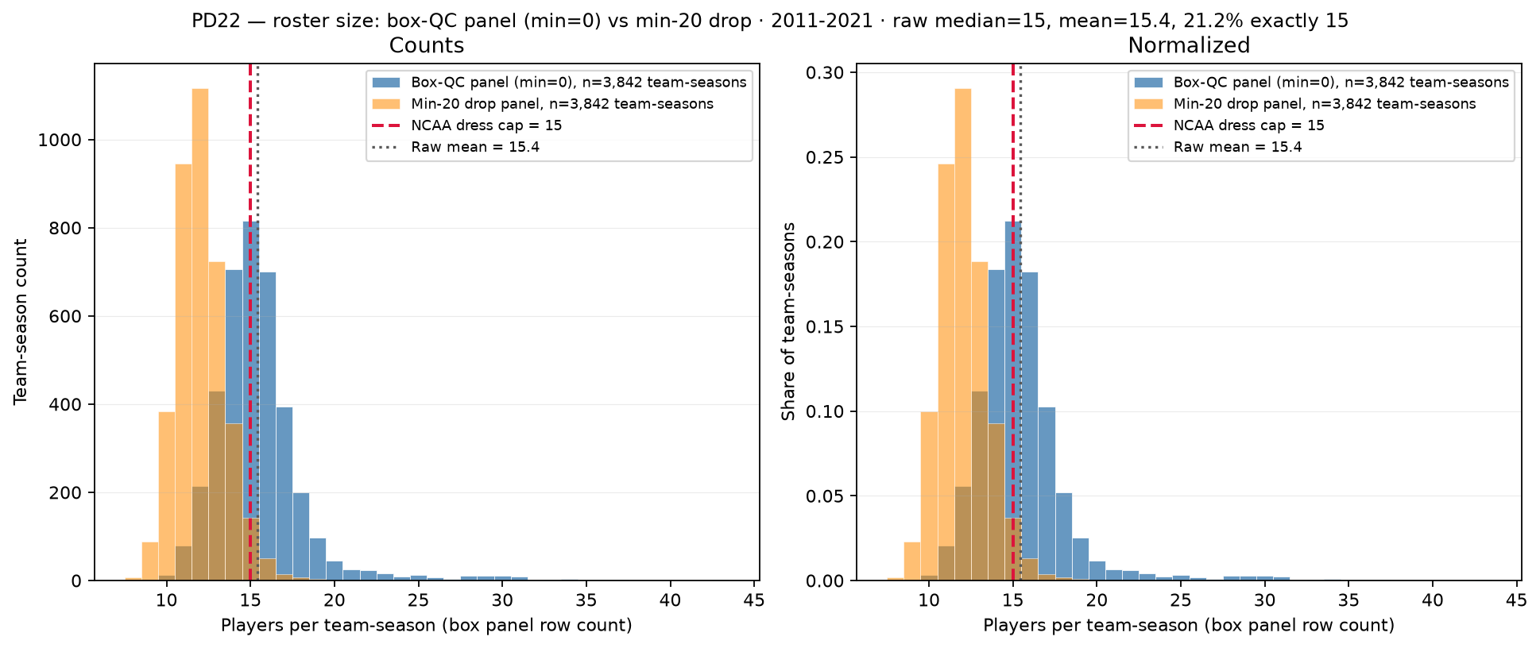
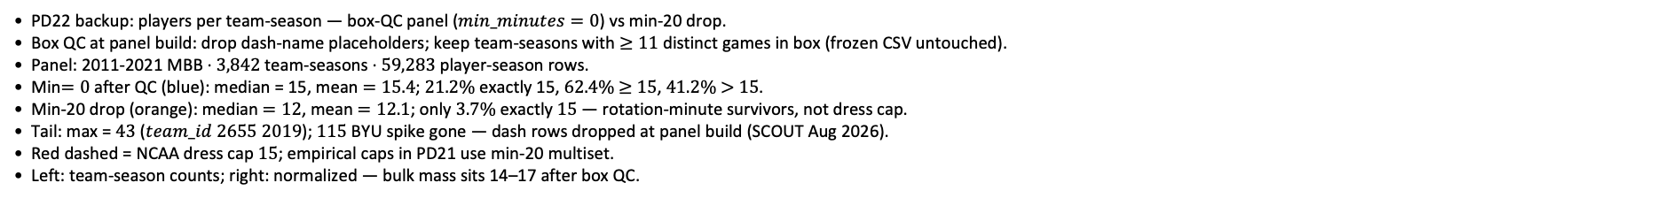
PD22 — Roster size: box-QC panel (min$=0$) vs min-20 drop
PD22 · roster size · 2011-2021 · raw median = $15$ · $21.2\%$ exactly $15$
PD22 backup: players per team-season — box-QC panel ($min_minutes=0$) vs min-20 drop.
Box QC at panel build: drop dash-name placeholders; keep team-seasons with $≥11$ distinct games in box (frozen CSV untouched).
Panel: 2011-2021 MBB · $3,842$ team-seasons · $59,283$ player-season rows.
Min$=0$ after QC (blue): median = 15, mean $=15.4$; $21.2\%$ exactly 15, $62.4\%$ $≥$ $15$, $41.2\%$ $>$ $15$.
Min-20 drop (orange): median $=12$, mean $=12.1$; only $3.7\%$ exactly $15$ — rotation-minute survivors, not dress cap.
Tail: max = $43$ ($team_id$ $2655$ $2019$); $115$ BYU spike gone — dash rows dropped at panel build (SCOUT Aug 2026).
Red dashed = NCAA dress cap $15$; empirical caps in PD21 use min-20 multiset.
Left: team-season counts; right: normalized — bulk mass sits 14–17 after box QC.
Claim (PD22 backup): After box QC, team-season roster counts cluster near NCAA dress cap $15$; empirical hero caps (min $≥$ $20$) count rotation-minute contributors — not game-day dress lists.

Slide 10
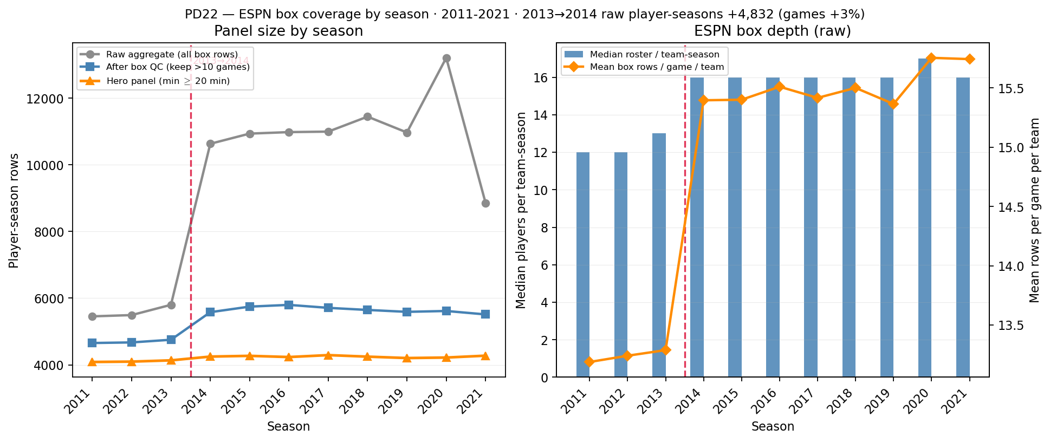
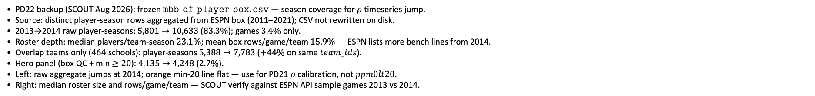
PD22 — ESPN box coverage by season (2013→2014 depth break)
PD22 · ESPN box coverage · 2011–2021 · 2013→2014 raw +$83.3\%$ · min-20 +$2.7\%$
PD22 backup (SCOUT Aug 2026): frozen $mbb_df_player_box.csv$ — season coverage for $ρ$ timeseries jump.
Source: distinct player-season rows aggregated from ESPN box (2011–2021); CSV not rewritten on disk.
2013→2014 raw player-seasons: $5,801→10,633$ ($83.3\%$); games $3.4\%$ only.
Roster depth: median players/team-season $23.1\%$; mean box rows/game/team $15.9\%$ — ESPN lists more bench lines from 2014.
Overlap teams only ($464$ schools): player-seasons $5,388→7,783$ ($+44\%$ on same $team_ids$).
Hero panel (box QC + min $≥20$): $4,135→4,248$ ($2.7\%$).
Left: raw aggregate jumps at 2014; orange min-20 line flat — use for PD21 $ρ$ calibration, not $ppm0lt20$.
Right: median roster size and rows/game/team — SCOUT verify against ESPN API sample games 2013 vs 2014.
Claim (PD22 backup): 2013→2014 jump in raw player-season counts is ESPN box depth (more players listed per game), not doubled games — hero min-20 panel is longitudinal-safe for $ρ$ / $H_{sort}$.

Slide 11
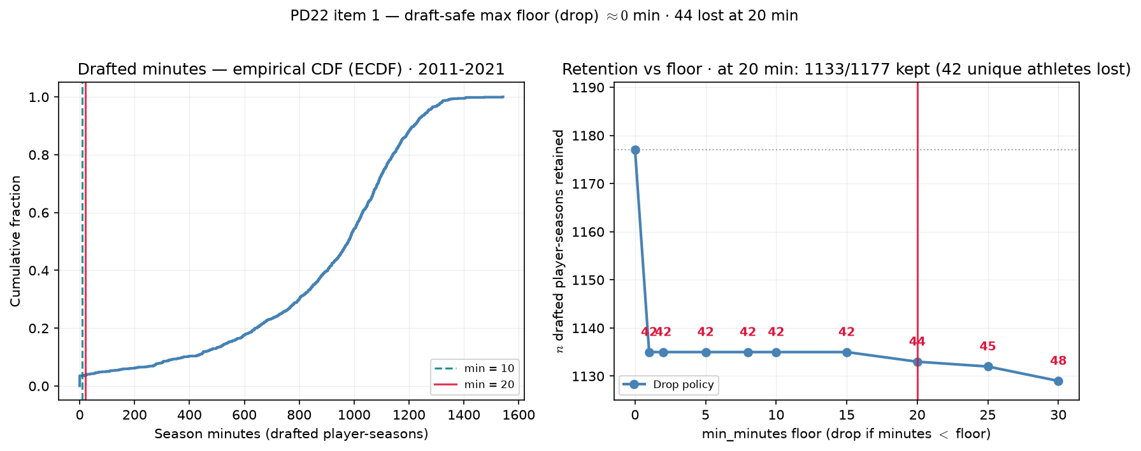
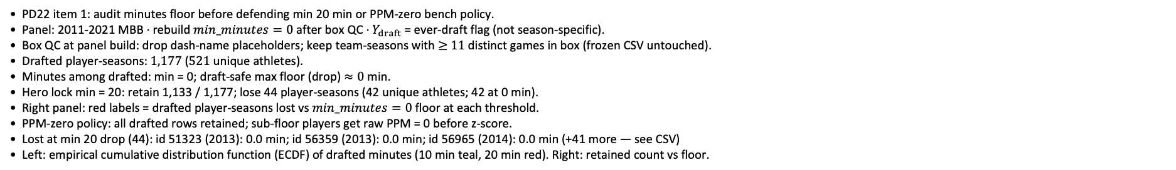
PD22 — Drafted-player retention vs playing-time floor
PD22 · drafted retention audit · 2011-2021 · at min 20 drop: 1133/1177 drafted player-seasons kept
PD22 item 1: audit minutes floor before defending min 20 min or PPM-zero bench policy.
Panel: 2011-2021 MBB · rebuild $min_minutes=0$ after box QC · $Y_{draft}$ = ever-draft flag (not season-specific).
Box QC at panel build: drop dash-name placeholders; keep team-seasons with $≥$ $11$ distinct games in box (frozen CSV untouched).
Drafted player-seasons: $1,177$ ($521$ unique athletes).
Minutes among drafted: min = 0; draft-safe max floor (drop) $≈0$ min.
Hero lock min = 20: retain 1,133 / 1,177; lose 44 player-seasons (42 unique athletes; 42 at 0 min).
Right panel: red labels = drafted player-seasons lost vs $min_minutes=0$ floor at each threshold.
PPM-zero policy: all drafted rows retained; sub-floor players get raw PPM = 0 before z-score.
Lost at min 20 drop (44): id 51323 (2013): 0.0 min; id 56359 (2013): 0.0 min; id 56965 (2014): 0.0 min (+41 more — see CSV)
Left: empirical cumulative distribution function (ECDF) of drafted minutes (10 min teal, 20 min red). Right: retained count vs floor.
Claim (PD22): Playing-time floor must be draft-safe — retain every ever-draft ($Y_{draft}=1$) player-season before we justify min 20 min or PPM-zero bench policy for $ρ$ / $H_{sort}$ calibration.

Slide 12
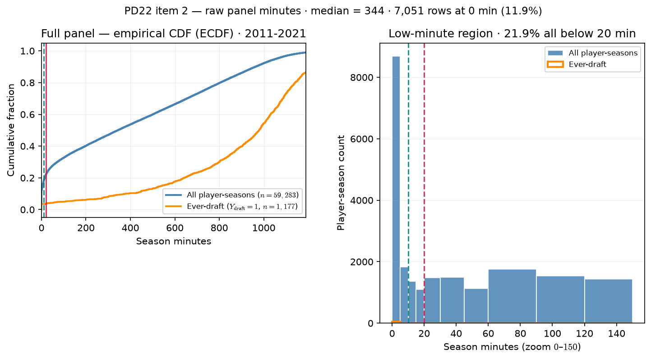
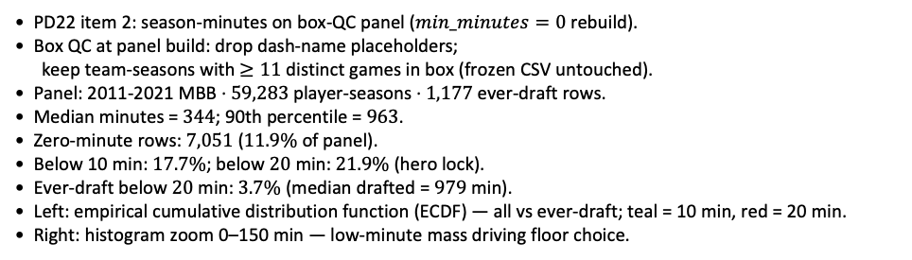
PD22 — Raw panel season-minutes distribution
PD22 · raw panel minutes · 2011-2021 · median = 344 min · $21.9\%$ below 20 min
PD22 item 2: season-minutes on box-QC panel ($min_minutes=0$ rebuild).
Box QC at panel build: drop dash-name placeholders;
keep team-seasons with $≥11$ distinct games in box (frozen CSV untouched).
Panel: 2011-2021 MBB · $59,283$ player-seasons · $1,177$ ever-draft rows.
Median minutes = $344$; 90th percentile = $963$.
Zero-minute rows: $7,051$ ($11.9\%$ of panel).
Below 10 min: $17.7\%$; below $20$ min: $21.9\%$ (hero lock).
Ever-draft below $20$ min: $3.7\%$ (median drafted = $979$ min).
Left: empirical cumulative distribution function (ECDF) — all vs ever-draft; teal = 10 min, red = 20 min.
Right: histogram zoom 0–150 min — low-minute mass driving floor choice.
Claim (PD22): Minutes floor must be grounded in the raw roster distribution — not an arbitrary cut — before we defend min 20 min for $ρ$/ ASSIGN panels.

Slide 13
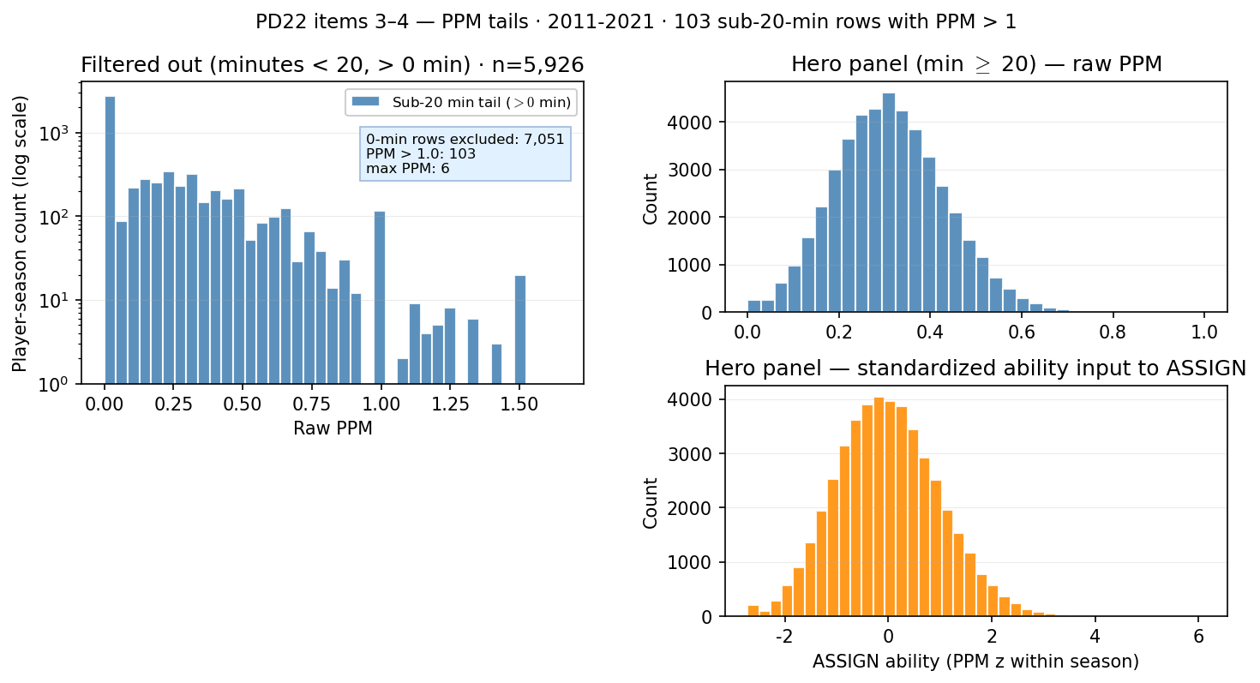
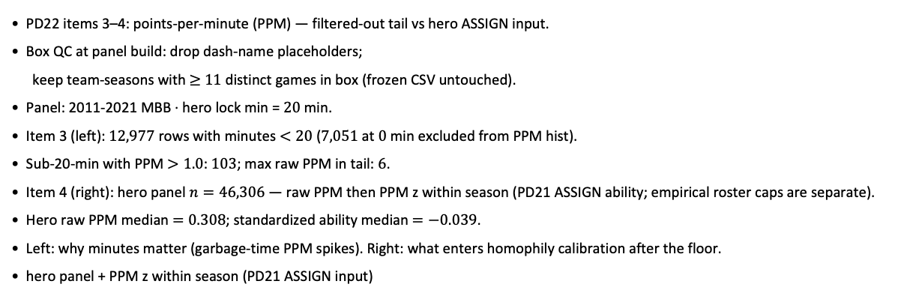
PD22 — PPM distribution: filtered-out tail vs hero ASSIGN input
PD22 · PPM tails · 2011-2021 · $103$ sub-20-min rows with PPM > 1
PD22 items 3–4: points-per-minute (PPM) — filtered-out tail vs hero ASSIGN input.
Box QC at panel build: drop dash-name placeholders;
keep team-seasons with $≥$ $11$ distinct games in box (frozen CSV untouched).
Panel: 2011-2021 MBB · hero lock min = $20$ min.
Item 3 (left): $12,977$ rows with minutes $<20$ ($7,051$ at $0$ min excluded from PPM hist).
Sub-20-min with PPM $>1.0$: $103$; max raw PPM in tail: $6$.
Item 4 (right): hero panel $n=46,306$ — raw PPM then PPM z within season (PD21 ASSIGN ability; empirical roster caps are separate).
Hero raw PPM median $=0.308$; standardized ability median $=−0.039$.
Left: why minutes matter (garbage-time PPM spikes). Right: what enters homophily calibration after the floor.
hero panel + PPM z within season (PD21 ASSIGN input)
Claim: Minutes floor guards against noisy PPM tails — sub-20-min rows include extreme points-per-minute spikes; hero ASSIGN uses PPM z-scored within season on the min-20 panel.

Slide 14
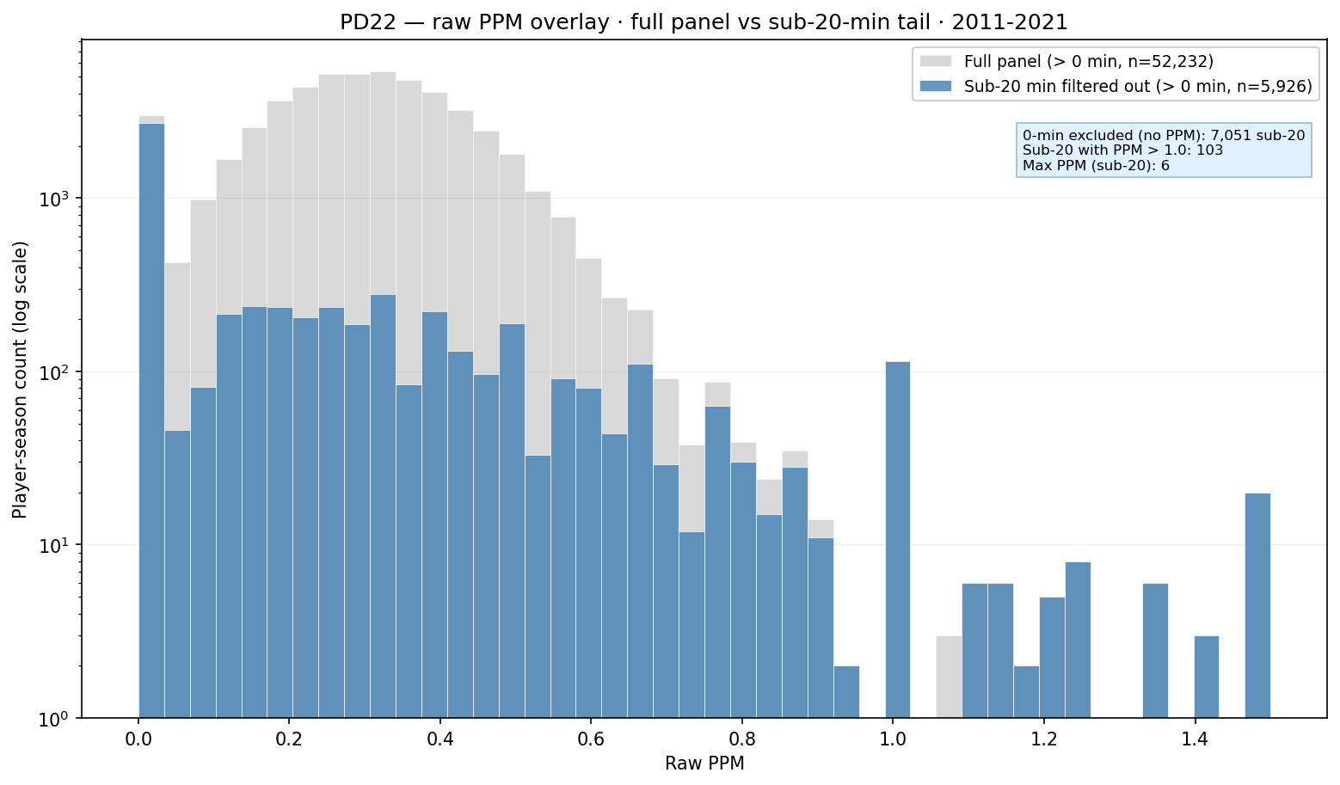
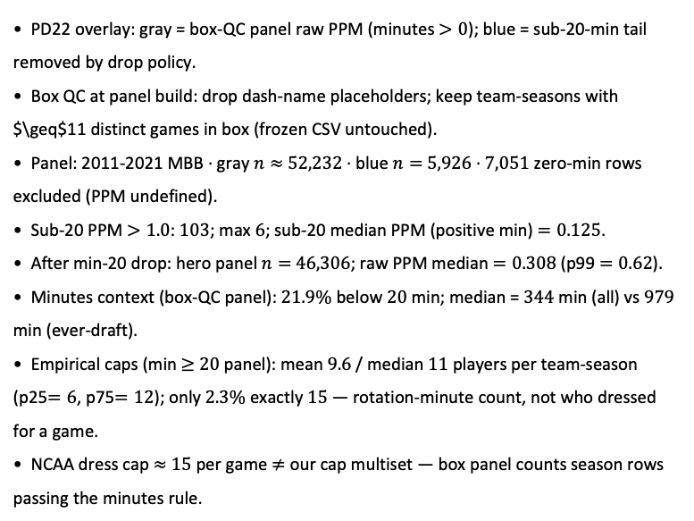
PD22 — Raw PPM: full panel vs sub-20-min filtered tail
PD22 · PPM overlay · 2011-2021 · 103 sub-20-min rows with PPM $>1$
PD22 overlay: gray = box-QC panel raw PPM (minutes $>0$); blue = sub-20-min tail removed by drop policy.
Box QC at panel build: drop dash-name placeholders; keep team-seasons with $\geq$11 distinct games in box (frozen CSV untouched).
Panel: 2011-2021 MBB · gray $n≈$ $52,232$ · blue $n=$ $5,926$ · $7,051$ zero-min rows excluded (PPM undefined).
Sub-20 PPM $>1.0$: $103$; max $6$; sub-20 median PPM (positive min) $=0.125$.
After min-20 drop: hero panel $n=$ $46,306$; raw PPM median $=0.308$ (p99 $=0.62$).
Minutes context (box-QC panel): $21.9\%$ below $20$ min; median = $344$ min (all) vs $979$ min (ever-draft).
Empirical caps (min $≥$ $20$ panel): mean $9.6$ / median $11$ players per team-season (p25$=6$, p75$=12$); only $2.3\%$ exactly $15$ — rotation-minute count, not who dressed for a game.
NCAA dress cap $≈$ $15$ per game $≠$ our cap multiset — box panel counts season rows passing the minutes rule.
Claim (PD22): Sub-20-min rows add PPM noise (103 with PPM $>1$, max 6) on top of a rotation-player cloud — minutes floor cleans ability before hero / ASSIGN; empirical roster caps count season contributors, not NCAA dress-out 15.

Slide 15
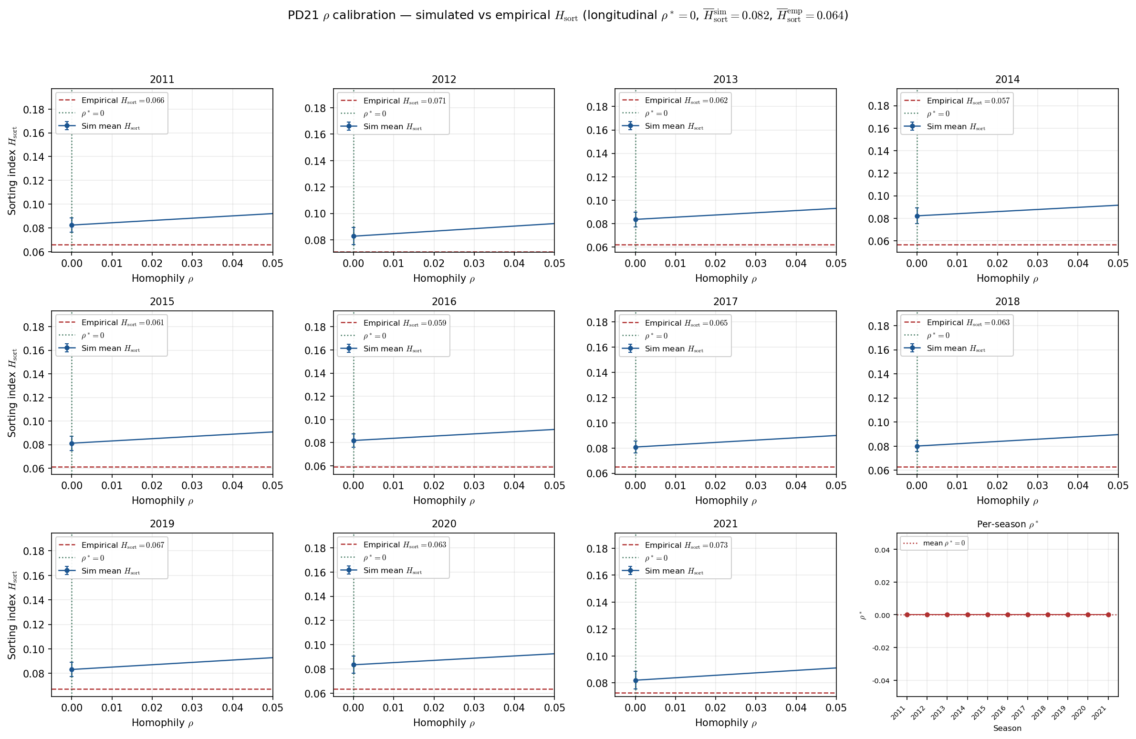
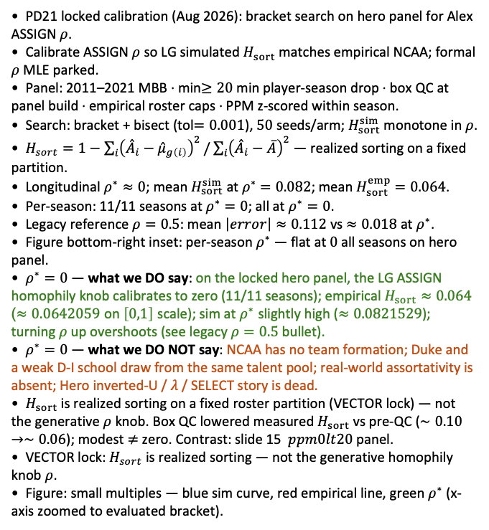
PD21 — Calibrate homophily $ρ$ to empirical sorting index $H_{sort}$ (hero panel — locked calibration)
PD21 · LG ASSIGN calibration · 2011-2021 · $50$ seeds · bracket tol$=0.001$ · longitudinal $ρ^{∗}≈0$ · hero panel
PD21 locked calibration (Aug 2026): bracket search on hero panel for Alex ASSIGN $ρ$.
Calibrate ASSIGN $ρ$ so LG simulated $H_{sort}$ matches empirical NCAA; formal $ρ$ MLE parked.
Panel: 2011–2021 MBB · min$≥20$ min player-season drop · box QC at panel build · empirical roster caps · PPM z-scored within season.
Search: bracket + bisect (tol$=0.001$), $50$ seeds/arm; $H_{sort}^{sim}$ monotone in $ρ$.
$H_{sort}=1−\sum_{i}{{\left({\overset{ˆ}{A}}_{i}−{\overset{ˆ}{μ}}_{g\left(i\right)}\right)}^{2}}/\sum_{i}{{\left({\overset{ˆ}{A}}_{i}−\overline{A}\right)}^{2}}$ — realized sorting on a fixed partition.
Longitudinal $ρ^{∗}≈0$; mean $H_{sort}^{sim}$ at $ρ^{∗}$ $=0.082$; mean $H_{sort}^{emp}$ $=0.064$.
Per-season: 11/11 seasons at $ρ^{∗}=0$; all at $ρ^{∗}=0$.
Legacy reference $ρ=0.5$: mean $\left|error\right|≈0.112$ vs $≈0.018$ at $ρ^{∗}$.
Figure bottom-right inset: per-season $ρ^{∗}$ — flat at $0$ all seasons on hero panel.
$ρ^{∗}=0$ — what we DO say: on the locked hero panel, the LG ASSIGN homophily knob calibrates to zero (11/11 seasons); empirical $H_{sort}≈0.064$ ($≈0.0642059$ on $\left[0,1\right]$ scale); sim at $ρ^{∗}$ slightly high ($≈0.0821529$); turning $ρ$ up overshoots (see legacy $ρ=0.5$ bullet).
$ρ^{∗}=0$ — what we DO NOT say: NCAA has no team formation; Duke and a weak D-I school draw from the same talent pool; real-world assortativity is absent; Hero inverted-U / $λ$ / SELECT story is dead.
$H_{sort}$ is realized sorting on a fixed roster partition (VECTOR lock) — not the generative $ρ$ knob. Box QC lowered measured $H_{sort}$ vs pre-QC ($∼0.10→∼0.06$); modest $≠$ zero. Contrast: slide 15 $ppm0lt20$ panel.
VECTOR lock: $H_{sort}$ is realized sorting — not the generative homophily knob $ρ$.
Figure: small multiples — blue sim curve, red empirical line, green $ρ^{∗}$ (x-axis zoomed to evaluated bracket).
Claim: Hero panel — LG ASSIGN $ρ^{∗}=0$ matches modest empirical $H_{sort}≈0.064$; legacy $ρ=0.5$ overshoots ($0.11$ mean $\left|error\right|$). Model–measurement fit on this panel — not a claim that NCAA rosters are random.

Slide 16
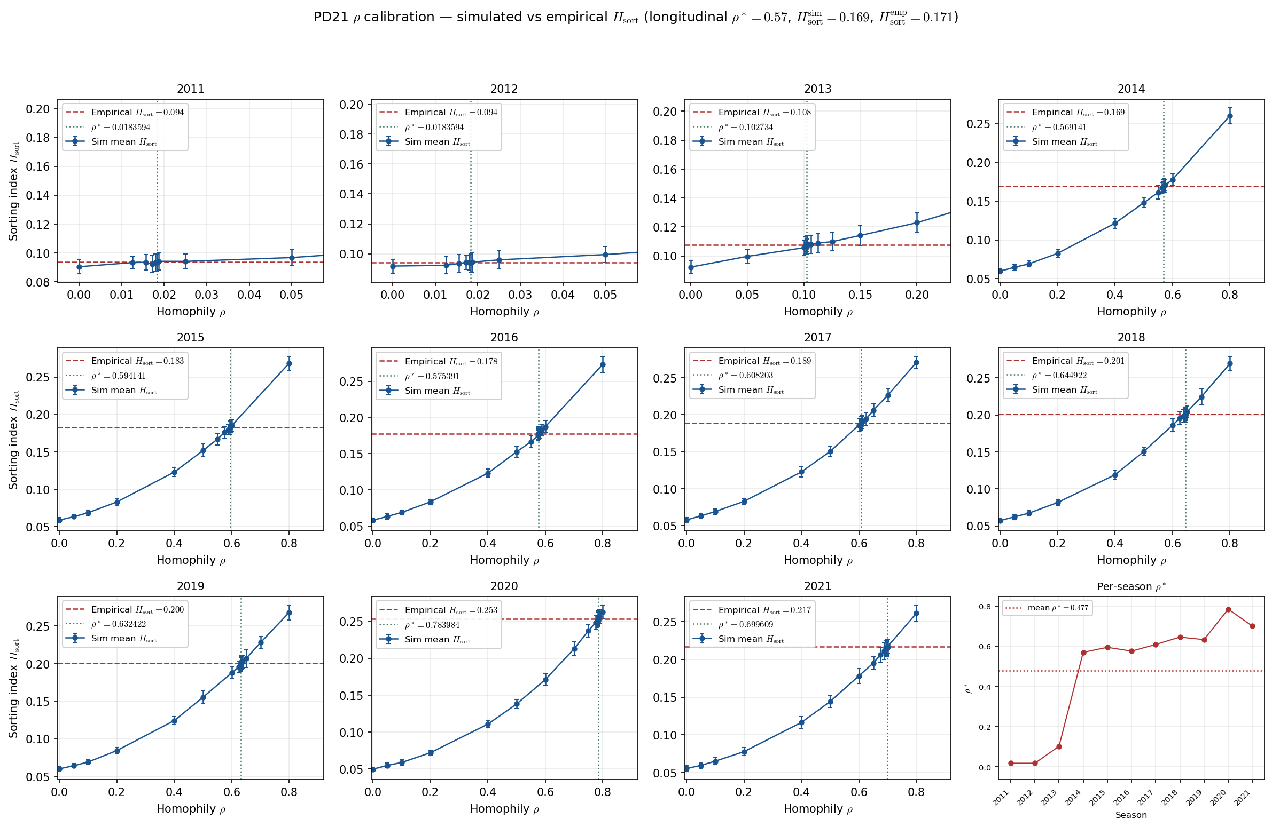
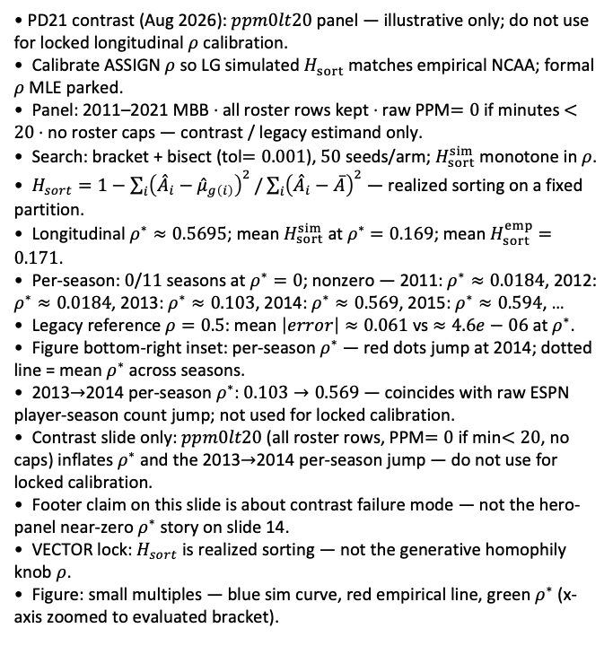
PD21 — Calibrate homophily $ρ$ to empirical sorting index $H_{sort}$ (contrast: $ppm0lt20$ — not for calibration)
PD21 · LG ASSIGN calibration · 2011-2021 · $50$ seeds · bracket tol$=0.001$ · longitudinal $ρ^{∗}≈0.57$ · contrast $ppm0lt20$
PD21 contrast (Aug 2026): $ppm0lt20$ panel — illustrative only; do not use for locked longitudinal $ρ$ calibration.
Calibrate ASSIGN $ρ$ so LG simulated $H_{sort}$ matches empirical NCAA; formal $ρ$ MLE parked.
Panel: 2011–2021 MBB · all roster rows kept · raw PPM$=0$ if minutes $<20$ · no roster caps — contrast / legacy estimand only.
Search: bracket + bisect (tol$=0.001$), $50$ seeds/arm; $H_{sort}^{sim}$ monotone in $ρ$.
$H_{sort}=1−\sum_{i}{{\left({\overset{ˆ}{A}}_{i}−{\overset{ˆ}{μ}}_{g\left(i\right)}\right)}^{2}}/\sum_{i}{{\left({\overset{ˆ}{A}}_{i}−\overline{A}\right)}^{2}}$ — realized sorting on a fixed partition.
Longitudinal $ρ^{∗}≈0.5695$; mean $H_{sort}^{sim}$ at $ρ^{∗}$ $=0.169$; mean $H_{sort}^{emp}$ $=0.171$.
Per-season: $0$/$11$ seasons at $ρ^{∗}=0$; nonzero — 2011: $ρ^{∗}≈0.0184$, 2012: $ρ^{∗}≈0.0184$, 2013: $ρ^{∗}≈0.103$, 2014: $ρ^{∗}≈0.569$, 2015: $ρ^{∗}≈0.594$, …
Legacy reference $ρ=0.5$: mean $\left|error\right|≈0.061$ vs $≈4.6e−06$ at $ρ^{∗}$.
Figure bottom-right inset: per-season $ρ^{∗}$ — red dots jump at 2014; dotted line = mean $ρ^{∗}$ across seasons.
2013$→$2014 per-season $ρ^{∗}$: $0.103→0.569$ — coincides with raw ESPN player-season count jump; not used for locked calibration.
Contrast slide only: $ppm0lt20$ (all roster rows, PPM$=0$ if min$<20$, no caps) inflates $ρ^{∗}$ and the 2013$→$2014 per-season jump — do not use for locked calibration.
Footer claim on this slide is about contrast failure mode — not the hero-panel near-zero $ρ^{∗}$ story on slide 14.
VECTOR lock: $H_{sort}$ is realized sorting — not the generative homophily knob $ρ$.
Figure: small multiples — blue sim curve, red empirical line, green $ρ^{∗}$ (x-axis zoomed to evaluated bracket).
Claim (PD21 contrast): $ppm0lt20$ inflates longitudinal $ρ^{∗}≈0.57$ — not the hero estimand; 2013$→$2014 per-season jump traces ESPN box-depth break (PD22 ESPN coverage backup slide).

Slide 17
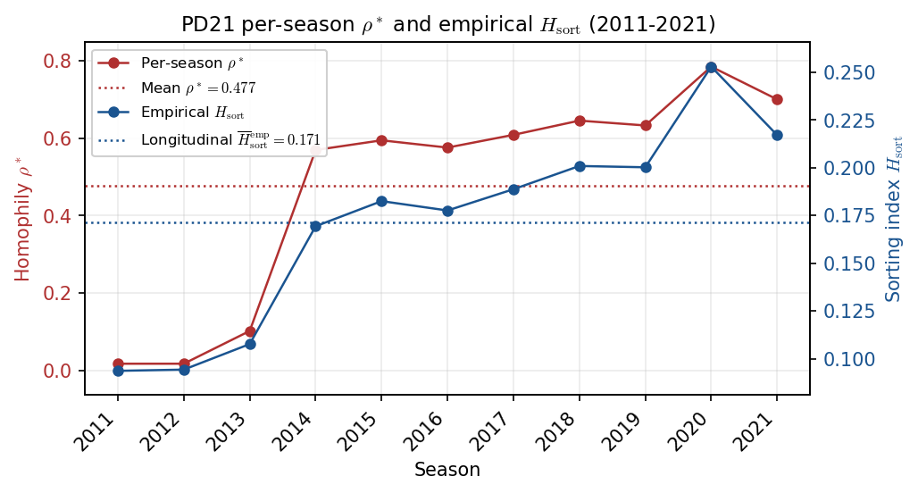
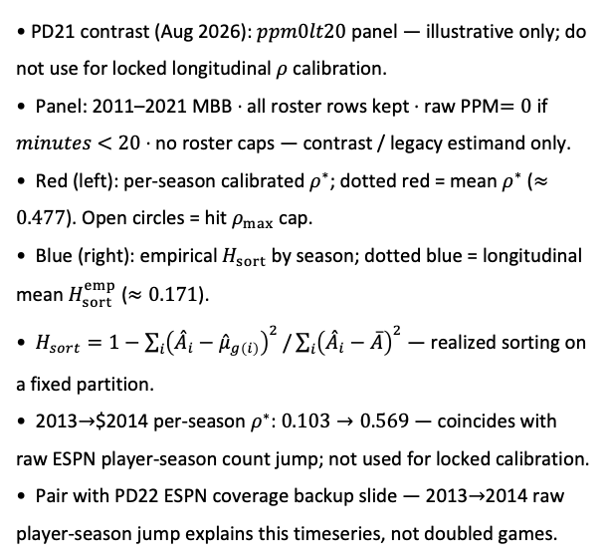
PD21 — Per-season $ρ^{∗}$ and empirical $H_{sort}$ (contrast: $ppm0lt20$ — not for calibration)
PD21 · per-season $ρ^{∗}$ vs empirical $H_{sort}$ · 2011-2021 · contrast $ppm0lt20$
PD21 contrast (Aug 2026): $ppm0lt20$ panel — illustrative only; do not use for locked longitudinal $ρ$ calibration.
Panel: 2011–2021 MBB · all roster rows kept · raw PPM$=0$ if $minutes$ $<20$ · no roster caps — contrast / legacy estimand only.
Red (left): per-season calibrated $ρ^{∗}$; dotted red = mean $ρ^{∗}$ ($≈0.477$). Open circles = hit $ρ_{max}$ cap.
Blue (right): empirical $H_{sort}$ by season; dotted blue = longitudinal mean $H_{sort}^{emp}$ ($≈0.171$).
$H_{sort}=1−\sum_{i}{{\left({\overset{ˆ}{A}}_{i}−{\overset{ˆ}{μ}}_{g\left(i\right)}\right)}^{2}}/\sum_{i}{{\left({\overset{ˆ}{A}}_{i}−\overline{A}\right)}^{2}}$ — realized sorting on a fixed partition.
2013$→$$2014 per-season $ρ^{∗}$: $0.103→0.569$ — coincides with raw ESPN player-season count jump; not used for locked calibration.
Pair with PD22 ESPN coverage backup slide — 2013$→$2014 raw player-season jump explains this timeseries, not doubled games.
Claim (PD21 contrast): 2013$→$2014 jump in per-season $ρ^{∗}$ on $ppm0lt20$ is ESPN roster-depth artifact — hero min-$20$ panel gives flat $ρ^{∗}$; see PD22 ESPN coverage backup.

Slide 18
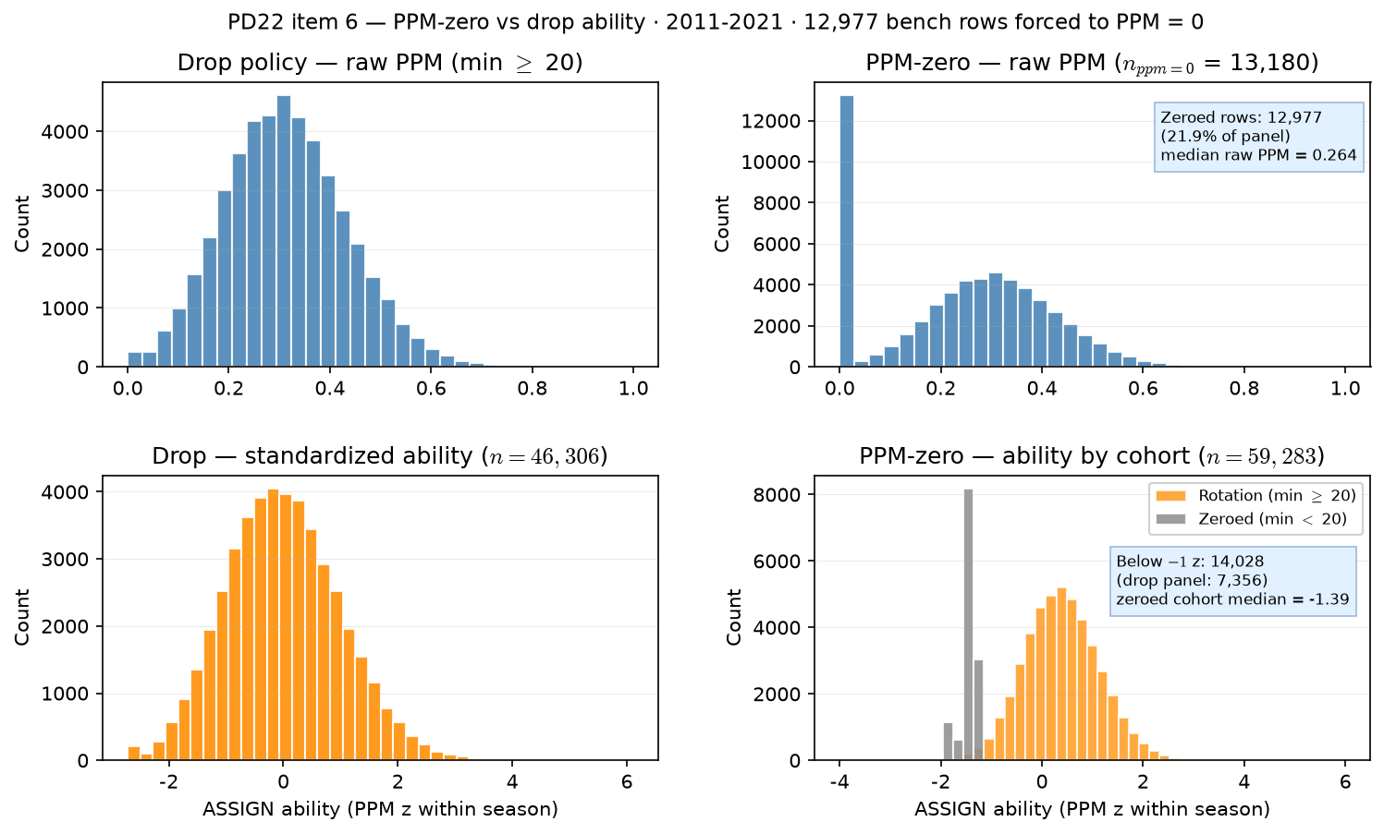
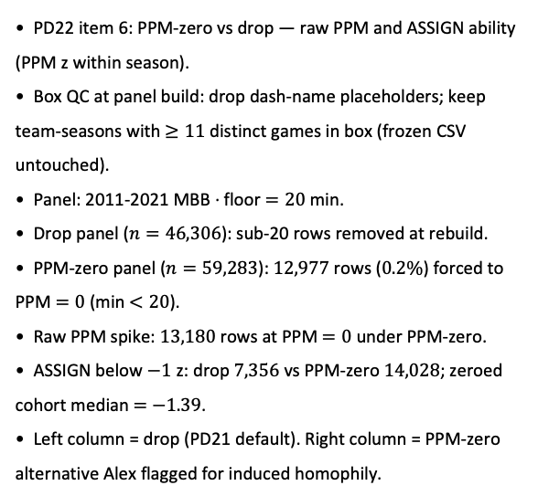
PD22 — ability under PPM-zero vs drop policy
PD22 item 6 · PPM-zero vs drop · 2011-2021 · $12,977$ bench rows at PPM $=0$
PD22 item 6: PPM-zero vs drop — raw PPM and ASSIGN ability (PPM z within season).
Box QC at panel build: drop dash-name placeholders; keep team-seasons with $≥11$ distinct games in box (frozen CSV untouched).
Panel: 2011-2021 MBB · floor $=20$ min.
Drop panel ($n=46,306$): sub-20 rows removed at rebuild.
PPM-zero panel ($n=59,283$): $12,977$ rows ($0.2\%$) forced to PPM $=0$ (min $<20$).
Raw PPM spike: $13,180$ rows at PPM $=0$ under PPM-zero.
ASSIGN below $−1$ z: drop $7,356$ vs PPM-zero $14,028$; zeroed cohort median $=$ $−1.39$.
Left column = drop (PD21 default). Right column = PPM-zero alternative Alex flagged for induced homophily.
Claim (PD22): PPM-zero keeps bench players on roster at forced PPM = 0 — expect a zero-heavy ability distribution vs the min-20 drop panel; may inflate homophily if identical zeros cluster on teams.

Slide 19
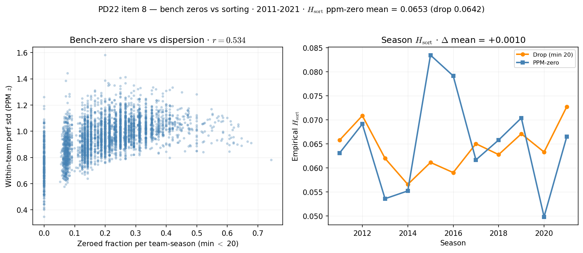
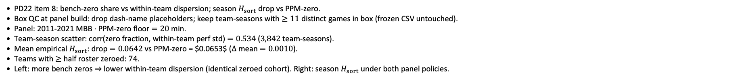
PD22 — bench-zero clustering vs empirical sorting
PD22 item 8 · bench zeros vs $H_{sort}$ · 2011-2021 · $Δ$ mean = $0.0010$
PD22 item 8: bench-zero share vs within-team dispersion; season $H_{sort}$ drop vs PPM-zero.
Box QC at panel build: drop dash-name placeholders; keep team-seasons with $≥11$ distinct games in box (frozen CSV untouched).
Panel: 2011-2021 MBB · PPM-zero floor $=20$ min.
Team-season scatter: corr(zero fraction, within-team perf std) $=0.534$ ($3,842$ team-seasons).
Mean empirical $H_{sort}$: drop $=0.0642$ vs PPM-zero = $0.0653$ ($Δ$ mean $=0.0010$).
Teams with $≥$ half roster zeroed: $74$.
Left: more bench zeros $⇒$ lower within-team dispersion (identical zeroed cohort). Right: season $H_{sort}$ under both panel policies.
Claim (PD22): PPM-zero piles identical bench abilities on rosters — check whether that mechanically inflates empirical $H_{sort}$ vs drop-at-20.

Slide 20
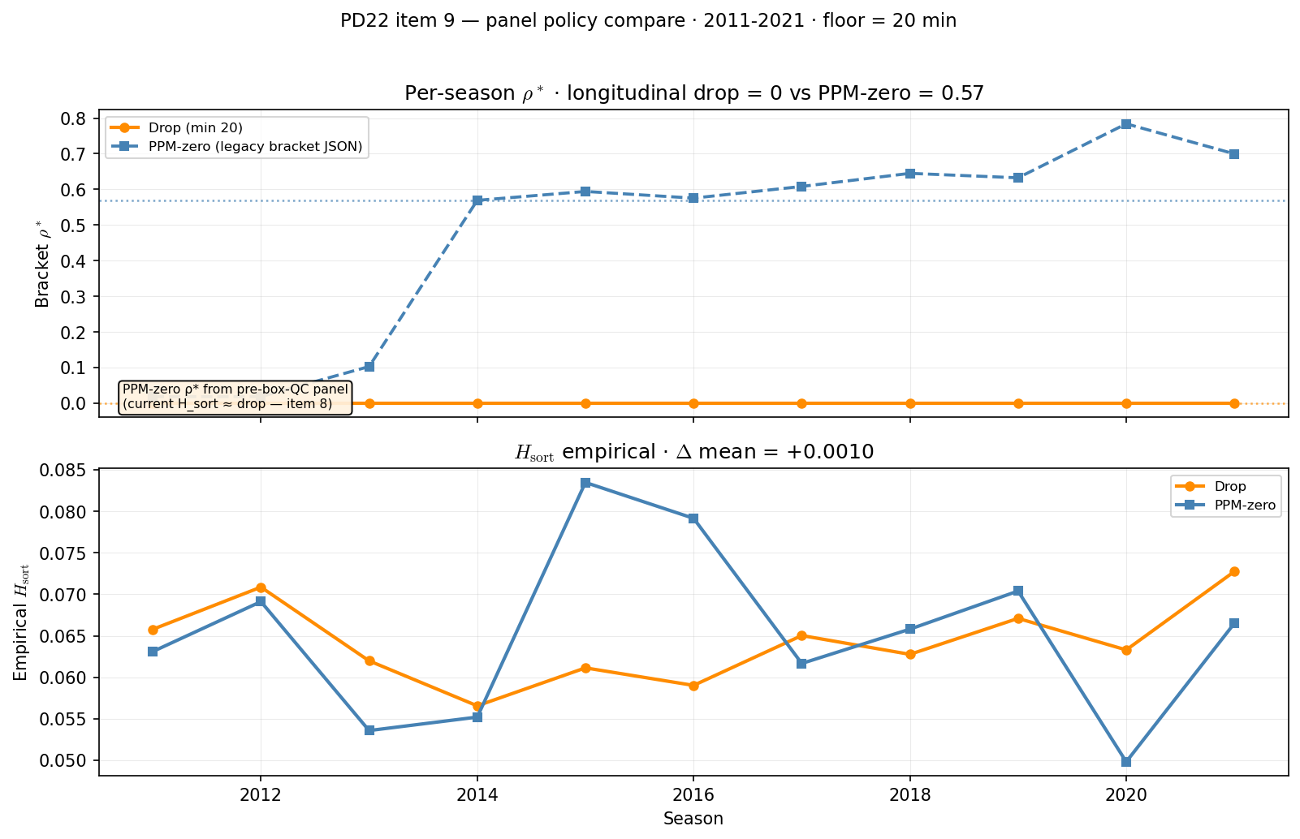
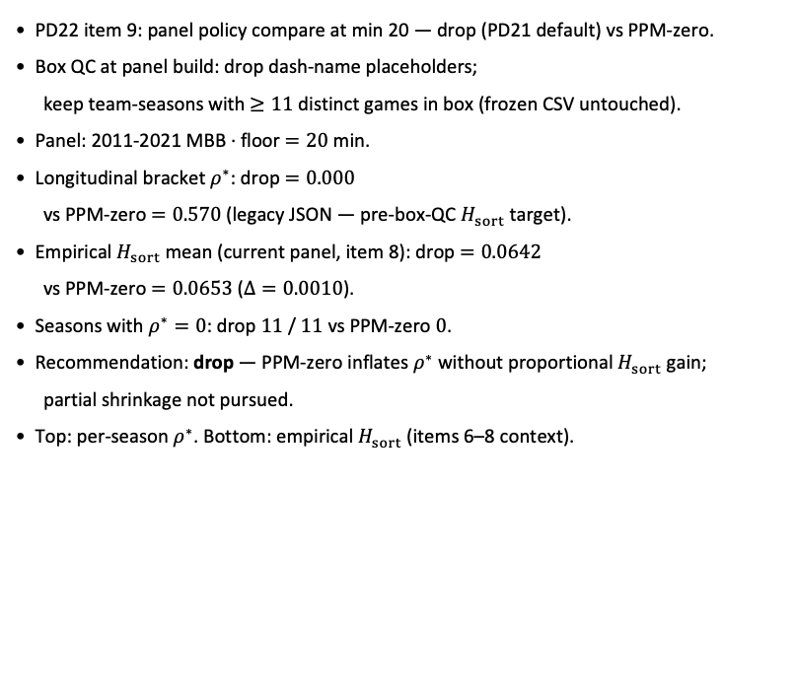
PD22 — panel policy: drop vs PPM-zero at min 20
PD22 item 9 · policy compare · 2011-2021 · $ρ^{∗}$ drop $0.000$ vs PPM-zero $0.570$
PD22 item 9: panel policy compare at min 20 — drop (PD21 default) vs PPM-zero.
Box QC at panel build: drop dash-name placeholders;
keep team-seasons with $≥11$ distinct games in box (frozen CSV untouched).
Panel: 2011-2021 MBB · floor $=20$ min.
Longitudinal bracket $ρ^{∗}$: drop $=0.000$
vs PPM-zero $=0.570$ (legacy JSON — pre-box-QC $H_{sort}$ target).
Empirical $H_{sort}$ mean (current panel, item 8): drop $=0.0642$
vs PPM-zero $=0.0653$ ($Δ=0.0010$).
Seasons with $ρ^{∗}=0$: drop $11$ / $11$ vs PPM-zero $0$.
Recommendation: drop — PPM-zero inflates $ρ^{∗}$ without proportional $H_{sort}$ gain;
partial shrinkage not pursued.
Top: per-season $ρ^{∗}$. Bottom: empirical $H_{sort}$ (items 6–8 context).
Claim (PD22): At min 20, drop vs PPM-zero — bracket $ρ^{∗}$ and empirical $H_{sort}$ decide which panel policy enters PD21 calibration.

Slide 21
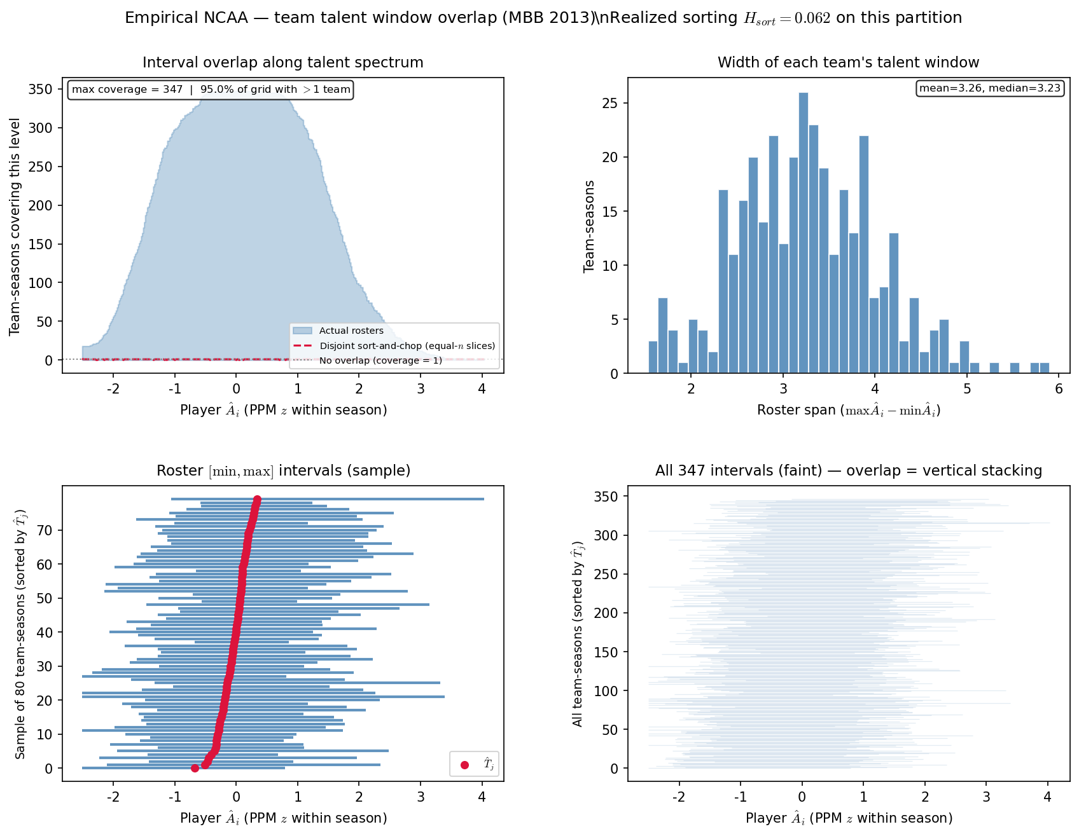
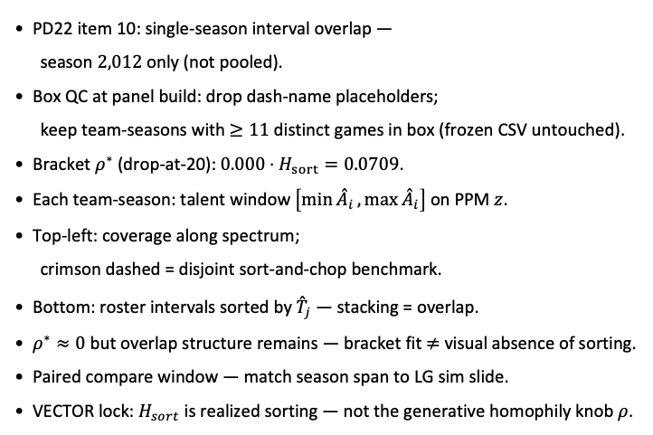
PD22 — team interval overlap · season 2012
PD22 item 10 · season 2012 · min 20 min drop panel · 345 team-seasons · $H_{sort}=0.071$ · $ρ^{∗}=0$
PD22 item 10: single-season interval overlap —
season $2,012$ only (not pooled).
Box QC at panel build: drop dash-name placeholders;
keep team-seasons with $≥11$ distinct games in box (frozen CSV untouched).
Bracket $ρ^{∗}$ (drop-at-20): $0.000$ · $H_{sort}=0.0709$.
Each team-season: talent window $\left[\min{{\overset{ˆ}{A}}_{i}},\max{{\overset{ˆ}{A}}_{i}}\right]$ on PPM $z$.
Top-left: coverage along spectrum;
crimson dashed = disjoint sort-and-chop benchmark.
Bottom: roster intervals sorted by ${\overset{ˆ}{T}}_{j}$ — stacking = overlap.
$ρ^{∗}≈0$ but overlap structure remains — bracket fit $≠$ visual absence of sorting.
Paired compare window — match season span to LG sim slide.
VECTOR lock: $H_{sort}$ is realized sorting — not the generative homophily knob $ρ$.
Claim (PD22): Single-season overlap diagnostic — does talent-window stacking persist when bracket $ρ^{∗}≈0$?

Slide 22
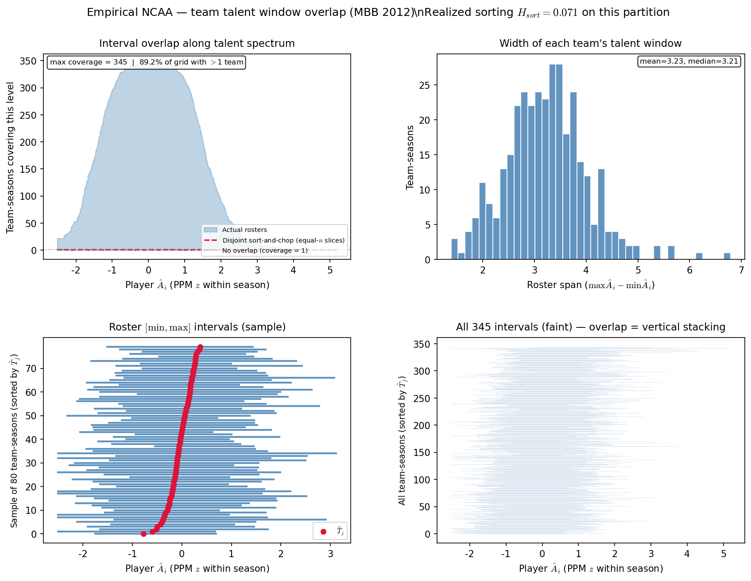
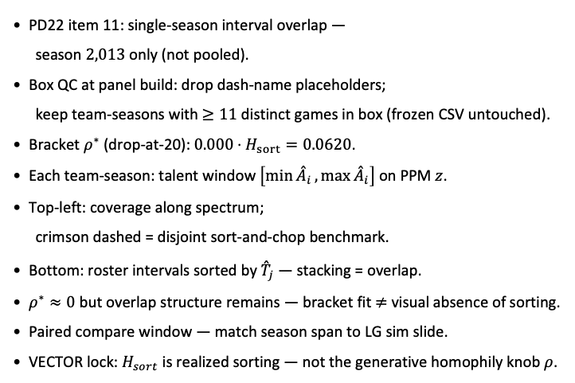
PD22 — team interval overlap · season 2013
PD22 item 11 · season 2013 · min 20 min drop panel · 347 team-seasons · $H_{sort}=0.062$ · $ρ^{∗}=0$
PD22 item 11: single-season interval overlap —
season $2,013$ only (not pooled).
Box QC at panel build: drop dash-name placeholders;
keep team-seasons with $≥11$ distinct games in box (frozen CSV untouched).
Bracket $ρ^{∗}$ (drop-at-20): $0.000$ · $H_{sort}=0.0620$.
Each team-season: talent window $\left[\min{{\overset{ˆ}{A}}_{i}},\max{{\overset{ˆ}{A}}_{i}}\right]$ on PPM $z$.
Top-left: coverage along spectrum;
crimson dashed = disjoint sort-and-chop benchmark.
Bottom: roster intervals sorted by ${\overset{ˆ}{T}}_{j}$ — stacking = overlap.
$ρ^{∗}≈0$ but overlap structure remains — bracket fit $≠$ visual absence of sorting.
Paired compare window — match season span to LG sim slide.
VECTOR lock: $H_{sort}$ is realized sorting — not the generative homophily knob $ρ$.
Claim (PD22): Single-season overlap diagnostic — does talent-window stacking persist when bracket $ρ^{∗}≈0$?

