Slide 1
MLE fit HAND

Slide 2
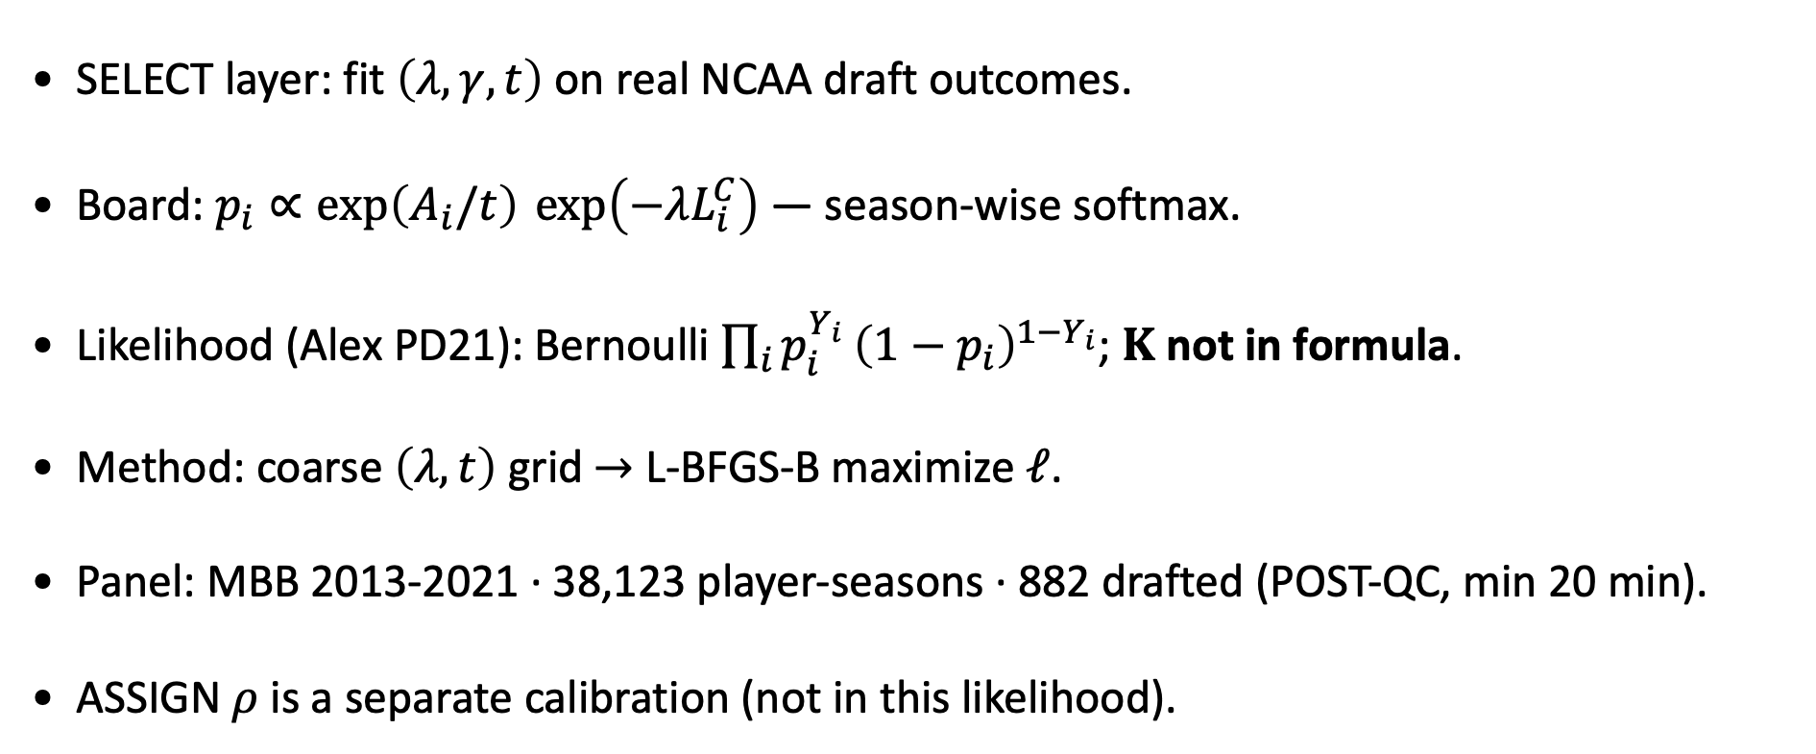

Draft MLE — $λ$, $γ$, $t$ on empirical NCAA outcomes
MBB 2013-2021 · Bernoulli softmax · Alex PD21 board factorization
SELECT layer: fit $\left(λ,γ,t\right)$ on real NCAA draft outcomes.
Board: $p_{i}∝\exp\left(A_{i}/t\right) \exp\left(−λL_{i}^{C}\right)$ — season-wise softmax.
Likelihood (Alex PD21): Bernoulli $\prod_{i}{p_{i}^{Y_{i}}}{\left(1−p_{i}\right)}^{1−Y_{i}}$; $K$ not in formula.
Method: coarse $\left(λ,t\right)$ grid $→$ L-BFGS-B maximize $ℓ$.
Panel: MBB 2013-2021 · 38,123 player-seasons · 882 drafted (POST-QC, min 20 min).
ASSIGN $ρ$ is a separate calibration (not in this likelihood).
Score $≠$ select — we fit the draft probability model, not ASSIGN $ρ$.

Slide 3
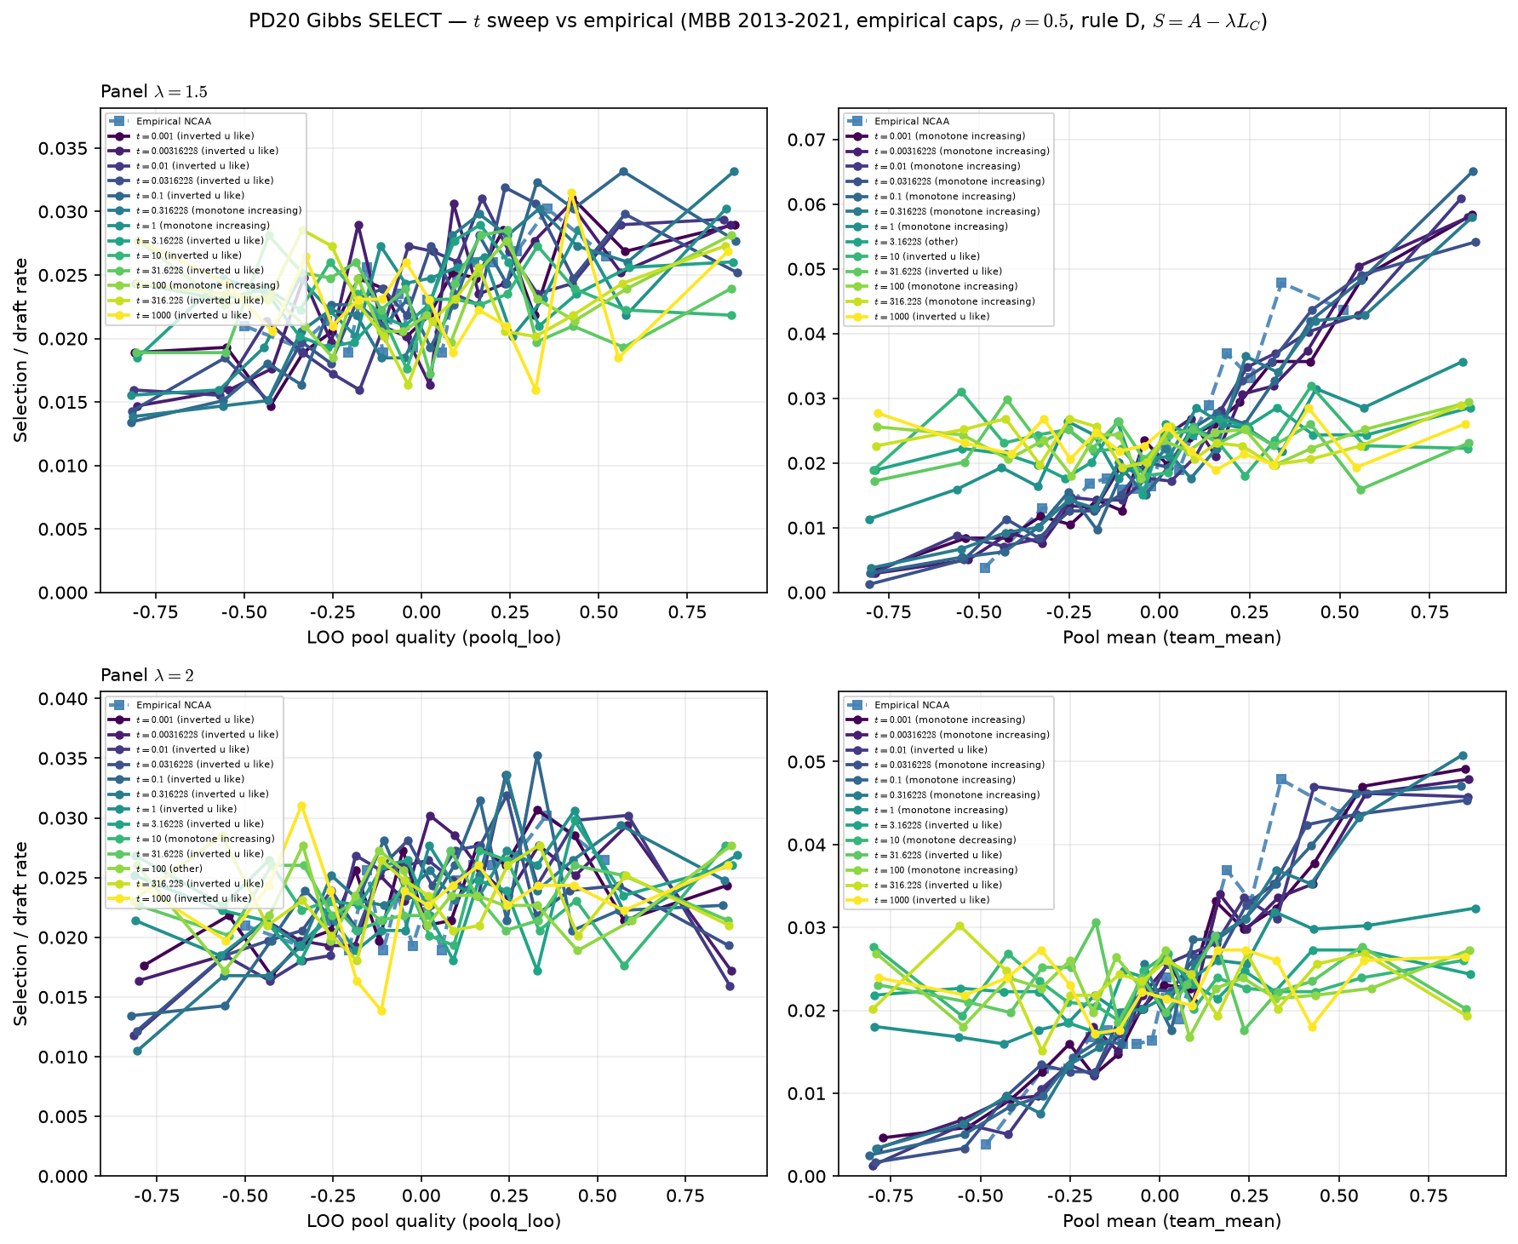
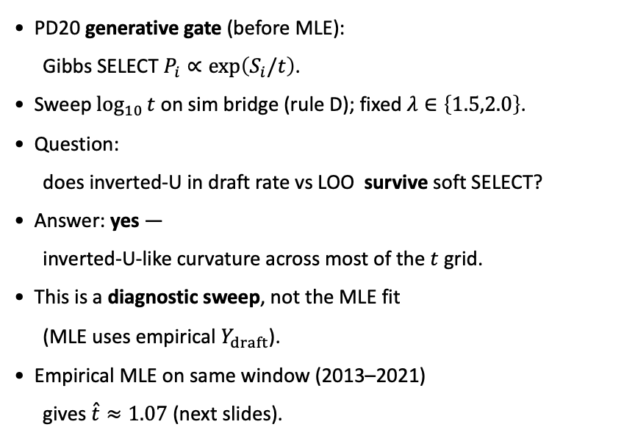
PD20 gate — temperature sweep (generative diagnostic)
Gibbs SELECT survives inverted-U · MBB 2013–2021
PD20 generative gate (before MLE):
Gibbs SELECT $P_{i}∝\exp\left(S_{i}/t\right)$.
Sweep $\log_{10}{t}$ on sim bridge (rule D); fixed $λ∈\left\{1.5,2.0\right\}$.
Question:
does inverted-U in draft rate vs LOO survive soft SELECT?
Answer: yes —
inverted-U-like curvature across most of the $t$ grid.
This is a diagnostic sweep, not the MLE fit
(MLE uses empirical $Y_{draft}$).
Empirical MLE on same window (2013–2021)
gives $\overset{ˆ}{t}≈1.07$ (next slides).
Soft SELECT cleared — MLE on empirical $Y_{draft}$ is the fit step.

Slide 4
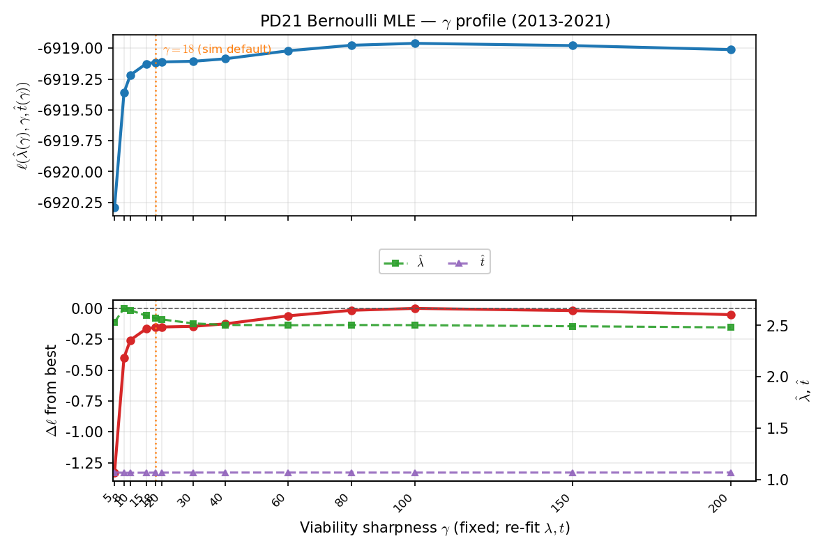



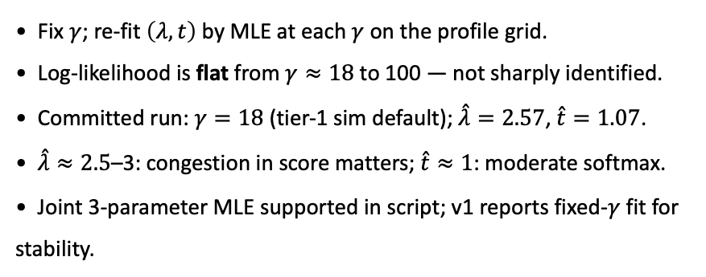
Bernoulli MLE — $γ$ profile ($λ$, $t$ re-fit at each $γ$)
Maximize $ℓ\left(λ,t∣γ\right)$ · panel 2013-2021
Fix $γ$; re-fit $\left(λ,t\right)$ by MLE at each $γ$ on the profile grid.
Log-likelihood is flat from $γ≈18$ to 100 — not sharply identified.
Committed run: $γ=18$ (tier-1 sim default); $\overset{ˆ}{λ}=2.57$, $\overset{ˆ}{t}=1.07$.
$\overset{ˆ}{λ}≈2.5$–3: congestion in score matters; $\overset{ˆ}{t}≈1$: moderate softmax.
Joint 3-parameter MLE supported in script; v1 reports fixed-$γ$ fit for stability.
Committed: $\overset{ˆ}{λ}≈2.6,\overset{ˆ}{t}≈1.1,γ=18$.

Slide 5
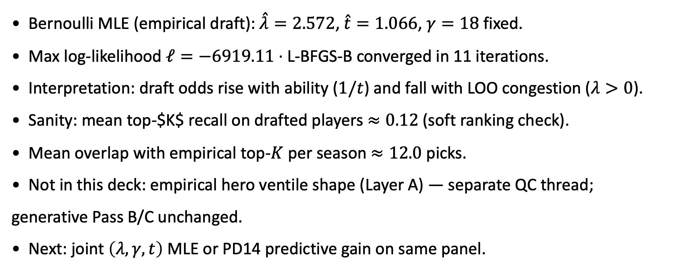
Fit summary
Empirical MLE on real draft labels · 2013-2021
Bernoulli MLE (empirical draft): $\overset{ˆ}{λ}=2.572$, $\overset{ˆ}{t}=1.066$, $γ=18$ fixed.
Max log-likelihood $ℓ=−6919.11$ · L-BFGS-B converged in 11 iterations.
Interpretation: draft odds rise with ability ($1/t$) and fall with LOO congestion ($λ>0$).
Sanity: mean top-$K$ recall on drafted players $≈0.12$ (soft ranking check).
Mean overlap with empirical top-$K$ per season $≈12.0$ picks.
Not in this deck: empirical hero ventile shape (Layer A) — separate QC thread; generative Pass B/C unchanged.
Next: joint $\left(λ,γ,t\right)$ MLE or PD14 predictive gain on same panel.
Yes: MLE on empirical data for $\left(λ,t\right)$; hero ventile read is a separate (parked) Layer A item.

