Slide 1
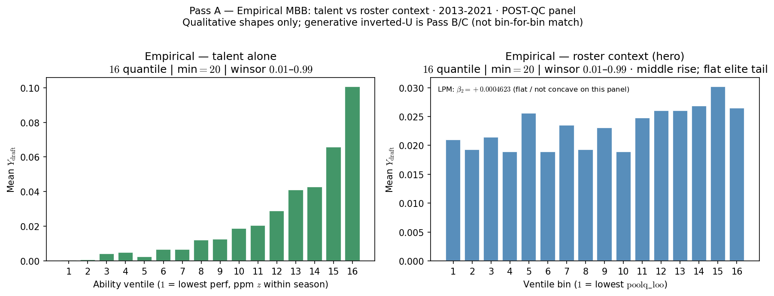
Pass A — Empirical MBB: Roster Pressure in the Data
Real NCAA panel (2013-2021): mean NBA draft rate by ventile.
Left — talent alone: ability (ppm z within season). Monotone up.
Right — roster context: middle rise; flat elite tail on POST-QC panel.
No λ in the empirical story — generative Pass B/C show inverted-U in sim.
Pipeline: VISUALIZE only (bin real Y_{draft} on ability | poolq\_{l}oo).
Assign arrow Score arrow Select in the real world; we read outcomes only.

Slide 2
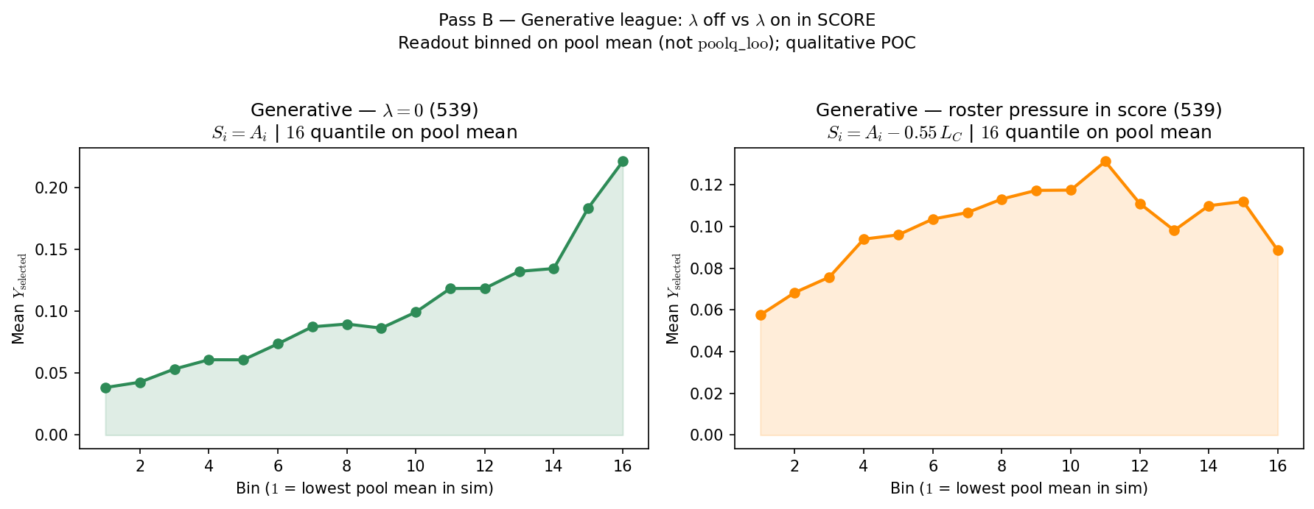
Pass B — Generative: Congestion in Score Bends the Curve
Synthetic league: ASSIGN arrow SCORE arrow SELECT arrow VISUALIZE (539 preset).
Left — λ = 0: score S_{i} = A_{i} only (talent-only ranking). Roughly monotone.
Right — λ > 0: score S_{i} = A_{i} - w · L_{C} (viable-peer congestion in SCORE).
VISUALIZE on pool mean (team ability, includes self) — not poolq\_{l}oo.
Claim: roster pressure in the advancement rule bends the curve (qualitative POC).
Pass B knob: λ / w in SCORE. Does not vary assignment ρ.

Slide 3
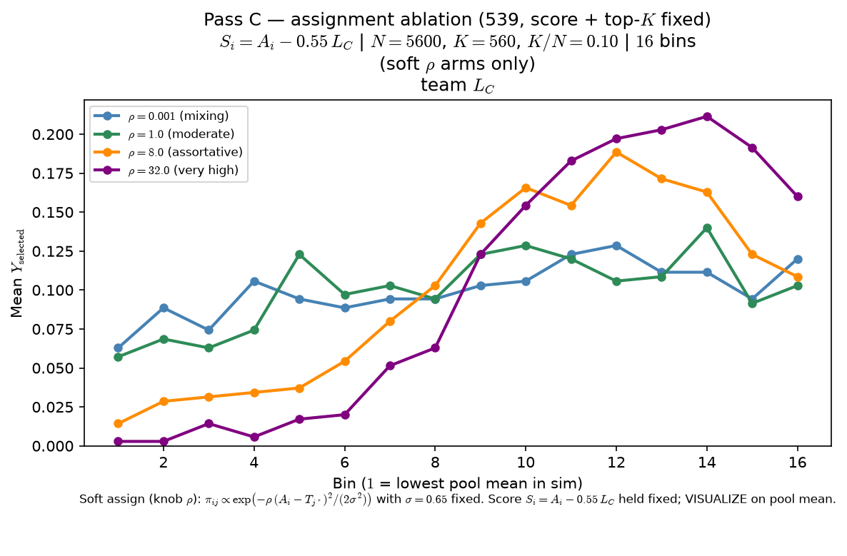
Pass C — Generative: Assortativity Shapes the Sorted World
Same 539 score as Pass B right arm — S_{i} = A_{i} - w · L_{C} held fixed.
One draw of talent; only ASSIGN changes (soft ρ ladder + sort-and-chop).
ρ controls how sharply players match team targets — roster sorting.
VISUALIZE on pool mean: assortativity moves the inverted-U readout.
Story: λ puts roster pressure in score; ρ delivers pressured environments.
Pass C knob: ρ in ASSIGN. Score + top-K fixed across arms.

