Slide 1
Draft MLE — $\lambda$, $\gamma$, $t$ on empirical NCAA outcomes
MBB 2013-2021 · Bernoulli softmax · Alex PD21 board factorization
SELECT layer: fit $(\lambda, \gamma, t)$ on real NCAA draft outcomes.
Board: $p_i \propto \exp(A_i/t)\,\exp(-\lambda L^C_i)$ — season-wise softmax.
Likelihood (Alex PD21): Bernoulli $\prod_i p_i^{Y_i}(1-p_i)^{1-Y_i}$; **$K$ not in formula**.
Method: coarse $(\lambda, t)$ grid $\rightarrow$ L-BFGS-B maximize $\ell$.
Panel: MBB 2013-2021 · 38,123 player-seasons · 882 drafted (POST-QC, min 20 min).
ASSIGN $\rho$ is a separate calibration (not in this likelihood).
Score $\neq$ select — we fit the **draft probability model**, not ASSIGN $\rho$.

Slide 2
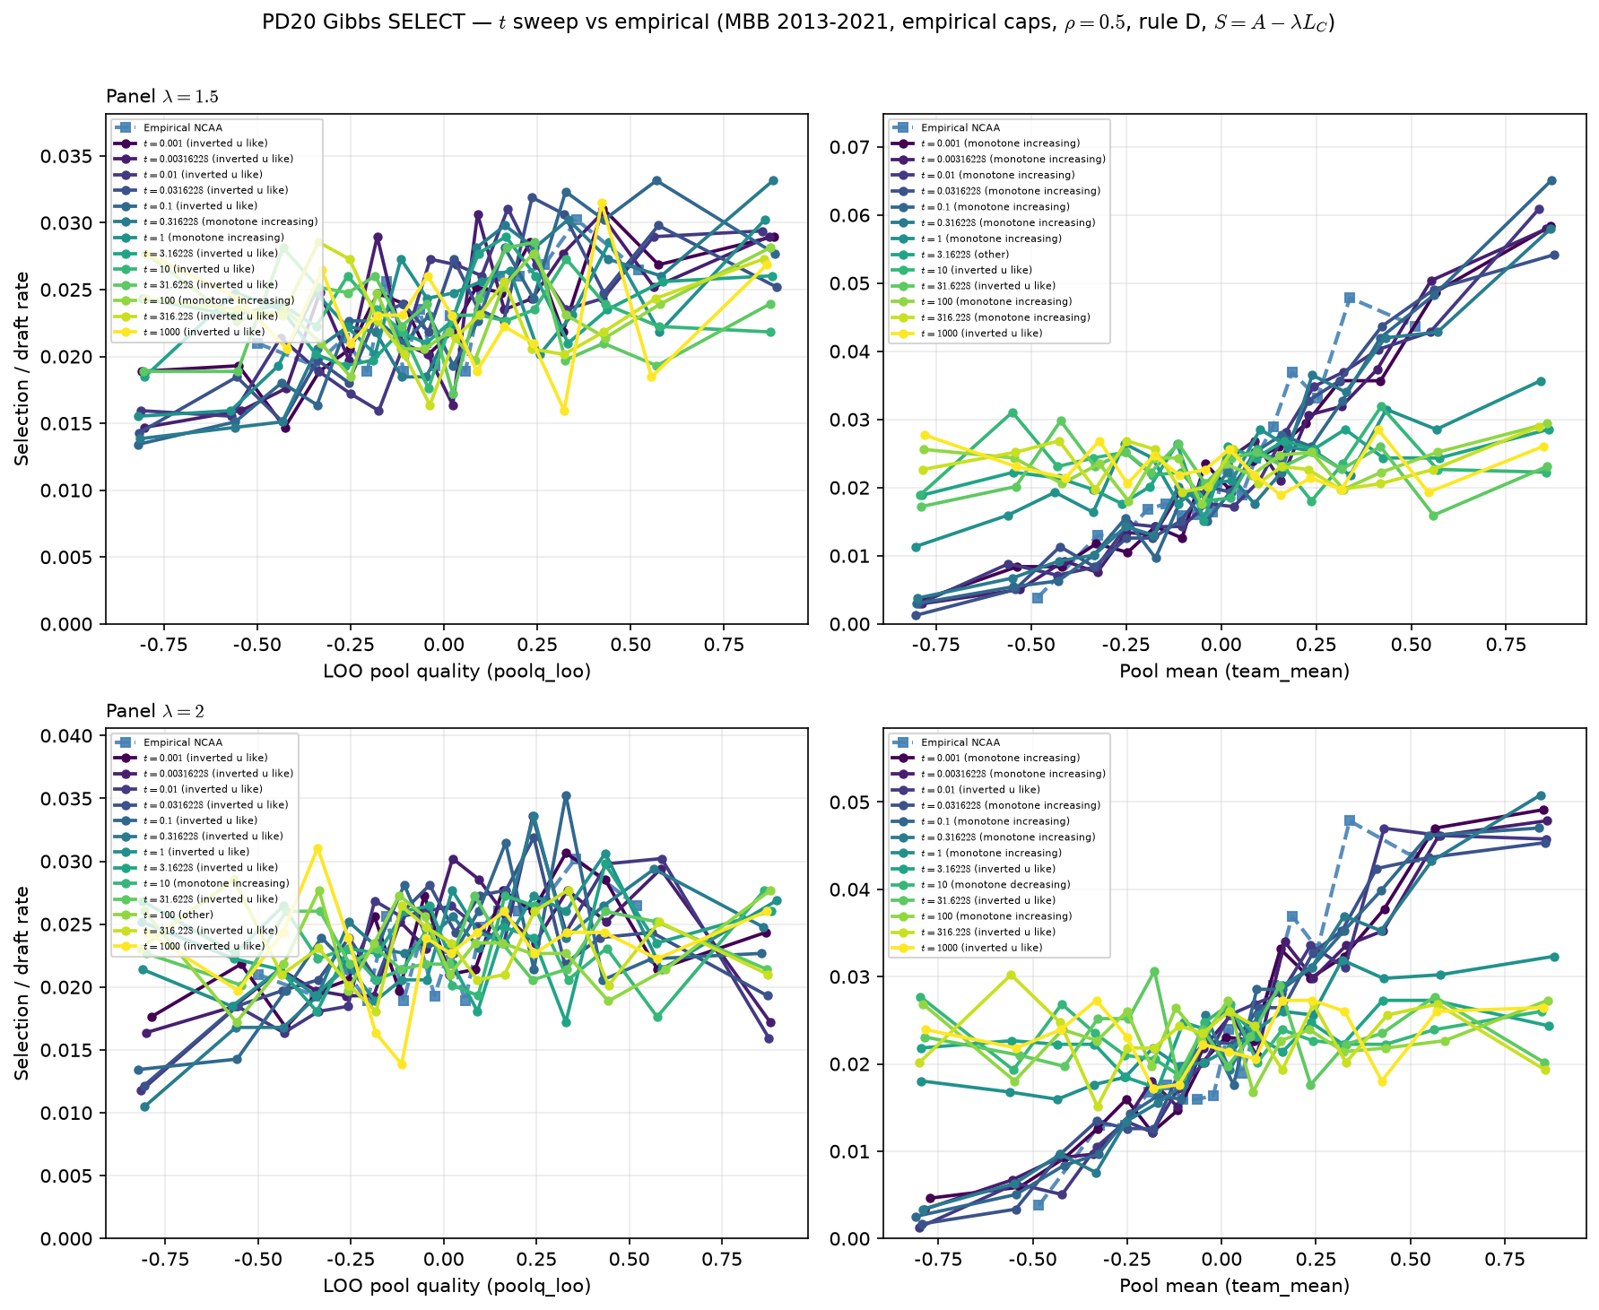
PD20 gate — temperature sweep (generative diagnostic)
Gibbs SELECT survives inverted-U · MBB 2013–2021
PD20 **generative gate** (before MLE): Gibbs SELECT $P_i \propto \exp(S_i/t)$.
Sweep $\log_{10} t$ on sim bridge (rule D); fixed $\lambda \in \{1.5, 2.0\}$.
Question: does inverted-U in draft rate vs LOO **survive** soft SELECT?
Answer: **yes** — inverted-U-like curvature across most of the $t$ grid.
This is a **diagnostic sweep**, not the MLE fit (MLE uses empirical $Y_{\mathrm{draft}}$).
Empirical MLE on same window (2013–2021) gives $\hat t \approx 1.07$ (next slides).
Soft SELECT cleared — MLE on empirical $Y_{\mathrm{draft}}$ is the fit step.

Slide 3
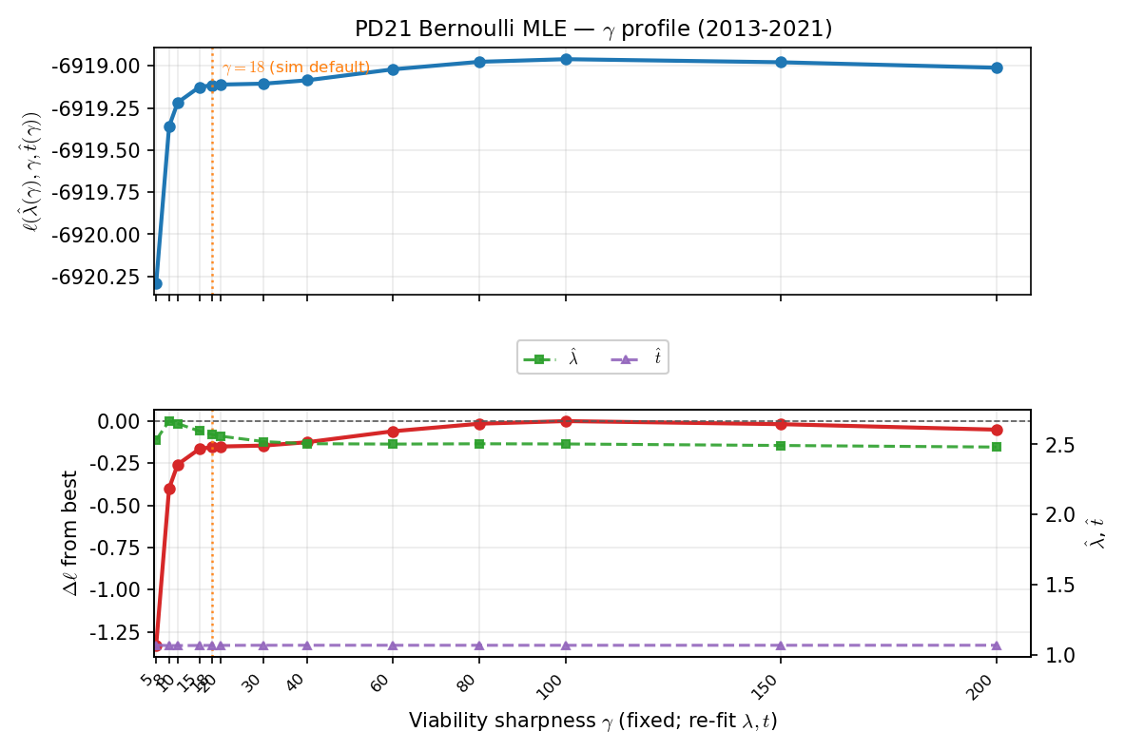
Bernoulli MLE — $\gamma$ profile ($\lambda$, $t$ re-fit at each $\gamma$)
Maximize $\ell(\lambda, t \mid \gamma)$ · panel 2013-2021
Fix $\gamma$; re-fit $(\lambda, t)$ by MLE at each $\gamma$ on the profile grid.
Log-likelihood is **flat** from $\gamma \approx 18$ to 100 — not sharply identified.
Committed run: $\gamma = 18$ (tier-1 sim default); $\hat\lambda = 2.57$, $\hat t = 1.07$.
$\hat\lambda \approx 2.5$–3: congestion in score matters; $\hat t \approx 1$: moderate softmax.
Joint 3-parameter MLE supported in script; v1 reports fixed-$\gamma$ fit for stability.
Committed: $\hat\lambda \approx 2.6$, $\hat t \approx 1.1$, $\gamma = 18$.

Slide 4
Fit summary — what to tell Alex
Empirical MLE on real draft labels · 2013-2021
Bernoulli MLE (empirical draft): $\hat\lambda = 2.572$, $\hat t = 1.066$, $\gamma = 18$ fixed.
Max log-likelihood $\ell = -6919.11$ · L-BFGS-B converged in 11 iterations.
Interpretation: draft odds rise with ability ($1/t$) and fall with LOO congestion ($\lambda>0$).
Sanity: mean top-$K$ recall on drafted players $\approx 0.12$ (soft ranking check).
Mean overlap with empirical top-$K$ per season $\approx 12.0$ picks.
Not in this deck: empirical hero ventile shape (Layer A) — separate QC thread; generative Pass B/C unchanged.
Next: joint $(\lambda, \gamma, t)$ MLE or PD14 predictive gain on same panel.
Yes: MLE on empirical data for $(\lambda, t)$; hero ventile read is a separate (parked) Layer A item.

