Slide 1
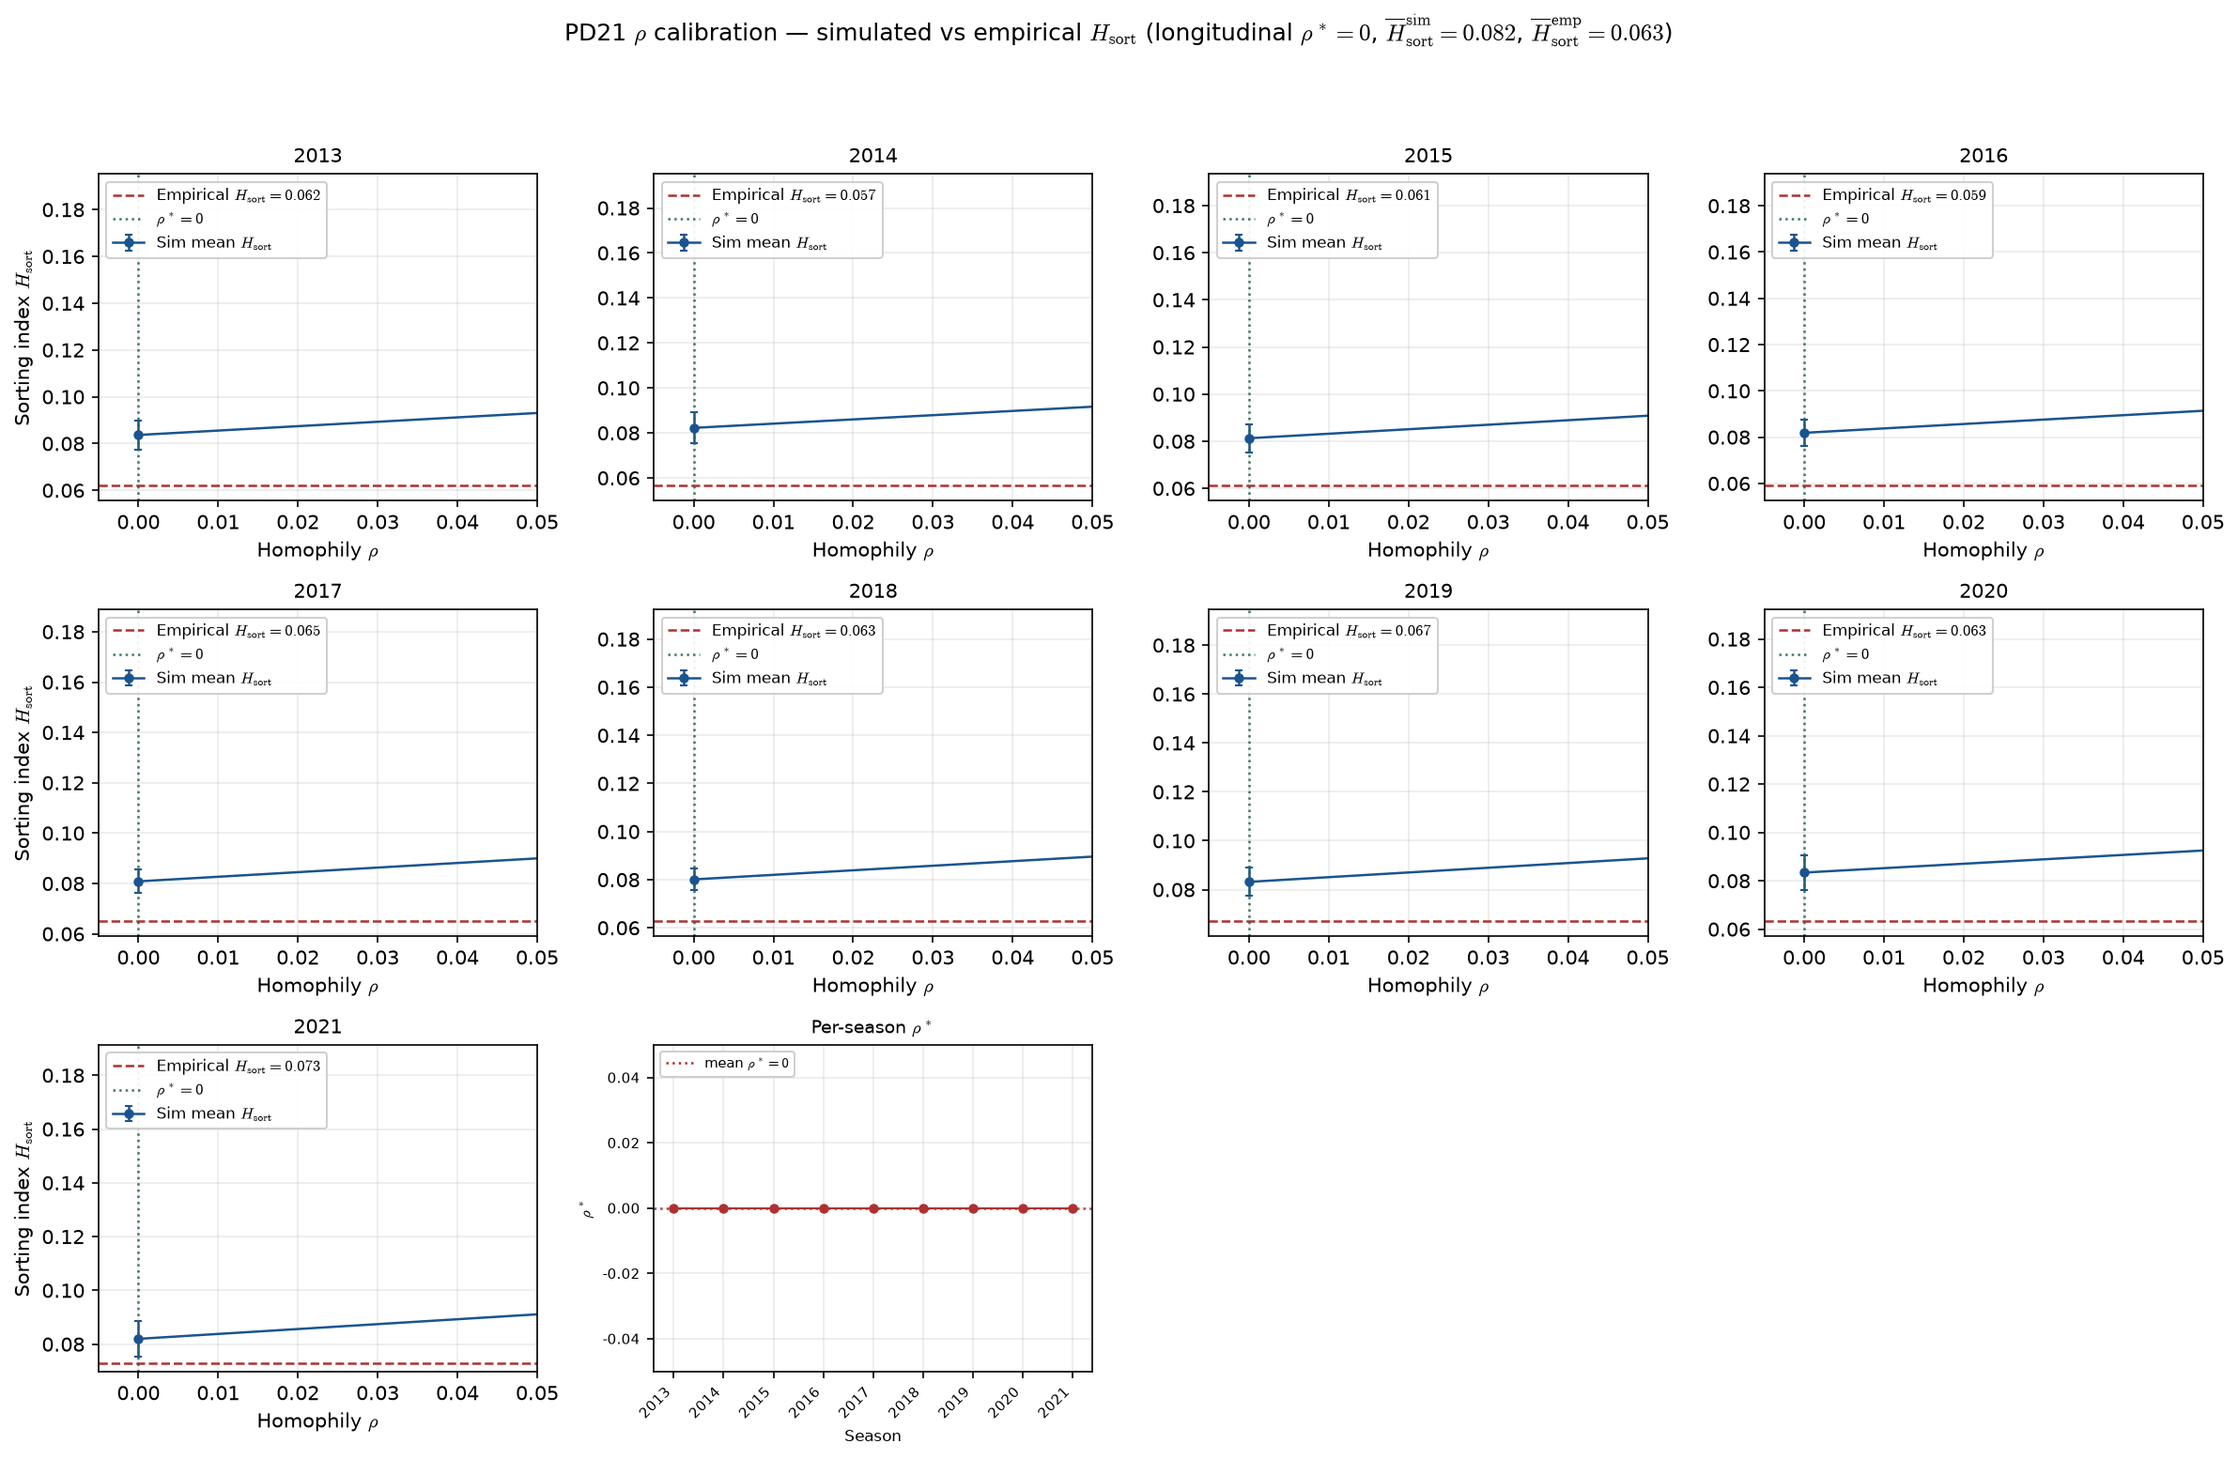
PD21 — Calibrate homophily $\rho$ to empirical sorting index $H_{\mathrm{sort}}$ (hero panel — locked calibration)
PD21 · LG ASSIGN calibration · 2013-2021 · 50 seeds · bracket tol=0.001 · longitudinal $\rho^* \approx 0$ · hero panel
PD21 locked calibration (Aug 2026): bracket search on hero panel for Alex ASSIGN $\rho$.
Alex (Aug 2026): calibrate ASSIGN $\rho$ so LG simulated $H_{\mathrm{sort}}$ matches empirical NCAA; formal $\rho$ MLE parked.
Panel: 2011–2021 MBB · min$\geq20$ min player-season drop · box QC at panel build · empirical roster caps · PPM z-scored within season.
Search: bracket + bisect (tol=0.001), 50 seeds/arm; $H_{\mathrm{sort}}^{\mathrm{sim}}$ monotone in $\rho$.
H_{sort} = 1 - \sum_i(\hat{A}_i - \hat{\mu}_{g(i)})^2 / \sum_i(\hat{A}_i - \bar{A})^2 — realized sorting on a fixed partition.
Longitudinal $\rho^* \approx 0$; mean $H_{\mathrm{sort}}^{\mathrm{sim}}$ at $\rho^*$ = 0.082; mean $H_{\mathrm{sort}}^{\mathrm{emp}}$ = 0.063.
Per-season: 9/9 seasons at $\rho^*=0$; all at $\rho^*=0$.
Legacy reference $\rho=0.5$: mean $|error| \approx 0.112$ vs $\approx 0.019$ at $\rho^*$.
Figure bottom-right inset: per-season $\rho^*$ — flat at $0$ all seasons on hero panel.
$\rho^*=0$ — what we DO say: on the locked hero panel, the LG ASSIGN homophily knob calibrates to zero (9/9 seasons); empirical $H_{\mathrm{sort}}\approx 0.063$ ($\approx 0.0632916$ on $[0,1]$ scale); sim at $\rho^*$ slightly high ($\approx 0.0820655$); turning $\rho$ up overshoots (see legacy $\rho=0.5$ bullet).
$\rho^*=0$ — what we DO NOT say: NCAA has no team formation; Duke and a weak D-I school draw from the same talent pool; real-world assortativity is absent; Hero inverted-U / $\lambda$ / SELECT story is dead.
$H_{{\mathrm{{sort}}}}$ is realized sorting on a fixed roster partition (VECTOR lock) — not the generative $\rho$ knob. Box QC lowered measured $H_{{\mathrm{{sort}}}}$ vs pre-QC ($\sim 0.10 \rightarrow \sim 0.06$); modest $\neq$ zero. Contrast: ppm0lt20 panel (HAND20 slide 15).
VECTOR lock: H_{sort} is realized sorting — not the generative homophily knob \rho.
Figure: small multiples — blue sim curve, red empirical line, green $\rho^*$ (x-axis zoomed to evaluated bracket).
Claim (Alex): Hero panel — LG ASSIGN $\rho^*=0$ matches modest empirical $H_{\mathrm{sort}}\approx0.063$; legacy $\rho=0.5$ overshoots ($0.11$ mean $|error|$). Model–measurement fit on this panel — not a claim that NCAA rosters are random.

