Slide 1
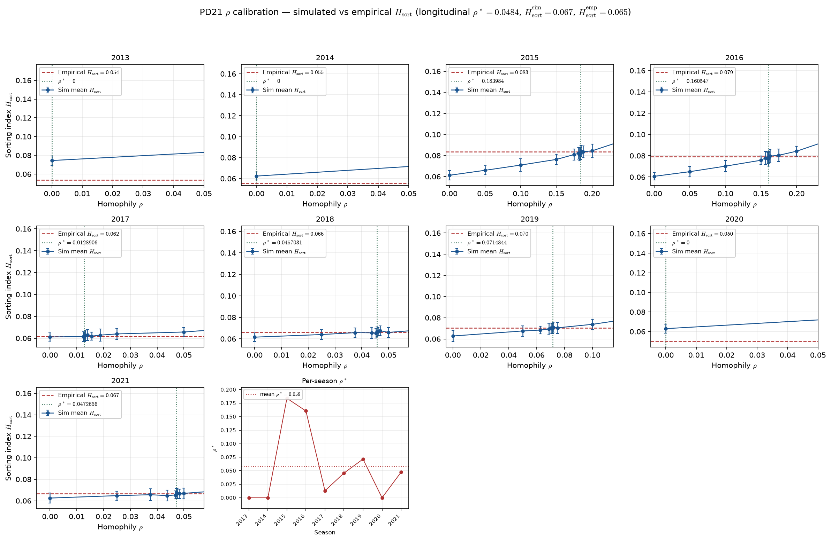
PD21 — Calibrate homophily $\rho$ to empirical sorting index $H_{\mathrm{sort}}$ (contrast: ppm0lt20 — not for calibration)
PD21 · LG ASSIGN calibration · 2013-2021 · 50 seeds · bracket tol=0.001 · longitudinal $\rho^* \approx 0.0484$ · contrast ppm0lt20
PD21 contrast (Aug 2026): ppm0lt20 panel — illustrative only; do not use for locked longitudinal $\rho$ calibration.
Alex (Aug 2026): calibrate ASSIGN $\rho$ so LG simulated $H_{\mathrm{sort}}$ matches empirical NCAA; formal $\rho$ MLE parked.
Panel: 2011–2021 MBB · all roster rows kept · raw PPM$=0$ if minutes$<20$ · no roster caps — contrast / legacy estimand only.
Search: bracket + bisect (tol=0.001), 50 seeds/arm; $H_{\mathrm{sort}}^{\mathrm{sim}}$ monotone in $\rho$.
H_{sort} = 1 - \sum_i(\hat{A}_i - \hat{\mu}_{g(i)})^2 / \sum_i(\hat{A}_i - \bar{A})^2 — realized sorting on a fixed partition.
Longitudinal $\rho^* \approx 0.04844$; mean $H_{\mathrm{sort}}^{\mathrm{sim}}$ at $\rho^*$ = 0.067; mean $H_{\mathrm{sort}}^{\mathrm{emp}}$ = 0.065.
Per-season: 3/9 seasons at $\rho^*=0$; nonzero — 2015: \rho^* \approx 0.184, 2016: \rho^* \approx 0.161, 2017: \rho^* \approx 0.0129, 2018: \rho^* \approx 0.0457, 2019: \rho^* \approx 0.0715, …
Legacy reference $\rho=0.5$: mean $|error| \approx 0.087$ vs $\approx 4.9e-06$ at $\rho^*$.
Figure bottom-right inset: per-season $\rho^*$ — red dots spike at 2015–2016; dotted line = mean $\rho^*$ across seasons.
2014$\rightarrow$2015 per-season $\rho^*$: $0.000\rightarrow0.184$ — mid-decade spike co-moves with empirical $H_{\mathrm{sort}}$; not used for locked calibration.
Contrast slide only: ppm0lt20 (all roster rows, PPM$=0$ if min$<20$, no caps) can yield positive per-season $\rho^*$ where hero drop gives $0$ — do not use for locked calibration.
Footer claim on this slide is about contrast failure mode — not the hero-panel near-zero $\rho^*$ story on the hero calibration slide (HAND20 slide 14).
VECTOR lock: H_{sort} is realized sorting — not the generative homophily knob \rho.
Figure: small multiples — blue sim curve, red empirical line, green $\rho^*$ (x-axis zoomed to evaluated bracket).
Claim (PD21 contrast): ppm0lt20 yields modest longitudinal $\rho^* \approx 0.0484$ (hero panel $=0$) — not the locked estimand; 2014$\rightarrow$2015 per-season spike co-moves with mid-decade $H_{\mathrm{sort}}$ on uncapped roster rows (PD22 ESPN coverage — HAND20 slide 9).

