Slide 1
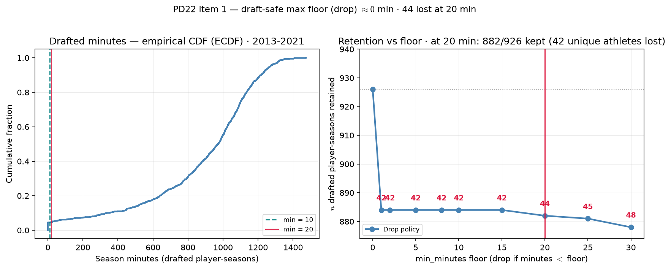
PD22 — Drafted-player retention vs playing-time floor
PD22 · drafted retention audit · 2013-2021 · at min $20$ drop: $882/926$ drafted player-seasons kept
PD22 item 1: audit minutes floor before defending min 20 min or PPM-zero bench policy.
Panel: 2013-2021 MBB · rebuild min\_minutes=0 after box QC · $Y_{\mathrm{draft}}$ = ever-draft flag (not season-specific).
Box QC at panel build: drop dash-name placeholders; keep team-seasons with $\geq 11$ distinct games in box (frozen CSV untouched).
Drafted player-seasons: $926$ ($425$ unique athletes).
Minutes among drafted: min = $0$; draft-safe max floor (drop) $\approx 0$ min.
Hero lock min = $20$: retain $882/926$; lose $44$ player-seasons ($42$ unique athletes; $42$ at $0$ min).
Right panel: red labels = drafted player-seasons lost vs min\_minutes=0 floor at each threshold.
PPM-zero policy: all drafted rows retained; sub-floor players get raw PPM = 0 before z-score.
Lost at min $20$ drop ($44$): id 51323 (2013): 0.0 min; id 56359 (2013): 0.0 min; id 56965 (2014): 0.0 min (+41 more — see CSV)
Left: empirical cumulative distribution function (ECDF) of drafted minutes ($10$ min teal, $20$ min red). Right: retained count vs floor.
Claim (PD22): Playing-time floor must be draft-safe — retain every ever-draft ($Y_{\mathrm{draft}}=1$) player-season before we justify min 20 min or PPM-zero bench policy for $\rho$ / $H_{\mathrm{sort}}$ calibration.

