Slide 1
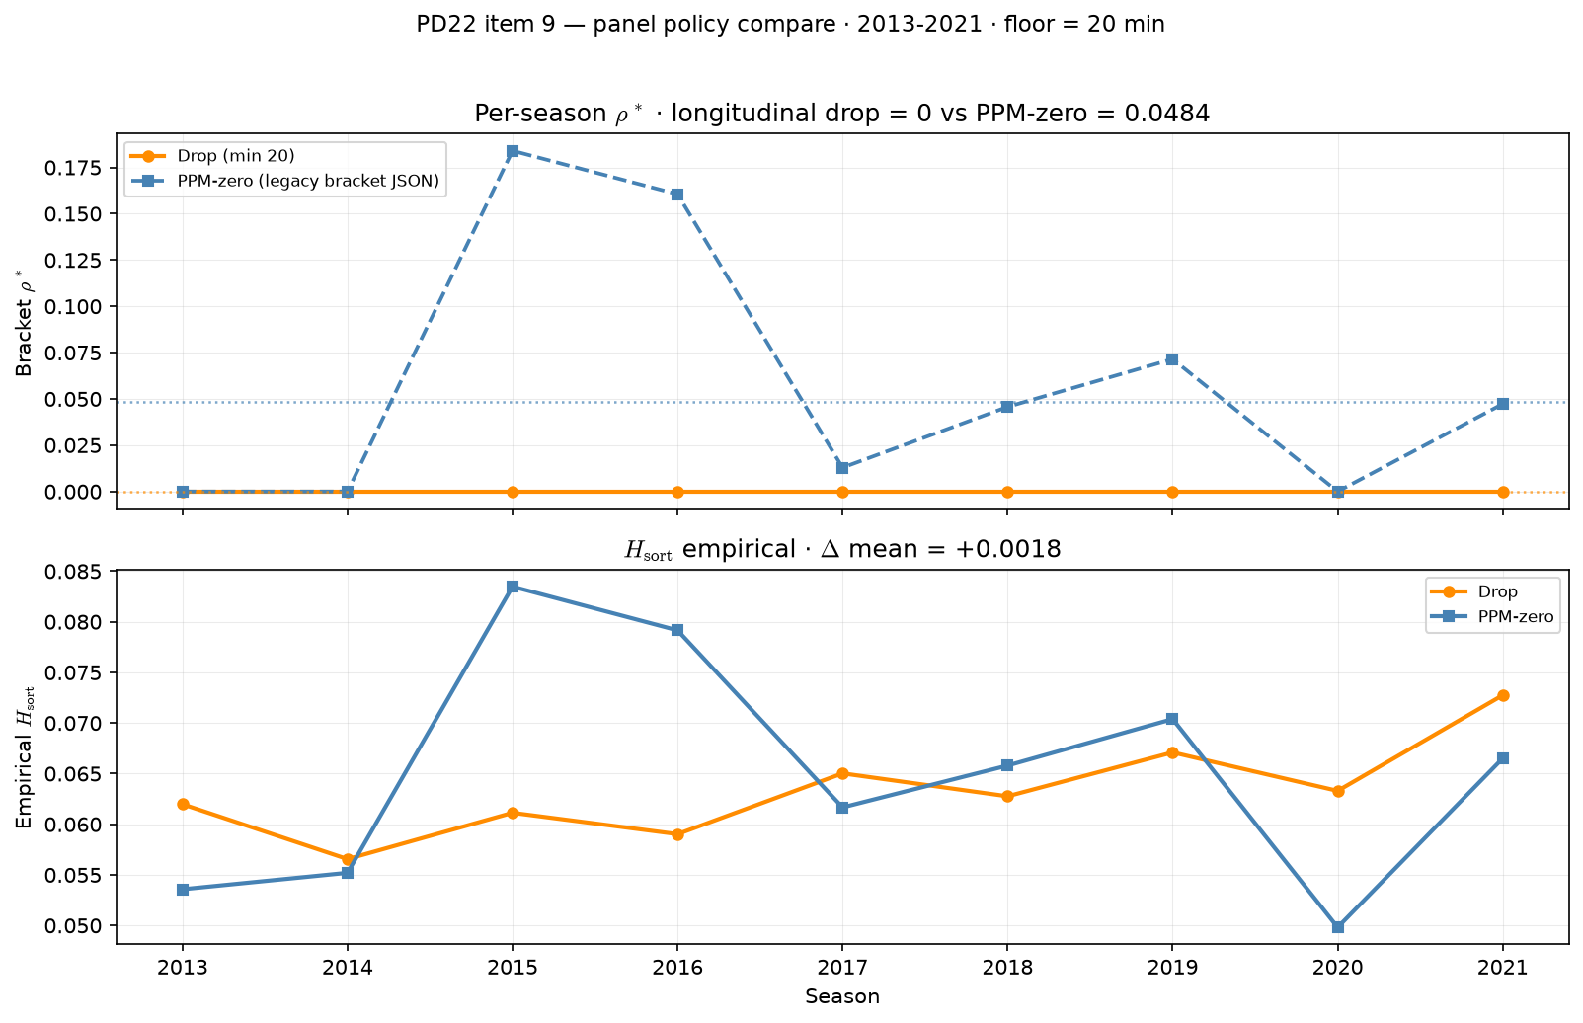
PD22 — panel policy: drop vs PPM-zero at min 20
PD22 item 9 · policy compare · 2013-2021 · $\rho^*$ drop $0.000$ vs PPM-zero $0.048$
PD22 item 9: panel policy compare at min 20 — drop (PD21 default) vs PPM-zero.
Box QC at panel build: drop dash-name placeholders; keep team-seasons with $\geq 11$ distinct games in box (frozen CSV untouched).
Panel: 2013-2021 MBB · floor = $20$ min.
Longitudinal bracket $\rho^*$: drop = $0.000$ vs PPM-zero = $0.048$ .
Empirical $H_{\mathrm{sort}}$ mean (current panel, item 8): drop = $0.0633$ vs PPM-zero = $0.0651$ ($\Delta$ = $0.0018$).
Seasons with $\rho^* = 0$: drop $9$ / $9$ vs PPM-zero $3$.
Recommendation: **drop** — PPM-zero inflates $\rho^*$ without proportional $H_{\mathrm{sort}}$ gain; partial shrinkage not pursued.
Top: per-season $\rho^*$. Bottom: empirical $H_{\mathrm{sort}}$ (items 6–8 context).
Claim (PD22): At min 20, drop vs PPM-zero — bracket $\rho^*$ and empirical $H_{\mathrm{sort}}$ decide which panel policy enters PD21 calibration.

