Slide 1
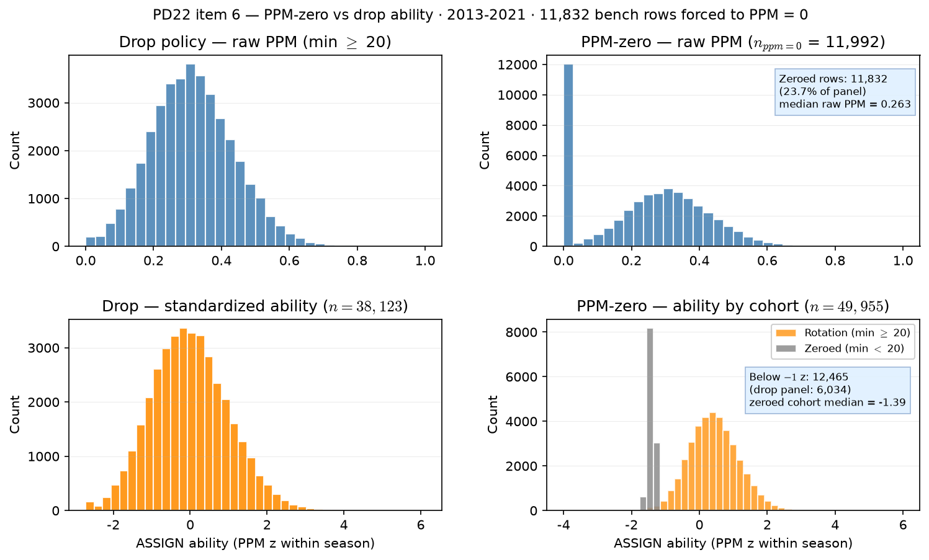
PD22 — ability under PPM-zero vs drop policy
PD22 item 6 · PPM-zero vs drop · 2013-2021 · $11,832$ bench rows at PPM $= 0$
PD22 item 6: PPM-zero vs drop — raw PPM and ASSIGN ability (PPM z within season).
Box QC at panel build: drop dash-name placeholders; keep team-seasons with $\geq 11$ distinct games in box (frozen CSV untouched).
Panel: 2013-2021 MBB · floor = $20$ min.
Drop panel ($n = 38,123$): sub-20 rows removed at rebuild.
PPM-zero panel ($n = 49,955$): $11,832$ rows ($0.2\%$) forced to PPM $= 0$ (min $< 20$).
Raw PPM spike: $11,992$ rows at PPM $= 0$ under PPM-zero.
ASSIGN below $-1$ z: drop $6,034$ vs PPM-zero $12,465$; zeroed cohort median = $-1.39$.
Left column = drop (PD21 default). Right column = PPM-zero alternative flagged for induced homophily.
Claim (PD22): PPM-zero keeps bench players on roster at forced PPM = 0 — expect a zero-heavy ability distribution vs the min-20 drop panel; may inflate homophily if identical zeros cluster on teams.

