Slide 1
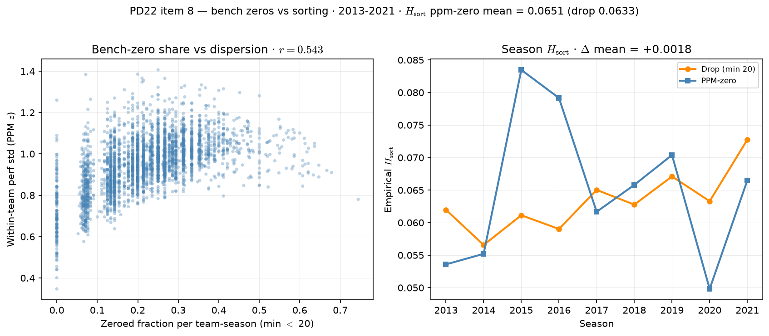
PD22 — bench-zero clustering vs empirical sorting
PD22 item 8 · bench zeros vs $H_{\mathrm{sort}}$ · 2013-2021 · $\Delta$ mean = $0.0018$
PD22 item 8: bench-zero share vs within-team dispersion; season $H_{\mathrm{sort}}$ drop vs PPM-zero.
Box QC at panel build: drop dash-name placeholders; keep team-seasons with $\geq 11$ distinct games in box (frozen CSV untouched).
Panel: 2013-2021 MBB · PPM-zero floor = $20$ min.
Team-season scatter: corr(zero fraction, within-team perf std) = $0.543$ ($3,152$ team-seasons).
Mean empirical $H_{\mathrm{sort}}$: drop = $0.0633$ vs PPM-zero = $0.0651$ ($\Delta$ mean = $0.0018$).
Teams with $\geq$ half roster zeroed: $74$.
Left: more bench zeros $\Rightarrow$ lower within-team dispersion (identical zeroed cohort). Right: season $H_{\mathrm{sort}}$ under both panel policies.
Claim (PD22): PPM-zero piles identical bench abilities on rosters — check whether that mechanically inflates empirical $H_{\mathrm{sort}}$ vs drop-at-20.

