Slide 1
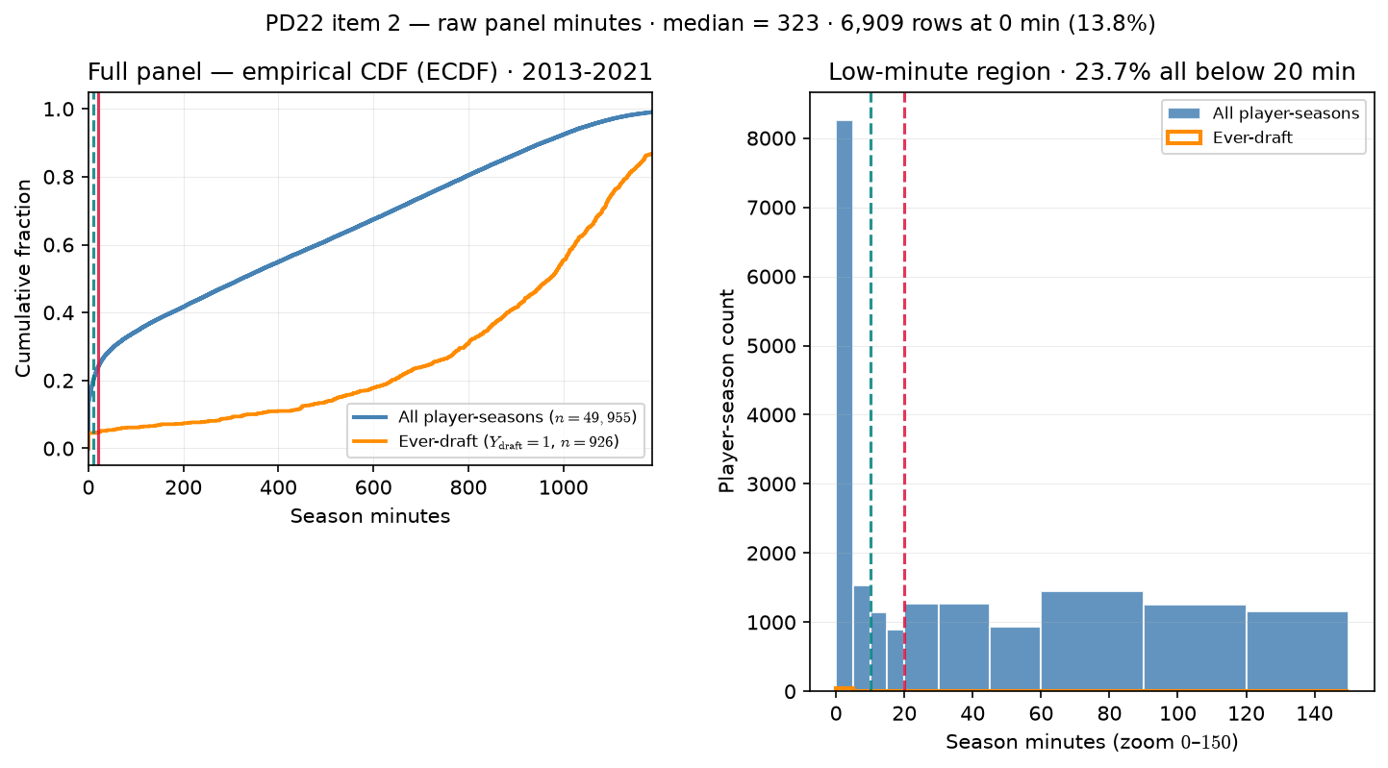
PD22 — Raw panel season-minutes distribution
PD22 · raw panel minutes · 2013-2021 · median = $323$ min · $23.7\%$ below $20$ min
PD22 item 2: season-minutes on box-QC panel (min\_minutes=0 rebuild).
Box QC at panel build: drop dash-name placeholders; keep team-seasons with $\geq 11$ distinct games in box (frozen CSV untouched).
Panel: 2013-2021 MBB · $49,955$ player-seasons · $926$ ever-draft rows.
Median minutes = $323$; 90th percentile = $956$.
Zero-minute rows: $6,909$ ($13.8\%$ of panel).
Below $10$ min: $19.6\%$; below $20$ min: $23.7\%$ (hero lock).
Ever-draft below $20$ min: $4.8\%$ (median drafted = $972$ min).
Left: empirical cumulative distribution function (ECDF) — all vs ever-draft; teal = $10$ min, red = $20$ min.
Right: histogram zoom $0$–$150$ min — low-minute mass driving floor choice.
Claim (PD22): Minutes floor must be grounded in the raw roster distribution — not an arbitrary cut — before we defend min 20 min for $\rho$ / ASSIGN panels.

