Slide 1
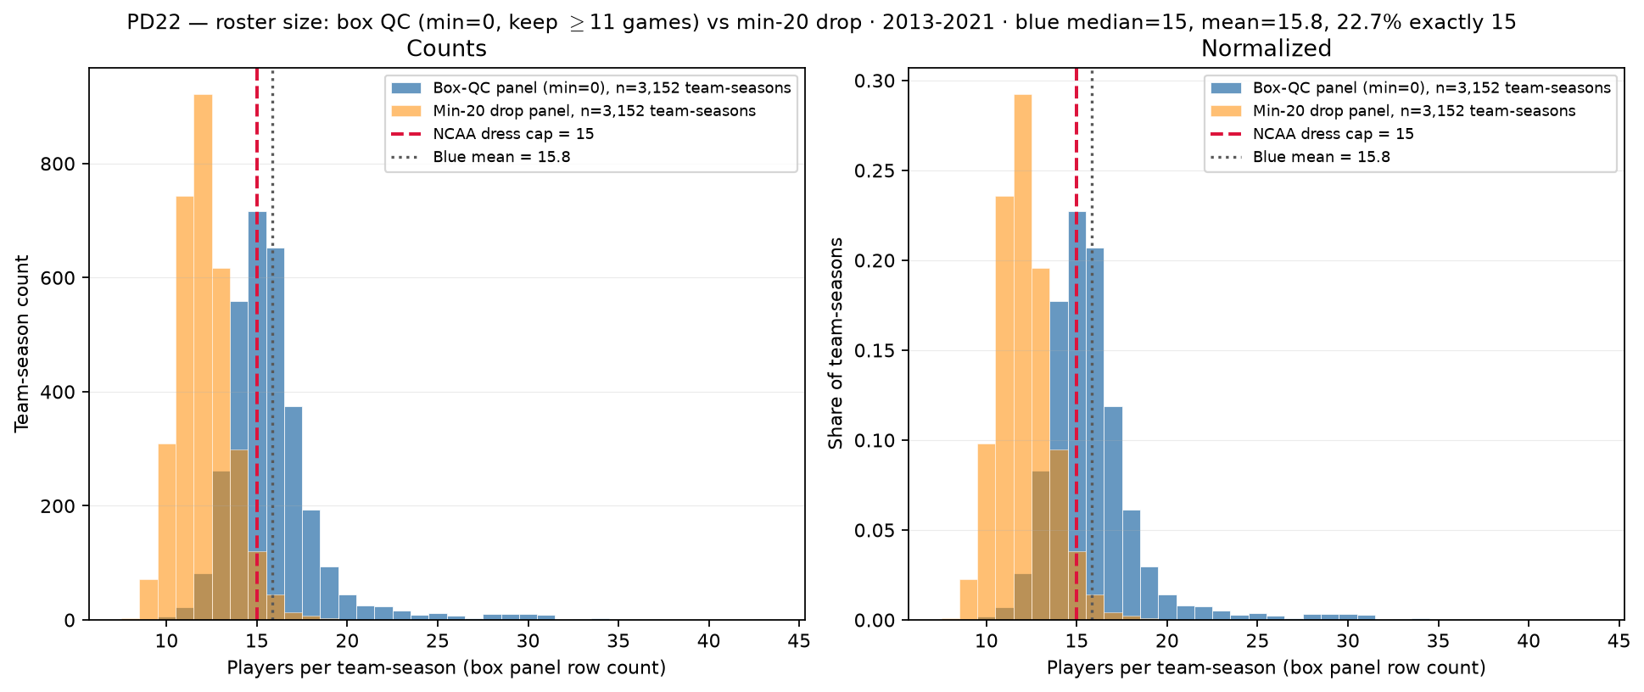
PD22 — Roster size: box-QC panel (min=0) vs min-20 drop
PD22 · roster size (after QC) · 2013-2021 · raw median = $15$ · $22.7\%$ exactly $15$
PD22 backup: players per team-season — box-QC panel (min\_minutes=0) vs min-20 drop.
Box QC at panel build: drop dash-name placeholders; keep team-seasons with $\geq 11$ distinct games in box (frozen CSV untouched).
Panel: 2013-2021 MBB · $3,152$ team-seasons · $49,955$ player-season rows.
Min=$0$ after QC (blue): median = $15$, mean = $15.8$; $22.7\%$ exactly $15$, $70.4\%$ $\geq 15$, $47.7\%$ $> 15$.
Min-20 drop (orange): median = $12$, mean = $12.1$; only $3.8\%$ exactly $15$ — rotation-minute survivors, not dress cap.
Tail: max = $43$ (team\_id 2655 $2,019$); $115$ BYU spike gone — dash rows dropped at panel build (SCOUT Aug $2,026$).
Red dashed = NCAA dress cap $15$; empirical caps in PD21 use min-20 multiset.
Left: team-season counts; right: normalized — bulk mass sits $14$–$17$ after box QC.
Claim (PD22 backup): After box QC, team-season roster counts cluster near NCAA dress cap $15$; empirical hero caps (min $\geq 20$) count rotation-minute contributors — not game-day dress lists.

