Slide 1
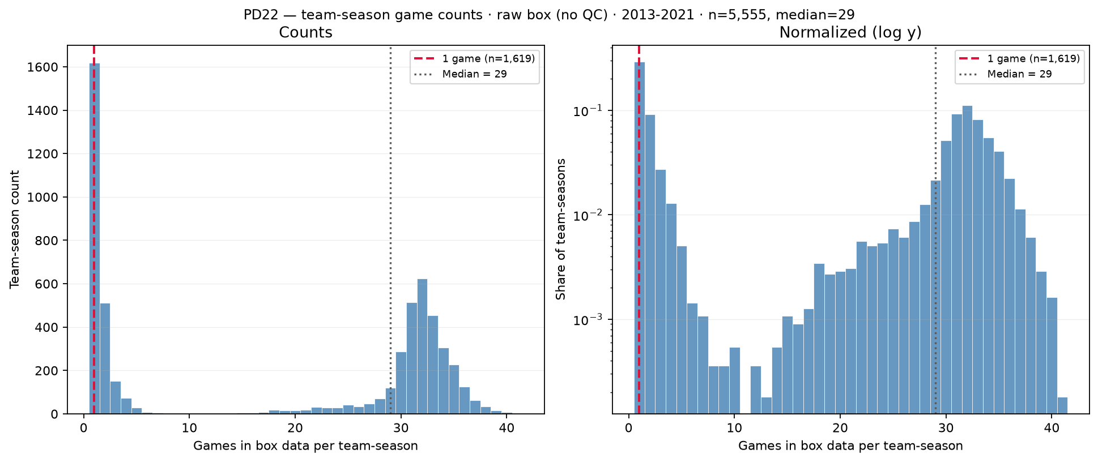
PD22 — Games per team-season in raw box data (before QC)
PD22 · team-season games · 2013–2021 · $1,619$ with $1$ game · median = $29$
PD22 backup: distinct game\_ids per (team\_id, season) in raw box (2011–2021).
Panel: $5,555$ team-seasons · median = $29$ games · mean = $18.5$ · max = $41$.
Bimodal: $1,619$ team-seasons ($29.1\%$) with only $1$ game (red line) vs cluster near $30$–$32$ (full seasons).
$\leq 10$ games: $2,403$ ($43.3\%$); $> 10$ games: $3,152$ — sparse tail is partial coverage / small-school noise.
Default box QC (panel\_rebuild): min\_team\_season\_games=10 drops team-seasons with $\leq 10$ games (keep $\geq 11$).
Left: linear counts; right: log $y$ — gap between spikes is low-frequency partial seasons, not hero-panel mass.
Pairs with roster-size backup: low-game team-seasons often inflate per-game roster anomalies (SCOUT ESPN dash rows).
Claim (PD22 backup): Box panel mixes full D-I seasons ($\sim 30$ games) with sparse one-game team-seasons — default min\_team\_season\_games=10 drops team-seasons with $\leq 10$ games (keep $\geq 11$) before player-season aggregation.

