Slide 1
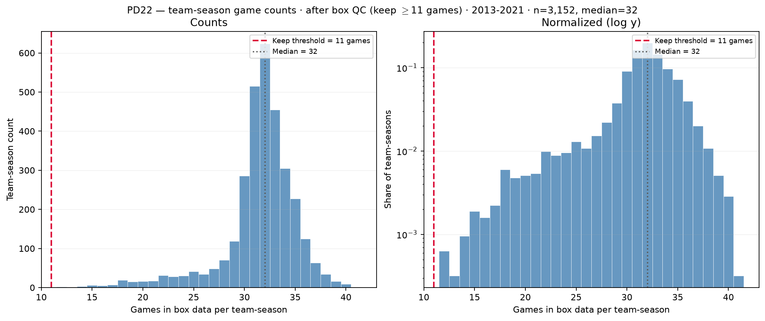
PD22 — Games per team-season after box QC
PD22 · games after box QC · 2013–2021 · $3,152$ team-seasons · median = $32$ · min $\geq 11$
PD22 backup (after filter): distinct game\_ids per (team\_id, season) surviving box QC.
Box QC at panel build: drop dash-name placeholders; keep team-seasons with $\geq 11$ distinct games in box (frozen CSV untouched).
Panel: $3,152$ team-seasons kept · median = $32$ games · mean = $31.5$ · min = $12$ (all $\geq 11$).
Removed by min\_team\_season\_games=10: $2,403$ team-seasons with $\leq 10$ games (see raw games-count slide).
Dropped dash rows: $175$ game rows before game-count tally.
No one-game spike — bulk mass sits near $28$–$32$ games (normal D-I seasons).
Left: linear counts; right: log $y$ — post-QC panel is what roster-size and minutes diagnostics use.
Claim (PD22 backup): After box QC, team-season game counts are full-season D-I coverage ($\geq 11$ games) — low-game tail ($\leq 10$ games) removed before panel build.

