Slide 1
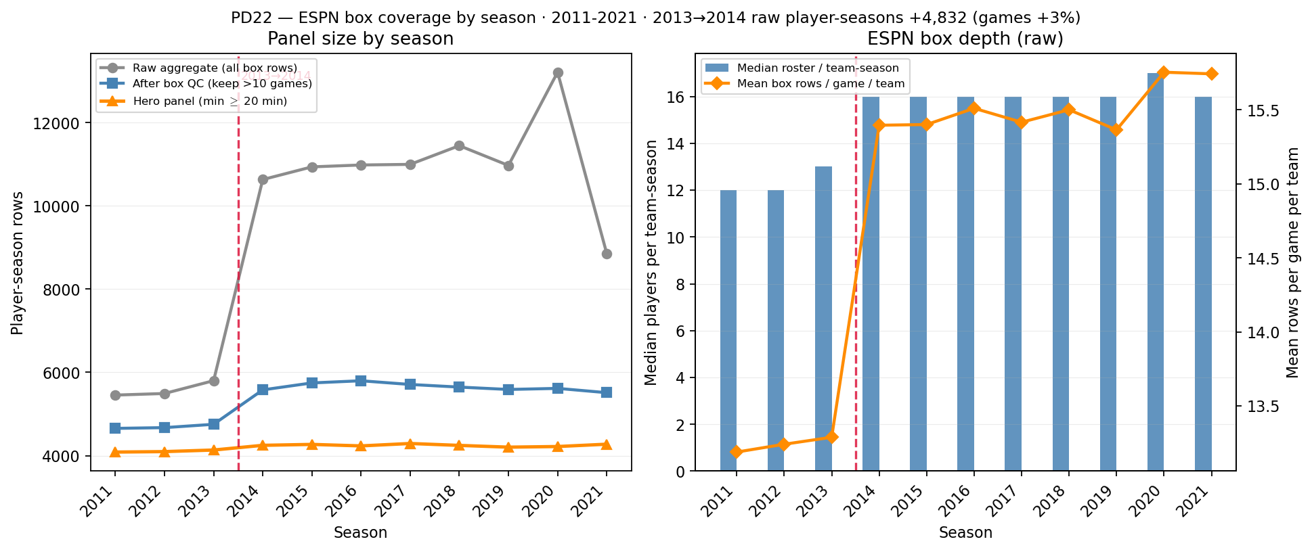
PD22 — ESPN box coverage by season (2013→2014 depth break)
PD22 · ESPN box coverage · 2011–2021 · 2013→2014 raw +$83.3\%$ · min-20 +$2.7\%$
PD22 backup (SCOUT Aug 2026): frozen \texttt{mbb\_df\_player\_box.csv} — season coverage for $\rho$ timeseries jump.
Source: distinct player-season rows aggregated from ESPN box (2011–2021); CSV not rewritten on disk.
2013→2014 raw player-seasons: $5,801\rightarrow10,633$ ($83.3\%$); games $3.4\%$ only.
Roster depth: median players/team-season $23.1\%$; mean box rows/game/team $15.9\%$ — ESPN lists more bench lines from 2014.
Overlap teams only ($464$ schools): player-seasons $5,388\rightarrow7,783$ (+44\% on same team\_ids).
Hero panel (box QC + min $\geq 20$): $4,135\rightarrow4,248$ ($2.7\%$).
Left: raw aggregate jumps at 2014; orange min-20 line flat — use for PD21 $\rho$ calibration, not ppm0lt20.
Right: median roster size and rows/game/team — SCOUT verify against ESPN API sample games 2013 vs 2014.
Claim (PD22 backup): 2013→2014 jump in raw player-season counts is ESPN box **depth** (more players listed per game), not doubled games — hero min-20 panel is longitudinal-safe for $\rho$ / $H_{\mathrm{sort}}$.

