Slide 1
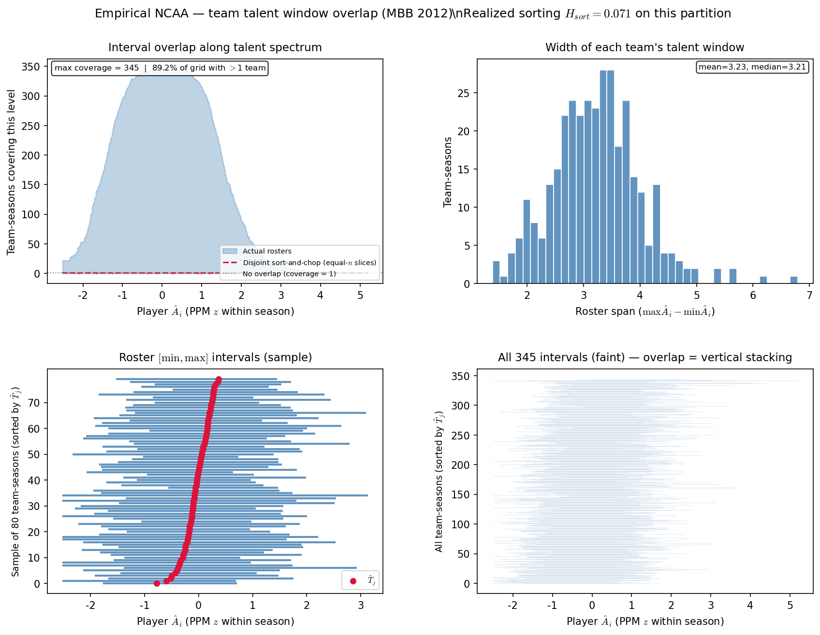
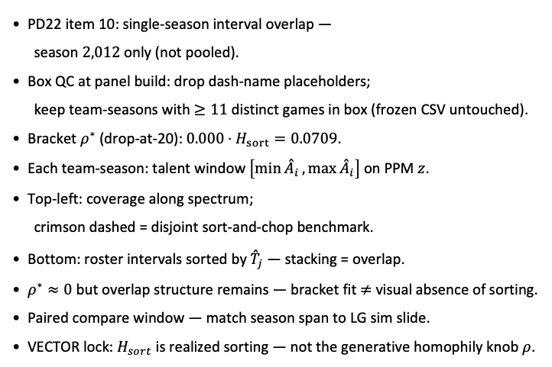
PD22 — team interval overlap · season 2012
PD22 item 10 · season 2012 · min 20 min drop panel · 345 team-seasons · $H_{sort}=0.071$ · $ρ^{∗}=0$
PD22 item 10: single-season interval overlap —
season $2,012$ only (not pooled).
Box QC at panel build: drop dash-name placeholders;
keep team-seasons with $≥11$ distinct games in box (frozen CSV untouched).
Bracket $ρ^{∗}$ (drop-at-20): $0.000$ · $H_{sort}=0.0709$.
Each team-season: talent window $\left[\min{{\overset{ˆ}{A}}_{i}},\max{{\overset{ˆ}{A}}_{i}}\right]$ on PPM $z$.
Top-left: coverage along spectrum;
crimson dashed = disjoint sort-and-chop benchmark.
Bottom: roster intervals sorted by ${\overset{ˆ}{T}}_{j}$ — stacking = overlap.
$ρ^{∗}≈0$ but overlap structure remains — bracket fit $≠$ visual absence of sorting.
Paired compare window — match season span to LG sim slide.
VECTOR lock: $H_{sort}$ is realized sorting — not the generative homophily knob $ρ$.
Claim (PD22): Single-season overlap diagnostic — does talent-window stacking persist when bracket $ρ^{∗}≈0$?

