Slide 1
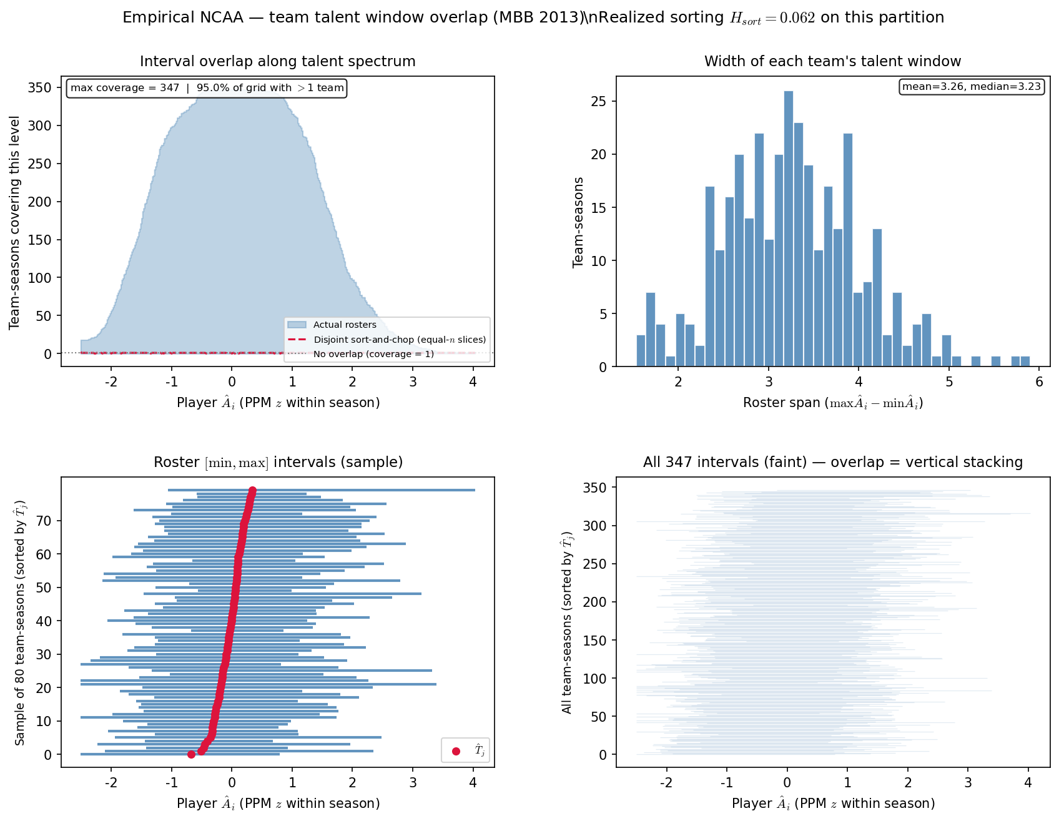
PD22 — team interval overlap · season 2013
PD22 item 11 · season 2013 · min 20 min drop panel · 347 team-seasons · $H_{\mathrm{sort}}=0.062$ · $\rho^*=0$
PD22 item 11: single-season interval overlap — season $2,013$ only (not pooled).
Box QC at panel build: drop dash-name placeholders; keep team-seasons with $\geq 11$ distinct games in box (frozen CSV untouched).
Bracket $\rho^*$ (drop-at-20): $0.000$ · $H_{\mathrm{sort}}$ = $0.0620$.
Each team-season: talent window $[\min \hat{A}_i, \max \hat{A}_i]$ on PPM $z$.
Top-left: coverage along spectrum; crimson dashed = disjoint sort-and-chop benchmark.
Bottom: roster intervals sorted by $\hat{T}_j$ — stacking = overlap.
$\rho^* \approx 0$ but overlap structure remains — bracket fit $\neq$ visual absence of sorting.
Paired compare window — match season span to LG sim slide.
VECTOR lock: H_{sort} is realized sorting — not the generative homophily knob \rho.
Claim (PD22): Single-season overlap diagnostic — does talent-window stacking persist when bracket $\rho^* \approx 0$?

