Slide 1
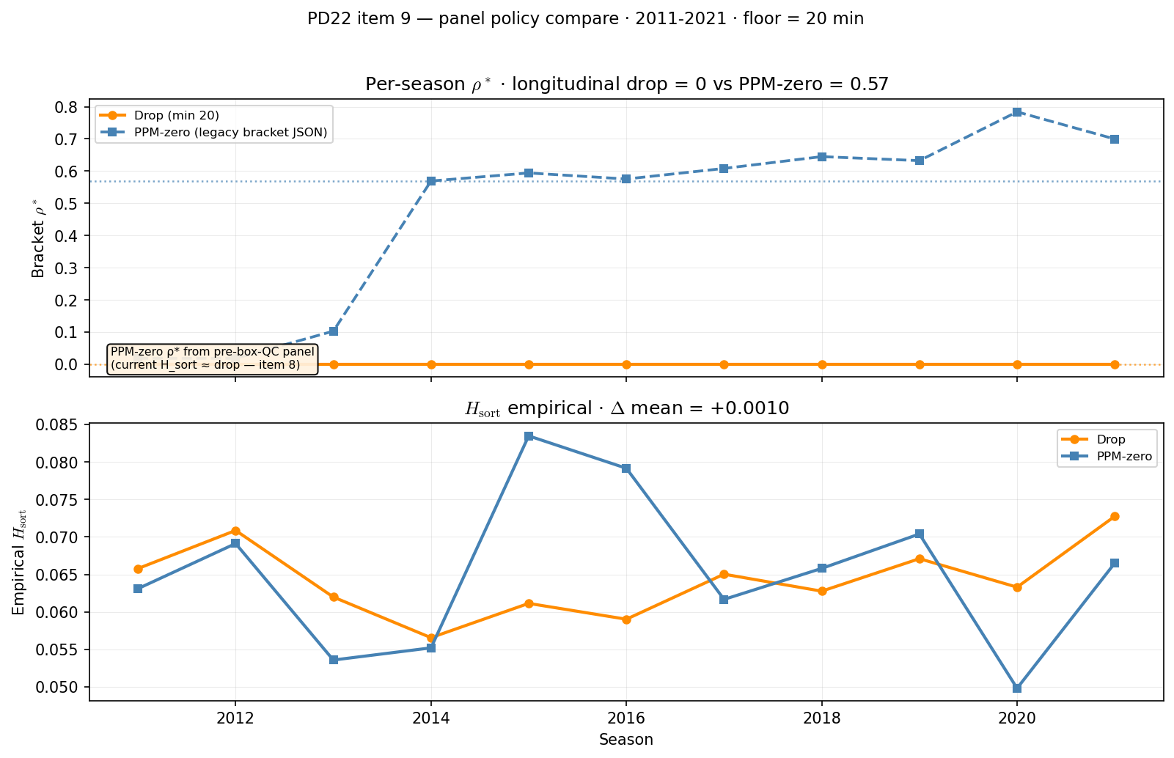
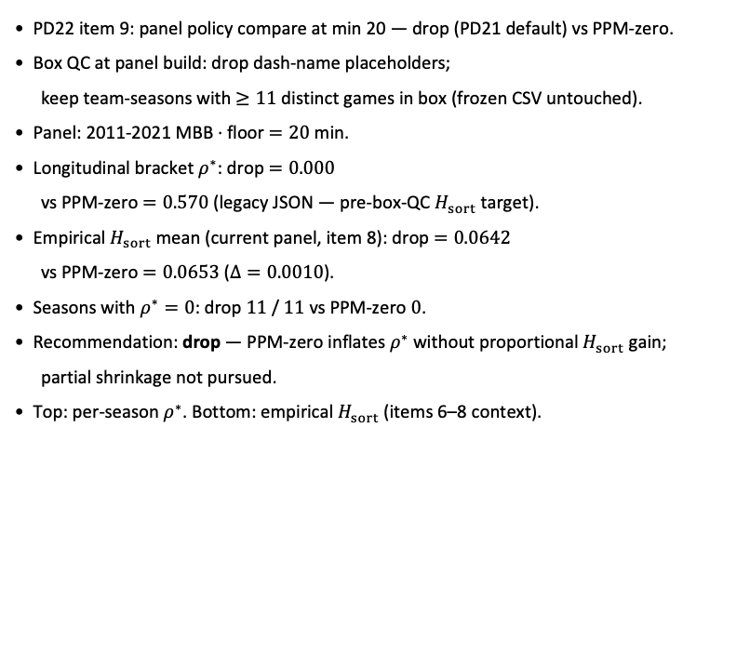
PD22 — panel policy: drop vs PPM-zero at min 20
PD22 item 9 · policy compare · 2011-2021 · $ρ^{∗}$ drop $0.000$ vs PPM-zero $0.570$
PD22 item 9: panel policy compare at min 20 — drop (PD21 default) vs PPM-zero.
Box QC at panel build: drop dash-name placeholders;
keep team-seasons with $≥11$ distinct games in box (frozen CSV untouched).
Panel: 2011-2021 MBB · floor $=20$ min.
Longitudinal bracket $ρ^{∗}$: drop $=0.000$
vs PPM-zero $=0.570$ (legacy JSON — pre-box-QC $H_{sort}$ target).
Empirical $H_{sort}$ mean (current panel, item 8): drop $=0.0642$
vs PPM-zero $=0.0653$ ($Δ=0.0010$).
Seasons with $ρ^{∗}=0$: drop $11$ / $11$ vs PPM-zero $0$.
Recommendation: drop — PPM-zero inflates $ρ^{∗}$ without proportional $H_{sort}$ gain;
partial shrinkage not pursued.
Top: per-season $ρ^{∗}$. Bottom: empirical $H_{sort}$ (items 6–8 context).
Claim (PD22): At min 20, drop vs PPM-zero — bracket $ρ^{∗}$ and empirical $H_{sort}$ decide which panel policy enters PD21 calibration.

