Slide 1
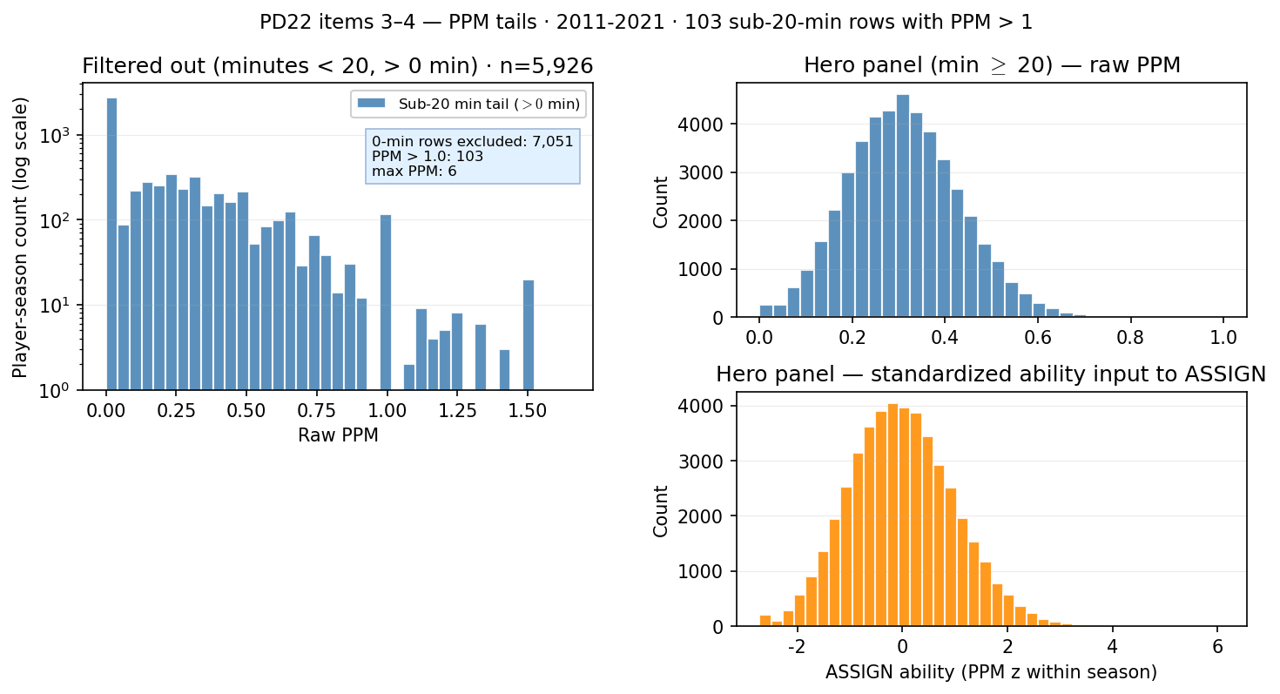
PD22 — PPM distribution: filtered-out tail vs hero ASSIGN input
PD22 · PPM tails · 2011-2021 · $103$ sub-20-min rows with PPM $> 1$
PD22 items 3–4: points-per-minute (PPM) — filtered-out tail vs hero ASSIGN input.
Box QC at panel build: drop dash-name placeholders; keep team-seasons with $\geq 11$ distinct games in box (frozen CSV untouched).
Panel: 2011-2021 MBB · hero lock min = $20$ min.
Item 3 (left): $12,977$ rows with minutes $< 20$ ($7,051$ at $0$ min excluded from PPM hist).
Sub-20-min with PPM $> 1$: $103$; max raw PPM in tail: $6.00$.
Item 4 (right): hero panel $n = 46,306$ — raw PPM then PPM z within season (PD21 ASSIGN ability; empirical roster caps are separate).
Hero raw PPM median = $0.308$; standardized ability median = $-0.04$.
Left: why minutes matter (garbage-time PPM spikes). Right: what enters homophily calibration after the floor.
hero panel + PPM z within season (PD21 ASSIGN input)
Claim (PD22): Minutes floor guards against noisy PPM tails — sub-20-min rows include extreme points-per-minute spikes; hero ASSIGN uses PPM z-scored within season on the min-20 panel.

