Slide 1
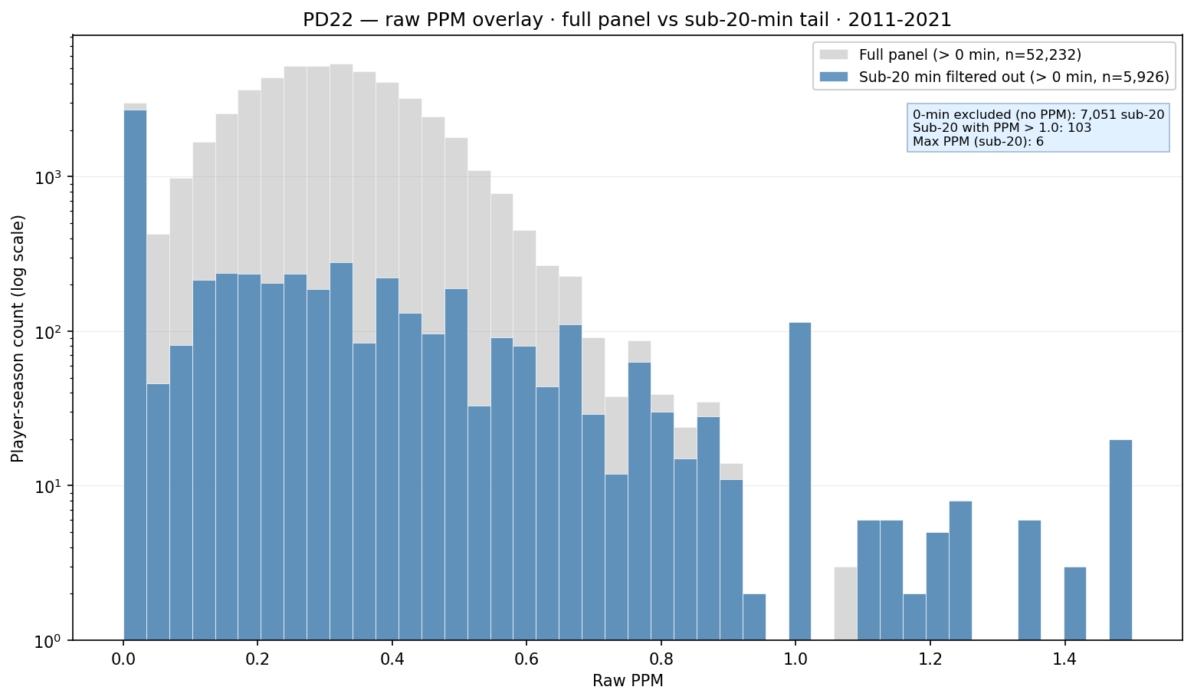
PD22 — Raw PPM: full panel vs sub-20-min filtered tail
PD22 · PPM overlay · 2011-2021 · $103$ sub-20-min rows with PPM $> 1$
PD22 overlay: gray = box-QC panel raw PPM (minutes $> 0$); blue = sub-20-min tail removed by drop policy.
Box QC at panel build: drop dash-name placeholders; keep team-seasons with $\geq 11$ distinct games in box (frozen CSV untouched).
Panel: 2011-2021 MBB · gray $n \approx 52,232$ · blue $n = 5,926$ · $7,051$ zero-min rows excluded (PPM undefined).
Sub-20 PPM $> 1$: $103$; max $6.00$; sub-20 median PPM (positive min) = $0.125$.
After min-20 drop: hero panel $n = 46,306$; raw PPM median = $0.308$ (p99 = $0.62$).
Minutes context (box-QC panel): $21.9\%$ below $20$ min; median = $344$ min (all) vs $979$ min (ever-draft).
Empirical caps (min $\geq 20$ panel): mean $9.6$ / median $11$ players per team-season (p25=$6$, p75=$12$); only $2.3\%$ exactly $15$ — rotation-minute count, not who dressed for a game.
NCAA dress cap $\approx 15$ per game $\neq$ our cap multiset — box panel counts season rows passing the minutes rule.
Claim (PD22): Sub-20-min rows add PPM noise ($103$ with PPM $> 1$, max $6.00$) on top of a rotation-player cloud — minutes floor cleans ability before hero / ASSIGN; empirical roster caps count season contributors, not NCAA dress-out $15$.

