Slide 1
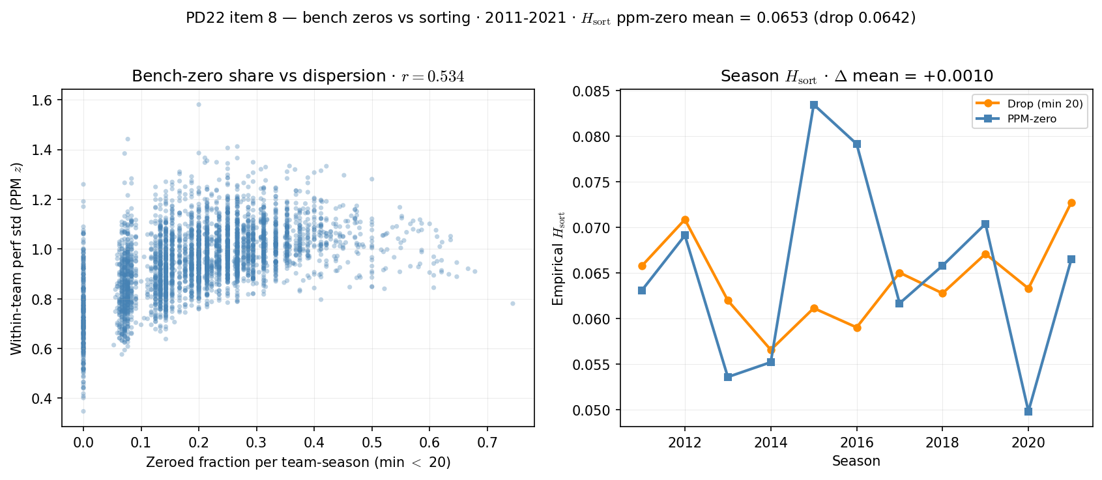
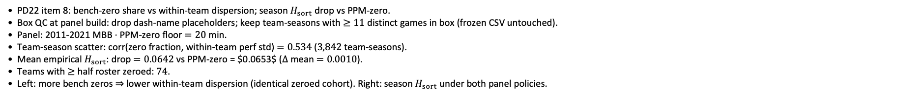
PD22 — bench-zero clustering vs empirical sorting
PD22 item 8 · bench zeros vs $H_{sort}$ · 2011-2021 · $Δ$ mean = $0.0010$
PD22 item 8: bench-zero share vs within-team dispersion; season $H_{sort}$ drop vs PPM-zero.
Box QC at panel build: drop dash-name placeholders; keep team-seasons with $≥11$ distinct games in box (frozen CSV untouched).
Panel: 2011-2021 MBB · PPM-zero floor $=20$ min.
Team-season scatter: corr(zero fraction, within-team perf std) $=0.534$ ($3,842$ team-seasons).
Mean empirical $H_{sort}$: drop $=0.0642$ vs PPM-zero = $0.0653$ ($Δ$ mean $=0.0010$).
Teams with $≥$ half roster zeroed: $74$.
Left: more bench zeros $⇒$ lower within-team dispersion (identical zeroed cohort). Right: season $H_{sort}$ under both panel policies.
Claim (PD22): PPM-zero piles identical bench abilities on rosters — check whether that mechanically inflates empirical $H_{sort}$ vs drop-at-20.

