Slide 1
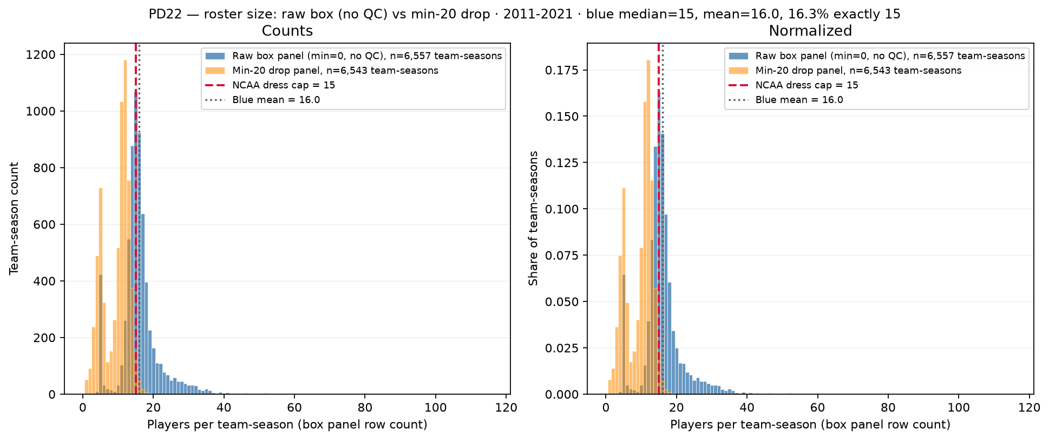
PD22 — Roster size: raw box (no QC) vs min-20 drop
PD22 · roster size (before QC) · 2011-2021 · raw median = $15$ · max = $115$
PD22 backup: players per team-season — legacy raw box (no QC) vs min-20 drop.
No box QC: dash-name placeholders and sparse team-seasons still in panel.
Panel: 2011-2021 MBB · $6,557$ team-seasons · $104,790$ player-season rows.
Min=$0$ raw box (blue): median = $15$, mean = $16.0$; $16.3\%$ exactly $15$, $64.5\%$ $\geq 15$, $48.1\%$ $> 15$.
Min-20 drop (orange): median = $11$, mean = $9.5$; only $2.3\%$ exactly $15$.
Tail: max = $115$ (BYU $2,018$); $115$ BYU spike from ESPN dash rows in one game (SCOUT Aug $2,026$).
Motivation for box QC at panel build — next slide shows after dash + min-games filters.
Left: team-season counts; right: normalized — long tail from junk box rows.
Claim (PD22 backup): Raw ESPN box rows inflate team-season roster counts — dash placeholders and sparse junk games before panel QC at build.

