Slide 1
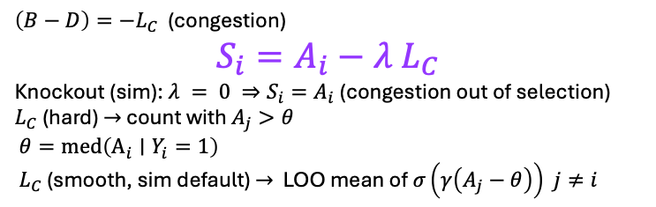

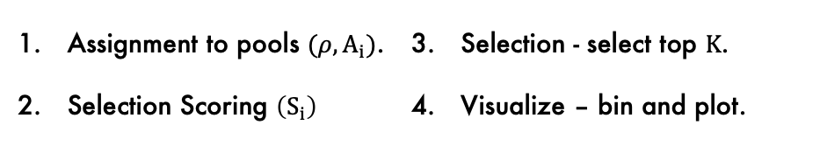



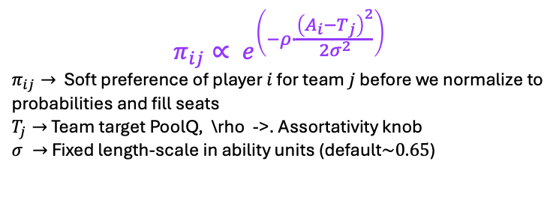
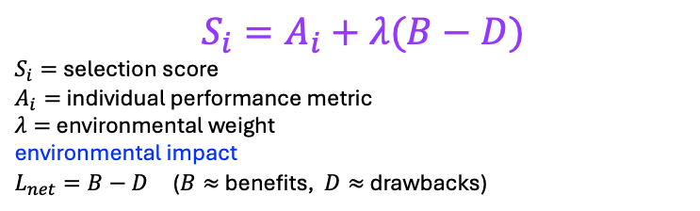
MODEL FOUR STEP PROCESS:
Assignment to pools $(ρ, A_{i})$.
Selection Scoring $\left(S_{i}\right)$
Selection - select top $K$.
Visualize – bin and plot.
1. Soft Assignment
3. Selection
$$π_{ij}∝ e^{\left(−ρ∙\frac{{\left(A_{i}−T_{j}\right)}^{2}}{2σ^{2}}\right)}$$
$π_{ij}→$ Soft preference of player $i$ for team $j$ before we normalize to probabilities and fill seats
$T_{j}→$ Team target PoolQ, \rho ->. Assortativity knob
$σ →$ Fixed length-scale in ability units (default$\sim 0.65$)
The current trivial method is just to choose the top $K$ players by $S_{i}$
Future methods could introduce stochastic noise $S_{i}+ δ$
4. Visualize
TALENT vs SELECTION
2. Unified Selection Score Equation
$S_{i}=A_{i}+λ(B−D)$
$S_{i}=$selection score
$A_{i}=$individual performance metric
$λ=$ environmental weight
environmental impact
$L_{net}=B−D$ ($B≈$ benefits, $D≈$ drawbacks)
Naïve (empirical)
HERO (empirical)
$$P(Y_{i}=1|A_{i})$$
$$P(Y_{i}=1|A_{i})$$
$$A_{i}$$
$$PoolQ LOO$$
Congestion Equation v1
$\left(B−D\right)=−L_{C}$ (congestion)
$$S_{i}=A_{i}−λ L_{C}$$
Knockout (sim): $λ = 0 ⇒S_{i}=A_{i}$ (congestion out of selection)
$L_{C}$(hard) $→$ count with $A_{j}>θ$
$θ=\operatorname{med}\left({\text{A}}_{i}∣Y_{i}=1\right)$
$L_{C}$ (smooth, sim default) $→$ LOO mean of $σ\left(γ\left(A_{j}−θ\right)\right)$ $j≠i$
Empirical (real panel)
Naïve: $P\left(Y_{i}=1|A_{i}\right) →$ $≈$ monotone Hero: $P\left(Y_{i}=1|PoolQ_LOO\right) →$ tail dip

