Slide 1

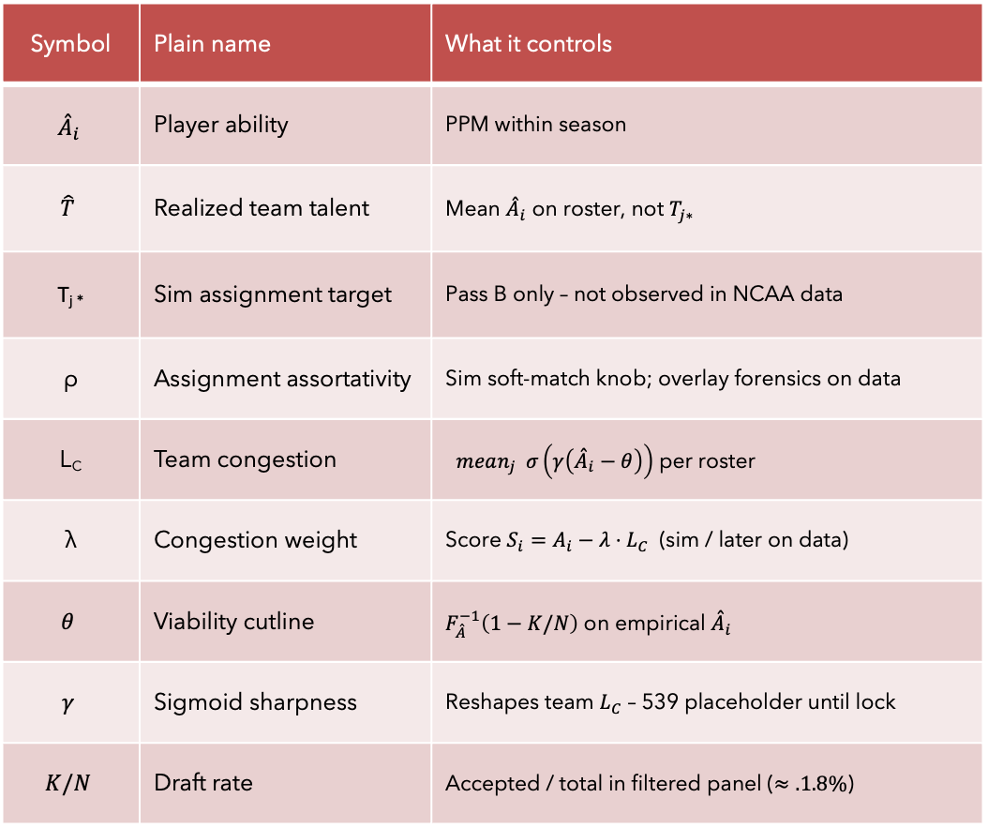
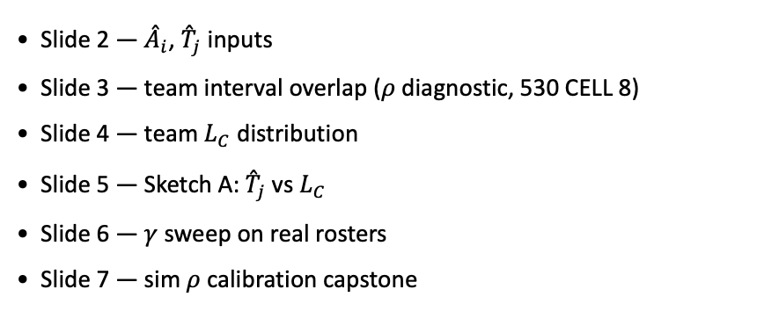
PD17 — Empirical MBB characterization
Knobs (mini glossary)
Symbol | Plain name | What it controls
$${\overset{ˆ}{A}}_{i}$$ | Player ability | PPM within season
$$\hat{T}$$ | Realized team talent | Mean ${\overset{ˆ}{A}}_{i}$ on roster, not $T_{j∗}$
T_{j *} | Sim assignment target | Pass B only – not observed in NCAA data
ρ | Assignment assortativity | Sim soft-match knob; overlay forensics on data
L_{C} | Team congestion | $mean_{j} σ\left(γ\left({\overset{ˆ}{A}}_{i}−θ\right)\right)$ per roster
λ | Congestion weight | Score $S_{i}=A_{i}−λ{⋅L}_{C}$ (sim / later on data)
$$θ$$ | Viability cutline | $F_{\overset{ˆ}{A}}^{−1}\left(1−K/N\right)$ on empirical ${\overset{ˆ}{A}}_{i}$
$$γ$$ | Sigmoid sharpness | Reshapes team $L_{C}$ – 539 placeholder until lock
$$K/N$$ | Draft rate | Accepted / total in filtered panel ($≈.1.8\%$)
Deck map (assign $→$score)
Slide 2 — ${\overset{ˆ}{A}}_{i}$, ${\overset{ˆ}{T}}_{j}$ inputs
Slide 3 — team interval overlap ($ρ$ diagnostic, 530 CELL 8)
Slide 4 — team $L_{C}$ distribution
Slide 5 — Sketch A: ${\overset{ˆ}{T}}_{j}$ vs $L_{C}$
Slide 6 — $γ$ sweep on real rosters
Slide 7 — sim $ρ$ calibration capstone
Claim (PD17): Map empirical properties of real rosters — prerequisite for pinning $ρ$ and $θ$ from data, then $γ$ and $λ$ without hero-curve matching.

Slide 2
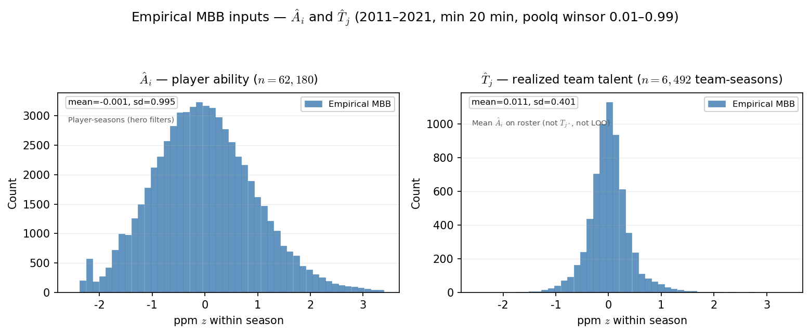

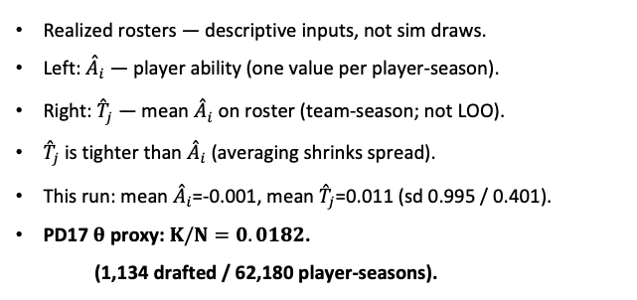
PD17 — Empirical MBB inputs: ${\overset{ˆ}{A}}_{i}$ and ${\overset{ˆ}{T}}_{j}$
MBB 2011-2021 · ppm z within season · min 20 min · poolq winsor 0.01–0.99
Realized rosters — descriptive inputs, not sim draws.
Left: ${\overset{ˆ}{A}}_{i}$ — player ability (one value per player-season).
Right: ${\overset{ˆ}{T}}_{j}$ — mean ${\overset{ˆ}{A}}_{i}$ on roster (team-season; not LOO).
${\overset{ˆ}{T}}_{j}$ is tighter than ${\overset{ˆ}{A}}_{i}$ (averaging shrinks spread).
This run: mean ${\overset{ˆ}{A}}_{i}$=-0.001, mean ${\overset{ˆ}{T}}_{j}$=0.011 (sd 0.995 / 0.401).
PD17 $θ$ proxy: $K/N=0.0182$.
(1,134 drafted / 62,180 player-seasons).
Claim (PD17): World-first inputs from the real MBB panel — ${\overset{ˆ}{A}}_{i}$ per player-season and ${\overset{ˆ}{T}}_{j}$ per team-season. Not $T_{j^{∗}}$(sim assignment targets).

Slide 3
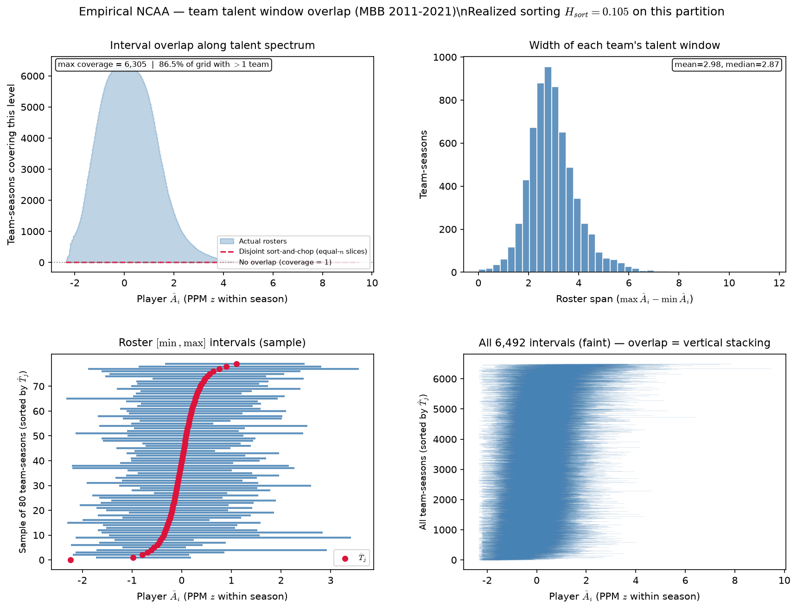
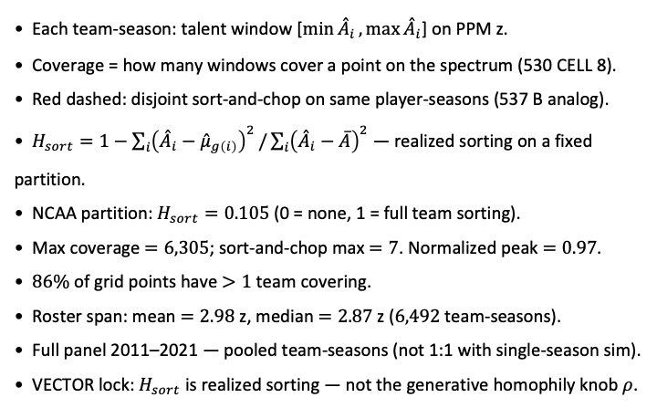
PD17 — Empirical team ${\overset{ˆ}{A}}_{i}$ interval overlap ($ρ$ diagnostic)
MBB 2011-2021 · PPM z within season · min 20 min · poolq winsor $0.01–0.99$ · $6,492$ team-seasons (530 CELL 8 port) · $H_{sort}=0.105$
Each team-season: talent window [$\min{{\overset{ˆ}{A}}_{i}},\max{{\overset{ˆ}{A}}_{i}}$] on PPM z.
Coverage = how many windows cover a point on the spectrum (530 CELL 8).
Red dashed: disjoint sort-and-chop on same player-seasons (537 B analog).
$H_{sort}=1−\sum_{i}{{\left({\overset{ˆ}{A}}_{i}−{\overset{ˆ}{μ}}_{g\left(i\right)}\right)}^{2}}/\sum_{i}{{\left({\overset{ˆ}{A}}_{i}−\overline{A}\right)}^{2}}$ — realized sorting on a fixed partition.
NCAA partition: $H_{sort}=0.105$ (0 = none, 1 = full team sorting).
Max coverage $=6,305$; sort-and-chop max $=7$. Normalized peak $=0.97$.
$86\%$ of grid points have $>1$ team covering.
Roster span: mean $=2.98$ z, median $=2.87$ z ($6,492$ team-seasons).
Full panel 2011–2021 — pooled team-seasons (not 1:1 with single-season sim).
VECTOR lock: $H_{sort}$ is realized sorting — not the generative homophily knob $ρ$.
Claim (PD17): Real NCAA rosters leave massively overlapping team talent windows — full 2011–2021 panel target for \rho characterization (530 CELL 8).

Slide 4
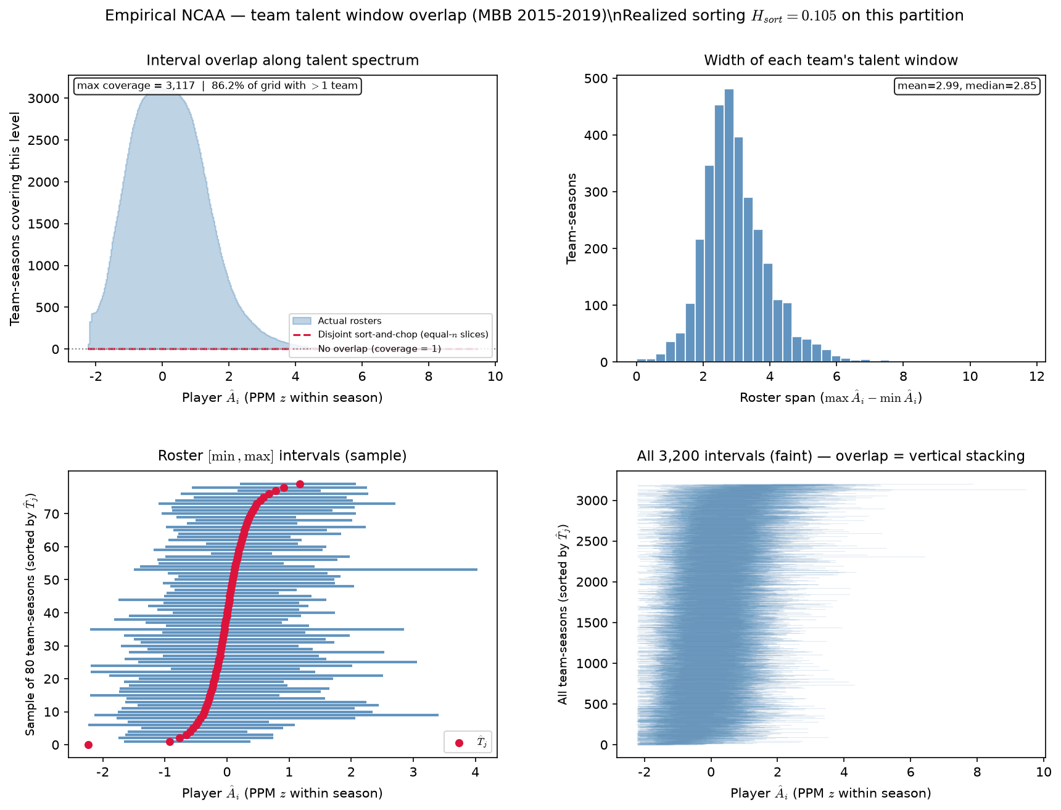

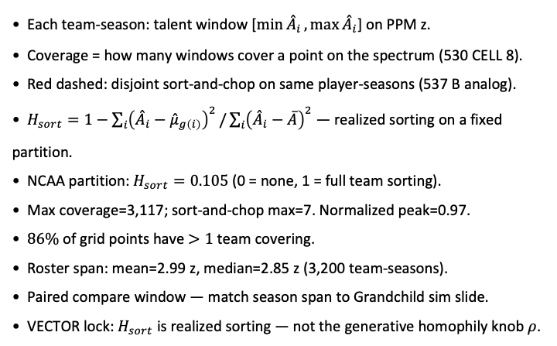
PD17 — NCAA team ${\overset{ˆ}{A}}_{i}$ interval overlap (2015-2019)
MBB 2015-2019 · PPM z within season · min 20 min · poolq winsor 0.01–0.99 · 3,200 team-seasons (530 CELL 8 port) · $H_{sort}=0.105$
Each team-season: talent window [$\min{{\overset{ˆ}{A}}_{i}},\max{{\overset{ˆ}{A}}_{i}}$] on PPM z.
Coverage = how many windows cover a point on the spectrum (530 CELL 8).
Red dashed: disjoint sort-and-chop on same player-seasons (537 B analog).
$H_{sort}=1−\sum_{i}{{\left({\overset{ˆ}{A}}_{i}−{\overset{ˆ}{μ}}_{g\left(i\right)}\right)}^{2}}/\sum_{i}{{\left({\overset{ˆ}{A}}_{i}−\overline{A}\right)}^{2}}$ — realized sorting on a fixed partition.
NCAA partition: $H_{sort}=0.105$ (0 = none, 1 = full team sorting).
Max coverage=3,117; sort-and-chop max=7. Normalized peak=0.97.
$86\%$ of grid points have $>1$ team covering.
Roster span: mean=2.99 z, median=2.85 z (3,200 team-seasons).
Paired compare window — match season span to Grandchild sim slide.
VECTOR lock: $H_{sort}$ is realized sorting — not the generative homophily knob $ρ$.
Claim: NCAA interval overlap on a fixed season window — paired compare to Grandchild ASSIGN sim on the same window.

Slide 5
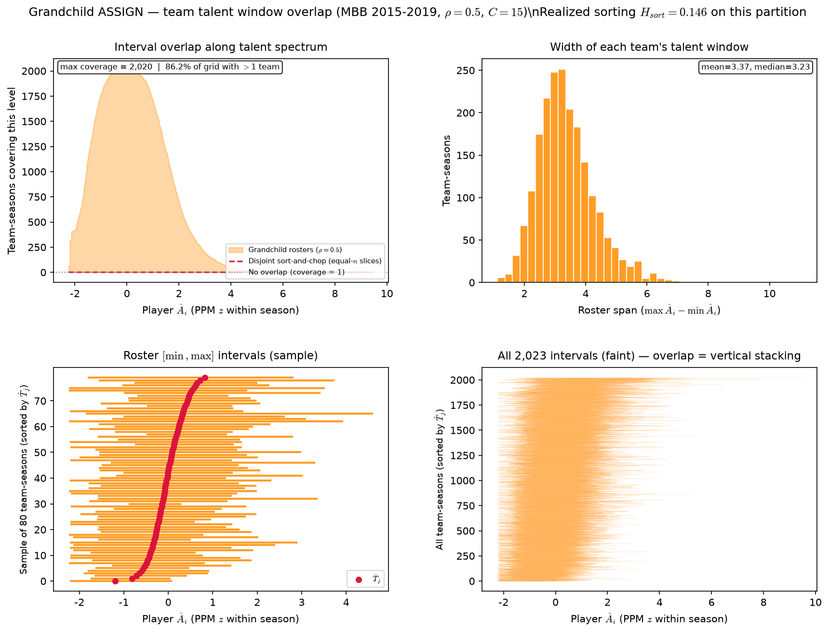
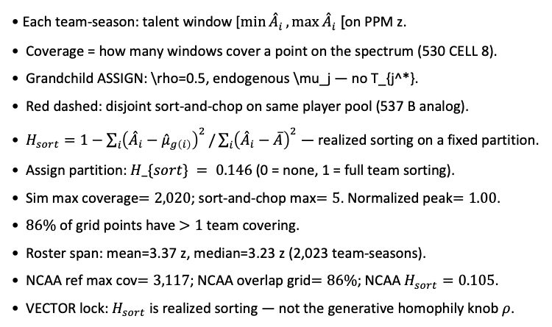
Grandchild sim — team \hat{A}_{i} interval overlap (2015-2019)
MBB 2015-2019 · Grandchild ASSIGN · $ρ=0.5$ · $C=15$ · $N=30,345$ $2,023$ team-seasons · $H_{sort}=0.146$
Each team-season: talent window [$\min{{\overset{ˆ}{A}}_{i}},\max{{\overset{ˆ}{A}}_{i}}$] on PPM z.
Coverage = how many windows cover a point on the spectrum (530 CELL 8).
Grandchild ASSIGN: \rho=0.5, endogenous \mu_j — no T_{j^*}.
Red dashed: disjoint sort-and-chop on same player pool (537 B analog).
$H_{sort}=1−\sum_{i}{{\left({\overset{ˆ}{A}}_{i}−{\overset{ˆ}{μ}}_{g\left(i\right)}\right)}^{2}}/\sum_{i}{{\left({\overset{ˆ}{A}}_{i}−\overline{A}\right)}^{2}}$ — realized sorting on a fixed partition.
Assign partition: $H_\{sort\} = 0.146$ (0 = none, 1 = full team sorting).
Sim max coverage$=2,020$; sort-and-chop max$=5$. Normalized peak$=1.00$.
$86\%$ of grid points have $>1$ team covering.
Roster span: mean=3.37 z, median=3.23 z (2,023 team-seasons).
NCAA ref max cov$=3,117$; NCAA overlap grid$=86\%$; NCAA $H_{sort}=0.105$.
VECTOR lock: $H_{sort}$ is realized sorting — not the generative homophily knob $ρ$.
Claim: Grandchild ASSIGN on the same season window as paired NCAA slide — one realization per season, stacked team-seasons.

Slide 6
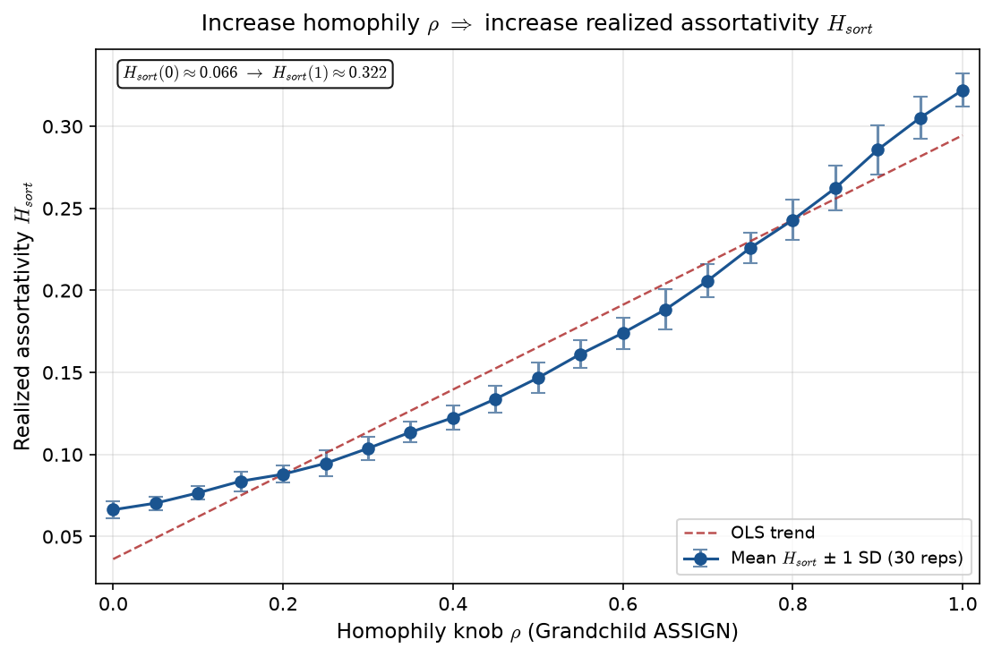

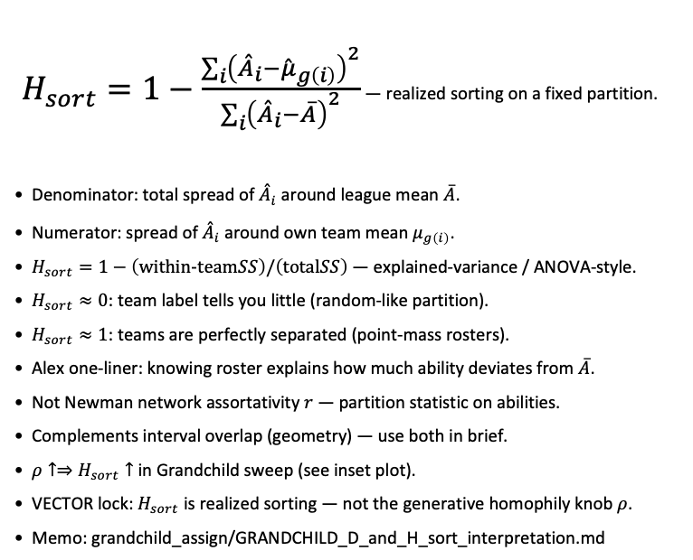
What is $H_{sort}$ ? Realized assortativity on rosters
Realized sorting index · Grandchild / PD17 · alias $sorting_index_h$ in code
$H_{sort}=1−\frac{\sum_{i}{{\left({\overset{ˆ}{A}}_{i}−{\overset{ˆ}{μ}}_{g\left(i\right)}\right)}^{2}}}{\sum_{i}{{\left({\overset{ˆ}{A}}_{i}−\overline{A}\right)}^{2}}}$ — realized sorting on a fixed partition.
Denominator: total spread of ${\overset{ˆ}{A}}_{i}$ around league mean $\overline{A}$.
Numerator: spread of ${\overset{ˆ}{A}}_{i}$ around own team mean $μ_{g\left(i\right)}$.
$H_{sort}=1−\left(\text{within-team}SS\right)/\left(\text{total}SS\right)$ — explained-variance / ANOVA-style.
$H_{sort}≈0$: team label tells you little (random-like partition).
$H_{sort}≈1$: teams are perfectly separated (point-mass rosters).
Alex one-liner: knowing roster explains how much ability deviates from $\overline{A}$.
Not Newman network assortativity $r$ — partition statistic on abilities.
Complements interval overlap (geometry) — use both in brief.
$ρ↑⇒H_{sort}↑$ in Grandchild sweep (see inset plot).
VECTOR lock: $H_{sort}$ is realized sorting — not the generative homophily knob $ρ$.
Memo: grandchild_assign/GRANDCHILD_D_and_H_sort_interpretation.md
Claim: $H_{sort}$ is realized assortativity on a fixed partition — generative homophily $ρ$ is the ASSIGN knob; measure $H_{sort}$ after assign.

Slide 7
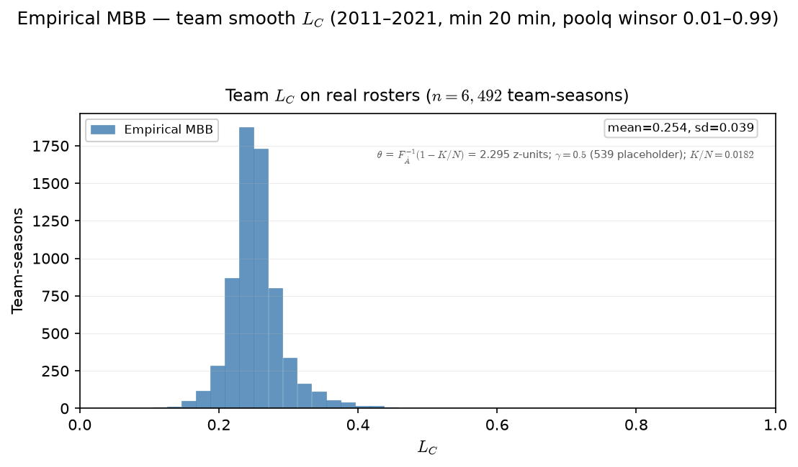

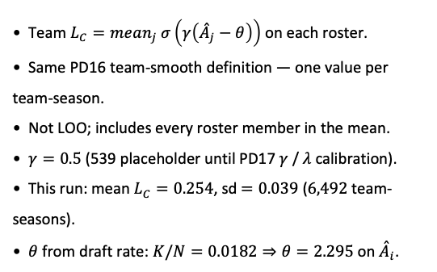
PD17 — Empirical team $L_{C}$ distribution
MBB 2011-2021 · team smooth $L_{C}$ · PPM z within season · min 20 min · $θ=F_{\overset{ˆ}{A}}^{−1}\left(1−K/N\right)=2.295 \left(K/N=0.0182\right)$· $γ=0.5$ placeholder
Team $L_{C}=mean_{j} σ\left(γ\left({\overset{ˆ}{A}}_{j}−θ\right)\right)$ on each roster.
Same PD16 team-smooth definition — one value per team-season.
Not LOO; includes every roster member in the mean.
$γ=0.5$ (539 placeholder until PD17 $γ$ / $λ$ calibration).
This run: mean $L_{C}=0.254$, sd$=0.039$ ($6,492$ team-seasons).
$θ$ from draft rate: $K/N=0.0182⇒θ=2.295$ on ${\overset{ˆ}{A}}_{i}$.
Claim (PD17): Real rosters carry a spread of team congestion $L_{C}$ — the descriptive input $ρ$ was meant to stratify in sim.

Slide 8
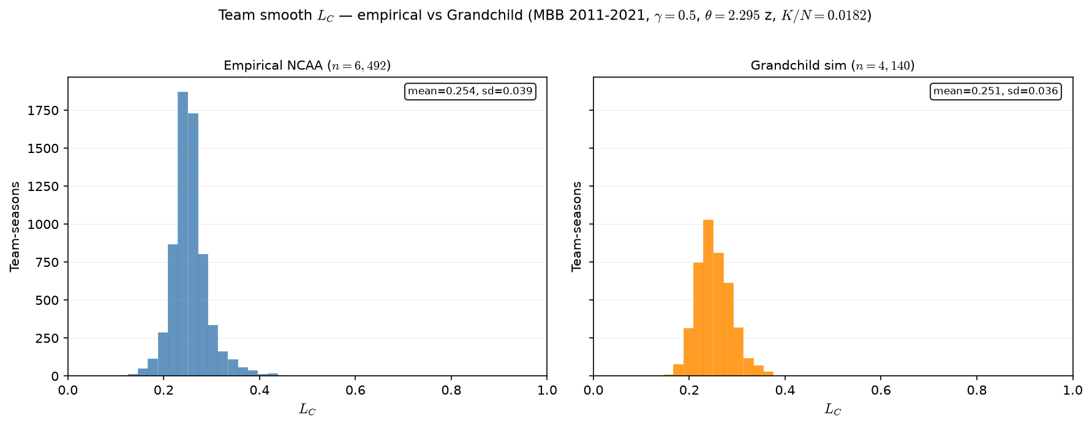

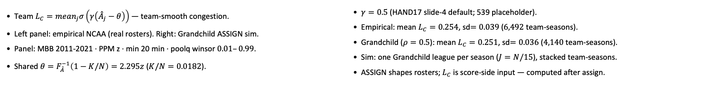
Empirical vs Grandchild — team $L_{C}$ distribution
MBB 2011-2021 · team smooth $L_{C}$ · Grandchild $ρ=0.5$ · $γ=0.5$ · $θ=2.295 z$ ($K/N=0.0182$)
Team $L_{C}=mean_{j}σ\left(γ\left({\overset{ˆ}{A}}_{j}−θ\right)\right)$ — team-smooth congestion.
Left panel: empirical NCAA (real rosters). Right: Grandchild ASSIGN sim.
Panel: MBB 2011-2021 · PPM z · min 20 min · poolq winsor $0.01–0.99$.
Shared $θ=F_{\overset{ˆ}{A}}^{−1}\left(1−K/N\right)=2.295z$ ($K/N=0.0182$).
$γ=0.5$ (HAND17 slide-4 default; 539 placeholder).
Empirical: mean $L_{C}=0.254$, sd$=0.039$ ($6,492$ team-seasons).
Grandchild ($ρ=0.5$): mean $L_{C}=0.251$, sd$=0.036$ ($4,140$ team-seasons).
Sim: one Grandchild league per season ($J=N/15$), stacked team-seasons.
ASSIGN shapes rosters; $L_{C}$ is score-side input — computed after assign.
Claim (PD17 / Grandchild): Team smooth $L_{C}$ on real rosters vs Grandchild sim — same $σ\left(γ\left({\overset{ˆ}{A}}_{j}−θ\right)\right)$ formula; compare distribution shape before SCORE.

Slide 9
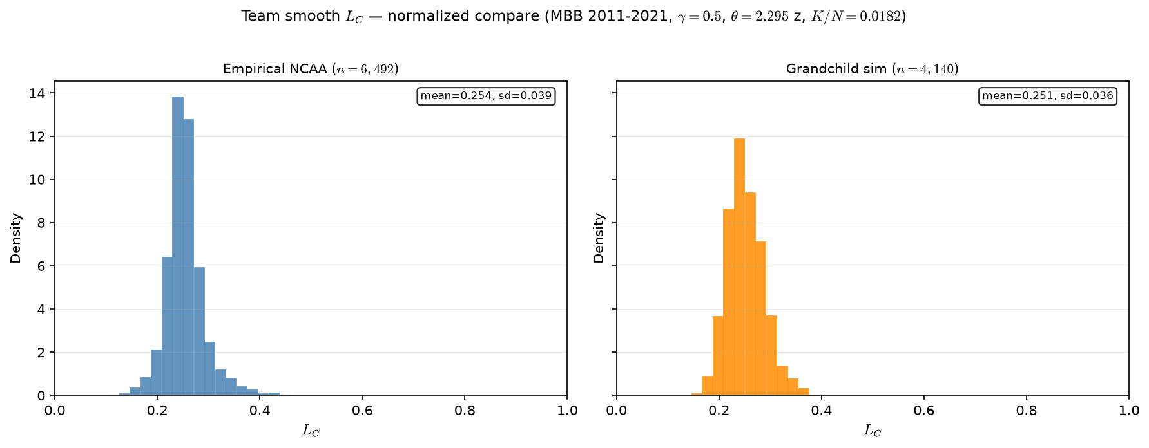
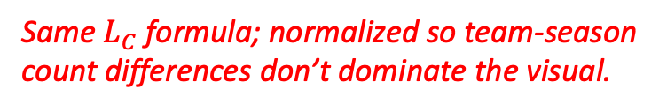
Empirical vs Grandchild — team $L_{C}$ distribution (normalized)
Same $L_{C}$ formula; normalized so team-season count differences don’t dominate the visual.
MBB 2011-2021 · team smooth $L_{C}$ · Grandchild $ρ=0.5$ · $γ=0.5$ · $θ=2.295 z$ ($K/N=0.0182$)
Team $L_{C}=mean_{j}σ\left(γ\left({\overset{ˆ}{A}}_{j}−θ\right)\right)$ — team-smooth congestion.
Left panel: empirical NCAA (real rosters). Right: Grandchild ASSIGN sim.
Panel: MBB 2011-2021 · PPM z · min 20 min · poolq winsor $0.01–0.99$.
Shared $θ=F_{\overset{ˆ}{A}}^{−1}\left(1−K/N\right)=2.295z$ ($K/N=0.0182$).
$γ=0.5$ (HAND17 slide-4 default; 539 placeholder).
Empirical: mean $L_{C}=0.254$, sd$=0.039$ ($6,492$ team-seasons).
Grandchild ($ρ=0.5$): mean $L_{C}=0.251$, sd$=0.036$ ($4,140$ team-seasons).
Sim: one Grandchild league per season ($J=N/15$), stacked team-seasons.
ASSIGN shapes rosters; $L_{C}$ is score-side input — computed after assign.
Claim (PD17 / Grandchild): Team smooth $L_{C}$ on real rosters vs Grandchild sim — same $σ\left(γ\left({\overset{ˆ}{A}}_{j}−θ\right)\right)$ formula; compare distribution shape before SCORE.

Slide 10
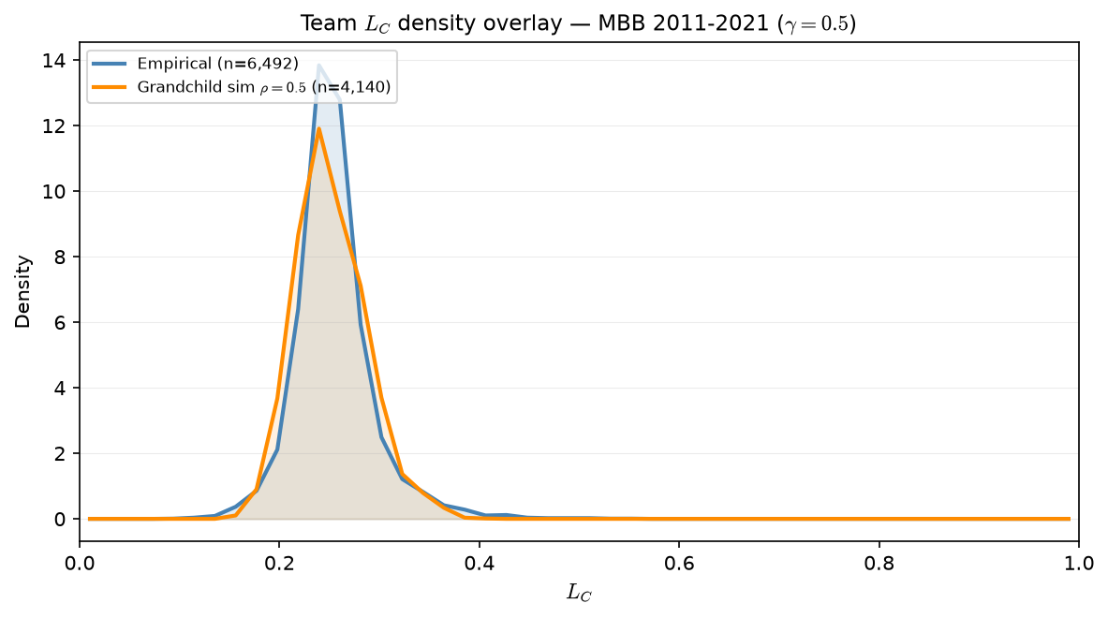
Empirical vs Grandchild — team $L_{C}$ distribution (normalized)
Same $L_{C}$ formula; normalized so team-season count differences don’t dominate the visual.
MBB 2011-2021 · team smooth $L_{C}$ · Grandchild $ρ=0.5$ · $γ=0.5$ · $θ=2.295 z$ ($K/N=0.0182$)
Team $L_{C}=mean_{j}σ\left(γ\left({\overset{ˆ}{A}}_{j}−θ\right)\right)$ — team-smooth congestion.
Left panel: empirical NCAA (real rosters). Right: Grandchild ASSIGN sim.
Panel: MBB 2011-2021 · PPM z · min 20 min · poolq winsor $0.01–0.99$.
Shared $θ=F_{\overset{ˆ}{A}}^{−1}\left(1−K/N\right)=2.295z$ ($K/N=0.0182$).
$γ=0.5$ (HAND17 slide-4 default; 539 placeholder).
Empirical: mean $L_{C}=0.254$, sd$=0.039$ ($6,492$ team-seasons).
Grandchild ($ρ=0.5$): mean $L_{C}=0.251$, sd$=0.036$ ($4,140$ team-seasons).
Sim: one Grandchild league per season ($J=N/15$), stacked team-seasons.
ASSIGN shapes rosters; $L_{C}$ is score-side input — computed after assign.
Claim (PD17 / Grandchild): Team smooth $L_{C}$ on real rosters vs Grandchild sim — same $σ\left(γ\left({\overset{ˆ}{A}}_{j}−θ\right)\right)$ formula; compare distribution shape before SCORE.

Slide 11
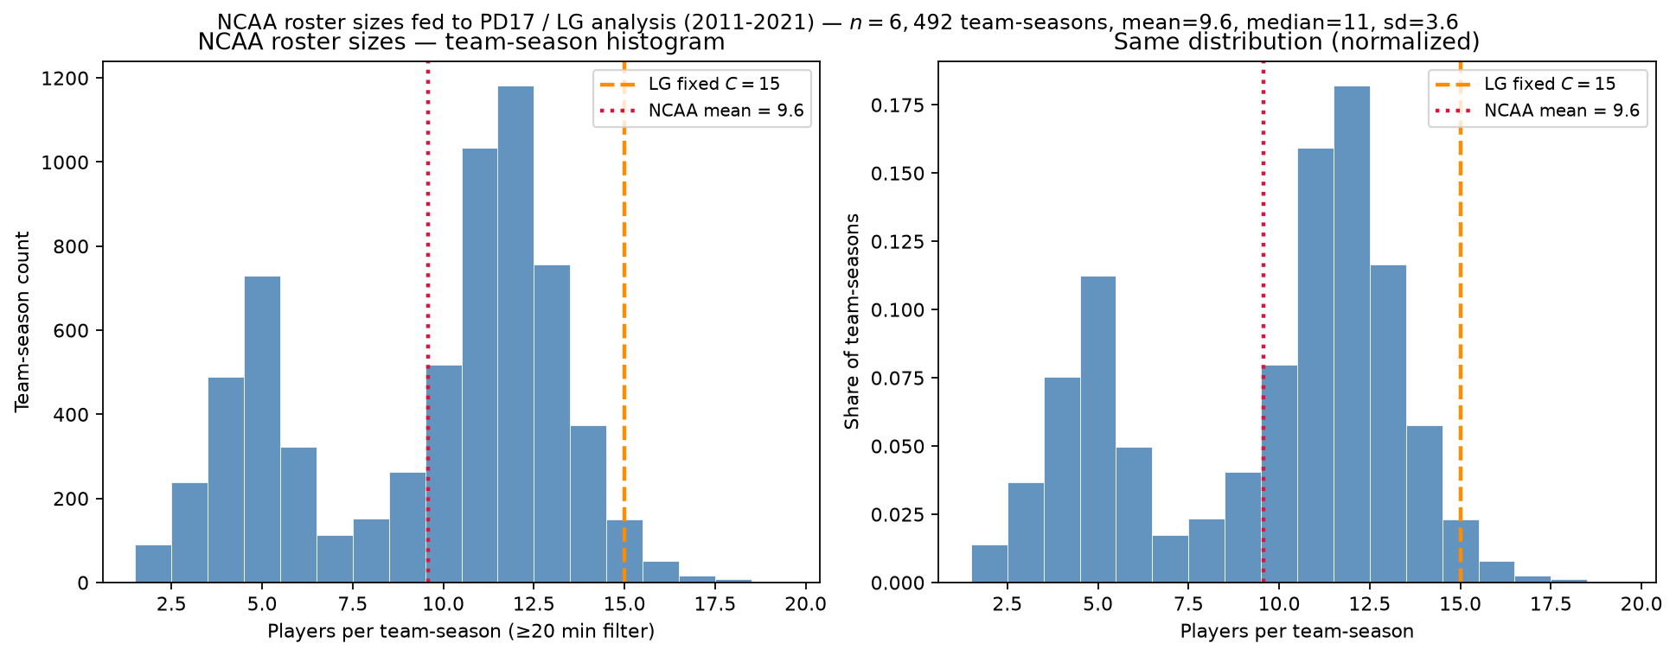
NCAA roster sizes after the minutes filter
MBB 2011-2021 · min 20 min · mean=9.6 vs LG $C=15$
Qualifying players per real NCAA team-season (\geq 20 ESPN minutes).
$n=6,492$ team-seasons · mean=9.6 · median=11 · sd=3.6.
Red dotted = NCAA mean; orange dashed = LG fixed $C=15$.
Only 2.3\% of teams have exactly 15 qualifying players.
Same ability pool ~62k; LG repacks into J=N/15 synthetic 15-man leagues.
Minutes floor shapes peer count — state explicitly in methods.
Talking point: empirical teams are ~10 rotation players; LG uses fixed 15 — comparability is distributional, not headcount.

Slide 12
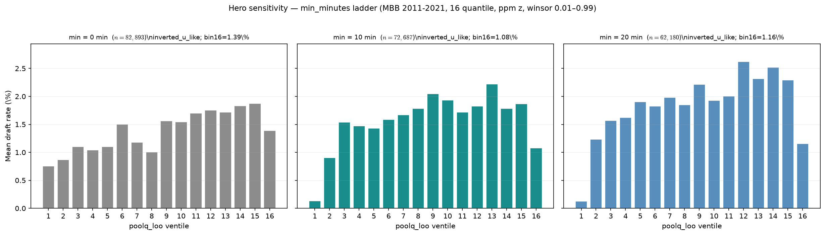
Hero sensitivity — min\_minutes ladder
MBB 2011-2021 · poolq\_loo ventiles · 0 / 10 / 20 min
Hero x-axis: draft rate vs poolq_loo ventiles · MBB 2011-2021 · 16 quantile.
min\_minutes defines who enters the panel and LOO peer pool — not neutral QC.
min=0: $n=82,893$, drafted=1,136, bin16=1.39\%, inverted_u_like.
min=10: $n=72,687$, drafted=1,136, bin16=1.08\%, inverted_u_like.
min=20: $n=62,180$, drafted=1,134, bin16=1.16\%, inverted_u_like.
Hero lock: min=20 — cleanest top-ventile cliff; min=10 robust appendix.
We are not simulating minutes in LG.
Talking point: inverted-U survives 10- and 20-minute floors; min=20 sharpens the elite ventile dip (+2 drafted vs min=0).

Slide 13
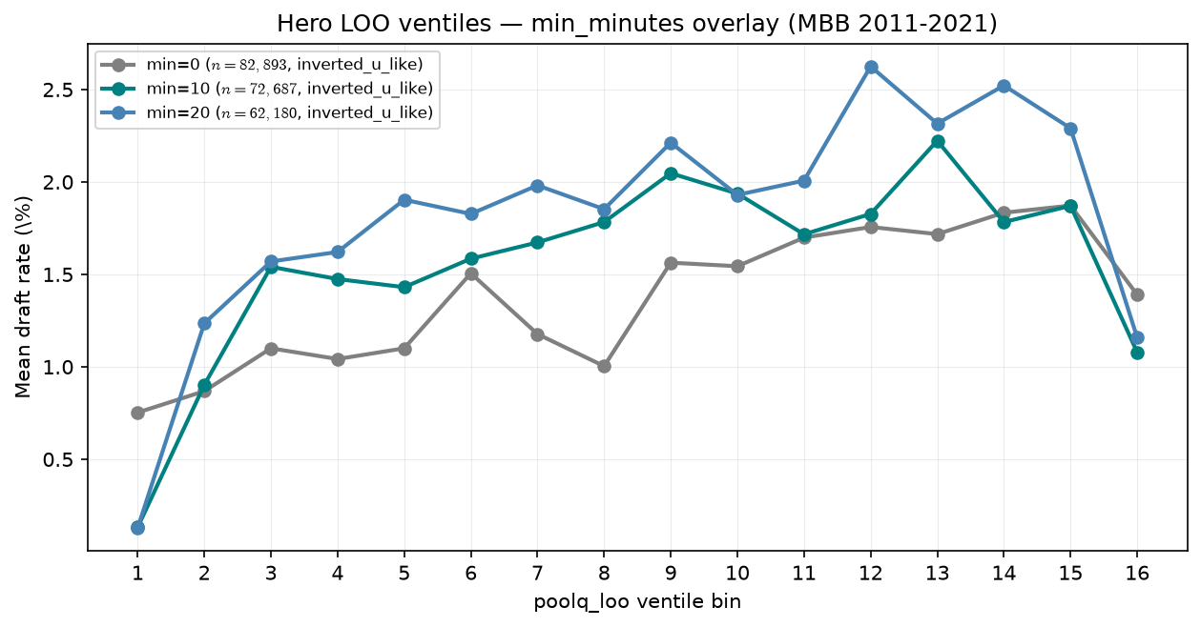
Hero sensitivity — min\_minutes overlay
MBB 2011-2021 · same bins, three floors
Hero x-axis: draft rate vs poolq_loo ventiles · MBB 2011-2021 · 16 quantile.
min\_minutes defines who enters the panel and LOO peer pool — not neutral QC.
min=0: $n=82,893$, drafted=1,136, bin16=1.39\%, inverted_u_like.
min=10: $n=72,687$, drafted=1,136, bin16=1.08\%, inverted_u_like.
min=20: $n=62,180$, drafted=1,134, bin16=1.16\%, inverted_u_like.
Overlay: same estimand, different playing-time floors.
We are not simulating minutes in LG.
Talking point: pattern is not an artifact of one arbitrary cutoff.

Slide 14
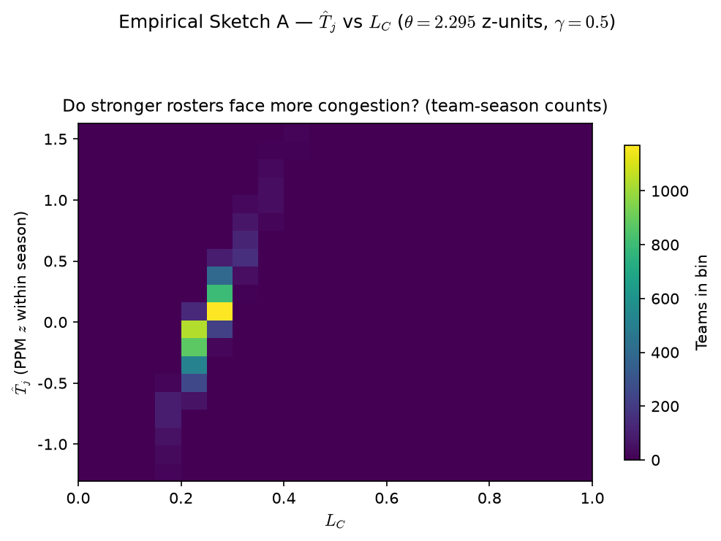

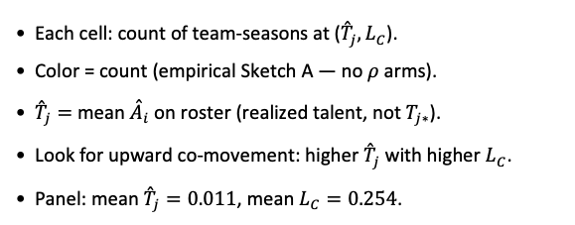
PD17 — Empirical Sketch A: ${\overset{ˆ}{T}}_{j}$ vs $L_{C}$
MBB 2011-2021 · team smooth $L_{C}$ · PPM z within season · min 20 min · $θ=F_{\overset{ˆ}{A}}^{−1}\left(1−K/N\right)=2.295. \left(K/N=0.0182\right)$ ·$γ=0.5$placeholder
Each cell: count of team-seasons at (${\overset{ˆ}{T}}_{j},L_{C}$).
Color = count (empirical Sketch A — no $ρ$ arms).
${\overset{ˆ}{T}}_{j}=$ mean ${\overset{ˆ}{A}}_{i}$ on roster (realized talent, not $T_{j∗}$).
Look for upward co-movement: higher ${\overset{ˆ}{T}}_{j}$ with higher $L_{C}$.
Panel: mean ${\overset{ˆ}{T}}_{j}=0.011$, mean $L_{C}=0.254$.
Claim (PD17): On actual team-seasons, stronger realized rosters (${\overset{ˆ}{T}}_{j}$) tend to co-occur with higher $L_{C}$ — empirical Sketch A.

Slide 15
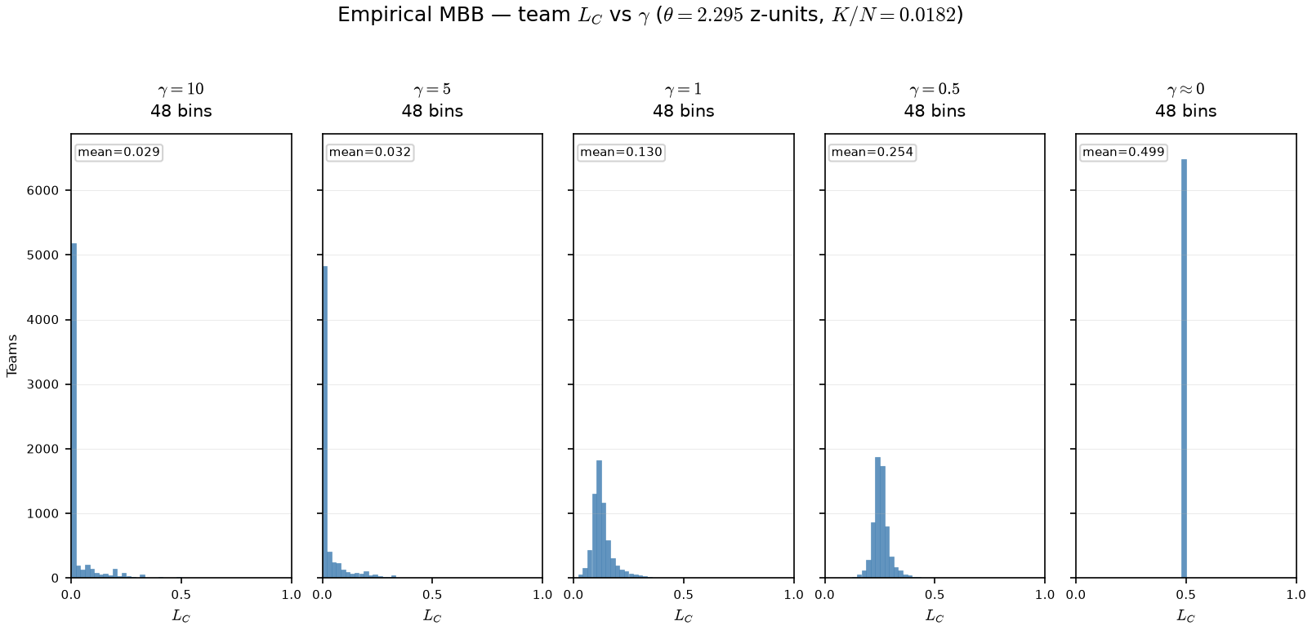

PD17 — Empirical $γ$ sweep: team $L_{C}$ on real rosters
MBB 2011-2021 · team smooth $L_{C}$ · PPM z · min 20 min · $θ=2.295$ z-units ($K/N=0.0182$) fixed across $γ$ arms
OAT on real panel: fixed $θ$ ($K/N$ cutline on PPM z); only $γ$ in $σ\left(γ\left(\overset{ˆ}{A}−θ\right)\right)$ changes.
Arms: $γ∈\left\{10,5,1,0.5,0.001\right\}$ — same team-seasons, same rosters.
At $γ=10$: mean $L_{C}=0.029, 84\%$ teams below $0.05$.
At $γ≈0$: mean $L_{C}=0.499$, max $L_{C}=0.500$ — spread opens on z-scale.
Claim (PD17): On real rosters, γ reshapes team $L_{C}$ — high γ compresses viability near 0 on the PPM-z scale; low γ spreads $L_{C}$ into the interior of [0,1].

Slide 16
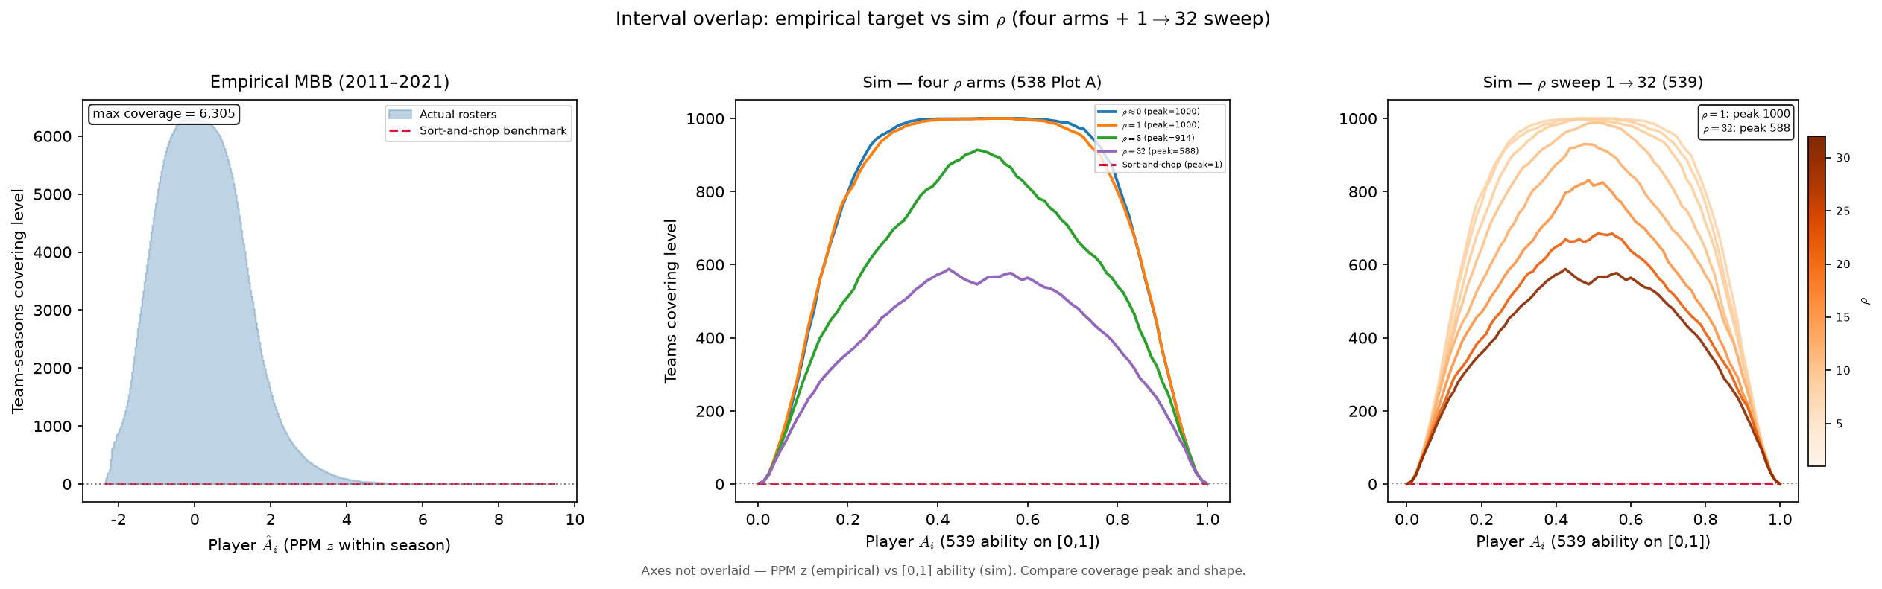
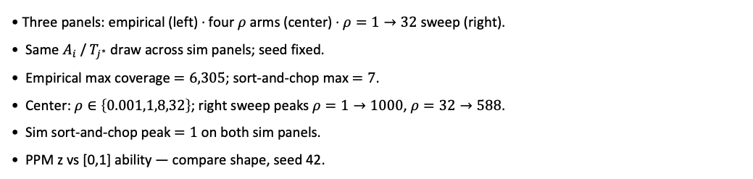
PD17 — Empirical vs sim interval overlap (\rho calibration target)
Assign block capstone · empirical MBB vs 539 sim · same coverage diagnostic
Three panels: empirical (left) · four $ρ$ arms (center) · $ρ=1→32$ sweep (right).
Same $A_{i}$ / $T_{j^{∗}}$ draw across sim panels; seed fixed.
Empirical max coverage $=6,305$; sort-and-chop max $=7$.
Center: $ρ∈\left\{0.001,1,8,32\right\}$; right sweep peaks $ρ=1→1000$, $ρ=32→588$.
Sim sort-and-chop peak $=1$ on both sim panels.
PPM z vs [0,1] ability — compare shape, seed 42.
Claim (PD17): Real rosters sit at high coverage peak — sim $ρ$ must be tuned so soft assign matches that overlap, not sort-and-chop.

