Slide 1
GPU-based real-time DCS processing
M. Walsh, J. Genest, March 2024

Slide 2
Software architecture
Python Interface
C++ console program
TCP Commands/data
Main Thread
Processing Thread
TCP
client
Flow
ctl
TCP
server
Save average igms to disk
Real-time ACQ
CUDA
kernels
keyboard Commands
GaGe
Params
.json
A priori
Params
.json
Save raw data to disk for later processing
computed
Params
.json
MATLAB.exe
pre-acquisition

Slide 3
Algo flow: Fast corrections

Slide 4
Algo flow: slow corrections

Slide 5
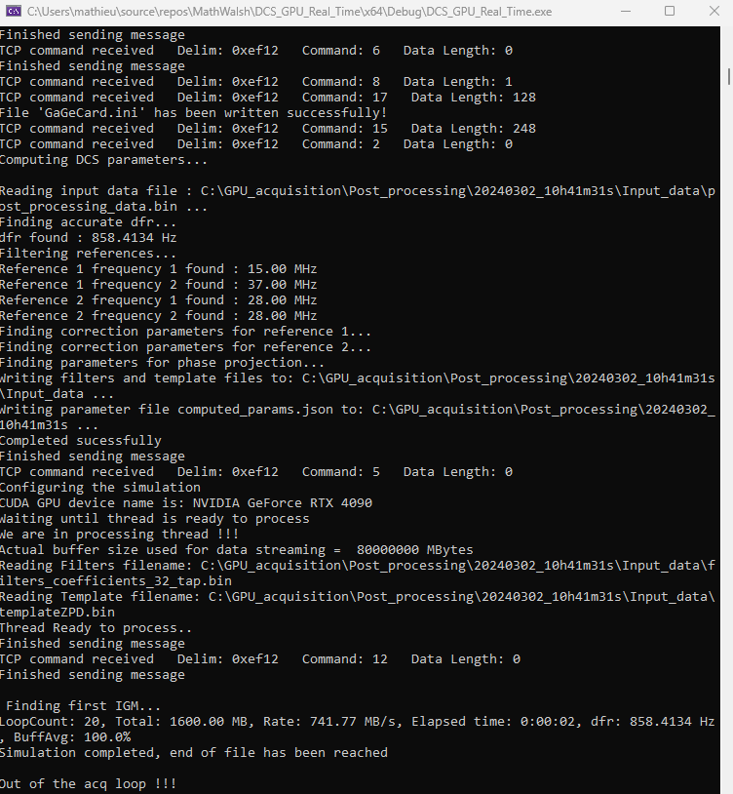
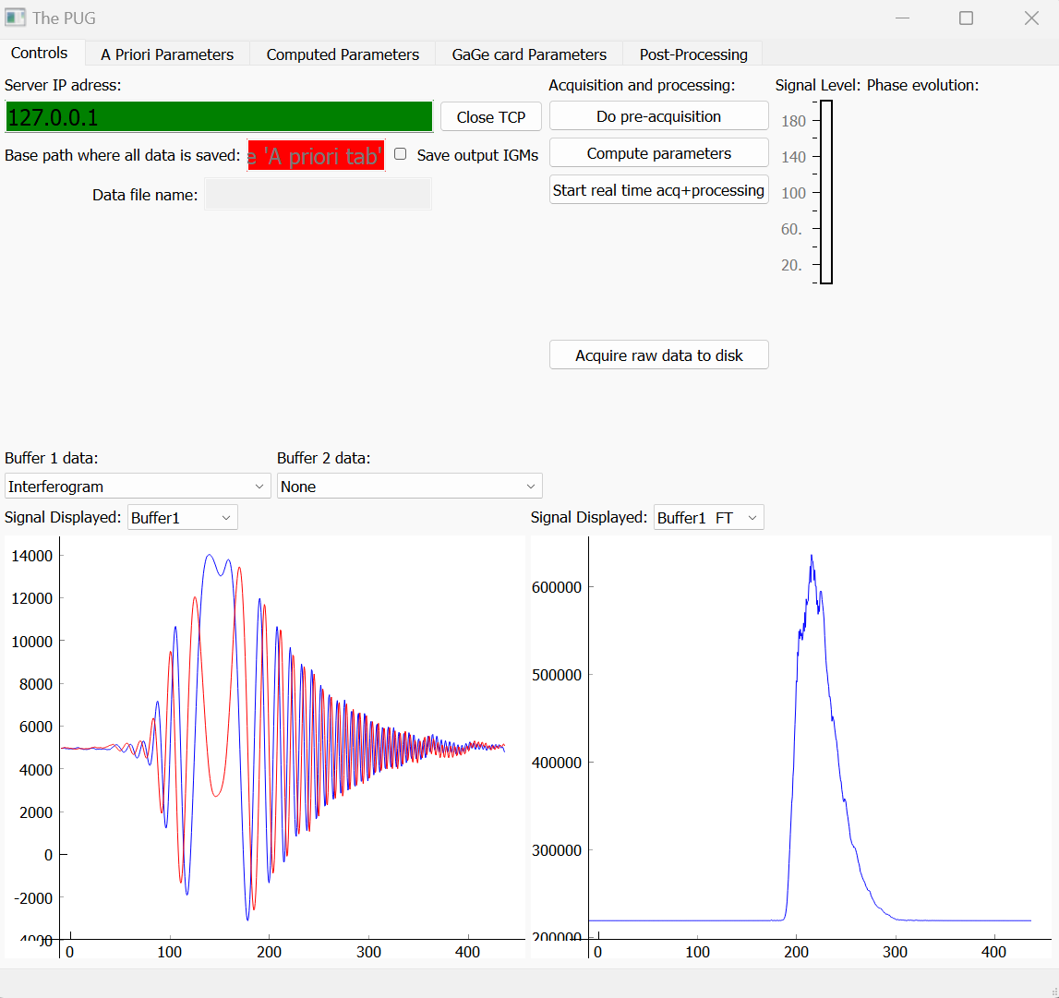
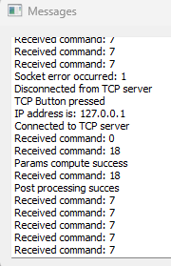
Demo…

