Slide 1
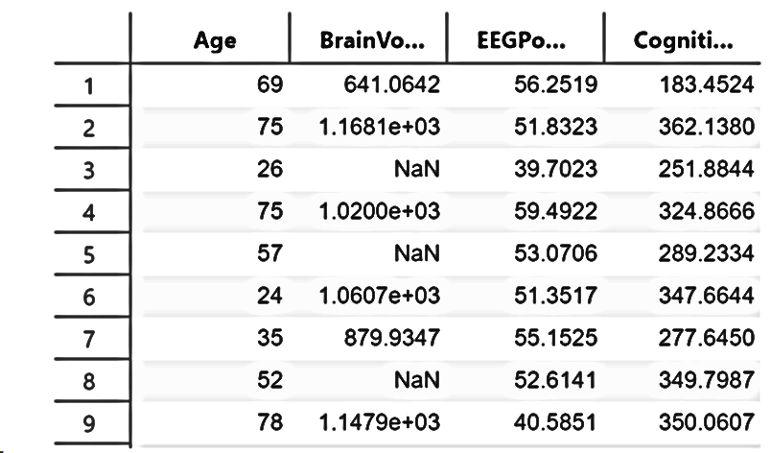
https://training-services-utilities.insidelabspages.mathworks.com/asset-browser/?viewUndistributable=true&orderBy=assetFileName&searchString=time

Slide 2
Machine Learning for Regression
Machine Learning for Regression
Machine Learning for Regression
Machine Learning for Regression
Machine Learning for Regression
Machine Learning for Regression
Regression Basics

Slide 3
Common Course Names
Most titles include “Machine Learning”
Common variants are:
Introduction to Machine Learning,
Applied Machine Learning,
Biomedical data science/ML,
Scientific ML,
ML for engineering.

Slide 4
Common Disciplines
Computer Science/Computing
Engineering/applied engineering,
Statistics/math/biostatistics,
Biomedical/health sciences.

Slide 5
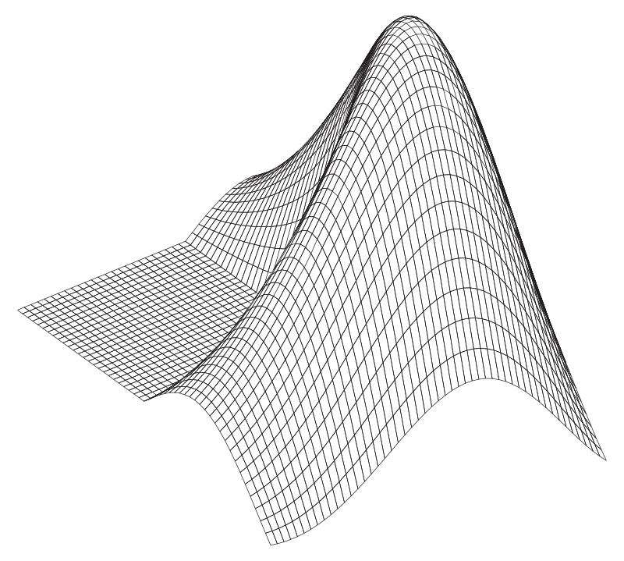
Image Resources
MathWorks Design System (Parula)
Learn how to create content that better represents the MathWorks brand and access MathWorks logos and release and service marks.
Best Practices for Finding Images and Stock Photos
Get guidelines for using the MathWorks Asset Library (with over 30k images), stock photography, illustrations, clip art, and more.
V23.0 Delete this slide before finalizing your presentation.

Slide 6
☐ Load data
☐ Explore variables
☐ Identify missing values
☐ Split training/testing data
☐ Visualize data quality
☐ Fill missing values
☐ Replace outliers
☐ Normalize predictors
☐ Train baseline model
☐ Train preprocessed model
☐ Compare RMSE
Loading and converting data into a timetable
Sorting observations chronologically
Auditing missing data
Visualizing data quality issues
Applying imputation methods
Evaluating preprocessing effects
Preparing features for modeling

Slide 7

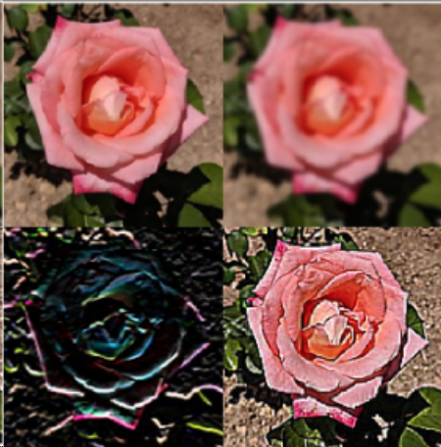
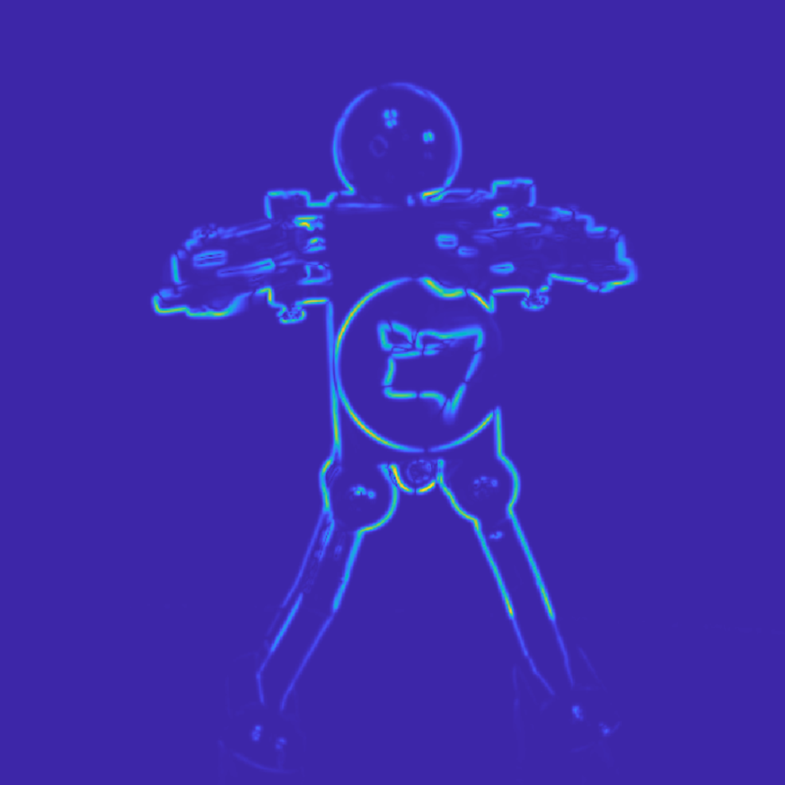

Slide 8
☐ Load and converting data into a timetable
☐ Sort observations chronologically
☐ Audit missing data
☐ Visualize data quality
☐ Apply imputation methods
☐ Evaluate preprocessing effects
☐ Prepare features for modeling
☐ Train baseline model
☐ Train preprocessed model
☐ Compare RMSE

Slide 9
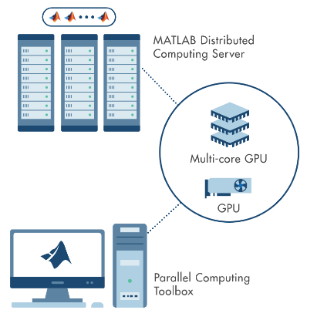
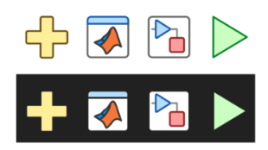
Image Resources
Technical and Workflow Diagram Toolkit
Create simple or complex technical diagrams using provided elements. Each component is an individual artifact for use in presentation materials or video assets.
Illustration Style
Get illustrations in categories including Avatars, Personas, Technology, Transportation, Sports, and more. Find the complete set alongside some rules and recommendations.
Icon Repository
Icon ID Catalog (theme-able)
Find toolstrip, block, plot, and other in-product icons.
V23.0 Delete this slide before finalizing your presentation.

Slide 10
Using the Corporate Template
Avoid manually formatting whenever possible. Instead, use built-in styles, templates, layouts, and colors.
When creating new presentations, select the slide layout that best suits your needs from the built-in theme, then add content.
When creating custom shapes, text boxes, and other elements, start from scratch rather than reformatting template shapes.
When applying the new template to existing presentations, review your presentation carefully and manually adjust any formatting issues that have occurred. For additional help, contact Creative Services.
V23.0 Delete this slide before finalizing your presentation.

Slide 11
Color Palette
MathWorks Brand Colors
The corporate colors are included in the Theme Colors of this PowerPoint file; the primary brand colors and HEX values are shown below. For more colors such as utility and neutral colors, visit the brand guide Color Palette.
MATLAB Code Colors
Below are the color values for MATLAB code. They are not included in this file’s default Color Themes due to limited colors, but you can either enter the values below or use the Eyedropper or Format Painter to copy and apply them.
PRIMARY COLORS
REGULAR CODE
HEX: 000000
RGB: 0, 0, 0
KEYWORD
HEX: 0000ff
RGB: 0, 0, 255
HEX: 0076A8
HEX: D78825
STRING
HEX: A020F6
RGB: 160, 32, 240
COMMENT
HEX: 228B22
RGB: 34, 139, 34
SECONDARY COLOR
WARNING
HEX: FF6400
RGB: 255, 100, 0
ERROR
HEX: FF0000
RGB: 255, 0, 0
HEX: 004B87
V23.0 Delete this slide before finalizing your presentation.

Slide 12
TRAIN
ITERATE
DERIVE
ACCESS & PREPROCESS
INTEGRATE
ACCESS & PREPROCESS
DERIVE
TRAIN
ITERATE
INTEGRATE

