Slide 1
CHATBOT
ELIZA: It is considered to be the first chatbot in the history of Computer Science which was developed by Joseph Weizenbaum at Massachusetts Institute of Technology (MIT). It was in 1994 that the term 'Chatterbot” was coined

Slide 2
What is chatbot?
A computer program designed to simulate conversation with human users, especially over the internet.
simulates and processes human conversation (either written or spoken), allowing humans to interact with digital devices as if they were communicating with a real person

Slide 3
What data does chatbot use?
To work out those answers, it will use data from previous conversations, emails, telephone chat transcripts and documents etc. This is the training data. Chatbots are only as good as the training data they are given. You can't just launch a chatbot with no data and expect customers to start using it.

Slide 4
How to make a chatbot from scratch in 8 steps
Step 1: Give your chatbot a purpose. ...
Step 2: Decide where you want it to appear. ...
Step 3: Choose the chatbot platform. ...
Step 4: Design the chatbot conversation in a chatbot editor. ...
Step 5: Test your chatbot. ...
Step 6: Train your chatbots. ...
Step 7: Collect feedback from users.

Slide 5
Here are 8 websites with chatbots qualifying leads, assisting with sales, and automating customer service with live chat integratioN
B2B: MobileMonkey.
Services: Massage Envy.
Restaurant: Domino's.
Ecommerce: Peloton.
Health care: American Well.
Brick-and-mortar: Lincoln Davies Building Supply.

Slide 6
Need for chatbots?
Widespread use of personal machines
Better Human Computer Interaction
“To express their interest, wishes, or queries directly and naturally, by speaking, typing, and pointing”.

Slide 7
What is the main use of chatbot in education?
Chatbots help teachers automate their repetitive tasks. The bots can answer any student query, be it related to the online courses, assignments, or deadlines, while the teachers monitor the student progress. Chatbots also personalize individual student experiences.

Slide 8
Benefits of Chatbots for Companies and Customers
Facilitate Seamless Live Communication.
Make Customer Service Available 24/7.
Save Time and Money.
Reduce People-to-People Interactions with Customers.
Eliminate Tedious Time-Consuming Tasks.
Offer a Smoother Customer Journey.
Reduce Stress for Consumers.

Slide 9
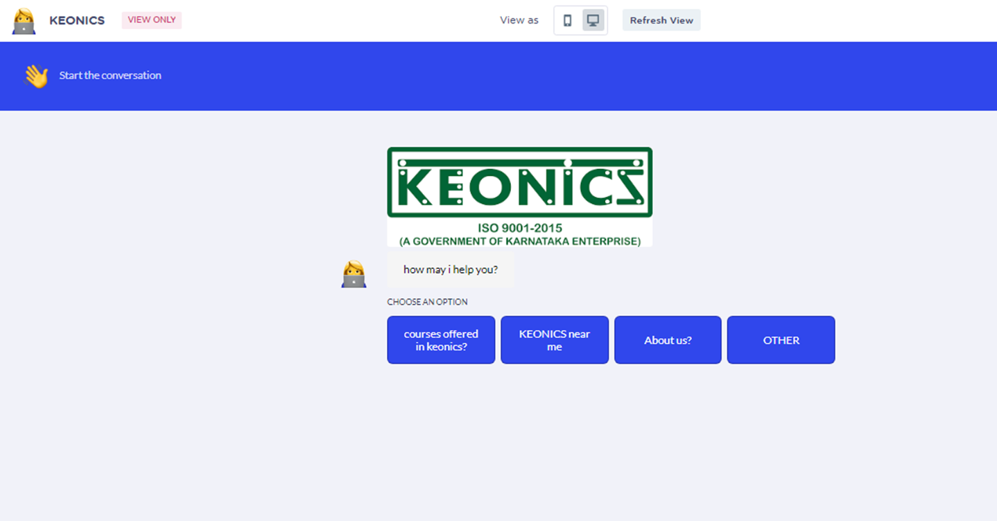
Here, I have created a chatbot named KEONICS in a website called landbot.io

Slide 10
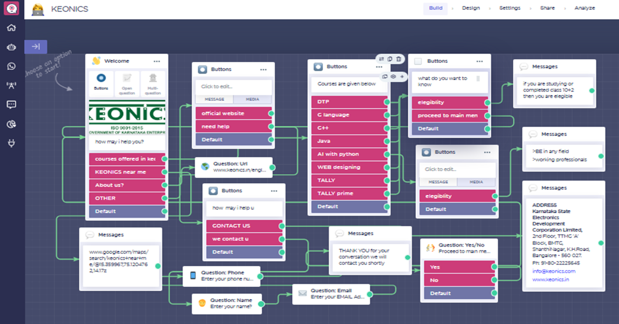
In this website we need to add buttons, url, question box, message box, location, connections as shown below

Slide 11

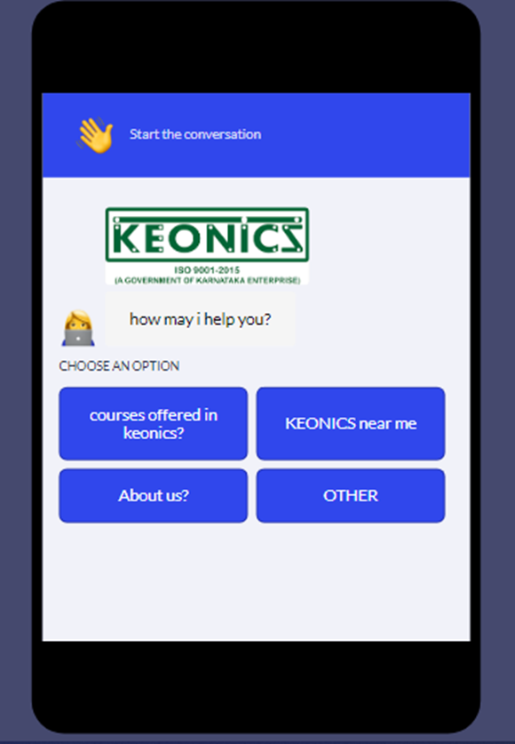
This chatbot supports mobile and as well as in pc

Slide 12
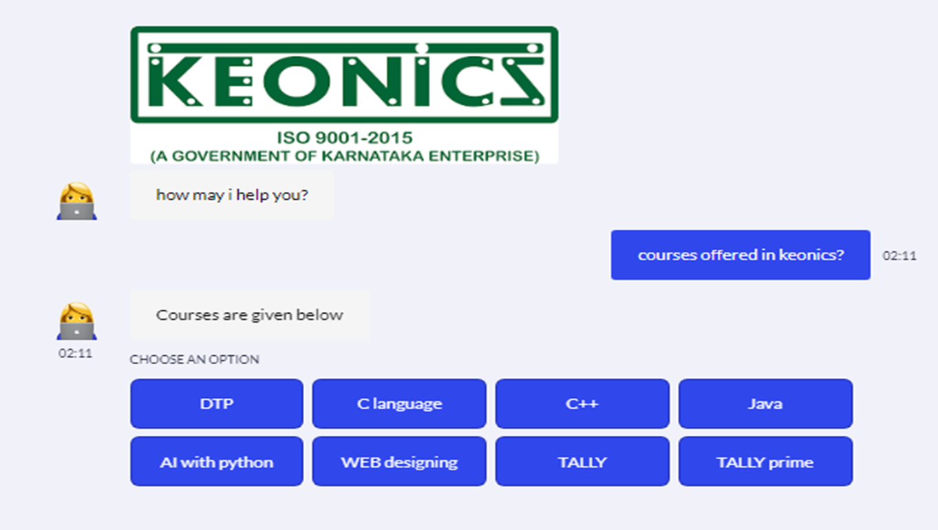
Here we can see that it shows options for courses when clicked on courses offered tab we can select which ever courses we want

Slide 13
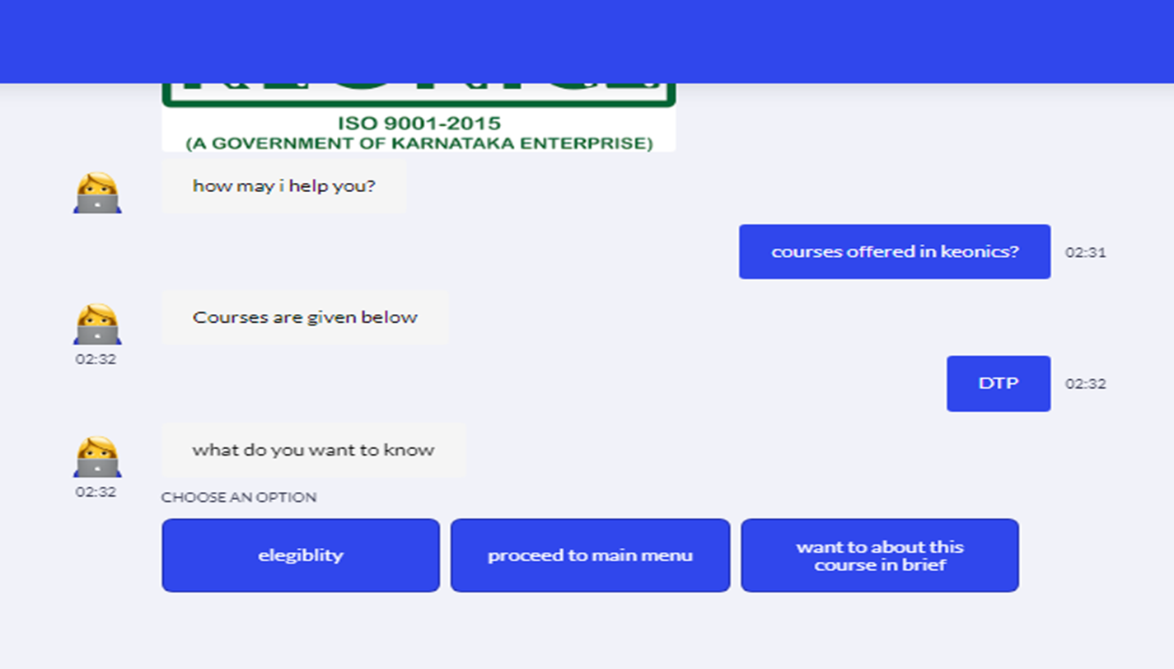
Once we click on any one of the offered courses like DTP we get three options as elegiblity,main menu,know brief

Slide 14
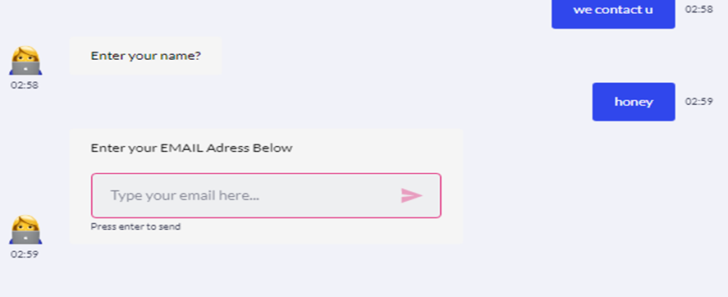
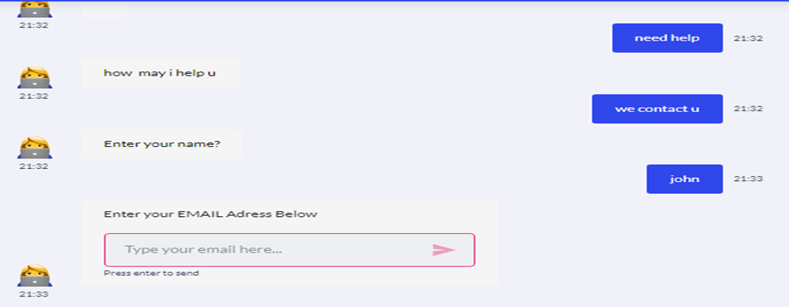
Here student can type their name, email,phone number so that we can contact them later

Slide 15
Code for chatbot
<html> <head> <meta charset="UTF-8"> <meta name="viewport" content="width=device-width, height=device-height, initial-scale=1.0, maximum-scale=1.0, user-scalable=no"> <title>Landbot | Convert a Landing Page into a Chatbot</title> </head> <body> <script SameSite="None; Secure" src="https://cdn.landbot.io/landbot-3/landbot-3.0.0.js"></script> <script> var myLandbot = new Landbot.Fullpage({ configUrl: 'https://landbot.site/v3/H-1319252-KVYQJSLU70RGEQWJ/index.json', }); </script> </body> </html>

Slide 16
THANK YOU

