Slide 1

REAL ESTATE INDUSTRY
TEAM MEMBERS: REKHA. K
APOORVA. M
L2 FACULTY: MOHAMMAD TAHIR MIRJI

Slide 2

What is Real Estate?
Real estate is real property that consists of land and improvements, which includes buildings, fixtures, roads, structures, and utility systems. Property rights give a title of ownership to the land, improvements, and natural resources such as minerals, plants, animals, water, etc.

Slide 3
PROBLEMS AND SOLUTIONS
Problems:
Managing the back-office task
Keeping track of all your back-office tasks can be a hassle.
If you have recently started a real estate business and think you’ve got plenty of time on your hand, you might want to rethink your decision.
The real estate industry is hectic; you need to stay on your toes all the time to capture more leads in the market.
So, you can’t stay relaxed, thinking the leads will come straight to you just because you have a website.
Solution:
Hire a real estate agent who is skilled enough to manage all your administration tasks easily. See if they exactly map your requirements.
Some of the top skills requirements in a real estate administration agent are managing paperwork, dealing with clients, keeping the listings organized, and looking after the legal documents.
This practice can help resolve the most crucial real estate problems and help realtors manage their tasks effortlessly.

Slide 4
Problems:
Managing paperwork
If you don’t want to get lost in a pile of paperwork, you need to form a proper workflow.
Managing the paperwork of every property and client can take a toll on you and consume most of your time. In fact, this can also hamper your overall productivity at work.
Solution:
Get a CRM that eliminates the dependency on manual paperwork and digitizes your documents.
Have access to all your documents within your CRM and exchange e-signed documents for speeding up the documentation process.
Moreover, you can also implement real estate marketing automation into your business process for lead generation, outreach, etc.
This way, you can access all the important information even when you’re on the way to meet your client.

Slide 5
Solution:
Whenever a person closes a deal, the sales process doesn’t just end there. Even after you’ve sold something, staying connected with clients and nurturing them is vital.
Building a strong relationship with your customers makes you more likely to get referred to others. So, nurture your clients by sending personalized messages, providing a solution, and consulting when required.
Problem
Failing to leverage on referrals
If you were a customer looking to buy a property, would you rather ask your known one about their experience with a certain realtor or rely on a website
We’re assuming that most buyers would trust their friends or family more.
Real estate markets mainly run on referrals, 25% of agents generate more than 50% of their revenue through only referrals.
It becomes difficult to get more leads when a realtor doesn’t have clients backing his work and referring to others.

Slide 6
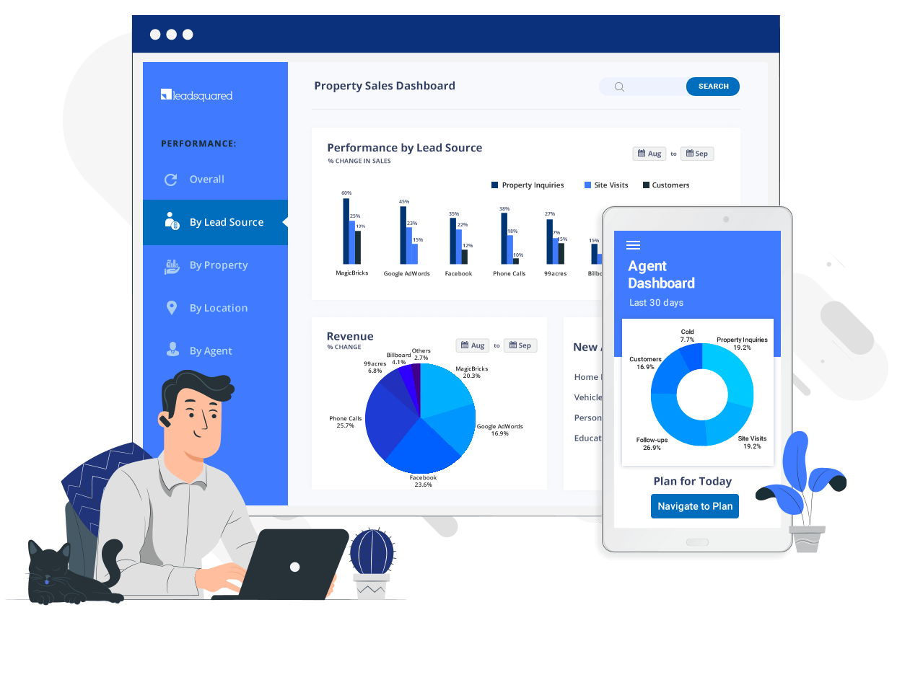
CONTENT MARKETING
A CRM to Manage your Real Estate Marketing
It feels like every time anyone talks about real estate marketing tools, social media is the first suggestion. And I'll get to social media, but there's one thing that outranks Facebook and Instagram when it comes to real estate marketing. That'd be a CRM.
A CRM or customer relationship management software is a tool that brings all of your marketing tools your email marketing platform, your social media accounts, marketing and sales documents, and workflows into one place.

Slide 7
Social Media
Platforms like:
Facebook
Instagram
Twitter
Whatsapp

Slide 8

rEAl estate
Real estate in the metaverse is a virtual ecosystem, a replica of real-world conditions. It combines technologies such as augmented reality, virtual reality, and video to create a digital space where users can interact, play and communicate virtually just like they do in the real world.
Every land parcel in metaverse stands unique and non-replicable. These assets are digital creations and programmable, and allow the users to meet, socialize, develop, play, hold meetings, and do transactions as they do in real-world scenarios.
Blockchain technology has been the major disruptor at the macro-level. Similarly, real estate in the metaverse would bring a seismic change in the years to come and investors across the sectors have started acknowledging it.
First movers progressing towards commercialization in the metaverse might be on edge in exploring the unique business opportunities and harnessing its potential in the future.

Slide 9

CONTENT FORMATS, CHANNELS
Magazines
Newspapers
Blogs
Vlogs
Telemarketing

Slide 10
Measuring success
Below are 4 critical real estate performance metrics to track:
Monthly Production
No matter whether your agents pay a flat fee to the brokerage or if they’re on traditional splits, the absolute number of closed transactions that each agent completes contributes to your total revenue.
Days on Market
The second metric to track closely is the time that agents’ listings remain actively listed on the market—or what’s most often referred to as Days on Market (DOM). Days on Market is simply the number of days in which the property is listed for sale on the MLS before it’s under contract.

Slide 11
Sale Price Vs. List Price
Similar to Days on Market, the difference between the list price and the final purchase price is another key metric to consider monthly. A price that needs to come down to sell doesn’t look good and often means that the property became stale. Conversely, pricing a property too low means you’re leaving money on the table—for your company, your agent, and your client.
Sales Volume
Sales volume is a prevalent metric of success—and one that’s often associated with ability. Real estate agents and brokerages alike use sales volume as a way to demonstrate their influence and performance. Essentially, sales volume is simply the total value of all closed transactions by sales price.

Slide 12
Thank you
th

