Slide 1

Structuring Document for the Web
Digital Media I (ART 277)

Slide 2
Objectives
Understand the use of tags, attributes and element
Discuss text formatting elements
Understand and use HTML Heading element
Understand and use HTML Paragraph elements
Discuss quotation and citation elements in HTML
Understand Meta tags and what they are use for
Learn to properly use HTML Comments

Slide 3
Tags and Attributes
Let’s brainstorm

Slide 4
Tags and Attributes
Tags and attributes are the basic building blocks of an HTML document.
Tags surround the content and apply meaning to it. It is written between < and > brackets.
Attribute provides extra information about the element, and it is applied within the start tag. An HTML attribute contains two fields:
Name
value

Slide 5
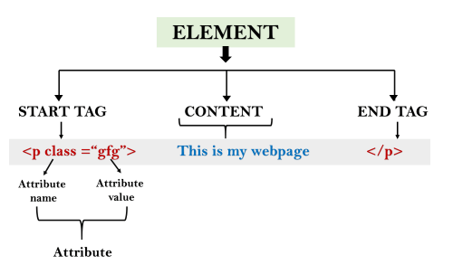
Elements
An HTML element is an individual component of an HTML file. In an HTML file, everything written within tags are termed as HTML elements.
An element in HTML usually consist of a start tag <tag name>, close tag </tag name> and content inserted between them.

Slide 6
Block-level and Inline Elements
For the default display and styling purpose in HTML, all the elements are divided into two categories:
Block-level element
Inline element
A block-level element always start with new line and takes the full width of web page, from left to right.
These elements does not start with new line and take width as per requirement.
The Inline elements are mostly used with other elements.

Slide 7
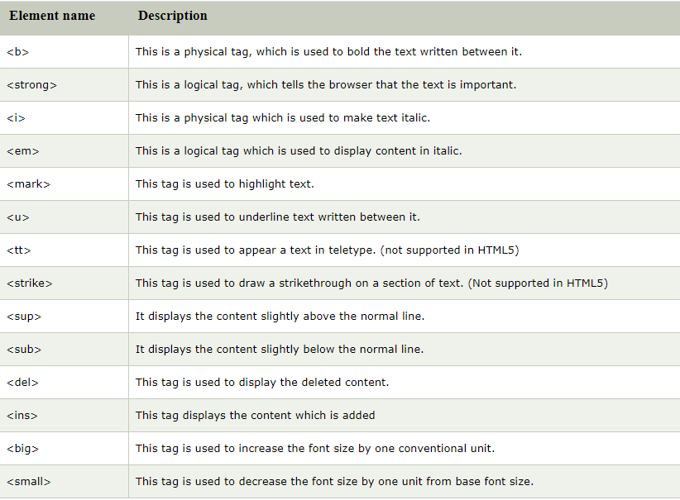
Text Formatting Elements
Text formatting elements are elements we use to format text in HTML.

Slide 8
Heading Elements
HTML heading or HTML h tag can be defined as a title or a subtitle which you want to display on the webpage.
There are six different HTML headings which are defined with the <h1> to <h6> tags, from highest level h1 (main heading) to the least level h6 (least important heading).
<h1> is the largest heading tag and <h6> is the smallest one. So <h1> is used for most important heading and <h6> is used for least important.
Search engines use the heading to index the structure and content of your web pages.
Each HTML heading has a default size.

Slide 9
Paragraph Elements
A paragraph always starts on a new line, and is usually a block of text.
HTML paragraph or HTML p tag is used to define a paragraph in a webpage.
It is a notable point that a browser itself add an empty line before and after a paragraph.
An HTML <p> tag indicates starting of new paragraph.
If we are using various <p> tags in one HTML file then browser automatically adds a single blank line between the two paragraphs.

Slide 10
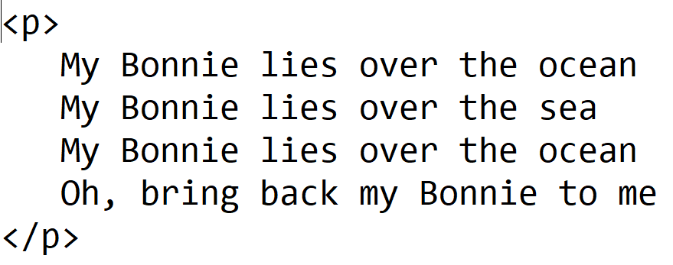
Line Break & Horizontal Rule
An HTML <br> tag is used for line break and it can be used with paragraph elements.
Use <br> if you want a line break (a new line) without starting a new paragraph
An HTML <hr> tag is used to apply a horizontal line between two statements or two paragraphs.

Slide 11
Quotation and Citation Elements
The HTML <blockquote> element defines a section that is quoted from another source. Browsers usually indent <blockquote> elements.
HTML <q> for Short Quotations. The HTML <q> tag defines a short quotation. Browsers normally insert quotation marks around the quotation.
The HTML <abbr> tag defines an abbreviation or an acronym, like "HTML", "CSS", "Mr.", "Dr.", "ASAP", "ATM". Marking abbreviations can give useful information to browsers, translation systems and search-engines.
HTML <address> for Contact Information. The HTML <address> tag defines the contact information for the author/owner of a document or an article. The contact information can be an email address, URL, physical address, phone number, social media handle, etc.
The text in the <address> element usually renders in italic, and browsers will always add a line break before and after the <address> element.

Slide 12
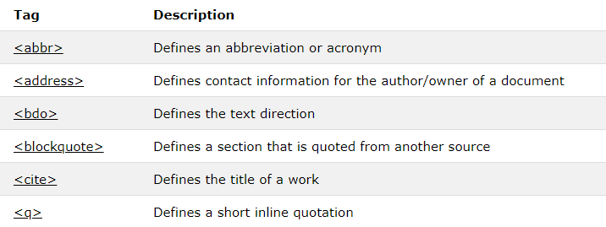
Quotation and Citation Elements Cont.
The HTML <cite> tag defines the title of a creative work (e.g. a book, a poem, a song, a movie, a painting, a sculpture, etc.). The text in the <cite> element usually renders in italic.

Slide 13
Meta Tags
HTML <meta> tag is used to represent the metadata about the HTML document. It specifies page description, keywords, copyright, language, author of the documents, etc.
The metadata does not display on the webpage, but it is used by search engines, browsers and other web services which scan the site or webpage to know about the webpage.
With the help of meta tag, you can experiment and preview that how your webpage will render on the browser.
The <meta> tag is placed within the <head> tag, and it can be used more than one times in a document.

Slide 14
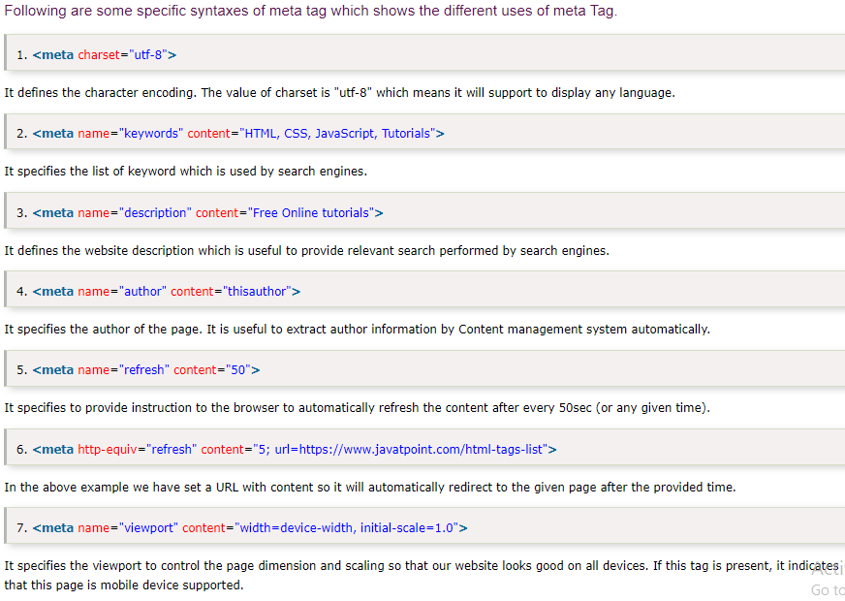
Meta Tags Cont.

Slide 15

HTML Comments
Comments are some text or code written in your code to give an explanation about the code, and not visible to the user.
Anything written between these tags will be ignored by the browser, so comments will not be visible on the webpage.
Comments of any code make code easy to understand and increase readability of code.
The commented code will not be visible to a webpage, and hence you can use comment tag for documentation purpose, and debugging purpose:

Slide 16
Summary
Tags and attributes are the basic building blocks of an HTML document.
Technically, an element is a collection of start tag, attributes, end tag, content between them.
A block-level element always start with new line and takes the full width of web page, from left to right.
Inline elements does not start with new line and take width as per requirement.
There are six different HTML headings which are defined with the <h1> to <h6> tags, from highest level h1 (main heading) to the least level h6 (least important heading).
A paragraph always starts on a new line, and is usually a block of text.
Comments are some text or code written in your code to give an explanation about the code, and not visible to the user.

