Slide 1
Smart Parking System
THEME : Life on Land
TEAM NAME : Sova
COLLEGE NAME : Amrita Vishwa Vidhyapeetham

Slide 2
TEAM DETAILS
S. No | Name | Email | Contact No
1 | Mathan Karthick M P | mathanmpmk@gmail.com | 9600776124
2 | Tarsana B | tarsanabalavijayan@gmail.com | 9597159772

Slide 3
PROBLEM STATEMENT
Car parking is a major problem in urban areas in both developed and developing countries. Following the rapid incense of car ownership, many cities are suffering from lacking of car parking areas with imbalance between parking supply and demand which can be considered the initial reason for metropolis parking problems. This imbalance is partially due to ineffective land use planning and miscalculations of space requirements during first stages of planning. Shortage of parking space, high parking tariffs, and traffic congestion due to visitors in search for a parking place are only a few examples of everyday parking problems.​

Slide 4
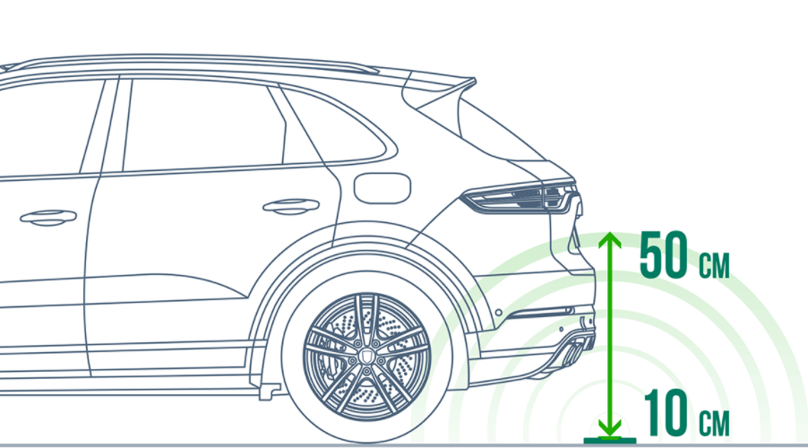
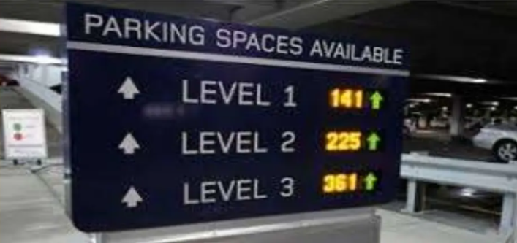
EXISTING SOLUTIONS
The problem with the existing solution is we dont know whether a parking slot is available or not before reaching the parkiing area
Another existing solution is the use of sensors where it need to be installed in every parking slot which is so expensive and the main disadvantage of using it is even if a leaf is detected in the sensor the it takes it as an parked slot.

Slide 5
YOUR SOLUTION
We aim to create an application that monitors parking slots via the camera placed in the areas and shows the accurate parking slot availability for cars. ​
Before entering a particular street, we can know the parking availability in that place.​
APPROACH:
To find empty/available parking space from the input images of parking area, we divide the problem statement into two parts-​
To obtain locations of parking spots in the images i.e which areas of the image correspond to parking spots. These locations will be used for subsequent images in the 3rd step.​
For new input images, identify car instances and their locations in the parking lot and determine the occupancy using the reference locations as described in previous sections.

Slide 6
KEY UNIQUENESS
Efficieny of City Workforce administration
Enhanced User Experience
Cost Efficient
Utility Monitering
Safety
TECHNOLOGY USED
AI/ML
Video Analytics
Advanced User Experience

Slide 7
PROTOTYPE
Video Link: https://drive.google.com/file/d/1OWtxWsb_cdth3LZujva7bJjG9lre8W87/view?usp=sharing​
GitHub Repository Link:
https://github.com/MathanMK/Smart-Parking-System​
Google Drive Link: https://drive.google.com/drive/folders/1NkDeFbPJEgUUFJOUjXiBOCr5eiIBLRn6?usp=sharing​

Slide 8
FURTHER IMPROVEMENTS
We are planning to extend this application from an organization-level parking monitoring to city-level parking.​
We are also planning to come up with an option to find your car once after it is parked in a spot.​
We are also planning to notify the user(person who parks the vehicle), the time and parking slot of the car that has been parked by detecting the number plate of the respective car. (This is for security purposes in case of theft)

