Slide 1



Department of Computer Science and Engineering
INTEGRATED ANTI-SPOOFING AND DEEPFAKE DETECTION SYSTEM USING MOBILENET AND RESNEXT
MATHAN SRI PRASATH E (211421104160)
MAHESH KUMAR D (211421104151)
NAVEEN G V(211421104171)
PROJECT GUIDE:
Dr. HARIHARAN S
COORDINATOR:
Dr. JOSEPHINE LEELA R
Integrated Anti-Spoofing and Deepfake Detection System Using MobileNet and ResNeXt
1

Slide 2
ABSTRACT
Secure Vision is an integrated solution designed to address both biometric spoofing and deepfake threats. It combines MobileNet, a lightweight CNN, for real-time spoofing detection (eye blinks, facial movements) and ResNeXt, a deeper CNN, for detecting deepfake videos through subtle artifacts. This unified approach overcomes existing challenges in separate detection systems by offering fast, accurate, and adaptable security. It uses diverse datasets, including ASVspoof for biometric spoofing and FaceForensics++ & DFDC for deepfake detection, ensuring robust performance against various attack techniques.
2
Integrated Anti-Spoofing and Deepfake Detection System Using MobileNet and ResNeXt

Slide 3
INTRODUCTION
Realism of Deepfakes: Hard to distinguish from real content.
Inefficiency of Traditional Methods: Detection models struggle with various manipulations.
Lack of Real-Time Performance: Existing anti-spoofing methods are too slow.
Fragmented Security Solutions: Separate systems for deepfake and spoofing leave vulnerabilities.
Secure Vision combines MobileNet for real-time spoofing detection and ResNeXt for deepfake detection, offering a comprehensive solution.
Integrated Anti-Spoofing and Deepfake Detection System Using MobileNet and ResNeXt
3
Notes:
3

Slide 4
OBJECTIVE OF THE PROJECT
Real-Time Spoofing Detection: Use MobileNet to quickly identify fake biometric data (e.g., photos, masks).
Deepfake Detection: Leverage ResNeXt to analyze and detect manipulated videos through subtle artifacts.
Unified Security Framework: Integrate both models to provide comprehensive protection against biometric spoofing and deepfakes.
Adaptability and Robustness: Train on diverse datasets to improve detection accuracy across various attack techniques.
Enhance Security Infrastructure: Bridge the gap between separate deepfake and spoofing detection systems for a more efficient and reliable security solution.
Integrated Anti-Spoofing and Deepfake Detection System Using MobileNet and ResNeXt
4

Slide 5
LITERATURE SURVEY
S.NO | PAPER DETAILS | SUMMARY | TECHNIQUES/ALGORITHMS USED | RESEARCH GAP
1 | DeepFake Detection with MobileNet and ResNeXt" (2021) | This paper presents an integrated system for detecting deepfakes and biometric spoofing using MobileNet for real-time detection and ResNeXt for feature extraction. | MobileNet, ResNeXt | The study lacks handling of adversarial attacks, which can be refined for better robustness.
Integrated Anti-Spoofing and Deepfake Detection System Using MobileNet and ResNeXt
5
Notes:
5

Slide 6
LITERATURE SURVEY
S.NO | PAPER DETAILS | SUMMARY | TECHNIQUES/ALGORITHMS USED | RESEARCH GAP
2 | A Novel Anti-Spoofing Approach Using ResNeXt for Deepfake Detection" (2020) | Focuses on utilizing ResNeXt to detect facial manipulations and deepfake artifacts, combined with anti-spoofing measures. | ResNeXt | Does not integrate real-time processing optimizations for live systems.
6
Integrated Anti-Spoofing and Deepfake Detection System Using MobileNet and ResNeXt
Notes:
6

Slide 7
LITERATURE SURVEY
S.NO | PAPER DETAILS | SUMMARY | TECHNIQUES/ALGORITHMS USED | RESEARCH GAP
3 | "Real-Time Face Spoofing and Deepfake Detection via Lightweight Neural Networks" (2021) | Proposes an anti-spoofing and deepfake detection system using lightweight CNN models for faster processing. | Lightweight CNNs, Anti-spoofing Algorithms | Limited scalability for handling large datasets.
Integrated Anti-Spoofing and Deepfake Detection System Using MobileNet and ResNeXt
7
Notes:
7

Slide 8
LITERATURE SURVEY
S.NO | PAPER DETAILS | SUMMARY | TECHNIQUES/ALGORITHMS USED | RESEARCH GAP
4 | "Biometric Anti-Spoofing and Deepfake Detection Using MobileNet" (2020) | Investigates MobileNet's effectiveness in detecting both spoofing attempts and deepfake media, with emphasis on biometric authentication. | MobileNet, Biometric Anti-Spoofing | The system’s generalization ability on diverse datasets needs improvement.
Integrated Anti-Spoofing and Deepfake Detection System Using MobileNet and ResNeXt
8
Notes:
8

Slide 9
LITERATURE SURVEY
S.NO | PAPER DETAILS | SUMMARY | TECHNIQUES/ALGORITHMS USED | RESEARCH GAP
5 | "Deepfake Detection via Multi-Modal Networks for Anti-Spoofing Applications" (2021) | Explores multi-modal networks for improving deepfake detection and anti-spoofing, combining both video and audio cues for better accuracy. | Multi-modal Networks | Limited focus on adversarial deepfake detection and edge case handling.
Integrated Anti-Spoofing and Deepfake Detection System Using MobileNet and ResNeXt
9
Notes:
9

Slide 10
PROBLEM STATEMENT
Deepfake Threats: AI-generated deepfakes impersonate individuals, spread misinformation, and manipulate public opinion.
Biometric Spoofing Risks: Fake biometric data (photos, videos, masks) can bypass authentication systems.
Detection Challenges: Deepfakes are highly realistic, and existing methods struggle to generalize across manipulations.
Performance Issues: Most anti-spoofing models are slow and unsuitable for real-time applications.
Secure Vision Solution: MobileNet is used for real-time biometric spoofing detection, and ResNeXt is used for deepfake video detection.
Integrated Anti-Spoofing and Deepfake Detection System Using MobileNet and ResNeXt
10

Slide 11
PROPOSED SYSTEM
The Secure Vision methodology is structured in three stages:
Stage 1: Data Collection & Preprocessing
Collect datasets for biometric spoofing and deepfake detection. Apply preprocessing techniques like resizing, normalization, and augmentation.
Stage 2: Model Training & Optimization
Train MobileNet for spoofing detection and ResNeXt for deepfake classification. Optimize using transfer learning and hyperparameter tuning.
Stage 3: System Integration & Deployment
Develop a web-based UI for real-time detection. Implement REST API for model integration and deploy on cloud/edge devices for scalability and efficiency.
This approach ensures Secure Vision is efficient, accurate, and scalable for real-time security applications.
11
Integrated Anti-Spoofing and Deepfake Detection System Using MobileNet and ResNeXt

Slide 12
HARDWARE REQUIREMENT
Processor: Intel Core i7 or higher / AMD Ryzen 7 or higher
GPU: NVIDIA RTX 3080 or higher (for model training and inference)
RAM: Minimum 16GB, recommended 32GB for deep learning tasks
Storage: SSD with at least 1TB capacity
Camera (for real-time testing): HD 1080p webcaM
12
Integrated Anti-Spoofing and Deepfake Detection System Using MobileNet and ResNeXt

Slide 13
SOFTWARE REQUIREMENT
Operating System: Ubuntu 20.04 LTS / Windows 10 or higher
Programming Language: Python 3.8+
Deep Learning Frameworks:
TensorFlow 2.x
PyTorch 1.10+
Libraries for Image and Video Processing:
OpenCV
Dlib (for face recognition and landmark detection)
Web Framework (for UI Integration): Flask / Streamlit
Development Environment: Jupyter Notebook / VS Code / PyCharm
13
Integrated Anti-Spoofing and Deepfake Detection System Using MobileNet and ResNeXt

Slide 14
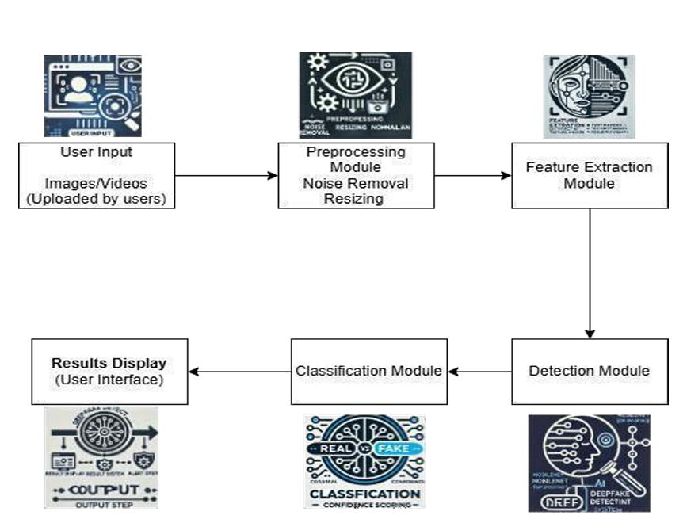
SYSTEM ARCHITECTURE
14
Integrated Anti-Spoofing and Deepfake Detection System Using MobileNet and ResNeXt

Slide 15
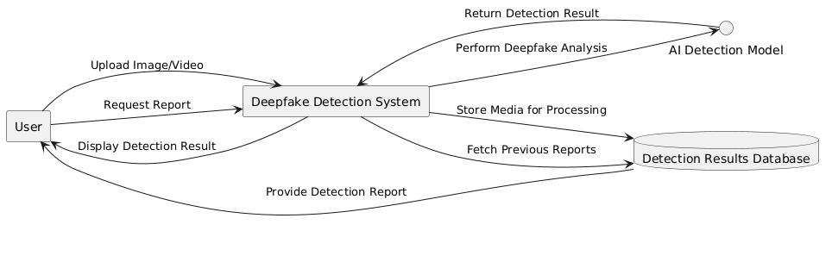
SYSTEM DESIGN - FLOW CHART/DFD/ER
DATA FLOW DIAGRAMS
15
Integrated Anti-Spoofing and Deepfake Detection System Using MobileNet and ResNeXt

Slide 16
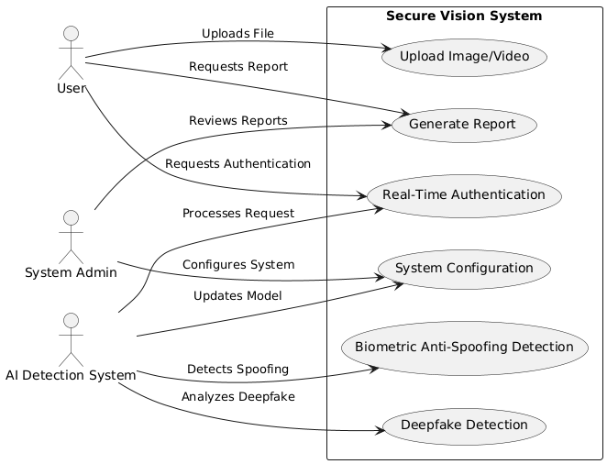
SYSTEM DESIGN - FLOW CHART/DFD/ER
UML DIAGRAMS
16
Integrated Anti-Spoofing and Deepfake Detection System Using MobileNet and ResNeXt

Slide 17
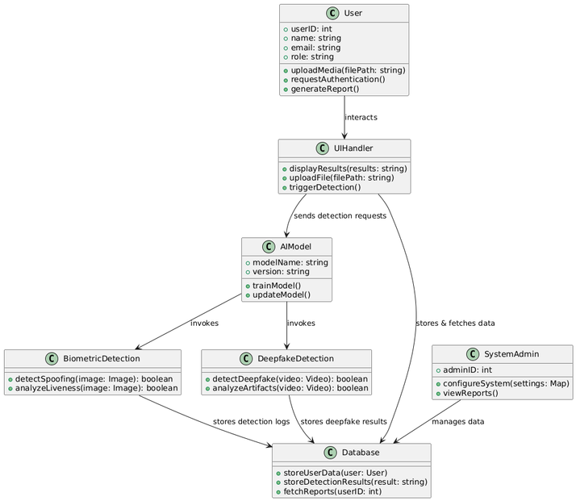
SYSTEM DESIGN - FLOW CHART/DFD/ER
USE CASE DIAGRAMS
17
Integrated Anti-Spoofing and Deepfake Detection System Using MobileNet and ResNeXt

Slide 18
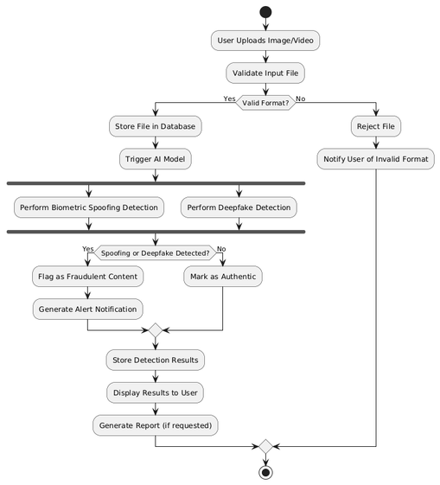
SYSTEM DESIGN - FLOW CHART/DFD/ER
ACTIVITY DIAGRAMS
18
Integrated Anti-Spoofing and Deepfake Detection System Using MobileNet and ResNeXt

Slide 19
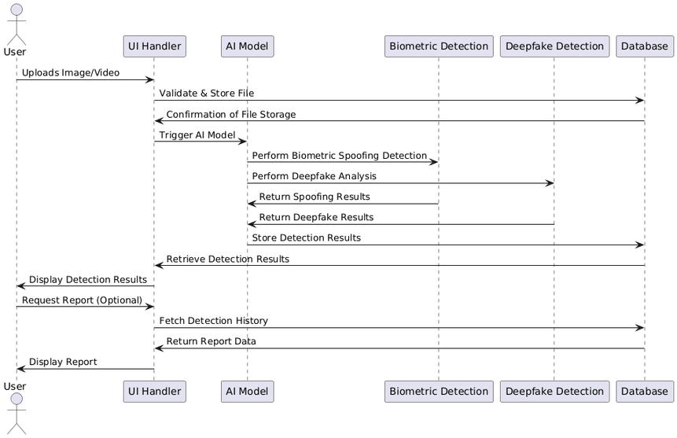
SYSTEM DESIGN - FLOW CHART/DFD/ER
SEQUENCE DIAGRAMS
Integrated Anti-Spoofing and Deepfake Detection System Using MobileNet and ResNeXt
19

Slide 20
MODULE DESCRIPTION
Preprocessing Module
Media Format Conversion: Supports JPEG, PNG, MP4, AVI. Converts images to RGB format, extracts frames from videos at 30 FPS.
Noise Reduction & Image Enhancement: Applies Gaussian Blur and Bilateral Filtering. Enhances contrast using histogram equalization.
Resizing & Normalization: Resizes images/frames to 224x224 pixels, normalizes pixel values between 0 and 1.
Frame Selection: Extracts keyframes using scene change detection to reduce computational cost.
20
Integrated Anti-Spoofing and Deepfake Detection System Using MobileNet and ResNeXt

Slide 21
MODULE DESCRIPTION
Feature Extraction Module
Facial Landmark Detection: Detects facial features (eyes, nose, mouth) using Dlib’s Facial Landmark Predictor.
Texture Analysis (LBP): Identifies synthetic textures through Local Binary Patterns.
Frequency Domain Analysis: Uses Fourier and Wavelet Transforms to detect high-frequency artifacts.
Blink Detection: Tracks unnatural blinking patterns to analyze liveness.
Integrated Anti-Spoofing and Deepfake Detection System Using MobileNet and ResNeXt
21

Slide 22
MODULE DESCRIPTION
Classification Module
Deep Learning Models: ResNeXt for face manipulation detection, MobileNet for real-time anti-spoofing.
Classification Workflow:
Input features into CNN for hierarchical pattern extraction.
Softmax activation for binary classification (Real vs Fake).
Confidence Scoring & Reporting: Calculates confidence score, flags media for review if below threshold, generates detailed report with detected artifacts.
Integrated Anti-Spoofing and Deepfake Detection System Using MobileNet and ResNeXt
22

Slide 23
TEST CASES
S.NO | Test Cases | Test Procedure | Test Input | Expected Result | Actual Result
1 | Video Upload Validation | Upload a valid video file | Deepfake Video (.mp4) | Video should be accepted | Video successfully uploaded
2 | Deepfake Detection Accuracy | Run deepfake detection on manipulated video | AI- Generated Deepfake Video | System detects as "Fake" | System detects as "Fake"
3 | Real Face Detection Accuracy | Run deepfake detection on real image | Real Face Image | System detects as "Real" | System detects as "Real"
Integrated Anti-Spoofing and Deepfake Detection System Using MobileNet and ResNeXt
23

Slide 24
TEST CASES
S.NO | Test Cases | Test Procedure | Test Input | Expected Result | Actual Result
4 | Biometric Anti- Spoofing | Analyze liveness cues | Static Image Attack | System detects as "Spoof" | System detects as "Spoof"
5 | System Performance | Measure response time | High- resolution video | Detection < 5 seconds | Detection took 4.8 seconds
6 | Invalid File Type Handling | Upload an unsupported file format | Text File (.txt) | Error message should appear | Error message displayed
Integrated Anti-Spoofing and Deepfake Detection System Using MobileNet and ResNeXt
24

Slide 25
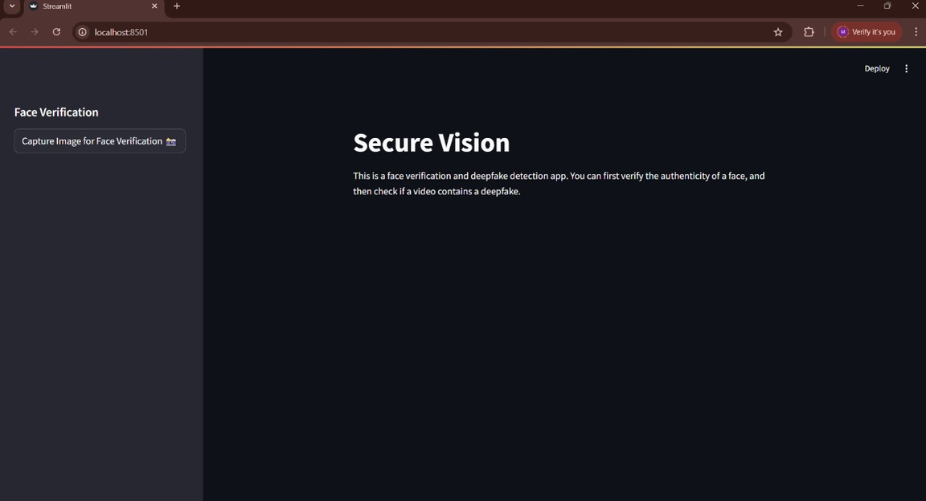
SCREEN SHOTS
25
Integrated Anti-Spoofing and Deepfake Detection System Using MobileNet and ResNeXt

Slide 26
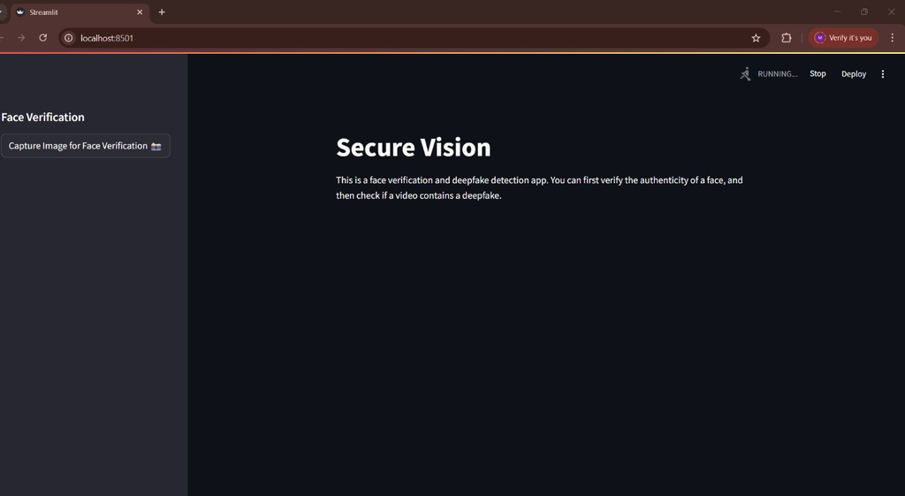
SCREEN SHOTS
26
Integrated Anti-Spoofing and Deepfake Detection System Using MobileNet and ResNeXt

Slide 27
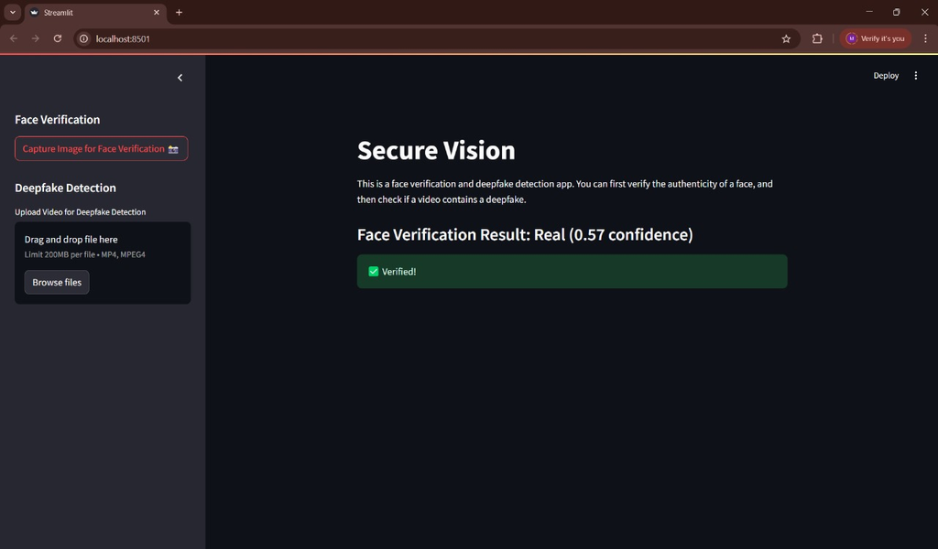
SCREEN SHOTS
27
Integrated Anti-Spoofing and Deepfake Detection System Using MobileNet and ResNeXt

Slide 28
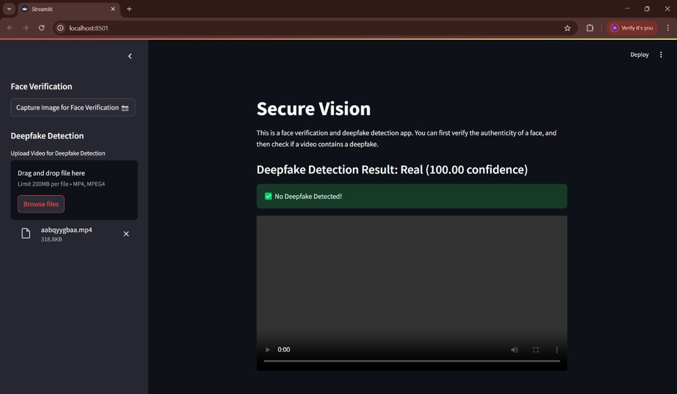
SCREEN SHOTS
28
Integrated Anti-Spoofing and Deepfake Detection System Using MobileNet and ResNeXt

Slide 29
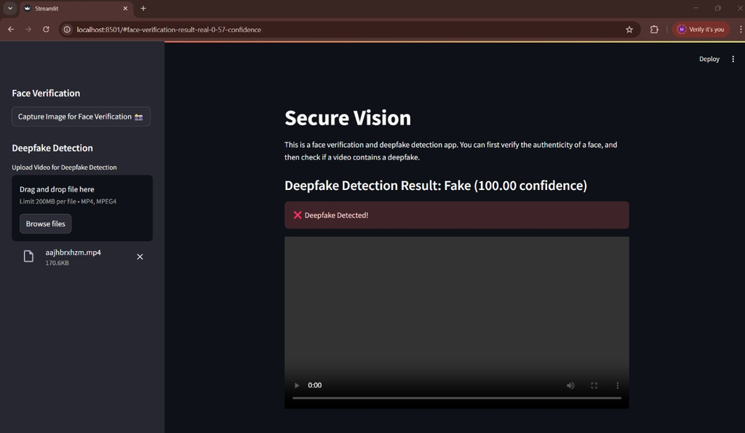
SCREEN SHOTS
29
Integrated Anti-Spoofing and Deepfake Detection System Using MobileNet and ResNeXt

Slide 30
FUTURE ENHANCEMENT
Real-Time Detection: Enhancing live stream analysis for social media, video calls, and news to flag deepfakes instantly using low-latency AI and cloud processing.
Multi-Modal Analysis: Combining audio, facial movements, and text cues to improve deepfake detection, especially for political speeches and impersonation scams.
Edge & Mobile Integration: Deploying lightweight AI models on mobile apps and edge devices for real-time detection without high computational power.
Cybersecurity & Forensics: Integrating with cybersecurity frameworks and law enforcement for identity fraud prevention and forensic evidence verification.
Explainable AI: Using XAI techniques (Grad-CAM, LIME, SHAP) to improve transparency and trust by visualizing how deepfakes are detected.
30
Integrated Anti-Spoofing and Deepfake Detection System Using MobileNet and ResNeXt

Slide 31
CONCLUSION
Advanced Detection Pipeline: Uses preprocessing, feature extraction, and deep learning (ResNeXt & MobileNet) to identify deepfakes and biometric spoofing.
Reliable Media Classification: Analyzes facial and texture features to classify content as real or manipulated for security applications like biometric authentication and forensics.
Comprehensive Reporting: Provides detailed insights to help users verify media authenticity and understand detection results.
Challenges & Limitations: Struggles with adversarial deepfake attacks and low-resolution media, requiring further refinement.
Future Enhancements: Focuses on scalability, improved AI training, dataset diversity, and real-time optimizations for better accuracy and efficiency.
31
Integrated Anti-Spoofing and Deepfake Detection System Using MobileNet and ResNeXt

Slide 32
REFERENCE PAPER
C. P. M. Chan, S. W. Lee, and J. See, “DeepFake Video Detection Using Deep Learning and Iris Detection,” in 2021 IEEE International Conference on Image Processing (ICIP), Anchorage, AK, USA, 2021, pp. 1239–1243, doi: 10.1109/ICIP42928.2021.9506664.
J. Dong, W. Wang, Y. Tang, Y. Zhang, and H. Liu, “Deepfake Video Detection Using Inception-ResNet and Attention Mechanism,” in 2021 IEEE International Conference on Multimedia and Expo (ICME), Shenzhen, China, 2021, pp. 1–6, doi: 10.1109/ICME51207.2021.9428434.
M. N. Husen, A. Kurniawan, and M. Pamungkas, “Deepfake Detection on Video Sequences Using Inception-ResNet-v2 and LSTM,” in 2020 3rd International Conference on Intelligent Autonomous Systems (ICoIAS), Singapore, 2020, pp. 134– 138, doi: 10.1109/ICoIAS49312.2020.9081914.
32
Integrated Anti-Spoofing and Deepfake Detection System Using MobileNet and ResNeXt

Slide 33
REFERENCE PAPER
D. S. Vahdati, T. D. Nguyen, A. Azizpour, and M. C. Stamm, “Beyond Deepfake Images: Detecting AI-Generated Videos,” 2024 IEEE/CVF Conference on Computer Vision and Pattern Recognition Workshops (CVPRW), 2024. doi: 10.1109/CVPRW63382.2024.00443.
J. Vijaya, A. A. Kazi, K. G. Mishra, and A. Praveen, “Generation and Detection of Deepfakes using Generative Adversarial Networks (GANs) and Affine Transformation,” 2023 14th International Conference on Computing Communication and Networking Technologies (ICCCNT), 2023. doi: 10.1109/ICCCNT56998.2023.1030781.
N. M. Alnaim, Z. M. Almutairi, M. S. Alsuwat, H. H. Alalawi, A. Alshobaili, and F. S. Alenezi, “DFFMD: A Deepfake Face Mask Dataset for Infectious Disease Era With Deepfake Detection Algorithms,” IEEE Access, vol. 11, pp,3246661, 2023. doi: 10.1109/ACCESS.2023.3246661.Martinez, F., Zhang, S., & Wu, Y. (2022).
Integrated Anti-Spoofing and Deepfake Detection System Using MobileNet and ResNeXt
33

