Slide 1
SDLC Overview
SDLC, Software Development Life Cycle is a process used by software industry to design, develop and test high quality softwares. The SDLC aims to produce a high quality software that meets or exceeds customer expectations, reaches completion within times and cost estimates.

Slide 2
A typical Software Development life cycle consists of the following stages:
Stage 1: Planning and Requirement Analysis
Stage 2: Defining Requirements
Stage 3: Designing the product architecture
Stage 4: Building or Developing the Product
Stage 5: Testing the Product
Stage 6: Deployment in the Market and Maintenance

Slide 3
Types
There are two most important and popular SDLC models followed in the industry:
Waterfall Model
Agile

Slide 4
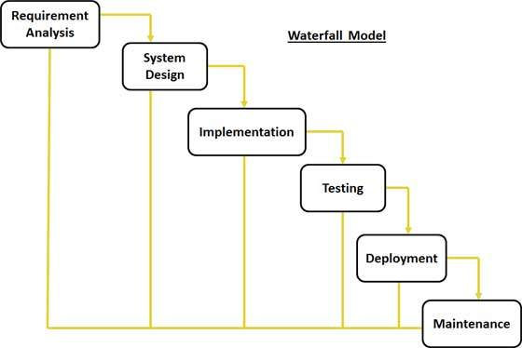
SDLC Waterfall Model

Slide 5
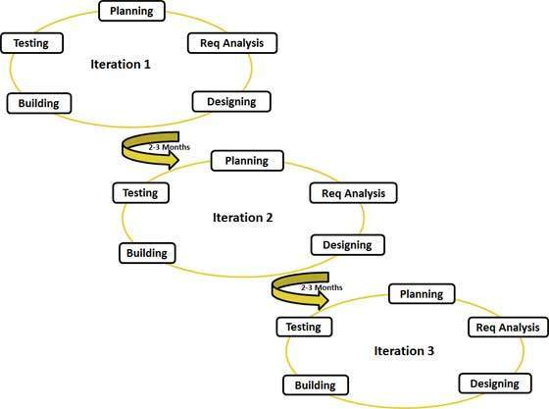
Agile Model

Slide 6
Waterfall Model Challenges
It was difficult to maintain ~100% uptime of the production environment.
Infrastructure Automation tools were not very affective.
Number of severs to be monitored keeps on increasing with time and hence the complexity.
It was very difficult to provide feedback and diagnose issue in the product.

Slide 7
New Challenge
Continuous Development
Continuous Integration
Continuous Testing
Continuous Monitoring
Virtualization and Containerization

Slide 8
What is DevOps?
DevOps (development and operations) is an enterprise software development phrase used to mean a type of agile relationship between Development and IT Operations.
The goal of DevOps is to change and improve the relationship by advocating better communication and collaboration between the two business units.

Slide 9
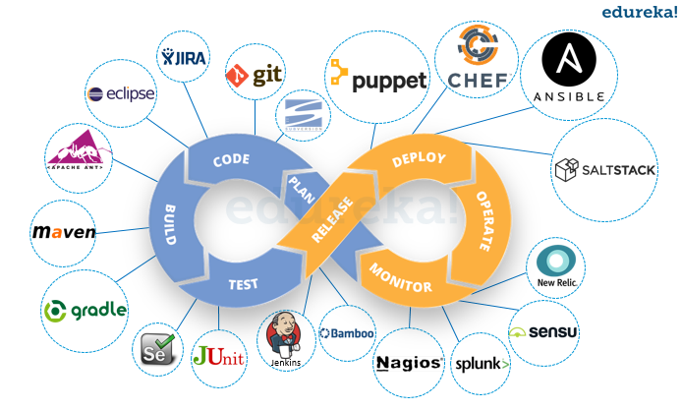
DevOps

Slide 10
DevOps Lifecycle can be broadly broken down into the below DevOps Stages:
Continuous Development
Continuous Integration
Continuous Testing
Continuous Monitoring
Virtualization and Containerization

