Slide 1
Lending Club Case Study
Batch: EPGML C55 July 2023
Group Members:
Mathangi M (mathangimr@gmail.com)
Kiran Prasad (kiranp37@gmail.com)

Slide 2
Problem Statement
Given the data provided about past loan applicants and whether they ‘defaulted’ or not, come up with an understanding on how various
consumer attributes and
loan attributes
influence the tendency of default.

Slide 3
Analysis Approach
Approach followed: Exploratory Data Analysis, including following steps:
Data understanding
Data cleansing & manipulation
Derived metrics generation
Univariate & segmented univariate analysis
Bivariate analysis

Slide 4
Metrics
Grade and sub-grade are type driven metrics which belong to ordinal variables.
Employment length falls under internal variables as they follow a certain order but doesn’t help us in any multiplication and division operations against defaulters.
Based on the income type, we can determine the amount which comes under each income range which belongs to a derived metric calculation.

Slide 5
Observations
Average annual income of defaulters are mainly less than 65000.
Average dti is 14 or above for defaulters.
Defaulted loans have average principal amount more than 12000.
Majority of defaulters have rented apartments or their home under mortgage.
More than 90% of defaulters belongs to low income group (<5 lakhs).
Average pay ratio is higher than 1.275 for defaulters and this is very high compared to fully paid loans.
There is a lot of defaulters who have taken loan amounts between 5000 to 10000.
If the interest rate is between 10-15%, then the defaulters number increases.
Large number of defaulters fall in the range around 10+ years while there are some of them similarly in the range of 0-2 years.
Loan Amount and installment has a higher correlation of 0.93. The pay ratio and interest rate has a correlation value of 0.73.

Slide 6
EDA Results and Visualizations – Univariate Analysis

Slide 7
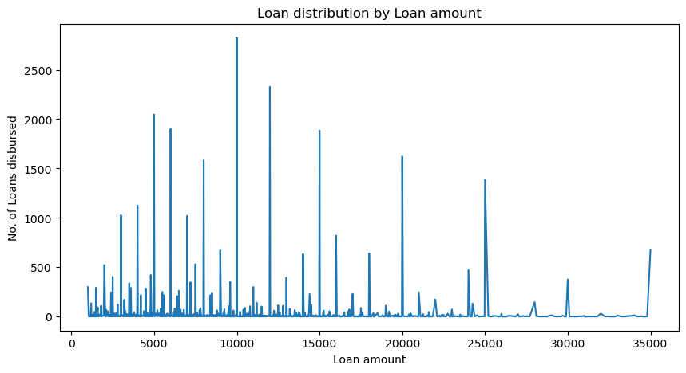
Loan distribution by Loan amount
Maximum loans disbursed are having amounts rounded to multiples of 1000s
Highest number of loans for a single amount is of amount 10000.
50% of loans are ranging between 5000 - 15000

Slide 8
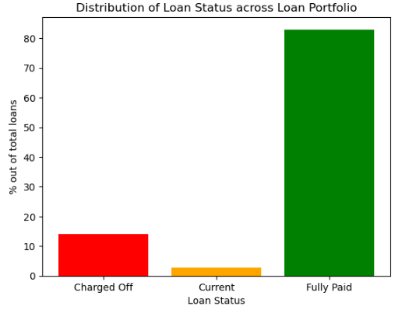
% distribution of Loan Status across the Loan portfolio
Around 15% of total loans disbursed are defaulted

Slide 9
Segmented Univariate Analysis

Slide 10
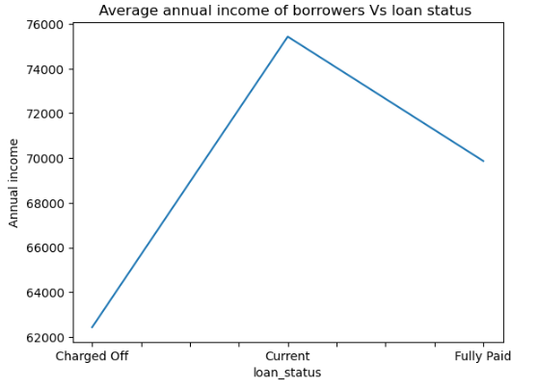
Average annual income of Borrowers Vs. Loan Status
Data set is segmented based on loan status and average annual income is calculated for each segment.
All defaulted borrowers are having lower annual income (specifically, below 65000)
There are no defaulters with average annual income is below 70000
This is customer attribute influencing tendency of default

Slide 11
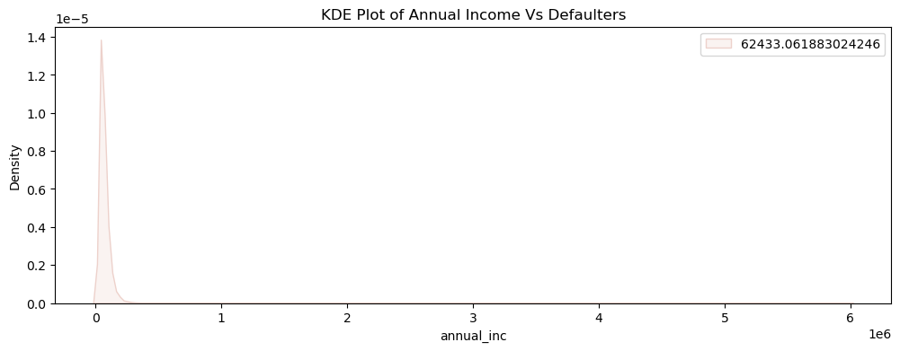
Annual Income of Defaulters

Slide 12
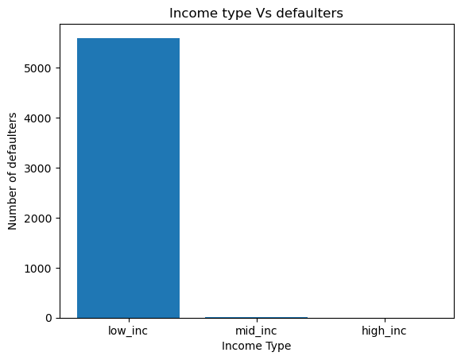
Income Type Vs. Defaulters
Annual income varies between 4000 to 60 lakhs. Hence customers are grouped into 3 categories:
1. low_inc = < 5 lakhs
2. mid_inc = Between 5 & 10 lakhs
3. high_inc = > 10 lakhs
More than 90% f defaulters belong to low income category

Slide 13
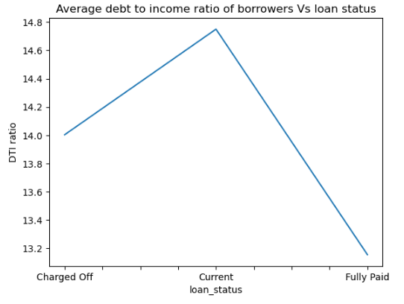
Average debt to income ratio of Borrowers Vs. Loan Status
Data set is segmented based on loan status and average debt to income ratio of borrowers is calculated for each segment.
All defaulted borrowers are having higher debt to income ratio (specifically, above 14)
This is customer attribute influencing tendency of default

Slide 14
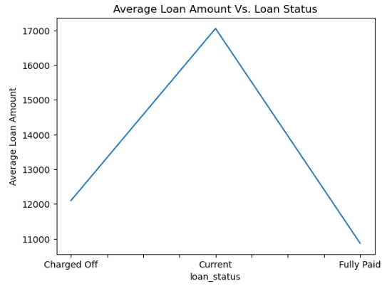
Average Loan Amount Vs. Loan Status
Data set is segmented based on loan status and average loan amount is calculated for each segment.
All defaulted borrowers are having average loan amount above 12000
This is loan attribute influencing tendency of default

Slide 15
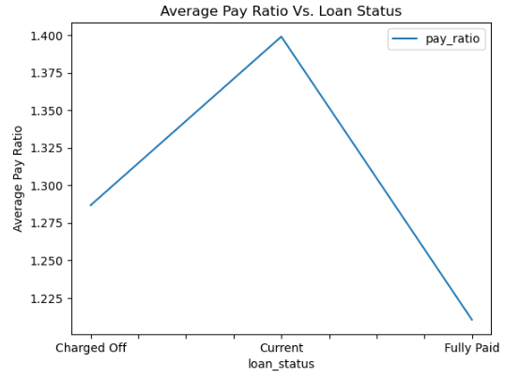
Average Pay Ratio Vs. Loan Status
Pay ratio = ratio of total payable amount to loan amount
Data set is segmented based on loan status and average pay ratio is calculated for each segment.
Loans with pay ratio > 1.275 are likely to default
This is loan attribute influencing tendency of default

Slide 16
In above figures, the average values for currently active loans are higher than charged off and fully paid loans. This is because:
Currently active loans are the least in number compared to others, thus average values goes up.
All of them are higher term loans (60 months) with high loan amounts
This also represents good borrowers

Slide 17
Bivariate Analysis

Slide 18
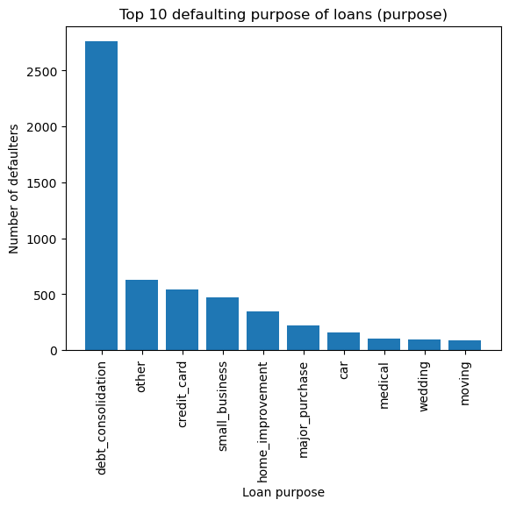
Top 10 defaulting ‘purpose’ of loans
Data set is segmented based on loan status and grouped based on the loan purpose.
Top 10 purpose covers more than 80% of total defaulters
This is loan attribute influencing tendency of default

Slide 19
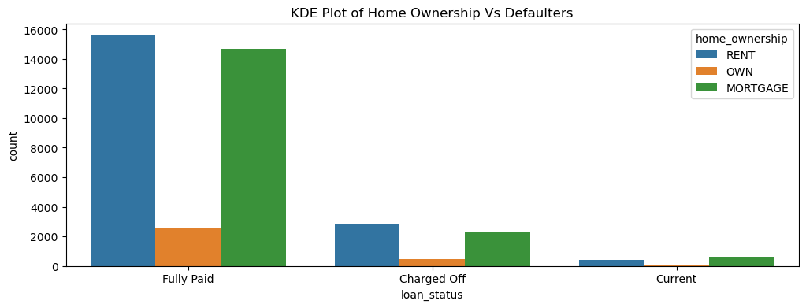
Home ownership of Borrowers across Loan portfolio

Slide 20
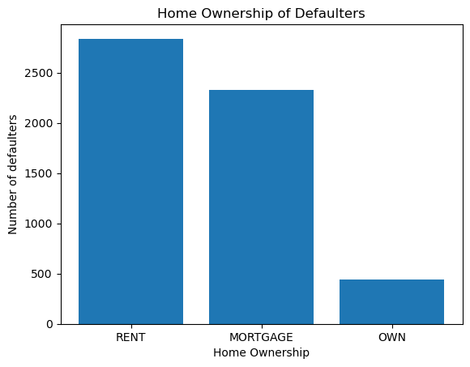
Home ownership of Defaulters
Data set is segmented based on loan status and grouped based on the type of home ownership
Largest group of defaulters are either on rent or have their homes mortgaged
This is costumer attribute influencing tendency of default

Slide 21
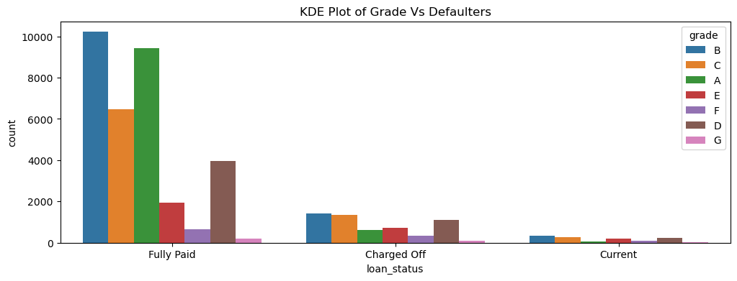
Borrower grade distribution across Loan portfolio

Slide 22
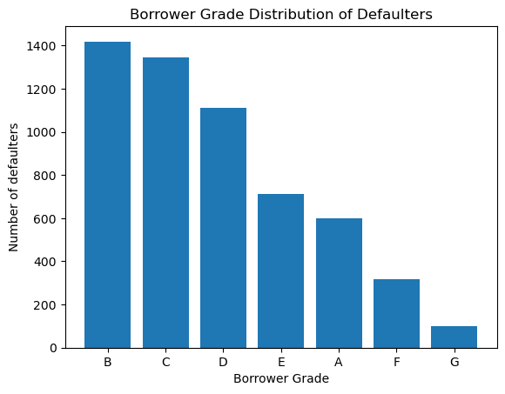
Borrower grade Vs. Defaulters
Data set is segmented based on loan status and grouped based on grade of borrowers
Largest group of defaulters are having grades B, C, D & E
Giving above average grades (B to D) to borrowers without proper evaluation by loan agents for increasing business can be a reason for this
This is customer attribute but decided by lender, influencing tendency of default

Slide 23
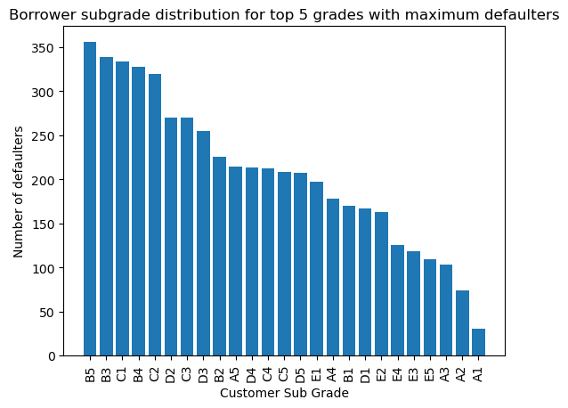
Borrower subgrade distribution for top 5 grades with maximum defaulters

Slide 24
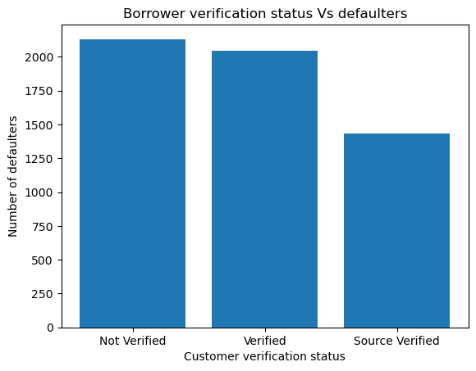
Borrower verification status Vs. Defaulters
Data set is segmented based on loan status and grouped based on verification status of borrowers.
Majority of defaulters are either not verified or source not verified.
This is customer attribute but decided by lender, influencing tendency of default

Slide 25
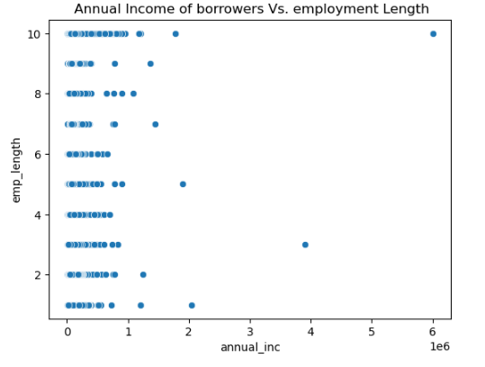
Annual income Vs. employment length of all Borrowers
Majority of borrowers have annual income < 10 lakhs
Scatter plot is used to determine the vital relationship between two variables

Slide 26
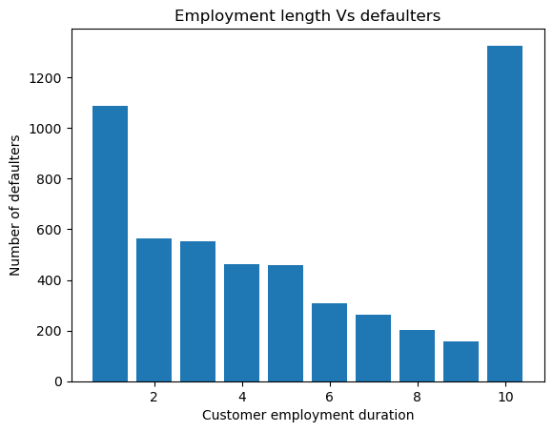
Employment length of defaulters
Data set is segmented based on loan status and grouped based on employment length of borrowers
Majority borrowers are employed for less than 5 years
Largest single group of defaulters are employed for 10 or more years.
Filling high employment length without proper evaluation by loan agents for increasing business can be a reason for this.
This is customer attribute influencing tendency of default

Slide 27
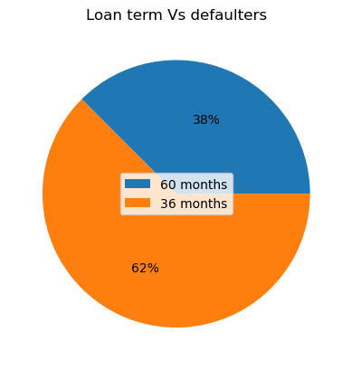
Term of loan Vs. Defaulters
Short term loans (36 months) have more defaulting tendency

Slide 28
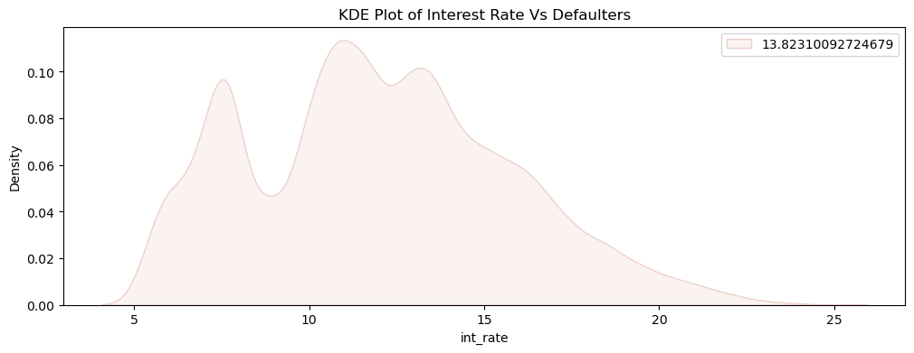
Interest Rate Vs. Defaulters
Majority loans defaulted have interest rates between 10% – 15%

Slide 29
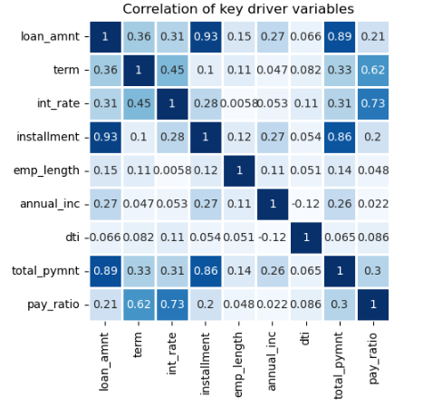
Correlation of key driver variables

Slide 30
Conclusion
Customer attributes affecting tendency for defaulting:
Home ownership (rented or mortgaged)
Average annual income (less than 65000)
Employment length (less than 5 years)
Debt to income ratio of customer (Above 14)
Grade of borrower
Loan attributes affecting tendency for defaulting
Loan Amount (> 12000)
Term of loan
Pay ratio
Interest rate

