Slide 1

YOU ONLY LOOK ONCE: UNIFIED, REAL-TIME OBJECT DETECTION
Fall 2024: IDC 6146 Deep Learning for Data Science | Prof.
Presented by:
Kavya Reddy Maale, Folarin John Madandola, Pavani Mathari, Sai Kumar Miryala

Slide 2
INTRODUCTION
YOLO is a cutting-edge, real-time object detection algorithm that processes images in a single pass through a neural network.
Why it matters:
YOLO's high speed and accuracy make it ideal for applications requiring immediate decision-making, such as:
Autonomous Driving: Detects vehicles, pedestrians, and traffic signs in real-time for safe navigation.
Surveillance: Identifies and tracks individuals or objects for security purposes.
Robotics: Enables robotic arms and drones to interact with dynamic environments

Slide 3
PROBLEM STATEMENT
Object detection involves identifying objects
Balancing speed and accuracy for real-time applications like autonomous driving.
Localizing objects in images (bounding box)

Slide 4
OBJECTIVE & SCOPE
Understand YOLO’s architecture and principles.
Simplifies object detection by treating it as a regression problem.
Compare YOLO with traditional methods.
Eliminates region proposals and multi-pass processing.
To implement YOLO and evaluate its performance on real-world datasets.
Enables real-time detection without sacrificing accuracy.

Slide 5
EXPANDED OBJECTIVES
Understanding Architecture and Principals
Explore how YOLO’s grid-based approach works for object detection.
Learn how the model predicts bounding boxes and class probabilities simultaneously.
Study the trade-offs between YOLO’s speed and accuracy.
Comparing YOLO with Traditional Methods
Highlight the differences between YOLO and region-based methods like Faster R-CNN.
Analyze computational efficiency and detection accuracy of YOLO versus multi-stage algorithms.
Examine the impact of YOLO's single-pass processing on real-time applications.
Simplifying Object Detection
Demonstrate how YOLO treats detection as a regression problem instead of classification and localization.
Understand how eliminating region proposals reduces computational complexity.

Slide 6
EXPANDED OBJECTIVES
…. Cont
Showcase how YOLO achieves a balance between simplicity and performance.
4) Enabling Real-Time Detection
Focus on YOLO’s ability to process images at high FPS (frames per second).
Evaluate the suitability of YOLO for time-sensitive tasks like autonomous driving and robotics.
Highlight improvements in real-time detection from YOLOv1 to YOLOv5+.
5) Implementation and Performance Evaluation
Apply YOLO to a dataset to detect and localize objects.
Measure performance metrics like mAP (mean Average Precision), IoU (Intersection over Union), and FPS.
Investigate the effect of hyperparameters like anchor boxes, learning rate, and batch size.

Slide 7
BACKGROUND AND LITERATURE REVIEW
Background:
Object Detection Evolution:
Earlier methods like HOG (Histogram of Oriented Gradients) and SIFT (Scale-Invariant Feature Transform) relied on hand-crafted features.
Transition to deep learning models like R-CNN and Faster R-CNN brought significant improvements in accuracy and versatility.
YOLO (You Only Look Once) introduced in 2016 revolutionized object detection by combining speed and accuracy through a single-pass CNN model.
Key Concepts in YOLO:
Divides the image into a grid for simultaneous detection and localization.
Predicts bounding boxes and class probabilities directly, eliminating multi-stage pipelines.

Slide 8
BACKGROUND AND LITERATURE REVIEW ….cont
Literature Review:
YOLOv1 (2016):
Introduced by Joseph Redmon. Simplified object detection into a regression task.
Pros: Real-time detection. Cons: Struggled with small objects.
YOLOv3 (2018):
Enhanced feature extraction using Darknet-53 backbone.
Introduced multi-scale detection to handle objects of different sizes.
YOLOv5 (2020):
Further improved efficiency and flexibility with better optimization techniques.
Widely used in practical applications due to ease of use and deployment.

Slide 9
HISTORY OF OBJECT DETECTION
1. Early Methods:
HOG (Histogram of Oriented Gradients) and SIFT (Scale-Invariant Feature Transform):
Traditional feature extraction methods used for object detection.
Relied on hand-crafted features, limiting flexibility and accuracy.
Struggled with varying lighting conditions and object orientations.
2. The Shift to Deep Learning:
R-CNN (Regions with CNN features):
Proposed by Ross B. Girshick in 2014, combining region proposals with CNNs for more accurate detection.
Significant improvement in accuracy but was slow due to multi-step processing.
Faster R-CNN (2015):
Introduced a Region Proposal Network (RPN) for faster and more efficient object detection.
Addressed some of R-CNN's computational inefficiencies but still had speed limitations.

Slide 10
HISTORY OF OBJECT DETECTION
….cont
3. YOLO: Revolutionizing Object Detection (2016 - present)
YOLOv1 (2016):
Introduced by Joseph Redmon.
Revolutionized the detection pipeline by predicting bounding boxes and class probabilities in a single pass.
Allowed real-time detection (45 frames per second) but struggled with small object detection.
YOLOv2 (2017):
Introduced improvements in speed and accuracy, using a better backbone (Darknet-19).
Capable of detecting objects at high resolution and better handling of small objects.
YOLOv3 (2018):
Introduced Darknet-53 backbone for better feature extraction.
Added multi-scale prediction for detecting objects of different sizes.
Achieved even faster speeds (60 FPS) with improved accuracy.

Slide 11
HISTORY OF OBJECT DETECTION
….cont
4. YOLOv5 (2020 - present):
Enhanced Performance and Optimization:
Achieved a balance between speed and accuracy with smaller, more efficient models suitable for real-time applications.
Flexibility and Customization:
Offers various model sizes (small, medium, large) and is highly customizable for specific detection tasks, with pre-trained models for rapid deployment.
Real-World Application Support:
Widely used across industries in surveillance, autonomous vehicles, and robotics due to its ease of use, compatibility with multiple frameworks, and improved detection capabilities.

Slide 12
WHY YOLO?
Most other detection systems repurpose classifiers to perform detection.
Example:
• DPM (deformable parts model): uses sliding window approach where classifier is run at evenly spaced locations over the entire image.
• R- CNN uses region proposal methods to generate bounding boxes then run a classifier on these proposed boxes.
In yolo object detection is reframed as a single regression problem
• Image pixel bounding box coordinate and class probabilities.
• Helps to answer the where and what

Slide 13
Key Features of YOLOv5
Better Performance and Optimization:
YOLOv5 focuses on efficiency with smaller models (suitable for real-time applications) and better performance for both speed and accuracy.
Offers flexibility in terms of model size (small, medium, large variants), which can be tuned for various applications.
Pre-trained Models and Easy Deployment:
YOLOv5 is available in PyTorch and comes with pre-trained models for easy deployment across different platforms.
Improved Anchor Boxes:
YOLOv5 optimizes anchor boxes for more accurate detection, especially for small and large objects.
Support for Multiple Frameworks:
Works well with frameworks like TensorFlow, PyTorch, and OpenCV.
Extended Post-Processing:
Better non-max suppression (NMS) methods for handling overlapping objects, improving overall detection accuracy.
Real-World Applications:
Used widely in industries for applications like surveillance, autonomous vehicles, and robotics.

Slide 14
ARCHITECTURE
YOLO Architecture Overview
Unified detection network: predicts all bounding boxes and classes simultaneously.
Grid-based division of the image (e.g., 7x7 grid for S=7).
Outputs include bounding box parameters, confidence scores, and class probabilities.
Key Features of YOLO
Speed: Real-time detection with over 45 FPS; Fast YOLO reaches 155 FPS.
Simplicity: Single-pass, end-to-end training.
Generalization: Performs well across diverse datasets, including non-natural images.

Slide 15
TECHNICAL FEATURES
CSP Backbone
Efficient feature extraction for high accuracy.
PAN (Path Aggregation Network)
Combines features from different layers for better detection.
Mosaic Augmentation
Enhances training data by merging multiple images.
AutoAnchor
Automatically selects the best anchor boxes for different objects.
Scalable Architecture
Multiple versions (YOLOv5s, YOLOv5m, etc.) for different use cases.

Slide 16
HOW DOES IT WORK
1.Divides image in to an SXS grid
2.If a center of an object falls on a cell then its responsible for detecting the object 3.Each grid predicts bounding boxes and confidence score. =Confidence score = pr(object) * IOU(intersection over union) • If the object doesn’t exist confidence = 0
Bounding box consists of 5 predictions : x, y, w, h, C
• Confidence(C) can be predicted as intersection over union between predict box over ground truth
• ( x, y) = represent coordinates relative to grid cells
Each grid also predicts the conditional class probabilities pr(classi/object) • It only predicts for one set of class probabilities per grid cell regardless of the number of boxes.

Slide 17
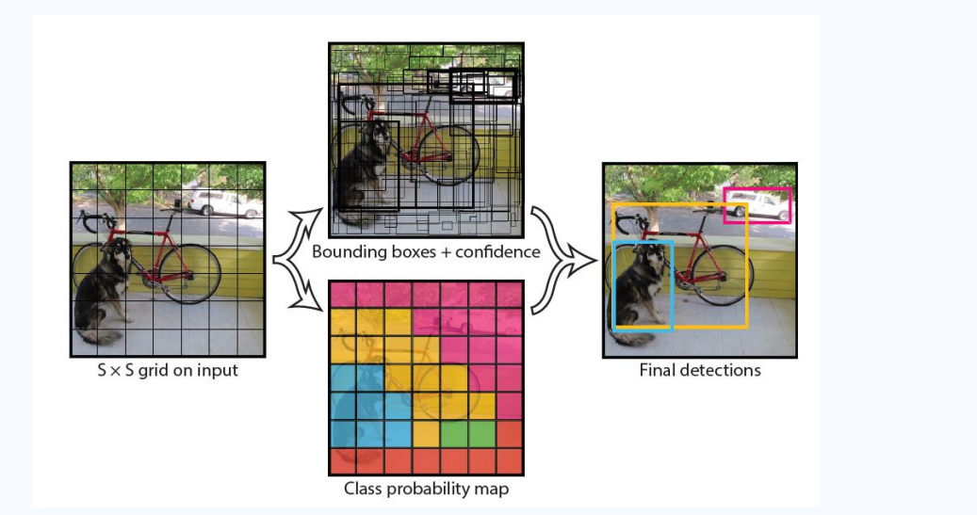
Conditional class probabilities x individual box confidence = class specific confidence score for each box • Pr(classi/object)* pr(object) *IOU = pr(classi)*iou

Slide 18
REVIEW
YOLO Version | Key Features | Performance Improvements | Limitations
YOLOv1 | Unified detection as regression, single network | Fast, single-stage pipeline | Localization errors, struggles with small objects
YOLOv2 | Anchor boxes, batch normalization, multi-scale | Improved accuracy, handles more classes | Issues with small objects
YOLOv3 | Feature pyramid network, Darknet-53 backbone | Multi-scale detection, better backbone | Increased complexity
YOLOv4 | CSPNet, PAN, mosaic augmentation | Better feature extraction, enhanced speed | Resource-intensive training
YOLOv5 | Lightweight design, scalable architecture sizes | Fast training, modular, deployment ease | Not official by original authors

Slide 19
METHODOLOGY
YOLOv5
Features:
CSP backbone, PAN for feature fusion, Mosaic Augmentation, AutoAnchor.
Scalable architecture (e.g., YOLOv5s, YOLOv5m).
Benefits: Efficient, modular, and highly accurate.
Dataset
Dataset: COCO (80 categories, 150k+ labeled images).
Preprocessing: Image resizing, normalization, and data augmentation.

Slide 20
TRAINING CONFIGURATION
HYPERPARAMETER TUNING:
• Learning Rate: An adaptive learning rate schedule was implemented, starting at 0.01 and decaying over epochs for stable convergence.
• Momentum: Set at 0.937 to stabilize updates and reduce oscillations.
• Batch Size: A batch size of 16 was used, optimized for the available GPU memory.
TRAINING FRAMEWORK:
• The implementation was carried out using PyTorch, leveraging its dynamic computation graph for ease of debugging and customization.

Slide 21
CONT…
VALIDATION:
• The validation set comprised 5,000 images to evaluate the model’s performance at each epoch, ensuring no overfitting.
HARDWARE SETUP:
• Training was performed on a Tesla T4 GPU with 16GB VRAM, enabling accelerated computation and reduced training time.
• Mixed-precision training was employed to balance computational speed and memory usage.

Slide 22
EXPERIMENTATION
• Data Subset for Rapid Prototyping:
• A subset of 3,000 training images, 500 validation images, and 500 test images was created to expedite experimentation.
• Comparative Analysis:
• Baselines were established using YOLOv5 pre-trained models, including YOLOv5n, YOLOv5m, and YOLOv5x, to assess trade-offs between inference speed and detection accuracy.
• Model Variants:
• YOLOv5s was fine-tuned to balance computational efficiency and accuracy.
• Experiments included varying image resolutions (320x320, 640x640) to analyze the impact on detection performance.

Slide 23
EVALUATION METRICS
Performance Metrics:
• Mean Average Precision (mAP):
• Calculated at IoU thresholds ranging from 0.5 to 0.95 (mAP@0.5:0.95) to evaluate the precision-recall trade-off.
• Precision and Recall:
• Precision was used to measure the fraction of correctly identified objects among detections.
• Recall measured the fraction of actual objects correctly identified by the model.
• F1-Score:
• Combined precision and recall to provide a single performance measure.

Slide 24
CONT..
Frames Per Second (FPS):
• Evaluated real-time capability by calculating the number of frames processed per second during inference.
• Validation Process:
• Metrics were calculated after each epoch on the validation set to monitor model performance improvements

Slide 25
INFERENCE AND DEPLOYMENT
• Inference Pipeline:
• Input images were resized and preprocessed to match the model requirements.
• The YOLO v5 model performed a forward pass to detect objects in a single stage, outputting bounding boxes, confidence scores, and class predictions.
• Visualization:
• Detection results were overlaid on images with labeled bounding boxes and confidence scores for interpretation.
• Real-Time Performance:
• The model achieved a significant FPS, ensuring suitability for applications requiring real-time detection.

Slide 26
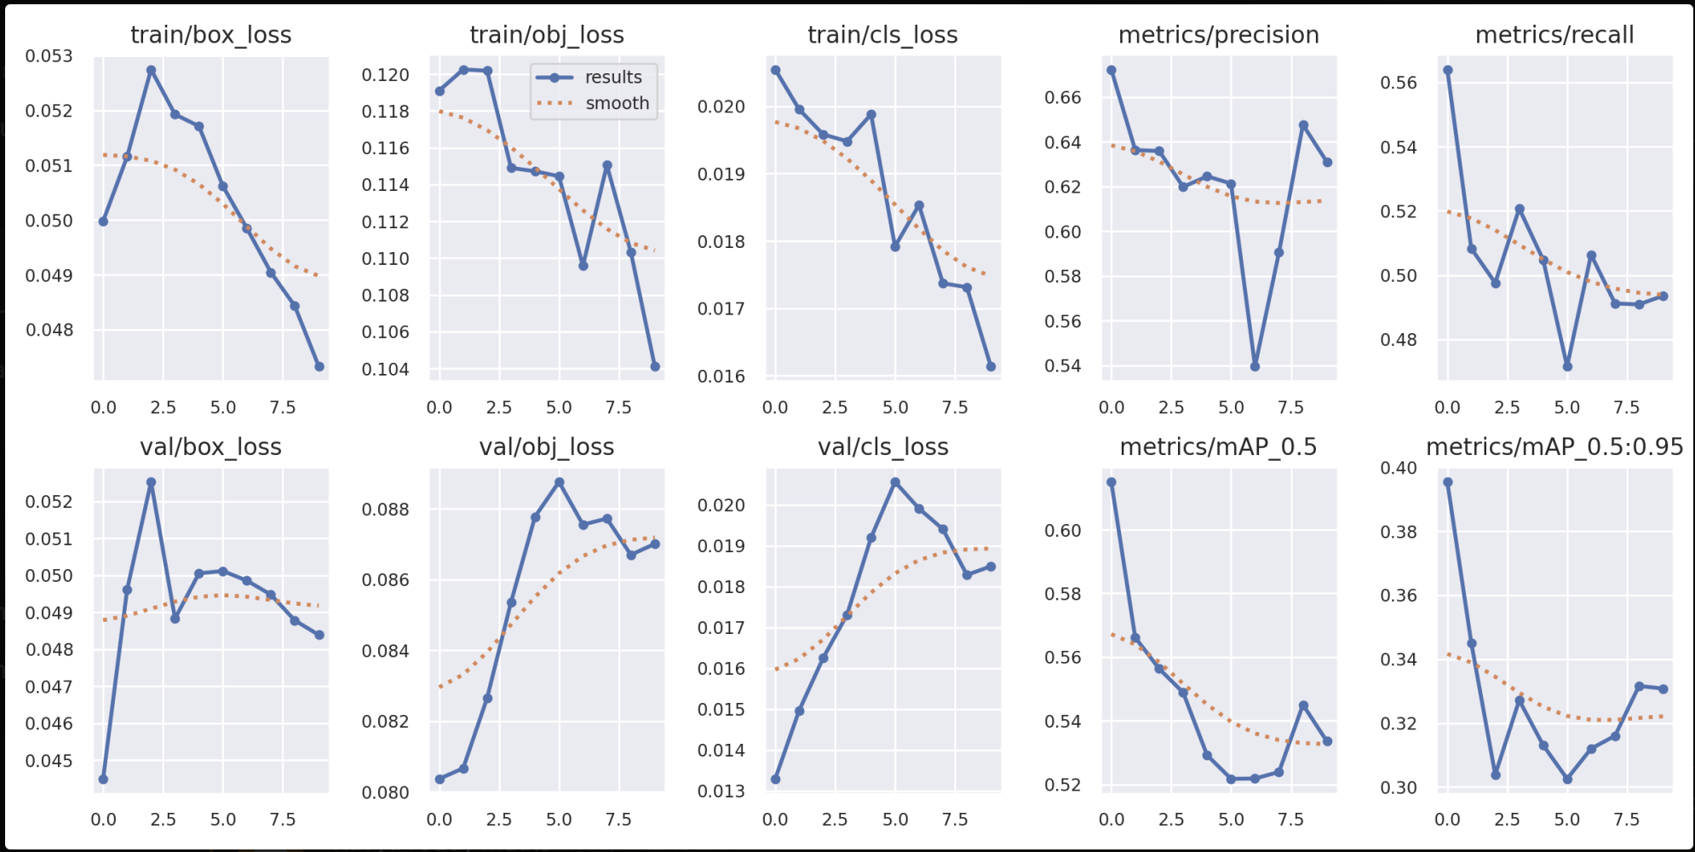
RESULTS
Model yolo5s
mAP (Validation) 63.4%
mAP (Test) 62.8%
Performance and Challenges
Strengths: High-speed detection and robust generalization.
Limitations: Struggles with small or densely packed objects.
Future improvements: Accuracy in cluttered/occluded scenes, application-specific optimizations.

Slide 27
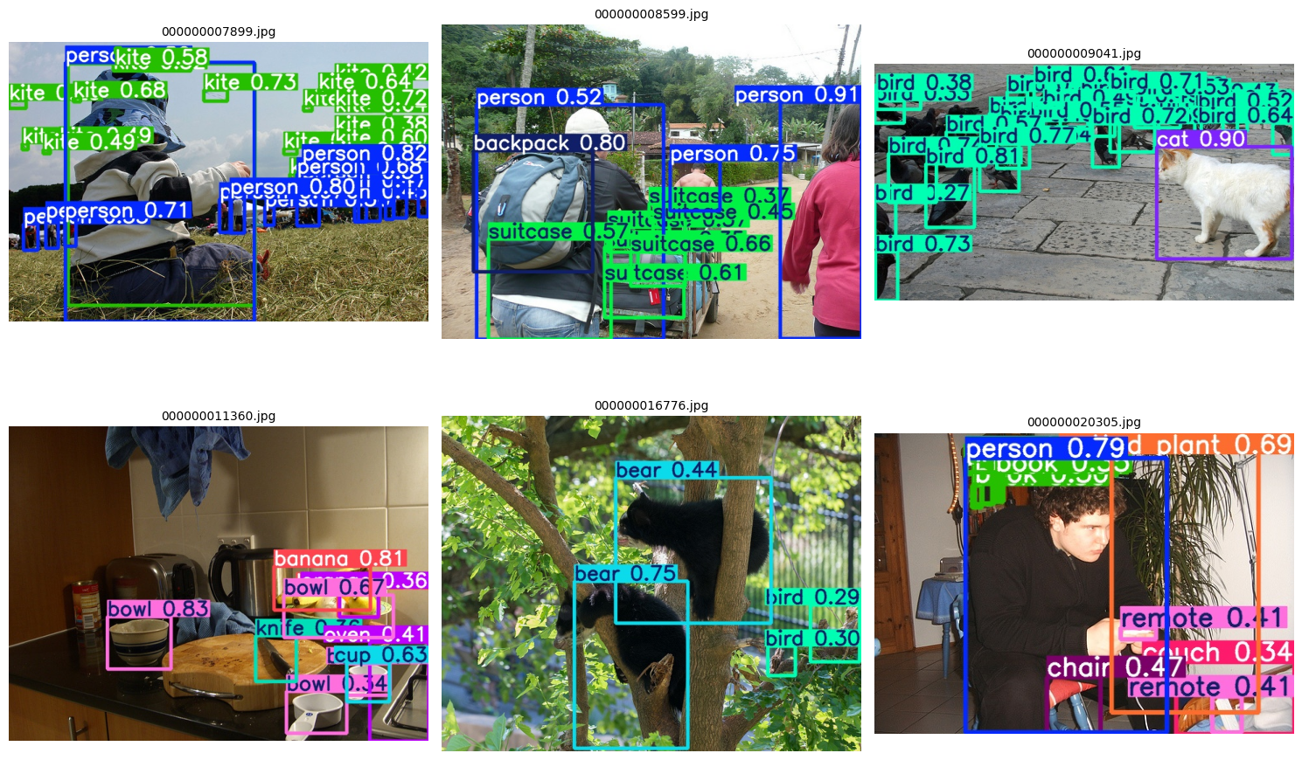
Output

Slide 28
Weakness and Area of improvement
Weaknesses:
Performance is lower than state-of-art
Makes more localization errors
Area of improvement:
Difficulty identifying small objects in crowded or cluttered scenes.
Struggles with detecting objects that are partially hidden.
Challenging to balance speed and accuracy on devices with limited resources.
Difficulty detecting underrepresented classes.

Slide 29
LIMITATIONS AND STRENGTHS
Loss of Accuracy caused by
Strong constraints on the bounding boxes
Downsampling images to lower resolution Hard to recognize small objects
Hard to recognize groups of object
Strengths :
Quick images process
Competitive detection accuracy.

Slide 30
CONCLUSION
Overall, this project highlights YOLO’s effectiveness as a unified and practical solution for object detection. By leveraging its strengths and addressing its weaknesses, future advancements can expand YOLO’s utility across a wide range of domains, pushing the boundaries of real-time object detection and its applications in intelligent systems.

Slide 31
THANK YOU
Link to code:
https://github.com/kavya-maale/Deep-Learning-project/blob/main/Object_Detection_YOLO_V5s_COCO.ipynb

