Slide 1
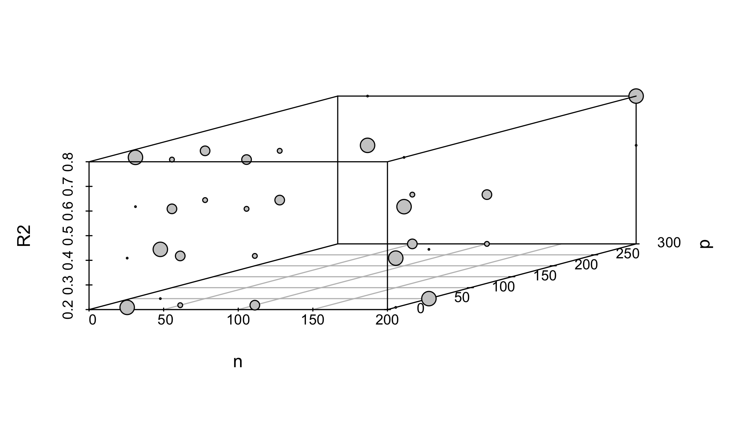
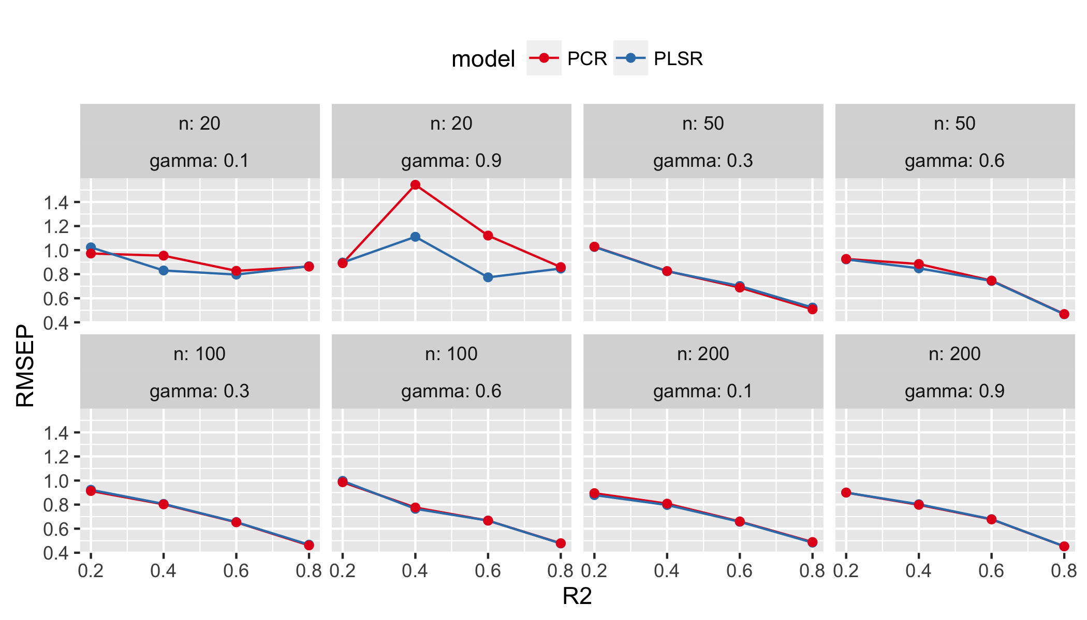

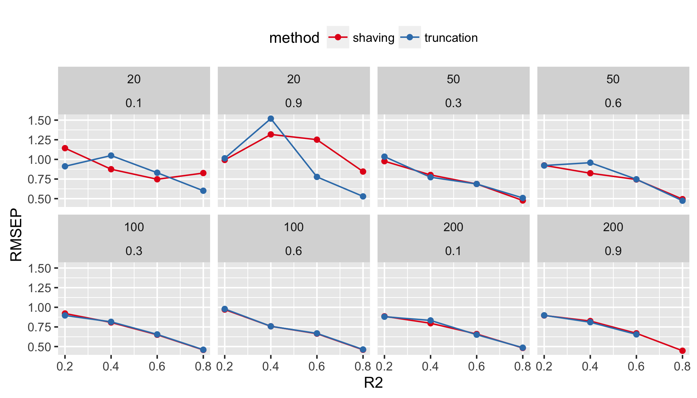

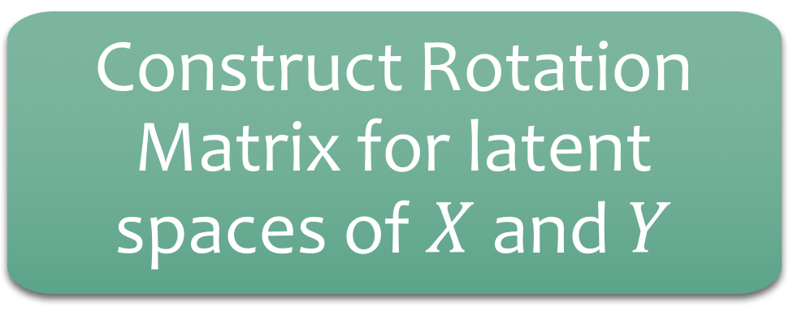

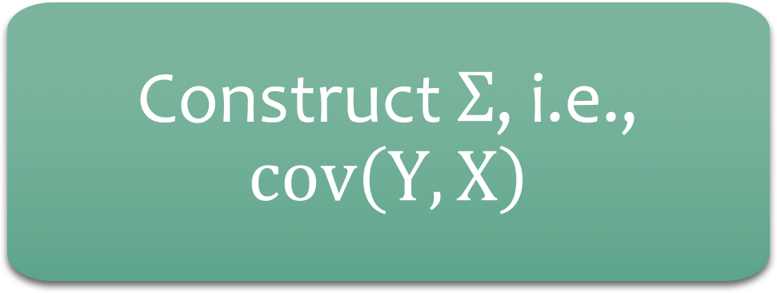
simrel-m: a simulation tool for multi-response linear model data
Examples
Raju Rimal, PhD Candidate ( Supervisors: Solve Sæbø, Trygve Almøy)
Simulate data from multi-response random regression model
Inputs
Construct $Σ$, i.e., $cov\left(Y, X\right)$
Easy design generation for computer experiments
Latent relevant spaces for both X and Y
Why simrel
Construct Rotation Matrix for latent spaces of $X$ and $Y$
Generate Latent Components
Handy tool for model and method comparison
Relevant and irrelevant predictors
Complex data structures controlled by few parameters
Simulate Data by random rotations of components
Fig1: Multilevel fractional Simulation Design created using simrel (size corresponds to gamma – multicollinearity factor)
Input Parameters
Number of responses, predictors and samples
simple tool for complex structure
SIMREL
Dimensions and variances of relevant X and Y spaces
2.0
Relevance of latent X space to latent Y space (Coefficient of Determination)
Fig2: Comparing PLS and PCR model on the basis of test prediction error for different combination of parameters
Unconditional and conditional correlation between responses
Degree of multicollinearity in X
Number of relevant predictors
Responses
Predictors
 | Relevant for $Y1$ |  | Relevant for both $Y1$ and $Y2$
 | Relevant for $Y2$ |  | Irrelevant
Sæbø, S., Almøy, T., & Helland, I. S. (2015). simrel—A versatile tool for linear model data simulation based on the concept of a relevant subspace and relevant predictors. Chemometrics and Intelligent Laboratory Systems, 146, 128-135.
Helland, I. S., & Almøy, T. (1994). Comparison of prediction methods when only a few components are relevant. Journal of the American Statistical Association, 89(426), 583-591.
References
Fig2: Comparing Variable selection methods (shaving vs truncation) on the basis of test prediction error for different combination of parameters
Norwegian University of Life Sciences, Ås, Norway
raju.rimal@nmbu.no | NORDSTAT, 2016

