Slide 1
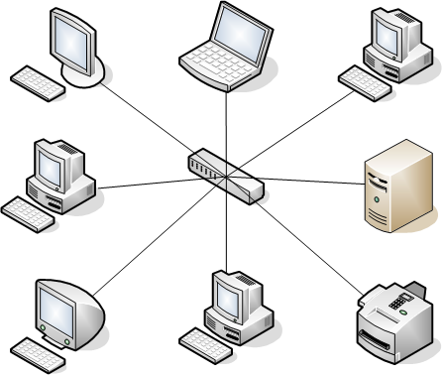
Star Topology

Slide 2
Star Topology
INTRODUCTION
Star topology is a network configuration where each device is connected to a central hub. The central hub acts as a server and controls communications between devices. The devices do not have a direct connection with each other, but can only communicate through the central device. In a star topology, the central hub acts like a server and the connecting nodes act like clients.
CLASSIFICATION
Star Topology is classified into three categories on the basis of working mechanism, which are as follows:
Passive Star Topology
Active Star Topology
However, the layout of star topology in each of the scenarios would be the same. But the working mechanism of each makes them different.

Slide 3
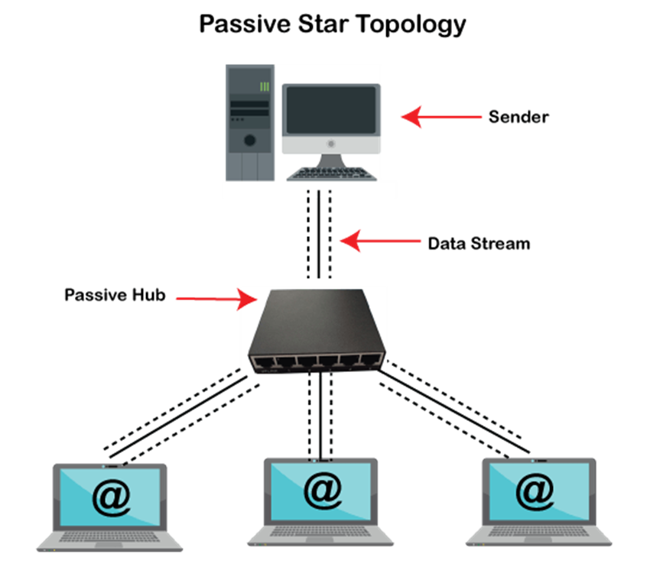
Passive Star Topology
A Passive Star Topology is created using a Passive Hub, which is a network's centre device. This central device in a computer network receives the signal from the sender and sends it to other stations. A passive Hub has the ability to enable the signal to pass without any intervention. In other words, the communication signals cannot be regenerated or reprocessed by the Passive Hub.

Slide 4
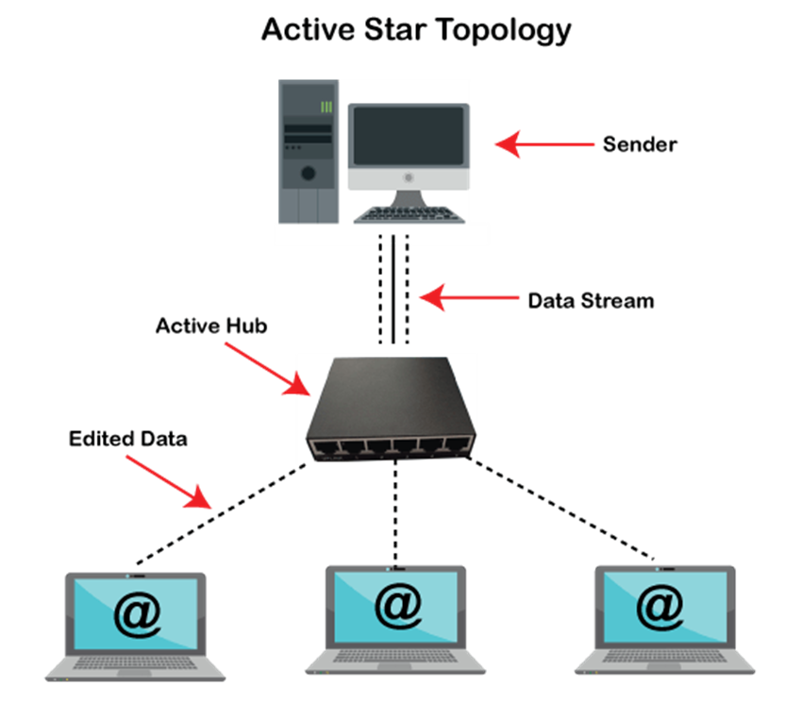
Active Star Topology
An Active Hub is present in the active star topology. In terms of passing the communication signals, this Hub performs additional functions. Active Hub, in contrast to Passive Hub, may reprocess or regenerate communication signals. After renewing sender communication signals, it broadcasts these to all other Nodes in the Computer Network. As a result, an Active Hub also serves as a Repeater.

Slide 5
Characteristics
Centralized Hub: The central hub or switch is the focal point of the network. All nodes connect directly to this central device.
Point-to-Point Connection: Each node has a dedicated connection to the central hub. This means that if one node wants to communicate with another, it sends the data to the central hub, which then forwards it to the destination node.
Isolation: If one node fails or has an issue, it typically does not affect the rest of the network. Other nodes can still communicate with each other via the central hub.
Scalability: It's relatively easy to add or remove nodes from a star network without disrupting the rest of the network. New nodes can simply connect to the central hub.

Slide 6
Characteristics
Performance: Since data does not have to travel through multiple nodes to reach its destination (like in a bus or ring topology), star topologies can offer good performance and faster data transfer speeds.
Dependence on Central Hub: The central hub is critical to the functioning of the network. If the hub fails, the entire network will be affected, as nodes will not be able to communicate with each other.
Cabling: Star topologies usually require more cabling than some other topologies, as each node needs its own cable to connect to the central hub.

Slide 7
Advantages
It is very reliable – if one cable or device fails then all the others will still work
It is high-performing as no data collisions can occur
Less expensive because each device only need one I/O port and wishes to be connected with hub with one link.
Easier to put in
Robust in nature
Easy fault detection because the link are often easily identified.
No disruptions to the network when connecting or removing devices.
Each device requires just one port i.e. to attach to the hub.

Slide 8
Disadvantages
Requires more cable than a linear bus .
If the connecting network device (network switch) fails, nodes attached are disabled and can’t participate in network communication.
More expensive than linear bus topology due to the value of the connecting devices (network switches)
If hub goes down everything goes down, none of the devices can work without hub.
Hub requires more resources and regular maintenance because it’s the central system of star .
Extra hardware is required (hubs or switches) which adds to cost
Performance is predicated on the one concentrator i.e. hub.

Slide 9
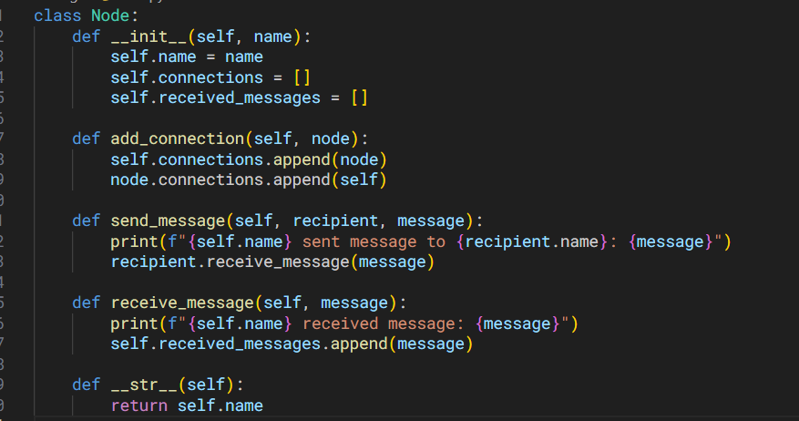
Code

Slide 10
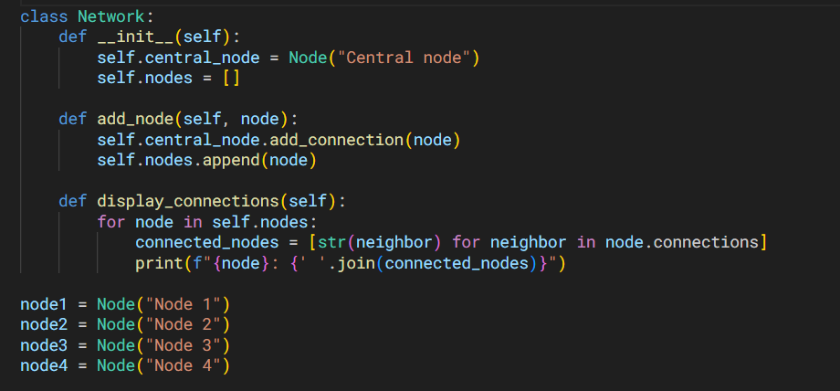
Code

Slide 11
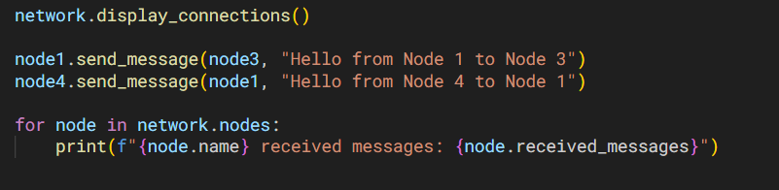
Code

Slide 12
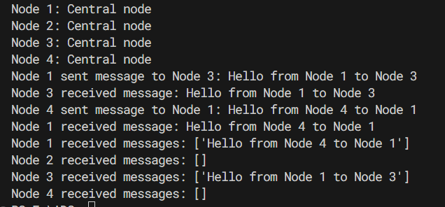
Output

