Slide 1


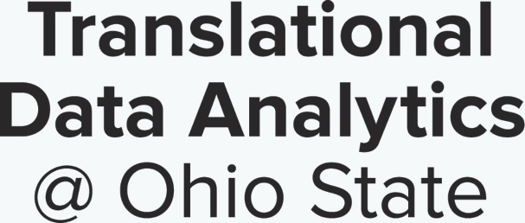
Git, looking at Your Data, and R
One Health Summer Institute
Introduction to Data Analytics, Statistics & Programming in Epidemiologic Research
Dr. Ewy Mathé, Assistant Professor
Department of Biomedical Informatics
u.osu.edu/mathelab

Slide 2
Git
Free, open-source version control system (like CVS, Subversion, etc.)
Automatically tracks changes between versions
No need for different names (e.g. File_v1, File_v2, …, File_Final, File_FinalFinal)
Very useful for team coding (if you’re ambitious, you can also use this to write papers)
Requires you to give a brief description of what changes you made
Bonus: you can readily go back to previous versions if you don’t like the changes made
Bonus 2: a good way to create a community!

Slide 3
Git
Numerous software rely on Git: GitHub, GitLab, Bitbucket, etc.
Let’s take a look at our GitLab repository for class:
https://code.bmi.osumc.edu/mathe.5/OHSI_DataAnalytics_Aug2019

Slide 4
Your data – organize!
Sample meta-data
Sample groups (e.g. outcome, covariables)
Technical/batch information
Molecular/questionnaire data
Raw or normalized abundances for all measurements available in each sample
QC samples (if available, duplicate data, etc.)
Molecular/questionnaire meta-data
How questionnaire data was coded
Properties for molecular data (e.g. gene name, gene id, gene pathways, etc.)

Slide 5
Now that you have data…take a look!
Sample meta-data
Molecular/questionnaire data
Molecular/questionnaire meta-data
Categorical/continuous, average, sd, how do these compare between your groups, can you answer your question?
Distribution of data, Range/CV across samples, transformation/normalization, missing values, etc.
Questionnaire data: check that values in your molecular/questionnaire data match coding
Look at properties for molecular data (e.g. gene name, gene id, gene pathways, etc.)
*** Pay attention to how missing values are coded or possible imputed!!!
Notes:
Duplicates: measured in two different platforms or different modes

Slide 6
Sample Meta-Data
Sample Name/ID | Time of Collection or Collection Number | Age | Gender | Treatment | Date Processed | … | Notes/ Description

Slide 7
Descriptive Table
Re-create tables stratifying by group and compare!
Group 1 Individuals
Group 2 Invidividuals
Mean age: 45
Gender: 20 F, 25 M
Smoking Status: 5 Smokers,
40 Non-Smokers
Site of Collection: 18 MD, 27 OH
Mean age: 45
Gender: 25 F, 24 M
Smoking Status: 45 Smokers,
4 Non-Smokers
Site of Collection: 20 MD, 29 OH
Why would you do this?

Slide 8
Levels of Quality Control
Enough good quality samples in each group?
Are groups balanced?
Are biases present and can they be accounted for?
Assess inclusion/exclusion criteria
Study Design
Positive and negative controls in molecular data (e.g. spiked-in metabolites, blank samples)?
Response rate of questionnaires?
Do categorizations make sense and are they respected? (e.g. are females coded as 1 and males as 0 as expected)
Molecular/
Questionnaire Data
Overall distribution of signal across all samples?
Reproducibility of replicate samples?
Any measurements outside your expected range? (e.g. age > 200, many missing values)
Sample Data

Slide 9
QC plots – Look at your data!
Histogram to make sure your replicate samples are more highly correlated than randomly selected pairs

Slide 10
QC plots – Look at your data!
Boxplots!
Normalized Abundances
Samples
Samples

Slide 11
QC plot: look at your data!
Positive Control: Extracted ion counts for 3 well characterized nicotine metabolites: cotinine, nicotine-N-oxide, and hydroxycotinine.

Slide 12
Your clean data…more preprocessing
After thorough QC analysis…(samples and features)
Transformation:
make your data close to normal. Why?
Combining replicates and filtering:
mean/median of replicates, filter out uninformative metabolites. Why?
Normalization/Scaling:
Make measurements comparable across samples
Minimize technical variation, in hopes of enhancing biological variation

Slide 13
Scaling vs normalization
After thorough QC analysis…(samples and features)
Scaling:
Typically multiplying by a constant
You’re modifying the range (e.g. all samples to 0 to 1)
Examples?
Normalization:
Also called feature scaling
You’re changing the distribution of your data (e.g. mean of 0 and standard deviation of 1)
Examples?
Why do we care?

Slide 14
Log transformation
Log transformed data is more interpretable (relative fold changes)
 | Gene A | Gene B
Treated | 10,000 | 1,000
Control | 1,000 | 100
Taking the absolute difference, gene A difference >> gene B difference
10,000 – 1,000 = 9,000 >> 1,000 – 100 = 900
However, both differences represent a 10-fold change!
4 - 3 = 1 == 3 - 2 = 1
log(10,000) log(1,000) log(1,000) log(100)
Notes:
Relative fold changes are most biologically relevant

Slide 15
Data Analysis: make a plan
What question are you trying to answer?
What input do you need? (non-normalized/normalized?)
What output do you expect?
Challenges with hypothesis-generating studies
Notes:
Relative fold changes are most biologically relevant

Slide 16
Considerations in data analysis
Are missing values allowed? If so, how do they affect the algorithm? If not, how do you impute?
How to normalize my data?
Look up the parameters of any function!!! Read the details, don’t just use defaults!
Look at your data after every operation you apply to it
Do results make sense after every step?

Slide 17
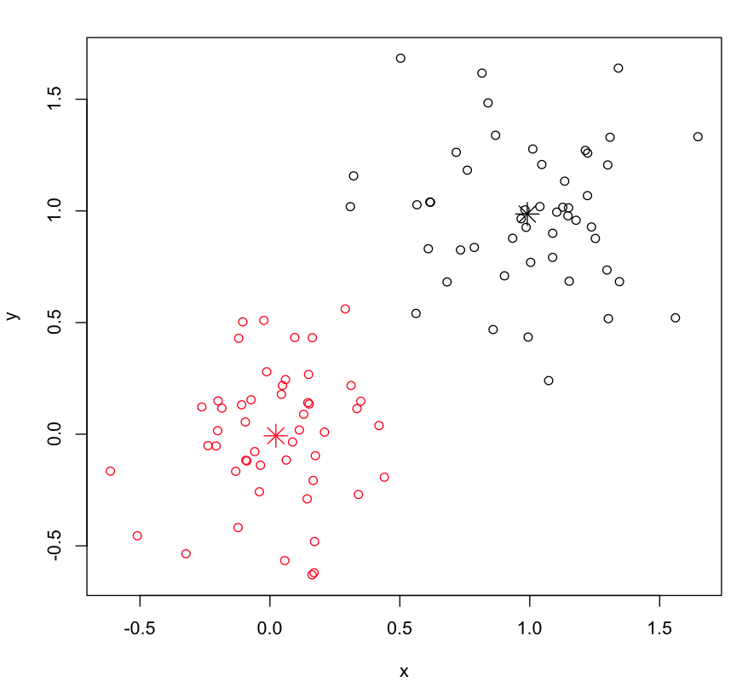
Visualization: Clustering
Hierarchical clustering and k-means
Organize data into groups, based on some relatedness measure (e.g. Euclidean Distance)
Need to provide distance metric (distance between two features) and linkage method (distance between two clusters, e.g single, complete, etc)
Need to know the number of groups a priori
Minimizes distance within-cluster sum of squares (e.g. variance)
Notes:
Single: distance between two closest features of two clusers, complete: median distance between all features in two clusters)
K-means: initialize with mean of randomly selected samples in N groups

Slide 18
Visualization: PCA
% variance explained: 6.5%
% variance explained: 93.5%
Notes:
Relative fold changes are most biologically relevant

Slide 19
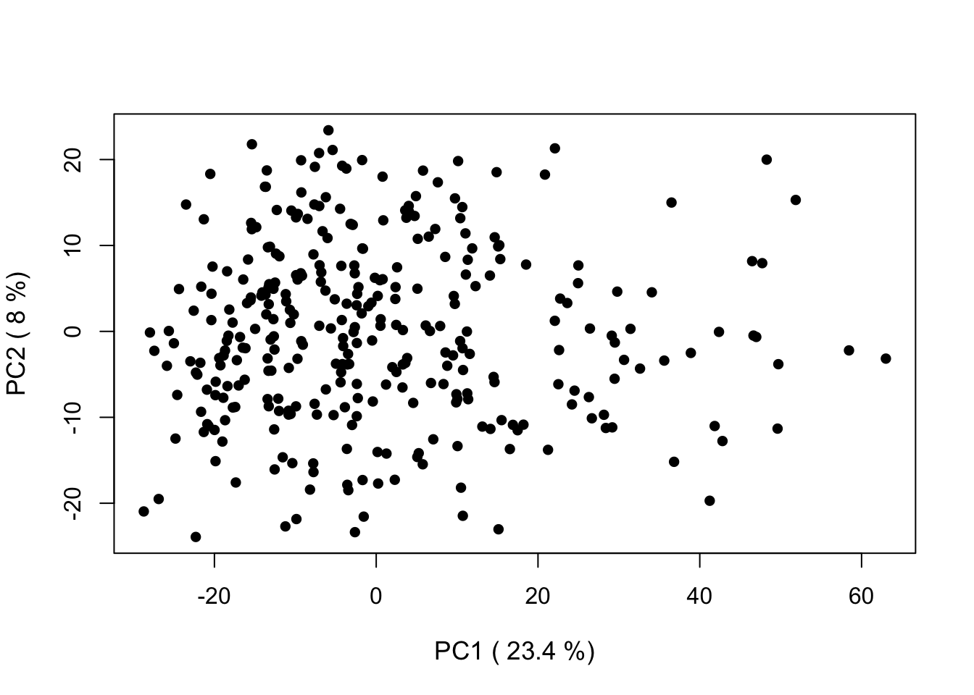
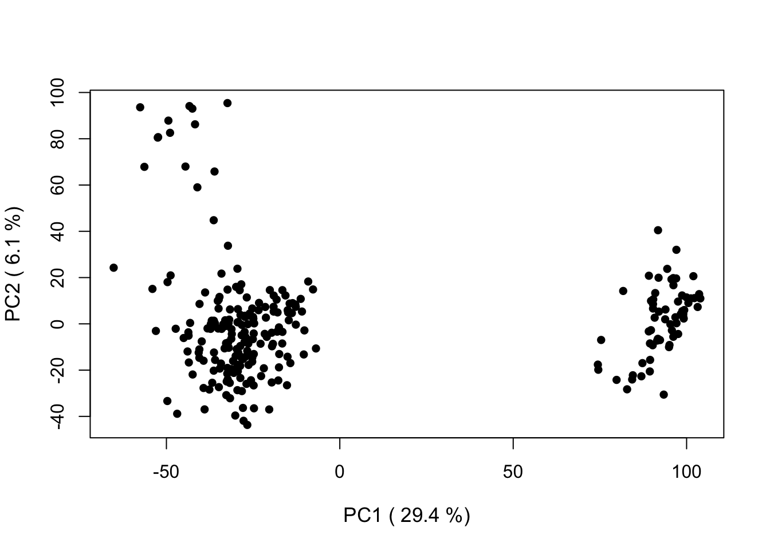
Class Discovery: PCA
Dimensionality Reduction: to reduce the number of features (metabolites) to several linear combinations (e.g. principal components) of the data.
Notes:
Relative fold changes are most biologically relevant

Slide 20
More on PCA
Neat visualization of the process:
http://setosa.io/ev/principal-component-analysis/
http://stats.stackexchange.com/questions/2691/making-sense-of-principal-component-analysis-eigenvectors-eigenvalues
Notes:
Relative fold changes are most biologically relevant

Slide 21
Basic R data structures
Element: character, numeric (double or integer), logic
> a <- 3
> a
[1] 3
Vector: contains elements of the same type
> a <- c(1,2,3)
> a
[1] 1 2 3
> a[1]
[1] 1
> a[2]
[1] 2
> typeof(a)
[1] "double"
> b=c("Metabolomics", "Rocks","!")
> b[3]
[1] "!"
> typeof(b)
[1] "character"

Slide 22
Basic R data structures: vector
Vectors: beware of mixing types!
> a=c(1.44,"A",2,"C")
> a
[1] "1.44" "A" "2" "C"
> typeof(a)
[1] "character"
> as.numeric(a)
[1] 1.44 NA 2.00 NA
Warning message:
NAs introduced by coercion
> a=c(1.44,A,2,C)
Error: object 'A' not found
> C <- 1:10
> C
[1] 1 2 3 4 5 6 7 8 9 10
> C[C < 3]
[1] 1 2
> C <- 10:1
> C
[1] 10 9 8 7 6 5 4 3 2 1
> which(C < 3)
[1] 9 10
> C[9:10]
[1] 2 1

Slide 23
Basic R data structures: matrix
Matrix: two dimensional structure (e.g. rows and columns) of the same type!
> a=c(1.44,"A",2,"C")
> a
[1] "1.44" "A" "2" "C"
> typeof(a)
[1] "character"
> as.numeric(a)
[1] 1.44 NA 2.00 NA
Warning message:
NAs introduced by coercion
> a=c(1.44,A,2,C)
Error: object 'A' not found
> C <- 1:10
> C
[1] 1 2 3 4 5 6 7 8 9 10
> C[C < 3]
[1] 1 2
> C <- 10:1
> C
[1] 10 9 8 7 6 5 4 3 2 1
> which(C < 3)
[1] 9 10
> C[9:10]
[1] 2 1

Slide 24
Basic R data structures: data frame
Data Frame: two dimensional structure (e.g. rows and columns) that different types! (it’s a generalization of a matrix, access is like a matrix)
> df <- data.frame(colA=1:3, colB=letters[1:3], colC=c(10,"A",200))
> df
colA colB colC
1 1 a 10
2 2 b A
3 3 c 200
> str(df)
'data.frame': 3 obs. of 3 variables:
$ colA: int 1 2 3
$ colB: Factor w/ 3 levels "a","b","c": 1 2 3
$ colC: Factor w/ 3 levels "10","200","A": 1 3 2
Beware of factors!!! By default, data.frame() will convert any characters vector to factors!!
Use stringsAsFactors=FALSE to suppress this behavior

Slide 25
Basic R data structures: data frame
> df <- data.frame(colA=1:3, colB=letters[1:3], colC=c(10,"A",200))
> df
colA colB colC
1 1 a 10
2 2 b A
3 3 c 200
> df$colC/2
[1] NA NA NA
Warning message:
In Ops.factor(df$colC, 2) : ‘/’ not meaningful for factors
> as.numeric(df$colC)/2
[1] 0.5 1.5 1.0
Beware of factors!!! By default, data.frame() will convert any characters vector to factors!!

Slide 26
Basic R data structures: data frame
> df <- data.frame(colA=1:3, colB=letters[1:3],
colC=c(10,"A",200),stringsAsFactors=FALSE)
> df
colA colB colC
1 1 a 10
2 2 b A
3 3 c 200
> str(df)
'data.frame': 3 obs. of 3 variables:
$ colA: int 1 2 3
$ colB: chr "a" "b" "c"
$ colC: chr "10" "A" "200"
> df$colC/2
Error in df$colC/2 : non-numeric argument to binary operator
> df$colC
[1] "10" "A" "200"
> typeof(df$colC)
[1] "character"

Slide 27
Basic R data structures: factors
Why do we care about factors? What if you have gender coded as 0/1, would you want them as factors?
Define factor:
Common error with numeric/factors
Change factor order (why?)
> a
[1] 1 2 3 4 5
> b <- as.factor(a)
> b
[1] 1 2 3 4 5
Levels: 1 2 3 4 5
> mode(b)
[1] "numeric"
> f <- factor(sample(1:100/100, 5))
> f
[1] 0.98 0.19 0.5 0.23 0.12
Levels: 0.12 0.19 0.23 0.5 0.98
> mode(f)
[1] "numeric"
> as.numeric(f)
[1] 5 2 4 3 1
> as.numeric(levels(f)[f])
[1] 0.98 0.19 0.50 0.23 0.12
> a <- as.factor(letters[1:3])
> a
[1] a b c
Levels: a b c
> a <- factor(a, levels=c("c","a","b"))
> a
[1] a b c
Levels: c a b
Look at your output for every step!!!!

Slide 28
Basic R data structures
Lists: has mixed data structures (e.g. numeric, character, matrices, etc…)
> mylist <- list("one"=TRUE, "two"=1:10, "three"=matrix(1:6,nrow=2))
> mylist
$one
[1] TRUE
$two
[1] 1 2 3 4 5 6 7 8 9 10
$three
[,1] [,2] [,3]
[1,] 1 3 5
[2,] 2 4 6
> str(mylist)
List of 3
$ one : logi TRUE
$ two : int [1:10] 1 2 3 4 5 6 7 8 9 10
$ three: int [1:2, 1:3] 1 2 3 4 5 6

Slide 29
Reading in Data
Do not use spaces in filenames. They are bad. Use underscores (“_”)
Read.csv(): reads in a comma-separated filename
Read.table: can define delimeters (e.g. space, comma, semi-colon, tab, etc)
Rio package: import()
These functions output a data.frame()!

Slide 30
RStudio/Rmd/Knitr
RStudio: Integrated Development Enterprise for R
R Markdown (Rmd): Uses Markdown (very simple markup language) that allows you to create documents with embedded R code very quickly.
Creates a log/notebook of your analytical experiments
Hallmark of reproducible research
https://rmarkdown.rstudio.com/authoring_basics.html
Knitr: generates an html or pdf report automatically (including running code if you want) by clicking the “knit” button in RStudio.
Let’s try it!

