Slide 2
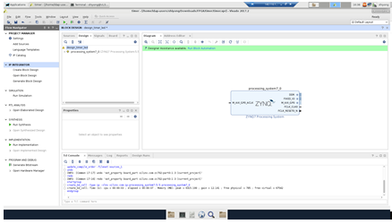
Add IP : ZYNQ7 Processing System
Click Run Block Automation

Slide 3
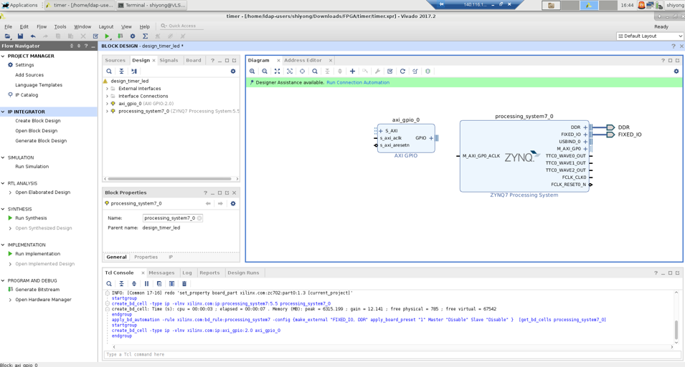
Add IP: gpio
Click Run Connection Automation

Slide 4
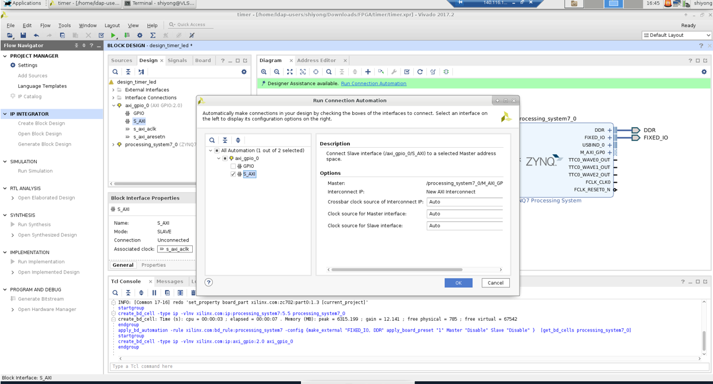

Slide 5
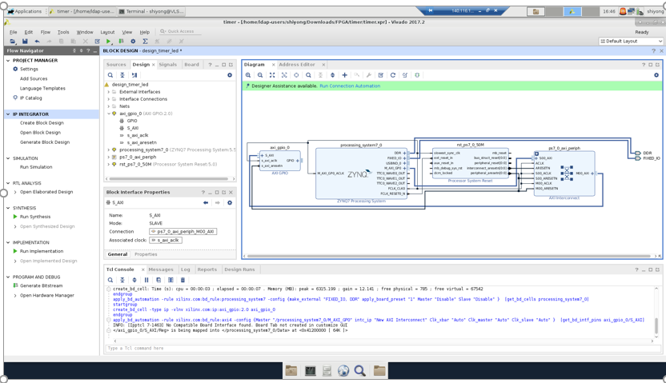
Click Run Connection Automation

Slide 6
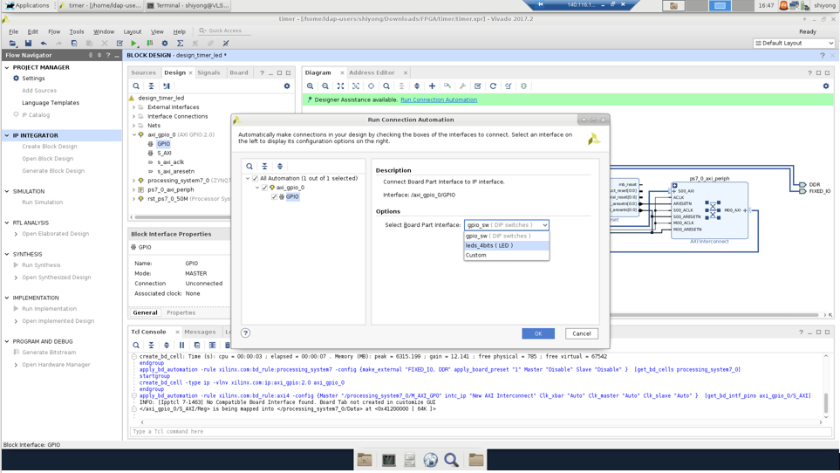
Select Board Part Interface : leds_4bits(LED)

Slide 7
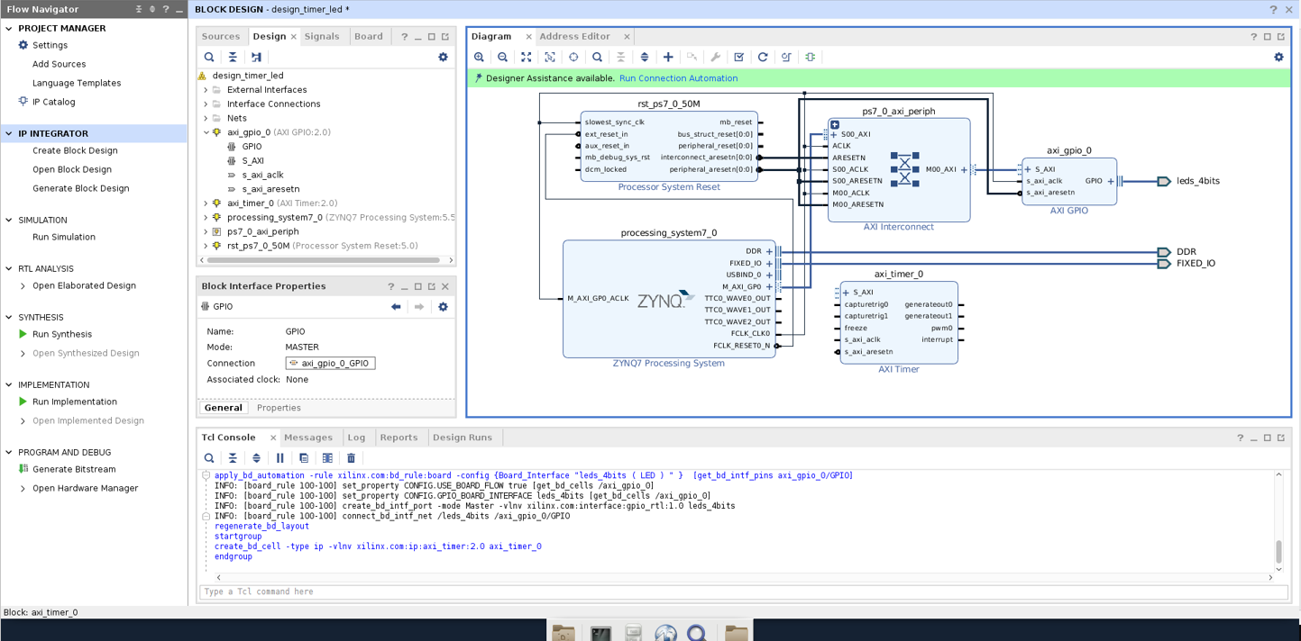
Add IP: AXI Timer
Click Run Connection Automation

Slide 8
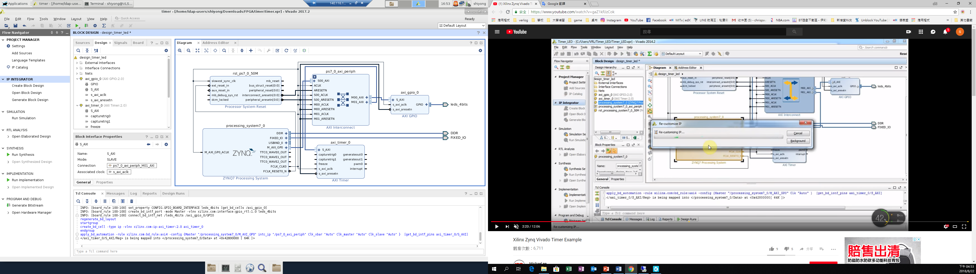

Slide 9
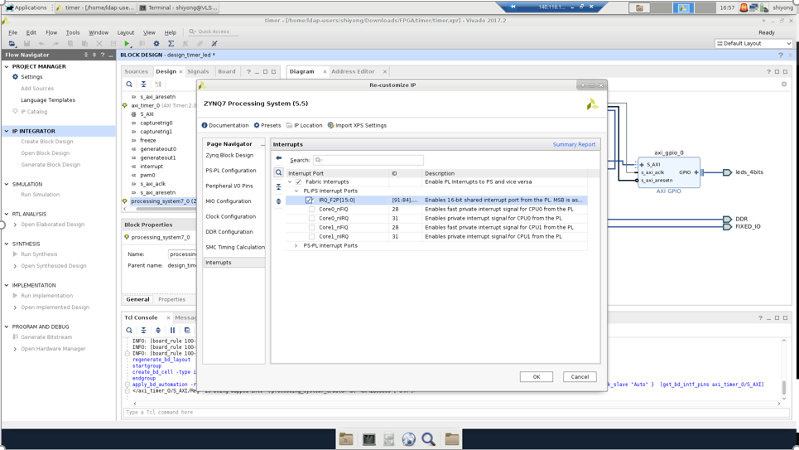
Click processing_system7_0 block
Interrupts IRQ_F2P

Slide 10
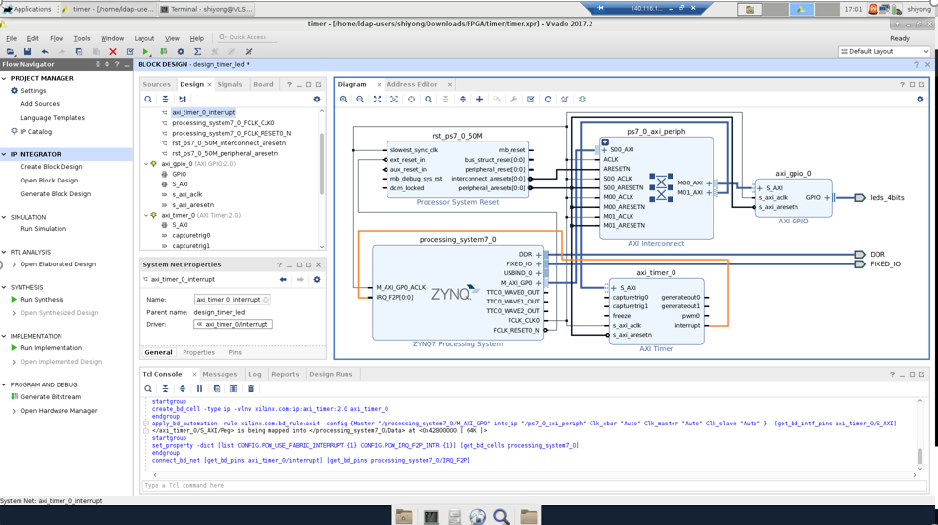
Connect axi_timer interrupt to processing_system7 IRQ_F2P

Slide 11
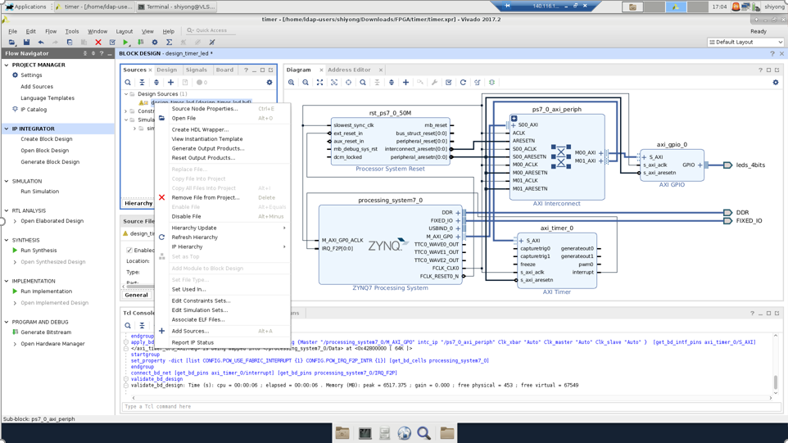
Click validate design
Sources
Create HDL Wrapper

Slide 12
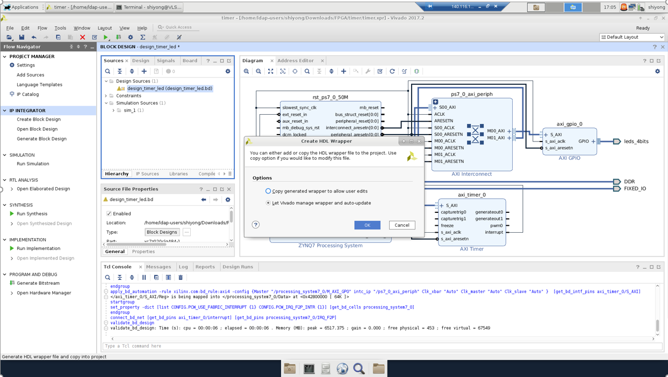

Slide 13
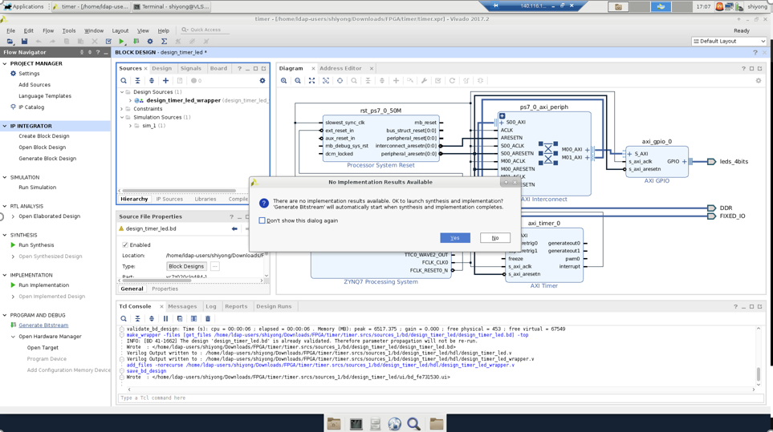
Generate Bitstream
Click save

Slide 14
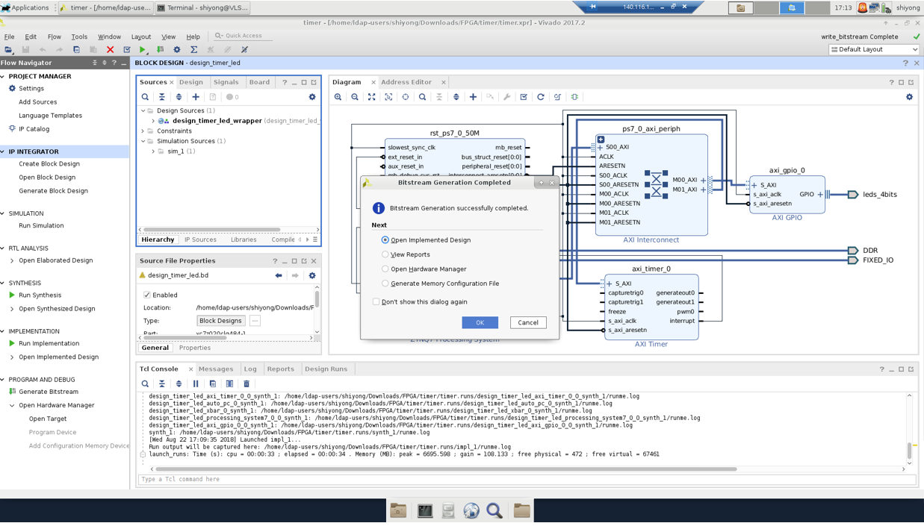
Click ok

Slide 15
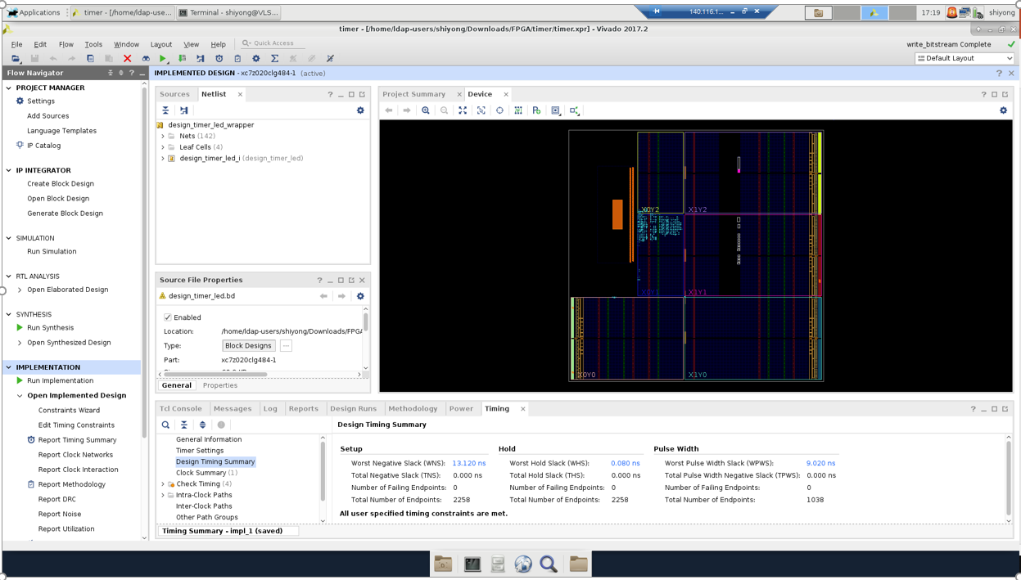

Slide 16
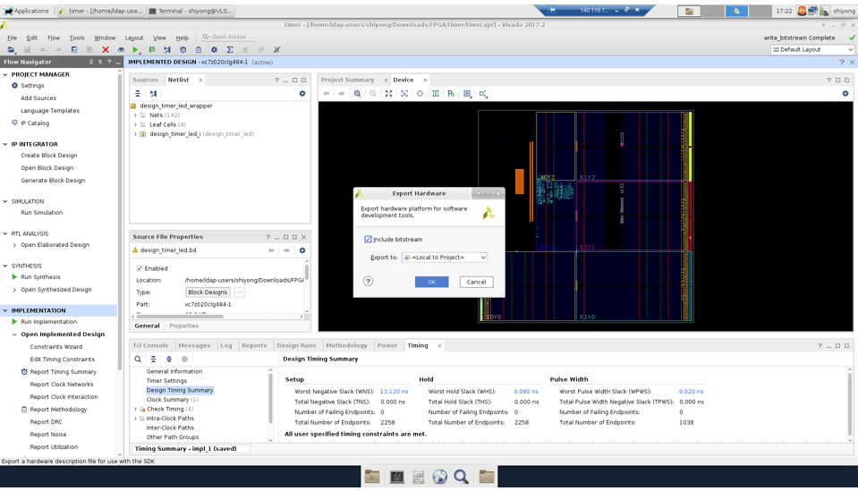
File >> Export>> Export Hardware
Click ok

Slide 17
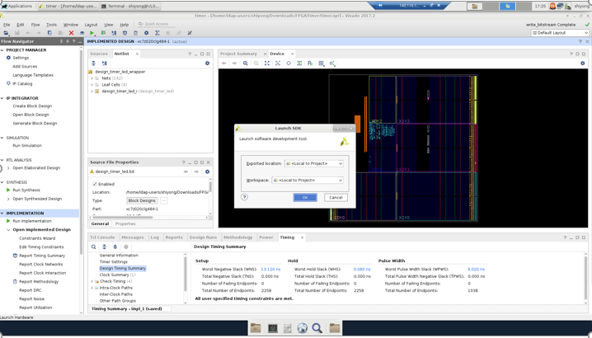
File>>Launch SDK

Slide 18
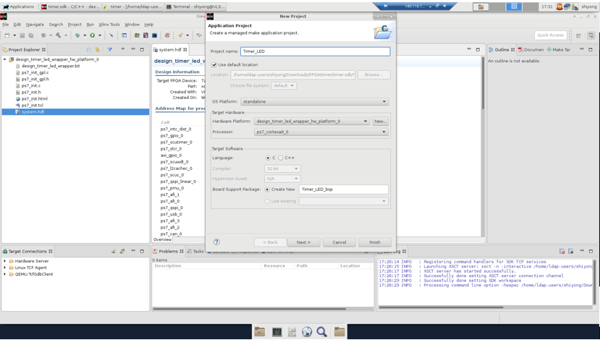
Timer_LED

Slide 19
Select “Hello World”

