Slide 1
Forecasting ED occupancy with Advanced ML Models and Multivariable Input
Peter the Great St. Petersburg Polytechnic University Institute of computer science and cybersecurity
Higher school of artificial intelligence
Student: Salimli A. Gr. 5130201/20102
Supervisor: Ph.D in Technical Science, D.E Motorin
Autumn 2024

Slide 2
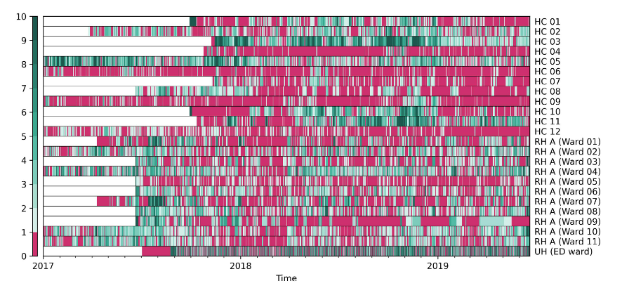
Introduction
Significance:
ML methods and multivariable input for accurate
ED occupancy forecasting to reduce overcrowding
Area of expertise:
ED forecasting
ML methods
Multivariable analysis
Statistic of RH, HC, UH

Slide 3
Problem statement
Outdated statistical models (e.g., ARIMA) underperform
compared to modern ML models
Uni-variable input problem
Real-time forecasting

Slide 4
Methods
Datasets
Real datas of hospital:
Trafic data
Hospital bed availability
Calendar variables
Website visits
Public events
https://github.com/tuomijal/ed-ml-multivar
Example of dataset part (direction_info.csv)

Slide 5
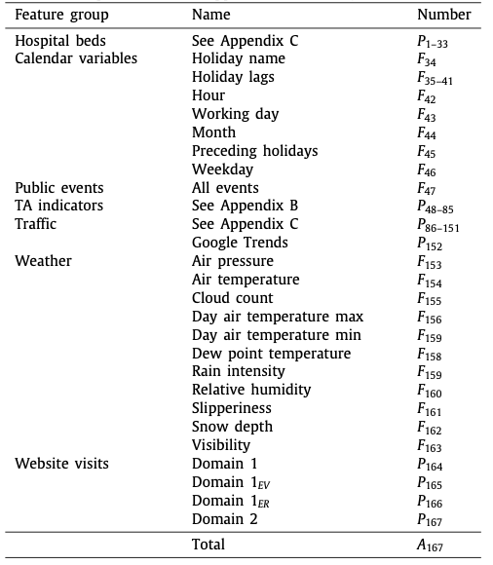
Methods
Approach
Multivariable input - for enriched forecasting
Time series forecasting - focus on predicting
occupancy based on time series data.
Re-training protocol - to account for changes over time
Hyper-parameters optimization - tree-structured Parzen
estimator for tuning model parameters
Variables

Slide 6
Methods
DeepAR, N-BEATS
Autoregressive RNN (DeepAR)
Time series decomposition (DeepAR)
Prediction without structure (N-BEATS)
DeepAR architecture
N-BEATS architecture with example

Slide 7
Methods
TFT, LightGBM
Multi-Horizon Forecasting. (TFT).
Single Passage Improvement. (GRN).
Efficient Forecasting with DT and RF. (LightGBM).

Slide 8
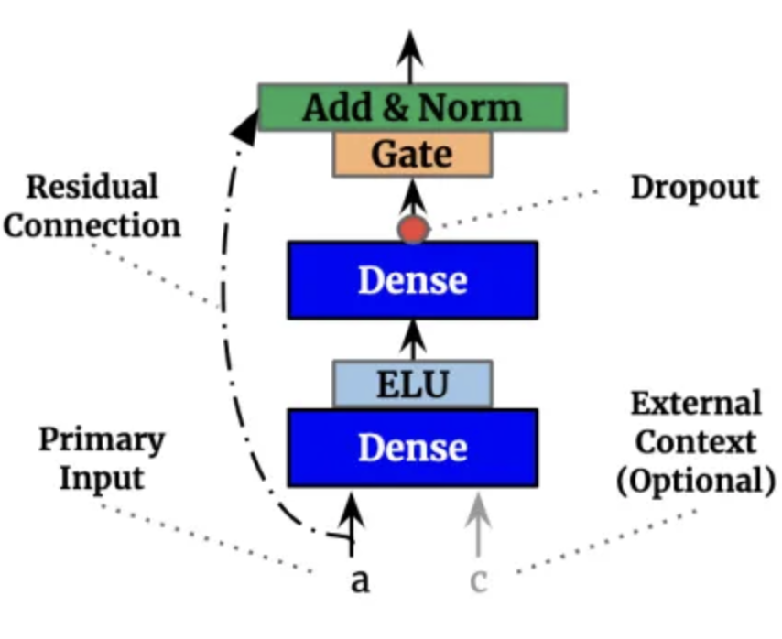
Methods
TFT, LightGBM
Gated residual net architecture
TFT architecture
LightGBM

Slide 9
Experiment
Set-up
Preparing datasets
Data splitting for testing and training
Testing models
Comparing models
Data split

Slide 10

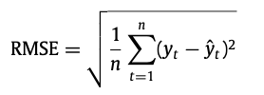

Perfomance metrics
Using a performance metrics to compare
the results of forecasting, by calculating errors
Mean absolute error
Root mean square error
Mean scaled interval score
In all metrics: yt - ground truth, y^t - prediction

Slide 11
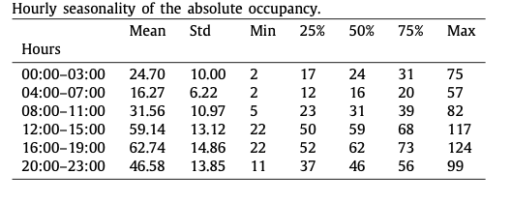
Experiment
Comparing old models (e.g ARIMA) with DeepAR, TFT and LightGBM.
Splitting feature sets into (a) Multi and (b) Uni variables
Forecasting time: +24 hours / 00:00 ± 3 hours
Testing period: 365 days

Slide 12
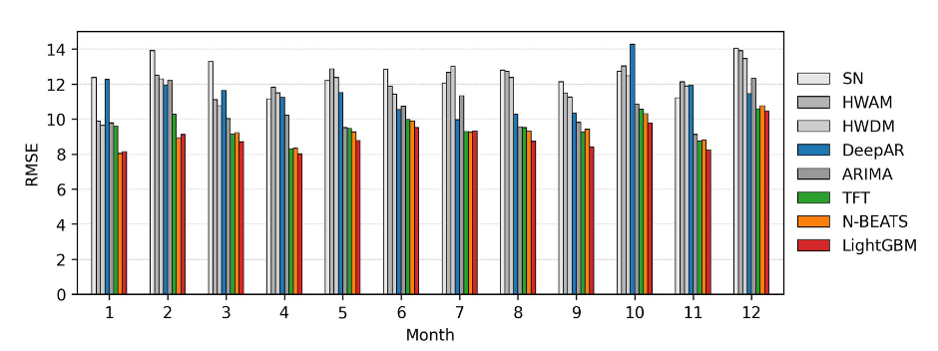
Results and discussion
Performance of the univariable models over different months of the test set

Slide 13
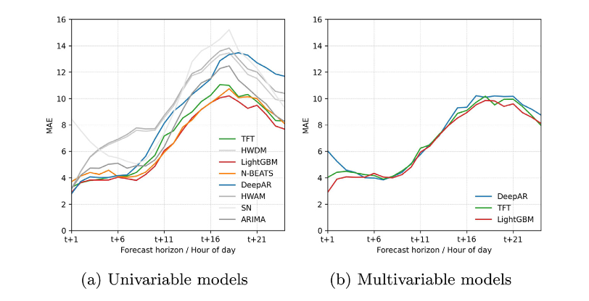
Results and discussion

Slide 14
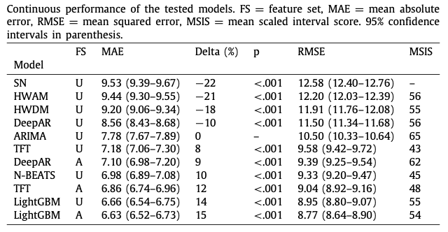
Results and discussion
Metrics and models

Slide 15
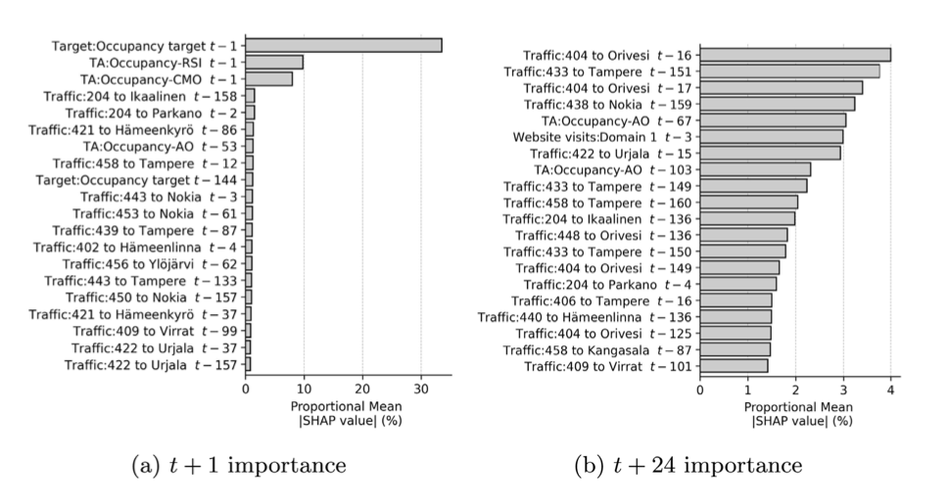
Results and discussion
Feature importance SHAP
statistics for the 20 most
important features
used with the LightGBM
model.

Slide 16
Limitations
Missing data on hospital beds: 11%
Single-center setup
Computational cost and model retraining

Slide 17
Conclusion
Machine learning models, particularly LightGBM, outperform ARIMA by 8-15%
in forecasting ED occupancy.
Forecasting time: 24 hour.
Multivariable data improve performance for some models (e.g., 17% for DeepAR and 4% for TFT).
The models are designed to be retrained monthly, allowing them
to adapt to changing conditions in the ED, ensuring their practical applicability in real-time healthcare settings

Slide 18
Thank you for listening!
Salimli A.
salimli.am@edu.spbstu.ru

