Slide 1
Emergency department forecasting with hourly occupancy using time series analysis
Peter the Great St. Petersburg Polytechnic University Institute of computer science and cybersecurity
Higher school of artificial intelligence
Student: Salimli A. Gr. 5130201/20102
Supervisor: Ph.D in Technical Science, D.E Motorin
Autumn 2024

Slide 2
Introduction
Significance:
24-hour SARIMAX model enables real-time, hour-specific predictions for short-time forecasting in EDs.
Area of expertise:
Hourly forecast
ML methods
Time series analysis

Slide 3
Problem statement
The basic ARIMA model underperforming modern models in forecast accuracy.
Not all ARIMA-based models can forecast in real-time.
Classic models shows less accuracy in short-term forecast.
Older versions cannot handle TSD.

Slide 4
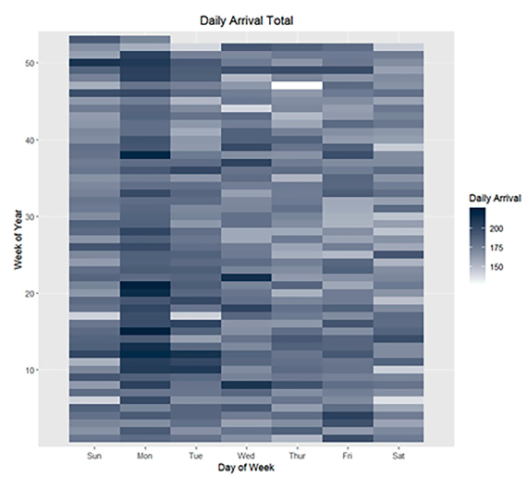
Methods
Datasets
Real datas of hospital:
Data source: an academic medical center with an ED, including 59 beds.
Data volume: 65,132 ED visits
Calendar variables

Slide 5

Methods
Approach
Cross-validation to improve forecasting accuracy.
Application of AIC criteria to determine model complexity and quality.
Use of Ljung–Box tests to check the distribution of model residuals.
Analysis of the impact of time and trends on forecasting accuracy.
Akaike criterion
k - |estimators|, L - max(likelihood)
$${\overset{̂}{Γ}}_{ℓ}=\frac{1}{T}\overset{T}{\underset{t=ℓ+1}{∑}}(r_{t}-\overline{r})(r_{t-ℓ}-\overline{r})^{′},ℓ≥0,$$
$$\overline{r}=\frac{\sum_{t=1}^{T}{r_{t}}}{T}$$
$${\overset{̂}{ρ}}_{ℓ}={\overset{̂}{D}}^{-1}{\overset{̂}{Γ}}_{ℓ}{\overset{̂}{D}}^{-1},ℓ≥0,$$
Ljung-Box test formula: autocovariance
function with data {ri|t = 1,…,T}

Slide 6
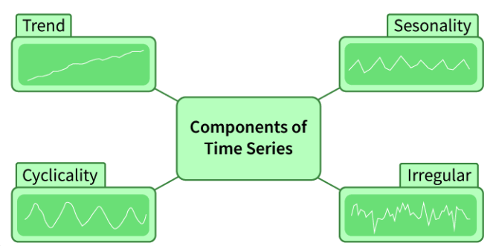
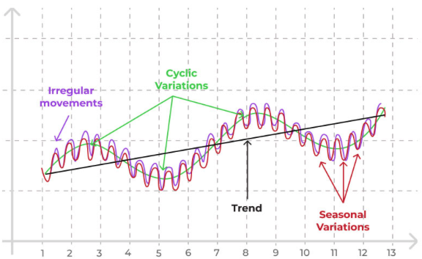
Methods
Approach
Use of time series with real-time ED occupancy, severity index, and patient count as regressors.
Model with seasonal regressors to account for time-of-day and day-of-week effects.
Analysis of the impact of time and trends on forecasting accuracy.
TSD components
TSA graph

Slide 7
Methods
ML Models
Selection of a SARIMAX model for forecasting with external regressors.
Evaluation of multiple model variants with different seasonal orders and regressors.
Hyper-parameters optimization - tree-structured Parzen
estimator for tuning model parameters

Slide 8
Methods
sARIMAx = ARIMA?
ARIMA model block-scheme
SARIMAX model block-scheme

Slide 9
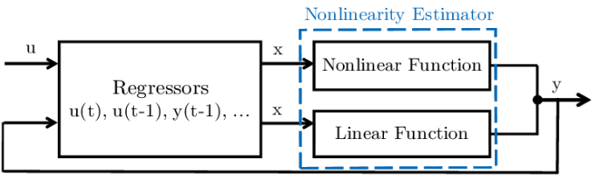
Methods
EXOGENOUS REGRESSORS
Nonlinear AutoRegressive exogenous model
ARIMA-based models triangle

Slide 10
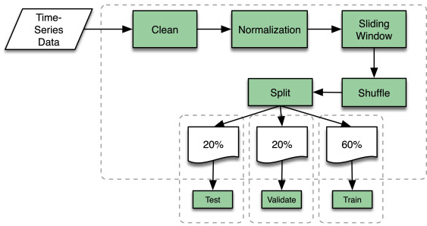
Experiment
Set-up
Preparing datasets
Division of data into training and testing sets (242 + 73 + 50 days).
Forecasts made 1-4 hours ahead during peak daily hours.
Assessment of predictive power (to improve forecast accuracy)
TSD splitting

Slide 11
Perfomance metrics
Using a performance metrics to compare
the results of forecasting, by calculating errors
MAPE
MAE
MSE
$$\text{MAPE}=\frac{1}{n}\overset{n}{\underset{i=1}{∑}}\left|\frac{Y_{i}-{\overset{̂}{Y}}_{i}}{Y_{i}}\right|$$
$$\text{MAE}=\frac{1}{n}\overset{n}{\underset{i=1}{∑}}\left|y_{i}-{\overset{̂}{y}}_{i}\right|$$
$$\text{MSE}=\frac{1}{N}\overset{N}{\underset{i=1}{∑}}(y_{i}-\overset{̂}{y})^{2}$$

Slide 12
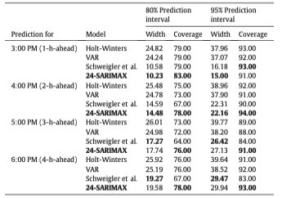
Experiment
Testing SARIMAX with regressors for more accurate predictions. (50 days testing period)
Comparison with other forecasting methods based on MAE, MSE, and MAPE.
Forecasting time: +4 hours / 03:00 PM + 1 hour
Evaluation of the width and coverage of prediction intervals.
24-SARIMAX testing

Slide 13
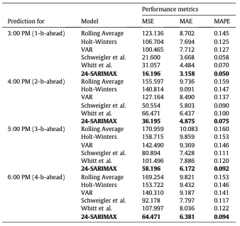

Results and discussion
SARIMAX showed the highest accuracy in forecasts 1-4 hours ahead.
The model reduced error by 60% compared to the rolling average method.
Advantages of using real-time data to enhance ED operational efficiency.
Comparison of SARIMAX with different regressors
Perfomance comparison of SARIMAX with existing models

Slide 14
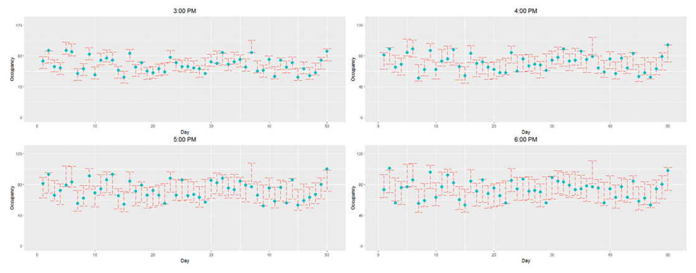
Results and discussion
95% prediction intervals of the first 50 days in the test set provided by our model 24-SARIMAX.

Slide 15
Limitations
Use of data from only one year. (May not capture long-term trends).
Only one medical center.
Limited number of variables.
SARIMAX provides accurate forecasts only for a short period.

Slide 16
Conclusion
The 24-SARIMAX model enables more accurate ED occupancy forecasting.
Use of real-time available data to enhance predictive accuracy
Model simplicity makes it accessible for integration into ED systems.
The results of SARIMAX are ideal for short-term forecasting,
as this model provides some of the most accurate outcomes.

Slide 17
Thank you for listening!
Salimli A.
salimli.am@edu.spbstu.ru

