Slide 1
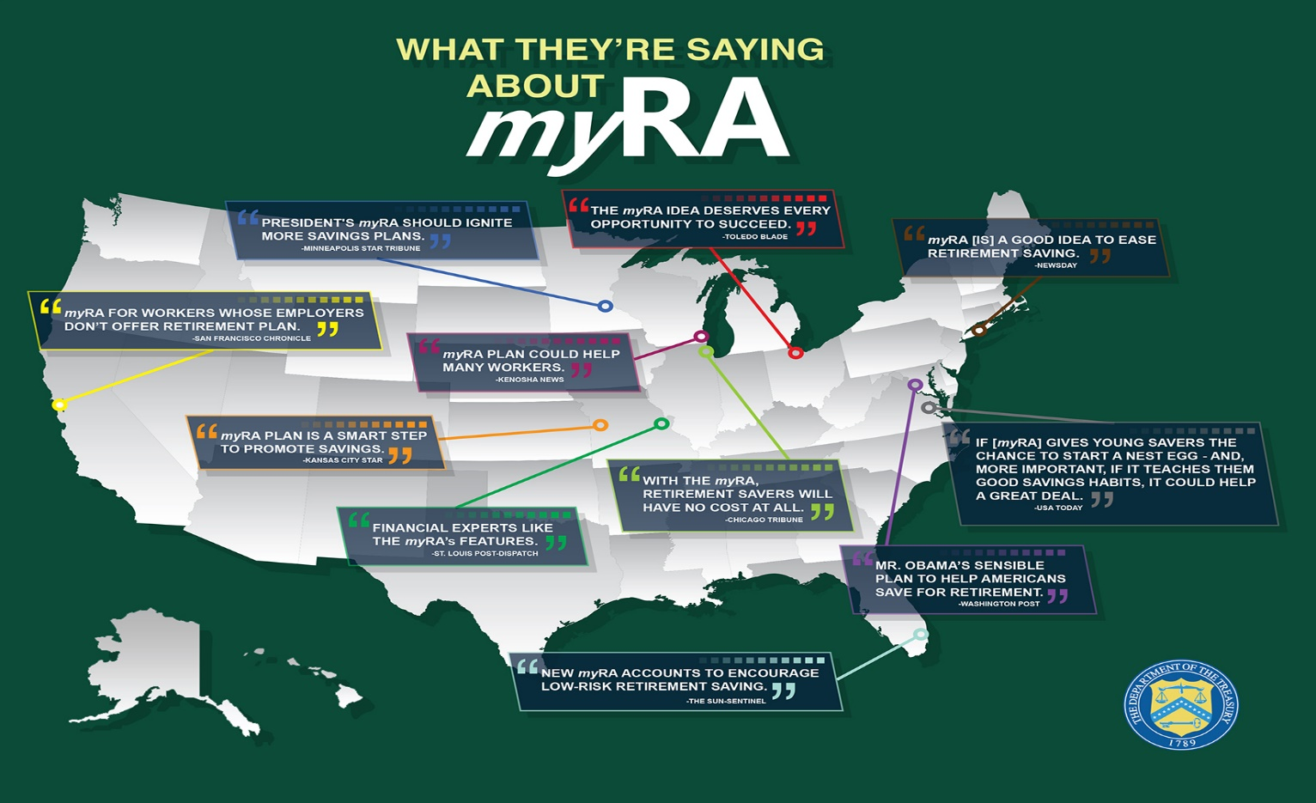
Investments for Retirement – Part 1
Samuel Chukwuemeka B.Eng., A.A.T, M.Ed., M.S
www.samuelchukwuemeka.com

Slide 2
Why Do We Need to Invest?
Raise your hand if you still want to be working very hard by age 60!
At what age would you want to retire?
What do you think the average age of retirement should be?
Which country has the highest retirement age for men, women? What are the ages?
Which country has the least retirement age for men, women? What are the ages?
Are you really planning for retirement? Or is it not your worry now?
What are some of the ways you are planning for retirement besides relying on Social Security benefits (if you are U.S citizen)? Are you aware that Social Security benefits continues to be one of the topics of political debate?
Pre-requisite Videos: Mathematics of Finance

Slide 3
Objectives
At the end of this presentation, students will:
List and define the basic types of investments in the United States.
Differentiate between Traditional IRAs and Roth IRAs.
Read and Interpret Stock Tables.
Perform calculations on several investments including 401(k) and IRAs.
Calculate the future value of an ordinary annuity.

Slide 4
Investment
Is defined as the investing of money or capital in a business in order to yield profitable returns. This is otherwise known as Cash Investment.
There are two main things associated with cash investments: Risk and Return.
Some investments carry no risk at all. For example, the U.S Federal Government insures up to $250,000 of money deposited (principal) in most bank accounts.
The return on investment (ROI) should be a profit, not a loss. Nobody wants to have a loss. The interest rate usually guarantees a percent increase in the investment ceteris paribus. Remember the two goals of every business: (1.) Maximize profits. (2.) Minimize cost.
Some investments will result in a profit. Some will result in a loss. Why?
Sometimes, the higher the risk; the higher the return. But, that is not a rule.

Slide 5
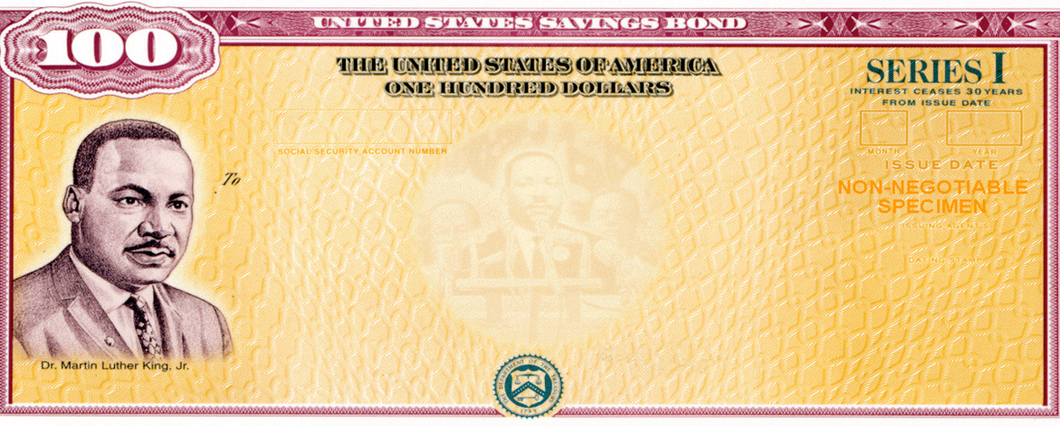
Basic Types of Investments in The U.S
Stocks
Bonds
Mutual Funds
Retirement Savings Accounts
Regular Savings Accounts
Other Investment Accounts (several of them – just ask your bank or financial institution)
Traditional IRA (Traditional Individual Retirement Account)
Roth IRA (Roth Individual Retirement Account)
Employer-sponsored Retirement Plans
401(k) Plan
403(b) Plan

Slide 6
Stock: Meaning and Basic Vocabulary Words 1
At some point, several corporations need money to expand their businesses to several locations; recruit, hire, and train employees; develop and test new product(s); and provide new services among others.
Two options are available: (1.) Borrow money from financial institutions. (2.) Raise money from investors by selling shares of stock / some ownership of the corporation to them.
A stock is defined as the ownership of a corporation, indicated by shares, and held by an individual or group. Stocks of public corporations usually have unique one, two, three, or four letter upper case symbols that identify them. These are called ticker symbols. Examples include: F (Ford Motor Company), KO (The Coca-Cola Company), XRX (Xerox Corporation), GOOG (Google Inc.), and MSFT (Microsoft Corporation) among others.
A corporation is a legal entity created and authorized to operate under the laws of a state for the purpose of conducting business.

Slide 7
Stock 2
Shares are certificates or electronically recorded entries that indicate the percent of ownership in a corporation.
A shareholder is a person or entity that owns shares of stock in a corporation.
Trading is defined as the buying and selling of shares of stock. Shares of stock need both a buyer and a seller to be traded.
Stock Exchange is defined as a formal marketplace for buying and selling securities (stocks). Some stock exchanges include the New York Stock Exchange, and International Securities Exchange among others.
Securities are investment instruments that signifies an ownership position in a corporation (a stock), a creditor relationship with a corporation (a bond), or rights to ownership.
The price of a corporation’s share of stock indicate how well the company is performing. When a corporation is doing well, the stock price of the company goes up. When a corporation does not do well, the stock price goes down.

Slide 8
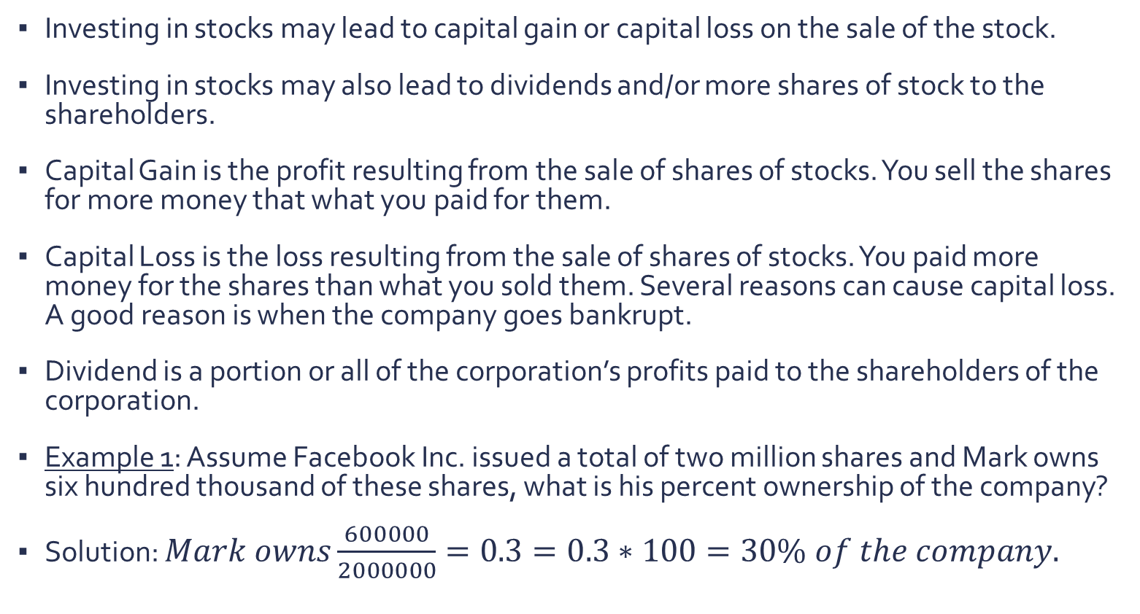
Stock 3
Investing in stocks may lead to capital gain or capital loss on the sale of the stock.
Investing in stocks may also lead to dividends and/or more shares of stock to the shareholders.
Capital Gain is the profit resulting from the sale of shares of stocks. You sell the shares for more money that what you paid for them.
Capital Loss is the loss resulting from the sale of shares of stocks. You paid more money for the shares than what you sold them. Several reasons can cause capital loss. A good reason is when the company goes bankrupt.
Dividend is a portion or all of the corporation’s profits paid to the shareholders of the corporation.
Example 1: Assume Facebook Inc. issued a total of two million shares and Mark owns six hundred thousand of these shares, what is his percent ownership of the company?
Solution: $Mark owns\frac{600000}{2000000}=0.3=0.3∗100=30\% of the company.$

Slide 9
Stock Tables 1
Stock tables are used to monitor the performance of the stock of a corporation. They also serve as a valuable tool in making investment decisions on which stocks to buy or not.
Let us study and interpret the stock table below:
52-Week High = $90.97. This is the highest price at which Wal-Mart stock traded during the past 52 weeks. This means that during the past 52 weeks, at least one investor was willing to pay $90.97 for a share of Wal-Mart stock.
52-Week High | 52-Week Low | Stock | SYM | Div | Yld % | P/E | Sales Vol 100s | High | Low | Close | Net Chg
90.97 | 72.27 | Wal-Mart | WMT | 1.92 | 2.2 | 18 | 46581 | 89.16 | 88.12 | 88.51 | +0.12

Slide 10
Stock Tables 2
52-Week Low = $72.27. This is the lowest price at which Wal-Mart stock traded per share during the past 52 weeks.
The Stock is Wal-Mart Stores Inc.
The SYM is a short form for Symbol. The ticker symbol is WMT.
The Div is $1.92. This is the dividend per share paid to the shareholders during the past year. Wal-Mart Stores Inc. paid a dividend of $1.92 per share.
The Yld % is the percent yield. The percent yield is 2.2%. This means that the investors had an annual return of 2.2% based on the dividends alone. The Yld % does not take into account that Wal-Mart stock prices might increase. If an investor sells for more than the purchase price, the gain will probably make Wal-Mart stock a better investment than a bank account.
The Sales Vol 100s is the sales volume in hundreds of shares that traded yesterday. This is 46581 * 100 = 4658100 shares. This means that a total of 4658100 shares of Wal-Mart stock were traded yesterday.

Slide 11
Stock Tables 3
The High = $89.16. This is the highest price at which Wal-Mart stock traded per share yesterday.
The Low = $88.12. Yesterday, Wal-Mart’s stock lowest trading price per share was $88.12.
The Close = $88.51. This is the price at which shares last traded when the stock exchange closed yesterday. The closing price for Wal-Mart shares when the stock exchange closed yesterday was $88.51 per share.
The Net Chg = +0.12. This is the change in price from when the stock exchange closed two days ago to when it closed yesterday. Therefore, the price of a share of Wal-Mart stock went up by $0.12 from the market close two days ago to the market close yesterday.
The P/E ratio = 18. This is the price-to-earnings ratio.

Slide 12
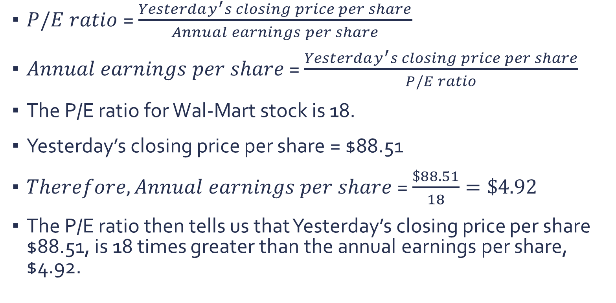
Stock Tables 4
$P/E ratio$= $\frac{Yesterday^{′}s closing price per share}{Annual earnings per share}$
$Annual earnings per share$= $\frac{Yesterday^{′}s closing price per share}{P/E ratio}$
The P/E ratio for Wal-Mart stock is 18.
Yesterday’s closing price per share = $88.51
$Therefore, Annual earnings per share$= $\frac{\$88.51}{18}=\$4.92$
The P/E ratio then tells us that Yesterday’s closing price per share $88.51, is 18 times greater than the annual earnings per share, $4.92.

Slide 13
Bond 1
The U.S Treasury Department needs to borrow money to cover federal deficits. The State of California needs to finance investments in their schools, roads, housing, parks, and public facilities among others. Mobile county needs to fund the technology initiative for its’ schools. The City of Truth and Consequences, New Mexico needs money for a geothermal development project. Ilorah Hospitals needs to fund research on a vaccine and a cure for the ebola virus. Hence, they issue bonds for the public to buy.
A bond is an evidence of debt in which the issuing corporation usually promises to pay the bondholder the face value of the bond on the maturity date, as well as the accrued interests over a given period of time.
The face value of the bond is the amount the issuer of the bond agrees to pay at the maturity date. It is also known as the maturity value of the par value. It is the principal amount of the bond.
Maturity date is the date that the bond finishes and is paid off. It is the due date to pay the principal amount of the bond.

Slide 14
Bond 2
Bondholder is the owner of the bond. The bondholder is the one who lends money to the corporation by buying their bonds. The bondholder is the creditor of the corporation.
Bondholders do not own part of the corporation, unlike shareholders. They just lend money to the corporation by buying the bonds of the corporations. Shareholders own part of the corporation by buying the shares of the corporation.
If a corporation goes bankrupt, the bondholders are the first to claim the assets of the corporation. They make their claims before the shareholders despite that they do not own part of the corporation. So, as you can see, investing in bonds is less risky than investing in stocks though the return is lower.

Slide 15
Mutual Fund
What if you do not want to “put all your eggs in one basket”? Have you thought of investing in a mutual fund?
A mutual fund is a fund operated by an investment company that accepts money from investors and invests it on their behalf in stocks and bonds among others.
You give your money to the fund manager. The fund manager combines your money, in addition with the money of other investors in the mutual fund. The fund manager then invests this pool of money - buying and selling bonds and shares 0f stocks to yield the maximum possible returns.
In essence, investors in mutual fund own a small part of many companies. The advantage is that mutual fund protects investors against the poor performance of a single company. It offers the advantages of diversification and professional management.
The total investments that a person has in a mutual fund is called a financial portfolio.
A mixture of low-risk and high-risk investments is called a diversified portfolio.

Slide 16
Retirement Savings Accounts
It is a great advice to begin saving some cash as soon as you get a job. Do not wait.
Retirement Savings Accounts include:
Regular Savings Accounts
Other Investment Accounts (several of them – just ask your bank or financial institution)
Traditional IRA (Traditional Individual Retirement Account)
Roth IRA (Roth Individual Retirement Account)
Employer-sponsored Retirement Plans
401(k) Plan
403(b) Plan

Slide 17
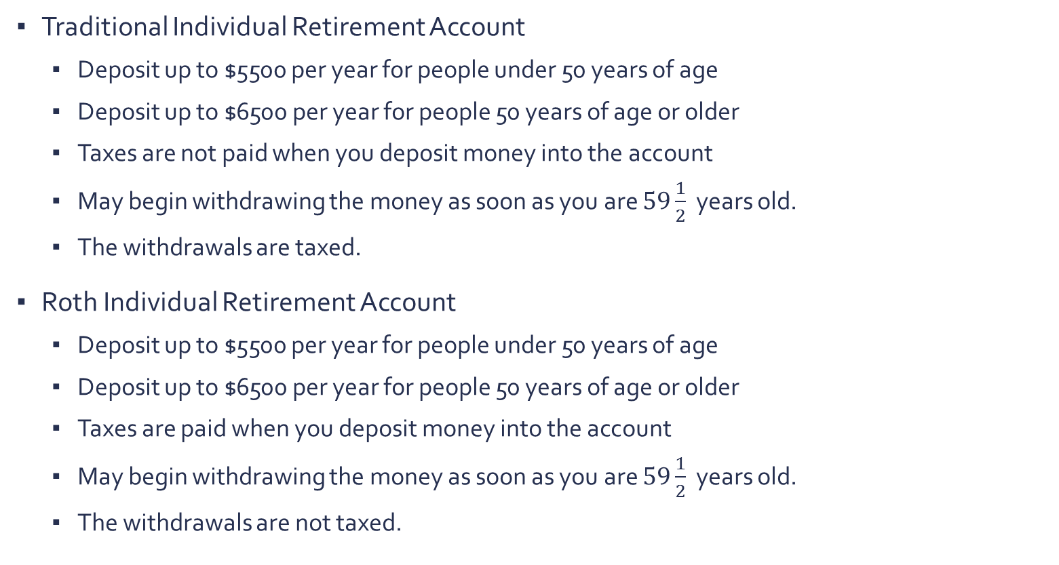
Traditional and Roth Individual Retirement Accounts
Traditional Individual Retirement Account
Deposit up to $5500 per year for people under 50 years of age
Deposit up to $6500 per year for people 50 years of age or older
Taxes are not paid when you deposit money into the account
May begin withdrawing the money as soon as you are $59\frac{1}{2}$ years old.
The withdrawals are taxed.
Roth Individual Retirement Account
Deposit up to $5500 per year for people under 50 years of age
Deposit up to $6500 per year for people 50 years of age or older
Taxes are paid when you deposit money into the account
May begin withdrawing the money as soon as you are $59\frac{1}{2}$ years old.
The withdrawals are not taxed.

Slide 18
401(K) Investment Plan Account
Formed as a law under section 401(K) of the Internal Revenue Tax Code.
Are offered by for-profit companies.
Is a deferred compensation plan set up by an employer so that employees can contribute for retirement on a pre-tax basis.
Employers match a percentage of the amount contributed by the employee.
Contributions by the employee and the employer, including earnings and interests are not taxed.
The withdrawals are taxed.
Currently, employees under 50 years of age can contribute up to 15% of their salary (but no more than $11000) annually.
Currently, employees 50 years of age or older can contribute up to 15% of their salary (but no more than $12000) annually.

Slide 19
403(b) and Other Investment Accounts
403(b)
Formed as a law under section 403(b) of the Internal Revenue Tax Code.
Are offered by tax-exempt organizations including schools, religious institutions and hospitals among others.
Similar to the 401(K) plan, the contributions are not taxed.
The withdrawals are taxed.
Other Investment Accounts
Regular Savings Account
Money Market Deposit Account
Interest-Bearing Checking Accounts
Certificates of Deposit (CDs)
Other investment and retirement accounts including Pension Plan

Slide 20
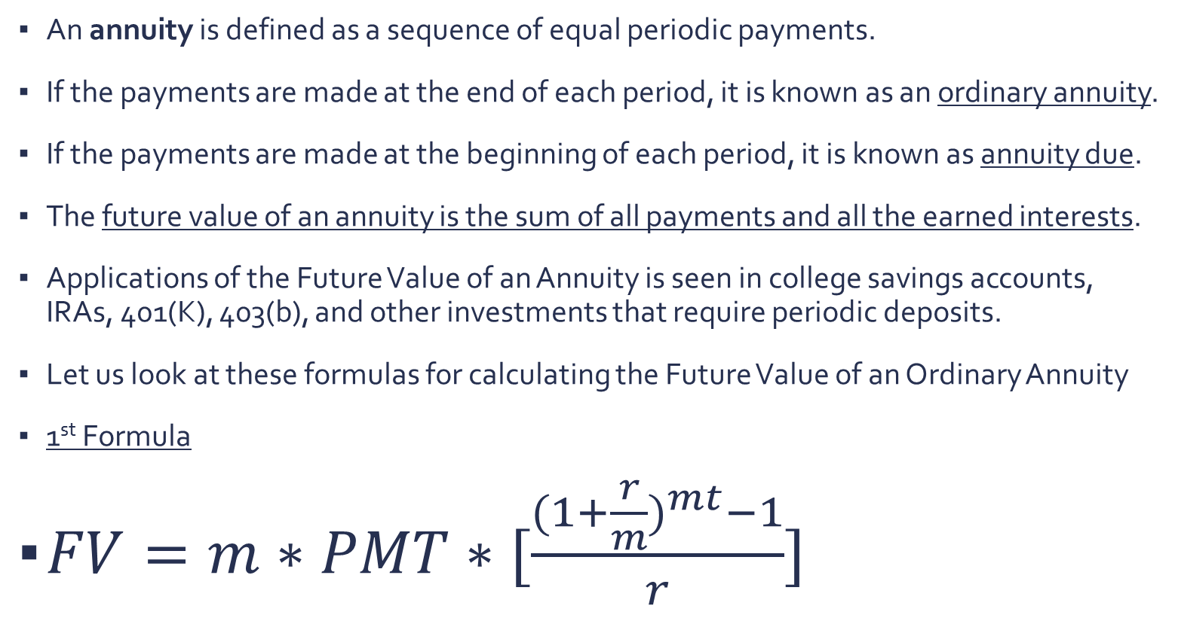
Annuity
An annuity is defined as a sequence of equal periodic payments.
If the payments are made at the end of each period, it is known as an ordinary annuity.
If the payments are made at the beginning of each period, it is known as annuity due.
The future value of an annuity is the sum of all payments and all the earned interests.
Applications of the Future Value of an Annuity is seen in college savings accounts, IRAs, 401(K), 403(b), and other investments that require periodic deposits.
Let us look at these formulas for calculating the Future Value of an Ordinary Annuity
1st Formula
$FV=m∗PMT∗[\frac{{(1+\frac{r}{m})}^{mt}−1}{r}]$

Slide 21

Future Value of an Ordinary Annuity
2nd Formula
$FV=PMT∗[\frac{{(1+i)}^{n}−1}{i}]$
$i=\frac{r}{m}$
$n=mt$ where
FV = future value or amount ($)
PMT = periodic payment ($)
r = annual interest rate (%)
m = number of compounding periods per year
t = time (years)
i = interest rate per period
n = number of payments (periods)

Slide 22
Question 1 1
Use the stock table below to answer the following questions.
(a.) What were the high and low prices for the past 52 weeks?
The high price for a share of Coca-Cola stock during the past 52 weeks was $45.00
The low price for a share of the company’s stock during the past 52 weeks was $36.89
(b.) If you owned 700 shares of Coca-Cola stock last year, what dividend did you receive?
The dividend received = $1.22 * 700 = $854.00
52-Week High | 52-Week Low | Stock | SYM | Div | Yld % | P/E | Sales Vol 100s | High | Low | Close | Net Chg
45.00 | 36.89 | Coca-Cola | KO | 1.22 | 3.0 | 23 | 191938 | 41.93 | 41.11 | 41.17 | …

Slide 23
Question 1 2
(c.) What is the annual return for dividends alone?
The annual return for dividends alone was 3.0%
(d.) How many shares of Coca-Cola stock were traded yesterday?
191938 * 100 = 19193800 shares of Coca-Cola stock were traded yesterday.
(e.) What were the high and low prices for Coca-Cola shares yesterday?
The high price for a share of Coca-Cola stock yesterday was $41.93
The low price for a share of the company’s stock yesterday was $41.11
(f.) What was the price at which Coca-Cola shares last traded when the stock exchange closed yesterday?
When the stock exchange closed yesterday, the price of a share of Coca-Cola stock was $41.17

Slide 24
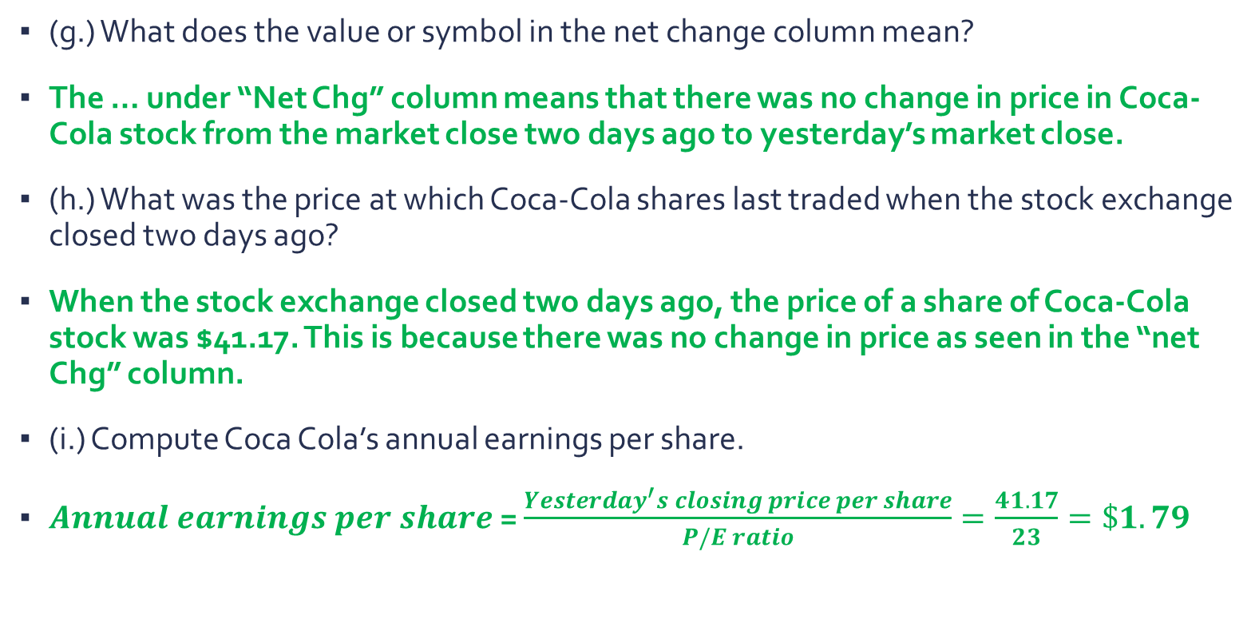
Question 1 3
(g.) What does the value or symbol in the net change column mean?
The … under “Net Chg” column means that there was no change in price in Coca-Cola stock from the market close two days ago to yesterday’s market close.
(h.) What was the price at which Coca-Cola shares last traded when the stock exchange closed two days ago?
When the stock exchange closed two days ago, the price of a share of Coca-Cola stock was $41.17. This is because there was no change in price as seen in the “net Chg” column.
(i.) Compute Coca Cola’s annual earnings per share.
$Annual earnings per share$= $\frac{Yesterday^{′}s closing price per share}{P/E ratio}=\frac{41.17}{23}=\$1.79$

Slide 25
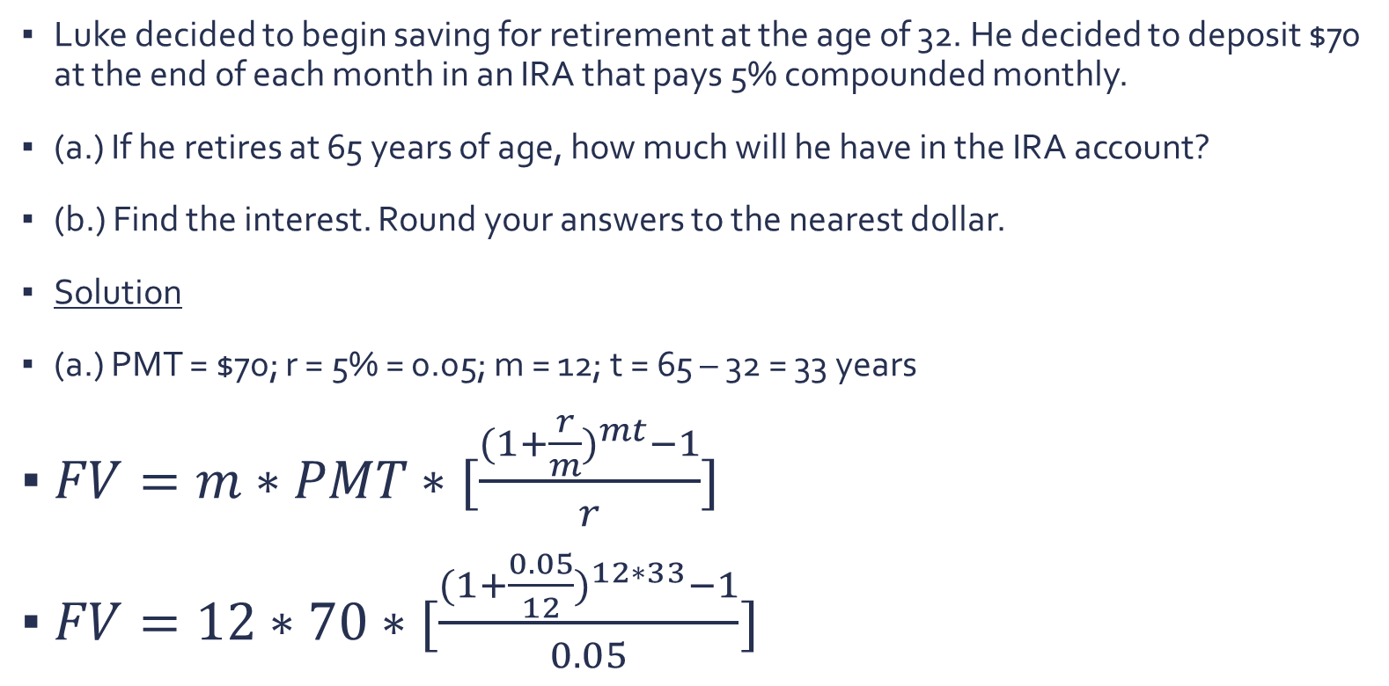
Question 2 1
Luke decided t0 begin saving for retirement at the age of 32. He decided to deposit $70 at the end of each month in an IRA that pays 5% compounded monthly.
(a.) If he retires at 65 years of age, how much will he have in the IRA account?
(b.) Find the interest. Round your answers to the nearest dollar.
Solution
(a.) PMT = $70; r = 5% = 0.05; m = 12; t = 65 – 32 = 33 years
$FV=m∗PMT∗[\frac{{(1+\frac{r}{m})}^{mt}−1}{r}]$
$FV=12∗70∗[\frac{{(1+\frac{0.05}{12})}^{12∗33}−1}{0.05}]$

Slide 26
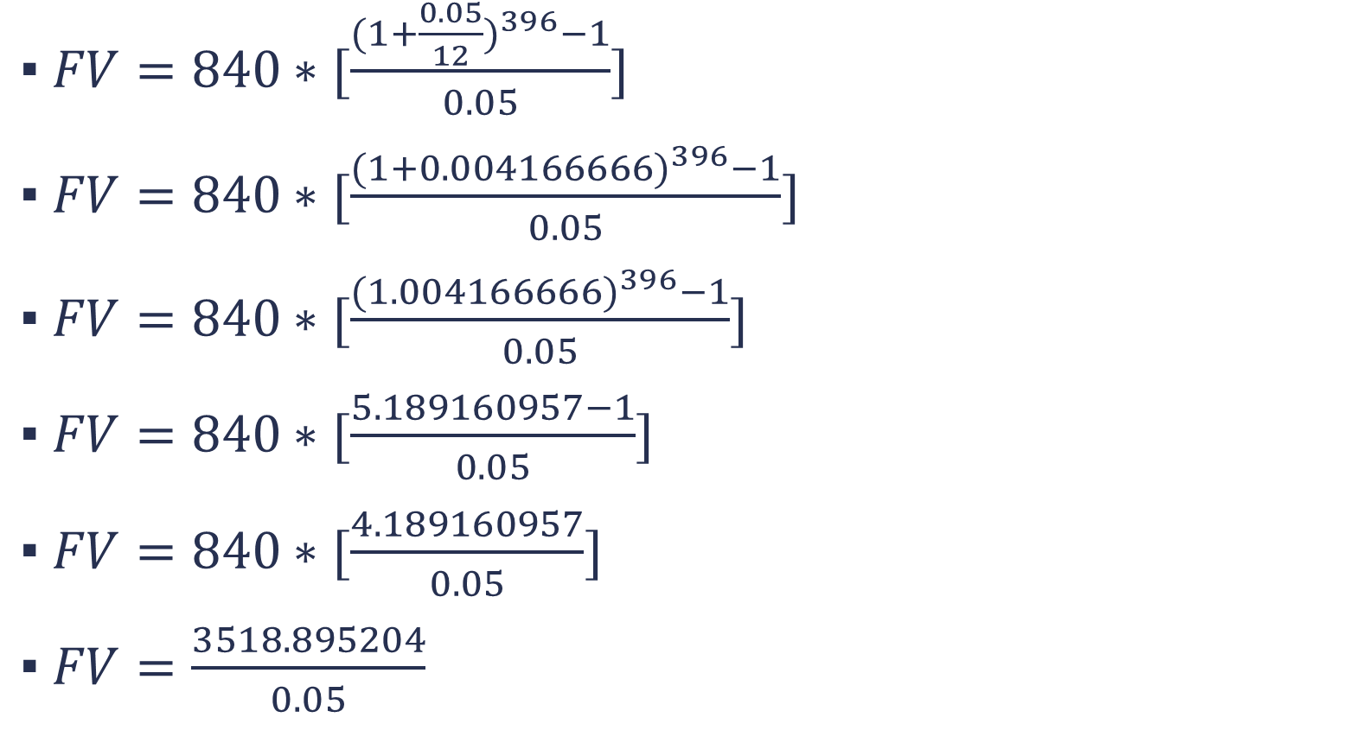
Question 2 2
$FV=840∗[\frac{{(1+\frac{0.05}{12})}^{396}−1}{0.05}]$
$FV=840∗[\frac{{(1+0.004166666)}^{396}−1}{0.05}]$
$FV=840∗[\frac{{(1.004166666)}^{396}−1}{0.05}]$
$FV=840∗[\frac{5.189160957−1}{0.05}]$
$FV=840∗[\frac{4.189160957}{0.05}]$
$FV=\frac{3518.895204}{0.05}$

Slide 27
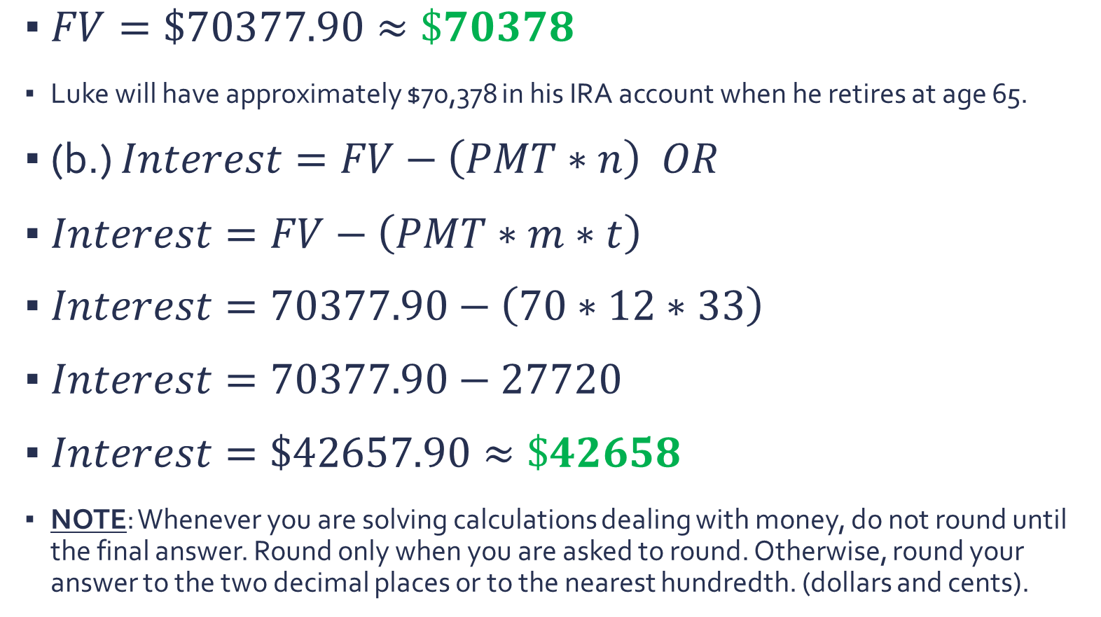
Question 2 3
$FV=\$70377.90≈\$70378$
Luke will have approximately $70,378 in his IRA account when he retires at age 65.
(b.) $Interest=FV−\left(PMT∗n\right) OR$
$Interest=FV−\left(PMT∗m∗t\right)$
$Interest=70377.90−\left(70∗12∗33\right)$
$Interest=70377.90−27720$
$Interest=\$42657.90≈\$42658$
NOTE: Whenever you are solving calculations dealing with money, do not round until the final answer. Round only when you are asked to round. Otherwise, round your answer to the two decimal places or to the nearest hundredth. (dollars and cents).

Slide 28
Question 3 1
(a.) Between the ages of 22 and 28, Rita contributed $7000 per year to a 401(k) and her employer contributed $3500 per year (matched it 50%) on her behalf. The interest rate is 8.6% compounded annually. What is the value of the 401(k) at the end of the 6 years? Round your answers to the nearest dollar and use the whole dollar amount for subsequent calculations.
(b.) After 6 years of working for this firm, she moved on to a new job. However, she kept her accumulated retirement funds in the 401(k). How much money will she have in the plan when she reaches age 65?
(c.) How much did she contribute to the 401(k) plan?
(d.) How much did her employer contribute to the plan?
(e.) What is the difference between the amount of money she would have accumulated in the 401(k) and the amount she contributed to the plan?

Slide 29
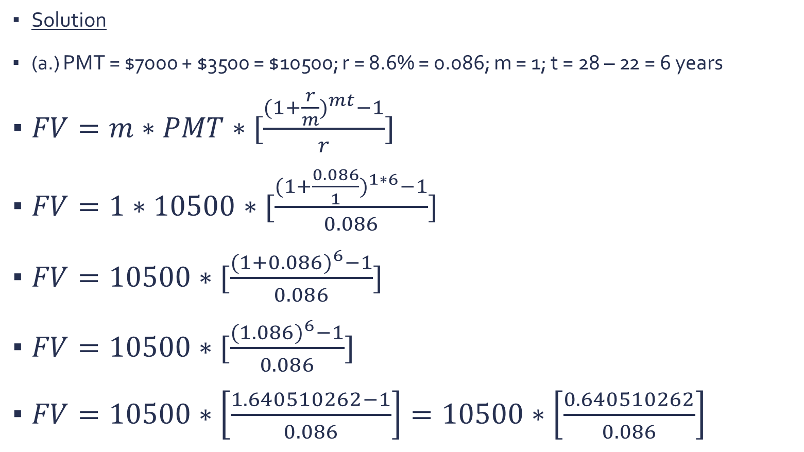
Question 3 2
Solution
(a.) PMT = $7000 + $3500 = $10500; r = 8.6% = 0.086; m = 1; t = 28 – 22 = 6 years
$FV=m∗PMT∗[\frac{{(1+\frac{r}{m})}^{mt}−1}{r}]$
$FV=1∗10500∗[\frac{{(1+\frac{0.086}{1})}^{1∗6}−1}{0.086}]$
$FV=10500∗[\frac{{(1+0.086)}^{6}−1}{0.086}]$
$FV=10500∗[\frac{{(1.086)}^{6}−1}{0.086}]$
$FV=10500∗\left[\frac{1.640510262−1}{0.086}\right]=10500∗\left[\frac{0.640510262}{0.086}\right]$

Slide 30
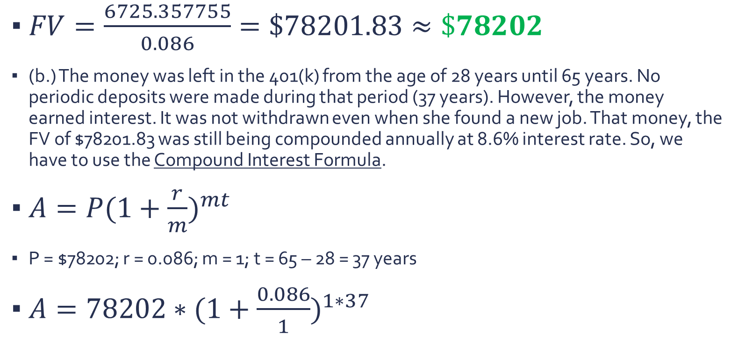
Question 3 3
$FV=\frac{6725.357755}{0.086}=\$78201.83≈\$78202$
(b.) The money was left in the 401(k) from the age of 28 years until 65 years. No periodic deposits were made during that period (37 years). However, the money earned interest. It was not withdrawn even when she found a new job. That money, the FV of $78201.83 was still being compounded annually at 8.6% interest rate. So, we have to use the Compound Interest Formula.
$A=P{(1+\frac{r}{m})}^{mt}$
P = $78202; r = 0.086; m = 1; t = 65 – 28 = 37 years
$A=78202∗{(1+\frac{0.086}{1})}^{1∗37}$

Slide 31
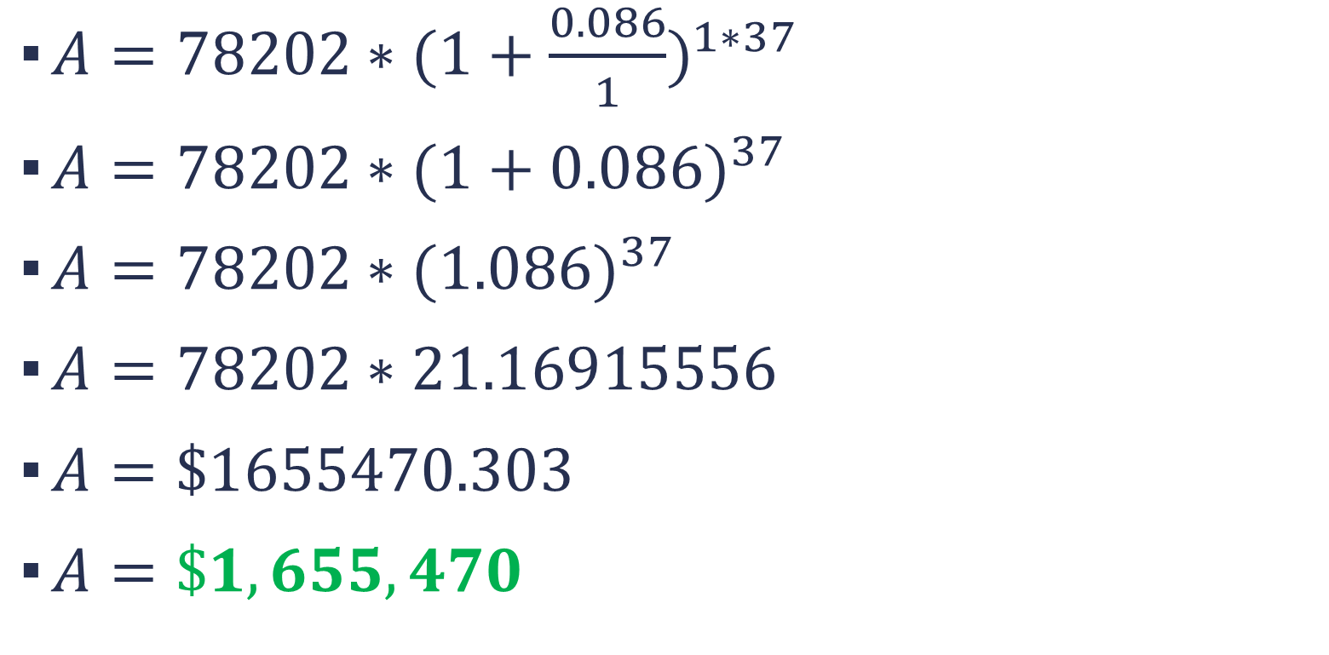
Question 3 4
$A=78202∗{(1+\frac{0.086}{1})}^{1∗37}$
$A=78202∗{(1+0.086)}^{37}$
$A=78202∗{(1.086)}^{37}$
$A=78202∗21.16915556$
$A=\$1655470.303$
$A=\$1,655,470$

Slide 32
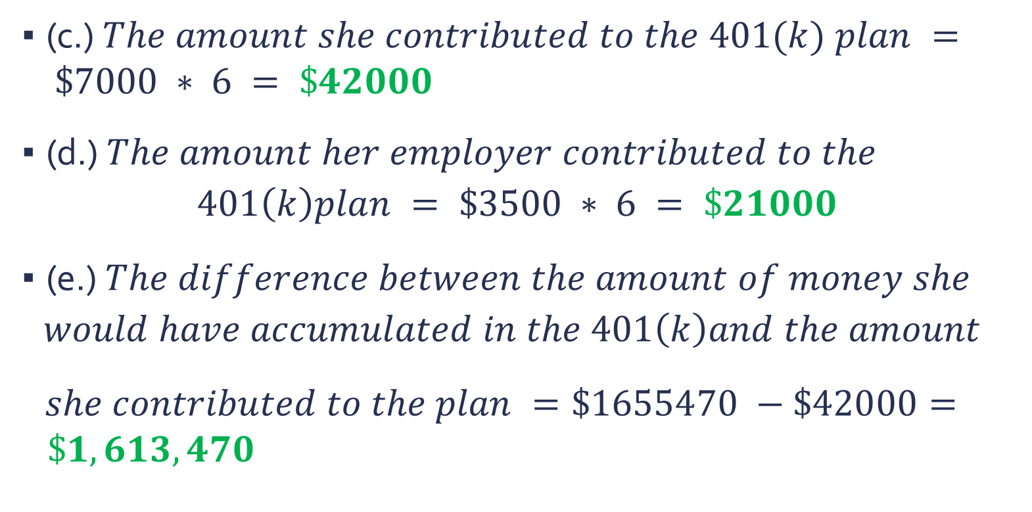
Question 3 5
(c.) $The amount she contributed to the 401(k) plan = \$7000 ∗ 6 = \$42000$
(d.) $The amount her employer contributed to the$
$$401\left(k\right)plan = \$3500 ∗ 6 = \$21000$$
(e.) $The difference between the amount of money she$
$$would have accumulated in the 401\left(k\right)and the amount$$
$she contributed to the plan =\$1655470 −\$42000= \$1,613,470$

Slide 33
Question 4 1
(a.) Between the ages of 25 and 40, Lucy contributed $5000 per year to a 401(k) and her employer matched this contribution dollar for dollar on her behalf. The interest rate is 7.5% compounded annually. What is the value of the 401(k) at the end of the 15 years? Round your answers to the nearest dollar and use the whole dollar amount for subsequent calculations.
(b.) After 15 years of working for this firm, she moved on to a new job. However, she kept her accumulated retirement funds in the 401(k). How much money will she have in the plan when she reaches age 65?
(c.) How much did she contribute to the 401(k) plan?
(d.) How much did her employer contribute to the plan?
(e.) What is the difference between the amount of money she would have accumulated in the 401(k) and the amount she contributed to the plan?

Slide 34
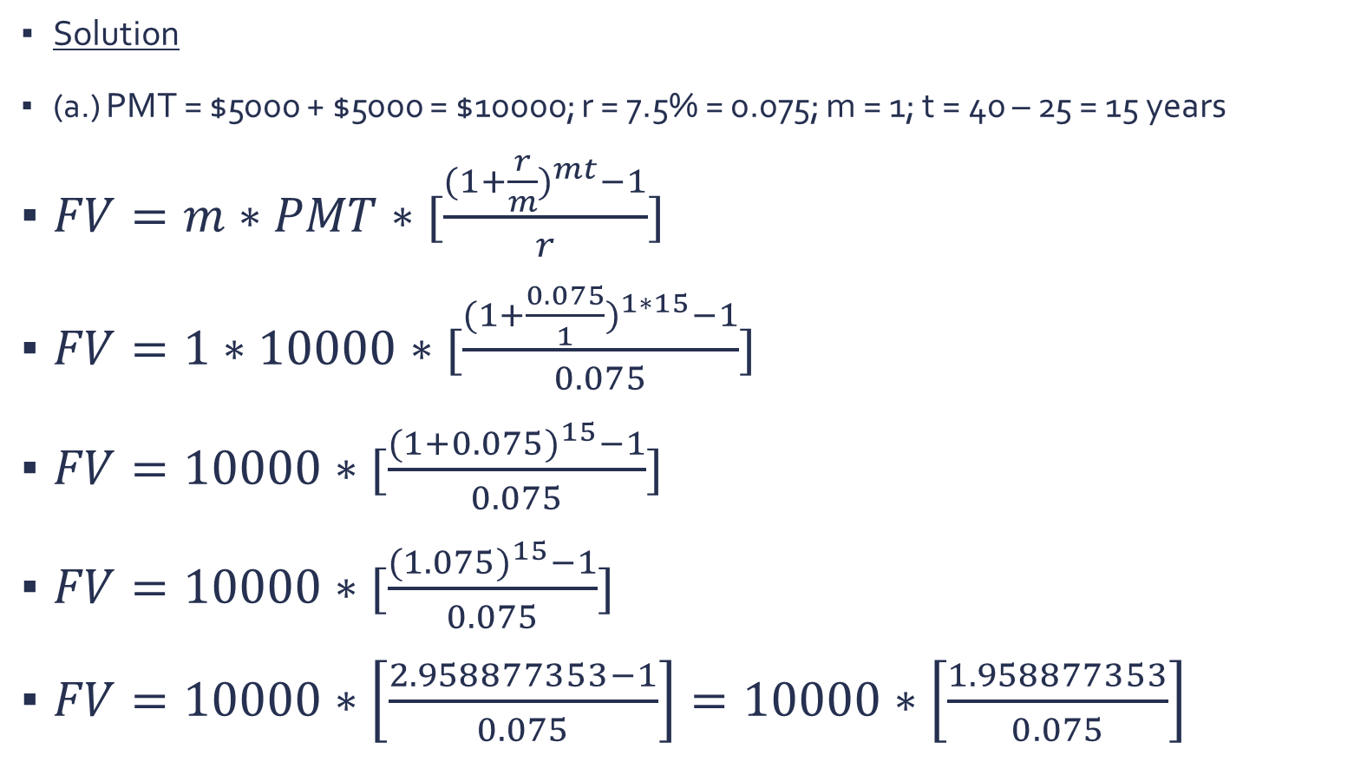
Question 4 2
Solution
(a.) PMT = $5000 + $5000 = $10000; r = 7.5% = 0.075; m = 1; t = 40 – 25 = 15 years
$FV=m∗PMT∗[\frac{{(1+\frac{r}{m})}^{mt}−1}{r}]$
$FV=1∗10000∗[\frac{{(1+\frac{0.075}{1})}^{1∗15}−1}{0.075}]$
$FV=10000∗[\frac{{(1+0.075)}^{15}−1}{0.075}]$
$FV=10000∗[\frac{{(1.075)}^{15}−1}{0.075}]$
$FV=10000∗\left[\frac{2.958877353−1}{0.075}\right]=10000∗\left[\frac{1.958877353}{0.075}\right]$

Slide 35
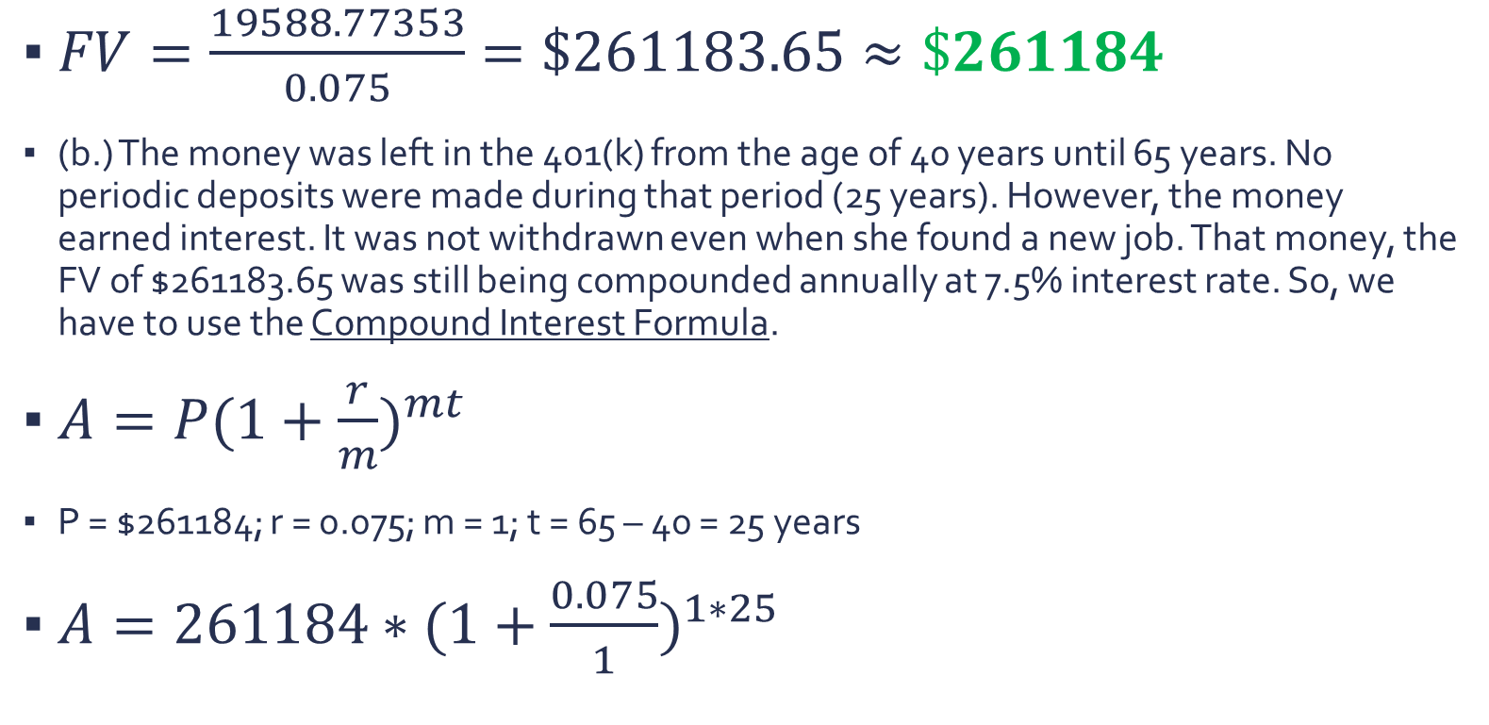
Question 4 3
$FV=\frac{19588.77353}{0.075}=\$261183.65≈\$261184$
(b.) The money was left in the 401(k) from the age of 40 years until 65 years. No periodic deposits were made during that period (25 years). However, the money earned interest. It was not withdrawn even when she found a new job. That money, the FV of $261183.65 was still being compounded annually at 7.5% interest rate. So, we have to use the Compound Interest Formula.
$A=P{(1+\frac{r}{m})}^{mt}$
P = $261184; r = 0.075; m = 1; t = 65 – 40 = 25 years
$A=261184∗{(1+\frac{0.075}{1})}^{1∗25}$

Slide 36
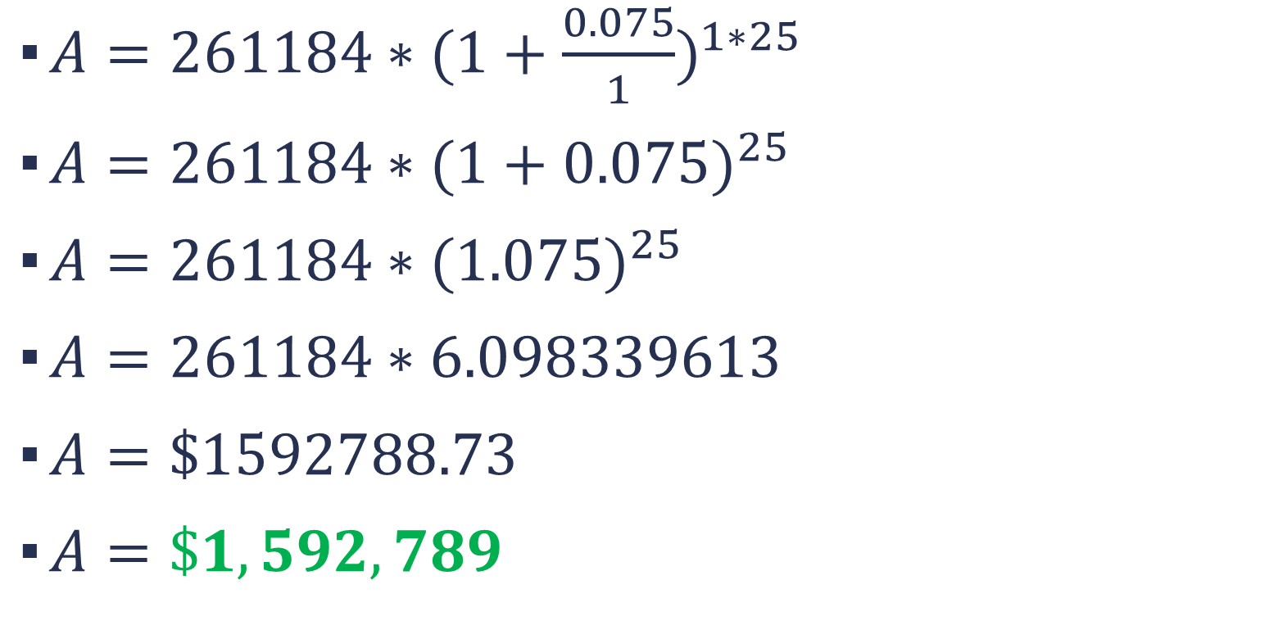
Question 4 4
$A=261184∗{(1+\frac{0.075}{1})}^{1∗25}$
$A=261184∗{(1+0.075)}^{25}$
$A=261184∗{(1.075)}^{25}$
$A=261184∗6.098339613$
$A=\$1592788.73$
$A=\$1,592,789$

Slide 37
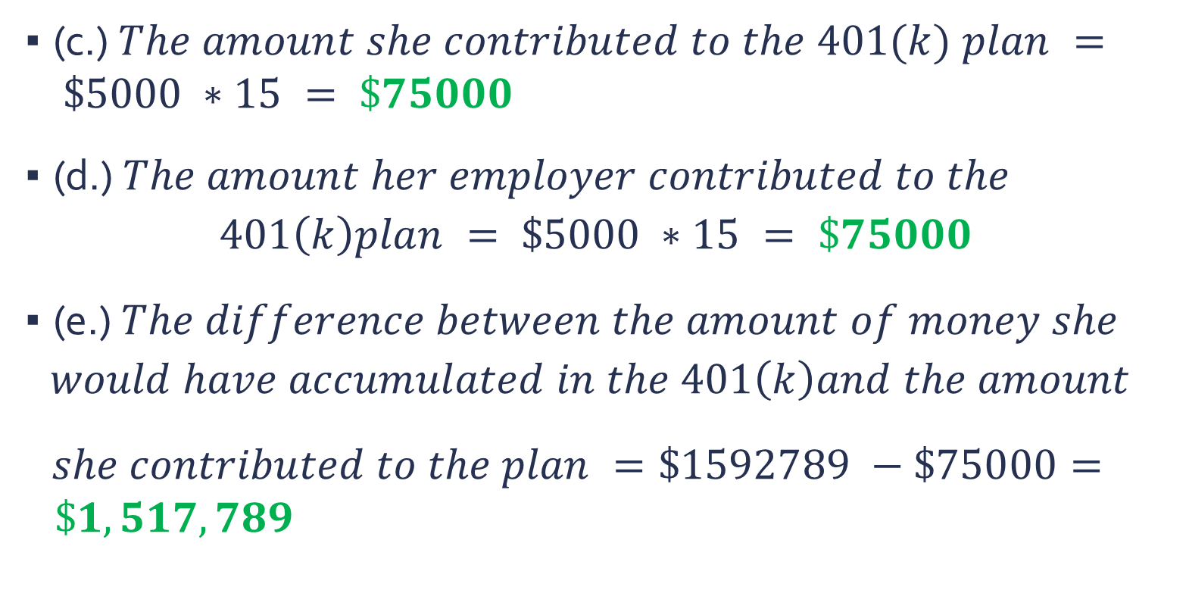
Question 4 5
(c.) $The amount she contributed to the 401(k) plan = \$5000 ∗15 = \$75000$
(d.) $The amount her employer contributed to the$
$$401\left(k\right)plan = \$5000 ∗15 = \$75000$$
(e.) $The difference between the amount of money she$
$$would have accumulated in the 401\left(k\right)and the amount$$
$she contributed to the plan =\$1592789 −\$75000= \$1,517,789$

Slide 38
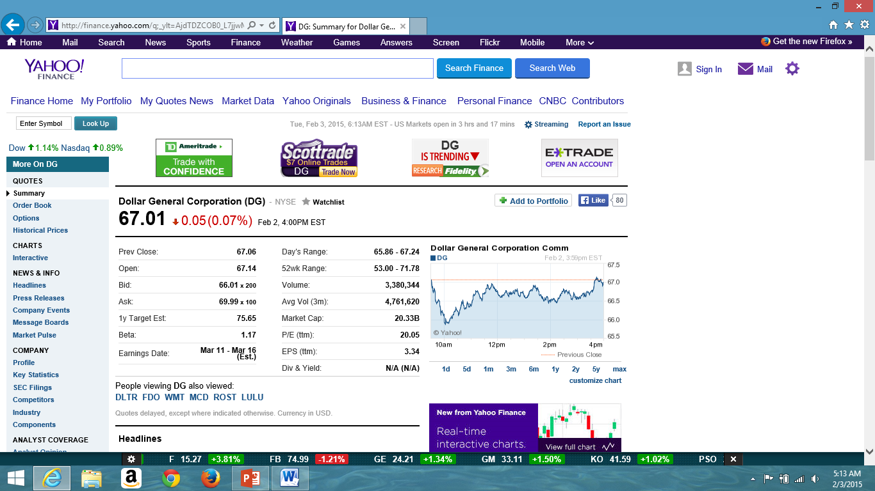
Question 5 1
The picture below is the information on the stock of Dollar General Corporation taken from the Yahoo Finance website. Answer the following questions.

Slide 39
Question 5 2
(a.) What were the high and low prices for the past 52 weeks?
The high price for a share of Dollar General stock during the past 52 weeks was $71.78
The low price for a share of the company’s stock during the past 52 weeks was $53.00
(b.) How many shares of Dollar General stock were traded yesterday?
3380344shares of Dollar General stock were traded yesterday.
(c.) What were the high and low prices for Coca-Cola shares yesterday?
The high price for a share of Dollar General stock yesterday was $67.24
The low price for a share of the company’s stock yesterday was $65.86
(d.) What is the difference between the opening price today and yesterday’s closing price?
The difference is eight cents: $67.14 - $67.06 = $0.08

Slide 40
Useful Websites / Referenced Websites / References
www.finance-calculators.appspot.com
http://investor.gov/
http://www.savingsbonds.gov/
http://www.nasdaq.com/investing/glossary/
http://www.computershare.com/us/Pages/glossary.aspx
http://www1.nyse.com/pdfs/glossary.pdf
http://www1.nyse.com/pdfs/NYSE_posterA_Mech.pdf
http://finance.yahoo.com/
http://www.sec.gov/divisions/marketreg/mrexchanges.shtml
Blitzer, R. (2015). Thinking Mathematically Plus New Mymathlab With Pearson Etext Access Card. Pearson College Div.

