Slide 1
Test 2 Study Guide – Part 1
Samuel Chukwuemeka B.Eng., A.A.T, M.Ed., M.S
“The Joy of a Teacher is the Success of his Students.” – Samuel Chukwuemeka
www.samuelchukwuemeka.com

Slide 2
Objectives and Pre-requisites
Students will:
Determine the probability of an event.
Determine the probabilities of independent events.
Determine the probabilities of dependent events.
Determine the probabilities of mutually exclusive events.
Determine the probabilities of complementary events.
Pre-requisite videos
Probability (all)
View the video for the verbal explanations.

Slide 3
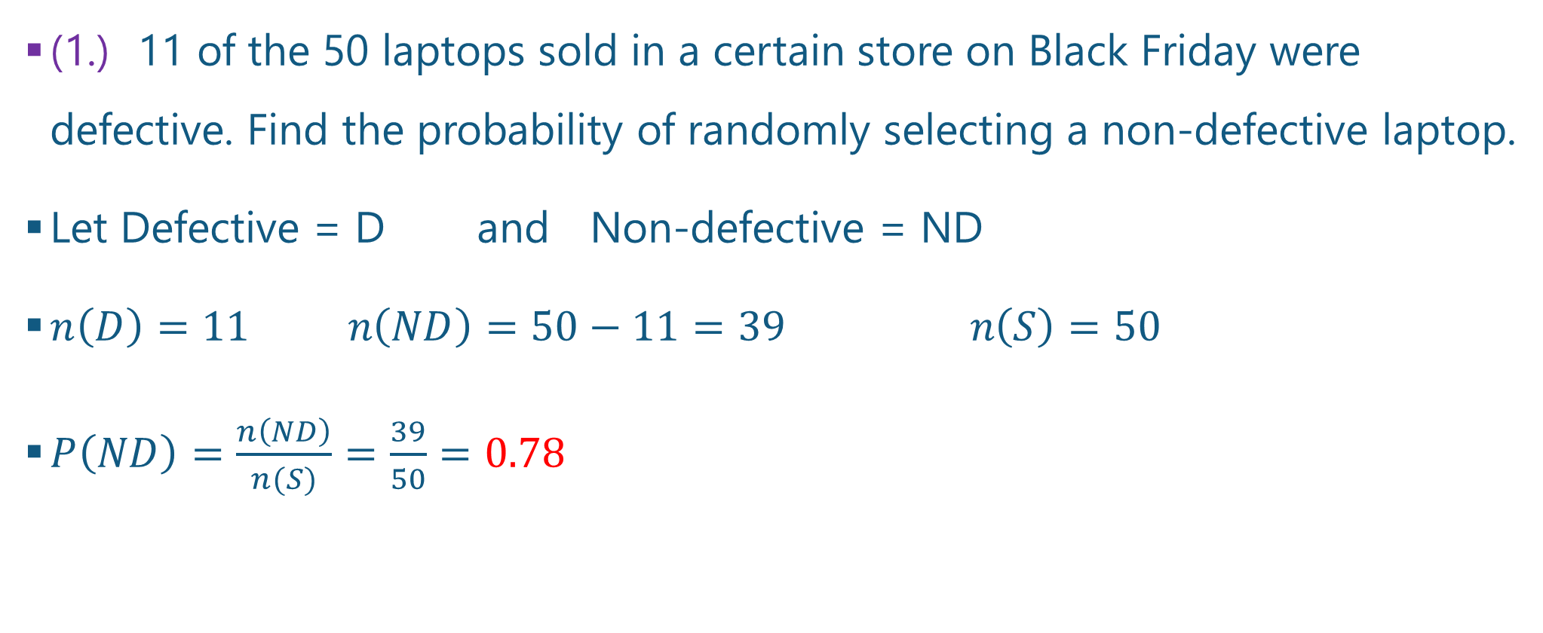
Questions and Answers 1-1.
(1.) 11 of the 50 laptops sold in a certain store on Black Friday were defective. Find the probability of randomly selecting a non-defective laptop.
Let Defective = D and Non-defective = ND
$n\left(D\right)=11 n\left(ND\right)=50−11=39 n\left(S\right)=50$
$P\left(ND\right)=\frac{n\left(ND\right)}{n(S)}=\frac{39}{50}=0.78$

Slide 4
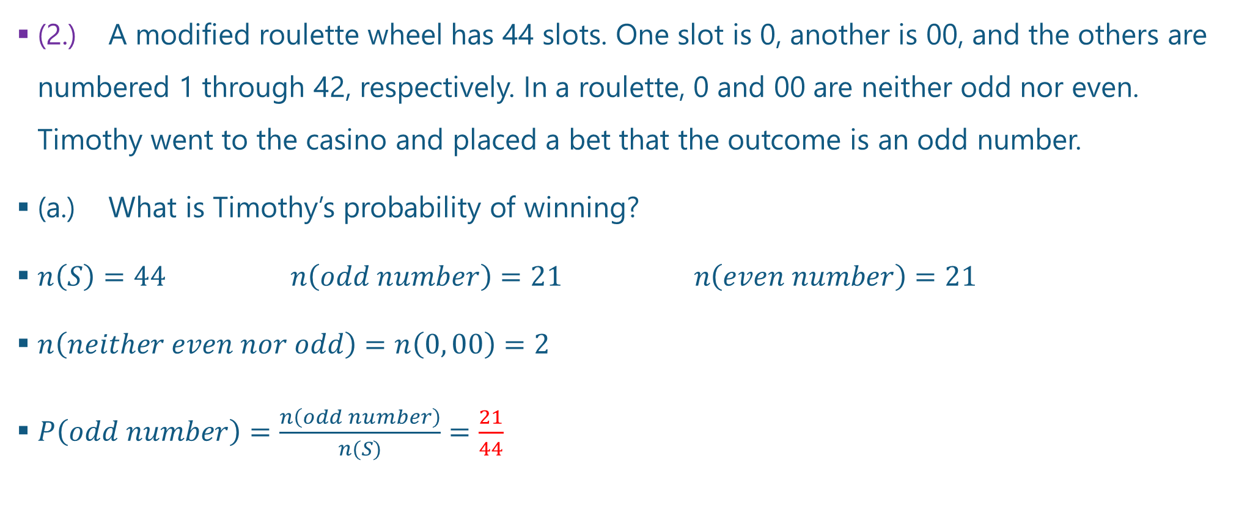
Questions and Answers 2-1.
(2.) A modified roulette wheel has 44 slots. One slot is 0, another is 00, and the others are numbered 1 through 42, respectively. In a roulette, 0 and 00 are neither odd nor even. Timothy went to the casino and placed a bet that the outcome is an odd number.
(a.) What is Timothy’s probability of winning?
$n\left(S\right)=44 n\left(odd number\right)=21 n\left(even number\right)=21$
$n\left(neither even nor odd\right)=n\left(0, 00\right)=2$
$P\left(odd number\right)=\frac{n\left(odd number\right)}{n(S)}=\frac{21}{44}$

Slide 5
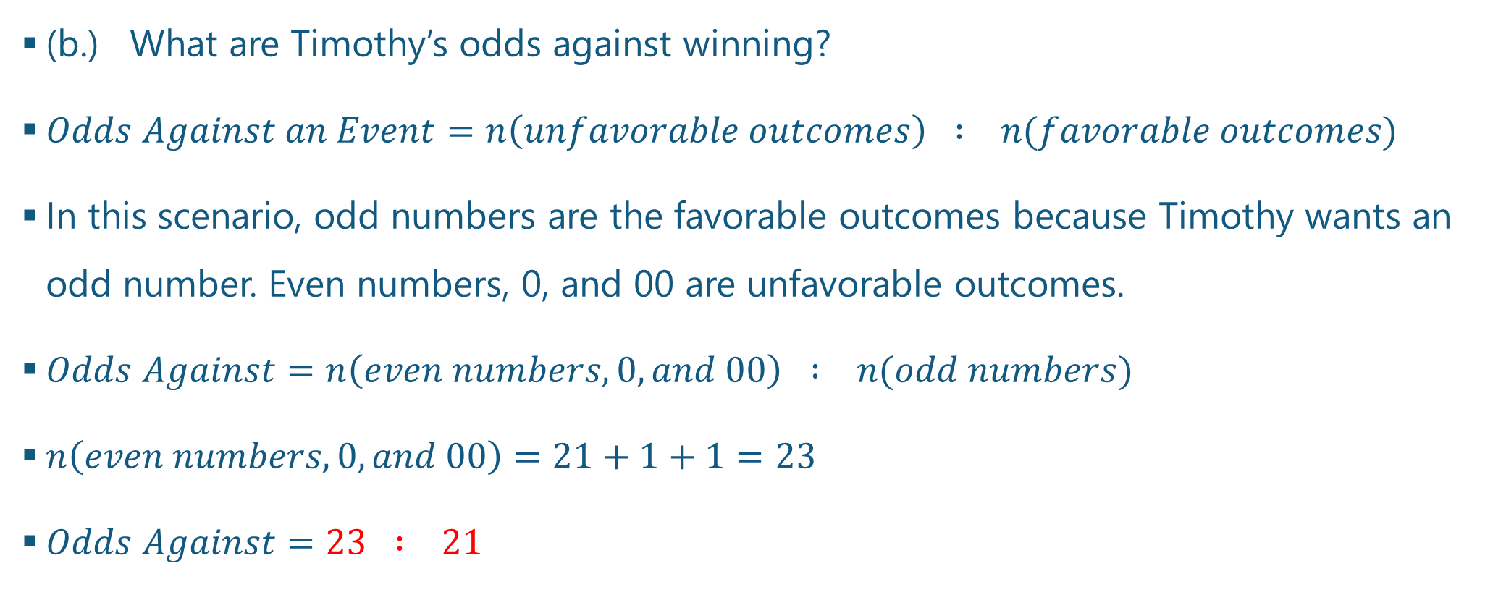
Questions and Answers 2-2.
(b.) What are Timothy’s odds against winning?
$Odds Against an Event=n\left(unfavorable outcomes\right) : n(favorable outcomes)$
In this scenario, odd numbers are the favorable outcomes because Timothy wants an odd number. Even numbers, 0, and 00 are unfavorable outcomes.
$Odds Against=n\left(even numbers, 0, and 00\right) : n(odd numbers)$
$n\left(even numbers, 0, and 00\right)=21+1+1=23$
$Odds Against=23 : 21$

Slide 6
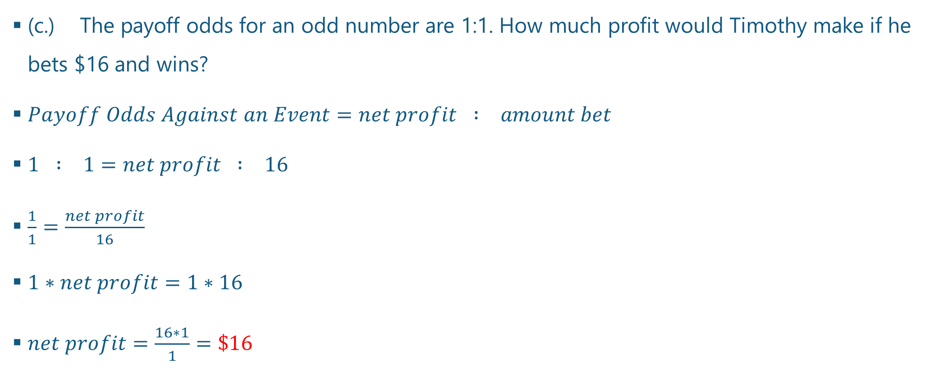
Questions and Answers 2-3.
(c.) The payoff odds for an odd number are 1:1. How much profit would Timothy make if he bets $16 and wins?
$Payoff Odds Against an Event=net profit : amount bet$
$1 : 1=net profit : 16$
$\frac{1}{1}=\frac{net profit}{16}$
$1∗net profit=1∗16$
$net profit=\frac{16∗1}{1}=\$16$

Slide 7
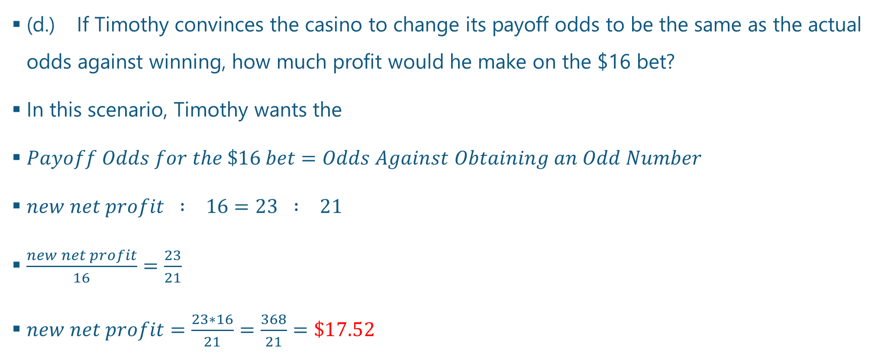
Questions and Answers 2-4.
(d.) If Timothy convinces the casino to change its payoff odds to be the same as the actual odds against winning, how much profit would he make on the $16 bet?
In this scenario, Timothy wants the
$Payoff Odds for the \$16 bet=Odds Against Obtaining an Odd Number$
$new net profit : 16=23 : 21$
$\frac{new net profit}{16}=\frac{23}{21}$
$new net profit=\frac{23∗16}{21}=\frac{368}{21}=\$17.52$

Slide 8
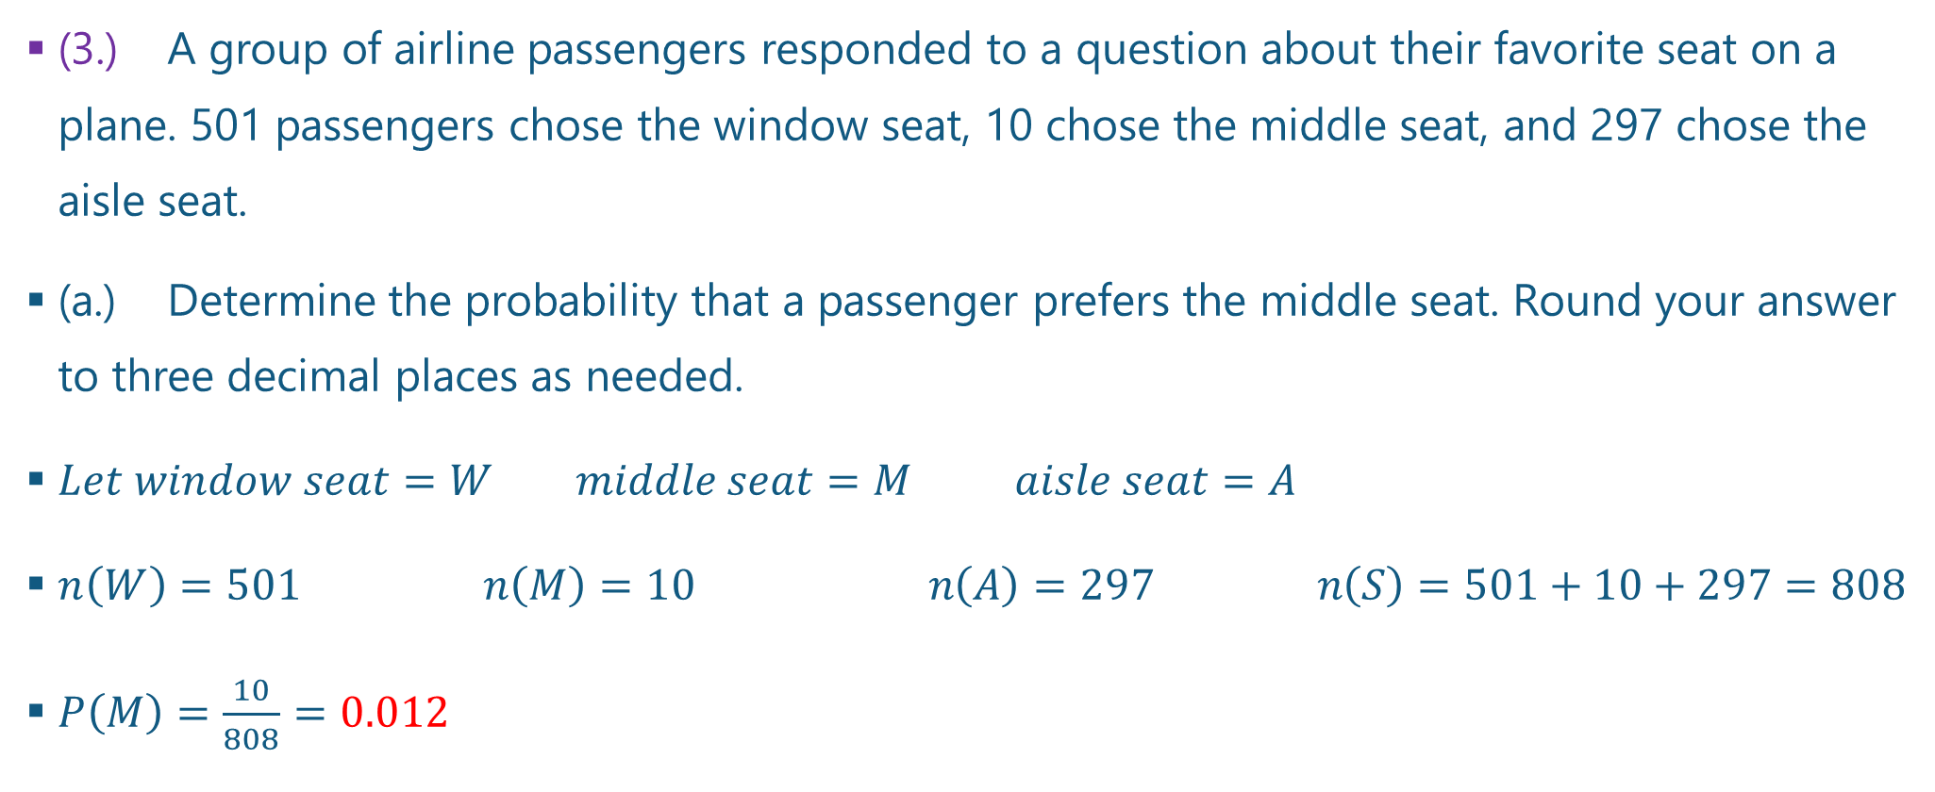
Questions and Answers 3-1.
(3.) A group of airline passengers responded to a question about their favorite seat on a plane. 501 passengers chose the window seat, 10 chose the middle seat, and 297 chose the aisle seat.
(a.) Determine the probability that a passenger prefers the middle seat. Round your answer to three decimal places as needed.
$Let window seat=W middle seat=M aisle seat=A$
$n\left(W\right)=501 n\left(M\right)=10 n\left(A\right)=297 n\left(S\right)=501+10+297=808$
$P\left(M\right)=\frac{10}{808}=0.012$

Slide 9
Questions and Answers 3-2.
(b.) Is it unlikely for a passenger to prefer the middle seat? Why?
Yes, it is unlikely for a passenger to prefer the middle seat because the probability that a passenger prefers the middle seat (0.012) is less than 0.05.
This may be due to the fact that the middle seat lacks: easy access to the aisle and an outside view, among others.

Slide 10
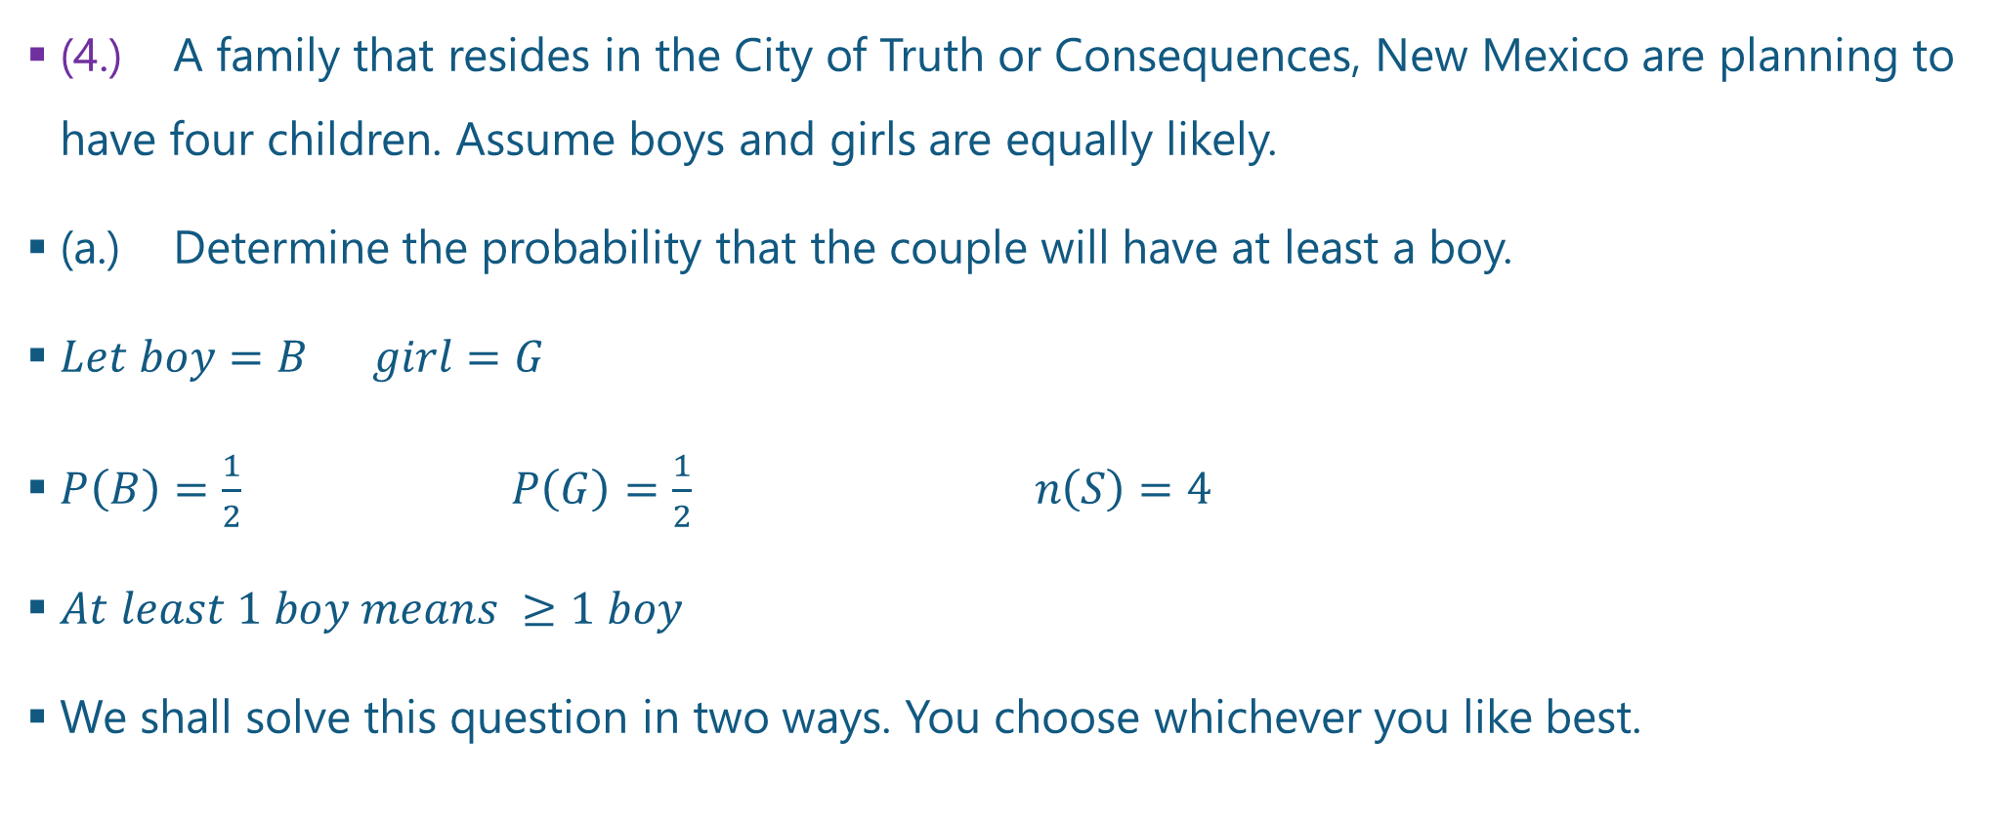
Questions and Answers 4-1.
(4.) A family that resides in the City of Truth or Consequences, New Mexico are planning to have four children. Assume boys and girls are equally likely.
(a.) Determine the probability that the couple will have at least a boy.
$Let boy=B girl=G$
$P\left(B\right)=\frac{1}{2} P\left(G\right)=\frac{1}{2} n\left(S\right)=4$
$At least 1 boy means ≥1 boy$
We shall solve this question in two ways. You choose whichever you like best.

Slide 11
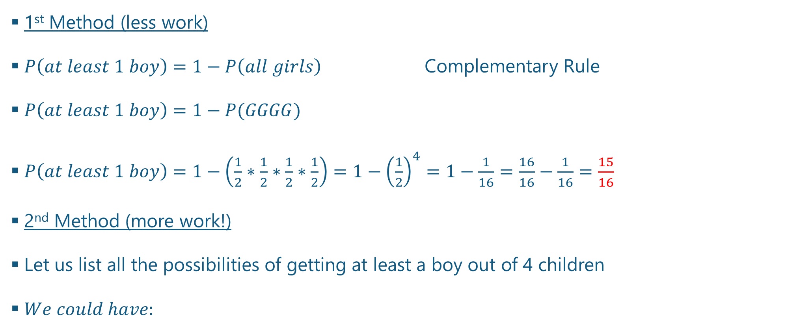
Questions and Answers 4-2.
1st Method (less work)
$P\left(at least 1 boy\right)=1−P\left(all girls\right)$ Complementary Rule
$P\left(at least 1 boy\right)=1−P(GGGG)$
$P\left(at least 1 boy\right)=1−\left(\frac{1}{2}∗\frac{1}{2}∗\frac{1}{2}∗\frac{1}{2}\right)=1−{\left(\frac{1}{2}\right)}^{4}=1−\frac{1}{16}=\frac{16}{16}−\frac{1}{16}=\frac{15}{16}$
2nd Method (more work!)
Let us list all the possibilities of getting at least a boy out of 4 children
$We could have:$

Slide 12
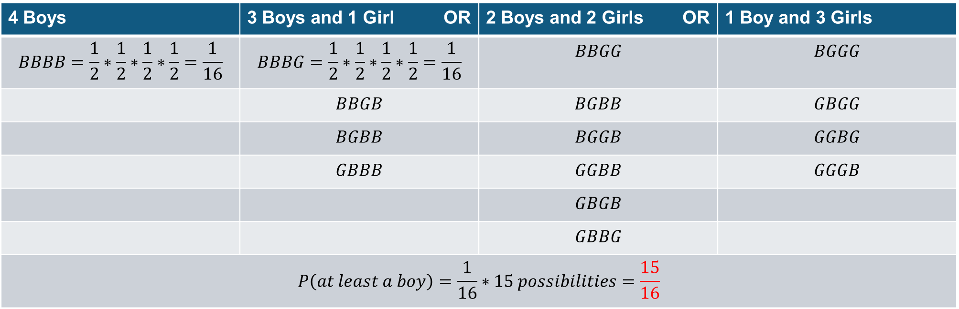

Questions and Answers 4-3.
4 Boys | 3 Boys and 1 Girl OR | 2 Boys and 2 Girls OR | 1 Boy and 3 Girls
$$BBBB=\frac{1}{2}∗\frac{1}{2}∗\frac{1}{2}∗\frac{1}{2}=\frac{1}{16}$$ | $$BBBG=\frac{1}{2}∗\frac{1}{2}∗\frac{1}{2}∗\frac{1}{2}=\frac{1}{16}$$ | $$BBGG$$ | $$BGGG$$
 | $$BBGB$$ | $$BGBB$$ | $$GBGG$$
 | $$BGBB$$ | $$BGGB$$ | $$GGBG$$
 | $$GBBB$$ | $$GGBB$$ | $$GGGB$$
 |  | $$GBGB$$
 |  | $$GBBG$$
$$P\left(at least a boy\right)=\frac{1}{16}∗15 possibilities=\frac{15}{16}$$
$Every possibility has a\frac{1}{16}chance of occurring.$ It is very likely that the couple will have at least a boy if they have 4 children because the probability, $\frac{15}{16}$ is close to 1.

Slide 13
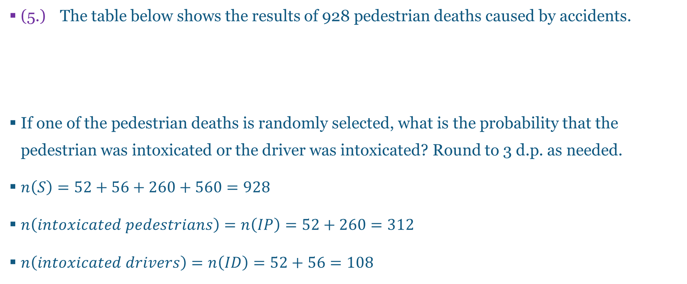
Questions and Answers 5-1.
(5.) The table below shows the results of 928 pedestrian deaths caused by accidents.
If one of the pedestrian deaths is randomly selected, what is the probability that the pedestrian was intoxicated or the driver was intoxicated? Round to 3 d.p. as needed.
$n\left(S\right)=52+56+260+560=928$
$n\left(intoxicated pedestrians\right)=n\left(IP\right)=52+260=312$
$n\left(intoxicated drivers\right)=n\left(ID\right)=52+56=108$
 |  | Pedestrian
 |  | Intoxicated | Not intoxicated
Driver | Intoxicated | 52 | 56
 | Not intoxicated | 260 | 560

Slide 14
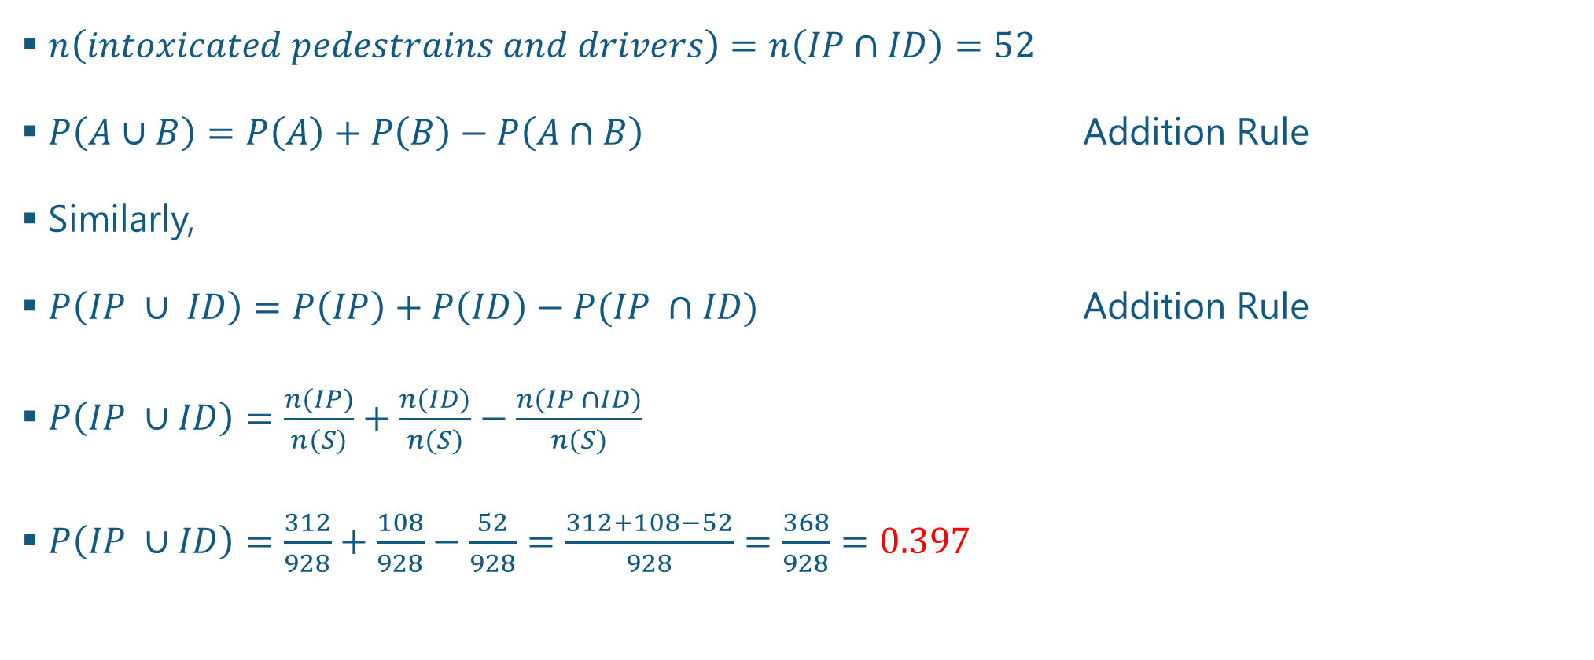
Questions and Answers 5-2.
$n\left(intoxicated pedestrains and drivers\right)=n\left(IP∩ID\right)=52$
$P\left(A∪B\right)=P\left(A\right)+P\left(B\right)−P\left(A∩B\right)$ Addition Rule
Similarly,
$P\left(IP ∪ ID\right)=P\left(IP\right)+P\left(ID\right)−P(IP ∩ID)$ Addition Rule
$P\left(IP ∪ID\right)=\frac{n(IP)}{n(S)}+\frac{n(ID)}{n(S)}−\frac{n(IP ∩ID)}{n(S)}$
$P\left(IP ∪ID\right)=\frac{312}{928}+\frac{108}{928}−\frac{52}{928}=\frac{312+108−52}{928}=\frac{368}{928}=0.397$

Slide 15
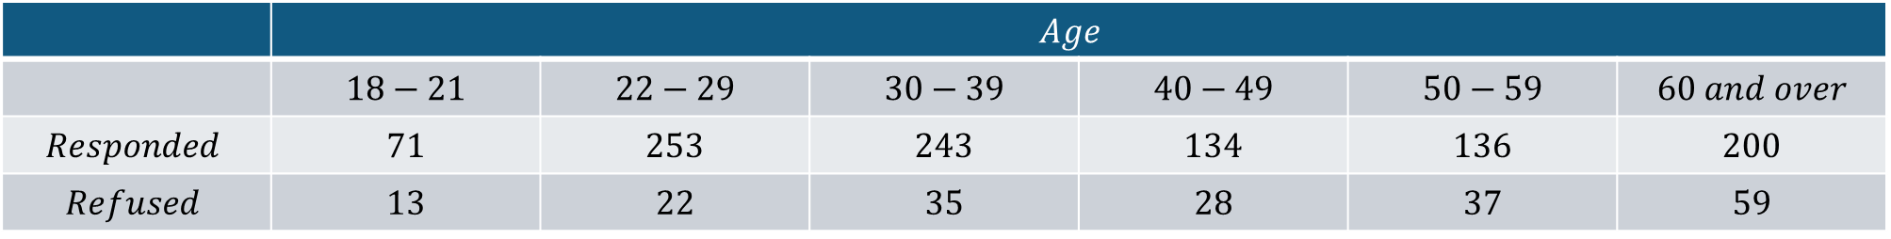
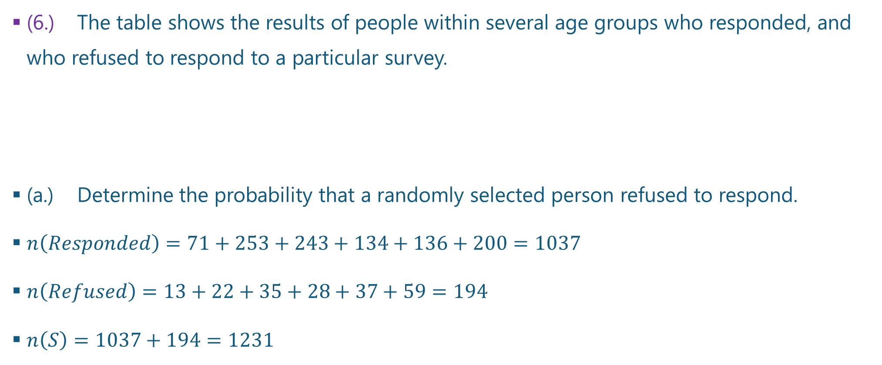
Questions and Answers 6-1.
(6.) The table shows the results of people within several age groups who responded, and who refused to respond to a particular survey.
(a.) Determine the probability that a randomly selected person refused to respond.
$n\left(Responded\right)=71+253+243+134+136+200=1037$
$n\left(Refused\right)=13+22+35+28+37+59=194$
$n\left(S\right)=1037+194=1231$
 | $$Age$$
 | $$18−21$$ | $$22−29$$ | $$30−39$$ | $$40−49$$ | $$50−59$$ | $$60 and over$$
$$Responded$$ | $$71$$ | $$253$$ | $$243$$ | $$134$$ | $$136$$ | $$200$$
$$Refused$$ | $$13$$ | $$22$$ | $$35$$ | $$28$$ | $$37$$ | $$59$$

Slide 16
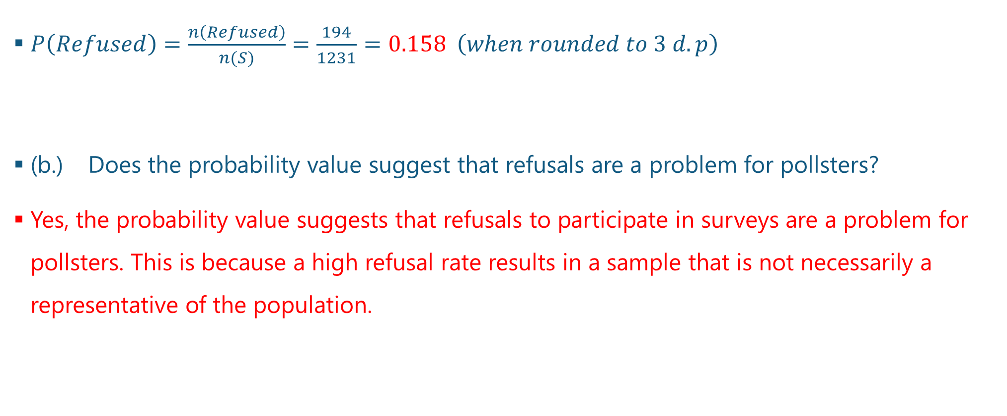
Questions and Answers 6-2.
$P\left(Refused\right)=\frac{n\left(Refused\right)}{n(S)}=\frac{194}{1231}=0.158 \left(when rounded to 3 d.p\right)$
(b.) Does the probability value suggest that refusals are a problem for pollsters?
Yes, the probability value suggests that refusals to participate in surveys are a problem for pollsters. This is because a high refusal rate results in a sample that is not necessarily a representative of the population.

Slide 17
Questions and Answers 7-1.
(7.) A drug testing company tested several job applicants for marijuana.
146 applicants tested positive, but among them were 26 false positive results.
160 applicants tested negative, but among them were 3 false negative.
(a.) Represent this information in a table.
Let us define some of these terms.
A false positive means that the applicant does not use marijuana but tested positive for it.
A false negative means that applicant used marijuana but tested negative for it.

Slide 18
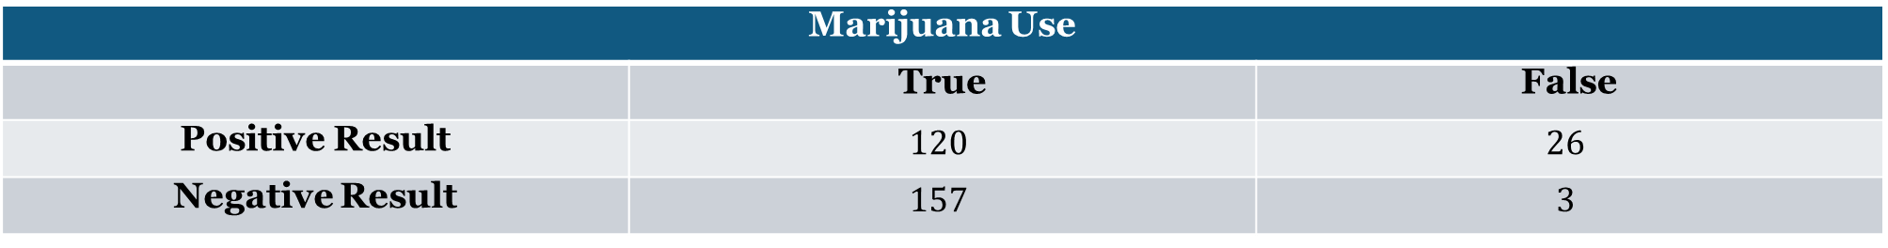
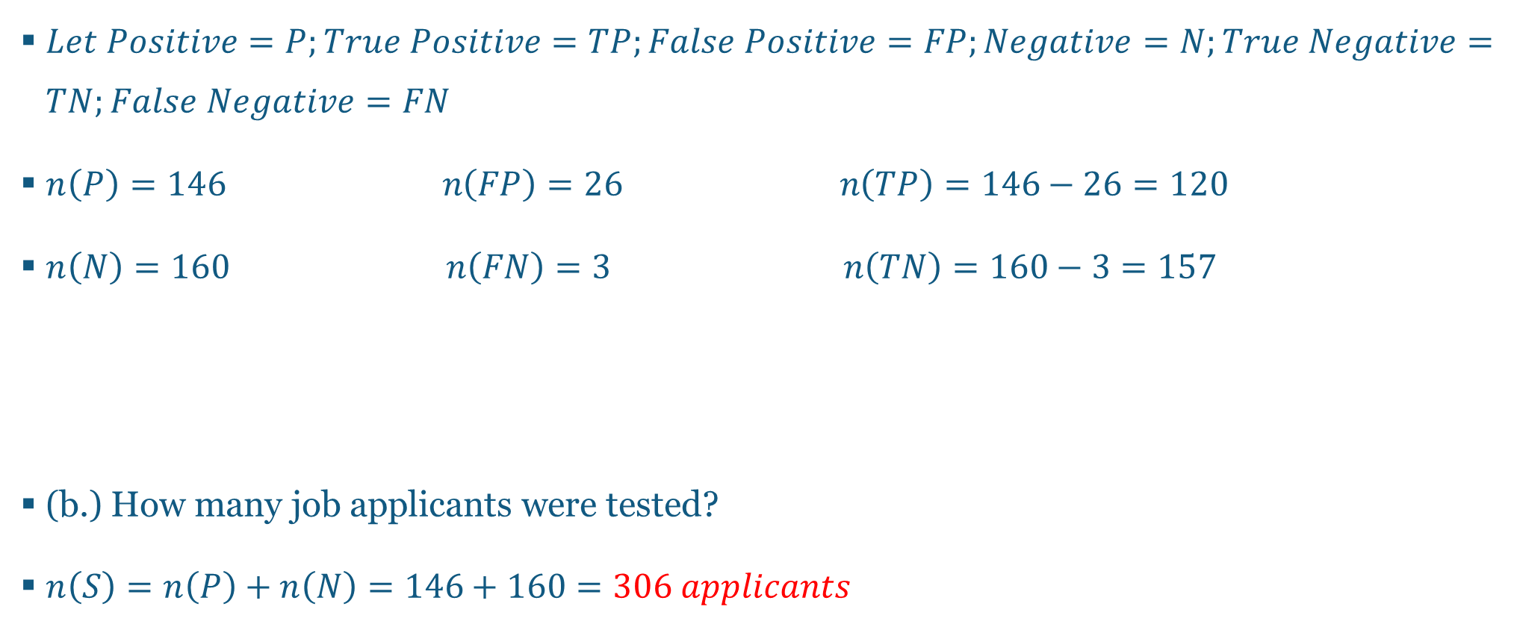
Questions and Answers 7-2.
$Let Positive=P;True Positive=TP;False Positive=FP;Negative=N;True Negative=TN;False Negative=FN$
$n\left(P\right)=146 n\left(FP\right)=26 n\left(TP\right)=146−26=120$
$n\left(N\right)=160 n\left(FN\right)=3 n\left(TN\right)=160−3=157$
(b.) How many job applicants were tested?
$n\left(S\right)=n\left(P\right)+n\left(N\right)=146+160=306 applicants$
Marijuana Use
 | True | False
Positive Result | $$120$$ | $$26$$
Negative Result | $$157$$ | $$3$$

Slide 19
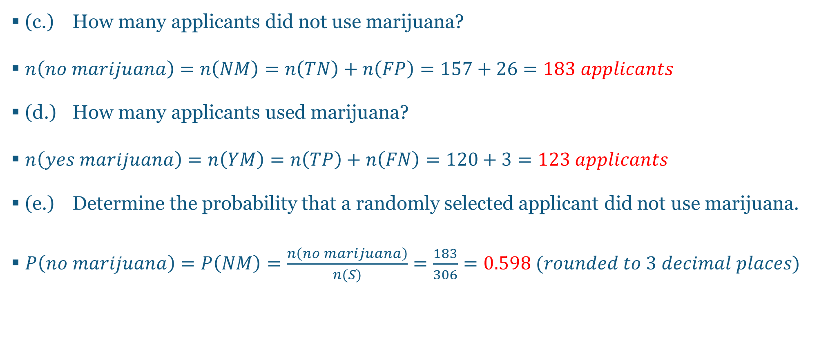
Questions and Answers 7-3.
(c.) How many applicants did not use marijuana?
$n\left(no marijuana\right)=n\left(NM\right)=n\left(TN\right)+n\left(FP\right)=157+26=183 applicants$
(d.) How many applicants used marijuana?
$n\left(yes marijuana\right)=n\left(YM\right)=n\left(TP\right)+n\left(FN\right)=120+3=123 applicants$
(e.) Determine the probability that a randomly selected applicant did not use marijuana.
$P\left(no marijuana\right)=P\left(NM\right)=\frac{n\left(no marijuana\right)}{n(S)}=\frac{183}{306}=0.598 (rounded to 3 decimal places)$

Slide 20
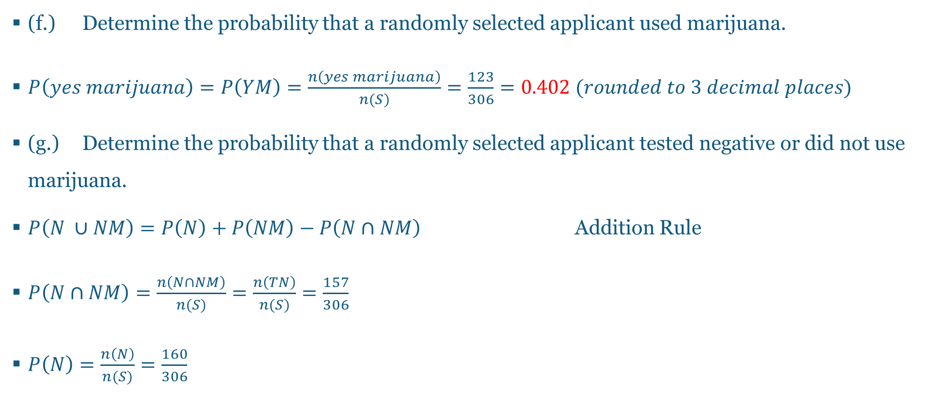
Questions and Answers 7-4.
(f.) Determine the probability that a randomly selected applicant used marijuana.
$P\left(yes marijuana\right)=P\left(YM\right)=\frac{n\left(yes marijuana\right)}{n(S)}=\frac{123}{306}=0.402 (rounded to 3 decimal places)$
(g.) Determine the probability that a randomly selected applicant tested negative or did not use marijuana.
$P\left(N ∪NM\right)=P\left(N\right)+P\left(NM\right)−P\left(N∩NM\right)$ Addition Rule
$P\left(N∩NM\right)=\frac{n\left(N∩NM\right)}{n(S)}=\frac{n\left(TN\right)}{n(S)}=\frac{157}{306}$
$P\left(N\right)=\frac{n\left(N\right)}{n(S)}=\frac{160}{306}$

Slide 21
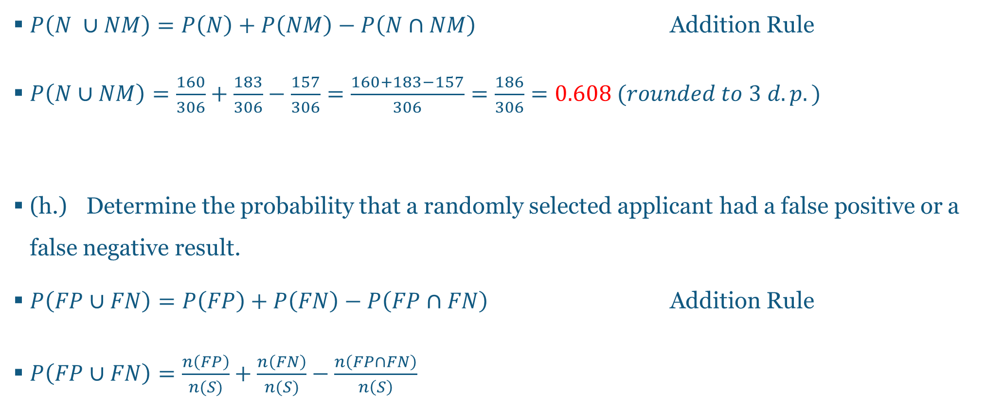
Questions and Answers 7-5.
$P\left(N ∪NM\right)=P\left(N\right)+P\left(NM\right)−P\left(N∩NM\right)$ Addition Rule
$P\left(N∪NM\right)=\frac{160}{306}+\frac{183}{306}−\frac{157}{306}=\frac{160+183−157}{306}=\frac{186}{306}=0.608 (rounded to 3 d.p.)$
(h.) Determine the probability that a randomly selected applicant had a false positive or a false negative result.
$P\left(FP∪FN\right)=P\left(FP\right)+P\left(FN\right)−P\left(FP∩FN\right)$ Addition Rule
$P\left(FP∪FN\right)=\frac{n\left(FP\right)}{n(S)}+\frac{n\left(FN\right)}{n(S)}−\frac{n\left(FP∩FN\right)}{n\left(S\right)}$

Slide 22
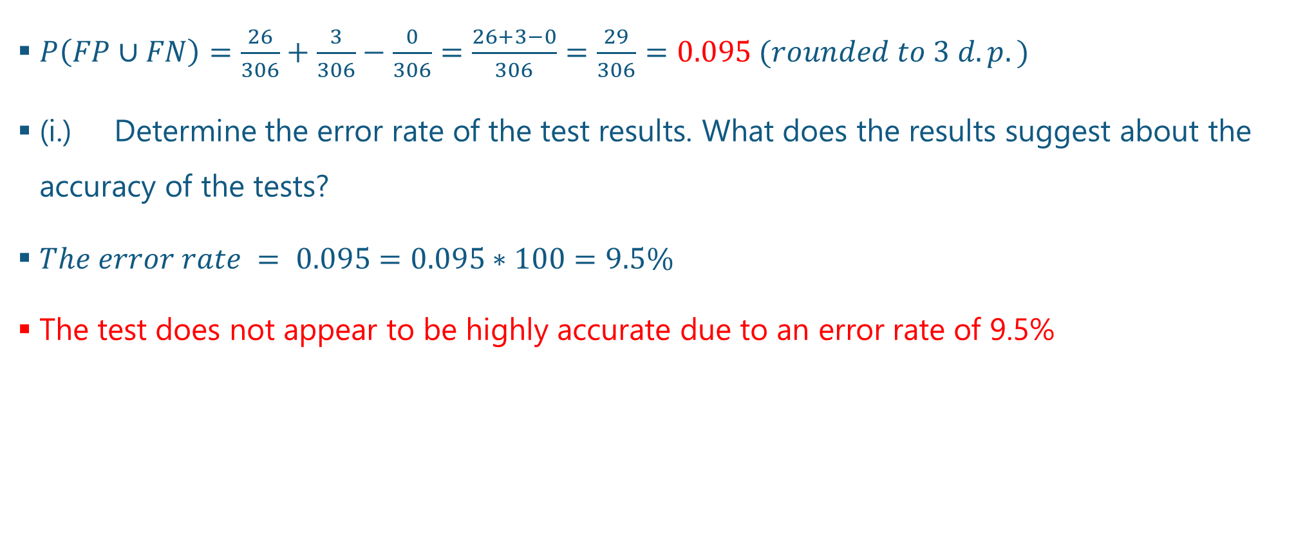
Questions and Answers 7-6.
$P\left(FP∪FN\right)=\frac{26}{306}+\frac{3}{306}−\frac{0}{306}=\frac{26+3−0}{306}=\frac{29}{306}=0.095 (rounded to 3 d.p.)$
(i.) Determine the error rate of the test results. What does the results suggest about the accuracy of the tests?
$The error rate = 0.095=0.095∗100=9.5\%$
The test does not appear to be highly accurate due to an error rate of 9.5%

Slide 23
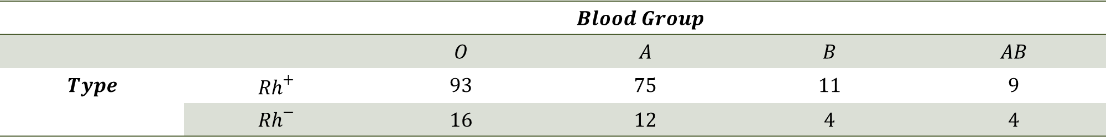
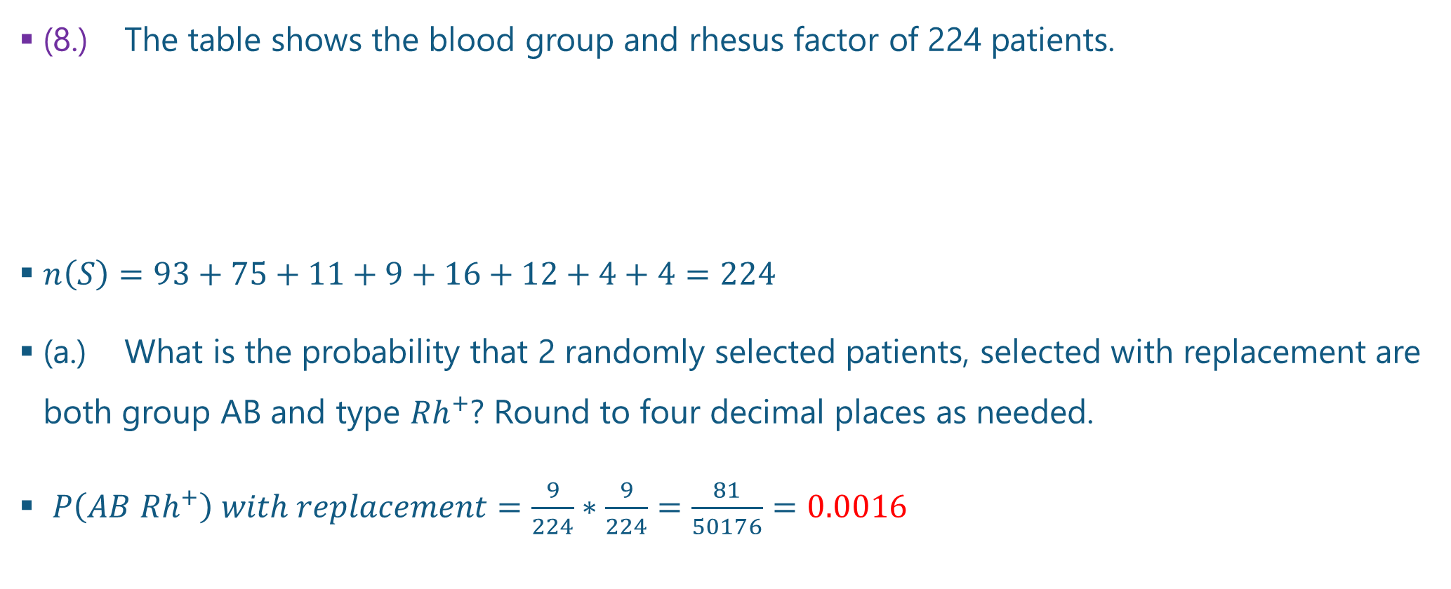
Questions and Answers 8-1.
(8.) The table shows the blood group and rhesus factor of 224 patients.
$n\left(S\right)=93+75+11+9+16+12+4+4=224$
(a.) What is the probability that 2 randomly selected patients, selected with replacement are both group AB and type ${Rh}^{+}$? Round to four decimal places as needed.
$P\left(AB {Rh}^{+}\right) with replacement=\frac{9}{224}∗\frac{9}{224}=\frac{81}{50176}=0.0016$
 | $$Blood Group$$
 |  | $$O$$ | $$A$$ | $$B$$ | $$AB$$
$$Type$$ | $${Rh}^{+}$$ | $$93$$ | $$75$$ | $$11$$ | $$9$$
 | $${Rh}^{−}$$ | $$16$$ | $$12$$ | $$4$$ | $$4$$

Slide 24

Questions and Answers 8-2.
$\text{(}\text{b}\text{.) } \text{What} \text{is} \text{the} \text{probability} \text{that}\text{ 2 }\text{randomly} \text{selected} \text{patients}\text{, }\text{selected} \text{without} \text{replacement} \text{are} \text{both} \text{group} \text{AB} \text{and} \text{type} {Rh}^{+}\text{? }\text{Round} \text{to} \text{four} \text{decimal} \text{places} \text{as} \text{needed}\text{.}$
$P\left(AB {Rh}^{+}\right) without replacement=\frac{9}{224}∗\frac{8}{223}=\frac{72}{49952}=0.0014$

Slide 25
References
Chukwuemeka, S. D. (2016, February 22). Samuel Chukwuemeka Tutorials – Math, Science, and Technology. Retrieved from http://www.samuelchukwuemeka.com/
Triola, M. F. (2015). Frequency Distributions. In Elementary statistics using the TI-83/84 plus calculator (4th ed.). Pearson.

