Slide 1
Test 2 Study Guide – Part 2
Samuel Chukwuemeka B.Eng., A.A.T, M.Ed., M.S
“The Joy of a Teacher is the Success of his Students.” – Samuel Chukwuemeka
www.samuelchukwuemeka.com

Slide 2
Objectives and Pre-requisites
Students will:
Determine the probability of any type of event.
Apply the Fundamental Counting Principle.
Calculate the probability of events using combinations.
Pre-requisite videos
Probability (all)
Combinatorics (all)
View the video for the verbal explanations.

Slide 3
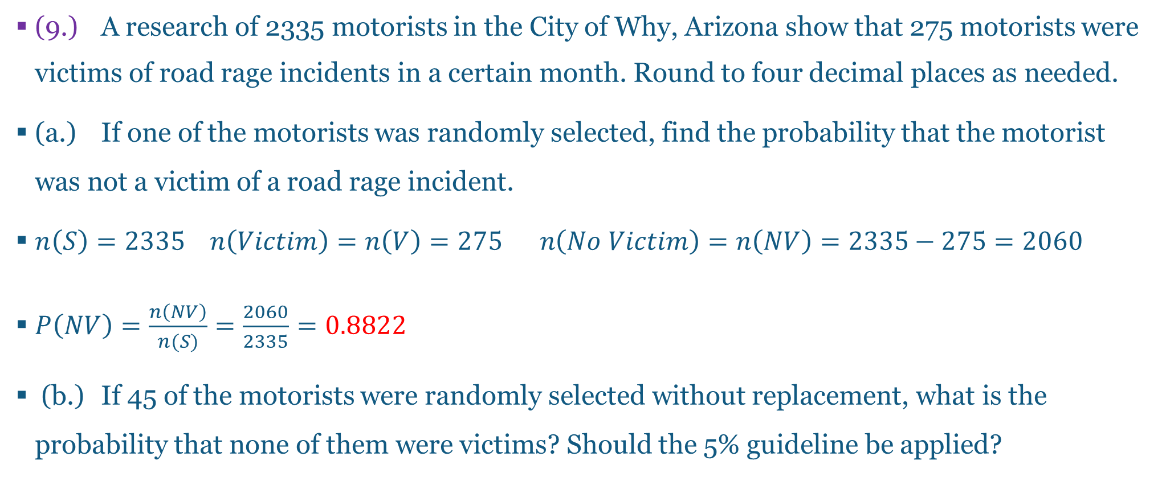
Questions and Answers 9-1.
(9.) A research of 2335 motorists in the City of Why, Arizona show that 275 motorists were victims of road rage incidents in a certain month. Round to four decimal places as needed.
(a.) If one of the motorists was randomly selected, find the probability that the motorist was not a victim of a road rage incident.
$n\left(S\right)=2335 n\left(Victim\right)=n\left(V\right)=275 n\left(No Victim\right)=n\left(NV\right)=2335−275=2060$
$P\left(NV\right)=\frac{n\left(NV\right)}{n(S)}=\frac{2060}{2335}=0.8822$
(b.) If 45 of the motorists were randomly selected without replacement, what is the probability that none of them were victims? Should the 5% guideline be applied?

Slide 4
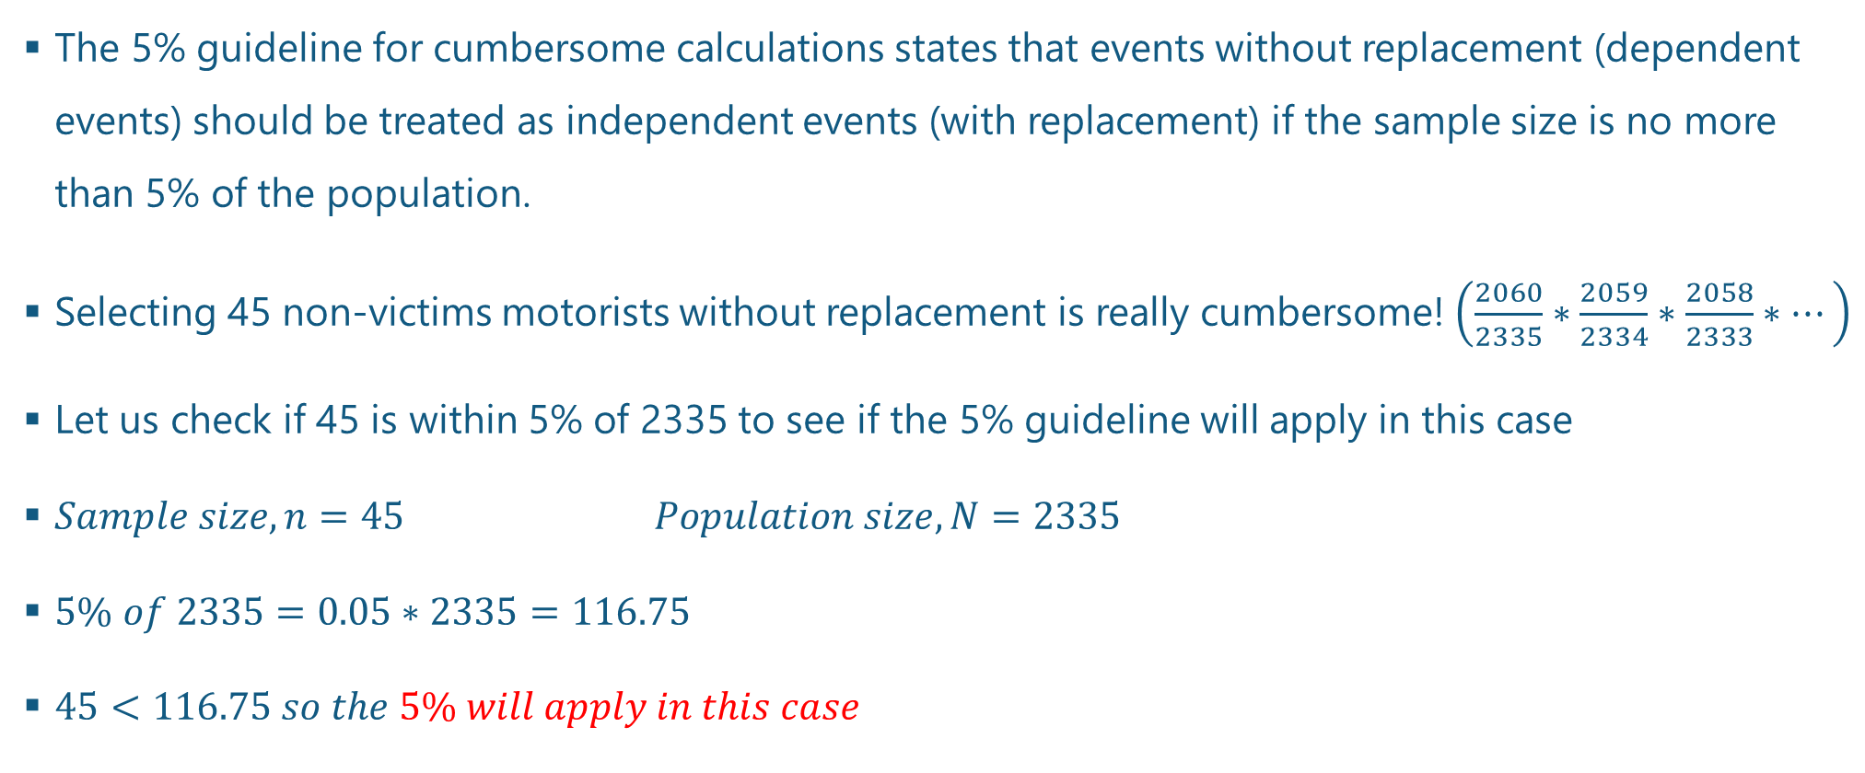
Questions and Answers 9-2.
The 5% guideline for cumbersome calculations states that events without replacement (dependent events) should be treated as independent events (with replacement) if the sample size is no more than 5% of the population.
Selecting 45 non-victims motorists without replacement is really cumbersome! $\left(\frac{2060}{2335}∗\frac{2059}{2334}∗\frac{2058}{2333}∗…\right)$
Let us check if 45 is within 5% of 2335 to see if the 5% guideline will apply in this case
$Sample size, n=45 Population size, N=2335$
$5\% of 2335=0.05∗2335=116.75$
$45<116.75 so the 5\% will apply in this case$

Slide 5

Questions and Answers 9-3.
This means that we shall treat the event as an independent event.
Selecting 45 non-victims motorists with replacement gives:
$P\left(NV\right)=\frac{n\left(NV\right)}{n(S)}=\frac{2060}{2335}∗\frac{2060}{2335}∗…∗\frac{2060}{2335}(45 times)={\left(\frac{2060}{2335}\right)}^{45}={\left(0.88222698\right)}^{45}=0.0036$

Slide 6
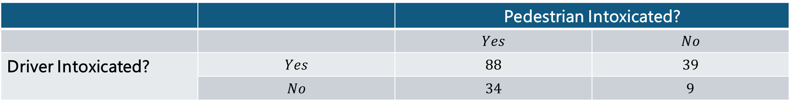
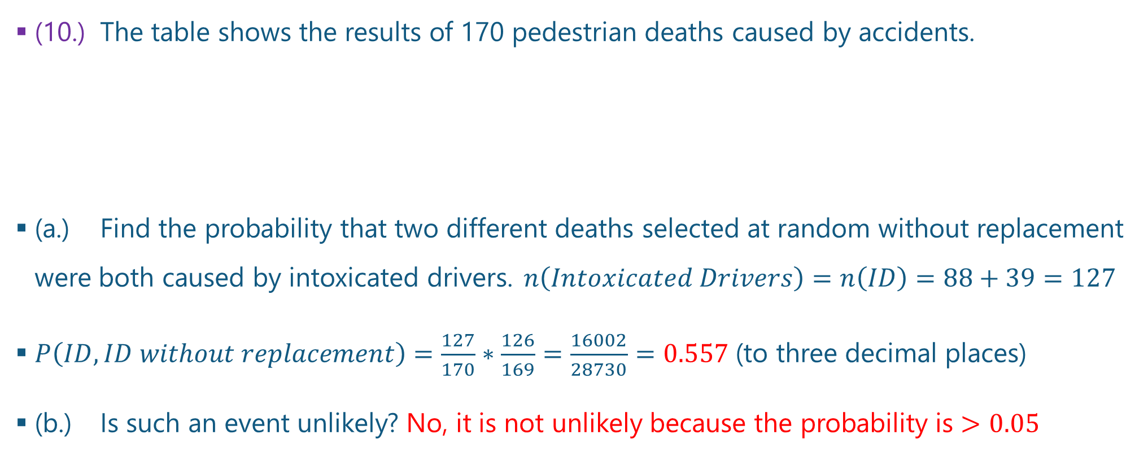
Questions and Answers 10-1.
(10.) The table shows the results of 170 pedestrian deaths caused by accidents.
(a.) Find the probability that two different deaths selected at random without replacement were both caused by intoxicated drivers. $n\left(Intoxicated Drivers\right)=n\left(ID\right)=88+39=127$
$P\left(ID, ID without replacement\right)=\frac{127}{170}∗\frac{126}{169}=\frac{16002}{28730}=0.557$ (to three decimal places)
(b.) Is such an event unlikely? No, it is not unlikely because the probability is $>0.05$
 |  | Pedestrian Intoxicated?
 |  | $$Yes$$ | $$No$$
Driver Intoxicated? | $$Yes$$ | $$88$$ | $$39$$
 | $$No$$ | $$34$$ | $$9$$

Slide 7
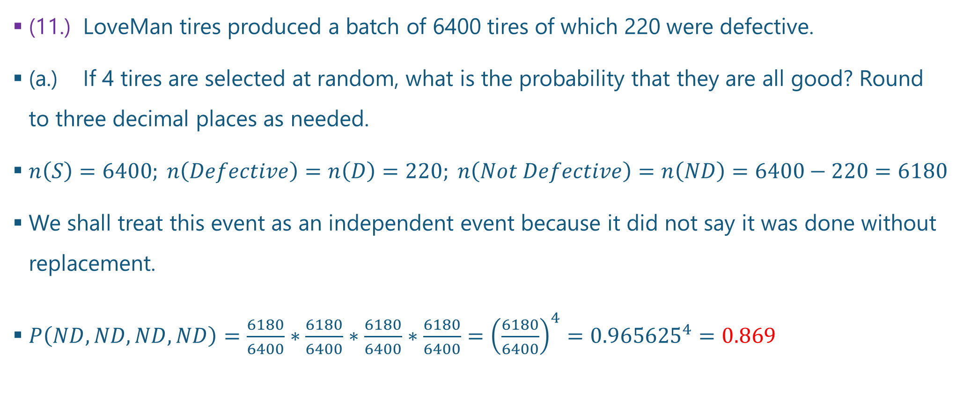
Questions and Answers 11-1.
(11.) LoveMan tires produced a batch of 6400 tires of which 220 were defective.
(a.) If 4 tires are selected at random, what is the probability that they are all good? Round to three decimal places as needed.
$n\left(S\right)=6400; n\left(Defective\right)=n\left(D\right)=220; n\left(Not Defective\right)=n\left(ND\right)=6400−220=6180$
We shall treat this event as an independent event because it did not say it was done without replacement.
$P\left(ND, ND, ND, ND\right)=\frac{6180}{6400}∗\frac{6180}{6400}∗\frac{6180}{6400}∗\frac{6180}{6400}={\left(\frac{6180}{6400}\right)}^{4}={0.965625}^{4}=0.869$

Slide 8
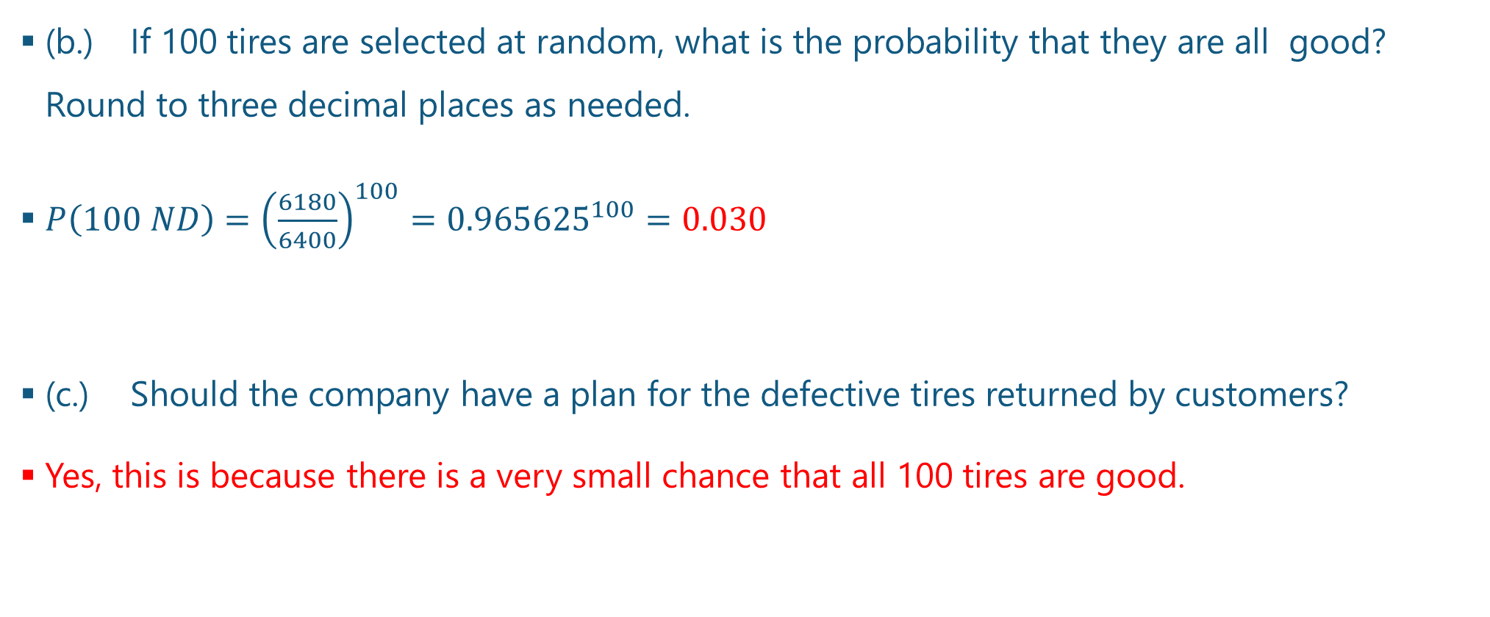
Questions and Answers 11-2.
(b.) If 100 tires are selected at random, what is the probability that they are all good? Round to three decimal places as needed.
$P\left(100 ND\right)={\left(\frac{6180}{6400}\right)}^{100}={0.965625}^{100}=0.030$
(c.) Should the company have a plan for the defective tires returned by customers?
Yes, this is because there is a very small chance that all 100 tires are good.

Slide 9
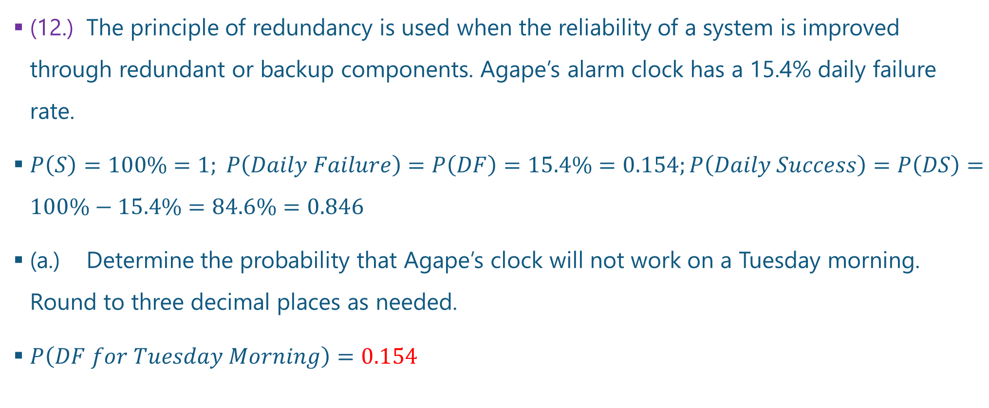
Questions and Answers 12-1.
(12.) The principle of redundancy is used when the reliability of a system is improved through redundant or backup components. Agape’s alarm clock has a 15.4% daily failure rate.
$P\left(S\right)=100\%=1; P\left(Daily Failure\right)=P\left(DF\right)=15.4\%=0.154;P\left(Daily Success\right)=P\left(DS\right)=100\%−15.4\%=84.6\%=0.846$
(a.) Determine the probability that Agape’s clock will not work on a Tuesday morning. Round to three decimal places as needed.
$P\left(DF for Tuesday Morning\right)=0.154$

Slide 10
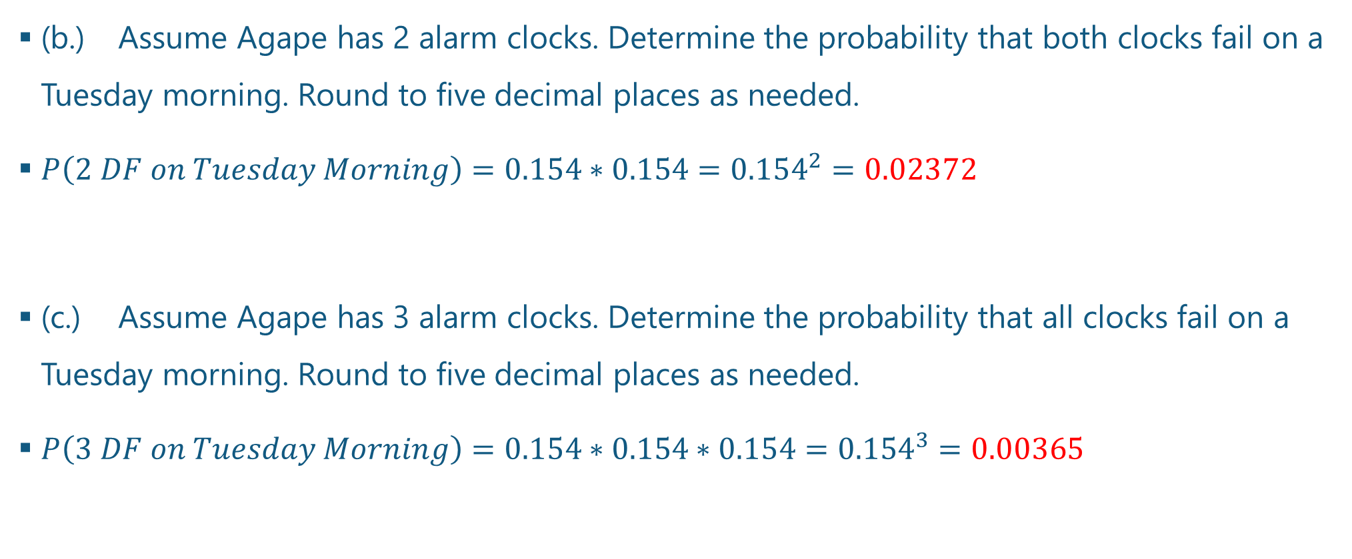
Questions and Answers 12-2.
(b.) Assume Agape has 2 alarm clocks. Determine the probability that both clocks fail on a Tuesday morning. Round to five decimal places as needed.
$P\left(2 DF on Tuesday Morning\right)=0.154∗0.154={0.154}^{2}=0.02372$
(c.) Assume Agape has 3 alarm clocks. Determine the probability that all clocks fail on a Tuesday morning. Round to five decimal places as needed.
$P\left(3 DF on Tuesday Morning\right)=0.154∗0.154∗0.154={0.154}^{3}=0.00365$

Slide 11
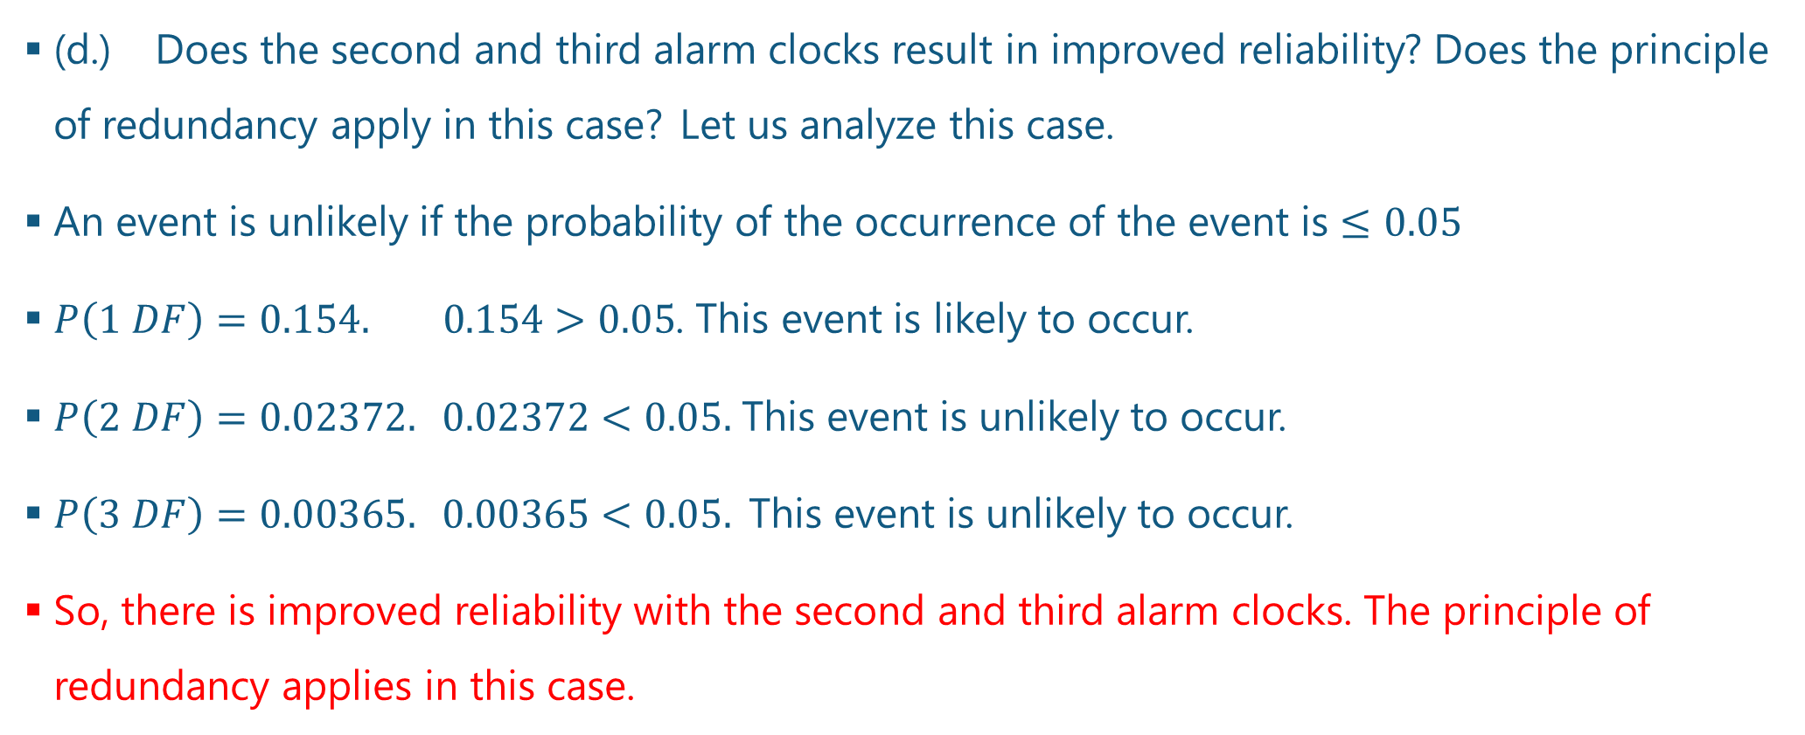
Questions and Answers 12-3.
(d.) Does the second and third alarm clocks result in improved reliability? Does the principle of redundancy apply in this case? Let us analyze this case.
An event is unlikely if the probability of the occurrence of the event is $≤0.05$
$P\left(1 DF\right)=0.154. 0.154>0.05$. This event is likely to occur.
$P\left(2 DF\right)=0.02372. 0.02372<0.05.$ This event is unlikely to occur.
$P\left(3 DF\right)=0.00365. 0.00365<0.05.$This event is unlikely to occur.
So, there is improved reliability with the second and third alarm clocks. The principle of redundancy applies in this case.

Slide 12
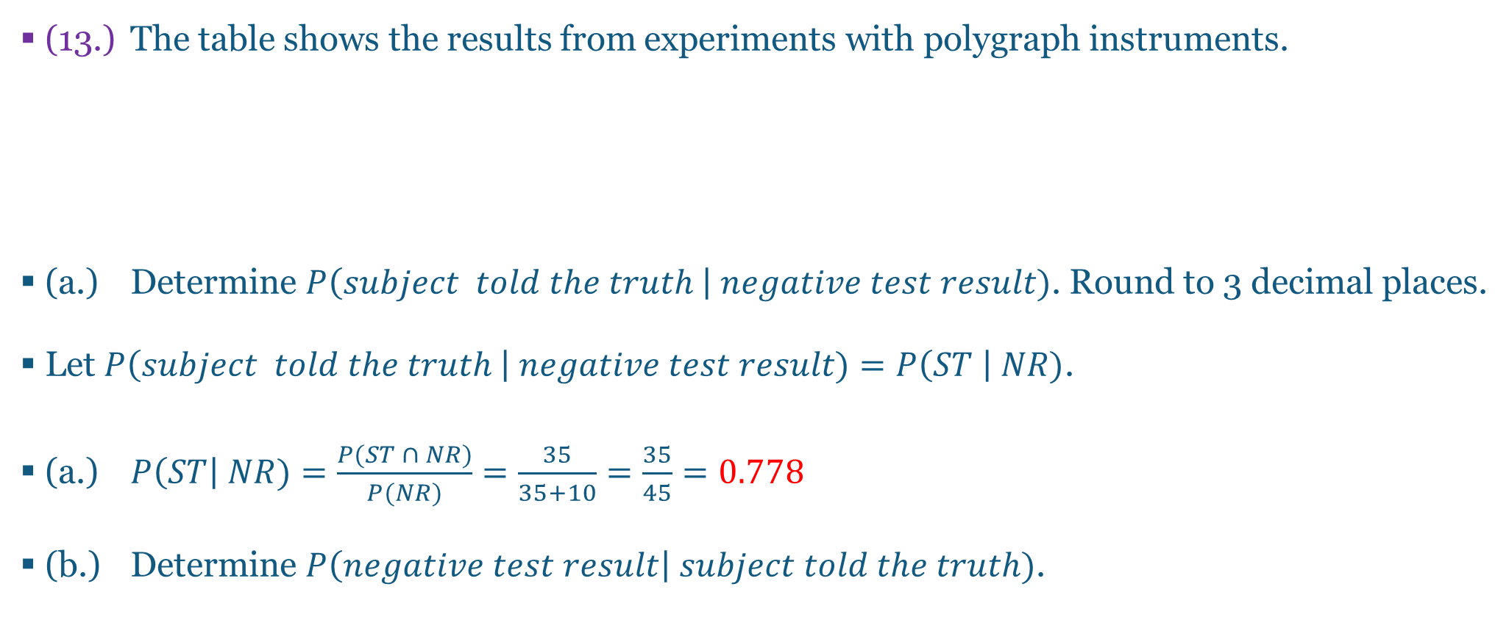
Questions and Answers 13-1.
(13.) The table shows the results from experiments with polygraph instruments.
(a.) Determine $P\left(subject told the truth \right| negative test result)$. Round to 3 decimal places.
Let $P\left(subject told the truth \right| negative test result)=P\left(ST \right| NR)$.
(a.) $P\left(ST\right| NR)=\frac{P(ST ∩ NR)}{P(NR)}=\frac{35}{35+10}=\frac{35}{45}=0.778$
(b.) Determine $P\left(negative test result\right| subject told the truth)$.
 | Did the Subject Actually Lie?
 | No (Did Not Lie) | Yes (Lied)
Positive test results | 15 | 44
Negative test results | 35 | 10

Slide 13
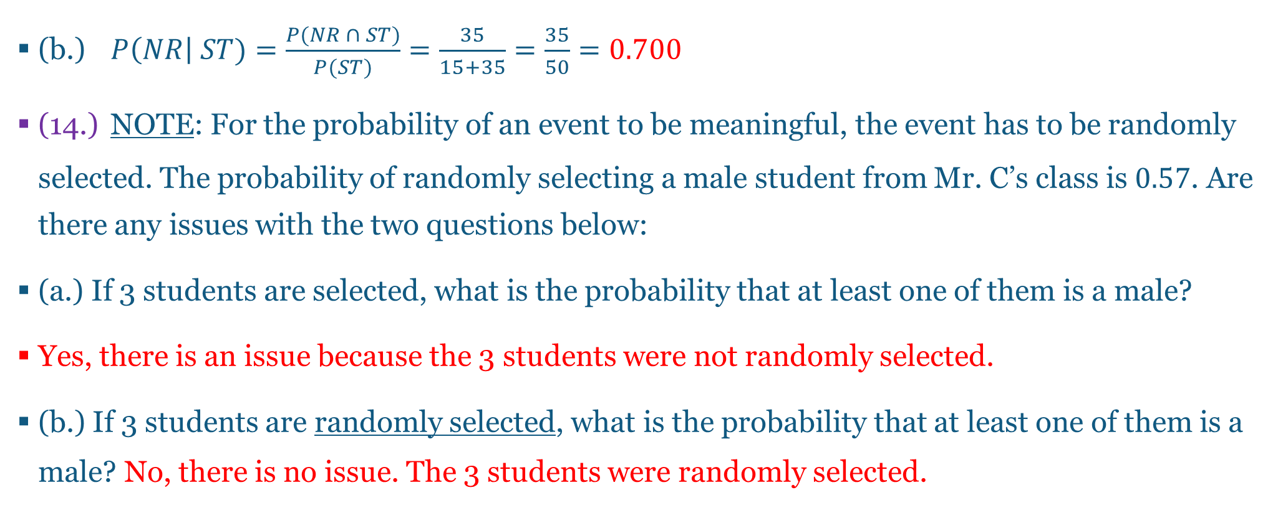
Questions and Answers 13-2 & 14.
(b.) $P\left(NR\right| ST)=\frac{P(NR ∩ ST)}{P(ST)}=\frac{35}{15+35}=\frac{35}{50}=0.700$
(14.) NOTE: For the probability of an event to be meaningful, the event has to be randomly selected. The probability of randomly selecting a male student from Mr. C’s class is $0.57$. Are there any issues with the two questions below:
(a.) If 3 students are selected, what is the probability that at least one of them is a male?
Yes, there is an issue because the 3 students were not randomly selected.
(b.) If 3 students are randomly selected, what is the probability that at least one of them is a male? No, there is no issue. The 3 students were randomly selected.

Slide 14
Questions and Answers 15-1.
(15.) Identical twins come from a single egg that split into two embryos. Fraternal twins come from separate fertilized eggs. In addition, identical twins must be of the same sex, but fraternal twins may be of same sex or opposite sex. However, both sexes of identical and fraternal twins are equally likely. A table showing the sexes of those twins is shown.
(a.) A pregnant woman is expected to have twins. Determine the probability that she will have identical twins.
Sexes of Twins
 | boy/boy | boy/girl | girl/boy | girl/girl
Identical Twins | $$6$$ | $$0$$ | $$0$$ | $$6$$
Fraternal Twins | $$7$$ | $$7$$ | $$7$$ | $$7$$

Slide 15
Questions and Answers 15-2.
$Let Identical Twins=IDTW and Fraternal Twins=FRTW$
$n\left(IDTW\right)=6+6=12 n\left(FRTW\right)=7+7+7+7=28 n\left(S\right)=12+28=40$
(a.) $P\left(IDTW\right)=\frac{n\left(IDTW\right)}{n(S)}=\frac{12}{40}=\frac{3}{10}$
(b.) Determine the probability that she will have identical twins given that the twins are boys.
$P\left(IDTW \right| boy/boy)=\frac{n\left(IDTW ∩ boy−boy\right)}{n\left(boy−boy\right)}=\frac{6}{6+7}=\frac{6}{13}$

Slide 16
Questions and Answers 15-3.
(c.) The pregnant woman was told she would have fraternal twins. Determine the probability that she will have one child of each sex.
In other words, determine the probability that the pregnant woman will have twins of opposite sex given that they are fraternal twins.
Fraternal twins of opposite sex could be boy/girl or girl/boy
$P\left(twins of opposite sex | FRTW\right)=\frac{n\left(twins of opposite sex ∩ FRTW\right)}{n(FRTW)}=\frac{7+7}{28}=\frac{14}{28}=\frac{1}{2}$

Slide 17
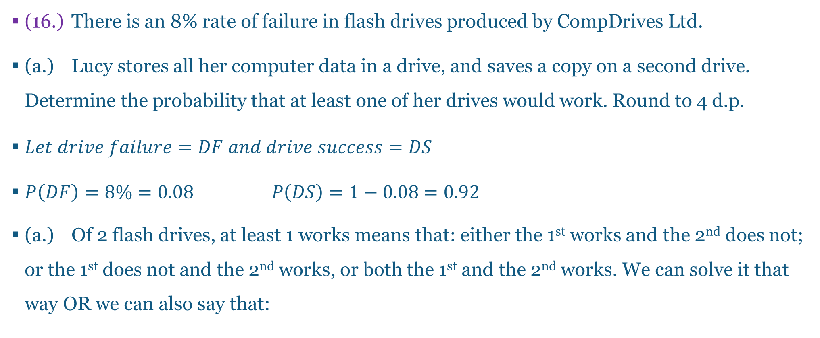
Questions and Answers 16-1.
(16.) There is an 8% rate of failure in flash drives produced by CompDrives Ltd.
(a.) Lucy stores all her computer data in a drive, and saves a copy on a second drive. Determine the probability that at least one of her drives would work. Round to 4 d.p.
$Let drive failure=DF and drive success=DS$
$P\left(DF\right)=8\%=0.08 P\left(DS\right)=1−0.08=0.92$
(a.) Of 2 flash drives, at least 1 works means that: either the 1st works and the 2nd does not; or the 1st does not and the 2nd works, or both the 1st and the 2nd works. We can solve it that way OR we can also say that:

Slide 18
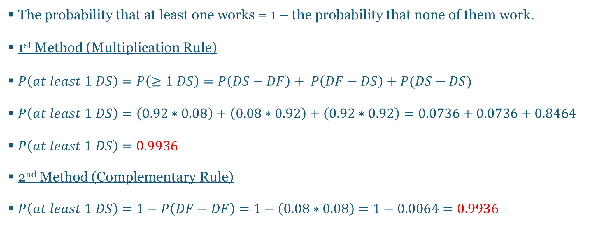
Questions and Answers 16-2.
The probability that at least one works = 1 – the probability that none of them work.
1st Method (Multiplication Rule)
$P\left(at least 1 DS\right)=P\left(≥1 DS\right)=P\left(DS−DF\right)+ P\left(DF−DS\right)+P(DS−DS)$
$P\left(at least 1 DS\right)=\left(0.92∗0.08\right)+\left(0.08∗0.92\right)+\left(0.92∗0.92\right)=0.0736+0.0736+0.8464$
$P\left(at least 1 DS\right)=0.9936$
2nd Method (Complementary Rule)
$P\left(at least 1 DS\right)=1−P\left(DF−DF\right)=1−\left(0.08∗0.08\right)=1−0.0064=0.9936$

Slide 19
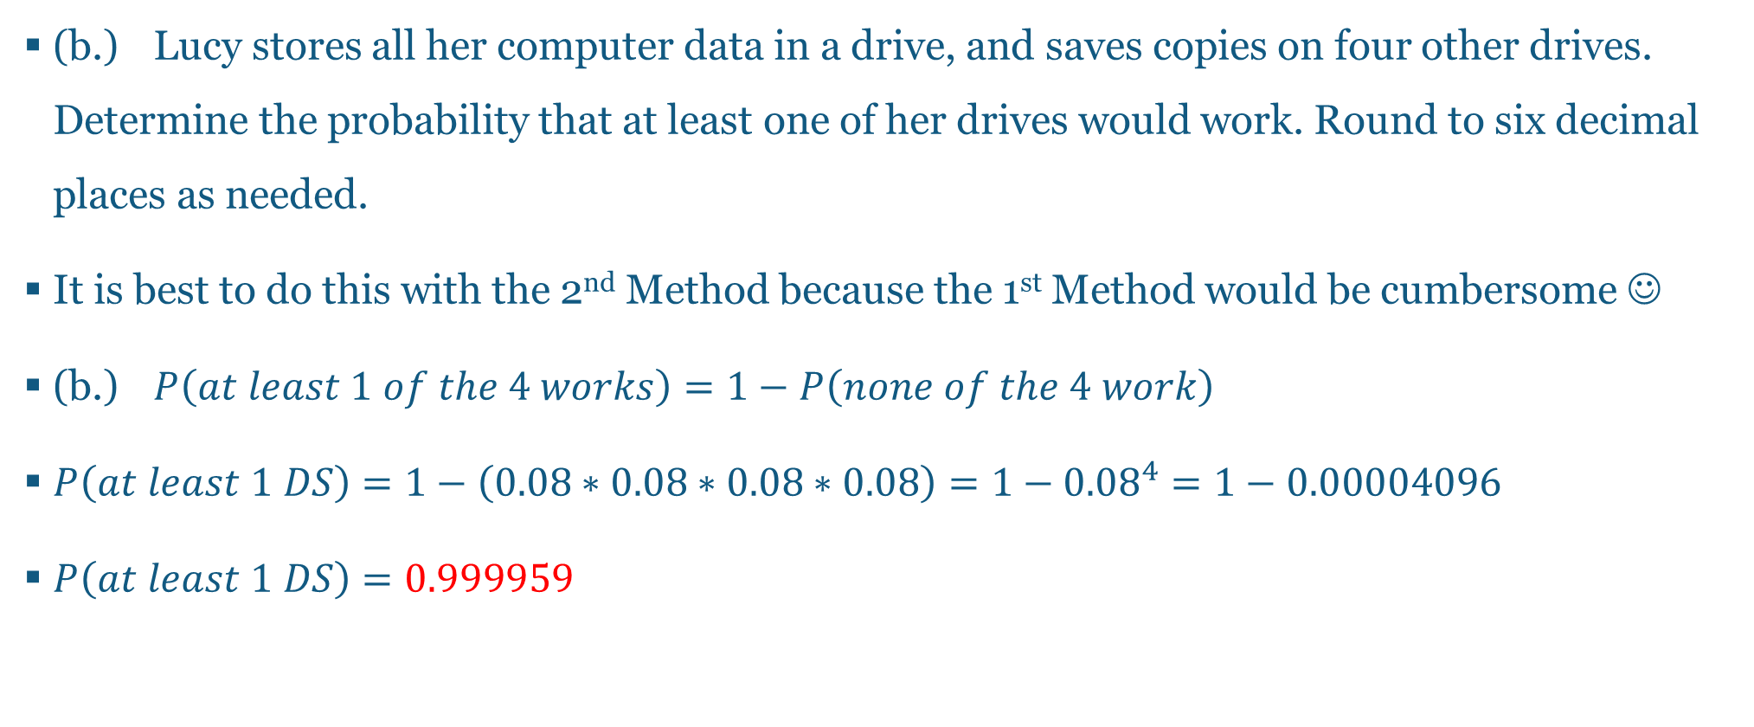
Questions and Answers 16-3.
(b.) Lucy stores all her computer data in a drive, and saves copies on four other drives. Determine the probability that at least one of her drives would work. Round to six decimal places as needed.
It is best to do this with the 2nd Method because the 1st Method would be cumbersome ☺
(b.) $P\left(at least 1 of the 4 works\right)=1−P\left(none of the 4 work\right)$
$P\left(at least 1 DS\right)=1−\left(0.08∗0.08∗0.08∗0.08\right)=1−{0.08}^{4}=1−0.00004096$
$P\left(at least 1 DS\right)=0.999959$

Slide 20
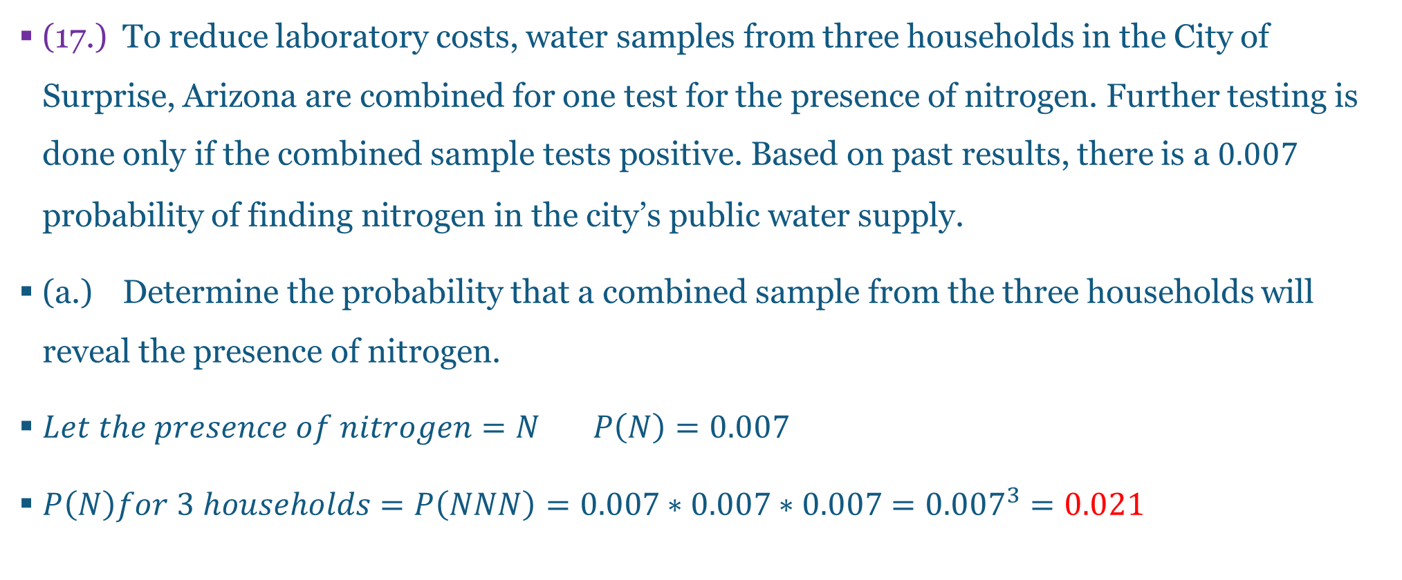
Questions and Answers 17-1.
(17.) To reduce laboratory costs, water samples from three households in the City of Surprise, Arizona are combined for one test for the presence of nitrogen. Further testing is done only if the combined sample tests positive. Based on past results, there is a $0.007$ probability of finding nitrogen in the city’s public water supply.
(a.) Determine the probability that a combined sample from the three households will reveal the presence of nitrogen.
$Let the presence of nitrogen=N P\left(N\right)=0.007$
$P\left(N\right)for 3 households=P\left(NNN\right)=0.007∗0.007∗0.007={0.007}^{3}=0.021$

Slide 21
Questions and Answers 17-2.
(b.) Is the probability low enough so that further testing of the individual samples is rarely needed?
Yes, the probability value is low enough to indicate that further testing of the individual samples will be rarely needed.

Slide 22
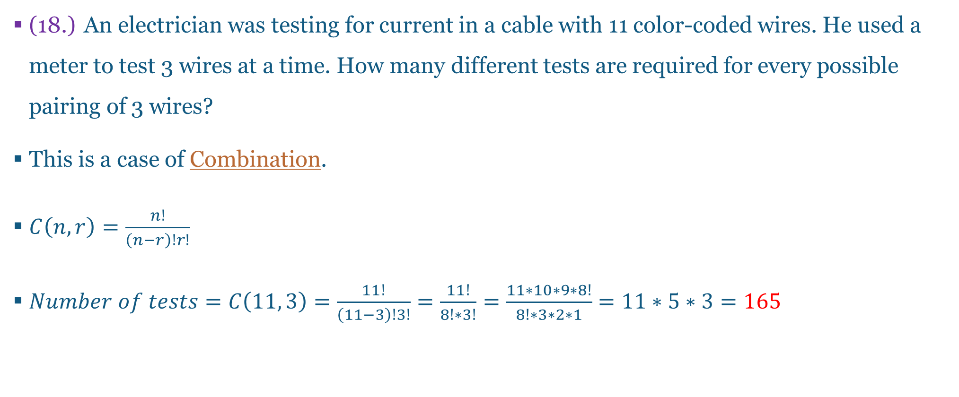
Questions and Answers 18-1.
(18.) An electrician was testing for current in a cable with 11 color-coded wires. He used a meter to test 3 wires at a time. How many different tests are required for every possible pairing of 3 wires?
This is a case of Combination.
$C\left(n, r\right)=\frac{n!}{\left(n−r\right)!r!}$
$Number of tests=C\left(11, 3\right)=\frac{11!}{\left(11−3\right)!3!}=\frac{11!}{8!∗3!}=\frac{11∗10∗9∗8!}{8!∗3∗2∗1}=11∗5∗3=165$

Slide 23
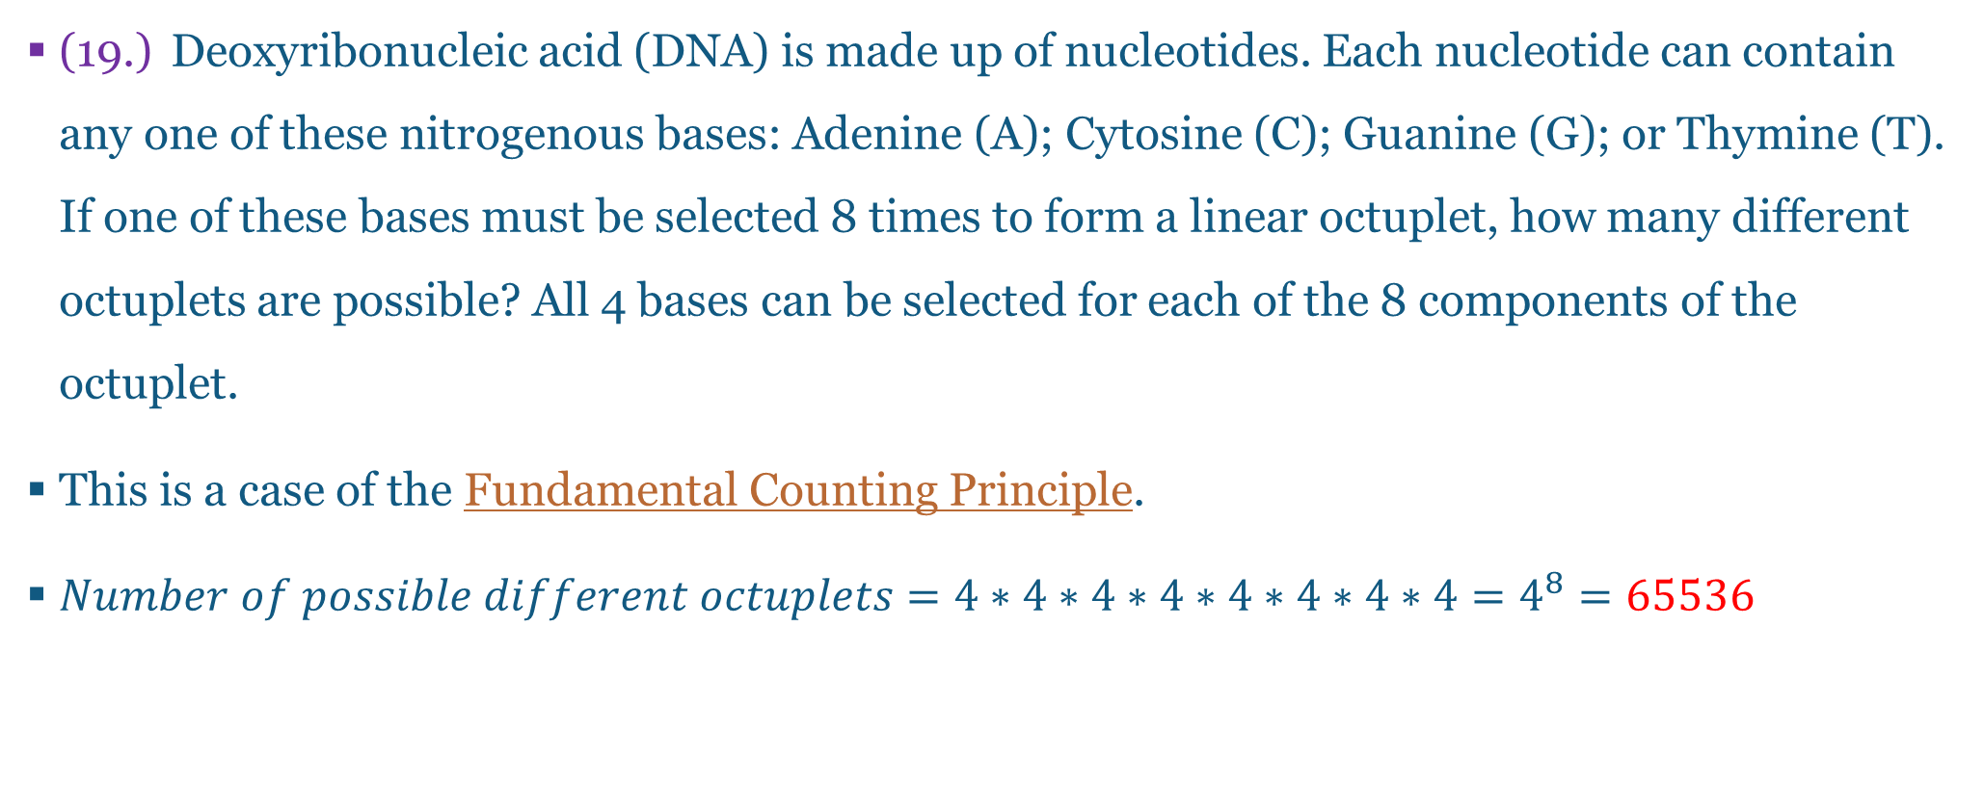
Questions and Answers 19-1.
(19.) Deoxyribonucleic acid (DNA) is made up of nucleotides. Each nucleotide can contain any one of these nitrogenous bases: Adenine (A); Cytosine (C); Guanine (G); or Thymine (T). If one of these bases must be selected 8 times to form a linear octuplet, how many different octuplets are possible? All 4 bases can be selected for each of the 8 components of the octuplet.
This is a case of the Fundamental Counting Principle.
$Number of possible different octuplets=4∗4∗4∗4∗4∗4∗4∗4=4^{8}=65536$

Slide 24
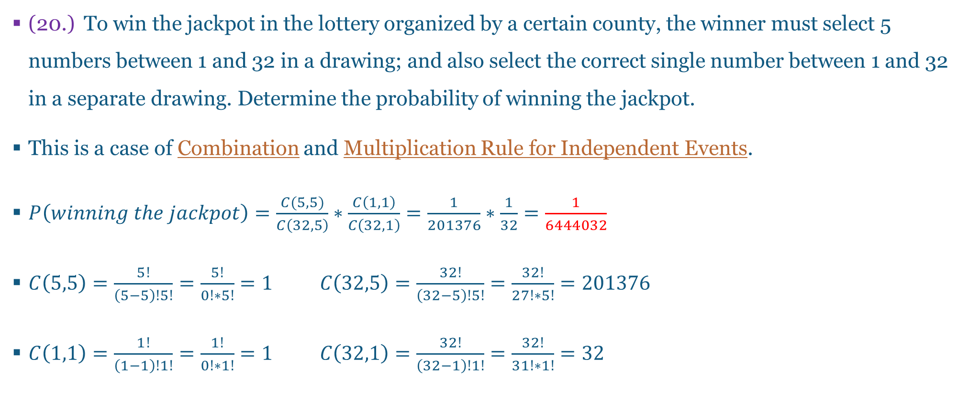
Questions and Answers 20-1.
(20.) To win the jackpot in the lottery organized by a certain county, the winner must select 5 numbers between 1 and 32 in a drawing; and also select the correct single number between 1 and 32 in a separate drawing. Determine the probability of winning the jackpot.
This is a case of Combination and Multiplication Rule for Independent Events.
$P\left(winning the jackpot\right)=\frac{C(5, 5)}{C\left(32, 5\right)}∗\frac{C\left(1, 1\right)}{C\left(32, 1\right)}=\frac{1}{201376}∗\frac{1}{32}=\frac{1}{6444032}$
$C\left(5,5\right)=\frac{5!}{\left(5−5\right)!5!}=\frac{5!}{0!∗5!}=1 C\left(32,5\right)=\frac{32!}{\left(32−5\right)!5!}=\frac{32!}{27!∗5!}=201376$
$C\left(1,1\right)=\frac{1!}{\left(1−1\right)!1!}=\frac{1!}{0!∗1!}=1 C\left(32,1\right)=\frac{32!}{\left(32−1\right)!1!}=\frac{32!}{31!∗1!}=32$

Slide 25
References
Chukwuemeka, S. D. (2016, February 22). Samuel Chukwuemeka Tutorials – Math, Science, and Technology. Retrieved from http://www.samuelchukwuemeka.com/
Triola, M. F. (2015). Frequency Distributions. In Elementary statistics using the TI-83/84 plus calculator (4th ed.). Pearson.

