Slide 1
Test 2 Study Guide – Part 3
Samuel Chukwuemeka B.Eng., A.A.T, M.Ed., M.S
“The Joy of a Teacher is the Success of his Students.” – Samuel Chukwuemeka
www.samuelchukwuemeka.com

Slide 2
Objectives and Pre-requisites
Students will:
Calculate the mean and standard deviation of a Binomial probability distribution.
Determine the probability of an event using a Binomial probability distribution.
Determine the probability of an event using a Poisson probability distribution.
Determine the expected value of a random variable.
Pre-requisite videos
Probability Distributions (all)
View the video for the verbal explanations.

Slide 3
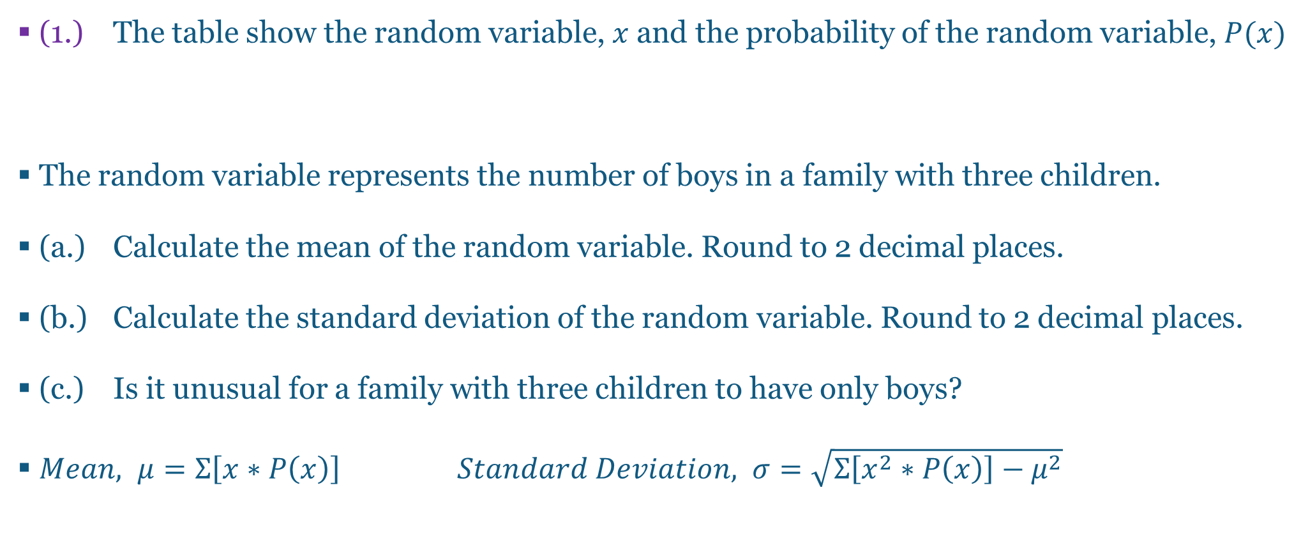
Questions and Answers 1-1.
(1.) The table show the random variable, $x$and the probability of the random variable, $P(x)$
The random variable represents the number of boys in a family with three children.
(a.) Calculate the mean of the random variable. Round to 2 decimal places.
(b.) Calculate the standard deviation of the random variable. Round to 2 decimal places.
(c.) Is it unusual for a family with three children to have only boys?
$Mean, μ=Σ\left[x∗P\left(x\right)\right] Standard Deviation, σ=\sqrt{Σ\left[x^{2}∗P\left(x\right)\right]−μ^{2}}$
$$x$$ | $$0$$ | $$1$$ | $$2$$ | $$3$$
$$P(x)$$ | $$0.141$$ | $$0.389$$ | $$0.359$$ | $$0.111$$

Slide 4
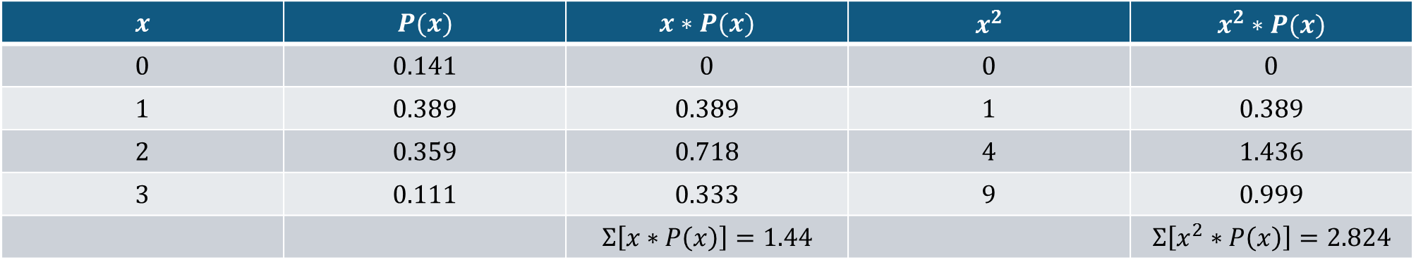

Questions and Answers 1-2.
$μ=Σ\left[x∗P\left(x\right)\right]=1.44$
$σ=\sqrt{Σ\left[x^{2}∗P\left(x\right)\right]−μ^{2}}=\sqrt{2.824−{1.44}^{2}}=\sqrt{2.824−2.0736}=\sqrt{0.7504}=0.87$
$P\left(3\right)=0.111>0.05$
Therefore, the probability of the family having only 3 boys is not unusual.
$$x$$ | $$P(x)$$ | $$x∗P(x)$$ | $$x^{2}$$ | $$x^{2}∗P(x)$$
$$0$$ | $$0.141$$ | $$0$$ | $$0$$ | $$0$$
$$1$$ | $$0.389$$ | $$0.389$$ | $$1$$ | $$0.389$$
$$2$$ | $$0.359$$ | $$0.718$$ | $$4$$ | $$1.436$$
$$3$$ | $$0.111$$ | $$0.333$$ | $$9$$ | $$0.999$$
 |  | $$Σ\left[x∗P\left(x\right)\right]=1.44$$ |  | $$Σ\left[x^{2}∗P\left(x\right)\right]=2.824$$

Slide 5
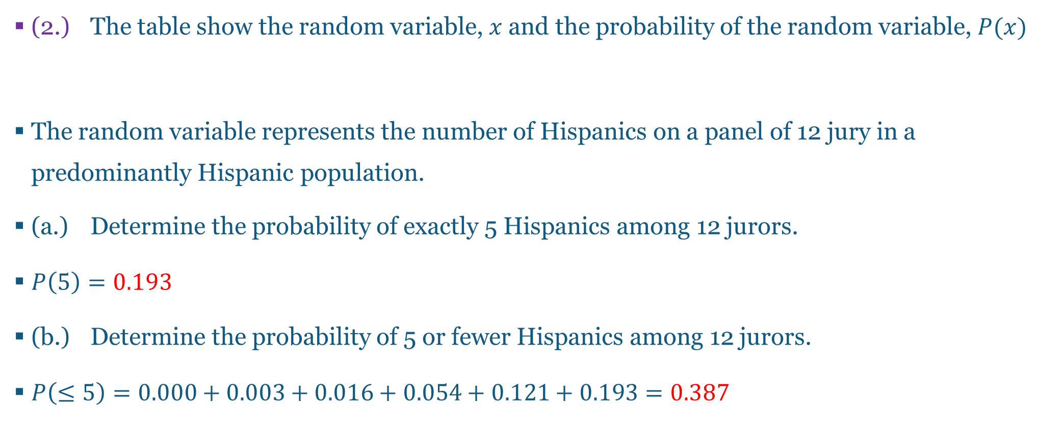
Questions and Answers 2-1.
(2.) The table show the random variable, $x$and the probability of the random variable, $P(x)$
The random variable represents the number of Hispanics on a panel of 12 jury in a predominantly Hispanic population.
(a.) Determine the probability of exactly 5 Hispanics among 12 jurors.
$P\left(5\right)=0.193$
(b.) Determine the probability of 5 or fewer Hispanics among 12 jurors.
$P\left(≤5\right)=0.000+0.003+0.016+0.054+0.121+0.193=0.387$
$$x$$ | $$0$$ | $$1$$ | $$2$$ | $$3$$ | $$4$$ | $$5$$ | $$6$$ | $$7$$ | $$8$$ | $$9$$ | $$10$$ | $$11$$ | $$12$$
$$P(x)$$ | $$0.000$$ | $$0.003$$ | $$0.016$$ | $$0.054$$ | $$0.121$$ | $$0.193$$ | $$0.226$$ | $$0.193$$ | $$0.121$$ | $$0.054$$ | $$0.016$$ | $$0.003$$ | $$0.000$$

Slide 6
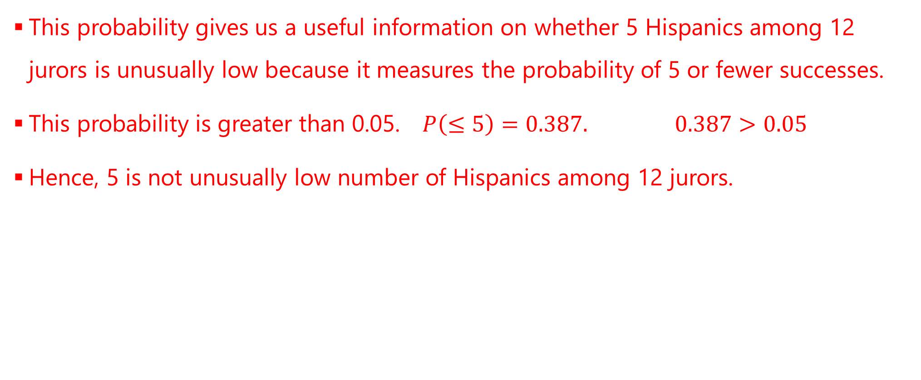
Questions and Answers 2-2.
This probability gives us a useful information on whether 5 Hispanics among 12 jurors is unusually low because it measures the probability of 5 or fewer successes.
This probability is greater than 0.05. $P\left(≤5\right)=0.387. 0.387>0.05$
Hence, 5 is not unusually low number of Hispanics among 12 jurors.

Slide 7
Questions and Answers 3-1.
(3.) If Cardano picks a sequence of three digits from the numbers 0 through 9 in a lottery game, he will pay $1.35. (He has to pay $1.35 to play the game. ) If he picks the same sequence of three digits in a drawing, he will win $487.64.
(a.) How many different selections are possible?
This is a case of the Fundamental Counting Principle where those numbers can be picked with repetition. If it cannot be picked without repetition, the question will specify such condition.
0 through 9 consists of 10 digits

Slide 8
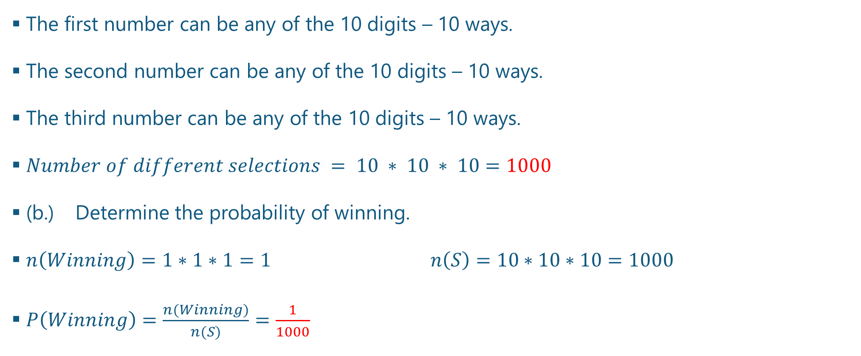
Questions and Answers 3-2.
The first number can be any of the 10 digits – 10 ways.
The second number can be any of the 10 digits – 10 ways.
The third number can be any of the 10 digits – 10 ways.
$Number of different selections = 10 ∗ 10 ∗ 10=1000$
(b.) Determine the probability of winning.
$n\left(Winning\right)=1∗1∗1=1 n\left(S\right)=10∗10∗10=1000$
$P\left(Winning\right)=\frac{n(Winning)}{n(S)}=\frac{1}{1000}$

Slide 9
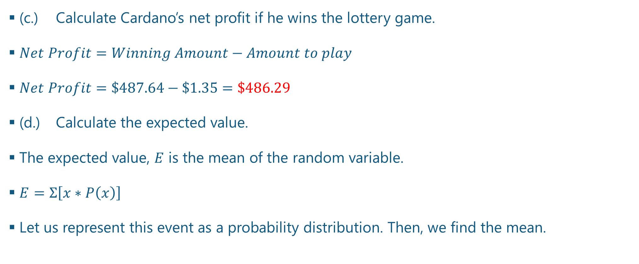
Questions and Answers 3-3.
(c.) Calculate Cardano’s net profit if he wins the lottery game.
$Net Profit=Winning Amount−Amount to play$
$Net Profit=\$487.64−\$1.35=\$486.29$
(d.) Calculate the expected value.
The expected value, $E$ is the mean of the random variable.
$E=Σ\left[x∗P\left(x\right)\right]$
Let us represent this event as a probability distribution. Then, we find the mean.

Slide 10
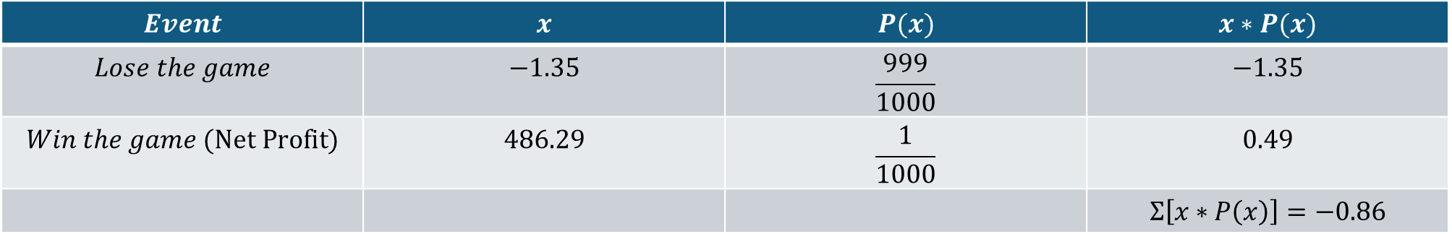

Questions and Answers 3-4.
$E=Σ\left[x∗P\left(x\right)\right]=−\$0.86$
$P\left(Winning\right)=\frac{1}{1000}$
$P\left(Losing\right)=1−P(Winning)$ Complementary Rule
$P\left(Losing\right)=1−\frac{1}{1000}=\frac{1000}{1000}−\frac{1}{1000}=\frac{1000−1}{1000}=\frac{999}{1000}$
$$Event$$ | $$x$$ | $$P(x)$$ | $$x∗P(x)$$
$$Lose the game$$ | $$−1.35$$ | $$\frac{999}{1000}$$ | $$−1.35$$
$$Win the game (Net Profit)$$ | $$486.29$$ | $$\frac{1}{1000}$$ | $$0.49$$
 |  |  | $$Σ\left[x∗P\left(x\right)\right]=−0.86$$

Slide 11
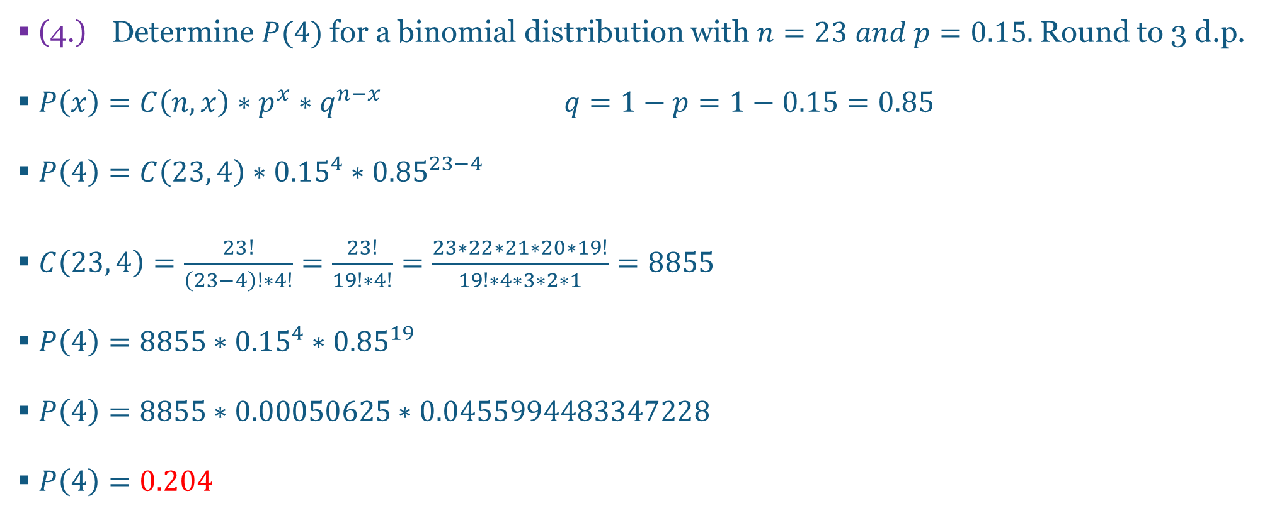
Questions and Answers 4-1.
(4.) Determine $P(4)$ for a binomial distribution with $n=23 and p=0.15.$ Round to 3 d.p.
$P\left(x\right)=C\left(n, x\right)∗p^{x}∗q^{n−x} q=1−p=1−0.15=0.85$
$P\left(4\right)=C\left(23, 4\right)∗{0.15}^{4}∗{0.85}^{23−4}$
$C\left(23, 4\right)=\frac{23!}{\left(23−4\right)!∗4!}=\frac{23!}{19!∗4!}=\frac{23∗22∗21∗20∗19!}{19!∗4∗3∗2∗1}=8855$
$P\left(4\right)=8855∗{0.15}^{4}∗{0.85}^{19}$
$P\left(4\right)=8855∗0.00050625∗0.0455994483347228$
$P\left(4\right)=0.204$

Slide 12
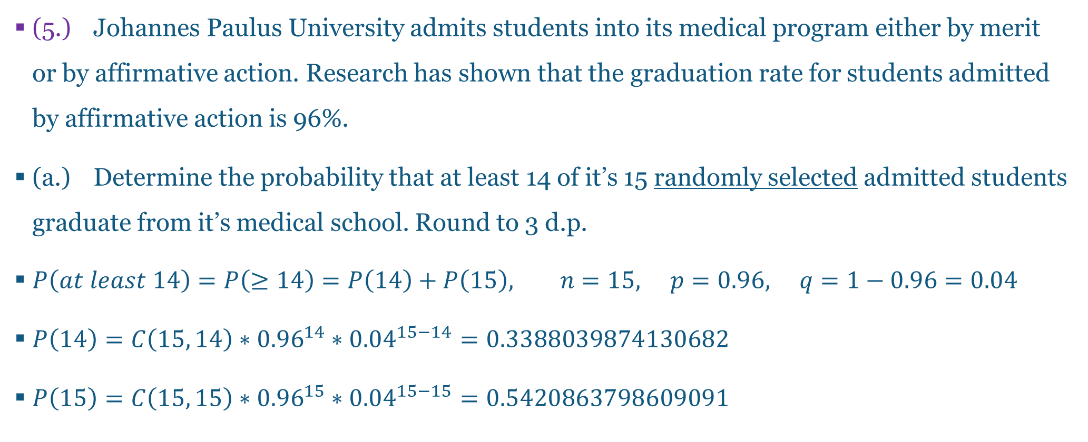
Questions and Answers 5-1.
(5.) Johannes Paulus University admits students into its medical program either by merit or by affirmative action. Research has shown that the graduation rate for students admitted by affirmative action is 96%.
(a.) Determine the probability that at least 14 of it’s 15 randomly selected admitted students graduate from it’s medical school. Round to 3 d.p.
$P\left(at least 14\right)=P\left(≥14\right)=P\left(14\right)+P\left(15\right), n=15, p=0.96, q=1−0.96=0.04$
$P\left(14\right)=C\left(15, 14\right)∗{0.96}^{14}∗{0.04}^{15−14}=0.3388039874130682$
$P\left(15\right)=C\left(15, 15\right)∗{0.96}^{15}∗{0.04}^{15−15}=0.5420863798609091$

Slide 13
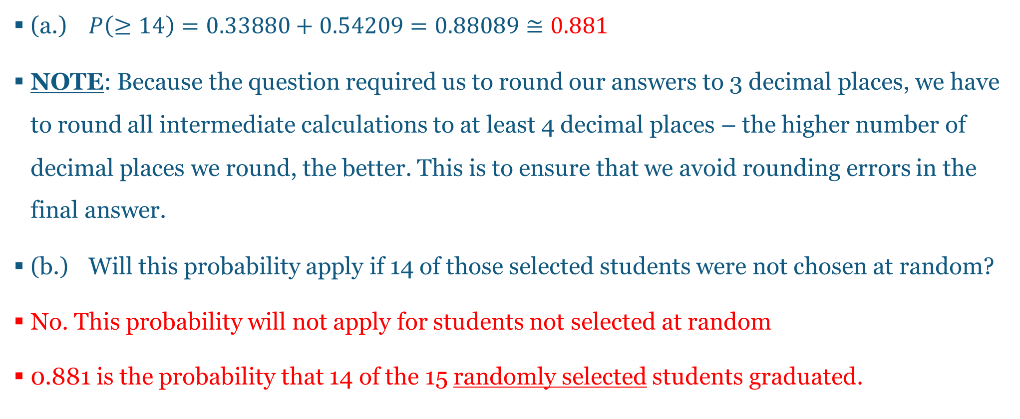
Questions and Answers 5-2.
(a.) $P\left(≥14\right)=0.33880+0.54209=0.88089≅0.881$
NOTE: Because the question required us to round our answers to 3 decimal places, we have to round all intermediate calculations to at least 4 decimal places – the higher number of decimal places we round, the better. This is to ensure that we avoid rounding errors in the final answer.
(b.) Will this probability apply if 14 of those selected students were not chosen at random?
No. This probability will not apply for students not selected at random
0.881 is the probability that 14 of the 15 randomly selected students graduated.

Slide 14
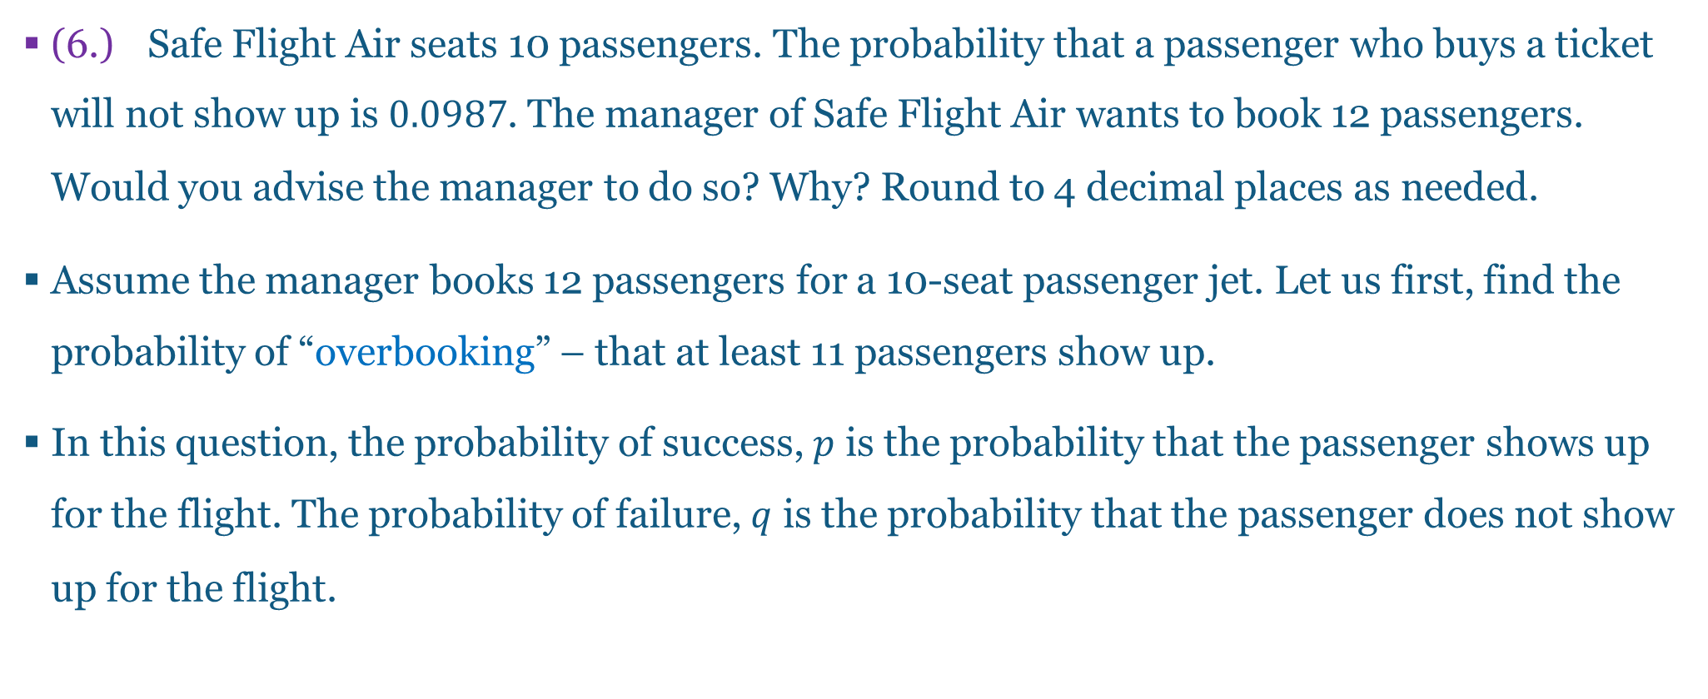
Questions and Answers 6-1.
(6.) Safe Flight Air seats 10 passengers. The probability that a passenger who buys a ticket will not show up is $0.0987$. The manager of Safe Flight Air wants to book 12 passengers. Would you advise the manager to do so? Why? Round to 4 decimal places as needed.
Assume the manager books 12 passengers for a 10-seat passenger jet. Let us first, find the probability of “overbooking” – that at least 11 passengers show up.
In this question, the probability of success, $p$ is the probability that the passenger shows up for the flight. The probability of failure, $q$ is the probability that the passenger does not show up for the flight.

Slide 15
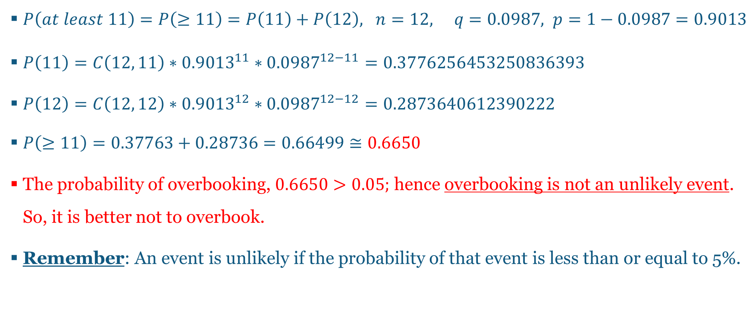
Questions and Answers 6-2.
$P\left(at least 11\right)=P\left(≥11\right)=P\left(11\right)+P\left(12\right), n=12, q=0.0987, p=1−0.0987=0.9013$
$P\left(11\right)=C\left(12, 11\right)∗{0.9013}^{11}∗{0.0987}^{12−11}=0.3776256453250836393$
$P\left(12\right)=C\left(12, 12\right)∗{0.9013}^{12}∗{0.0987}^{12−12}=0.2873640612390222$
$P\left(≥11\right)=0.37763+0.28736=0.66499≅0.6650$
The probability of overbooking, $0.6650>0.05;$ hence overbooking is not an unlikely event. So, it is better not to overbook.
Remember: An event is unlikely if the probability of that event is less than or equal to 5%.

Slide 16
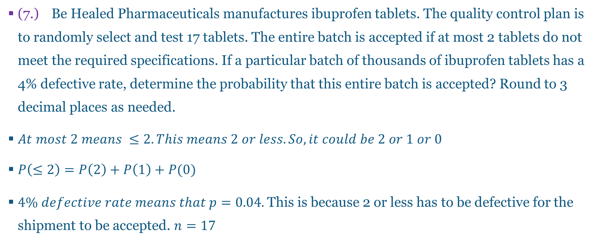
Questions and Answers 7-1.
(7.) Be Healed Pharmaceuticals manufactures ibuprofen tablets. The quality control plan is to randomly select and test 17 tablets. The entire batch is accepted if at most 2 tablets do not meet the required specifications. If a particular batch of thousands of ibuprofen tablets has a 4% defective rate, determine the probability that this entire batch is accepted? Round to 3 decimal places as needed.
$At most 2 means ≤2. This means 2 or less. So, it could be 2 or 1 or 0$
$P\left(≤2\right)=P\left(2\right)+P\left(1\right)+P(0)$
$4\% defective rate means that p=0.04.$ This is because 2 or less has to be defective for the shipment to be accepted. $n=17$

Slide 17
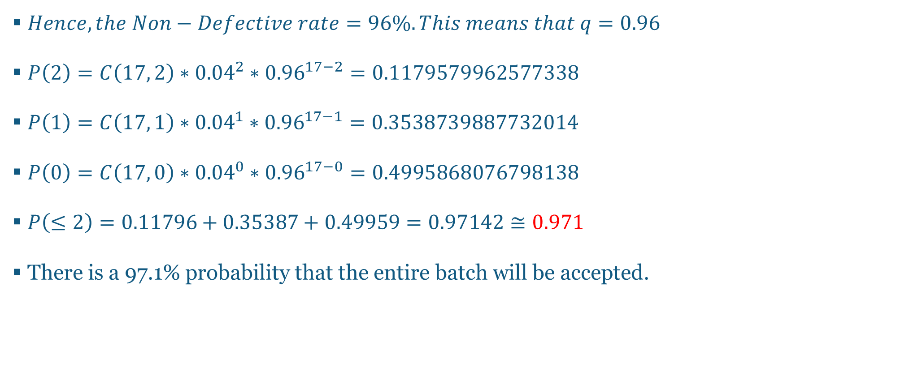
Questions and Answers 7-2.
$Hence, the Non−Defective rate=96\%. This means that q=0.96$
$P\left(2\right)=C\left(17, 2\right)∗{0.04}^{2}∗{0.96}^{17−2}=0.1179579962577338$
$P\left(1\right)=C\left(17, 1\right)∗{0.04}^{1}∗{0.96}^{17−1}=0.3538739887732014$
$P\left(0\right)=C\left(17, 0\right)∗{0.04}^{0}∗{0.96}^{17−0}=0.4995868076798138$
$P\left(≤2\right)=0.11796+0.35387+0.49959=0.97142≅0.971$
There is a 97.1% probability that the entire batch will be accepted.

Slide 18
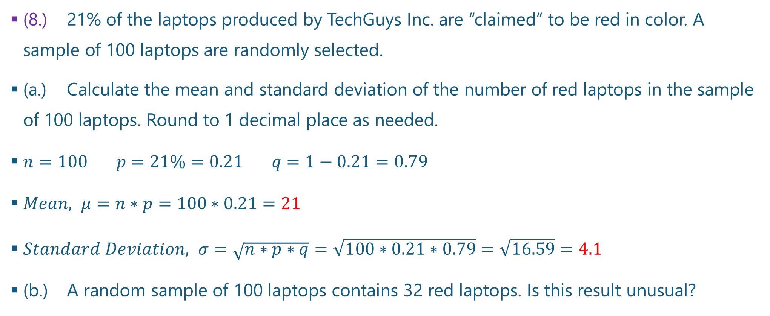
Questions and Answers 8-1.
(8.) 21% of the laptops produced by TechGuys Inc. are “claimed” to be red in color. A sample of 100 laptops are randomly selected.
(a.) Calculate the mean and standard deviation of the number of red laptops in the sample of 100 laptops. Round to 1 decimal place as needed.
$n=100 p=21\%=0.21 q=1−0.21=0.79$
$Mean, μ=n∗p=100∗0.21=21$
$Standard Deviation, σ=\sqrt{n∗p∗q}=\sqrt{100∗0.21∗0.79}=\sqrt{16.59}=4.1$
(b.) A random sample of 100 laptops contains 32 red laptops. Is this result unusual?

Slide 19
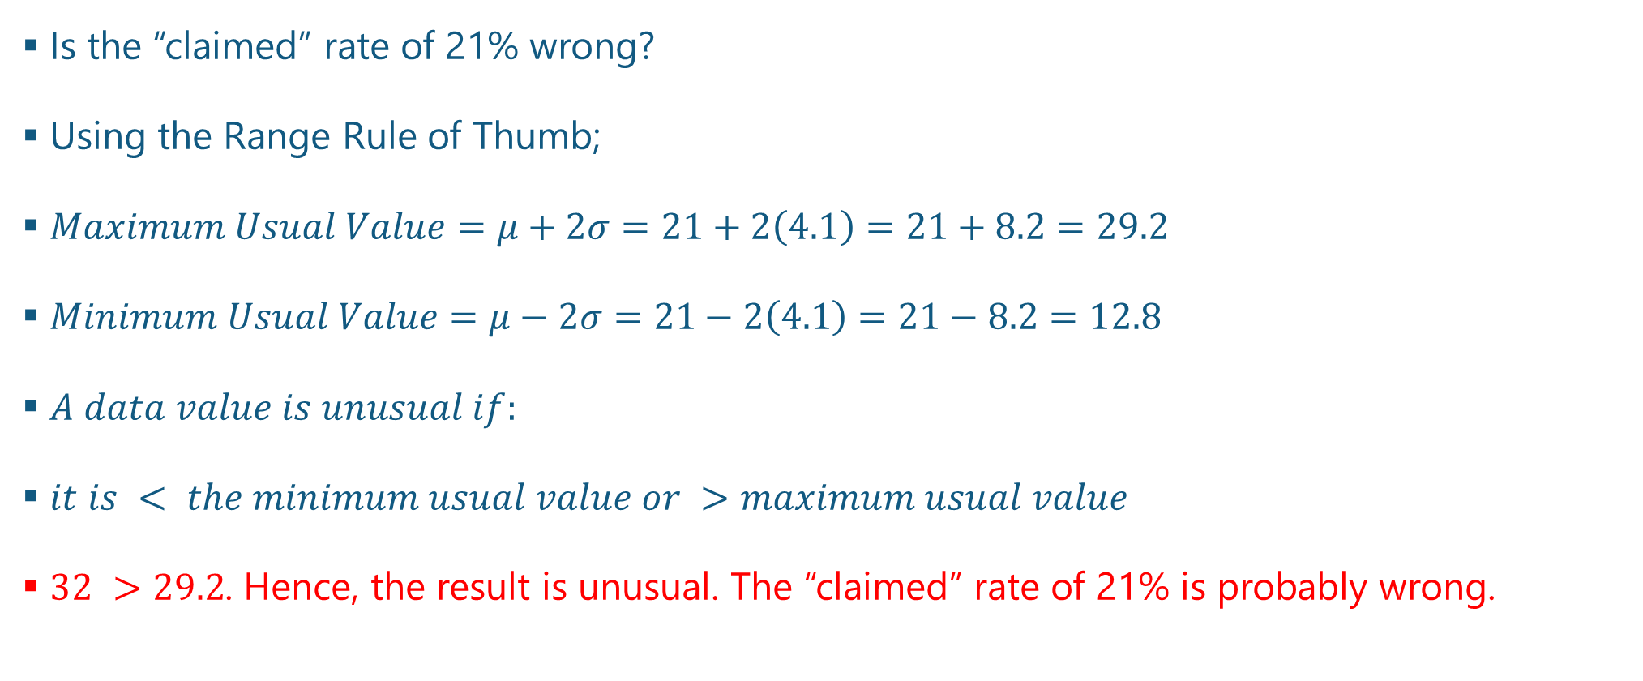
Questions and Answers 8-2.
Is the “claimed” rate of 21% wrong?
Using the Range Rule of Thumb;
$Maximum Usual Value=μ+2σ=21+2\left(4.1\right)=21+8.2=29.2$
$Minimum Usual Value=μ−2σ=21−2\left(4.1\right)=21−8.2=12.8$
$A data value is unusual if:$
$it is < the minimum usual value or >maximum usual value$
$32 >29.2$. Hence, the result is unusual. The “claimed” rate of 21% is probably wrong.

Slide 20
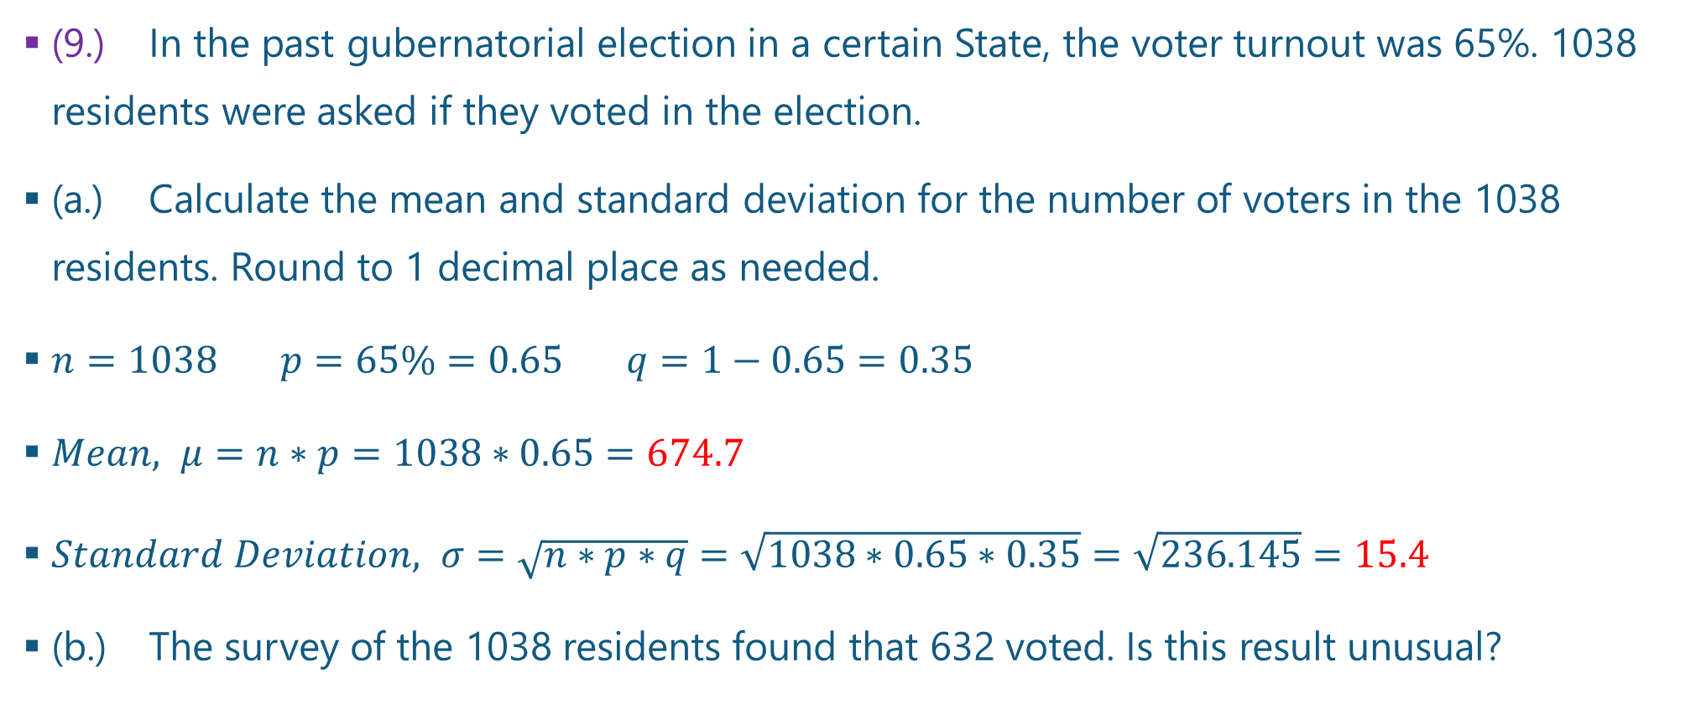
Questions and Answers 9-1.
(9.) In the past gubernatorial election in a certain State, the voter turnout was 65%. 1038 residents were asked if they voted in the election.
(a.) Calculate the mean and standard deviation for the number of voters in the 1038 residents. Round to 1 decimal place as needed.
$n=1038 p=65\%=0.65 q=1−0.65=0.35$
$Mean, μ=n∗p=1038∗0.65=674.7$
$Standard Deviation, σ=\sqrt{n∗p∗q}=\sqrt{1038∗0.65∗0.35}=\sqrt{236.145}=15.4$
(b.) The survey of the 1038 residents found that 632 voted. Is this result unusual?

Slide 21
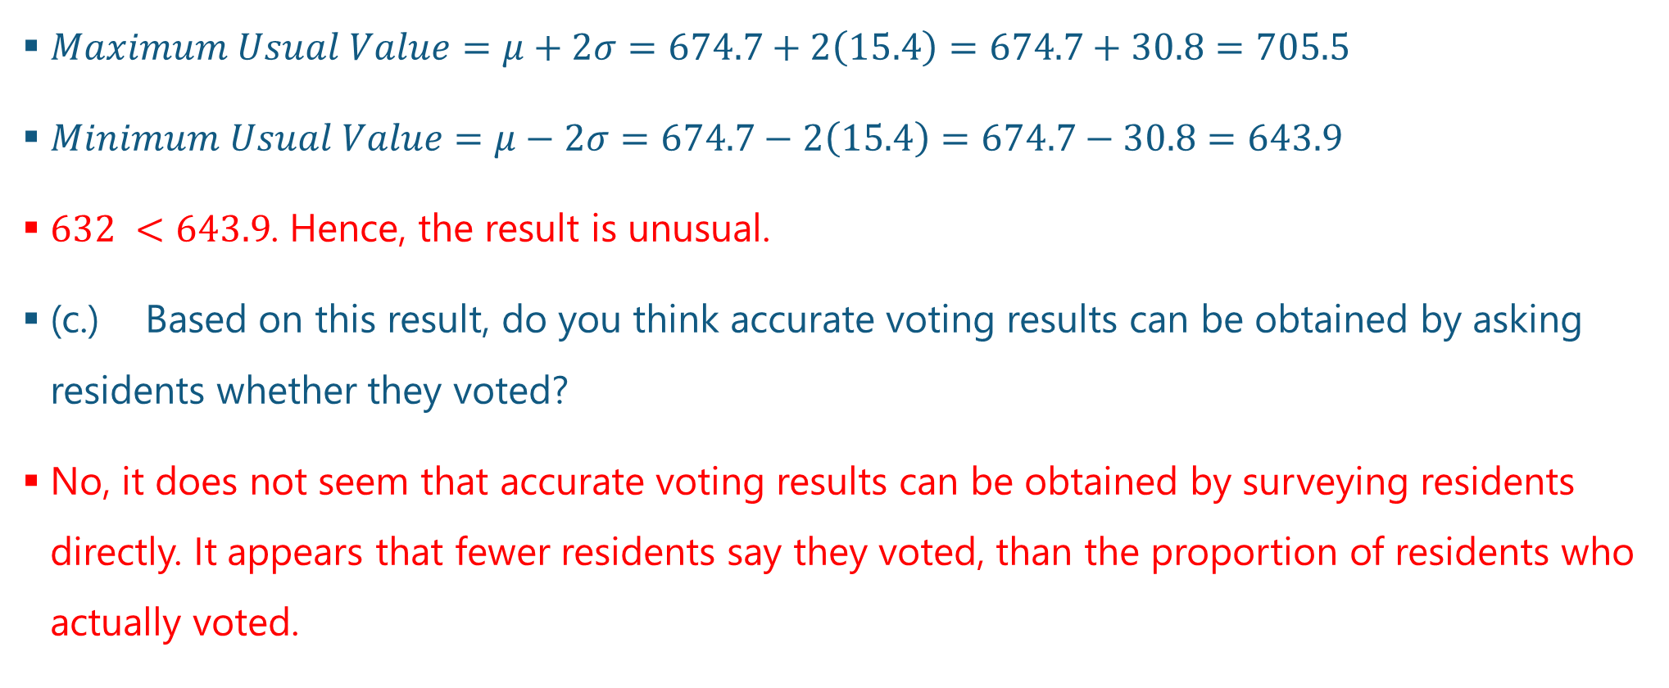
Questions and Answers 9-2.
$Maximum Usual Value=μ+2σ=674.7+2\left(15.4\right)=674.7+30.8=705.5$
$Minimum Usual Value=μ−2σ=674.7−2\left(15.4\right)=674.7−30.8=643.9$
$632 <643.9$. Hence, the result is unusual.
(c.) Based on this result, do you think accurate voting results can be obtained by asking residents whether they voted?
No, it does not seem that accurate voting results can be obtained by surveying residents directly. It appears that fewer residents say they voted, than the proportion of residents who actually voted.

Slide 22
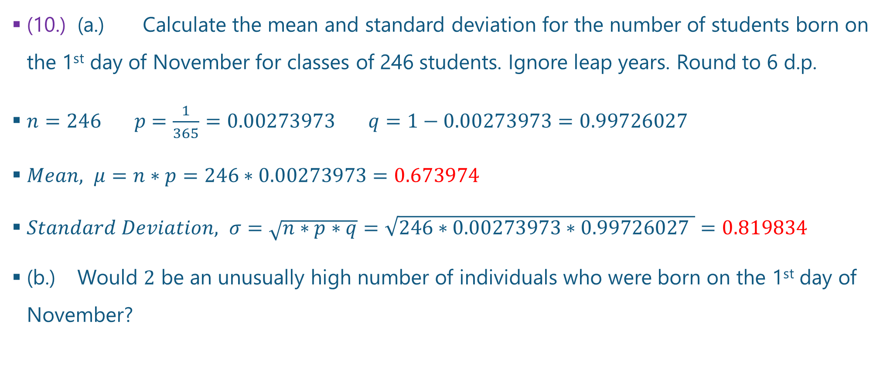
Questions and Answers 10-1.
(10.) (a.) Calculate the mean and standard deviation for the number of students born on the 1st day of November for classes of 246 students. Ignore leap years. Round to 6 d.p.
$n=246 p=\frac{1}{365}=0.00273973 q=1−0.00273973=0.99726027$
$Mean, μ=n∗p=246∗0.00273973=0.673974$
$Standard Deviation, σ=\sqrt{n∗p∗q}=\sqrt{246∗0.00273973∗0.99726027 }=0.819834$
(b.) Would $2$ be an unusually high number of individuals who were born on the 1st day of November?

Slide 23

Questions and Answers 10-2.
$Maximum Usual Value=μ+2σ=0.673974+2\left(0.819834\right)=2.313642$
$Minimum Usual Value=μ−2σ=0.673974−2\left(0.819834\right)=−0.965694$
$−0.965694≤2≤2.313642$
$2 is within the range of the usual values. Hence it is not unusual.$

Slide 24
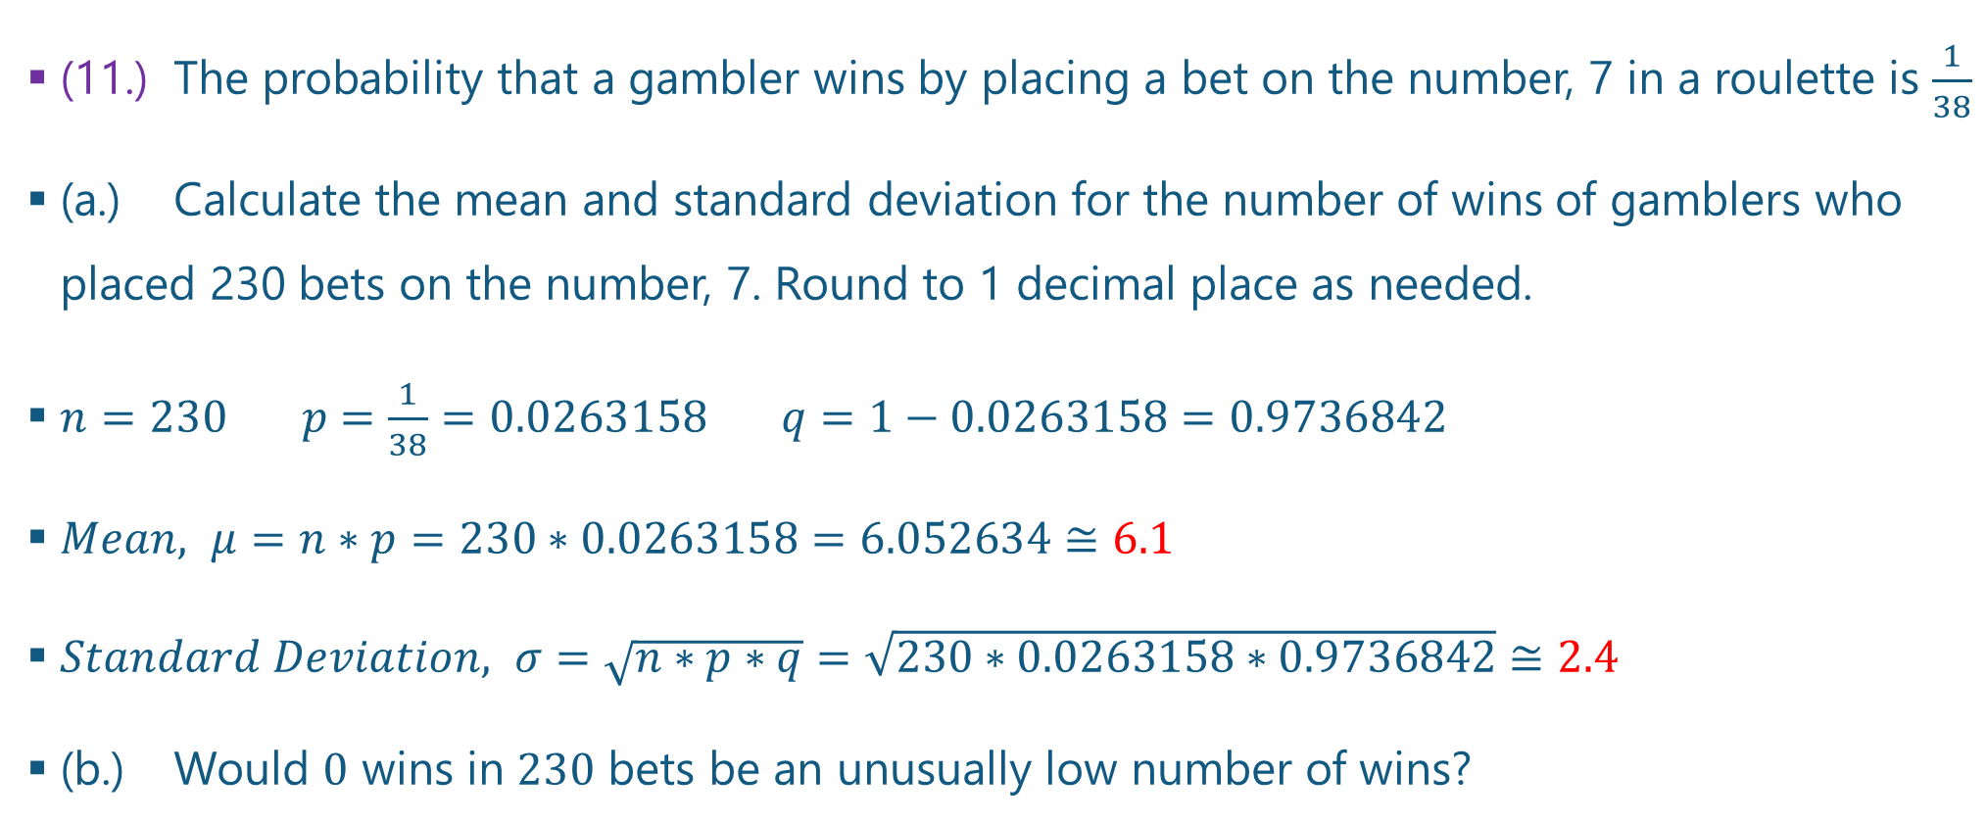
Questions and Answers 11-1.
(11.) The probability that a gambler wins by placing a bet on the number, 7 in a roulette is $\frac{1}{38}$
(a.) Calculate the mean and standard deviation for the number of wins of gamblers who placed 230 bets on the number, 7. Round to 1 decimal place as needed.
$n=230 p=\frac{1}{38}=0.0263158 q=1−0.0263158=0.9736842$
$Mean, μ=n∗p=230∗0.0263158=6.052634≅6.1$
$Standard Deviation, σ=\sqrt{n∗p∗q}=\sqrt{230∗0.0263158∗0.9736842}≅2.4$
(b.) Would $0$ wins in $230$ bets be an unusually low number of wins?

Slide 25

Questions and Answers 11-2.
$Maximum Usual Value=μ+2σ=6.1+2\left(2.4\right)=6.1+4.8=10.9$
$Minimum Usual Value=μ−2σ=6.1−2\left(2.4\right)=6.1−4.8=1.3$
$0 <1.3$. Hence, the result is unusual.
It is unusual to have no wins in 230 bets. (:-

Slide 26
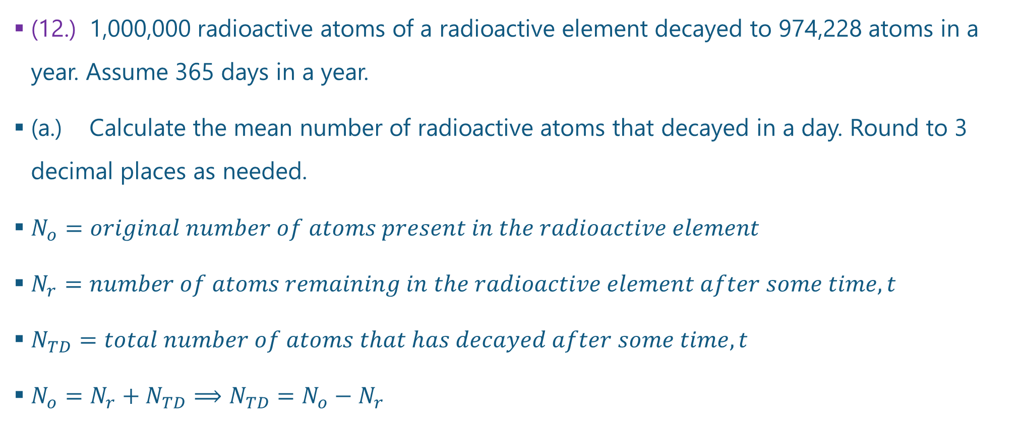
Questions and Answers 12-1.
(12.) 1,000,000 radioactive atoms of a radioactive element decayed to 974,228 atoms in a year. Assume 365 days in a year.
(a.) Calculate the mean number of radioactive atoms that decayed in a day. Round to 3 decimal places as needed.
$N_{o}=original number of atoms present in the radioactive element$
$N_{r}=number of atoms remaining in the radioactive element after some time, t$
$N_{TD}=total number of atoms that has decayed after some time, t$
$N_{o}=N_{r}+N_{TD}⟹N_{TD}=N_{o}−N_{r}$

Slide 27
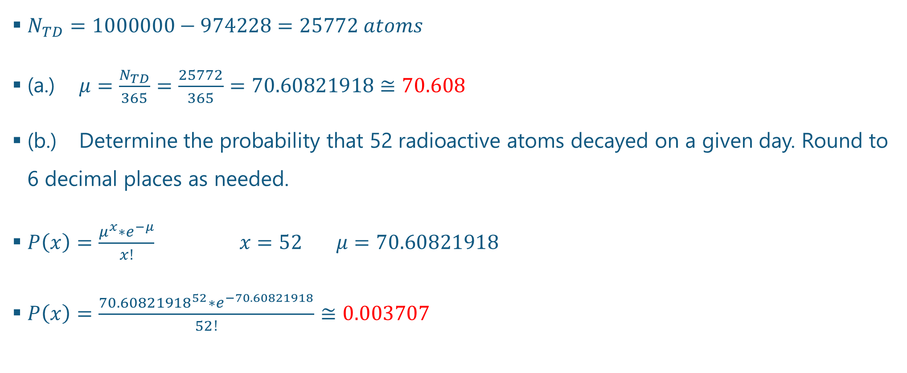
Questions and Answers 12-2.
$N_{TD}=1000000−974228=25772 atoms$
(a.) $μ=\frac{N_{TD}}{365}=\frac{25772}{365}=70.60821918≅70.608$
(b.) Determine the probability that 52 radioactive atoms decayed on a given day. Round to 6 decimal places as needed.
$P\left(x\right)=\frac{μ^{x}∗e^{−μ}}{x!} x=52 μ=70.60821918$
$P\left(x\right)=\frac{{70.60821918}^{52}∗e^{−70.60821918}}{52!}≅0.003707$

Slide 28
References
Chukwuemeka, S. D. (2016, March 18). Samuel Chukwuemeka Tutorials – Math, Science, and Technology. Retrieved from http://www.samuelchukwuemeka.com/
Triola, M. F. (2015). Frequency Distributions. In Elementary statistics using the TI-83/84 plus calculator (4th ed.). Pearson.

