Slide 1
Upwork.com as freelance site
https://www.upwork.com/
1. Job feed
2. Tests
3. Using ?
4. Freelancer Profile &Get Started
5. Safety

Slide 2
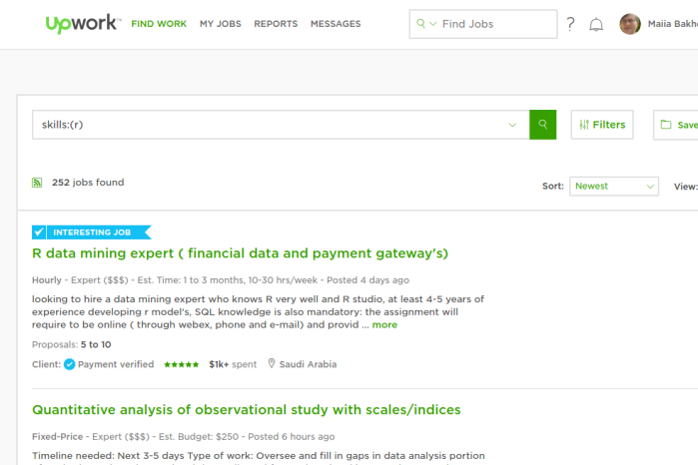
Main page

Slide 3
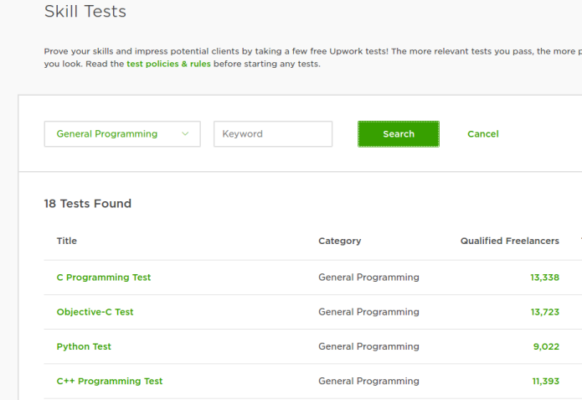
Tests

Slide 4
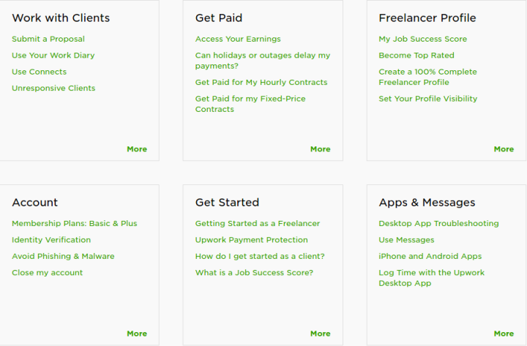
Get started: Account, Profile

Slide 5
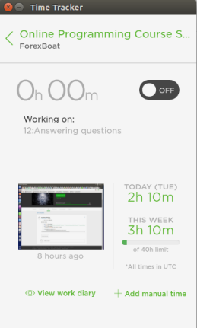
Help
Help and support
Interactive webinars for
beginners
Types of contracts
Forums
Dispute resolution

Slide 6
Safety
Questionable job offers
Freeloaders
Cheaters
Precautions and reporting

