Slide 1
Data Visualization
Brenna Craft

Slide 2
Four Basic Presentation Types
Comparison
Composition
Distribution
Relationship

Slide 3
Select the Right Visualization
How many variables do you want to show in a single chart? One, two, three, many?
How many data points will you display for each variable? Only a few or many?
Will you display values over a period of time, or among items or groups

Slide 4
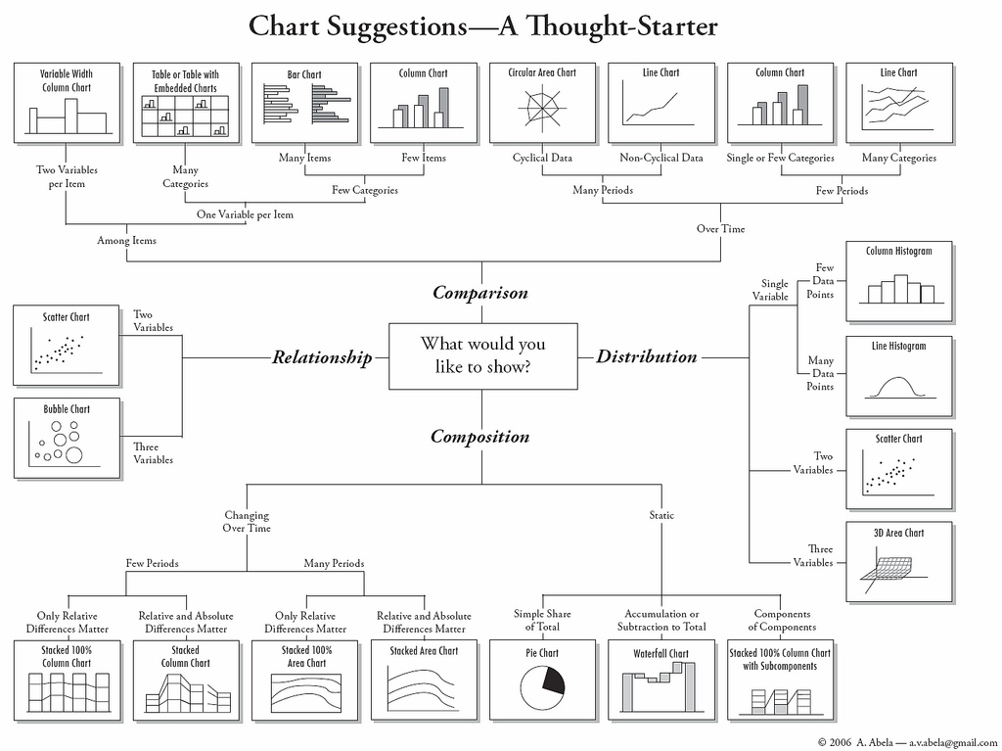
Abela, Andrew. Chart Suggestions - A Thought Starter. 2007. Present Flowing Data. n.d. Web 18 June 2015. From https://flowingdata.com/wp-content/uploads/2009/01/chart-chart1.jpg

Slide 5
The Column Chart: Comparison

Slide 6
The Column Chart
Probably the most commonly used chart type. Why?
The human eye can perceive the length of straight linear objects which share a common baseline with a high degree of accuracy
Ideal for comparison when the number of categories is small - up to five -
Outperforms its rival, the pie chart
I
Soegaard, Mads, and Rikke Friis Dam. "The encyclopedia of human-computer interaction." The Encyclopedia of Human-Computer Interaction (2012).

Slide 7
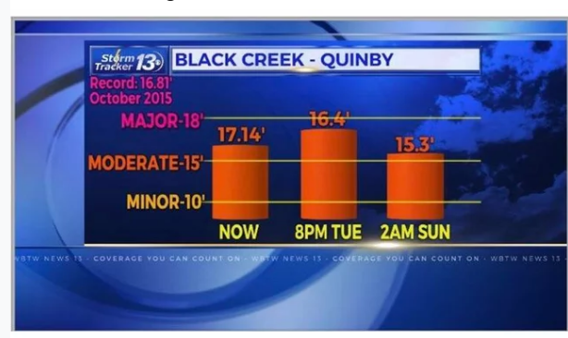
A Bad Column Chart
Source:https://www.reddit.com/r/dataisugly/comments/9gxhmx/looks_like_164_is_higher_than_1714/

Slide 8
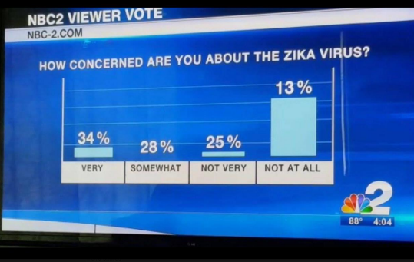
A Bad Column Chart

Slide 9
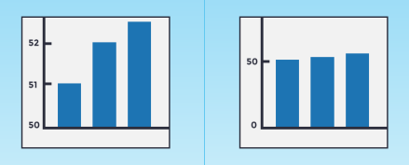
Column Chart Best Practices
Consider carefully before creating an axis that doesn’t start at zero
We are very sensitive to the height of columns, so truncating the columns can allow for inaccurate conclusions

Slide 10
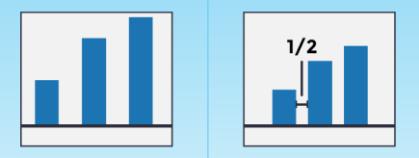
Column Chart Best Practices
Use spaces between bars
Spacing should be about half the width of your bars

Slide 11
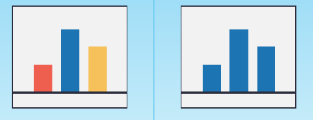
Column Chart Best Practices
Use the same color bars
Exception 1: you are representing a third variable with color
Exception 2: The colors correspond particularly well to each X-axis variable (e.g. Yellow for McDonalds and Red for KFC
Exception 3: You are focusing the viewer’s attention using color

Slide 12
The Pie Chart: Composition

Slide 13
The Pie Chart
The most misused chart in all data visualization
Ideal for:
Making part-to-whole comparisons
Observing fractions of a whole
Small datasets

Slide 14
A Bad Pie Chart
All Pie Charts

Slide 15
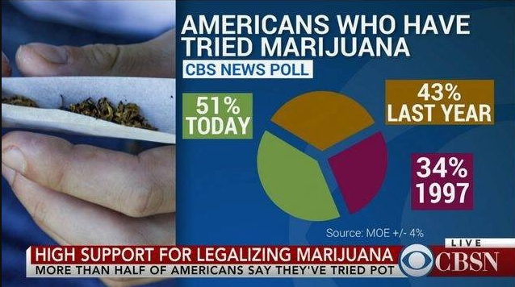
A Bad Pie Chart

Slide 16
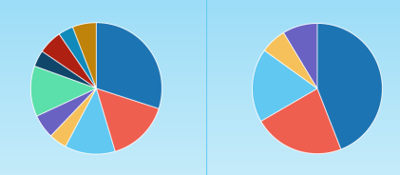
Pie Chart Best Practices
Have no more than 5 categories

Slide 17
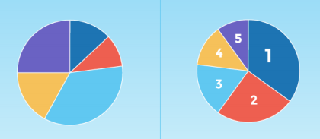
Pie Chart Best Practices
Order slices correctly.

Slide 18
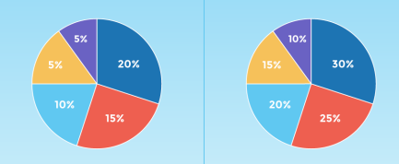
Pie Chart Best Practices
Check that the slice sizes sum to 100%
Watch for rounding

Slide 19
“Visual perception in humans has not evolved to support accurate decoding of areas, angles, or distance along a curve”.
Soegaard, Mads, and Rikke Friis Dam. "The encyclopedia of human-computer interaction." The Encyclopedia of Human-Computer Interaction (2012).

Slide 20
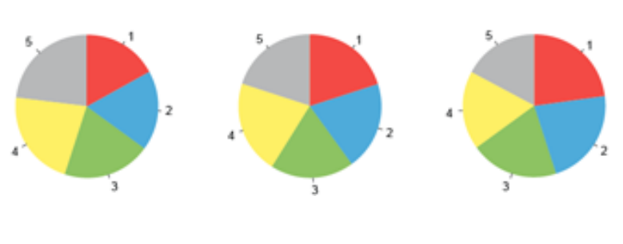
Notes:
Visual perception in humans has not evolved to support accurate decoding of areas, angles, or distance along a curve. Source: https://www.interaction-design.org/literature/book/the-encyclopedia-of-human-computer-interaction-2nd-ed/data-visualization-for-human-perception

Slide 21
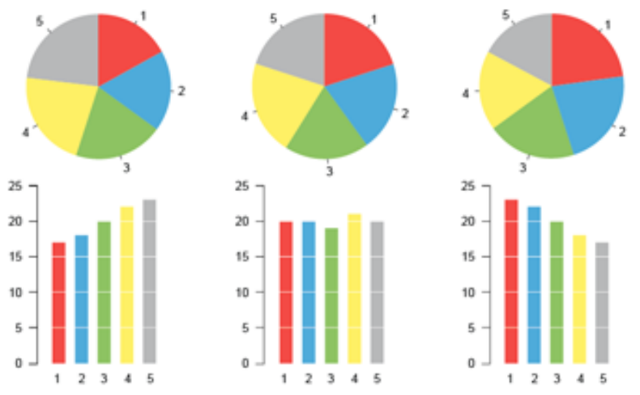

Slide 22
The Histogram: Distribution

Slide 23
The Histogram
The king of visualizations for a single continuous variable
Ideal for showing frequency and density estimation
X-axis shows interval, Y-axis shows frequency
Not available in Excel out of the box
Area of bar is meaningful

Slide 24
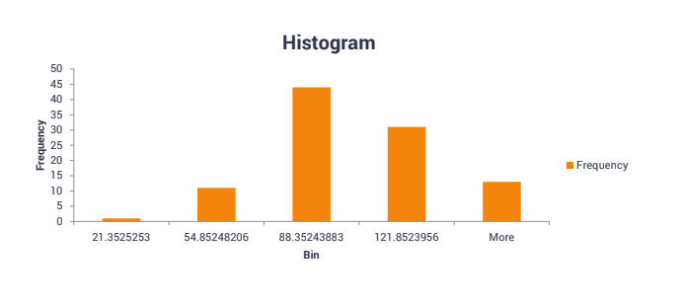
A Bad Histogram

Slide 25
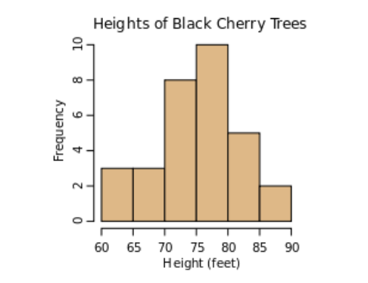
A Good Histogram

Slide 26
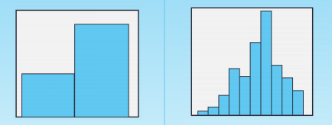
Histogram Best Practices
Choose an appropriate bin width
Enough bins to reveal details in shape
Not so many bins that too gaps are produced
Bin width: try the square root of n

Slide 27
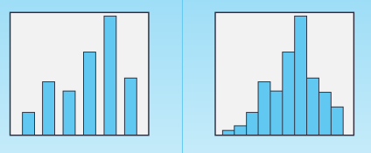
Histogram Best Practices
Bars must be touching
Why?
The X-axis is a continuous measure
The space in between bars contains numeric meaning

Slide 28
The Scatter Plot: Relationship

Slide 29
The Scatter Plot
Ideal for showing relationships between two variables
Positive, Negative, None, Linear, Exponential
Can be used for two continuous variables and a categorical variable (color coded scatter)
Do not use when
Comparing trends over time
Your variables represent percentages or rates of change

Slide 30
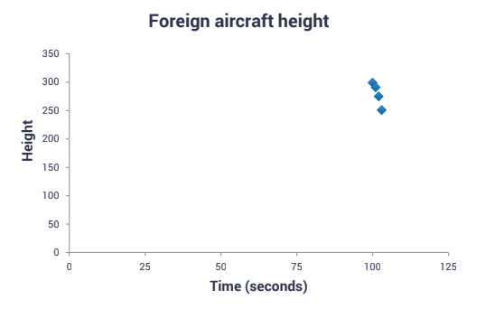
A Bad Scatter Plot

Slide 31
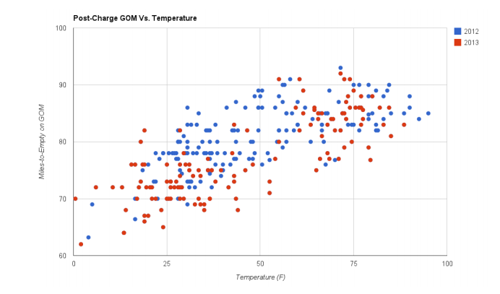
A Good Scatter Plot

Slide 32
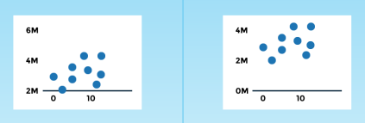
Scatter Plot Best Practices
Start both axises at zero

Slide 33
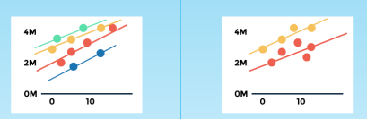
Scatter Plot Best Practices
Use trend lines when showing a trend
However, don’t go overboard (try to limit to two trend lines

Slide 34
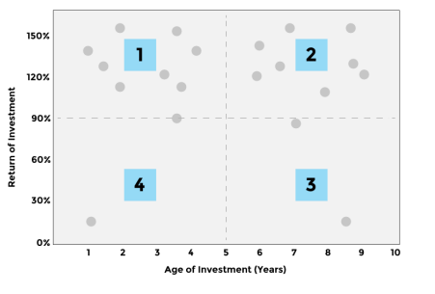
Scatter Plot Best Practices
Use quadrants or dividers where appropriate

Slide 35
Resources
Tufte, Edward R. (1983): The Visual Display of Quantitative Information. Cheshire, CT, Graphics Press
Cleveland, William S. (1994): The Elements of Graphing Data. Hobart Press
Harris, Robert L. (2000): Information Graphics: A Comprehensive Illustrated Reference.Oxford University Press, USA
Card, Stuart K., Mackinlay, Jock D. and Shneiderman, Ben (eds.) (1999): Readings in Information Visualization: Using Vision to Think. Academic Press
Few, Stephen (2004): Show Me the Numbers: Designing Tables and Graphs to Enlighten.Analytics Press
Ware, Colin (2008): Visual Thinking: for Design. Morgan Kaufmann
Few, Stephen (2009): Now You See It: Simple Visualization Techniques for Quantitative Analysis. Analytics Press

